Slide 1
Introduction to NGS Analysis (Day 2)
Lyda Hill department of Bioinformatics 2022 Nanocourse Series
Date & Time: May 19-20: 9AM-5PM (NG3.202)
Course Instructors: Bo Li, Daehwan Kim, Christopher Chaney, & Micah Thornton

Slide 2
Day 2: Section IV (Using IGV, and Genotype Information to Assess Phenotype in Human Genomic Data)

Slide 3
What you will learn in this Section (2 Parts)
What is the Integrative Genomics Viewer (IGV)?
History & Background Information.
How to Access the IGV:
Local installation of IGV.
Accessing IGV using the BioHPC and training accounts (associated with this nanocourse).
How to analyze human and other kinds of sequencing data to determine where variants are.
How to Analyze RNA Sequencing Data using the Hisat2 Alignment tool.

Slide 4

Part 1: NGS Analysis with The Broad Institute IGV
Usage, Examples, and Exercises
$(≈3$ hours$)$

Slide 5
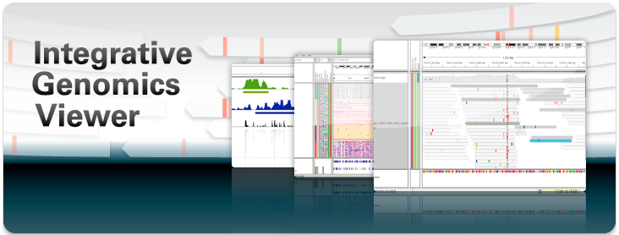

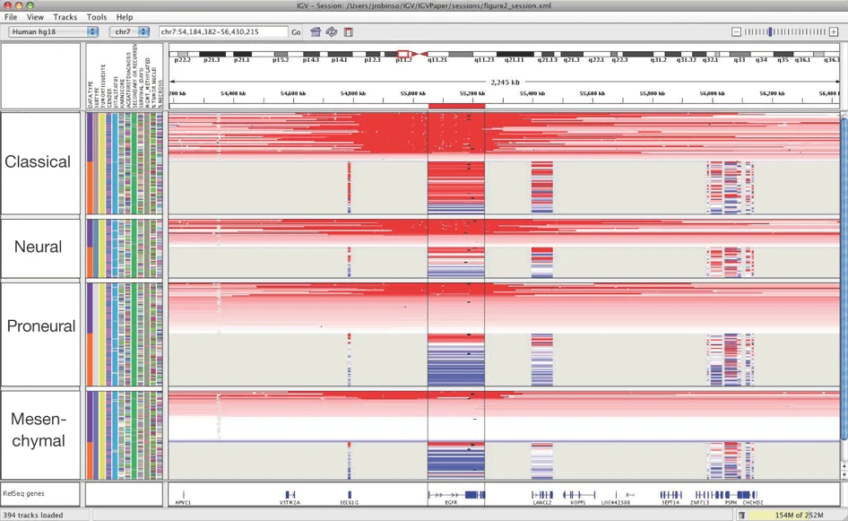
The Broad Institute Integrative Genomics Viewer
Developed and Maintained by the Broad Institute:
A Joint Institute of Harvard and MIT.
Founded in 2004 (from organizational remnants of the Human Genome Project) for the purposes of [from https://www.broadinstitute.org/about-us ]:
“Illuminating Human Disease”
“Reading and Editing Genomes”
“Sharing Data and Tools”
“Building Communities”
“Developing Diagnostics and Treatments”
“Collaborating, Innovating, and Empowering”
Integrative Genomics Viewer (IGV) is a software environment for analyzing NGS data
Provided and maintained by The Broad Institute, with IGV team based at UC San Diego, and MIT/Harvard Broad Institute.
Supported by funding from:
The National Cancer Institute (NCI)
The National Institutes of Health (NIH)
Informatics Technology for Cancer Research (ITCR)
Starr Cancer Consortium
Written in Java, hence allowing use of platform independent jvm.
From Robinson, J., Thorvaldsdóttir, H., Winckler, W. et al. Integrative genomics viewer. Nat Biotechnol 29, 24–26 (2011). https://doi.org/10.1038/nbt.1754

Slide 6
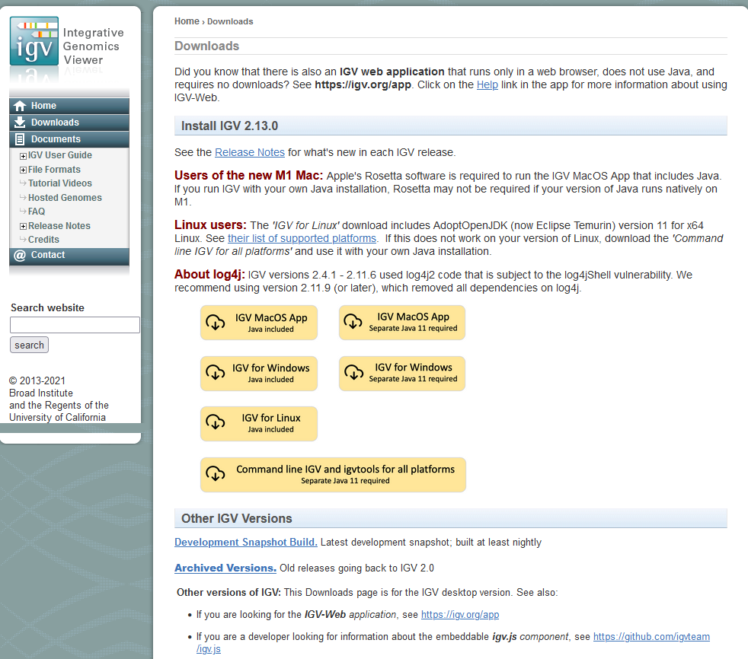
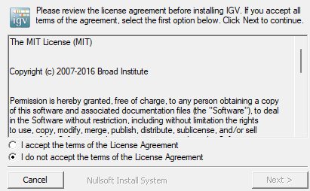
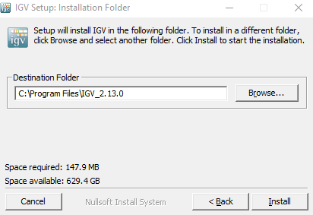
Locally Installing the IGV
IGV is freely available for download and use, and since it was written using java, versions exist for all major operating systems (on which the JVM can run):
Mac OS
Windows
Linux
Very non-restrictive license.
May do many things, as long as copy of original license included.
More info: https://choosealicense.com/licenses/mit/
Note: Must agree to The MIT License to install and use IGV.

Slide 7
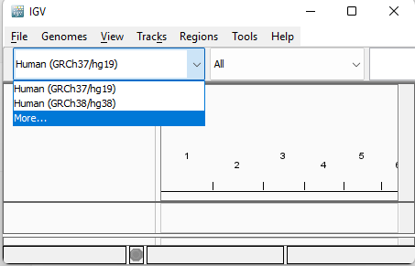
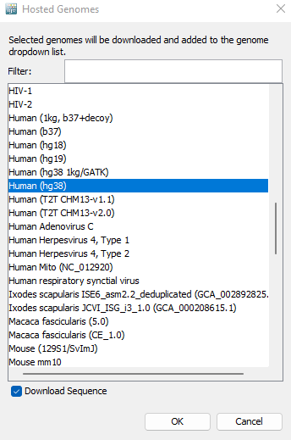
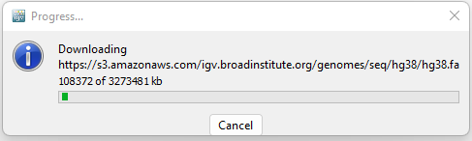
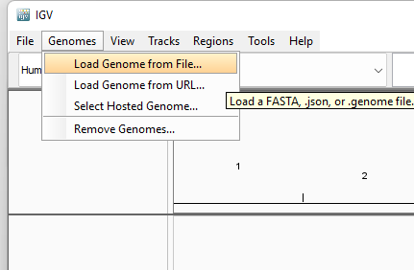
Installing new reference genomes in IGV
Recall that reference genomes are very large files which contain FASTA format versions of the consensus of many samples of the same organism.
The most commonly used version of the human reference genome is called GRCh38, which was the co-ordinated result (by the Genome Reference Consortium) of many different studies including
1000 Genomes Project
GRCh38 was released in December of 2013.
Most recent version February 2022
Gapless except chromosome Y.
Many different references available for download!
Can also install directly from downloaded or
Manually assembled FASTA reference file.

Slide 8
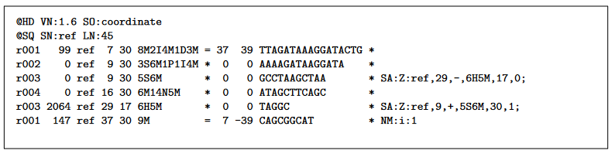
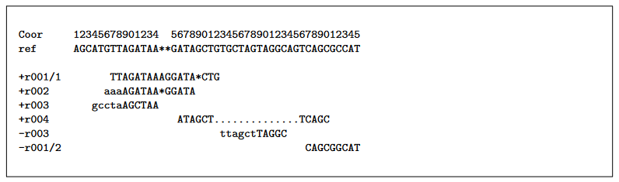
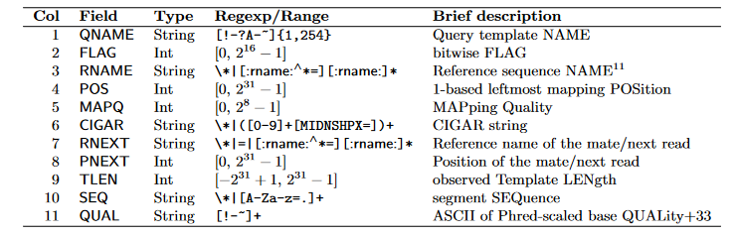
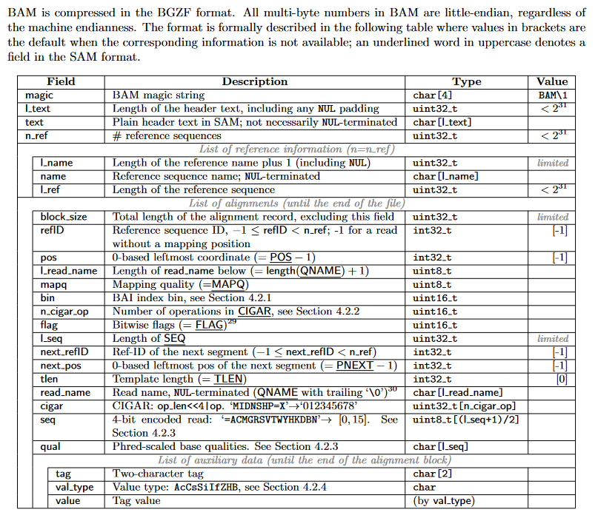
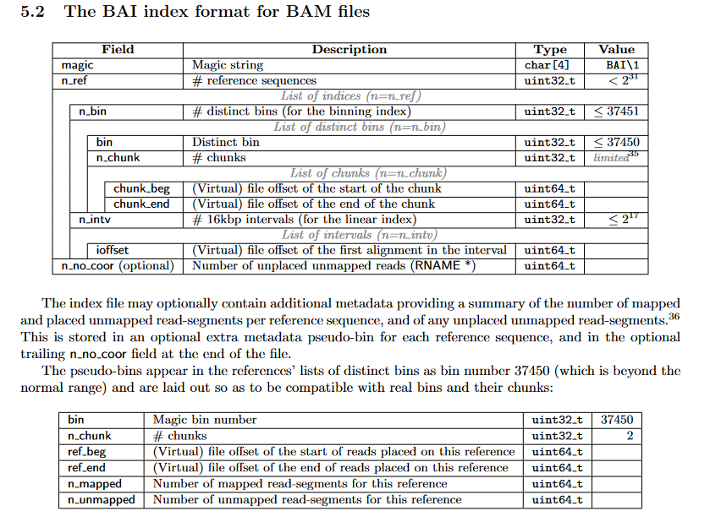
Loading a Sequence Alignment Map File (aligned sequencing reads file)
Two Result Files necessary for display:
Binary Alignment Map (.bam)
Binary Alignment Index (.bai)
Example SAM output (input to igv)
Alignment tool:
HISAT2
Bowtie
BWT
STAR
Example Queries and Reference (input reads to aligner)
samtools view file.sam > file.bam
Fields of SAM
Format Specification Images all defined in SAM format document, images from document available below, with more detail:
https://samtools.github.io/hts-specs/SAMv1.pdf
(SAM Specification)
samtools sort file.bam file
samtools index file.bam
BAI – Binary Alignment Index
BAM – Binary Encoding of SAM

Slide 9
Finding and downloading Read Files for your analyses using SRA
Get sra-toolkit for linux! (or windows subsystem for linux)
wget http://ftp-trace.ncbi.nlm.nih.gov/sra/sdk/2.4.1/sratoolkit.2.4.1-ubuntu64.tar.gz
tar xzvf sratoolkit.2.4.1-ubuntu64.tar.gz
export PATH=$PATH:/directory/sratoolkit.2.4.1-ubuntu64/bin
https://www.reneshbedre.com/blog/ncbi_sra_toolkit.html
(SRA Toolkit Download Full Tutorial)

Slide 10
Loading a Sequence Alignment Map File (aligned sequencing reads file)

Slide 11

Part 2: NGS RNA-Seq Data Alignment using Hisat2
Usage, Examples, and Exercises
$(≈1$ hours$)$

Slide 12
References for Further Information and Practice

Slide 13
Thank you for your attention & Interest!
Please do not forget to complete the course survey! ☺.

