Slide 1
Logistic Granger Clustering Test for Randomness
Micah Andrew Thornton

Slide 2
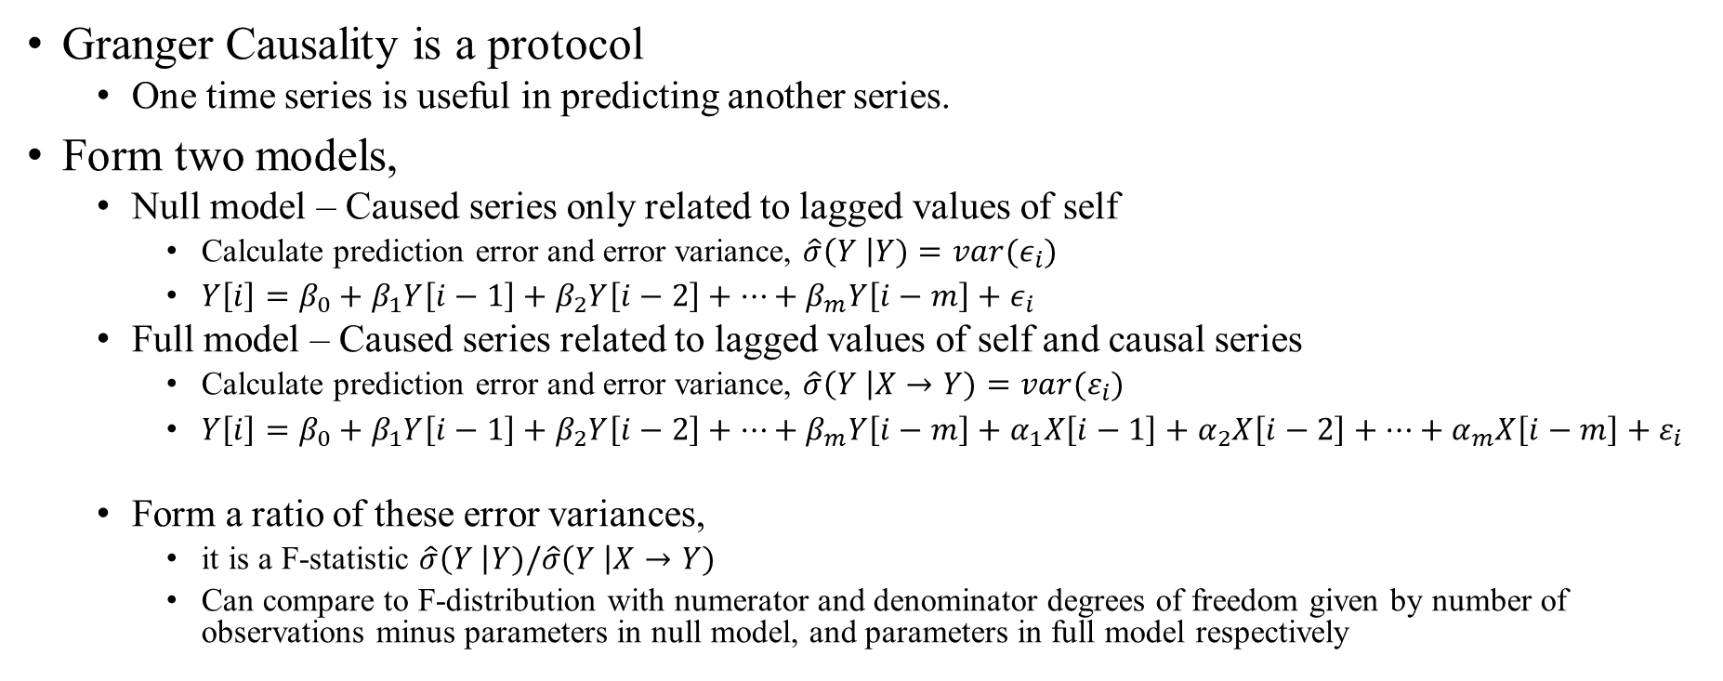
Granger-Causality
Granger Causality is a protocol
One time series is useful in predicting another series.
Form two models,
Null model – Caused series only related to lagged values of self
Calculate prediction error and error variance, $\hat{σ}\left(Y \right|Y)=var(ε_{i})$
$Y\left[i\right]=β_{0}+β_{1}Y\left[i−1\right]+β_{2}Y\left[i−2\right]+…+β_{m}Y\left[i−m\right]+ε_{i}$
Full model – Caused series related to lagged values of self and causal series
Calculate prediction error and error variance, $\hat{σ}\left(Y \right|X→Y)=var(ε_{i})$
$Y\left[i\right]=β_{0}+β_{1}Y\left[i−1\right]+β_{2}Y\left[i−2\right]+…+β_{m}Y\left[i−m\right]+α_{1}X\left[i−1\right]+α_{2}X\left[i−2\right]+…+α_{m}X\left[i−m\right]+ε_{i}$
Form a ratio of these error variances,
it is a F-statistic $\hat{σ}\left(Y \right|Y)/\hat{σ}\left(Y \right|X→Y)$
Can compare to F-distribution with numerator and denominator degrees of freedom given by number of observations minus parameters in null model, and parameters in full model respectively

Slide 3
The Granger-Causality Protocol
For two time series A and B, indexed by i and of the same size N,
We could say that B granger-causes A for a given model structure,
A is better predicted when lagged values of B are included in the model,
the error variance of prediction of
A[i] by the proper lagged values of A, and the proper lagged values of B is lower than
A[i] is predicted by the proper lagged values of A only.
Granger-Causality can be assessed in any modeled relationship.
0110110101101010010 0

Slide 4
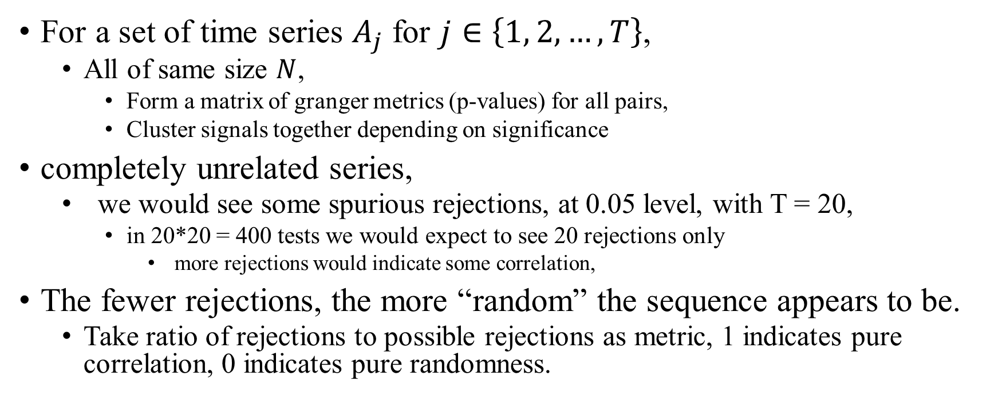
The Granger Causality Clustering Approach
For a set of time series $A_{j}$ for $j∈\left\{1, 2, …, T\right\}$,
All of same size $N$,
Form a matrix of granger metrics (p-values) for all pairs,
Cluster signals together depending on significance
completely unrelated series,
we would see some spurious rejections, at 0.05 level, with T = 20,
in 20*20 = 400 tests we would expect to see 20 rejections only
more rejections would indicate some correlation,
The fewer rejections, the more “random” the sequence appears to be.
Take ratio of rejections to possible rejections as metric, 1 indicates pure correlation, 0 indicates pure randomness.

Slide 5

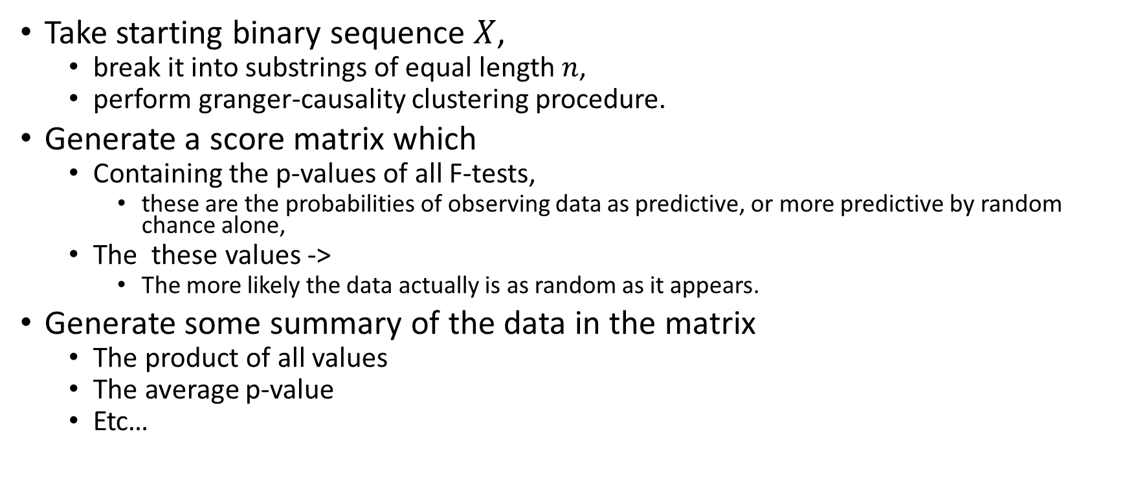
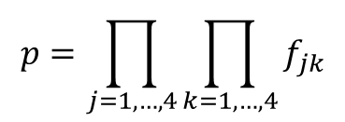


The Granger-Causality Clustering Test for Randomness
$X$ =
0111010001011010101110001010101001001110
Take starting binary sequence $X$,
break it into substrings of equal length $n$,
perform granger-causality clustering procedure.
Generate a score matrix which
Containing the p-values of all F-tests,
these are the probabilities of observing data as predictive, or more predictive by random chance alone,
The these values ->
The more likely the data actually is as random as it appears.
Generate some summary of the data in the matrix
The product of all values
The average p-value
Etc…
$X_{1}$ =
0111010001
0110101011
1000101010
1001001110
$X_{2}$ =
$X_{3}$ =
$X_{4}$ =
$$\left[\begin{matrix}f_{11} & f_{12} & f_{13} & f_{14} \\ f_{21} & f_{22} & f_{23} & f_{24} \\ f_{31} & f_{32} & f_{33} & f_{34} \\ f_{41} & f_{42} & f_{43} & f_{44}\end{matrix}\right]$$
$f_{jk}=PR\left(\frac{\hat{σ}\left(X_{k} | X_{j}→X_{k}\right)}{\hat{σ}\left(X_{k}\right|X_{k})}≥F\right)$ for $F$ a value from the $F$ distribution with numerator and denominator degrees of freedom given by the parameters in the full and null models respectively.
$$p=\prod_{j=1,…,4}{\prod_{k=1,…,4}{f_{jk}}}$$

Slide 6
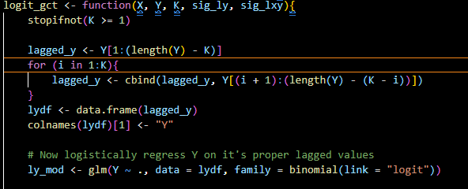
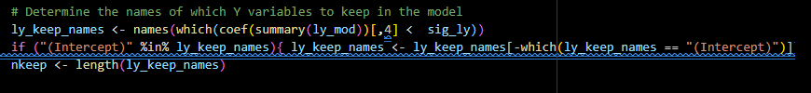
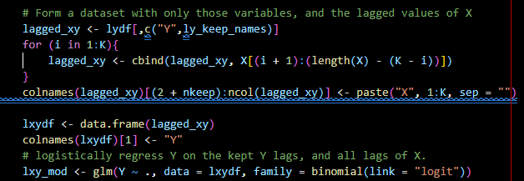

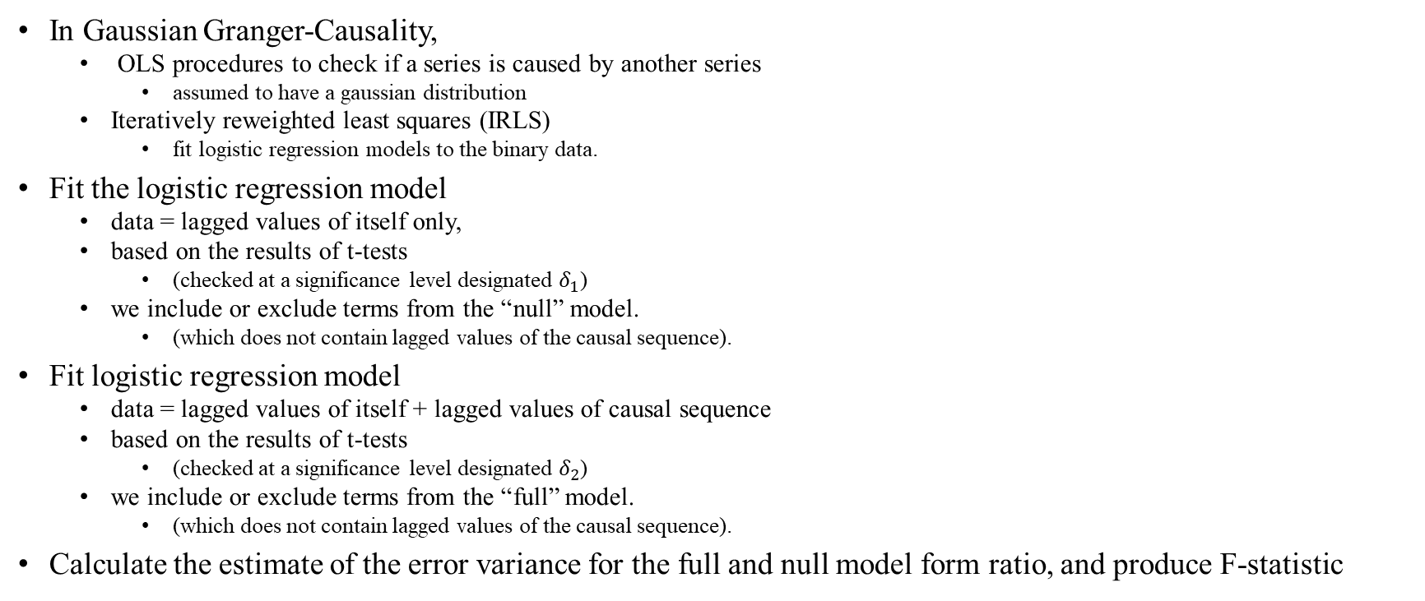
The Logistic Granger-Causality Test
In Gaussian Granger-Causality,
OLS procedures to check if a series is caused by another series
assumed to have a gaussian distribution
Iteratively reweighted least squares (IRLS)
fit logistic regression models to the binary data.
Fit the logistic regression model
data = lagged values of itself only,
based on the results of t-tests
(checked at a significance level designated $δ_{1}$)
we include or exclude terms from the “null” model.
(which does not contain lagged values of the causal sequence).
Fit logistic regression model
data = lagged values of itself + lagged values of causal sequence
based on the results of t-tests
(checked at a significance level designated $δ_{2}$)
we include or exclude terms from the “full” model.
(which does not contain lagged values of the causal sequence).
Calculate the estimate of the error variance for the full and null model form ratio, and produce F-statistic

Slide 7
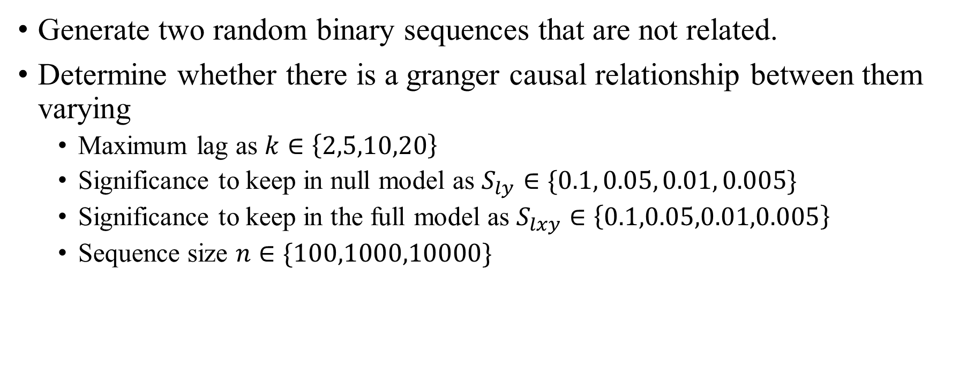
Simulation Study for Simple Logistic Regression
Generate two random binary sequences that are not related.
Determine whether there is a granger causal relationship between them varying
Maximum lag as $k∈\left\{2,5,10,20\right\}$
Significance to keep in null model as $S_{ly}∈\{0.1, 0.05, 0.01, 0.005\}$
Significance to keep in the full model as $S_{lxy}∈\left\{0.1,0.05,0.01,0.005\right\}$
Sequence size $n∈\{100,1000,10000\}$

Slide 8
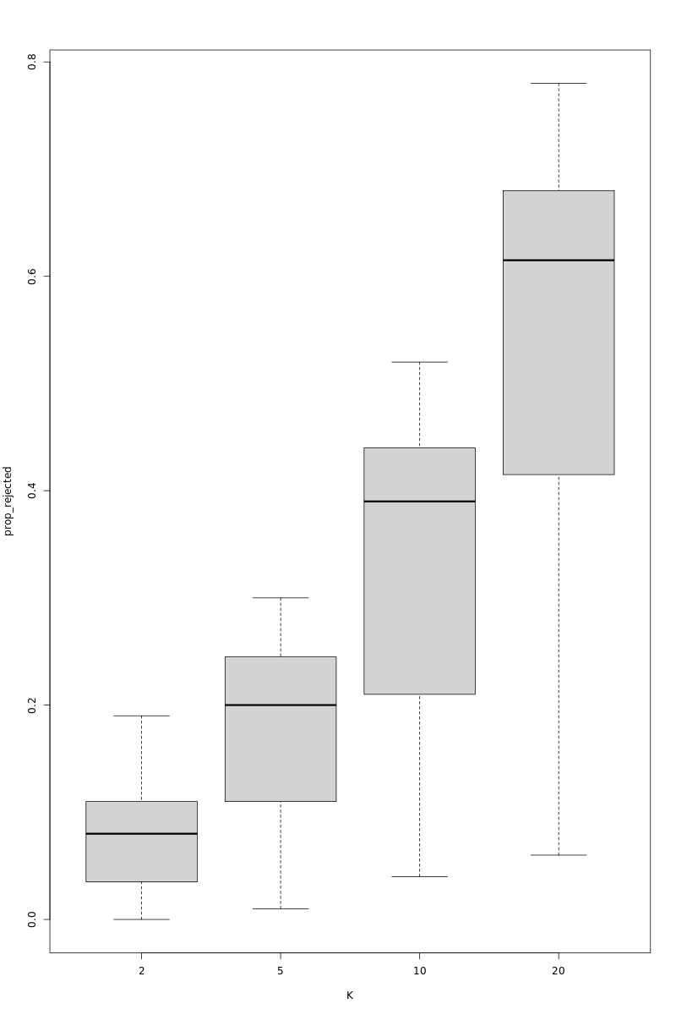
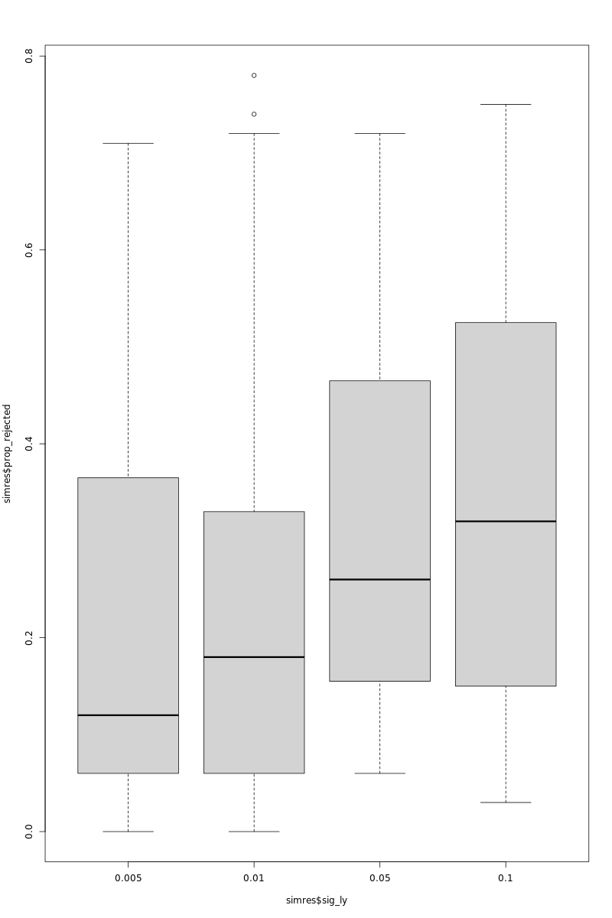
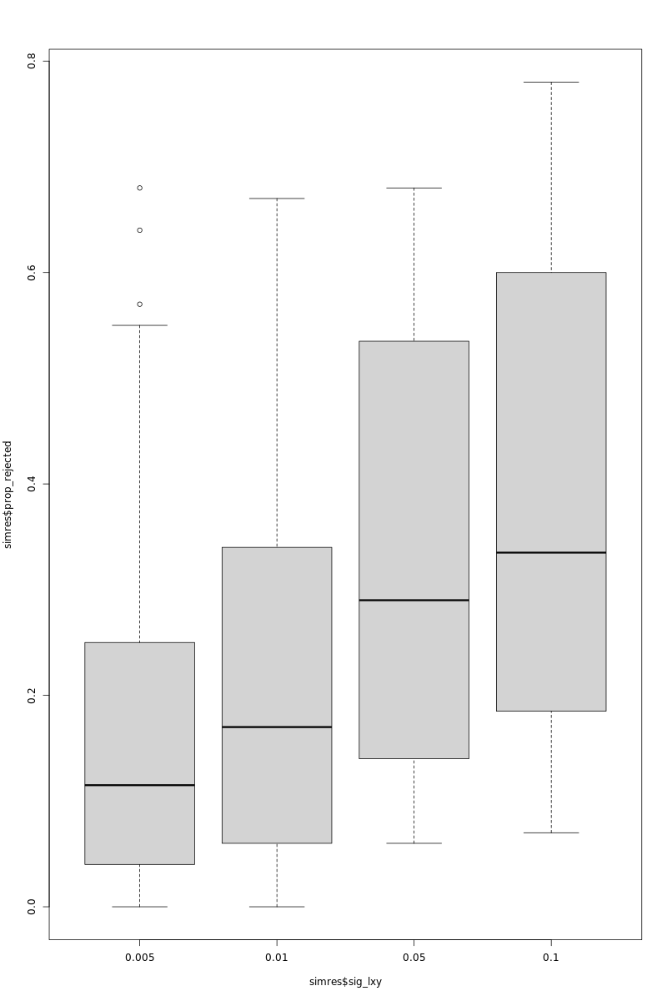
Simulation Study of Logistic Granger Causality

Slide 9
Next Steps with Granger Clustering Randomness Test (GCRT)
Finish writing IRLS procedure for implementing granger causality in C++.
Complete the surrounding procedures for the granger clustering test.
Write some unit tests for the full granger clustering randomness test.
Integrate the GCRT into STEER.

