Slide 1
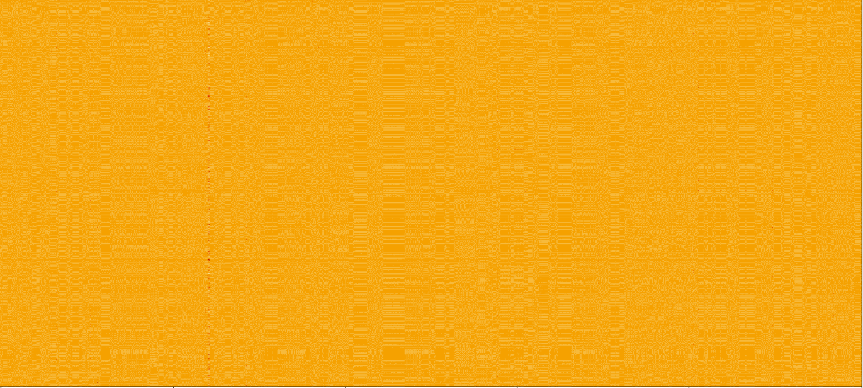
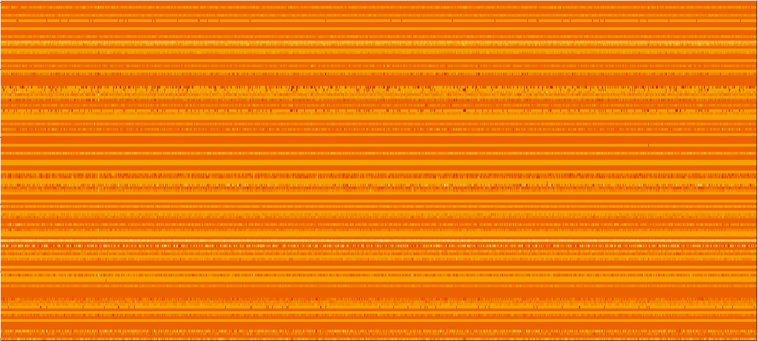
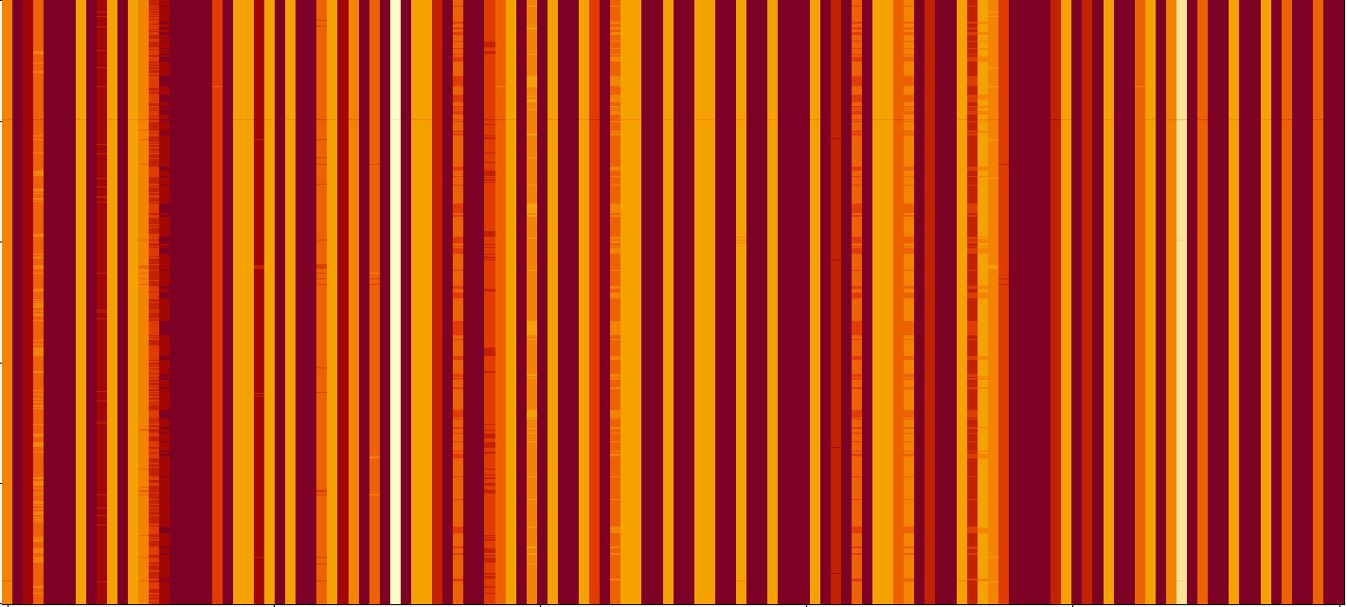
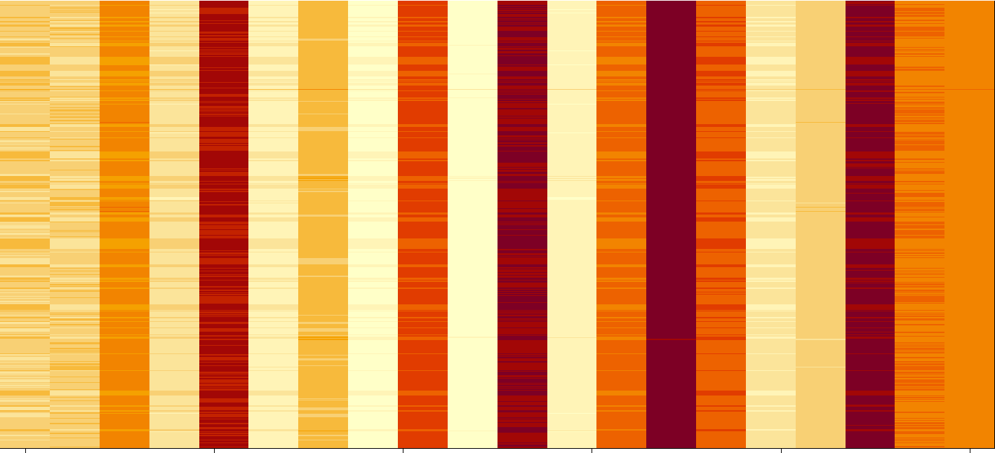
a)
b)
Sequence Number (1,397 Total)
CNN Learned Filters (128 Total)
c)
Power Spectral Coefficient (30,563 Total)
Power Spectral Coefficient (30,563 Coefficients Total)
d)
Sequence Number (1,397 Total)
Sequence Number (1,397 Total)
CNN Learned Filtered Coefficients (128 Total)
Max Variance CNN Learned Filtered Coefficients (20 Total)
The Full Data Image, all 1397 sequences PS (scaled)
The 128 Filters learned by the 1D CNN
The 128 Filters applied to the 1397 PS
The top twenty highest variance filtered values from the CNN filters.

Slide 2

Genomic Power Spectra
Filter 1
Filter 2
Filter 3
Filter 4
…
Filter $p$
………………………
Hidden Layers
Output

Slide 3
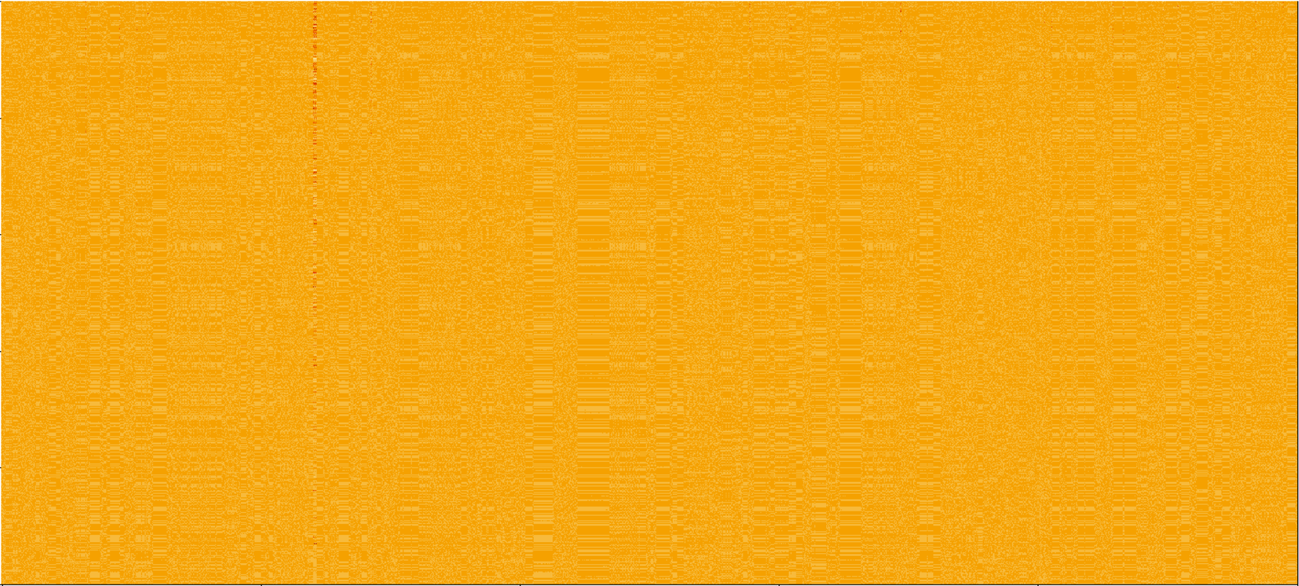
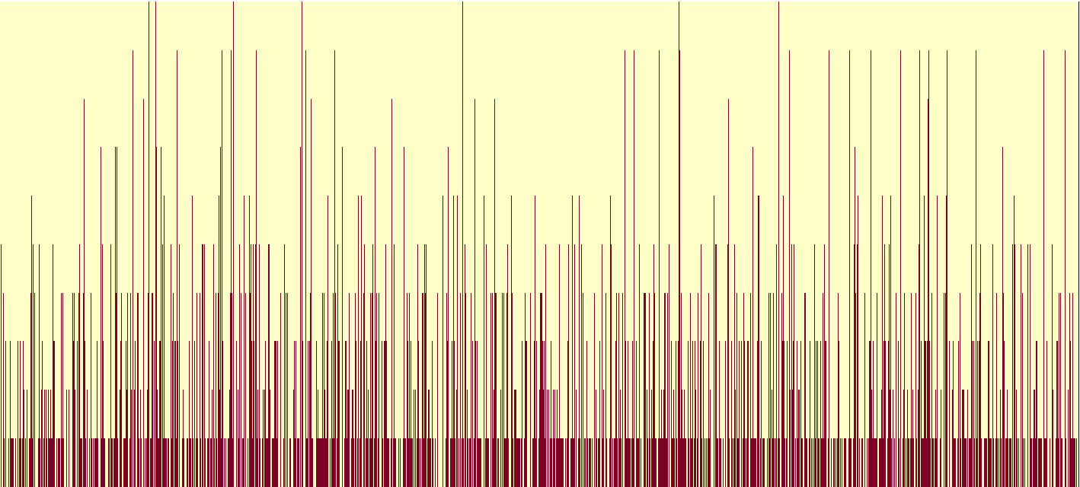
Sequence Number (1,397 Total)
Power Spectral Coefficient (30,563 Total)
Power Spectral Coefficient (30,563 Total)

