Slide 1
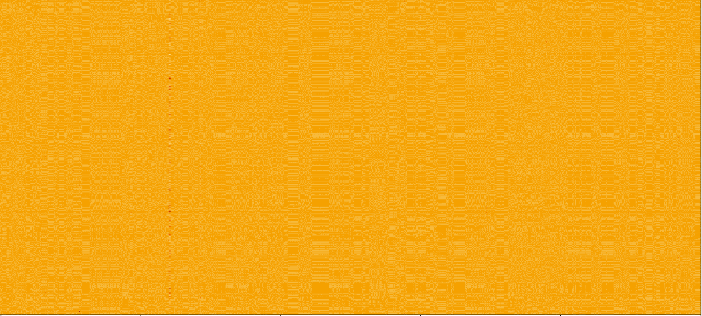
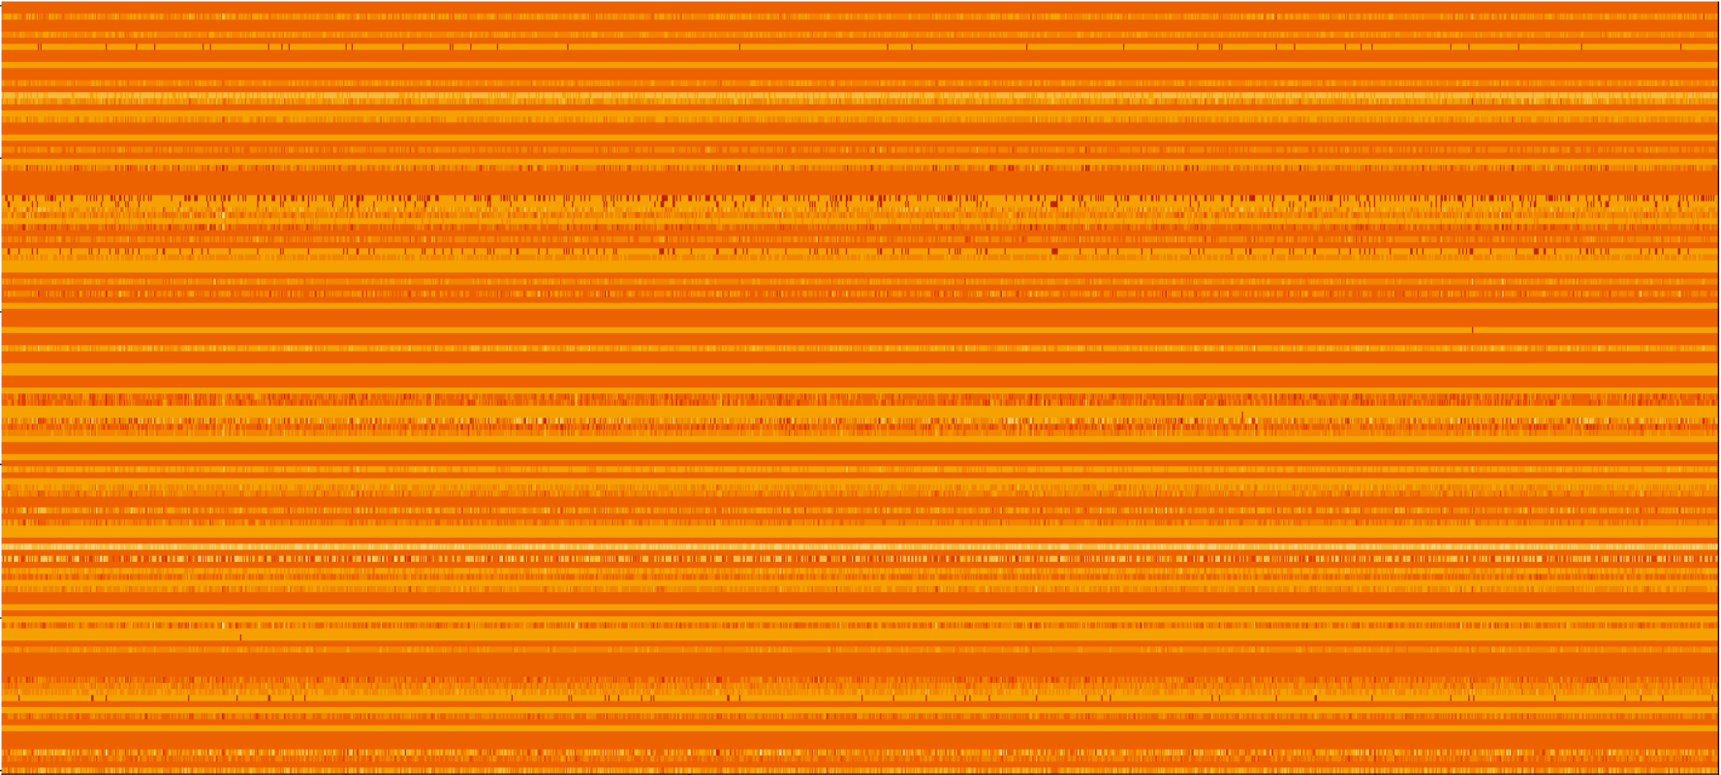
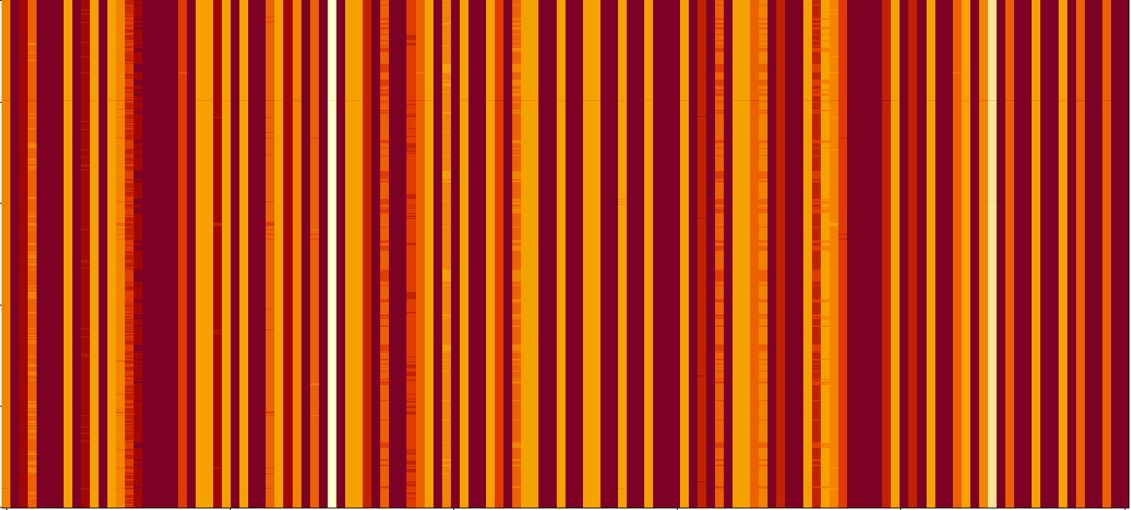
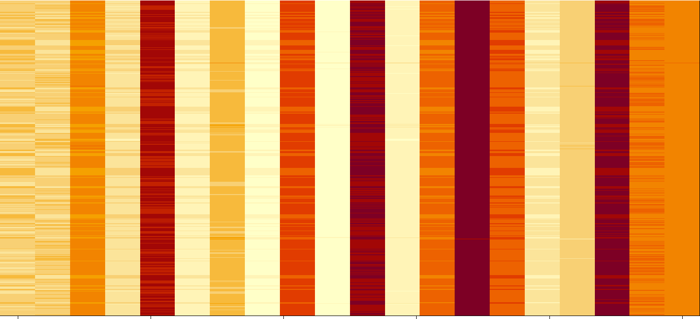
a)
b)
Sequence Number
(1,397 Total)
CNN Learned Filters
(128 Total)
c)
Power Spectral Coefficient (30,563 Total)
Power Spectral Coefficient (30,563 Total)
d)
Sequence Number
(1,397 Total)
Sequence Number
(1,397 Total)
CNN Learned Filtered Coefficients (128 Total)
Max Variance CNN Learned Filtered Coefficients
(20 Total)
The Full Data Image, all 1397 sequences PS (scaled)
The 128 Filters learned by the 1D CNN
The 128 Filters applied to the 1397 PS
The top twenty highest variance filtered values from the CNN filters.

Slide 2
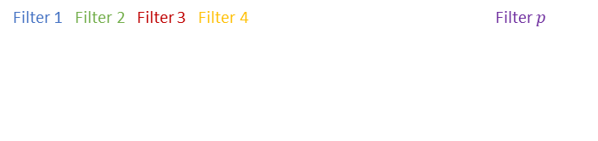
Genomic Power Spectra
………………………
Filter 1 Filter 2 Filter 3 Filter 4 Filter $p$
Hidden Layers
Output

Slide 3
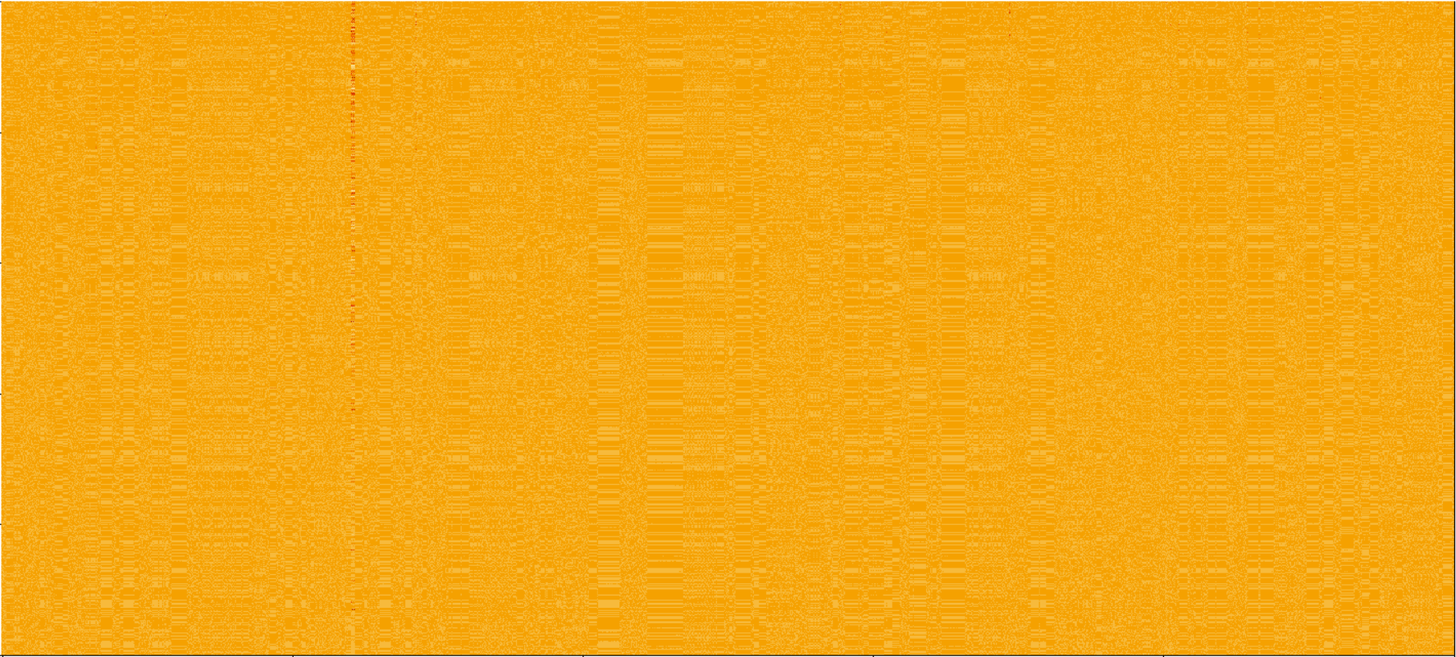
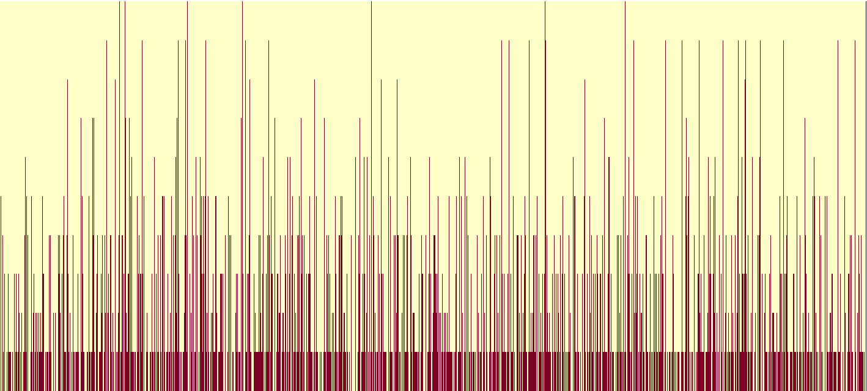
Sequence Number (1,397 Total)
Power Spectral Coefficient (30,563 Total)
Power Spectral Coefficient (30,563 Total)

Slide 4


Slide 5
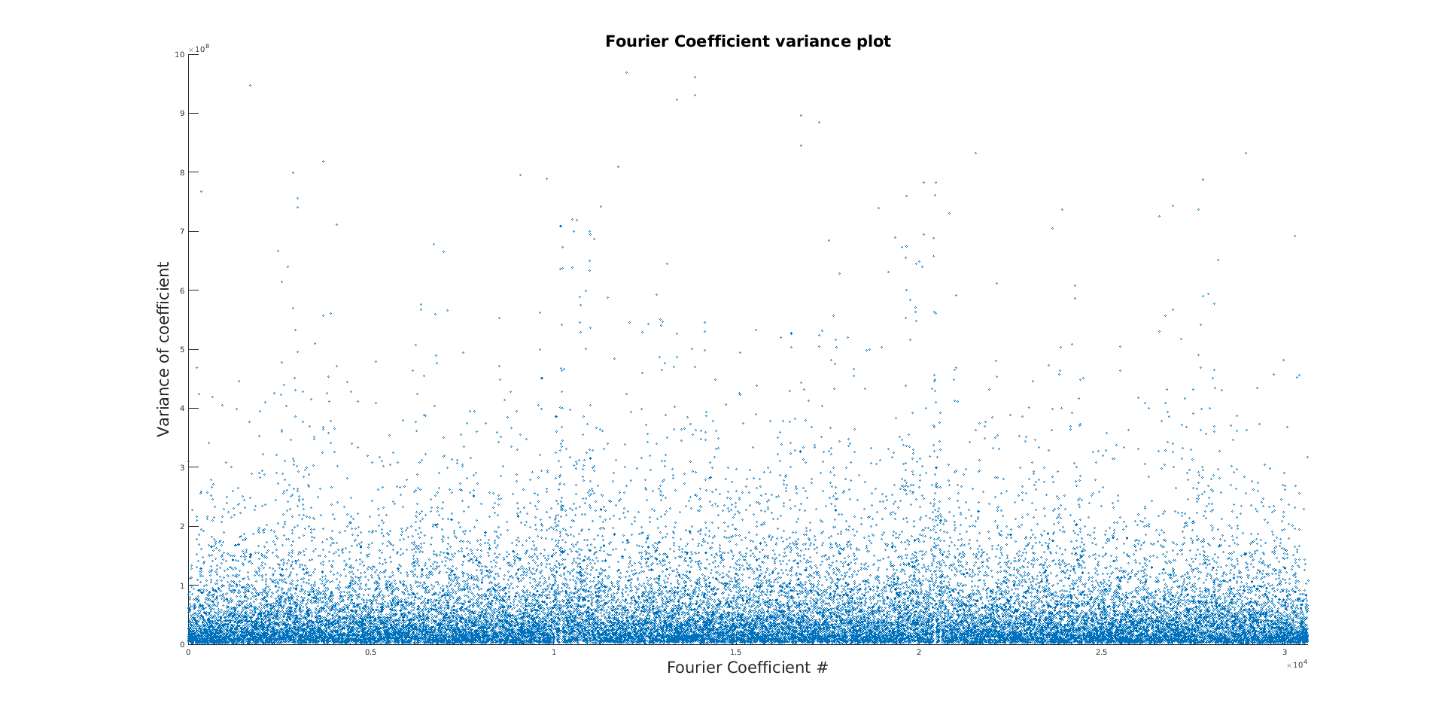
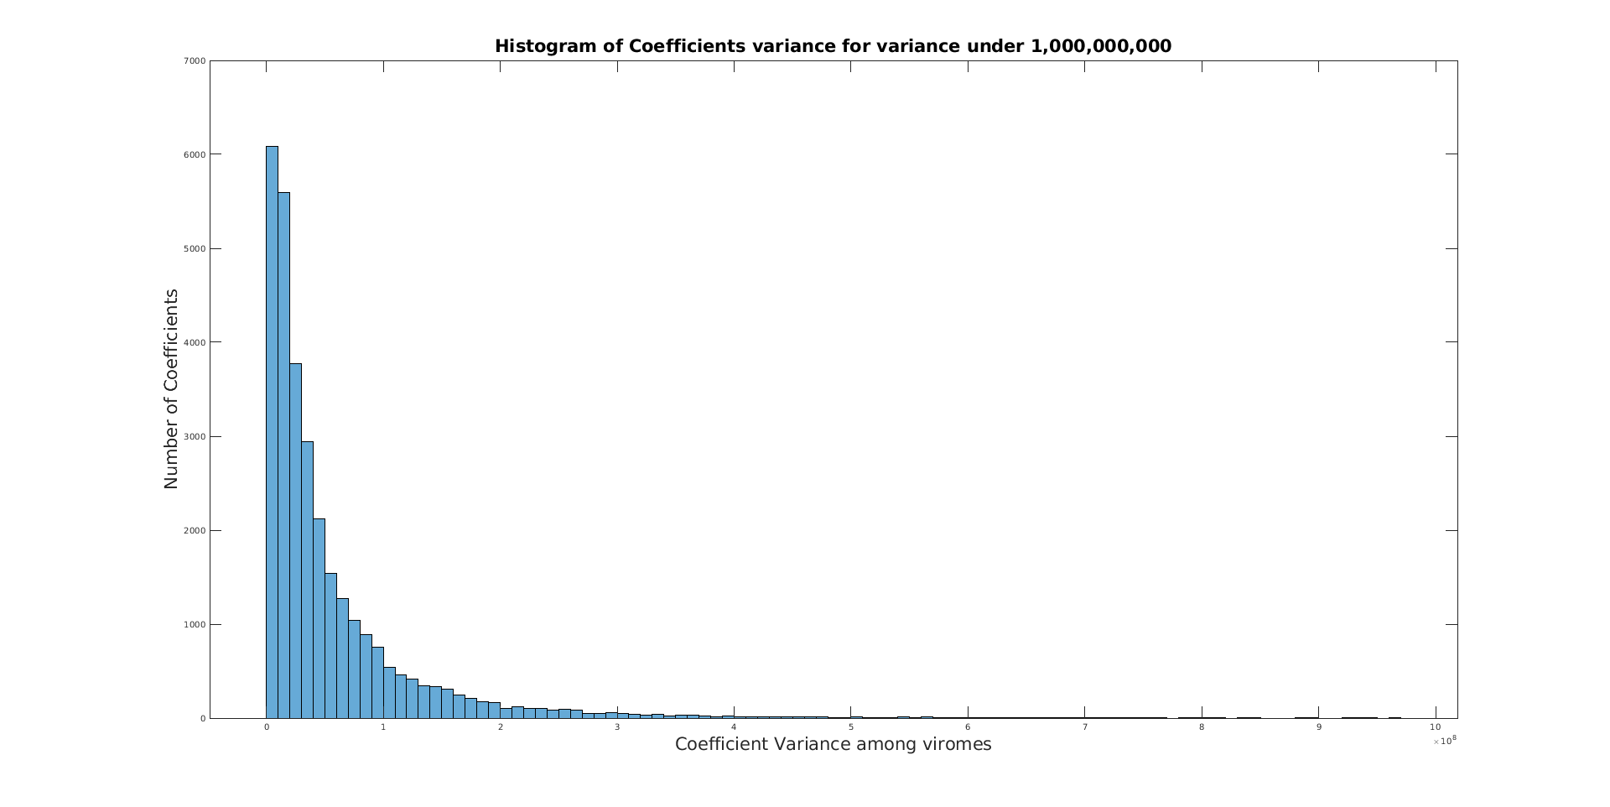
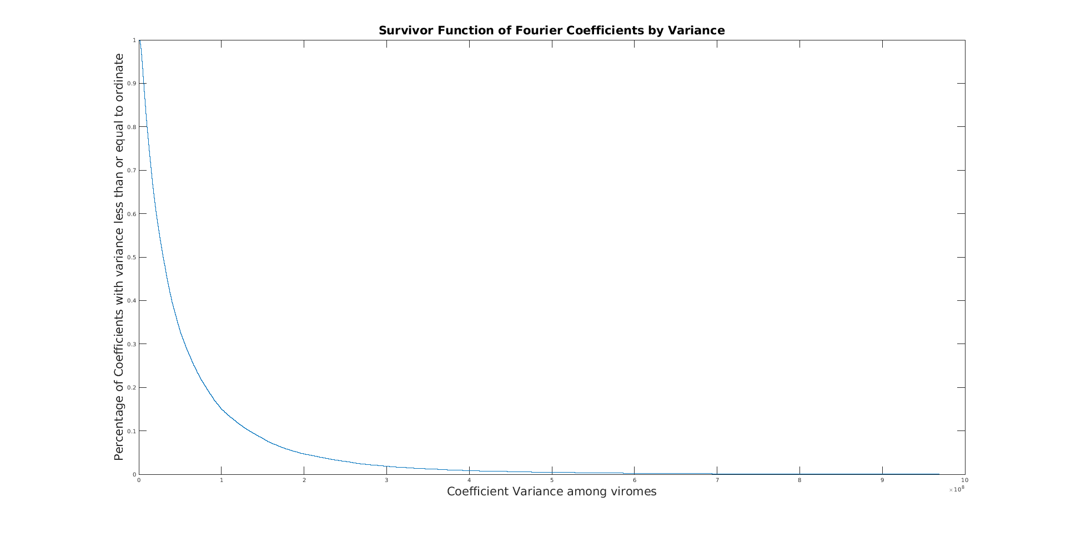
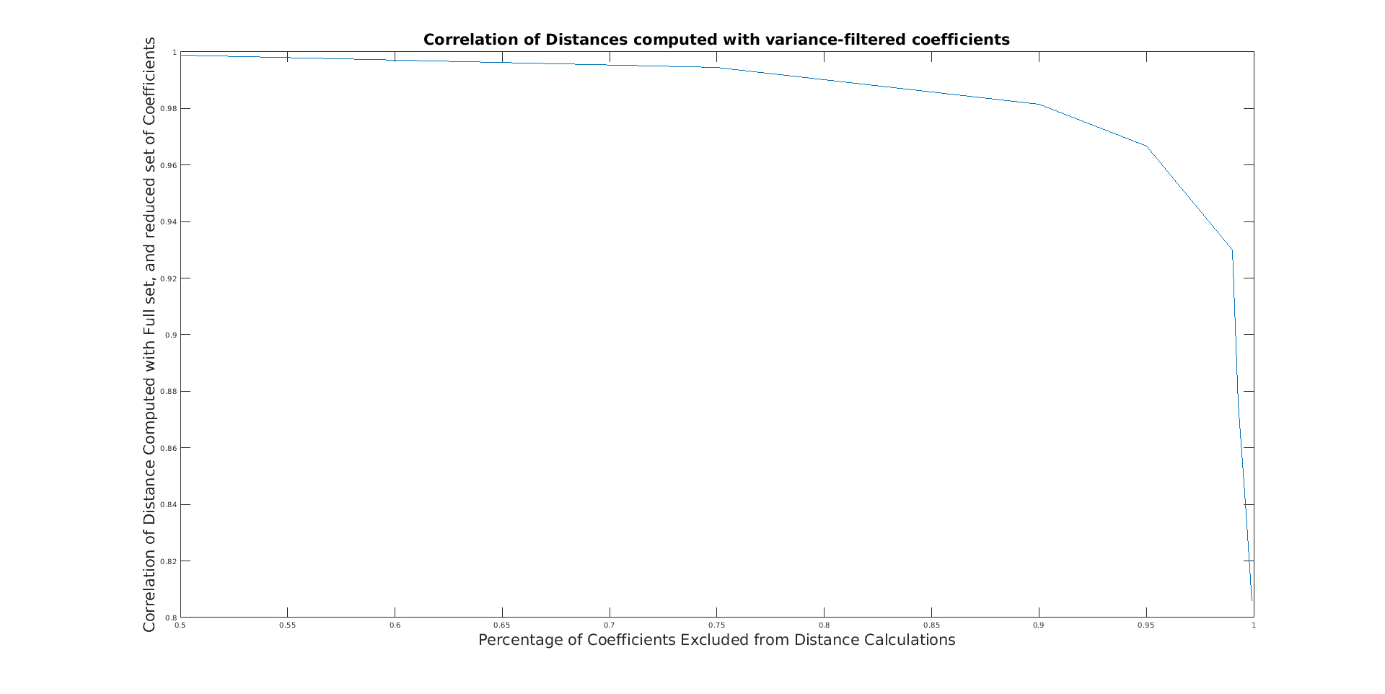
a)
b)
c)
d)

Slide 6
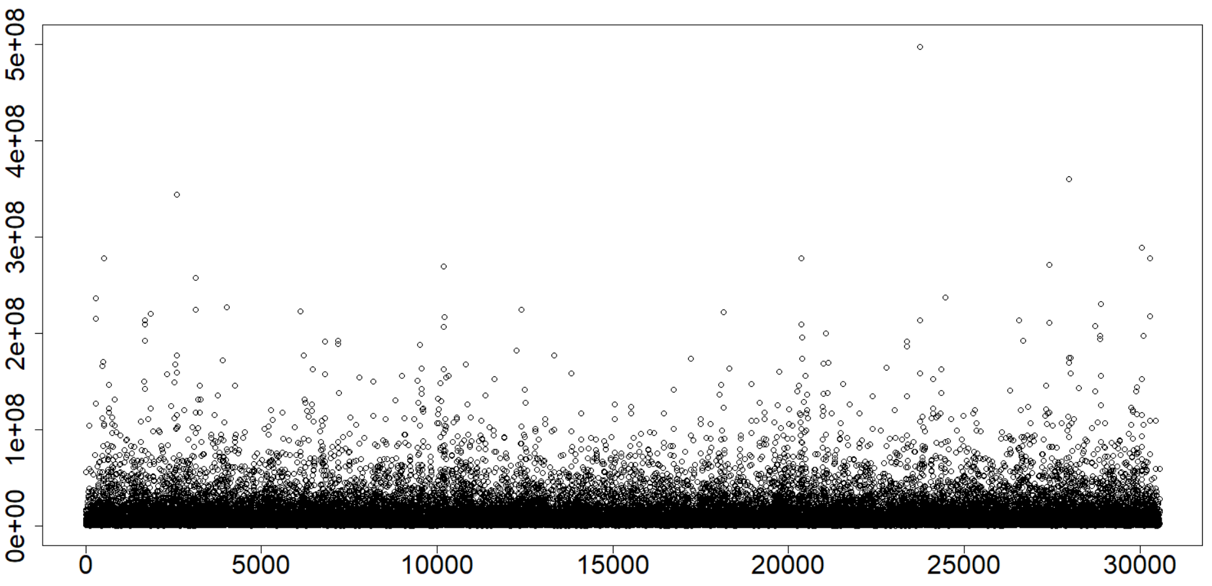
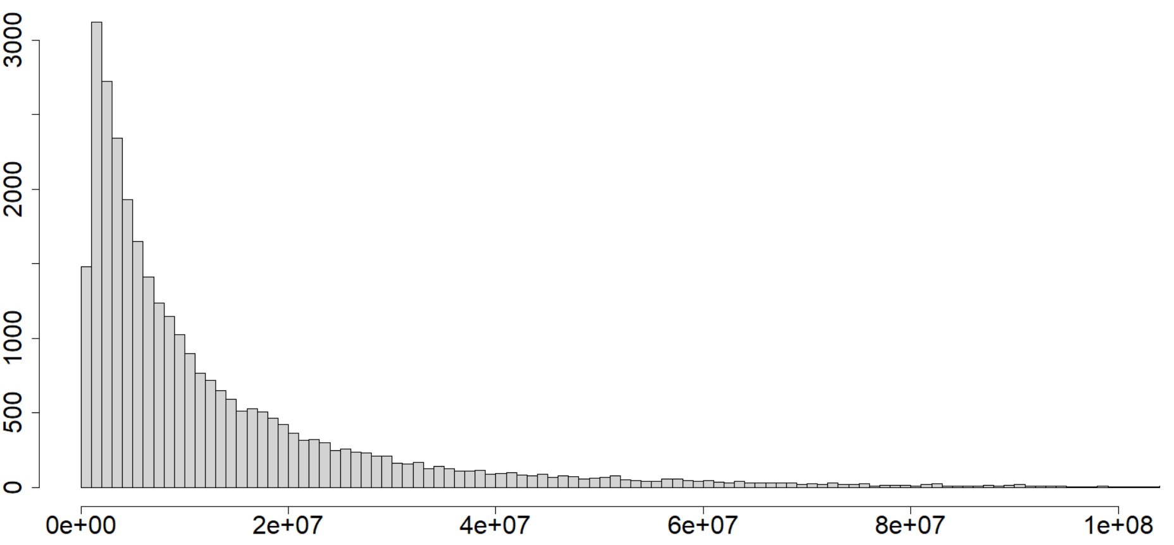
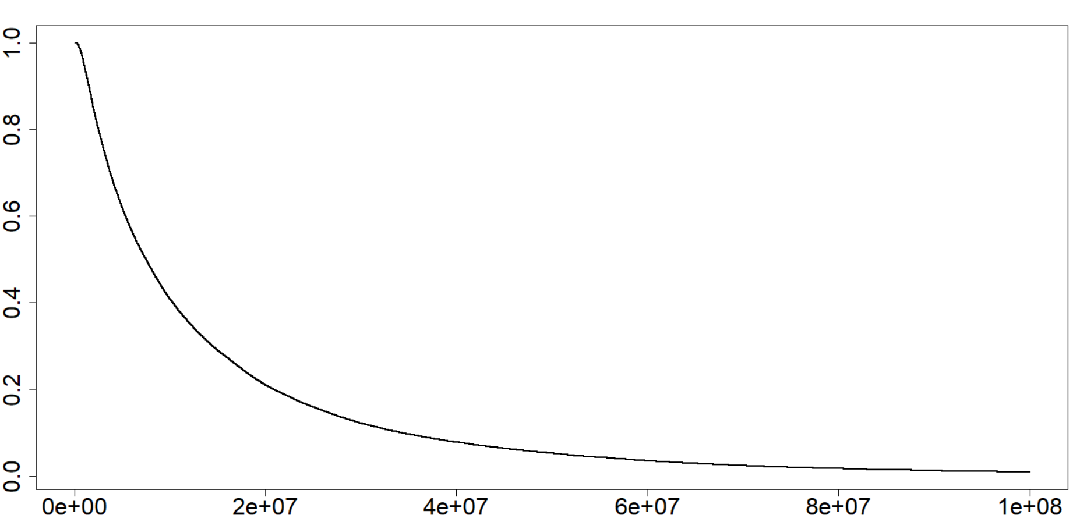
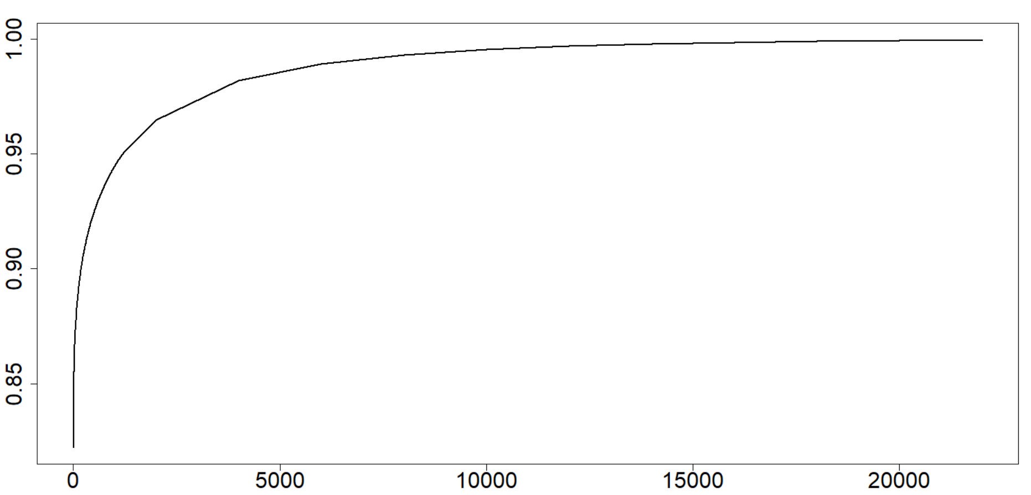
a)
b)
Variance of PS Coefficient
(Sample 1,397)
Number of Coefficients (30,563 Total)
PS Coefficient Position (30,563 Total)
Variance of PS Coefficient (Sample 1,397)
c)
d)
Correlation to Distances
from Unfiltered PS
Percentage of Coefficients (30,563 Total)
Variance of PS Coefficient (Sample 1,397)
PS Coefficients Not Filtered (30,563 Total)

Slide 7
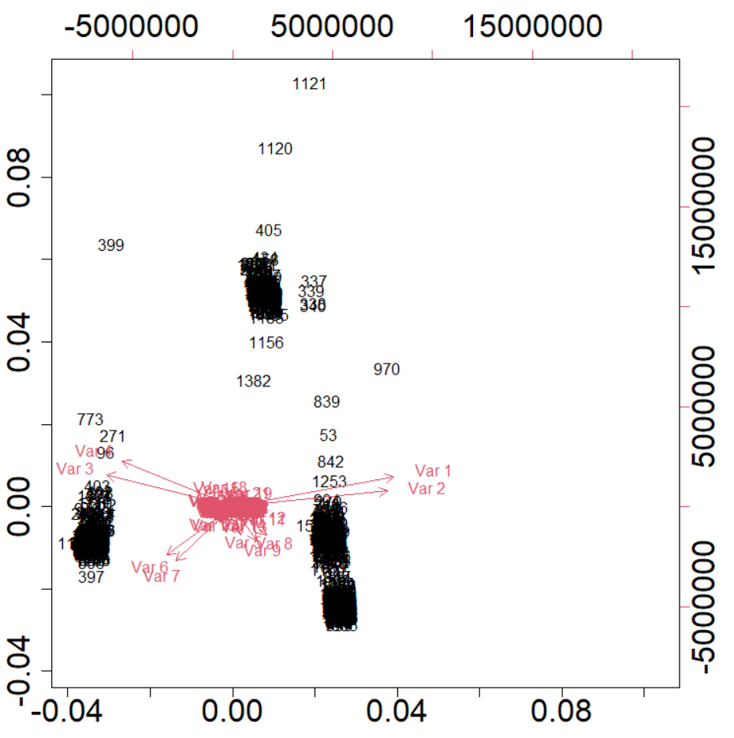
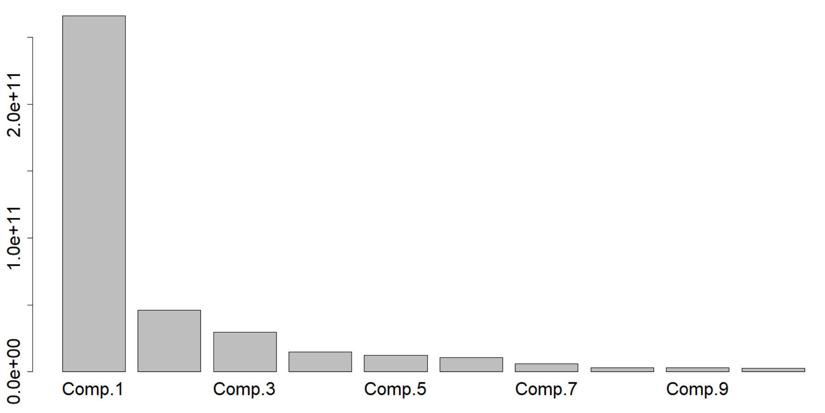
a)
b)
Variance
Component 2
Component
Component 1

