Slide 1
Principal Components Analysis
An Introduction to Principal Components Analysis for the Biomedical Sciences
Presented By: Micah Thornton
June 15, 2023

Slide 2
What are principal components?
Principal components are a groups of linear combinations of variables which
Maximize the variance along a given direction
Are orthogonal to each other (that is perpendicular lines in high dimensional space)
Can be considered as:
A new set of axes on which to interpret the data
A dimensionality reduction technique
A set of rotations to apply to the data to maximize the spread

Slide 3

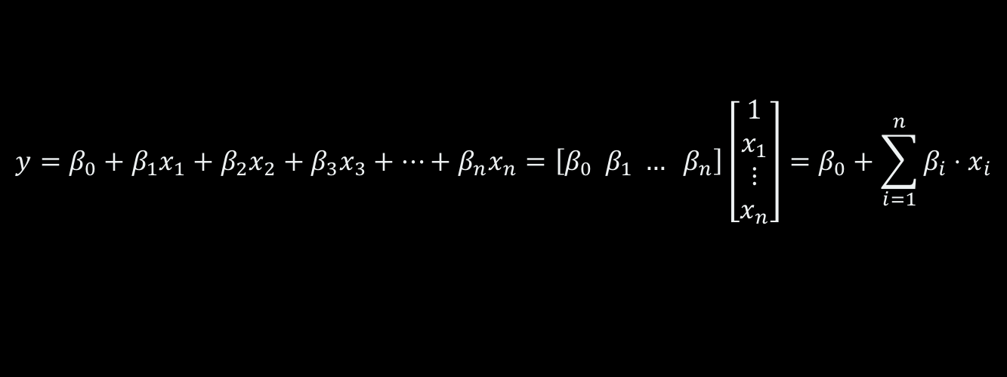
What is a linear combination (additive)?
An additive linear combination of a set of variables involves
Multiplying the variables by a set of coefficients and
Summing the results
Example: Consider n variables, $x_{1},x_{2},…,x_{n}$, an additive linear combination is given:
$$y=β_{0}+β_{1}x_{1}+β_{2}x_{2}+β_{3}x_{3}+…+β_{n}x_{n}=\left[β_{0} β_{1} … β_{n}\right]\left[\begin{matrix}1 \\ x_{1} \\ ⋮ \\ x_{n}\end{matrix}\right]=β_{0}+\sum_{i=1}^{n}{β_{i}⋅x_{i}}$$

Slide 4

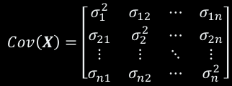
Linear Combinations of Random Variables
$$Cov\left(X\right)=\left[\begin{matrix}σ_{1}^{2} & σ_{12} & ⋯ & σ_{1n} \\ σ_{21} & σ_{2}^{2} & ⋯ & σ_{2n} \\ ⋮ & ⋮ & ⋱ & ⋮ \\ σ_{n1} & σ_{n2} & ⋯ & σ_{n}^{2}\end{matrix}\right]$$
Suppose we have a set of Random Variables,$X = [X_{1} X_{2} … X_{n}]$
Let the Variance-Covariance matrix of this set of RV be given by $Cov(X)$
Consider the change of variable given by
$$Y=\left[\begin{matrix}Y_{1} \\ Y_{2} \\ ⋮ \\ Y_{n}\end{matrix}\right]=BX^{T}=\left[\begin{matrix}β_{11} & β_{12} & ⋯ & β_{1n} \\ β_{21} & β_{22} & ⋯ & β_{2n} \\ ⋮ & ⋮ & ⋱ & ⋮ \\ β_{n1} & β_{n2} & ⋯ & β_{nn}\end{matrix}\right]\left[\begin{matrix}X_{1} \\ \begin{aligned}X_{2} \\ ⋮\end{aligned} \\ X_{n}\end{matrix}\right]$$
The vector Y contains the principal components of X if $Var(Y_{1})$ is maximized subject to the constraint that $\sum_{i=1}^{n}{β_{1i}^{2}}=1$
And that each subsequent component $Y_{j}$ for $j>1$ has maximized $Var(Y_{j})$ subject to the constraints that $\sum_{i=1}^{n}{β_{ji}^{2}}=1, Cov\left(Y_{j},Y_{k}\right)=0 ∀ k<j$
(In other words, is orthogonal to all previous components)
Where:
$$σ_{i}^{2}=Var\left(X_{i}\right)=E\left({\left(X_{i}−μ_{i}\right)}^{2}\right)=E\left(X_{i}^{2}\right)−E{\left(X_{i}\right)}^{2}=E\left(X_{i}^{2}\right)−μ_{i}^{2}$$
$$σ_{ij}=Cov\left(X_{i},X_{j}\right)=E\left(\left(X_{i}−μ_{i}\right)\left(X_{j}−μ_{j}\right)\right)=E\left(X_{i}X_{j}\right)−μ_{i}μ_{j}$$
$$E\left(X_{i}\right)=μ_{i}=\int_{S_{X_{i}}}{x⋅\operatorname{Pr}\left(X_{i}=x\right)dx}$$
Riemann -Stieltjes Integral
*Adapted from Applied Multivariate Statistical Analysis, PennState Eberly College of Science Notes
https://online.stat.psu.edu/stat505/lesson/11/11.1

Slide 5
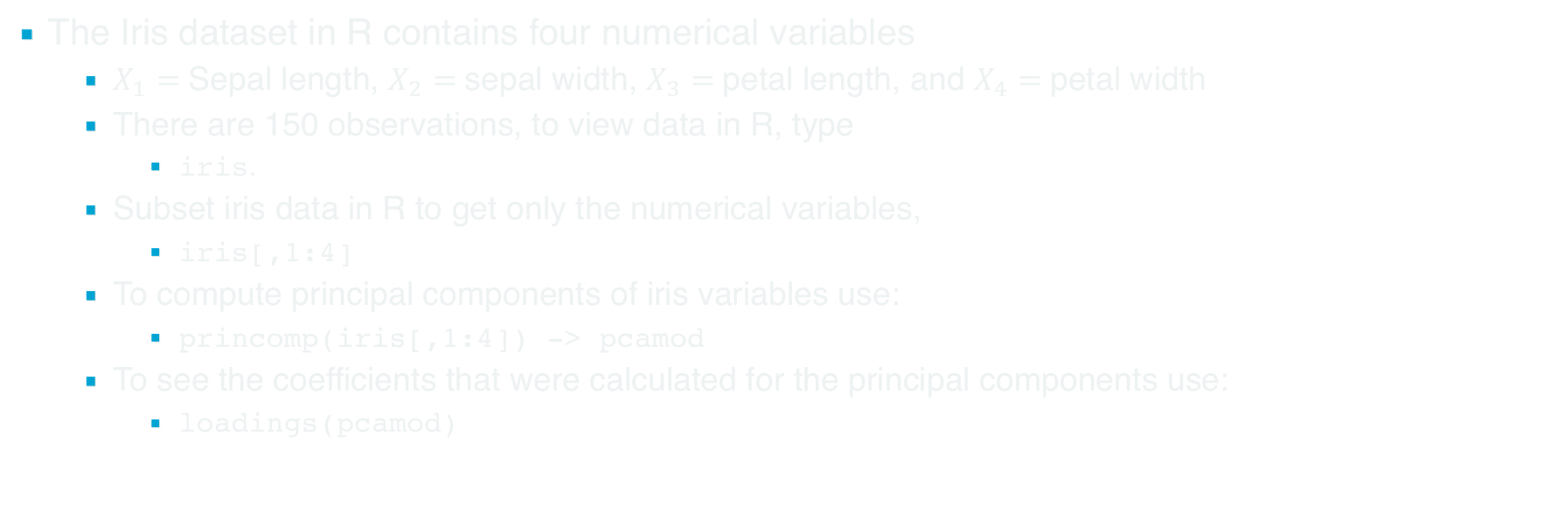
Example Principal Components Analysis: Iris Dataset
The Iris dataset in R contains four numerical variables
$X_{1}=$Sepal length, $X_{2}=$sepal width, $X_{3}=$petal length, and $X_{4}=$petal width
There are 150 observations, to view data in R, type
iris.
Subset iris data in R to get only the numerical variables,
iris[,1:4]
To compute principal components of iris variables use:
princomp(iris[,1:4]) -> pcamod
To see the coefficients that were calculated for the principal components use:
loadings(pcamod)

Slide 6
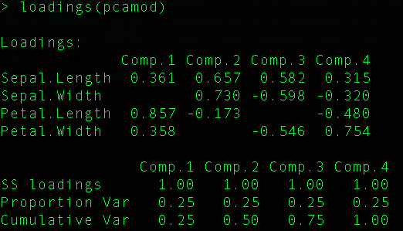

Iris Example Continued
Keeping with previous notation we can see that:
$Y_{1}=0.361X_{1}+0.857X_{3}+0.358X_{4}$
$Y_{2}=0.657X_{1}+0.730X_{2}−0.173X_{3}$
…
Suppose we would like to produce what is known as a “biplot”
Displays $Y_{1}$ vs. $Y_{2}$ for 150 datapoints
Can call axes Dim1 and Dim2
Proportion of Variance Explained
For each dim, take variance, divide by total

Slide 7
Screeplot
Can also look at scree plot,
screeplot(pcamod)
Describes the variance in each component

Slide 8

Genomic Principal components explanation
Suppose we have five samples,
break reference into five portions
Quantitate reads in five portions $(X_{1},X_{2},…,X_{5})$ for each sample
Compute Principal components $(Y_{1},Y_{2},…,Y_{5})$
Plot $Y_{1} vs Y_{2}$ for the five samples,
Replicates should appear near each other in biplot.
Variance explained by components can be calculated directly.

