Slide 1
Non-parametric copula-based dependence modeling of intrinsic properties of stochastic Boolean objects
Francisco Mendoza-Torres

Slide 2
Outline
Stochastic models
Boolean models
Point process
Copula theory
Bézier approximation
Results
Software development

Slide 3
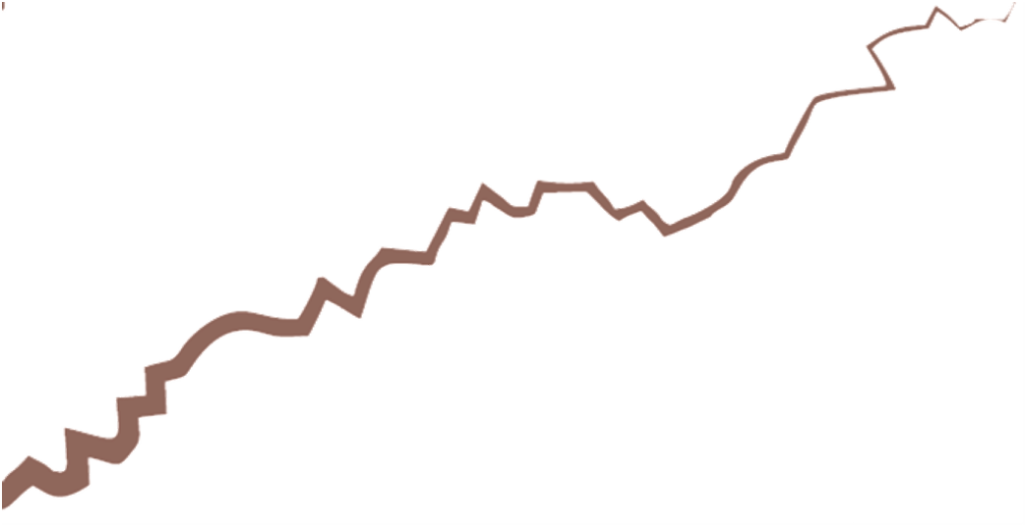

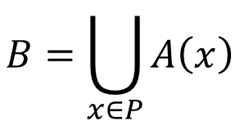
Boolean model
$$B=\bigcup_{x∈P}{A\left(x\right)}$$
Notes:
Shneider, Weil: A random set in a space E is defined, in agreement with the usual approach of axiomatic probability, as a set-valued random variable, that is, as a measurable map from some abstract probability space into a system of subsets of E, endowed with a suitable σ-algebra. It has turned out to be particularly tractable to assume that E is a locally compact space with a countable base and to consider the system F of its closed subsets, equipped with the topology of closed convergence and the induced σ-algebra of Borel sets.
Lantuejoul:
A stochastic model is completely specified by a probability space, that is a triplet (\omega, A, P),
- Q is the set of all possible realizations (or states) of the model.
- A is the set of events. An event is a family of realizations.
- P is a probability measure. It measures the frequency of occurrence of each event.
Two basic and independent ingredients are required for the construction of a boolean model in R^n
i) a set of germs, that is, a Poisson point process P with intensity function
B = (B(x), x E R^n).
ii) a family (A(x), x E R^d) of independent random non-empty compact subsets of R^n. The subset A( x) is called the object implanted at x and its hitting functional is denoted by Tx.
Definition 13.1.1. A boolean model X is the union of all the objects implanted at the Poisson germs
3 Different objects (disk/pores/cells, sinusoids/channels, fractures/line segments). Their properties are different. These objects can also have non-graphical characteristics.

Slide 4
Boolean model
Notes:
On the left we have, Deterministic object properties but random locations.
On the right we have, random objects
Poisson sticks
Direction and length

Slide 5
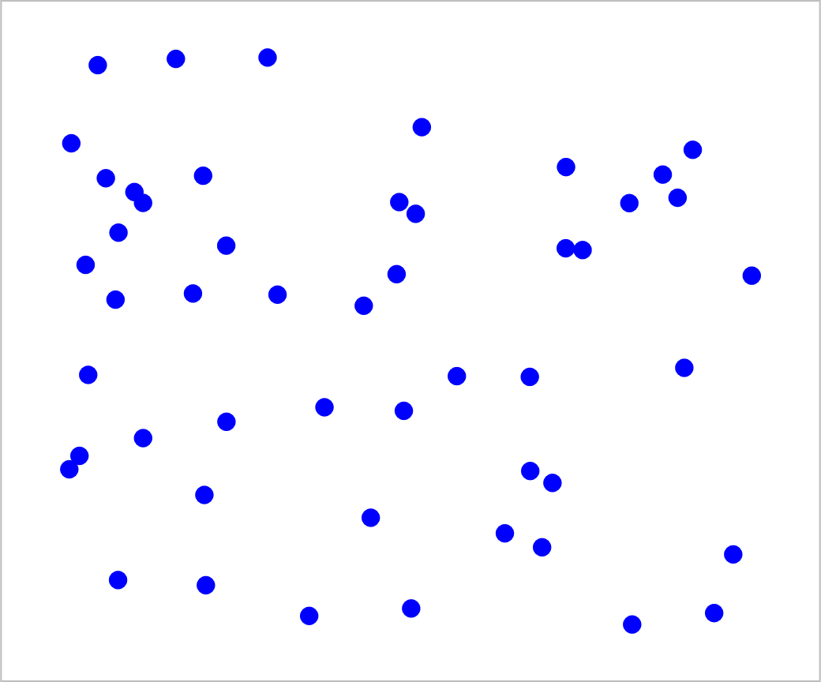
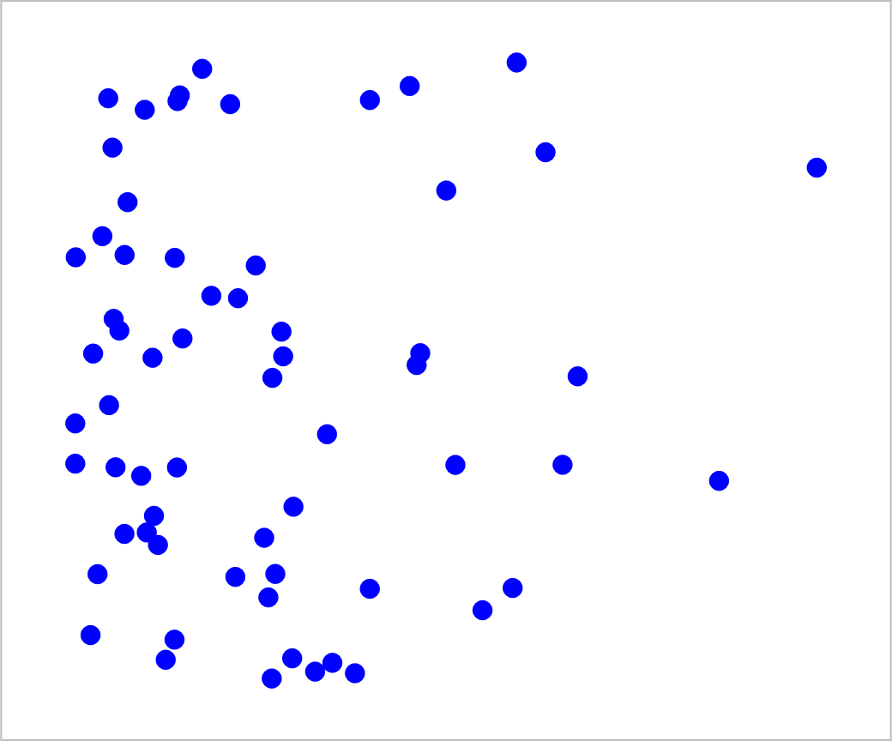
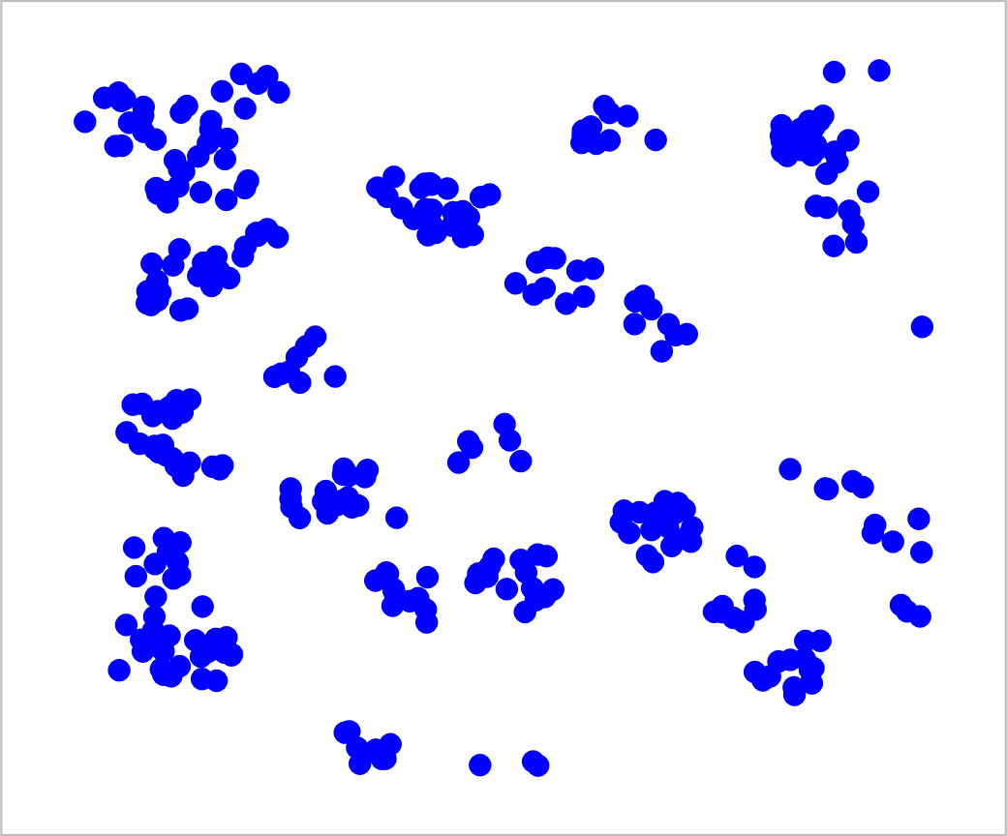
Point process
Spatial Intensity modeled by a Scalar, possibly Random, Field
Notes:
Todo: Add the intensity field that was used to generate the realization (the points)
A random point process in R^n is a random set each realization of which is made up of a finite or countable number of points.
A locally finite point process is a typical example of a closed one. This is a point process for which the number of points falling within any compact subset is almost surely finite.
The spatial distribution of a homogeneous Poisson point process with intensity B is characterized by the following two properties:
if A E Ba, then the number N(A) of points in A is a Poisson random variable with parameter B IAI where IAI denotes the d-volume of A
[BIAlln P{N(A)=n} = exp{-BIAI} --,-n.
ii)if (Ai, i E I) is a finite family of pairwise disjoint elements of Ba, then the random variables (N (Ai), i E I) are mutually independent.
Since the mean value of a Poisson distribution coincides with its parameter, the mean number of points within A is equal to BIAI. In particular, B is the mean number of points per unit d-volume.
A random function Z is a family of random variables {Z (x)} where x belongs to R^d or some subset of it. In the case d = 1, we prefer to speak of a stochastic process .

Slide 6
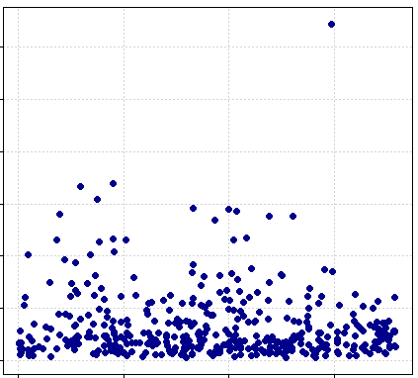
Copula theory
Notes:
No linear model can be succesfully fitted to this dataset. Even penilized b-splines because the regression assumptions do not hold. Copulas are multivariate functions that can model de dependence structure between univariate margins. I am not talking of a single or finite set of numbers, the correlation coefficients. No even the linear models.
Terminology:
Correlation
Measure of association
Dependence structure

Slide 7
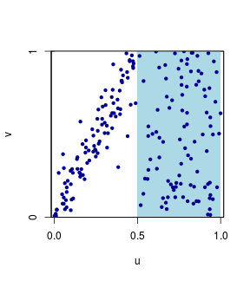
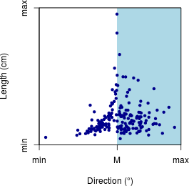

Copula theory
$$H\left(x,y\right)=C\left(F\left(x\right),G\left(y\right)\right)$$
Notes:
In this bivariate example, H is the joint distribution function. Notice that it can be decomposed in 3 functions: the marginals and the copula.
Let H be a joint distribution function with margins F and G. Then there exists a copula C such that for all x,y in R, H(x,y) = C(F(x),G(y)). (2.3.1)
If F and G are continuous, then C is unique; otherwise, C is uniquely determined on RanF \ RanG. Conversely, if C is a copula and F and G are distribution functions, then the function H defined by (2.3.1) is a joint distribution function with margins F and G.
A copula is a función defined on the unit square
C is uniformly continuous on its domain.

Slide 8
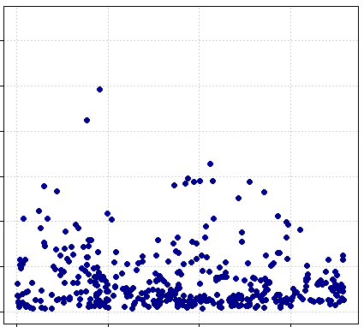
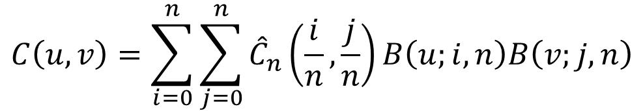

Copula theory. Bernstein copula
$$C\left(u,v\right)=\sum_{i=0}^{n}{\sum_{j=0}^{n}{{\hat{C}}_{n}\left(\frac{i}{n},\frac{j}{n}\right)B\left(u;i,n\right)B\left(v;j,n\right)}}$$
$$B(w;k,n)≔\left(\begin{matrix}n \\ k\end{matrix}\right)w^{k}{\left(1−w\right)}^{n−k}$$
Notes:
sequences of polynomials named after their creator S. N. Bernstein. Given a function f on [0, 1], we define the Bernstein polynomial for each positive integer n. If f
is continuous on [0, 1], its sequence of Bernstein polynomials converges uniformly to f on [0, 1]
Bernstein polynomial for f interpolates f at both endpoints of the interval [0, 1]
It can be proved that Bn the Bernstein is a linear monotone operator; it maps a function f, defined on [0, 1], to Bnf, where the function Bnf evaluated at x is denoted by Bn(f; x).
Thus the Bernstein polynomials for x2 converge uniformly to x2 like 1/n, very slowly. We will see from Voronovskaya’s Theorem 7.1.10 that this rate of convergence holds for all functions that are twice differentiable.
Binomial distribution

Slide 9
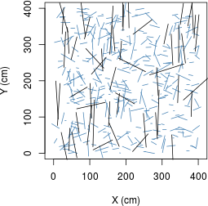
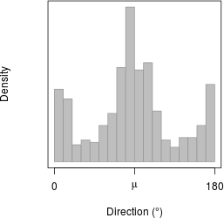
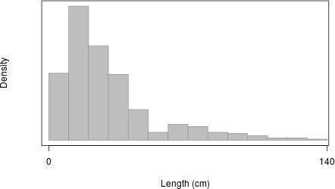
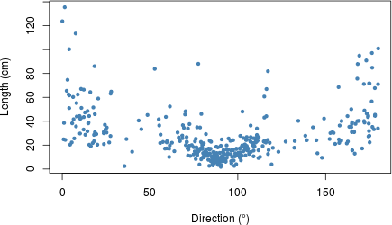
Poisson sticks

Slide 10
Poisson sticks

Slide 11
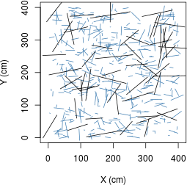
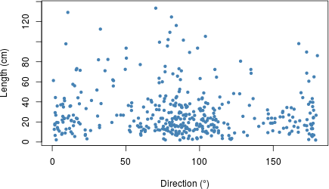
Poisson sticks

Slide 12
Independent Dependent

Slide 13
Vine copulas
Notes:
Graph theory helps to represent multivariate distribution functions as a sequence of trees composed by copulas. This leads to a multivariate copula formulation in terms of bivariate components.

Slide 14
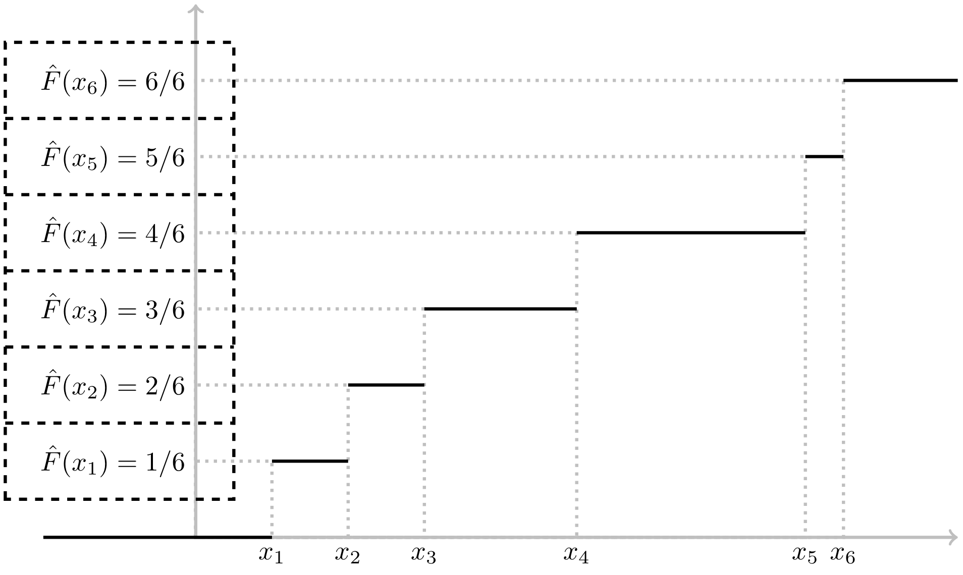
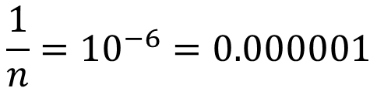
Software development
$$\frac{1}{n}={10}^{−6}=0.000001$$
For n=10^6
Notes:
The univariate empírical distribution function, shown in black line segments, can give an idea of the multivariate empirical distribution function both theoretically and computationally.
From the computational point of view, The dashed rectangles resemble the array storage in some programming language.
From this, we can see that denominator can be factored out. Procedure which let us to have an array of unsigned intergers, which in turn is less memory demanding.
Another advantage is better computation accuracy/precission. Lets say we have a simple size of 1 million. Then, the empirical distribution value is this small. Now, let’s say we are using Bezier curve, then each w is of the order of 0.1, therefore the bezier curve order is of the same order as the empirical distribution. A complete computation would be of this order. Now, let’s go to 2D, imagine 3D. What is the precisión of your computer? 3D? 4D? To work with higher dimensions is important to understand precission.

Slide 15
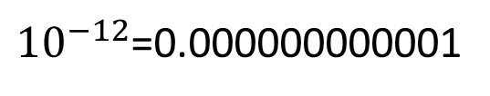



Software development
$$B\left(w | k,n\right)≔\left(\begin{matrix}n \\ k\end{matrix}\right)w^{k}{\left(1−w\right)}^{n−k}$$
$$w\sim 1^{−1}$$
$$B\left(w\right)\sim {10}^{−6}$$
${10}^{−12}$=0.000000000001
Now, let’s go to 2D
$$\frac{1}{n}={10}^{−6}=0.000001$$
For n=10^6
Notes:
The univariate empírical distribution function, shown in black line segments, can give an idea of the multivariate empirical distribution function both theoretically and computationally.
From the computational point of view, The dashed rectangles resemble the array storage in some programming language.
From this, we can see that denominator can be factored out. Procedure which let us to have an array of unsigned intergers, which in turn is less memory demanding.
Another advantage is on computation accuracy/precission. Lets say we have a simple size of 1 million. Then, the empirical distribution value is this small. Now, let’s say we are using Bezier curve (or any other polynomial), then each w is of the order of 0.1, therefore the bezier curve order is of the same order as the empirical distribution. A complete computation would be of this order. Now, let’s go to 2D, imagine 3D. What is the precisión of your computer? 3D? 4D? To work with higher dimensions is important to understand precission.

Slide 16
Software development
$$B\left(w | k,n\right)≔\left(\begin{matrix}n \\ k\end{matrix}\right)w^{k}{\left(1−w\right)}^{n−k}$$
$$w\sim 1^{−1}$$
$$B\left(w\right)\sim {10}^{−6}$$
${10}^{−12}$=0.000000000001
Now, let’s go to 2D
$$\frac{1}{n}={10}^{−6}=0.000001$$
For n=10^6
Notes:
The univariate empírical distribution function, shown in black line segments, can give an idea of the multivariate empirical distribution function both theoretically and computationally.
From the computational point of view, The dashed rectangles resemble the array storage in some programming language.
From this, we can see that denominator can be factored out. Procedure which let us to have an array of unsigned intergers, which in turn is less memory demanding.
Another advantage is on computation accuracy/precission. Lets say we have a simple size of 1 million. Then, the empirical distribution value is this small. Now, let’s say we are using Bezier curve, then each w is of the order of 0.1, therefore the bezier curve order is of the same order as the empirical distribution. A complete computation would be of this order. Now, let’s go to 2D, imagine 3D. What is the precisión of your computer? 3D? 4D? To work with higher dimensions is important to understand precission.

Slide 17
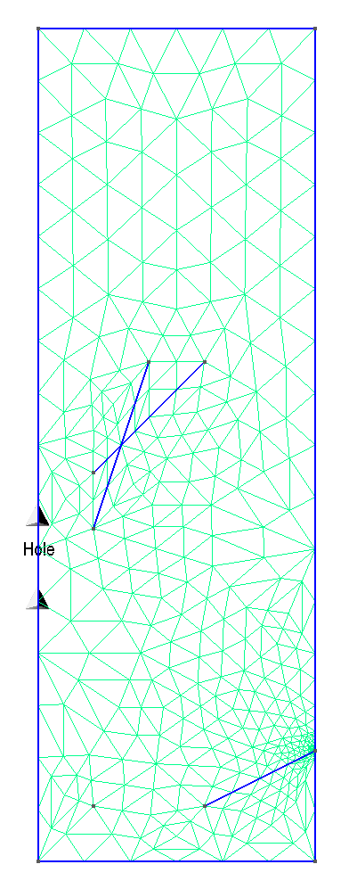
Software development
https://github.com/mathphysmx/gmshR
An R package to export geometric elements
to .geo gmsh files.

Slide 18
Software development
R packages
percolation
Bernsteincopula
empiricalDistribution
inverseFunction
bezierTensor
https://github.com/mathphysmx/gmshR

Slide 19
Comments?
Do you need a post-doc? mentofran@gmail.com

