Slide 1
Hue values (0-255)
import numpy as np
a=[32,64,96,128,160,192,224,255]
np.random.choice(a=a,size=1)

Slide 2
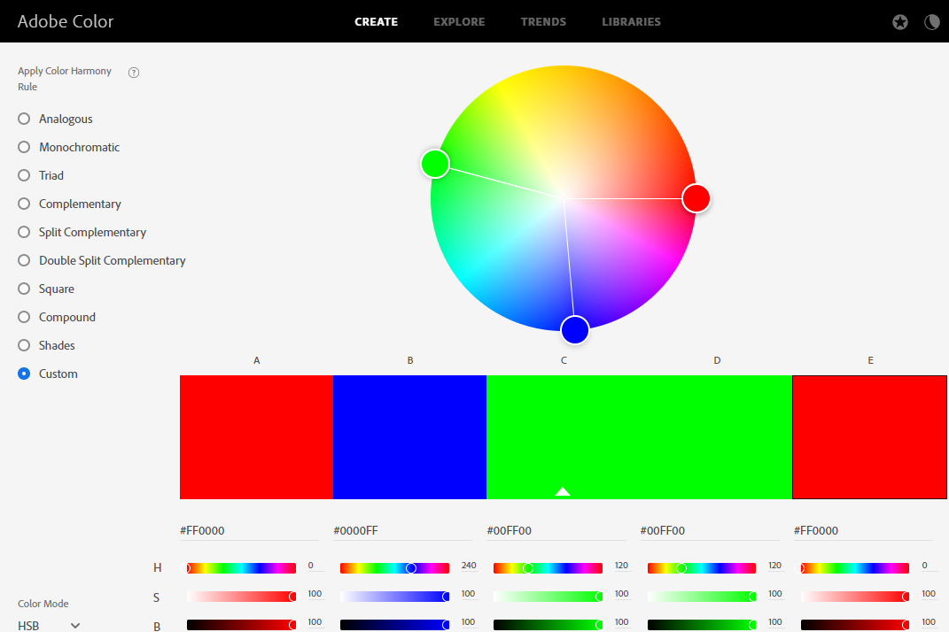
Hue

Slide 3
256/12 colors = 21.333 $≈$ 21 360/12 =30
RED #FF0000 (255,0,0)
Hue: 0 (0°)
Sat = 255
Lum = 128
Orange
#FF8000 (255,128,0) Hue: 21
Sat = 255
Lum = 128
YELLOW #FFFF00 (255,255,0)
Hue: 42
Sat = 255
Lum = 128
chartreuse
#80FF00 (128,255,0)
Hue:64
Sat = 255
Lum = 128
GREEN #00FF00 (0,255,0)
Hue: 85
Sat = 255
Lum = 128
SPRING GREEN
#00FF80 (0,255,128)
Hue: 106
Sat = 255
Lum = 128
AZURE #0000FF (0,128,255)
Hue: 149
Sat = 255
Lum = 128
Violet
#8000FF (128,0,255)
Hue: 191
Sat = 255
Lum = 128
MAGENTA/Fucshia #FF00FF (255,0,255) Hue: 213
Sat = 255
Lum = 128
Rose
#FF0080 (255,0,128) Hue: 234
Sat = 255
Lum = 128
CYAN/Aqua #00FFFF (0,255,255)
Hue: 127 (180°)
Sat = 255
Lum = 128
BLUE #0000FF (0,0,255) Hue: 170
Sat = 255
Lum = 128
https://colordesigner.io/color-mixer
https://www.w3schools.com/colors/colors_wheels.asp
https://combinecolors.com/rgb-color-blender
https://pinetools.com/blend-colors
Color names

Slide 4
(255, 255, 128)
Canary
#FFFF80
Hue:60°
(128, 255, 255)
Electric Blue
#80FFFF
Hue = 180°
(255, 128, 255)
Fuchsia Pink
#FF80FF
Hue = 300°

Slide 7
Notes:
https://colordesigner.io/color-mixer
https://www.w3schools.com/colors/colors_wheels.asp
https://combinecolors.com/rgb-color-blender
https://pinetools.com/blend-colors

Slide 11
Mint Green
rgb(128, 255, 128)
#80FF80
Hue = 120°
Light Slate Blue
rgb(128, 128, 255)
#8080FF
Hue = 240°
Mona Lisa
rgb(255, 128, 128)
#FF8080
Hue = 0°

Slide 14
128
Maroon
128
#800000
Purple
(128, 0, 128)
#800080
Olive
(128, 128, 0)
#808000
128
Green
128
#008000
Hsb(120°,100%, 50%)
Grey (/ɡreɪ/)
(128, 128, 128)
#808080
Teal
(0, 128, 128)
#008080
Navy
128
#000080

Slide 17
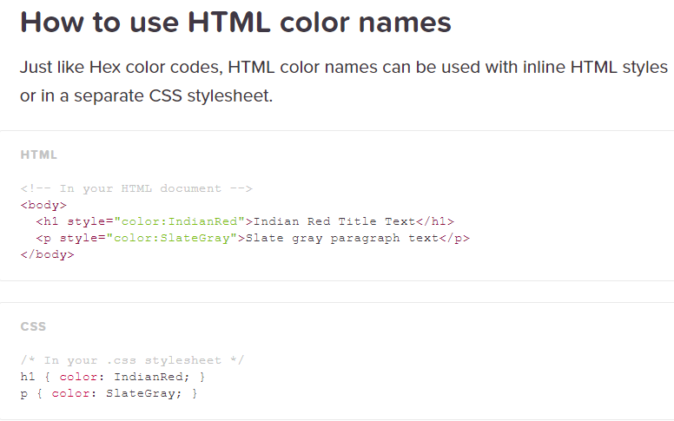
Color names in web development
https://www.color-blindness.com/color-name-hue/
https://www.color-name.com/
https://colornames.org/

Slide 18
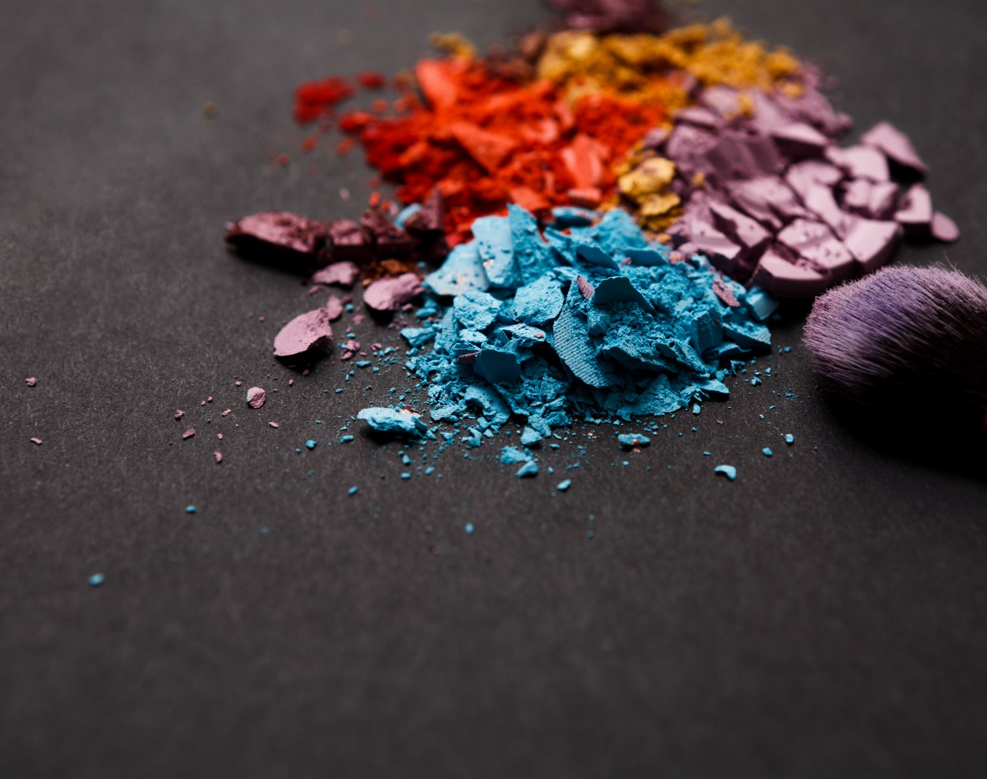
Saturation

Slide 20
Sunset
rgb(192, 64, 64)
hsl(0,129,128)
#C04040
Lime Green
rgb(64, 192, 64)
hsl(85,129,128)
#C04040
Free Speech Blue
rgb(64,64, 192)
hsl(170,129,128)
#4040C0

Slide 22
Luminosity

Slide 24
rgb(64, 0,0)
H:0,S:255
L:32
rgb(128, 0,0)
H:0,S:255
L:64
#C00000
rgb(192, 0,0)
H:0,S:255
L:96
rgb(255, 0,0)
H:0,S:255
L:128
rgb(255,65,65)
H:0,S:255
L:160
Mona Lisa
#FF8181
rgb(255,129,129)
hsl(0,255,192)
#FFC1C1
rgb(255,193,193)
hsl(0,255,224)
rgb(0 64,0)
H:85,S:255
L:32
rgb(0, 128,0)
H:85,S:255
L:64
rgb(0, 192,0)
H:85,S:255
L:128
rgb(0, 255,0)
H:85,S:255
L:128
rgb(255,65,65)
H:0,S:255
L:160
Mint (light) Green
#81FF81
rgb(129,255,129)
hsl(85, 255, 192)
Tea Green
#C1FFC1
rgb(193,255,193)
hsl(85,255,224)
rgb(0, 0,64)
H:170,S:255
L:32
rgb(0, 0,128)
H:170,S:255
L:64
rgb(0, 0,192)
H:170,S:255
L:128
rgb(0, 0, 255)
H:170,S:255
L:128
rgb(255,65,65)
H:0,S:255
L:160
Light Slate Blue
#8181FF
rgb(129,129,255)
hsl(170,255,192)
Lavender Blue
#C1C1FF
rgb(193,193,255)
hsl(170,255,224)

Slide 25
Color contrast

Slide 26
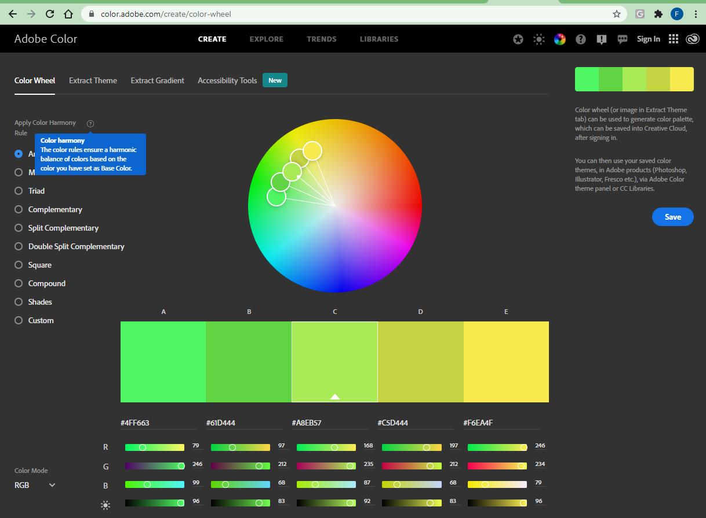
Color relationships (harmony rules)

Slide 27
Color harmony rule
Analogous
Monochromatic
Triad
Complementary
Split complementary
Double split complementary
Square
Compound
Shades

Slide 28
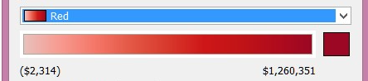
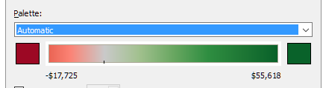
Color schemes
Sequential
Monochromatic
Divergent
Divergent
Categorical (a.k.a. qualitative) Palette

Slide 29
https://en.wikipedia.org/wiki/Color_depth#True_color_(24-bit)

Slide 30
Psychology
Orange is energetic and warm. Some common associations with orange include creativity, enthusiasm, lightheartedness, and affordability.
Red is the color of blood, so it’s often associated with energy, war, danger, and power but also passion, desire, and love. Some common associations with red include action, adventure, aggression, and excitement.
Yellow evokes positivity, youth, joy, playfulness, sunshine, and warmth.
Pink evokes feelings of innocence and delicateness, gratitude, romance, softness, and appreciation.
Blue is perceived as authoritative, dependable, and trustworthy. Common associations with blue include calmness, serenity, confidence, dignity, and security.
Green is the color of nature. It symbolizes growth, freshness, serenity, money, health, and healing.
Black represents power, elegance, and authority. Common associations with black also include class, distinction, formality, mystery, secrecy, and seriousness.

Slide 31
Accessibility (luminosity contrast ratio)
https://www.w3.org/WAI/perspective-videos/contrast/
https://accessible-colors.com/
https://web.dev/color-and-contrast-accessibility/

Slide 32
Color models
RGB, HSL, Pantone

Slide 33
References

Slide 34
Books
2017 Katherine A. Hughes - Graphic Design Learn It, Do It.pdf
2016 Rhyne, Theresa Marie - Applying color theory to digital media and visualization.pdf
2017 Samara, Timothy - Making and breaking the grid _ a graphic design layout workshop.pdf

Slide 35
Random color match
https://codepen.io/polly_nomial/pen/sGKIv
n = 2 # n = 2, 4, 8
return (256/n)*Math.floor(Math.random() * n);
https://github.com/davidmerfield/randomColor
https://www.npmjs.com/package/randomcolor
https://www.kirupa.com/html5/generating_random_colors.htm
https://css-tricks.com/snippets/javascript/random-hex-color/
https://thisinterestsme.com/random-color-javascript/
https://dev.to/akhil_001/generating-random-color-with-single-line-of-js-code-fhj
https://www.youtube.com/watch?v=GMxR6ZJDiMo

Slide 36
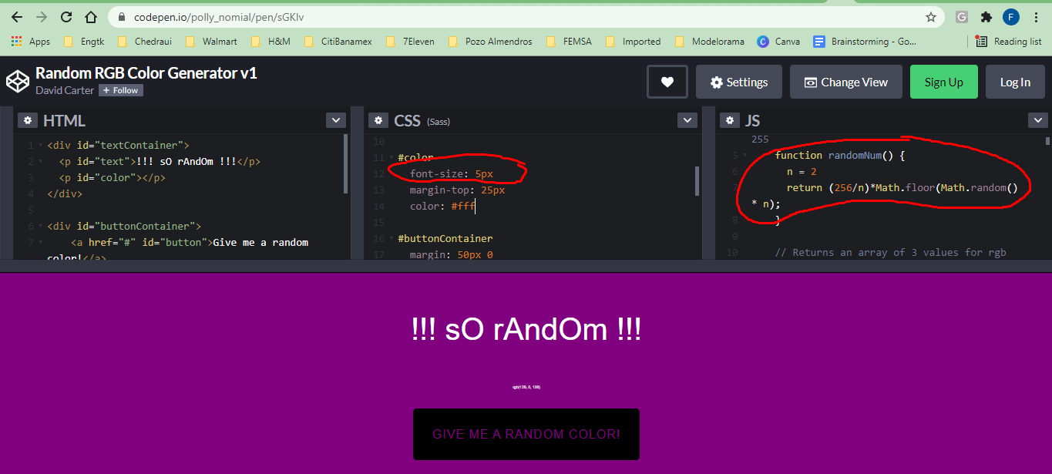
https://codepen.io/polly_nomial/pen/sGKIv
var myArray= [0, 128, 255];
return myArray[Math.floor(Math.random()*myArray.length)];
n = 2 # n = 2, 4, 8
return (256/n)*Math.floor(Math.random() * n);

Slide 37
https://www.w3schools.com/colors/colors_2021.asp
https://mode.com/blog/how-to-use-brand-color-palette-in-data-visualizations/
https://ubiq.co/analytics-blog/5-best-color-palettes-business-dashboard/
https://www.pinterest.com/gregmarkzimmerman/trending-data-visualization-design/
https://www.quicksprout.com/trending-website-color-schemes/
https://visme.co/blog/website-color-schemes/
Canva course on graphic design basics

Slide 38
https://blog.prototypr.io/q-a-how-can-digital-designers-mix-rgb-colors-more-effectively-74aa6915ed97
https://www.rapidtables.com/web/color/RGB_Color.html
http://changingminds.org/explanations/perception/visual/hsl.htm#:~:text=Luminosity%20is%20a%20measure%20of,as%20in%20the%20image%20below.
https://www.carbondesignsystem.com/data-visualization/chart-types/
https://www.displayr.com/choosing-color-palettes-in-displayr/
https://www.datanovia.com/en/blog/top-r-color-palettes-to-know-for-great-data-visualization/
Adobe guide for data visualization
Material Design / Data Visualization

Slide 39
Color Schemes/palettes
https://color.adobe.com/create/color-wheel
https://coolors.co/
https://mycolor.space/
How to choose a brand color palette

Slide 40
GAMES
https://color.adobe.com/color-wheel-game
https://color.method.ac/
https://www.proprofsgames.com/colour-mixing/
Android apps:
RGBit - Color Mixing Game
Color Mixer - Match, mix, learn colors for Free

Slide 41
Accesibility
Color contrast
Accessibility course
https://webaim.org/articles/contrast/
https://webaim.org/resources/contrastchecker/
https://digital.cigna.com/patterns-and-components/accessibility-implementation/color-contrast-grids#full-grid

Slide 42
Color contrast
https://www.cambridgeincolour.com/tutorials/histograms1.htm
https://www.deepspacesparkle.com/teach-contrast-emphasis/
https://processingraw.com/tutorial-dynamic-contrast/
https://blog.nightnurse.ch/09/2020/tutorial-color-in-composition/
For charts
https://www.gimp.org/tutorials/ContrastMask/
https://worqx.com/color/color_proportion.htm
https://www.photoshopessentials.com/photo-editing/contrast-black-and-white/

Slide 43
Colors for digital displays
https://www.uxmatters.com/mt/archives/2006/01/color-theory-for-digital-displays-a-quick-reference-part-i.php
https://www.gimp.org/tutorials/Basic_Color_Curves/
https://blog.frame.io/2017/09/20/beginners-guide-to-color-curves/
https://mixinglight.com/color-grading-tutorials/
https://www.rocketstock.com/blog/color-grading-color-correcting-tutorial/
https://www.bhphotovideo.com/explora/video/tips-and-solutions/introduction-color-grading

Slide 44
Photoshop tutorials
https://helpx.adobe.com/photoshop/using/curves-adjustment.html
https://helpx.adobe.com/photoshop/using/adjust-color-tone-levels-curves.html
https://helpx.adobe.com/photoshop/using/adjusting-color-tone-cs6.html
https://helpx.adobe.com/photoshop/using/adjusting-hue-saturation.html
https://helpx.adobe.com/photoshop/using/convert-color-image-black-white.html
https://helpx.adobe.com/photoshop/using/adjust-shadow-highlight-detail.html
https://helpx.adobe.com/photoshop/using/levels-adjustment.html

