Slide 1
Machine Learning / Tree based methods

Slide 2
Decision Trees
Regression

Slide 3
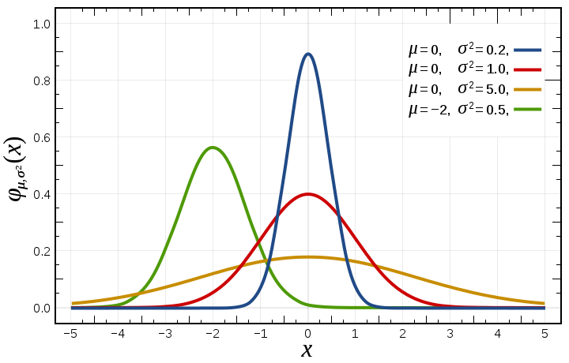
Variance

Slide 4
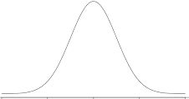
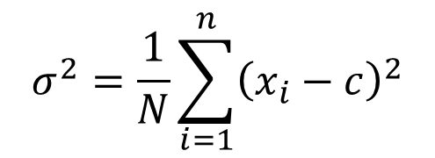
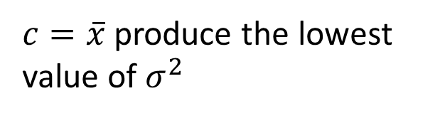
Variance
$$σ^{2}=\frac{1}{N}\sum_{i=1}^{n}{{\left(x_{i}−c\right)}^{2}}$$
$c=\overline{x}$ produce the lowest value of $σ^{2}$

Slide 5
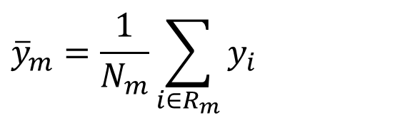




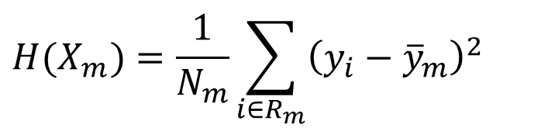
Domain partitioning
$$f(x_{1},x_{2})=y$$
$${\overline{y}}_{3}=6.74$$
$${\overline{y}}_{m}=\frac{1}{N_{m}}\sum_{i∈R_{m}}{y_{i}}$$
Root node
$${\overline{y}}_{1}=5.11$$
$$H(X_{m})=\frac{1}{N_{m}}\sum_{i∈R_{m}}{{\left(y_{i}−{\overline{y}}_{m}\right)}^{2} }$$
Internal node
$${\overline{y}}_{2}=6.0$$
Leaf
Leaf
Leaf

Slide 6
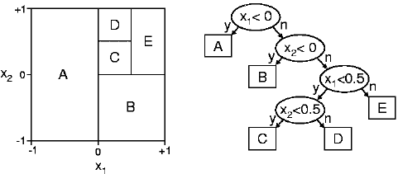

Slide 7
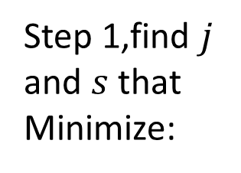
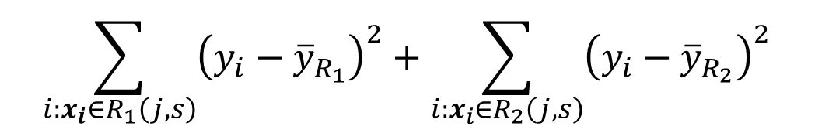




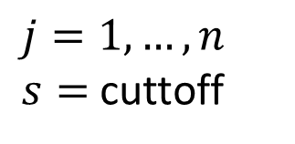
Fitting
$${\overline{y}}_{R_{1}}$$
$${\overline{y}}_{R_{2}}$$
$$R_{1}$$
$$R_{2}$$
Fit
Step 1,find $j$ and $s$ that Minimize:
$$\sum_{i:x_{i}∈R_{1}\left(j,s\right)}{{\left(y_{i}−{\overline{y}}_{R_{1}}\right)}^{2}+\sum_{i:x_{i}∈R_{2}\left(j,s\right)}{{\left(y_{i}−{\overline{y}}_{R_{2}}\right)}^{2}} }$$
$j=1,…, n$
$s=$ cuttoff
Notes:
$n=$ Number of predictor variables

Slide 8
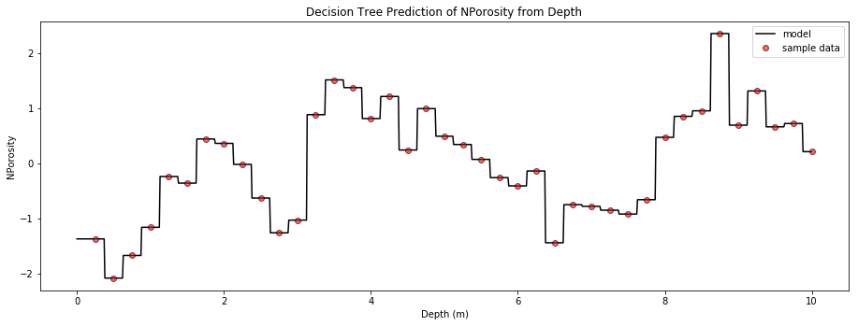
https://github.com/GeostatsGuy/PythonNumericalDemos/blob/master/SubsurfaceDataAnalytics_PolygonalRegression.ipynb

Slide 9
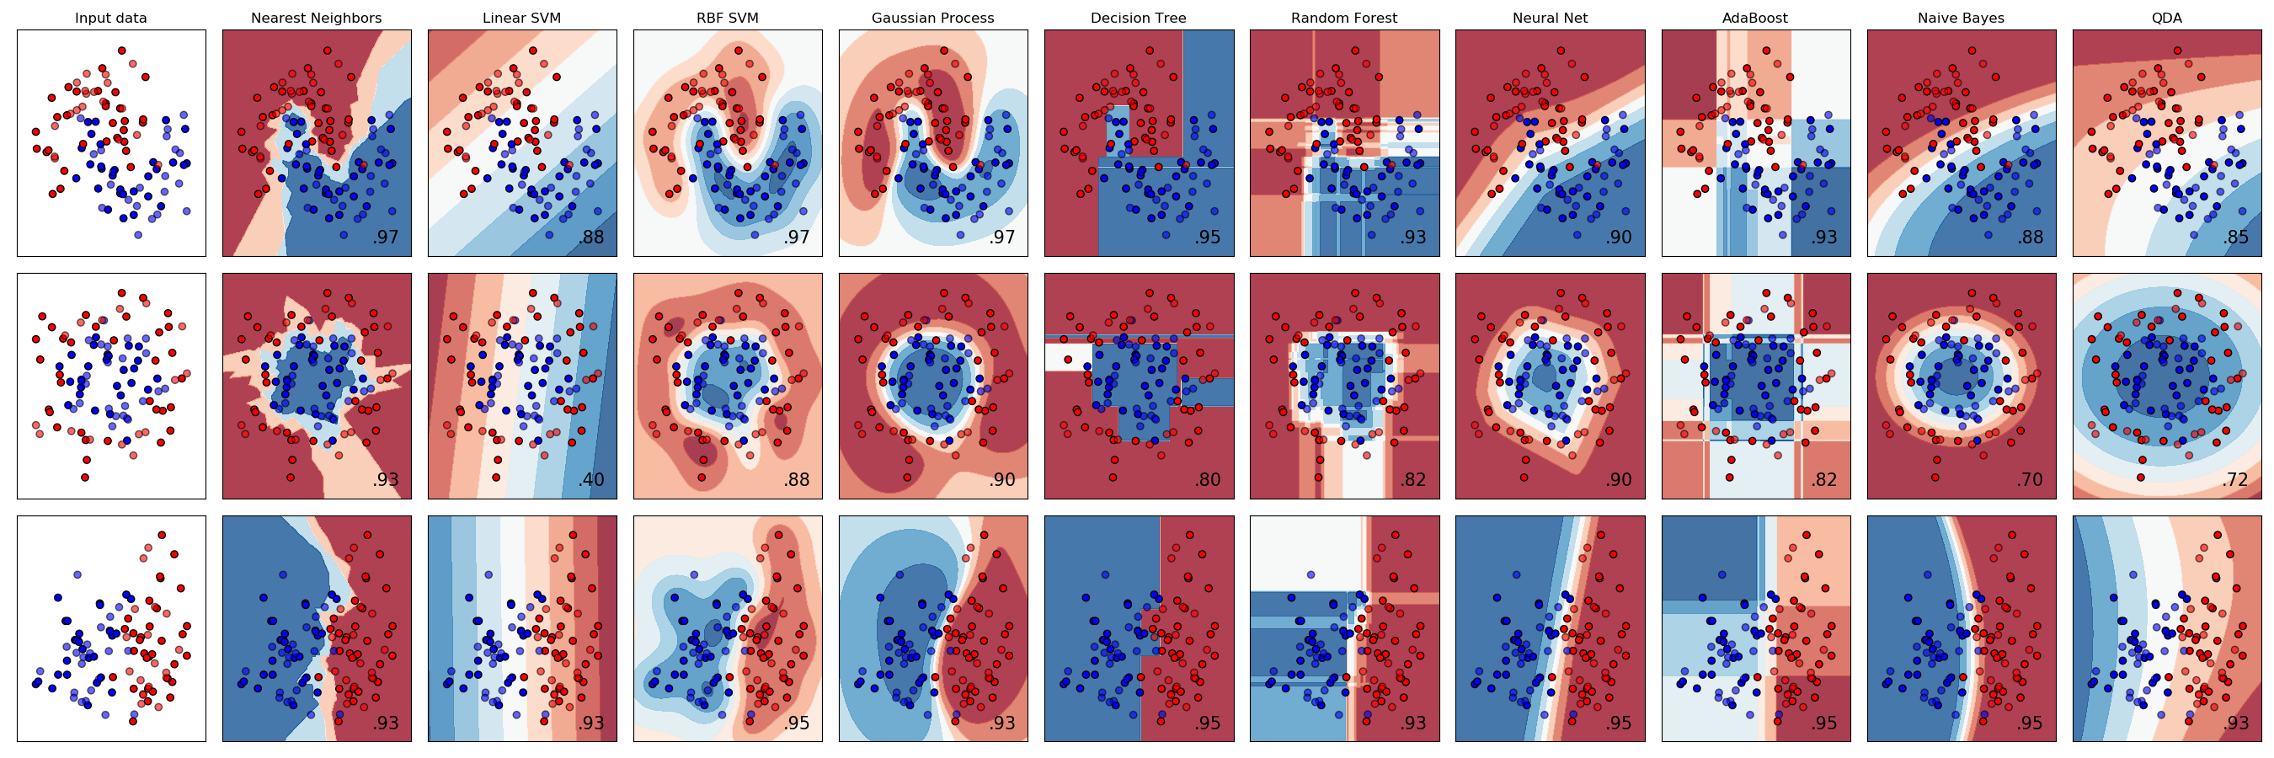
Decision Trees
Classification

Slide 10
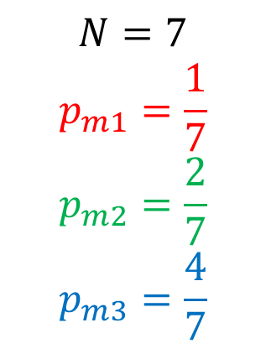
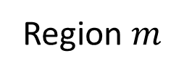
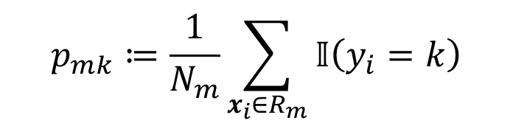
Proportions
Region $m$
$$p_{mk}≔\frac{1}{N_{m}}\sum_{x_{i}∈R_{m}}{𝕀\left(y_{i}=k\right)}$$
$$N=7$$
$$p_{m1}=\frac{1}{7}$$
$$p_{m2}=\frac{2}{7}$$
$$p_{m3}=\frac{4}{7}$$
https://scikit-learn.org/stable/modules/tree.html#classification-criteria
p. 311-313, Hastie, 2014
Notes:
How would you color the grey dot/point/instance?

Slide 11
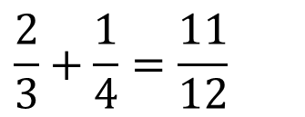


Misclassification measure
Region $m$
$$H\left(X_{m}\right)=1−\max_{k}{(p_{mk})}$$
Misclassification
$$s_{1}$$
$$\frac{2}{3}+\frac{1}{4}=\frac{11}{12}$$
https://scikit-learn.org/stable/modules/tree.html#classification-criteria
p. 311-313, Hastie, 2014

Slide 12
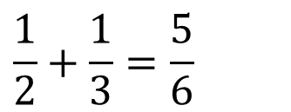

Misclassification measure
Region $m$
$$H\left(X_{m}\right)=1−\max_{k}{(p_{mk})}$$
Misclassification
$$s_{2}$$
$$\frac{2}{3}+\frac{1}{4}=\frac{11}{12}$$
$$\frac{1}{2}+\frac{1}{3}=\frac{5}{6}$$
https://scikit-learn.org/stable/modules/tree.html#classification-criteria
p. 311-313, Hastie, 2014

Slide 13

Misclassification measure
Region $m$
$$H\left(X_{m}\right)=1−\max_{k}{(p_{mk})}$$
Misclassification
$$s_{3}$$
$$\frac{2}{3}+\frac{1}{4}=\frac{11}{12}$$
$$\frac{1}{2}+\frac{1}{3}=\frac{5}{6}$$
https://scikit-learn.org/stable/modules/tree.html#classification-criteria
p. 311-313, Hastie, 2014
Notes:
Missclassification= Classification error

Slide 14
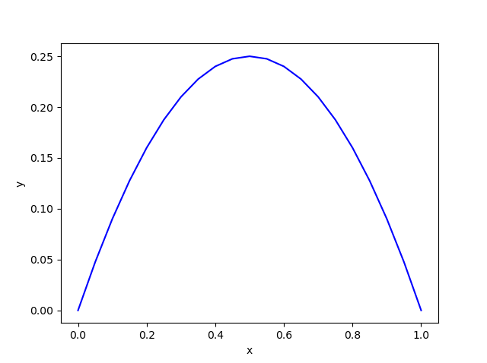
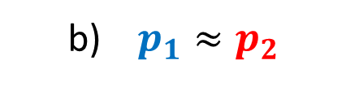
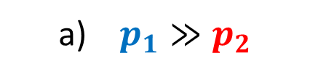
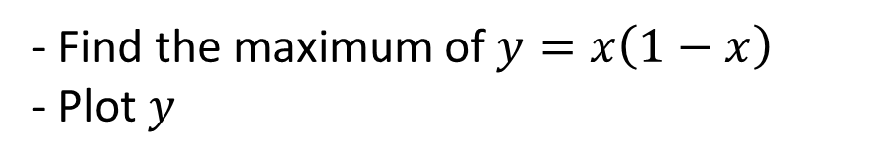
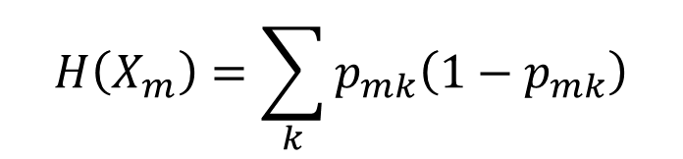
Impurity functions. Gini Index
$$H\left(X_{m}\right)=\sum_{k}{p_{mk}\left(1−p_{mk}\right)}$$
- Find the maximum of $y=x\left(1−x\right)$
- Plot $y$
If only 2 classes, consider the following 2 cases
a) $p_{1}≫p_{2}$
b) $p_{1}≈p_{2}$
https://scikit-learn.org/stable/modules/tree.html#classification-criteria
p. 311-313, Hastie, 2014
Notes:
Maximo. $y\left(0.5\right)=0.25$
x = np.linspace(0,1, 21)
y=x*(1-x)
plt.plot(x, y, 'b-')
plt.axvline(0.5)
plt.show()
# 2 Classes: $p_{1}+p_{2}=1$, compute the Gini index as function of $p_{1}$, compare case a) vs b)

Slide 15
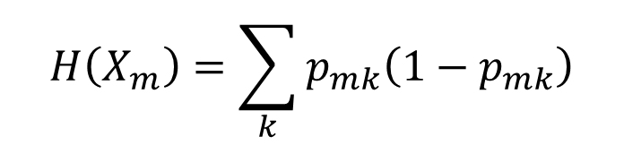
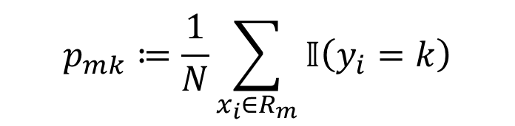

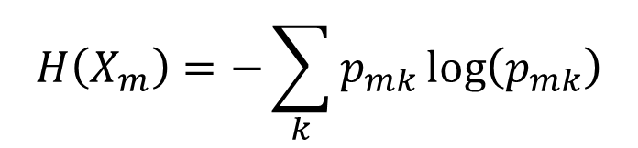
Impurity functions
Region $m$
$$p_{mk}≔\frac{1}{N}\sum_{x_{i}∈R_{m}}{𝕀\left(y_{i}=k\right)}$$
$$H\left(X_{m}\right)=1−\max_{k}{(p_{mk})}$$
Misclassification
$$H\left(X_{m}\right)=\sum_{k}{p_{mk}\left(1−p_{mk}\right)}$$
Gini Index
$$H\left(X_{m}\right)=−\sum_{k}{p_{mk}\log\left(p_{mk}\right)}$$
Entropy
https://scikit-learn.org/stable/modules/tree.html#classification-criteria
p. 311-313, Hastie, 2014

Slide 16
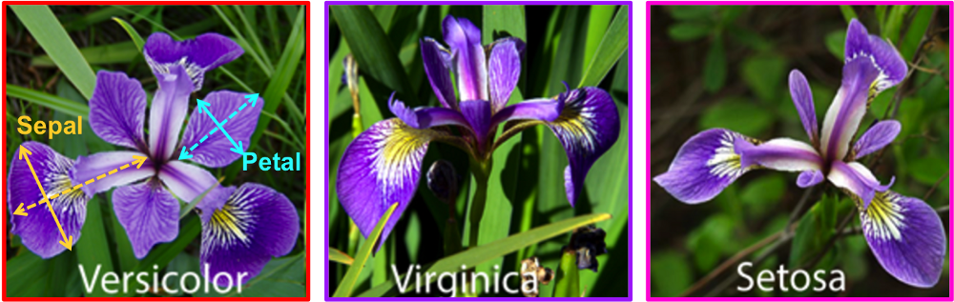
Iris dataset
Notes:
[Setosa, Versicolor, Virginica]
Compute the Gini index for the green box
https://medium.com/@ml.at.berkeley/machine-learning-crash-course-part-5-decision-trees-and-ensemble-models-dcc5a36af8cd

Slide 17
Homework assigment
Train and fine-tune a Decision Tree for the moons dataset.
a. Generate a moons dataset using make_moons(n_samples=10000, noise=0.4).
b. Split it into a training set and a test set using train_test_split().
c. Use grid search with cross-validation (with the help of the GridSearchCV class) to find good hyperparameter values for a DecisionTreeClassifier.
Hint: try various values for max_leaf_nodes.
d. Train it on the full training set using these hyperparameters, and measure your model’s performance on the test set. You should get roughly 85% to 87% accuracy.

Slide 18
Decision Trees advantages and disadvantages
Are simple to understand and interpret
Have value even with little hard data
A decision tree does not require normalization or scaling of data
Help determine worst, best and expected values for different scenarios
High variance
They are often relatively inaccurate
Rectangular domains
Notes:
https://kharshit.github.io/blog/2018/03/23/scaling-vs-normalization
https://www.analyticsvidhya.com/blog/2020/04/feature-scaling-machine-learning-normalization-standardization/
https://medium.com/@nsethi610/data-cleaning-scale-and-normalize-data-4a7c781dd628

Slide 19

Ensemble methods
$${\hat{f}}_{avg}\left(x\right)=\frac{1}{B}\sum_{b=1}^{B}{{\hat{f}}^{b}\left(x\right)}$$

Slide 20
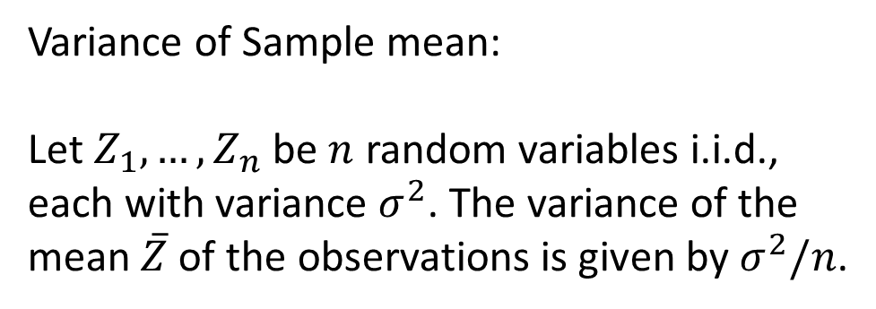
Theoretical origin
Variance of Sample mean:
Let $Z_{1},…,Z_{n}$ be $n$ random variables i.i.d., each with variance $σ^{2}$. The variance of the mean $\overline{Z}$ of the observations is given by $σ^{2}/n$.

Slide 21
Random Guessing and Weak learners
Weak learner. An algorithm that performs poorly, i.e., slightly better than random guessing
Notes:
Image a

Slide 22
Classification (Voting)
Hard (majority) voting, i.e., the mode
Soft voting (argmax of probabilities)
 | Class A | Class B
Classifier 1 | 99% | 1%
Classifier 2 | 49% | 51%
Classifier 3 | 49% | 51%
Ensemble | (99 + 49 + 49) / 3 =65.7%
Notes:
https://stats.stackexchange.com/questions/349540/hard-voting-soft-voting-in-ensemble-based-methods

Slide 23
Bagging (Bootstrap Aggregation. Parallel-wise model fitting)
Bootstraping. Sampling instances with replacement
Out Of Bag Error (oob 63+37).
Predictor 0 | Predictor 1 | Predictor 2 | Predictor 3 | Predictor 4 | Label
https://scikit-learn.org/stable/modules/generated/sklearn.ensemble.BaggingClassifier.html
https://scikit-learn.org/stable/modules/generated/sklearn.ensemble.BaggingRegressor.html
Notes:
https://www.econometrics-with-r.org/2-2-RSATDOSA.html
http://pages.stat.wisc.edu/~yandell/st571/R/append5.pdf

Slide 24
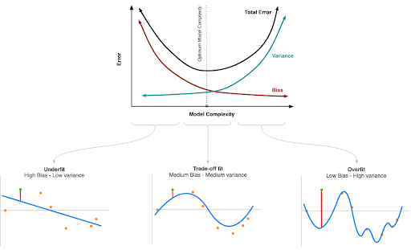
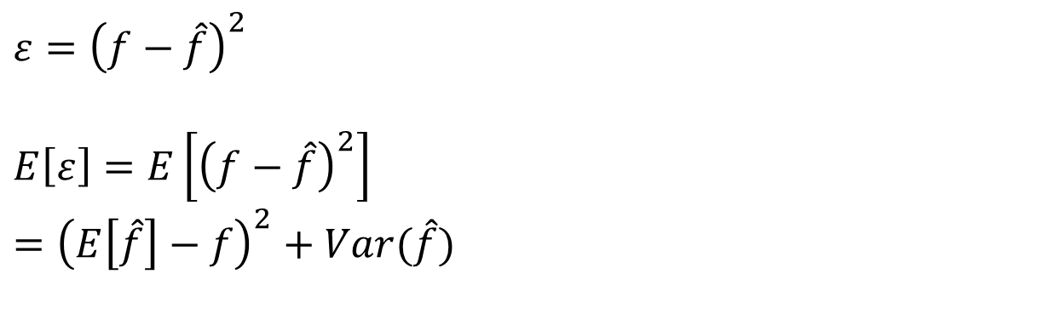
Bias vs Variance
$ε={\left(f−\hat{f}\right)}^{2}$
$E\left[ε\right]=E\left[{\left(f−\hat{f}\right)}^{2}\right]$
$={\left(E\left[\hat{f}\right]−f\right)}^{2}+Var(\hat{f})$

Slide 25
Random Forests
Multiple Decision Trees, each grown by sampling predictor variables
Predictor 0 | Predictor 1 | Predictor 2 | Predictor 3 | Predictor 4 | Label

Slide 26
Boosting
Sequentially
Aurelien, 2019. Page 207
Video_Trevor Hastie - Gradient Boosting Machine Learning
Notes:
https://www.analyticsvidhya.com/blog/2018/09/an-end-to-end-guide-to-understand-the-math-behind-xgboost/
http://www.ccs.neu.edu/home/vip/teach/MLcourse/4_boosting/slides/gradient_boosting.pdf
https://statweb.stanford.edu/~jhf/ftp/trebst.pdf

Slide 27
Boosting
Sequentially
Bishop, 2007.
Video_Trevor Hastie - Gradient Boosting Machine Learning
Notes:
https://www.analyticsvidhya.com/blog/2018/09/an-end-to-end-guide-to-understand-the-math-behind-xgboost/
http://www.ccs.neu.edu/home/vip/teach/MLcourse/4_boosting/slides/gradient_boosting.pdf
https://statweb.stanford.edu/~jhf/ftp/trebst.pdf

Slide 28
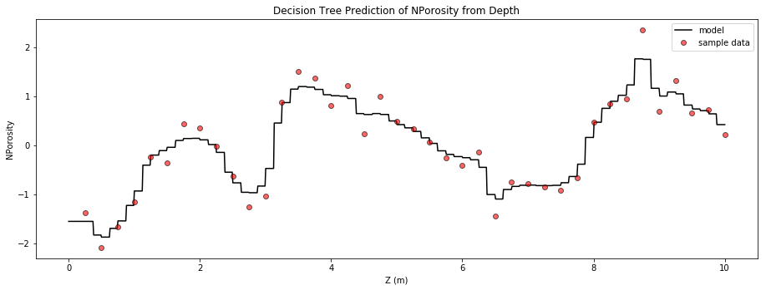
Random Forest
https://github.com/GeostatsGuy/PythonNumericalDemos/blob/master/SubsurfaceDataAnalytics_PolygonalRegression.ipynb

Slide 29
Binary accuracy assesment
2019 Sridhar Alla_Beginning Anomaly Detection Using Python-Based Deep Learning With Keras and PyTorch.pdf
Notes:
Precision=accuracy of the positive predictions
False Positive (FP)-Also know as a Type I error
False Negative (FN)-Also know as a Type II error

Slide 30
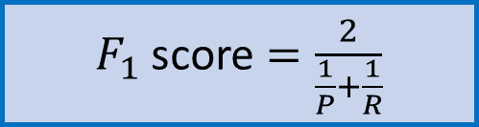
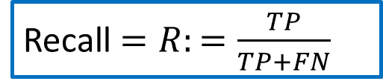
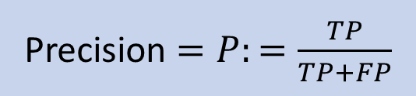
Accuracy assessment (Confusion Matrix, Precision and Recall)
Precision $=P:=\frac{TP}{TP+FP}$
Recall $=R:=\frac{TP}{TP+FN}$
$F_{1}$ score $=\frac{2}{\frac{1}{P}+\frac{1}{R}}$
Notes:
Precision=accuracy of the positive predictions
False Positive (FP)-Also know as a Type I error
False Negative (FN)-Also know as a Type II error

Slide 31



Accuracy assessment (Confusion Matrix, Precision and Recall)
Precision $=P:=\frac{TP}{TP+FP}$
Recall $=R:=\frac{TP}{TP+FN}$
$F_{1}$ score $=\frac{2}{\frac{1}{P}+\frac{1}{R}}$
Notes:
Precision=accuracy of the positive predictions

Slide 32
of All digits

Slide 33
Homework assigment
Train and fine-tune a SVM, Random Forest, ANN, Extra-Trees, AdaBoost for the moons dataset.
a. Generate a moons dataset using make_moons(n_samples=10000, noise=0.4).
b. Split it into a training set and a test set using train_test_split().
c. Measure your model’s performance on the test set.

