Slide 1

Machine Learning for Geosciences
By Francisco Mendoza
mentofran@gmail.com
Course material:
https://github.com/mathphysmx/teaching-ml

Slide 2
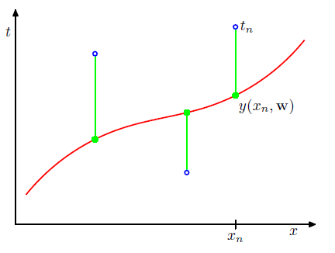
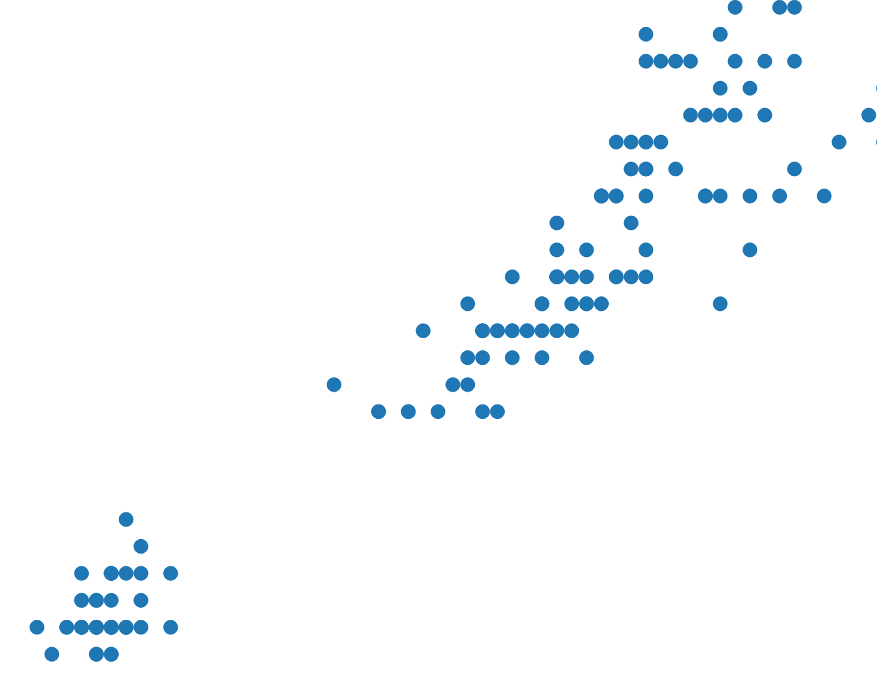
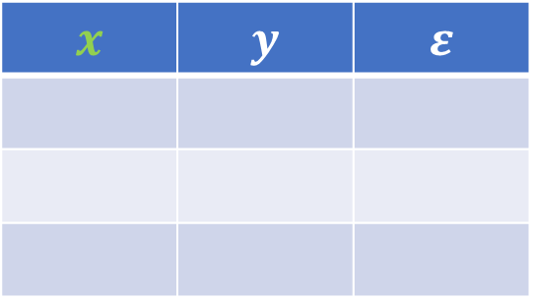

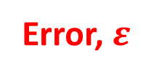
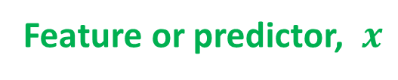

Basic concepts
Instances
Labels, $y$
Error, $ε$
All previous concepts used in statistics such as (in)?dependent variable, input/output variables, etc plus the following,
Feature or predictor, $x$
Training set
Features
Labels
Error
$$x$$ | $$y$$ | $$ε$$
Instance 1
Instance 2
$$⋮$$
Notes:
Scatterplot with fit line : Iris dataset. This example can be used for regression(supervised), clustering (unsupervised) and for classification (supervised) (iris especies) problems.
It also helps to show the problem of well balanced sample selection for training/ test sets. For instance, if too many high values of x axis, then the regression line would only represent that species

Slide 3
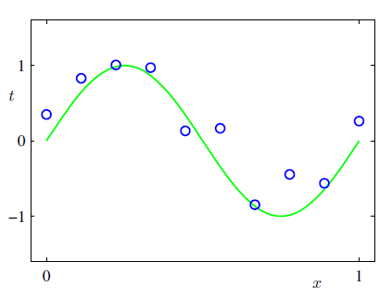
Machine learning. Introduction

Slide 4
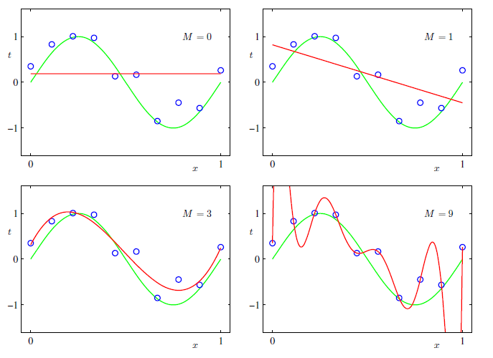
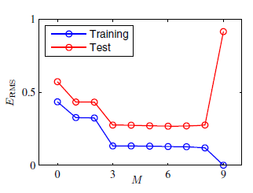
Model selection

Slide 5
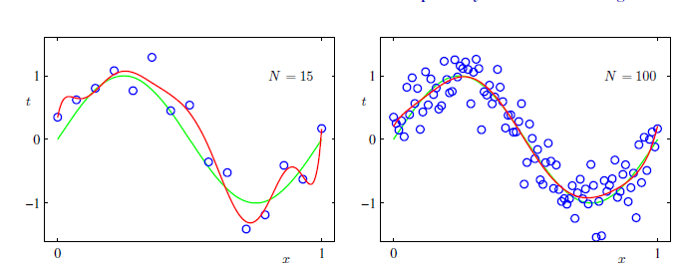
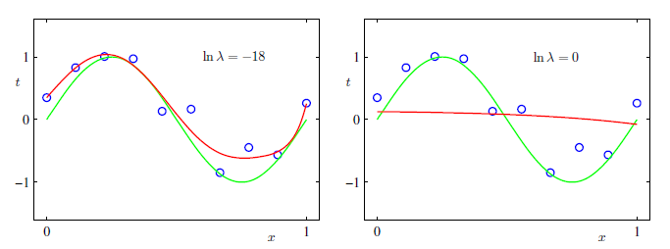
Over-fitting?
Notes:
Generalization

Slide 6
Concepts review
Notes:
What are the concepts leaned? Feature, labels, error, training set. (By asking this question, students are move to speak in English, at least some words)

Slide 7


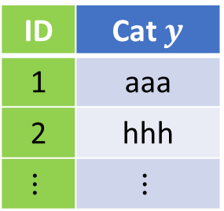

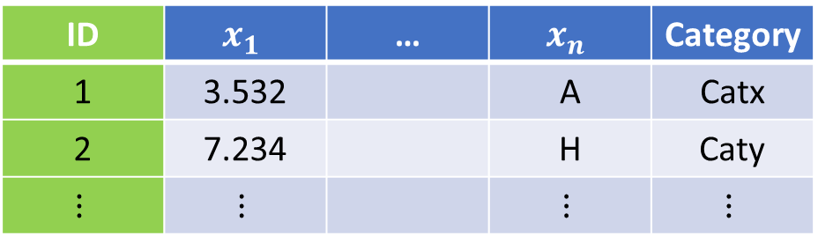


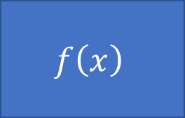

Type of problems, data types
Model
$$f\left(x\right)$$
$$x→y$$
Supervised
$$x$$
$$y$$
$$(x_{1},x_{2},…,x_{n})→y$$
$$(x_{1},x_{2},…,x_{n})→(y_{1},y_{2},…,y_{k})$$
$$f:X→Y$$
Unsupervised
ID | $$x_{1}$$ | … | $$x_{n}$$ | Category
1 | 3.532 |  | A | Catx
2 | 7.234 |  | H | Caty
$$⋮$$ | $$⋮$$ |  | $$⋮$$ | $$⋮$$
ID | Cat $y$
1 | aaa
2 | hhh
$$⋮$$ | $$⋮$$
Notes:
Continuous, Ordinal (likert as example), categorical (a.k.a. nominal) dichotomous and binary as example of categorical.
Ordinal: bad, regular, good, excellent
Categorical: Red, Green, Blue
ordinal = ordered "categorical" interval = equally spaced ordinal vars. ratio = interval variables with zero
Truncated, censored, compositional
Truncated data is data with intervals removed. Censored is data in which data falling in a given interval are grouped.
https://www.theanalysisfactor.com/the-difference-between-truncated-and-censored-data/
Also images. For instance. In Semi-supervised learning, face detection, then face identification (adding lables/names to each face).

Slide 8
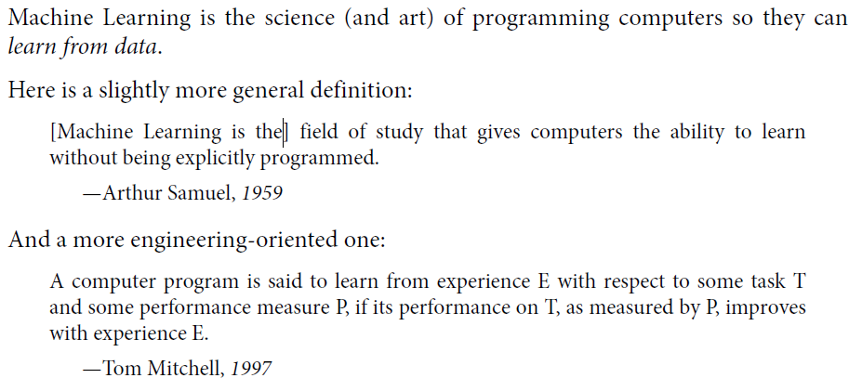
What is ML

Slide 9
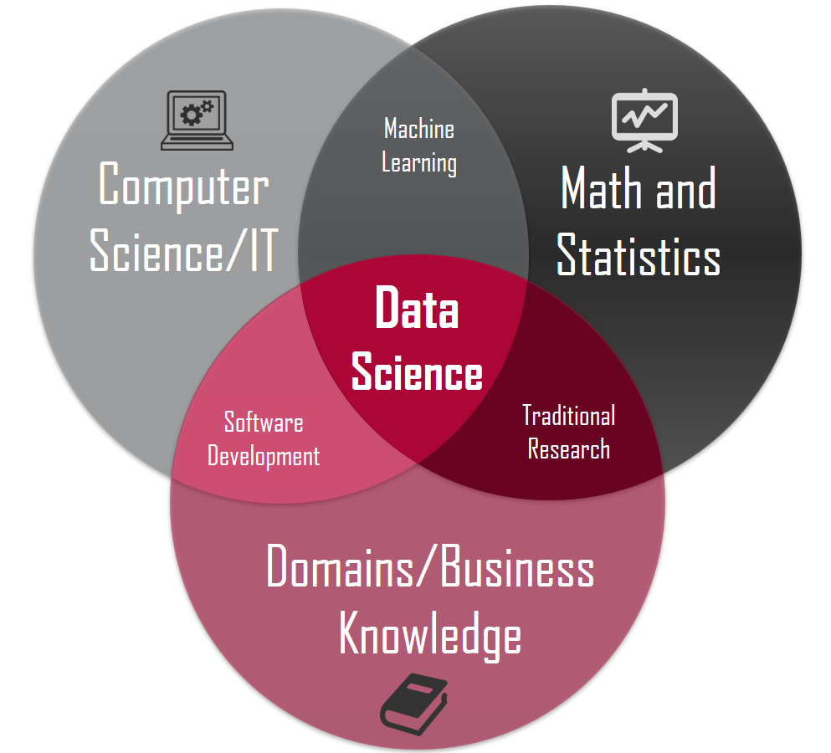
Related areas. Data Science
Data manipulation (50 – 80 %)
Machine Learning
Deep learning
http://sitiobigdata.com/2018/08/27/los-tres-nucleos-de-data-science/

Slide 10
Applications in this course
Hydrology, geothermal, radioactive waste disposal, oil and gas, CO2 sequestration, mining
Fluid volume production from a well
Porosity from depth (Pyrcz)
…
Mostly based on
https://github.com/GeostatsGuy
Guangren Shi, 2014. Data Mining and Knowledge Discovery for Geoscientists

Slide 11
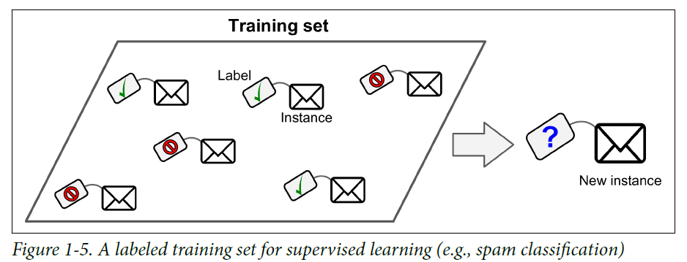
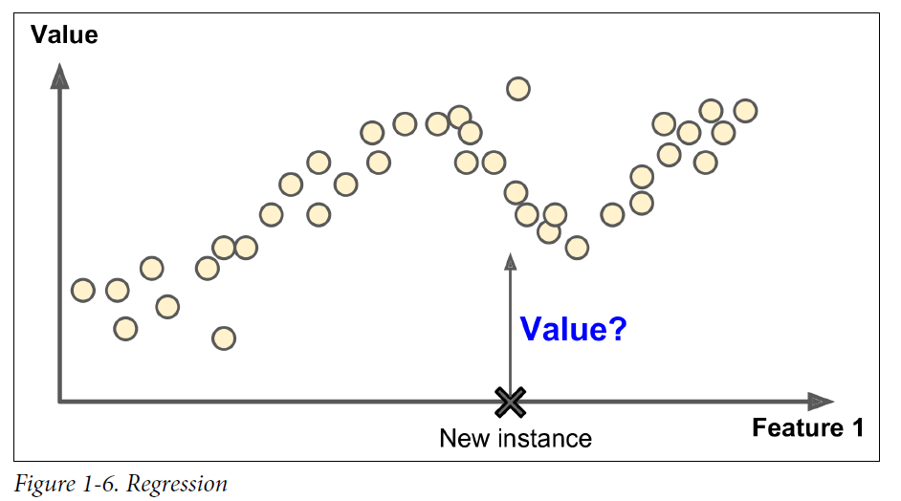
Types of Machine learning algorithms
Supervised
• k-Nearest Neighbors
• Linear Regression
• Logistic Regression
• Support Vector Machines (SVMs)
• Decision Trees, Ensemble methods
• Neural networks
Unsupervised
Clustering: K-means, Hierarchical Cluster Analysis (HCA)
Visualization and dimensionality reduction (Kernel)? PCA, t-distributed Stochastic Neighbor Embedding (t-SNE)
Reinforcement learning
Batch and Online learning

Slide 12
Grading
30% Exercises (Theoretical, computational)
30% Homework Assignments (Computational exercises)
20% Exams
20% Oral presentation of application of ML in Geosciences
20% MOOC (Coursera, Udemy, …)

Slide 13
Current research (Journals)
Mathematical Geosciences
Neural Networks
Machine learning
Computer and Geosciences
Neural networks
TensorFlow
Machine learning
Computational Geosciences
Neural Networks
TensorFlow
Machine learning

Slide 14
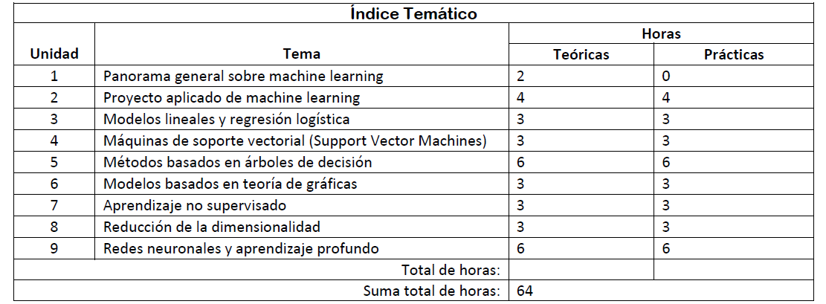
Table of Content (TOC)

Slide 15
Bibliography

Slide 16
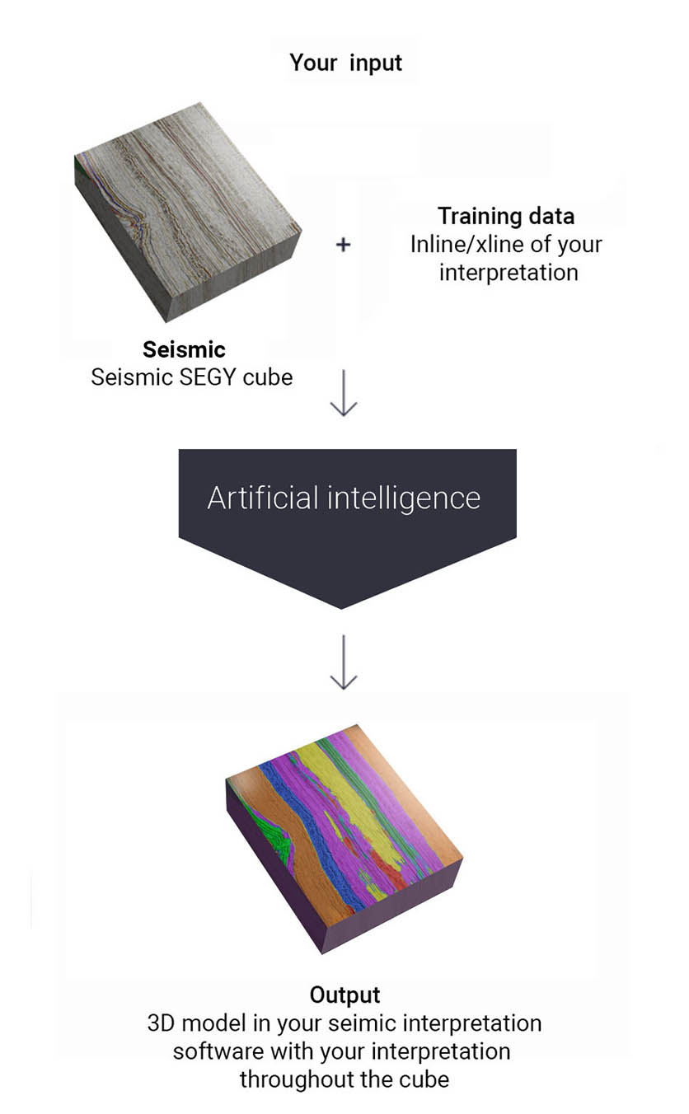

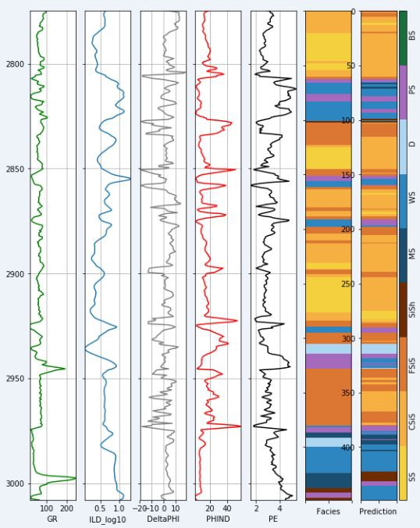


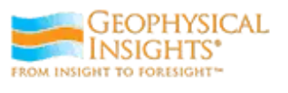

Companies
All big companies +
Well spacing
Earth models
Seismic horizons interpretation

Slide 17
Concepts review
Notes:
What are the concepts leaned? Feature, labels, error, training set. (By asking this question, students are move to speak in English, at least some words)

Slide 18

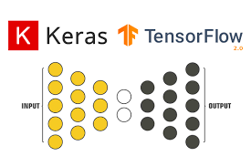






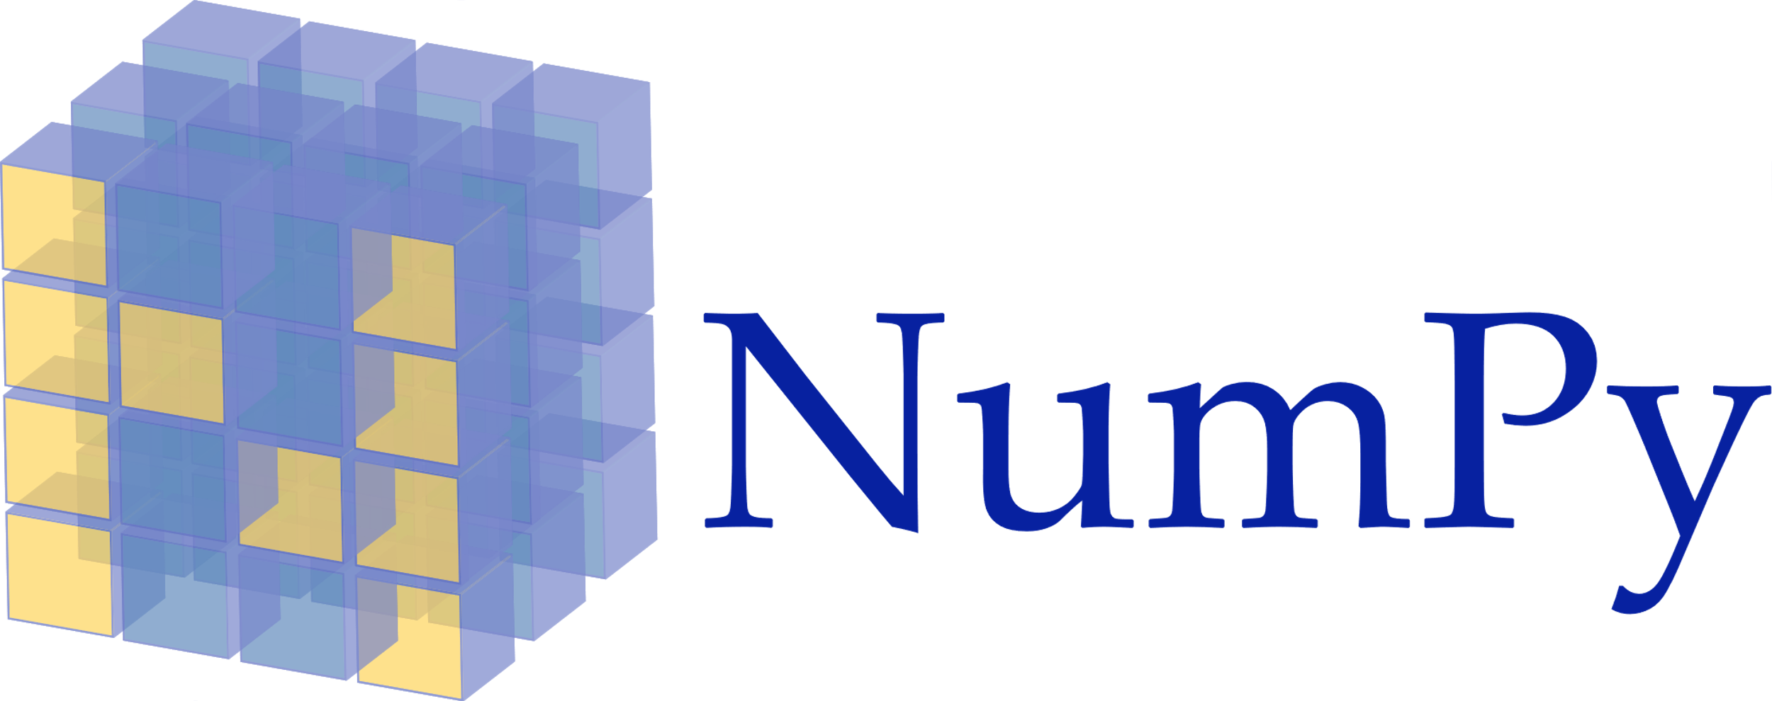


Software stack

Slide 19
Bibliography
Gareth James, Daniela Witten, Trevor Hastie and Robert Tibshirani. An Introduction to Statistical Learning, with Applications in R.
Bishop, Christopher. 2006. Pattern Recognition and Machine Learning. Information Science and Statistics. New York: Springer-Verlag. https://www.springer.com/us/book/9780387310732.
Software tools. Géron, Aurélien. 2019. Hands-On Machine Learning with Scikit-Learn, Keras and TensorFlow. https://www.oreilly.com/library/view/hands-on-machine-learning/9781492032632/.
https://www.deeplearningbook.org/
https://www.tensorflow.org/resources/learn-ml/theoretical-and-advanced-machine-learning

Slide 20
See also
YouTube Michael Pyrcz 00 Machine Learning: Introduction
YouTube Michael Pyrcz 06 Machine Learning: Intro to Machine Learning
Machine learning algorithms in Big Data (Apache Spark)

Slide 21
Machine Learning for Geosciences
By Francisco Mendoza
mentofran@gmail.com
Course material:
https://github.com/mathphysmx/teaching-ml

Slide 22
Other topics
Copulas in Machine Learning
https://medium.com/kxytechnologies/a-primer-on-copulas-from-a-machine-learning-perspective-b9ea11c8681b

