Slide 1
Linear models

Slide 2
Linear regression
Notes:
Besides regression, what other kind of ML problem exists?
$$y=mx+b={θ_{0}+θ}_{1}x$$

Slide 3
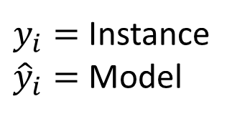





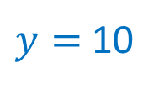
Error definition
$y_{i}=$ Instance
${\hat{y}}_{i}=$ Model
Green
Model
$$ε ∝ {\hat{y}}_{i}−y_{i}$$
$$ε=0$$
$$ε=0$$
$$\left(12, 15\right)$$
Blue
Model
$y=$ 10
$$\left(7, 5\right)$$
Notes:
Which model has less error?
How can we define de error?
How many instances are there in this problem? 2 observations

Slide 4
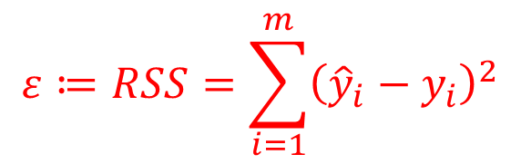
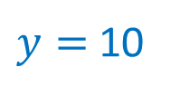
Error definition
Green
Model
$$ε ∝ {\hat{y}}_{i}−y_{i}$$
$$ε=0$$
$$ε=0$$
$$\left(12, 15\right)$$
$y=$ 10
Blue
Model
Solution:
$$\left(7, 5\right)$$
$$ε≔RSS=\sum_{i=1}^{m}{{\left({\hat{y}}_{i}−y_{i}\right)}^{2}}$$
Residual sum of squares (RSS)
Page 62, Gareth & Hastie, 2014.
Notes:
Which model has less error?
How can we define de error?

Slide 5
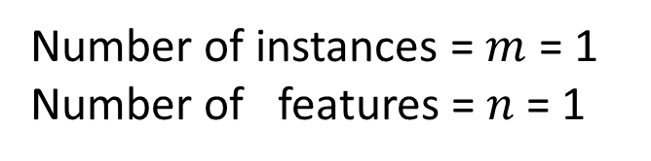
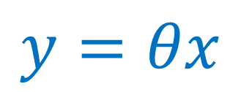
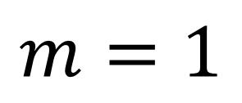


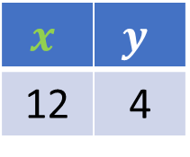
$$y=θx$$
$$m=1$$
Number of instances = $m$ = 1
Number of features = $n$ = 1
$$x$$ | $$y$$
12 | 4
$$ε$$
$$\left(12, 4\right)$$
Notes:
This problem only has 1 feature ($x$) and 1 instance $m=1$
How many colors do we see in the image? What do you think each color represents?
ToDo: Create an interactive plot (charts.js?) with a slider to change the slope $m$ of the line in order to visualize the error variation with respect to this varaible $m$.

Slide 6




$$y=θx$$
$$m=1$$
$$y=θx$$
$ε$?
$$\left(12, 4\right)$$
$$y_{i}$$
$$x_{i}$$
Notes:
How many colors do we see in the image? What do you think each color represents?
ToDo: Create an interactive plot (charts.js?) with a slider to change the slope $m$ of the line in order to visualize the error variation with respect to this varaible $m$.

Slide 7
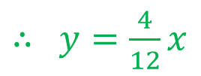
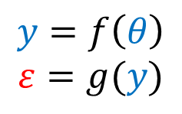




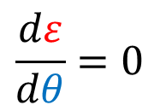

$$y=θx$$
$$m=1$$
$$ε= {\left( y −4 \right)}^{2}$$
$$={\left(12θ −4\right)}^{2}$$
$$y=θx$$
$$={\left(x_{i}θ−y_{i}\right)}^{2}$$
$$\frac{dε}{dθ}=0$$
$⇒ θ=4/12=y_{i}/x_{i}$
$$ε$$
$$\left(12, 4\right)$$
$∴$ $y=\frac{4}{12}x$
$$y_{i}$$
$$x_{i}$$
$$y=f\left(θ\right)$$
$$ε=g(y)$$
$⇒$ $ε=h(θ)$
Notes:
How many colors do we see in the image? What do you think each color represents?
Function compositions $ε=g∘y=g(y(θ))$
There are 3 ways to find $\frac{dε}{dθ}$. 1) expanding the polynomial, the deriving 2) Chain rule for derivation
ToDo: In Python, compute the error $ε$
ToDo: Create an interactive plot (charts.js?) with a slider to change the slope $m$ of the line in order to visualize the error variation with respect to this varaible $m$.

Slide 8
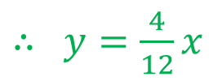





$$y=θx$$
$$m=1$$
>_ Code
$∴$ $y=\frac{4}{12}x$
$$y=θx$$
import matplotlib.pyplot as plt
xi = 12 # data points o o o o o
yi = 4
theta = yi/xi
plt.scatter(xi,yi)
# model
x = np.linspace(10, 14, num = 5)
y = theta * x
plt.plot(x, y)
plt.axis('equal')
plt.show()
$$ε$$
$$\left(12, 4\right)$$
$$y_{i}$$
$$x_{i}$$

Slide 9


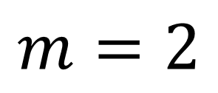

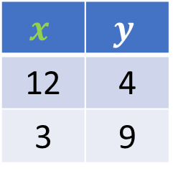
$$y=θx$$
$$m=2$$
$$x$$ | $$y$$
12 | 4
3 | 9
$$y=θx$$
$$x_{2}=\left(3, 9\right)$$
$$x_{1}=\left(12, 4\right)$$

Slide 10


$$y=θx$$
$$m=2$$
$$ε= {\left(θx_{1} −y_{1} \right)}^{2}$$
$$y=θx$$
$${+\left(θx_{2} −y_{2} \right)}^{2}$$
$$x_{2}=\left(3, 9\right)$$
$$x_{1}=\left(12, 4\right)$$

Slide 11
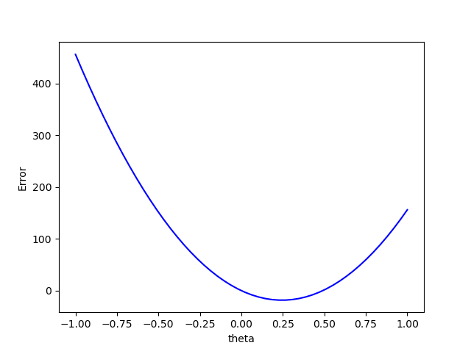

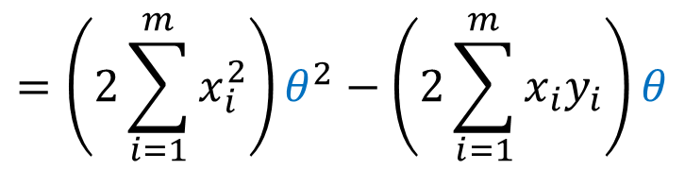

$$y=θx$$
$$m=2$$
$$ε= {\left(θx_{1} −y_{1} \right)}^{2}$$
$${+\left(θx_{2} −y_{2} \right)}^{2}$$
$$y=θx$$
$$=\left(2\sum_{i=1}^{m}{x_{i}^{2}}\right)θ^{2}−\left(2\sum_{i=1}^{m}{x_{i}y_{i}}\right)θ$$
$$x_{2}=\left(3, 9\right)$$
$$x_{1}=\left(12, 4\right)$$
x=np.array([12,3])
y=np.array([4,9])
theta=np.linspace(-1, 1)
error=2*np.sum(x**2)*theta**2-2*np.sum(x*y)*theta
plt.plot(theta,cost,'b-')
plt.show()
Notes:
Error = cost function = loss function. This notation is used in Deep learning

Slide 12
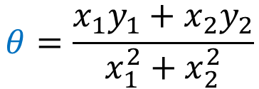
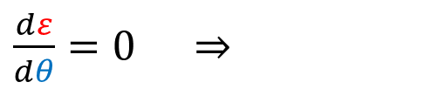
$$y=θx$$
$$m=2$$
$$ε= {\left(θx_{1} −y_{1} \right)}^{2}$$
$$y=θx$$
$${+\left(θx_{2} −y_{2} \right)}^{2}$$
$$x_{2}=\left(3, 9\right)$$
$\frac{dε}{dθ}=0$ $⇒$
$$θ=\frac{x_{1}y_{1}+x_{2}y_{2}}{x_{1}^{2}+x_{2}^{2}}$$
$$x_{1}=\left(12, 4\right)$$

Slide 13

$$y=θx$$
$$m=2$$
$$ε= {\left(θx_{1} −y_{1} \right)}^{2}$$
$$y=θx$$
$${+\left(θx_{2} −y_{2} \right)}^{2}$$
$$x_{2}=\left(3, 9\right)$$
$\frac{dε}{dθ}=0$ $⇒$
$$θ=\frac{x_{1}y_{1}+x_{2}y_{2}}{x_{1}^{2}+x_{2}^{2}}$$
$$x_{1}=\left(12, 4\right)$$
Matrix form for fast vectorized computations
Notes:
Why matrix form is important? Because it makes notations easier, it helps to abstract up theory, it’s the preferred way to compute since there is compiler speed up for vectorized form, in contrast to (for) loops.
What could be a matrix form to compute $θ$? There are 2 ways ($x$, $y$ or $x_{1}$, $x_{2}$), i. e., if the data set is in a table/tabular form, then we could slice by rows ($x_{1}$, $x_{2}$) or by columns ($x$, $y$). Create a pandas.DataFrame and slice

Slide 14
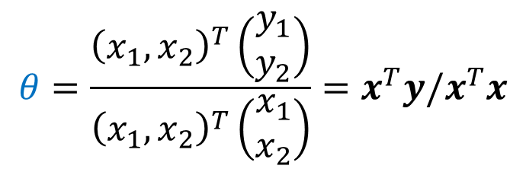

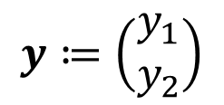
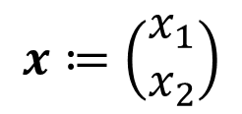
$$y=θx$$
$$m=2$$
$$ε= {\left(θx_{1} −y_{1} \right)}^{2}$$
$$y=θx$$
$${+\left(θx_{2} −y_{2} \right)}^{2}$$
$$x_{2}=\left(3, 9\right)$$
$\frac{dε}{dθ}=0$ $⇒$
$$θ=\frac{x_{1}y_{1}+x_{2}y_{2}}{x_{1}^{2}+x_{2}^{2}}$$
$$x_{1}=\left(12, 4\right)$$
Matrix form for fast vectorized computations
$$x≔\left(\begin{matrix}x_{1} \\ x_{2}\end{matrix}\right)$$
$$y≔\left(\begin{matrix}y_{1} \\ y_{2}\end{matrix}\right)$$
$$θ=\frac{{\left(x_{1},x_{2}\right)}^{T}\left(\begin{matrix}y_{1} \\ y_{2}\end{matrix}\right)}{{\left(x_{1},x_{2}\right)}^{T}\left(\begin{matrix}x_{1} \\ x_{2}\end{matrix}\right)}=x^{T}y/x^{T}x$$
$$⇒$$
>_ Code

Slide 15
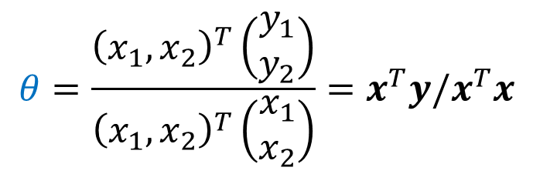
$$θ=\frac{{\left(x_{1},x_{2}\right)}^{T}\left(\begin{matrix}y_{1} \\ y_{2}\end{matrix}\right)}{{\left(x_{1},x_{2}\right)}^{T}\left(\begin{matrix}x_{1} \\ x_{2}\end{matrix}\right)}=x^{T}y/x^{T}x$$
$$y=θx$$
$$m=2$$
>_ Code
$$y=θx$$
$$x_{2}=\left(3, 9\right)$$
import numpy as np
import matplotlib.pyplot as plt
xi=np.array([3, 12]) # data points o o o
yi=np.array([9, 4])
theta=sum(xi*yi)/sum(xi**2)
plt.scatter(xi,yi)
# model
x=np.linspace(min(xi),max(xi),num=5) y=theta*x
plt.plot(x, y)
plt.axis('equal')
plt.show()
$$x_{1}=\left(12, 4\right)$$
Notes:
What is this code different from the $m=1$ case?
Simple cases:
(0, 5), (5,0)
(0, a), (b, 0) # what happens to the fit line when a = b, a < b. What is the behavior of the line as with decreasing values of $a$.
Compute the total error $ε$ first by hand., then, using Numpy
ToDo: In Python, compute the error $ε$

Slide 16
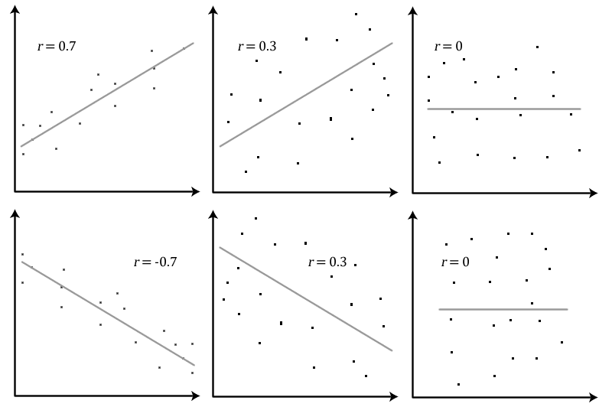
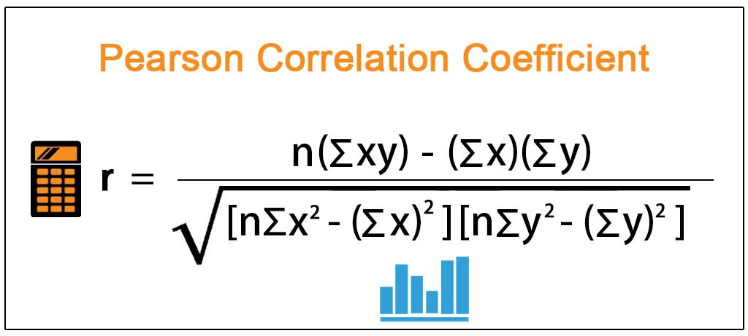
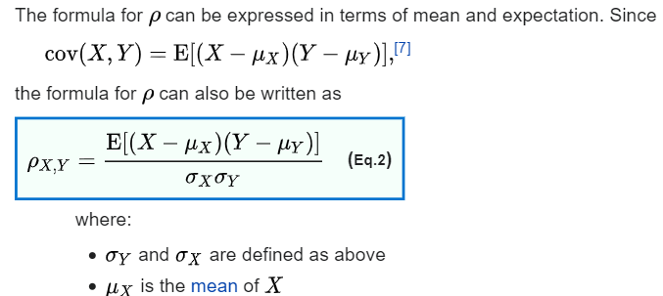
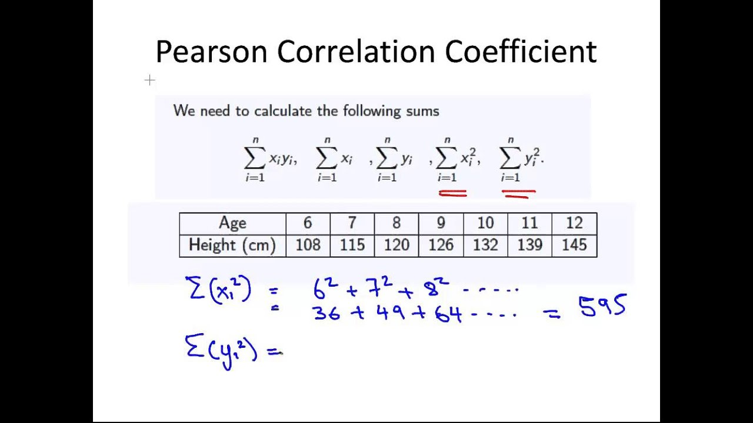
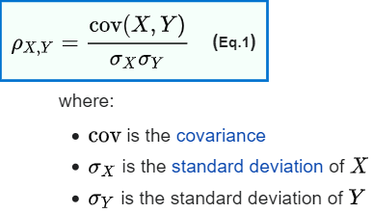
Model Evaluation. Pearson correlation coefficient

Slide 17

Model Evaluation. $R^{2}$ Statistic
Pages 69,70,71. Gareth & Hastie 2014.

Slide 18

$$y=θx$$
$$m=2$$
$$y=θx$$
Notes:
Why matrix form is important? Because it makes notations easier, it helps to abstract up theory, it’s the preferred way to compute since there is compiler speed up for vectorized form, in contrast to (for) loops.

Slide 19




$$y=θx$$
$$m=2$$
$$ε= {\left(θx_{1} −y_{1} \right)}^{2}$$
$${+\left(θx_{2} −y_{2} \right)}^{2}$$
$$⋮$$
$$y=θx$$
$${+\left(θx_{m} −y_{m} \right)}^{2}$$
Notes:
Why matrix form is important? Because it makes notations easier, it helps to abstract up theory, it’s the preferred way to compute since there is compiler speed up for vectorized form, in contrast to (for) loops.

Slide 20
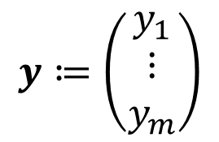

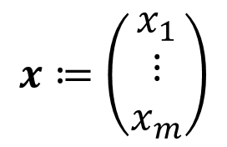

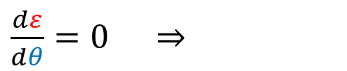
$$y=θx$$
$$m=2$$
$$ε= {\left(θx_{1} −y_{1} \right)}^{2}$$
$${+\left(θx_{2} −y_{2} \right)}^{2}$$
$$⋮$$
$$y=θx$$
$${+\left(θx_{m} −y_{m} \right)}^{2}$$
$\frac{dε}{dθ}=0$ $⇒$
$$θ=\frac{\sum_{i=1}^{m}{x_{i}y_{i}}}{\sum_{i=1}^{m}{x_{i}^{2}}}$$
Matrix form for fast vectorized computations
$$x≔\left(\begin{matrix}x_{1} \\ ⋮ \\ x_{m}\end{matrix}\right)$$
$$y≔\left(\begin{matrix}y_{1} \\ ⋮ \\ y_{m}\end{matrix}\right)$$
$$⇒$$
$$θ=x^{T}y/x^{T}x$$
>_ Code
Notes:
Why matrix form is important? Because it makes notations easier, it helps to abstract up theory, it’s the preferred way to compute since there is compiler speed up for vectorized form, in contrast to (for) loops.

Slide 21


Your turn
1.
$$y=θx+5$$
2.
$$y=A\sin{(x)}$$

Slide 22
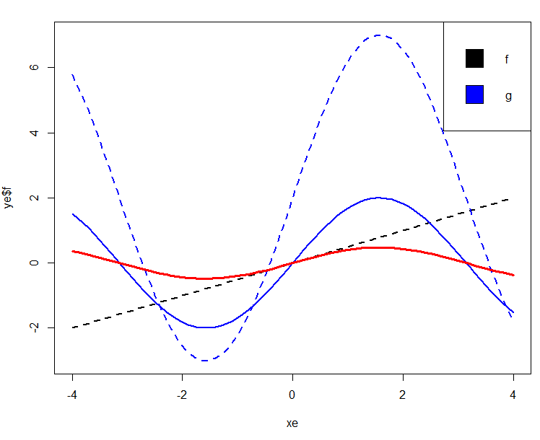
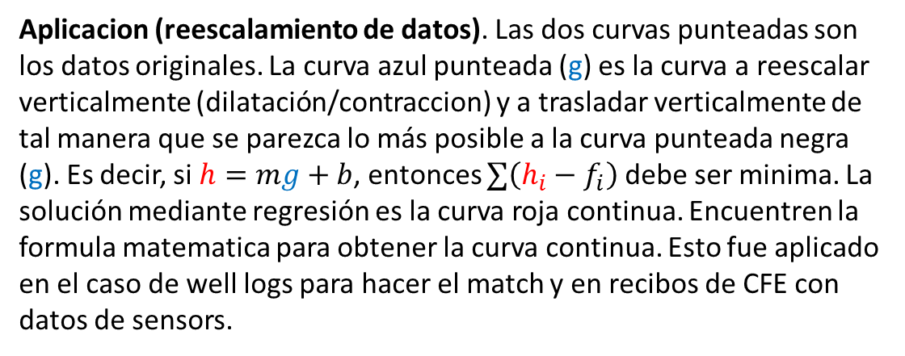
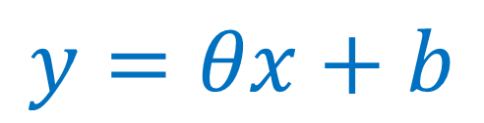
$$y=θx+b$$
Aplicacion (reescalamiento de datos). Las dos curvas punteadas son los datos originales. La curva azul punteada (g) es la curva a reescalar verticalmente (dilatación/contraccion) y a trasladar verticalmente de tal manera que se parezca lo más posible a la curva punteada negra (g). Es decir, si $h=mg+b$, entonces $∑\left(h_{i}−f_{i}\right)$ debe ser minima. La solución mediante regresión es la curva roja continua. Encuentren la formula matematica para obtener la curva continua. Esto fue aplicado en el caso de well logs para hacer el match y en recibos de CFE con datos de sensors.
>_ Code
Notes:
virtualAssetR/R/Rescale_curve.R

Slide 23

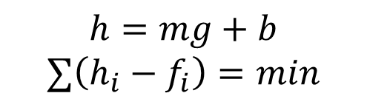






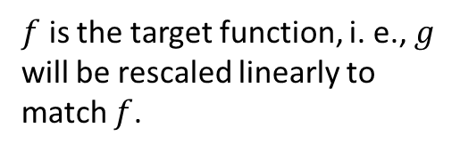
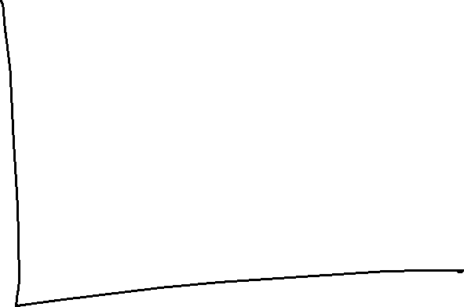


Rescaling
$f$ is the target function, i. e., $g$ will be rescaled linearly to match $f$.
$$h=mg+b$$
$$∑\left(h_{i}−f_{i}\right)=min$$

Slide 24

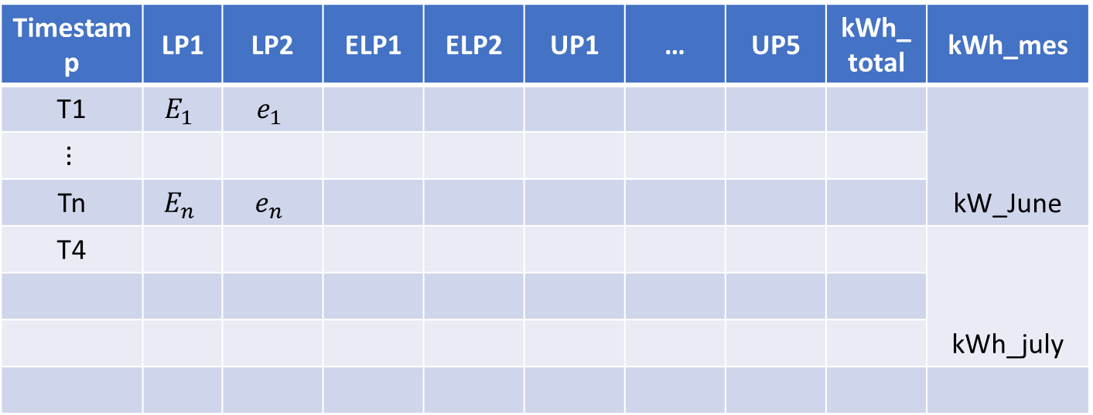
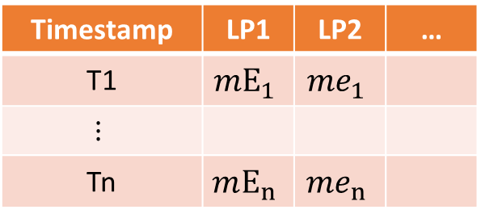
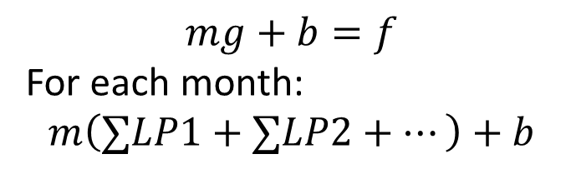
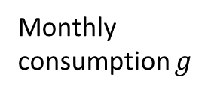



Synthetic Sensor Data generation from similar branch
Monthly consumption $g$
$g$ rescaled
CFE objetivo ($f$)
Timestamp | LP1 | LP2 | ELP1 | ELP2 | UP1 | … | UP5 | kWh_total | kWh_mes
T1 | $$E_{1}$$ | $$e_{1}$$ |  |  |  |  |  |  | kW_June
$$⋮$$
Tn | $$E_{n}$$ | $$e_{n}$$
T4 |  |  |  |  |  |  |  |  | kWh_july
$$mg_{june}+b$$
247918
$$mg_{july}+b$$
14234
$$mg+b=f$$
For each month:
$$m\left(∑LP1+∑LP2+⋯\right)+b$$
Timestamp | LP1 | LP2 | …
T1 | $$mE_{1}$$ | $$me_{1}$$
$$⋮$$
Tn | $$mE_{n}$$ | $$me_{n}$$
Notes:
Timestamp is every 5 mins, but kWh_mes is every month
$g$ is Malecón Cancún, $f$ is el Dorado. We want to synthetically generate data for

Slide 25
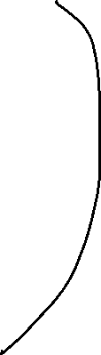








Malecón Proxy (Andares rescaled)
Dorado datapoints
$$α_{1}$$
$$α_{2}$$
$$α_{n}$$

Slide 26
Evaluation metrics for regression
metrics.explained_variance_score(y_true, …) | Explained variance regression score function
metrics.max_error(y_true, y_pred) | max_error metric calculates the maximum residual error.
metrics.mean_absolute_error(y_true, y_pred, \*) | Mean absolute error regression loss
metrics.mean_squared_error(y_true, y_pred, \*) | Mean squared error regression loss
metrics.mean_squared_log_error(y_true, …) | Mean squared logarithmic error regression loss
metrics.median_absolute_error(y_true, y_pred, \*) | Median absolute error regression loss
metrics.r2_score(y_true, y_pred, \*[, …]) | R^2 (coefficient of determination) regression score function.
metrics.mean_poisson_deviance(y_true, y_pred, \*) | Mean Poisson deviance regression loss.
metrics.mean_gamma_deviance(y_true, y_pred, \*) | Mean Gamma deviance regression loss.
metrics.mean_tweedie_deviance(y_true, y_pred, \*) | Mean Tweedie deviance regression loss.
https://scikit-learn.org/stable/modules/classes.html#module-sklearn.metrics
https://www.dataquest.io/blog/understanding-regression-error-metrics/

Slide 27
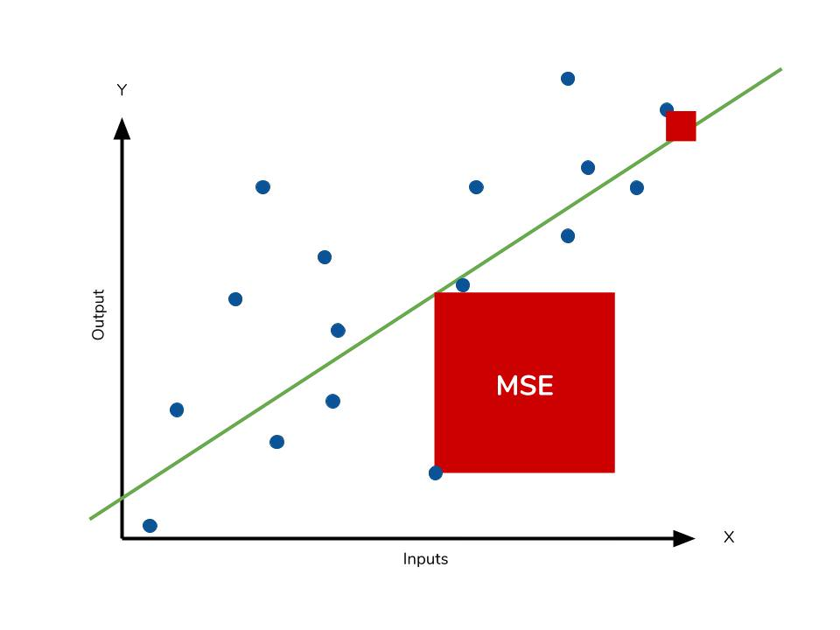
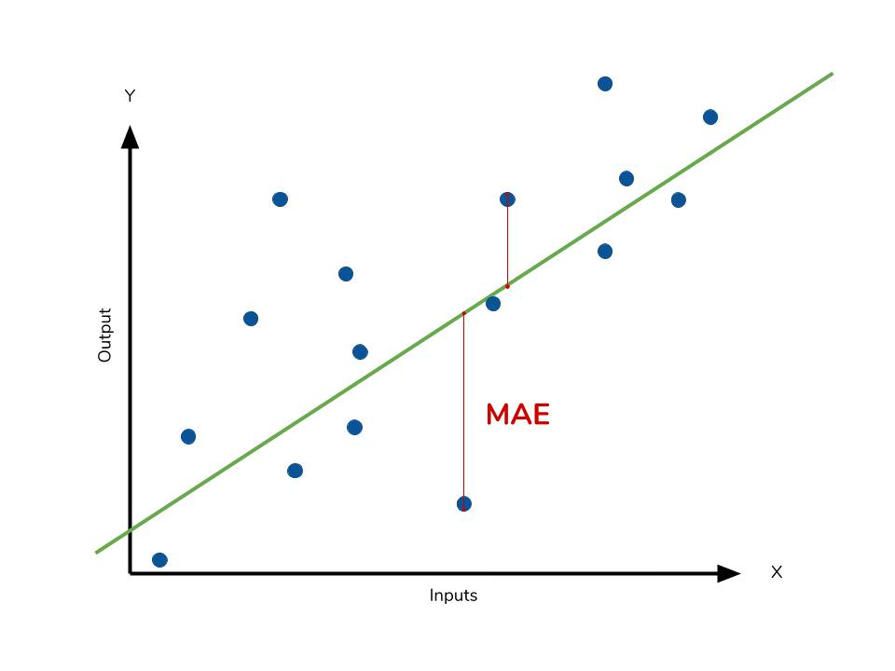
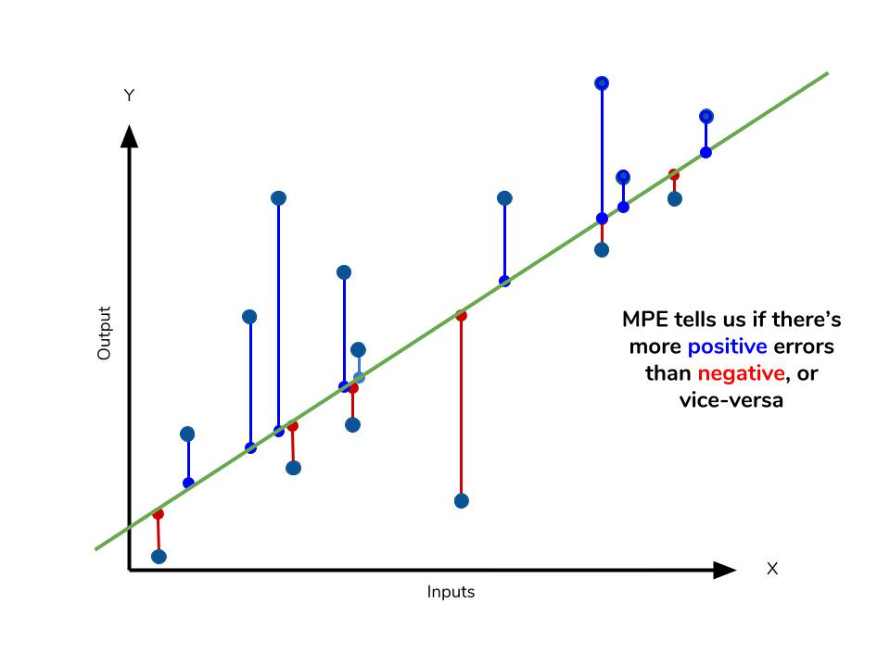
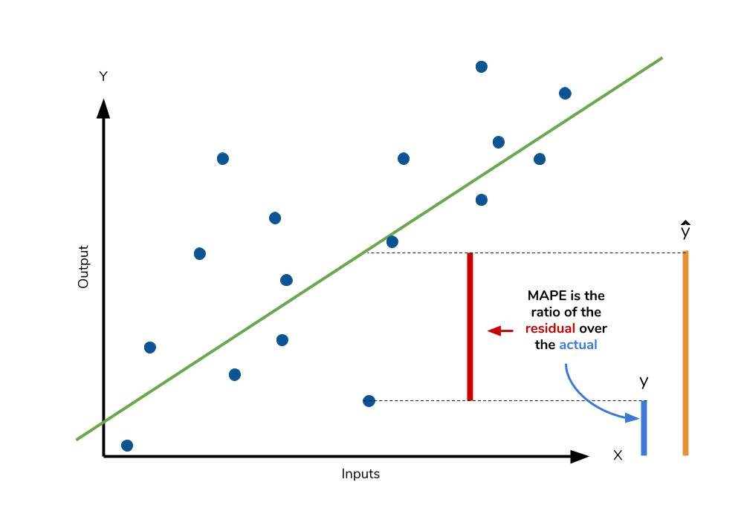

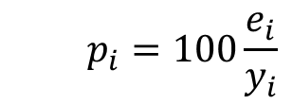




Evaluation metrics for regression
$$e_{i}=y_{i}−\hat{y_{i}}$$
$$=mean\left(\left|e_{i}\right|\right)$$
MSE $=mean\left(e_{i}^{2}\right)$
$$p_{i}=100\frac{e_{i}}{y_{i}}$$
MAPE $=mean\left({|p}_{i}|\right)$
MPE $=mean\left(p_{i}\right)$
https://www.dataquest.io/blog/understanding-regression-error-metrics/

Slide 28


Evaluation metrics for regression (Accuracy)
For time series:
2013 A Survey of forecast error measures
https://otexts.com/fpp2/accuracy.html
Rob J Hyndman, Anne B Koehler (2006). Another look at measures of forecast accuracy
2009 Elena Deza, Michel Marie Deza_Encyclopedia of Distances, metric dissimilarity error

Slide 29
Multiple linear Regression
Page 73, Gareth & Hastie, 2014.

Slide 30
References
Interactive App for linear regression at https://phet.colorado.edu/en/simulation/least-squares-regression

