Slide 1
End-to-end Project

Slide 2





Get and Read data
Images (lab thin films, radar, seismic,…)
.LAS, .FAB, .Ecl, .xml, .html

Slide 3
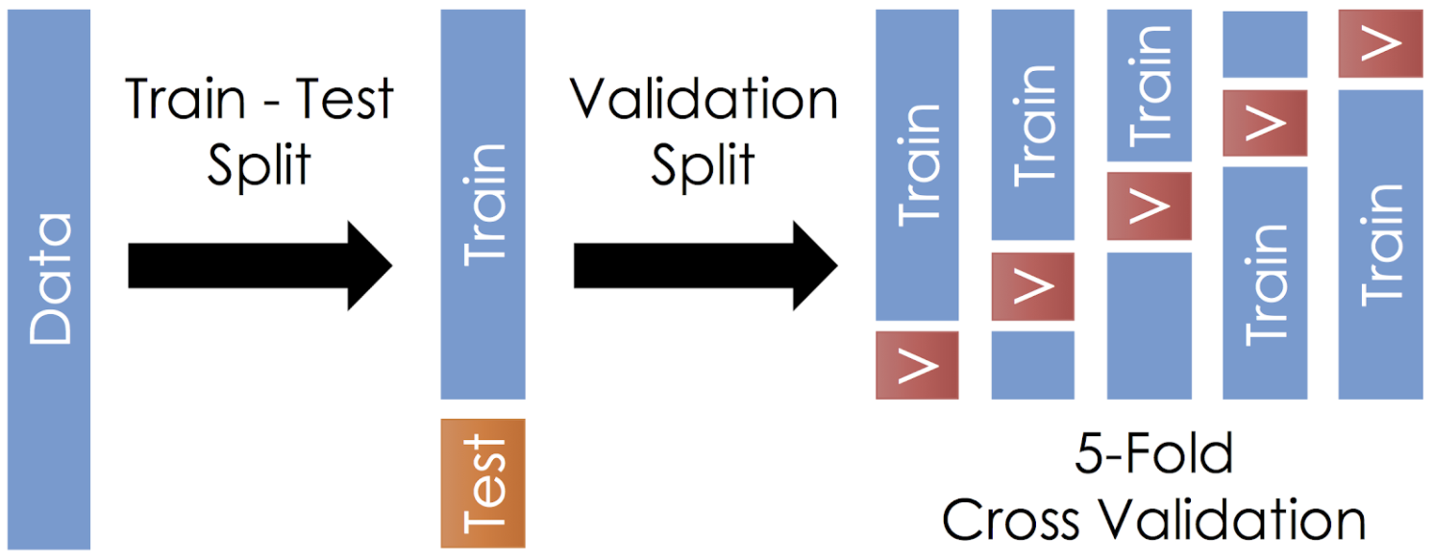
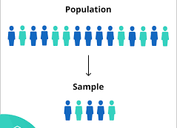
Train-Test split
Sampling
import seaborn as sns
iris=sns.load_dataset('iris')
iris.sample(3)
iris.sample(3,random_state=42)
iris.sample(frac=0.2,random_state=42)
Split
from sklearn.model_selection import train_test_split
train_set, test__set = train_test_split(iris, test_size=0.2, random_state=42)
Notes:
from sklearn.model_selection import train_test_split, StratifiedShuffleSplit
iris['new_cat']= np.random.choice(['a', 'b'], len(iris), p = [0.4, 0.6])
split = StratifiedShuffleSplit(n_splits=1, test_size=0.2, random_state=42)
for train_index, test_index in split.split(iris, iris[['species', 'nc']]):
train_set = iris.loc[train_index]
test__set = iris.loc[test_index]
train_set.new_cat.value_counts()/len(train_set)
test__set.new_cat.value_counts()/len(test__set)

Slide 4
Train test split
https://medium.com/@hi.martinez/train-test-split-cross-validation-you-b87f662445e1

Slide 5
Ordinal encoding
Notes:
Task 1: Implemente Scikit-learn OrdinalEncoder() using Pandas.Series()

Slide 6
One-Hot Encoding
 | COLOR
1 | 0 | 0
0 | 0 | 1
0 | 0 | 1
0 | 1 | 0
0 | 0 | 1
1 | 0 | 0
0 | 1 | 0
Red
Green
Blue
Red
Blue
Blue
Green
Blue
Red
Green
http://contrib.scikit-learn.org/categorical-encoding/index.html
Notes:
Task 1: Implement One-hot encoding using pandas.DataFrame()
Task 2: What happens with NA’s? Run Scikit-learn OneHotEncoder()

Slide 7
Ordinal Encoding
 | QUALITY
 | 0
 | 1
 | 2
 | 2
 | 1
 | QUALITY
 | BAD
 | REGULAR
 | GOOD
 | GOOD
 | REGULAR
Opción 1
 | QUALITY
 | -1
 | 0
 | 1
 | 1
 | 0
Opción 2
http://contrib.scikit-learn.org/categorical-encoding/index.html
Notes:
Task 1: Implement One-hot encoding using pandas.DataFrame()
Task 2: What happens with NA’s? Run Scikit-learn OneHotEncoder()

Slide 8
ML model fitting (Scikit-learn)
>_ Code
from sklearn.tree import DecisionTreeRegressor
mlmodel_reg = DecisionTreeRegressor()
mlmodel_reg.fit(data_predictor_variables, data_labels)
mlmodel = linear_model | tree | ensemble | svm | …
MachineLearningModelRegressor = LinearRegression | DecisionTreeRegressor | RandomForestRegressor | SVR |…
Measuring Error
from sklearn.metrics import mean_squared_error
test_predictions = mlmodel_reg.predict(test_dataset)
mlmodel__mse = mean_squared_error(test_labels, test_predictions)
mlmodel_rmse = np.sqrt(mlmodel_mse)
Notes:
Fit LinearRegressor() for the dataset in presentation 02_ML_Linear_modelsA.pptx

Slide 9
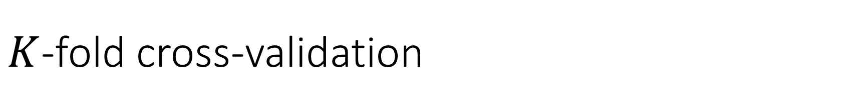
$K$-fold cross-validation
Dataset
4-fold cross-validation
Test Set

Slide 10
$K$-fold cross-validation
Dataset
Validation Set
4-fold cross-validation
Training Set
Training Set
Training Set

Slide 11
$K$-fold cross-validation
Dataset
Training Set
4-fold cross-validation
Validation Set
Training Set
Training Set

Slide 12
$K$-fold cross-validation
Dataset
Training Set
4-fold cross-validation
Training Set
Validation Set
Training Set

Slide 13
$K$-fold cross-validation
Dataset
Training Set
4-fold cross-validation
Training Set
Training Set
Validation Set

Slide 14
$K$-fold cross-validation
Dataset
Training Set
4-fold cross-validation
Training Set
Training Set
Validation Set
from sklearn.model_selection import cross_val_score

Slide 15
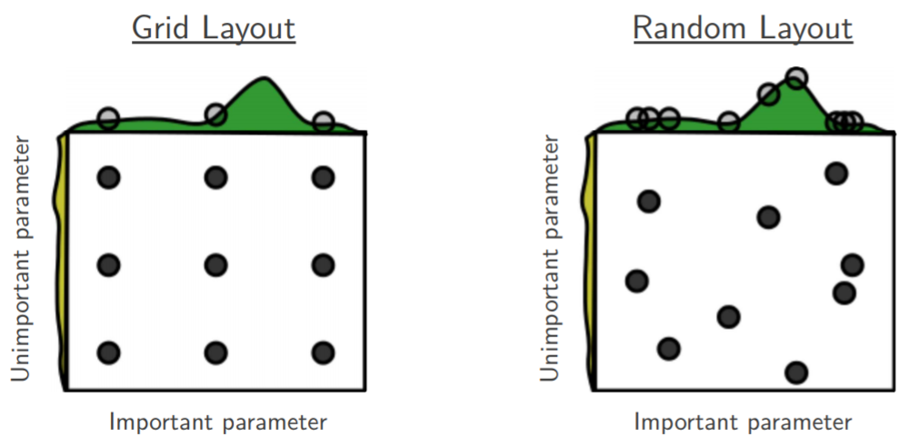
Hyperparameter tuning
Grid search
Randomized search
Bayesian optimization
Informed search
def my_ML_model(data, a, b):
c = find_model_best_param(data, a, b)
return(c)
https://blog.usejournal.com/a-comparison-of-grid-search-and-randomized-search-using-scikit-learn-29823179bc85
Notes:
https://www.datasciencecentral.com/profiles/blogs/automated-machine-learning-hyperparameter-tuning-in-python-a
HyperOpt
https://ray.readthedocs.io/en/latest/tune.html

