Slide 1
Machine Learning / Tree based methods

Slide 2
Decision Trees
Regression

Slide 3
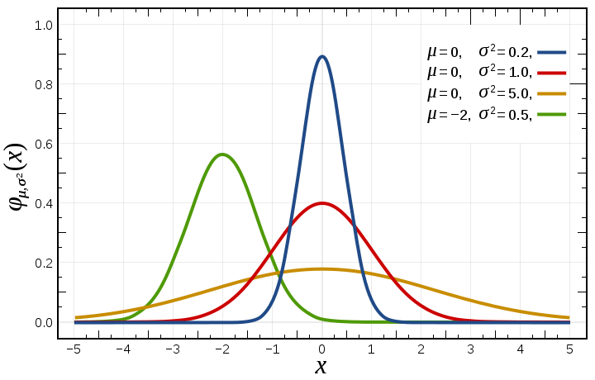
Variance

Slide 4
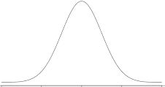
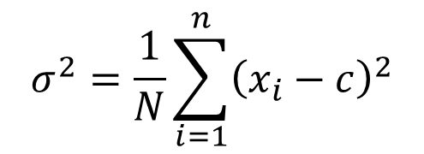
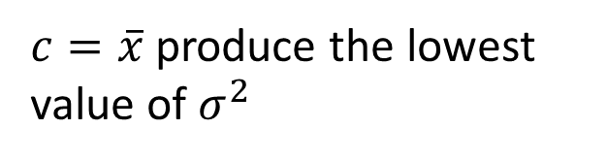
Variance
$$σ^{2}=\frac{1}{N}\sum_{i=1}^{n}{{\left(x_{i}−c\right)}^{2}}$$
$c=\overline{x}$ produce the lowest value of $σ^{2}$

Slide 5
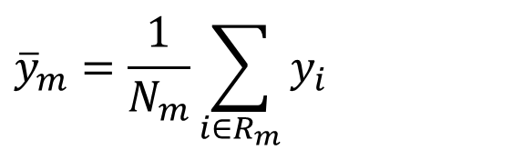




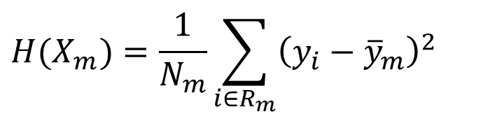
Domain partitioning
$$f(x_{1},x_{2})=y$$
$${\overline{y}}_{m}=\frac{1}{N_{m}}\sum_{i∈R_{m}}{y_{i}}$$
Root node
$${\overline{y}}_{3}=6.74$$
$${\overline{y}}_{1}=5.11$$
$$H(X_{m})=\frac{1}{N_{m}}\sum_{i∈R_{m}}{{\left(y_{i}−{\overline{y}}_{m}\right)}^{2} }$$
Internal node
$${\overline{y}}_{2}=6.0$$
Leaf
Leaf
Leaf

Slide 6
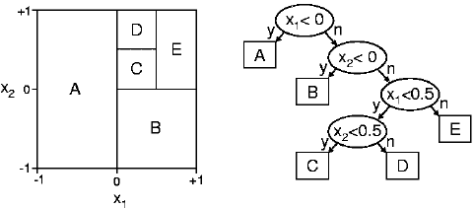

Slide 7
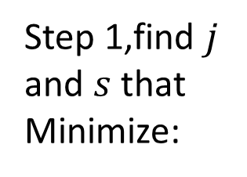
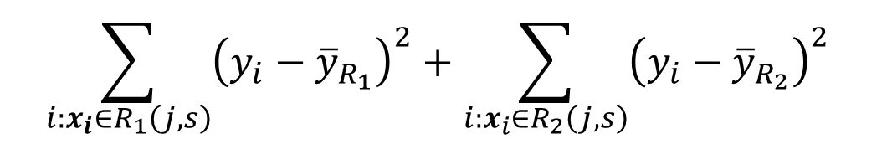




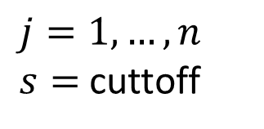
Fitting
$${\overline{y}}_{R_{1}}$$
$${\overline{y}}_{R_{2}}$$
$$R_{1}$$
$$R_{2}$$
Fit
Step 1,find $j$ and $s$ that Minimize:
$$\sum_{i:x_{i}∈R_{1}\left(j,s\right)}{{\left(y_{i}−{\overline{y}}_{R_{1}}\right)}^{2}+\sum_{i:x_{i}∈R_{2}\left(j,s\right)}{{\left(y_{i}−{\overline{y}}_{R_{2}}\right)}^{2}} }$$
$j=1,…, n$
$s=$ cuttoff
Notes:
$n=$ Number of predictor variables

Slide 8
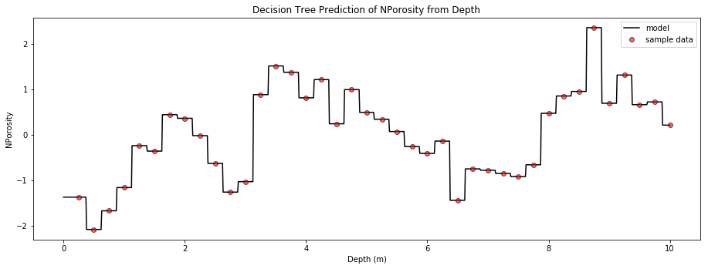
https://github.com/GeostatsGuy/PythonNumericalDemos/blob/master/SubsurfaceDataAnalytics_PolygonalRegression.ipynb

Slide 9
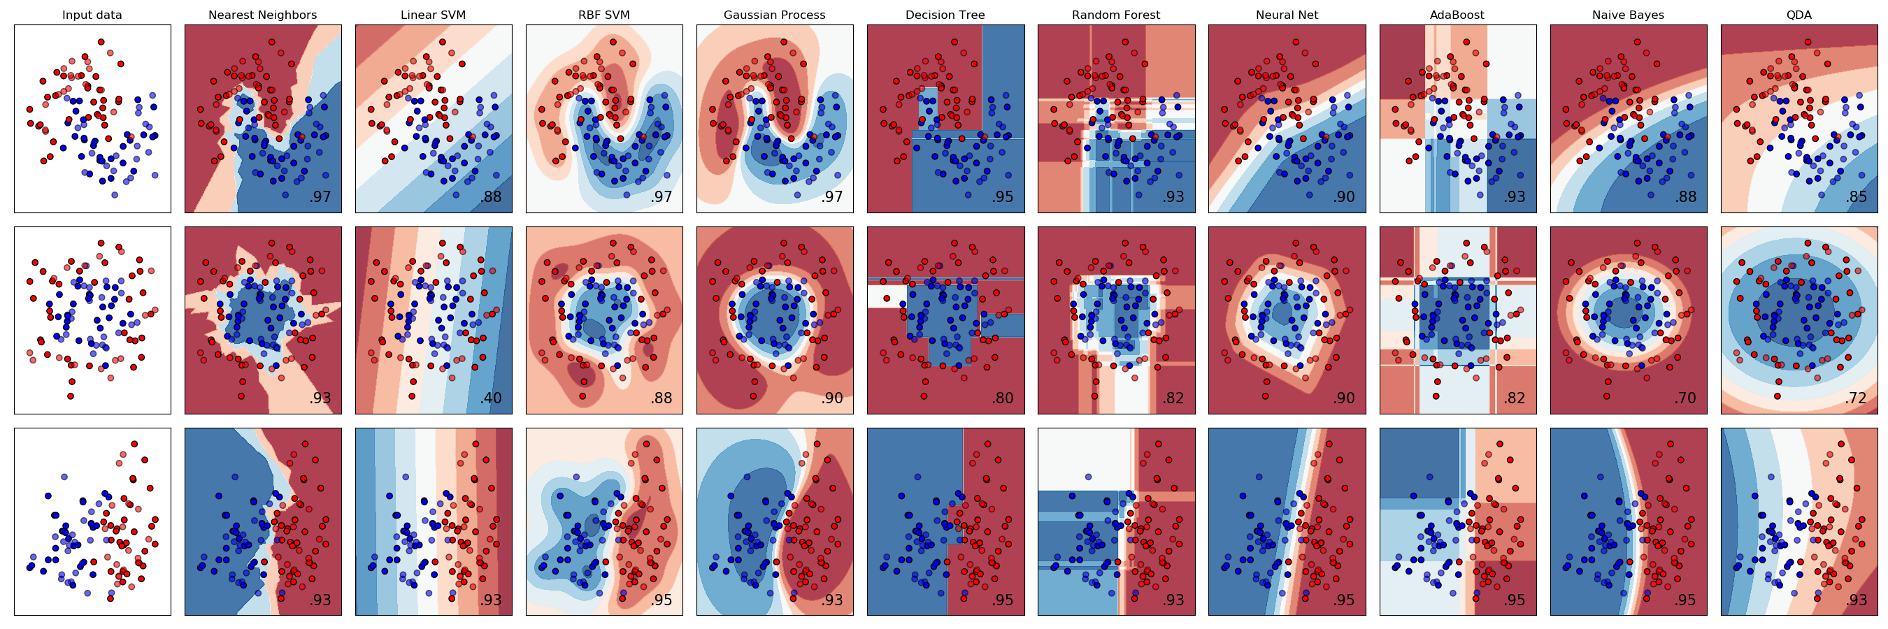
Decision Trees
Classification

Slide 10
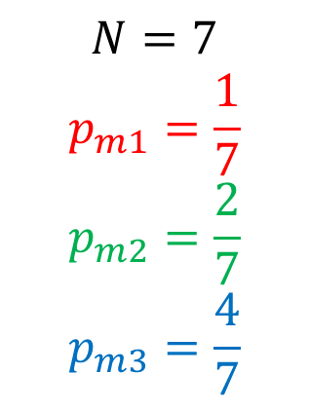
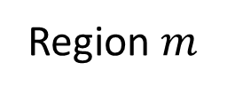
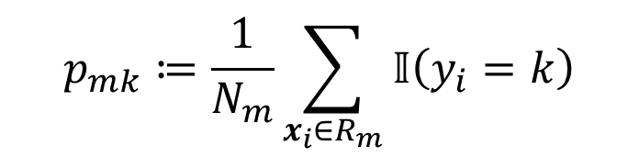
Proportions
Region $m$
$$p_{mk}≔\frac{1}{N_{m}}\sum_{x_{i}∈R_{m}}{𝕀\left(y_{i}=k\right)}$$
$$N=7$$
$$p_{m1}=\frac{1}{7}$$
$$p_{m2}=\frac{2}{7}$$
$$p_{m3}=\frac{4}{7}$$
https://scikit-learn.org/stable/modules/tree.html#classification-criteria
p. 311-313, Hastie, 2014

Slide 11
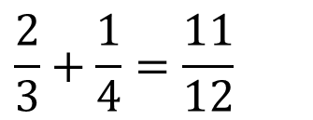


Impurity functions. Misclassification
Region $m$
$$H\left(X_{m}\right)=1−\max_{k}{(p_{mk})}$$
Misclassification
$$s_{1}$$
$$\frac{2}{3}+\frac{1}{4}=\frac{11}{12}$$
https://scikit-learn.org/stable/modules/tree.html#classification-criteria
p. 311-313, Hastie, 2014

Slide 12
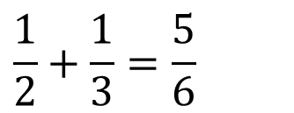

Impurity functions. Misclassification
Region $m$
$$H\left(X_{m}\right)=1−\max_{k}{(p_{mk})}$$
Misclassification
$$s_{2}$$
$$\frac{2}{3}+\frac{1}{4}=\frac{11}{12}$$
$$\frac{1}{2}+\frac{1}{3}=\frac{5}{6}$$
https://scikit-learn.org/stable/modules/tree.html#classification-criteria
p. 311-313, Hastie, 2014

Slide 13

Impurity functions. Misclassification
Region $m$
$$H\left(X_{m}\right)=1−\max_{k}{(p_{mk})}$$
Misclassification
$$s_{3}$$
$$\frac{2}{3}+\frac{1}{4}=\frac{11}{12}$$
$$\frac{1}{2}+\frac{1}{3}=\frac{5}{6}$$
https://scikit-learn.org/stable/modules/tree.html#classification-criteria
p. 311-313, Hastie, 2014

Slide 14
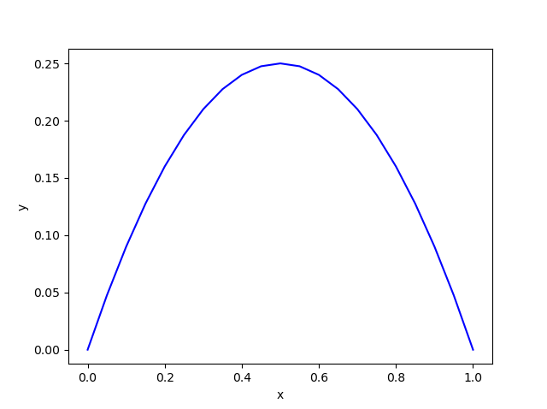
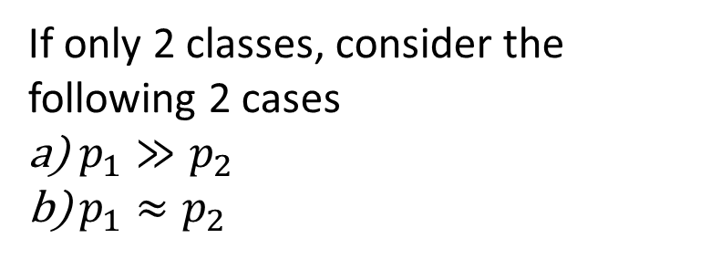
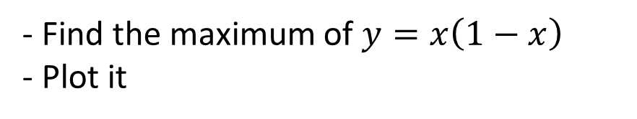
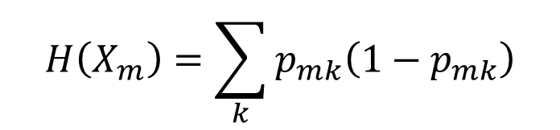
Impurity functions. Gini Index
Region $m$
$$H\left(X_{m}\right)=\sum_{k}{p_{mk}\left(1−p_{mk}\right)}$$
- Find the maximum of $y=x\left(1−x\right)$
- Plot it
If only 2 classes, consider the following 2 cases
$p_{1}≫p_{2}$
$p_{1}≈p_{2}$
https://scikit-learn.org/stable/modules/tree.html#classification-criteria
p. 311-313, Hastie, 2014
Notes:
Maximo. $y\left(0.5\right)=0.25$
x = np.linspace(0,1, 21)
y=x*(1-x)
plt.plot(x, y, 'b-')
plt.axvline(0.5)
plt.show()

Slide 15
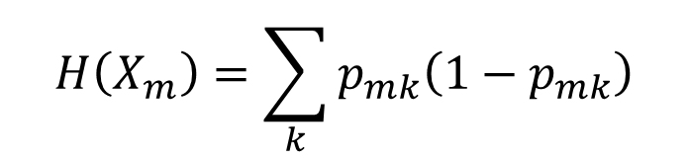
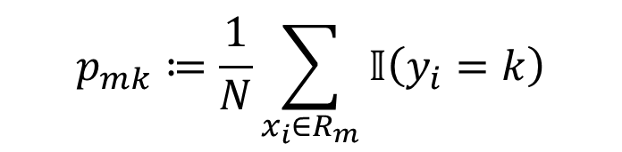

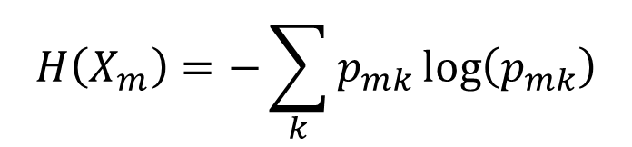
Impurity functions
Region $m$
$$p_{mk}≔\frac{1}{N}\sum_{x_{i}∈R_{m}}{𝕀\left(y_{i}=k\right)}$$
$$H\left(X_{m}\right)=1−\max_{k}{(p_{mk})}$$
Misclassification
$$H\left(X_{m}\right)=\sum_{k}{p_{mk}\left(1−p_{mk}\right)}$$
Gini Index
$$H\left(X_{m}\right)=−\sum_{k}{p_{mk}\log\left(p_{mk}\right)}$$
Entropy
https://scikit-learn.org/stable/modules/tree.html#classification-criteria
p. 311-313, Hastie, 2014

Slide 16
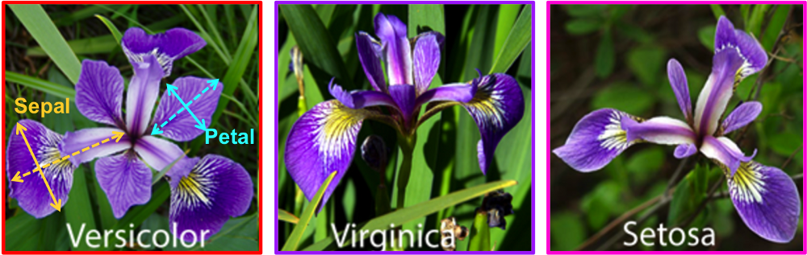
Iris dataset
Notes:
[Setosa, Versicolor, Virginica]
Compute the Gini index for the green box
https://medium.com/@ml.at.berkeley/machine-learning-crash-course-part-5-decision-trees-and-ensemble-models-dcc5a36af8cd

Slide 17
Homework assigment
Train and fine-tune a Decision Tree for the moons dataset.
a. Generate a moons dataset using make_moons(n_samples=10000, noise=0.4).
b. Split it into a training set and a test set using train_test_split().
c. Use grid search with cross-validation (with the help of the GridSearchCV class) to find good hyperparameter values for a DecisionTreeClassifier.
Hint: try various values for max_leaf_nodes.
d. Train it on the full training set using these hyperparameters, and measure your model’s performance on the test set. You should get roughly 85% to 87% accuracy.

