Slide 1
Software tutorial

Slide 2
VSCode
Install Visual Studio Code
Explain the GUI of VSCode
Show example of MarkDown visualization
Show example of installing VSCode extensions

Slide 3
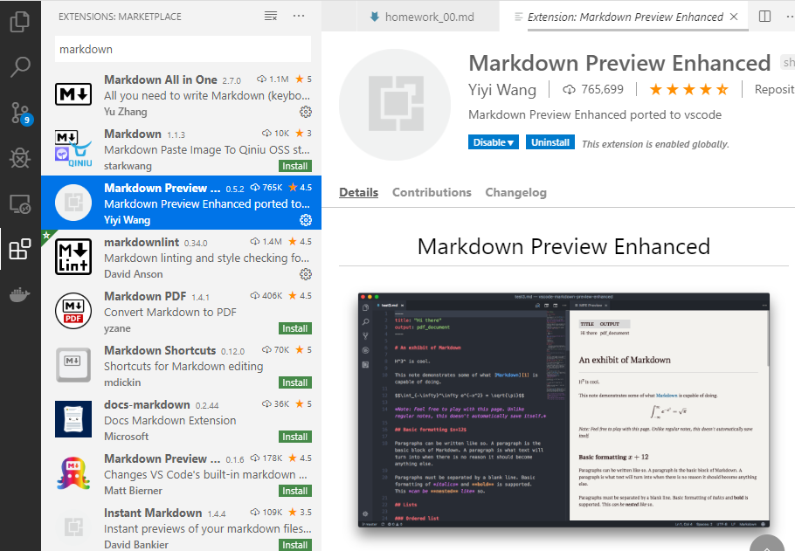


VSCode MarkDown (.md)

Slide 4


Anaconda Python Environments
Notes:
Launch Python from Anaconda batch
Show Anaconda navigator

Slide 5
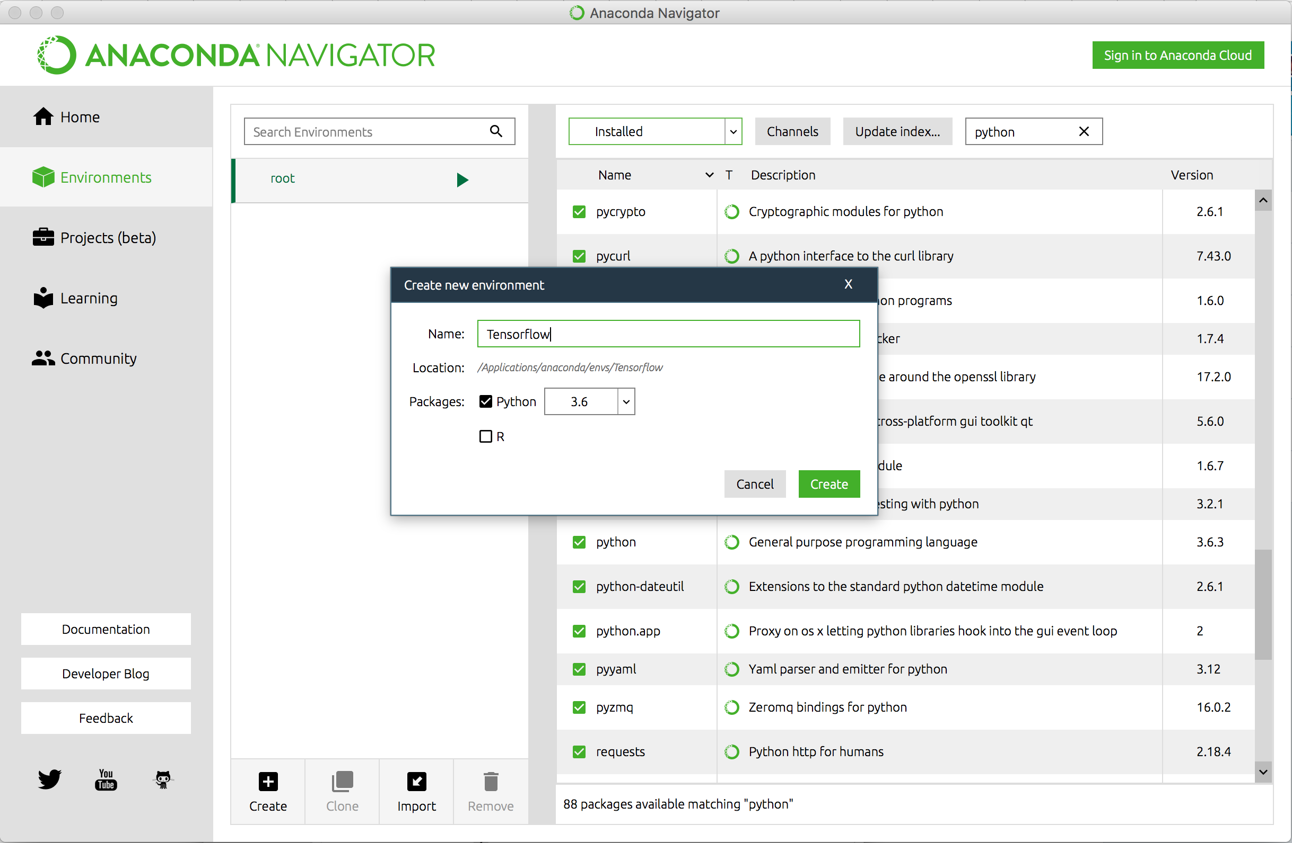
Anaconda Python Environments
Notes:
Launch Python from Anaconda (black screen version)
Show Anaconda navigator

Slide 6

Python

Slide 7
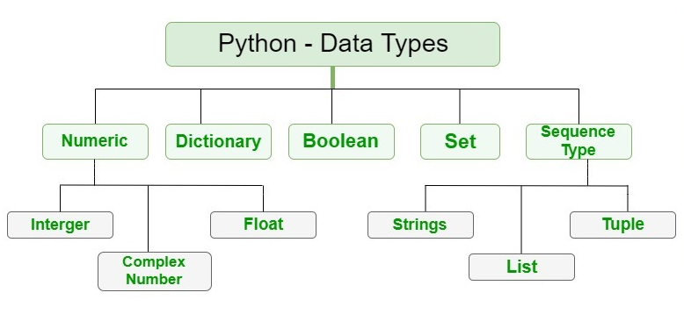
Python
https://www.geeksforgeeks.org/python-data-types/

Slide 8
Python (Data Types/Structures)
# THIS IS A COMMENT
# NUMBERS
a = 5 # Integers
print("Type of a: ", type(a))
b = 5.0 # Numbers on the real line (float)
print("\nType of b: ", type(b))
>_ Code
Notes:
Show this code in plain python, i. e., no IDE, VSCode, Jupyter,…

Slide 9
Python (Data Types/Structures)
# TEXT
my_string = "My 1st string"
print(my_string)
my_string = 'My 2nd string'
print(my_string)
my_string[0]
my_string[-3]
my_string[4:]
my_string[:4]
my_string[-3:]
my_string[:-3]
M | y |  | 2 | n | d |  | s | t | r | i | n | g
0 | 1 | 2 | 3 | 4 | 5 | 6 | 7 | 8 | 9 | 10 | 11 | 12
-13 | -12 | -11 | -10 | -9 | -8 | -7 | -6 | -5 | -4 | -3 | -2 | -1
Notes:
my_string[4:9]

Slide 10
Python (Data Types/Structures)
('a', 5) # tuple
['a', 5, True] # list
{2, 'a'} # set
mydict={'a':['Professor','Students'],'x':[111,555]}# Dictionary
mydict.keys()
Notes:
Print(type()) # for each
The difference between sets and dictionary is that each dictionary entry has a key-value pair, we can access it by name in contrast to sets
Do some slicing of a list of the alphabet:
import string
x=list(string.ascii_lowercase)
x[3:7]

Slide 11
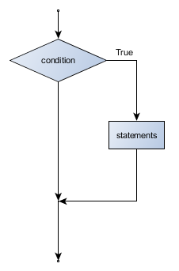
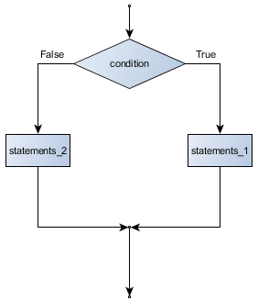
Python (Coonditionals and loops)
if
if/else
for
Notes:
for i in range(3): #iterator
for x in ‘ABCD’: # list
for x in (4, 6, 8): # tuples
for i in {'a':4, 'b':5}: # dict

Slide 12
Python Exceptions
x=6,denominator=4
try:
y=x/denominator
# print('d2i0 removed')
except Exception as e:
print("Error. Division by 0")
print(e)

Slide 13
Python function definition
def hw(x, a="aaaa", b=4, mylist=[5, 'KKK', 'PPP']):
y=5*b
return(a)
hw(x=3)
Notes:
def smn(*args):
print(type(args))# tuple
pass

Slide 14
Exercise
Create a function that return the sum of 3 numbers
Create a function is_even() that checks if a number is divisible by 2
Create a for loop that prints only even numbers (5%2)
Create a function that prints only the last 3 characters of a string, one-by-one
Notes:
http://www.openbookproject.net/books/bpp4awd/exercises/ch04/ch04s01.html#ch04s01
http://www.openbookproject.net/books/bpp4awd/exercises/ch04/ch04s02.html#ch04s02
def adder(*num): sum = 0 for n in num: sum = sum + n print("Sum:",sum) adder(3,5) adder(4,5,6,7) adder(1,2,3,5,6)

Slide 15

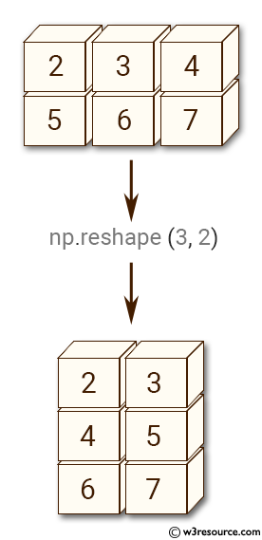
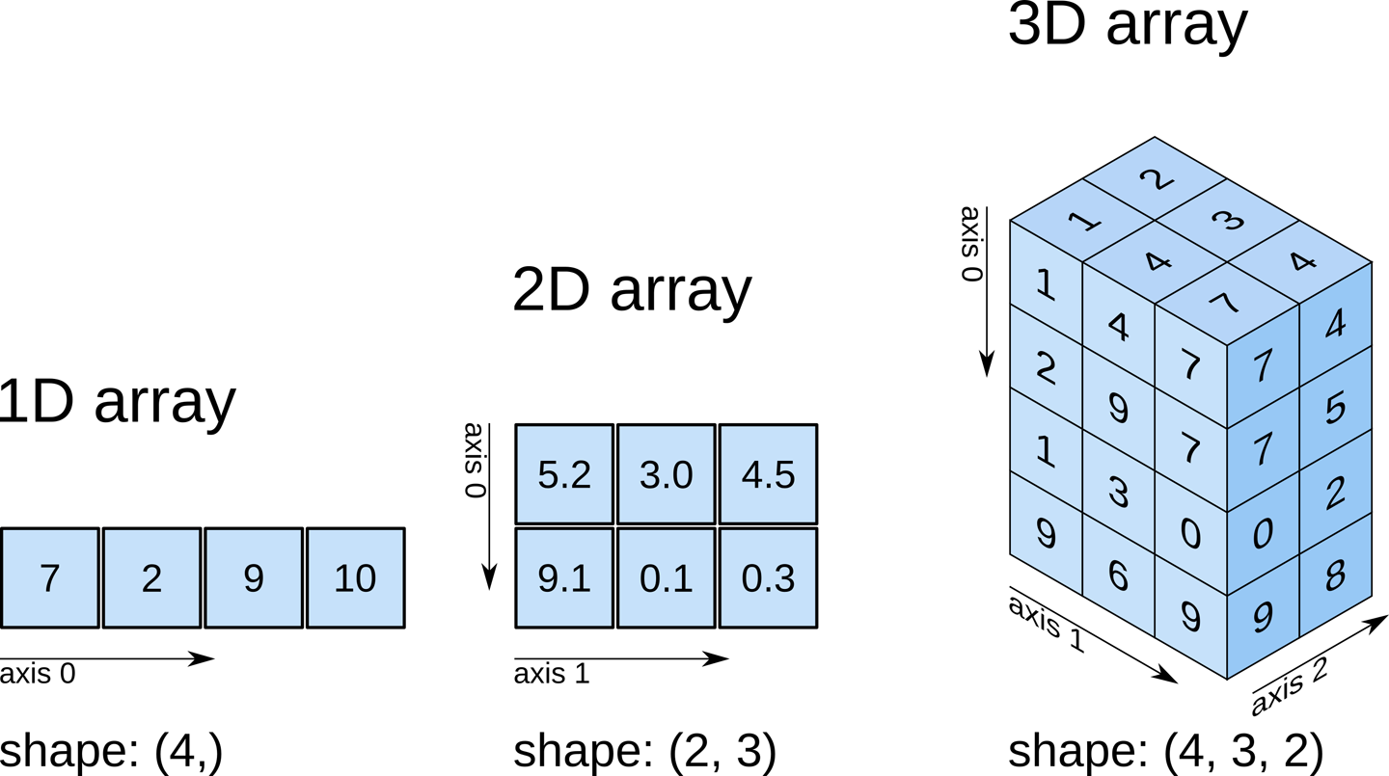
NumPy Arrays
import numpy as np
a=np.array([7.,2.,9.,10.])
x=np.array([[2,3,4],[5,6,7]])
x.shape
X[,-1]; X[,-1:]
x.reshape(3,2)
x.reshape(3,-1)
Notes:
3D arrays examples: RGB images
a2D=np.array([[1,2,3,4],[4,5,6,7],range(8,12)]);a2D.shape;a2D
x=np.array([a2D,100*a2D]);x.shape
x[1,2,3]

Slide 16

import numpy as np
import matplotlib.pyplot as plt
x=np.random.rand(100)
y=np.random.normal(0,2,(100,1))
graph=plt.plot(x,y,'b.')
plt.axhline(0.5)
plt.axvline(0.5,c='r')
plt.axis('equal')
plt.show()
plt.scatter(x=x, y=y, c='g')
plt.show()
Notes:
import pandas as pd
import numpy as np
import matplotlib.pyplot as plt
timestamp=pd.date_range("2020-02-01","2020-02-25",freq="d")
n=len(timestamp)
x=np.random.randn(n)
y=np.random.randn(n)
a = np.random.choice(['N', 'Y'],size=n)
df=pd.DataFrame(data={'x':x,'y':y,'a':a},index=timestamp)
df['y'].plot(kind='hist')
plt.show()
df['y'].plot()
plt.show()
df.plot(x='x',y='y',kind='scatter')
plt.show()

Slide 17

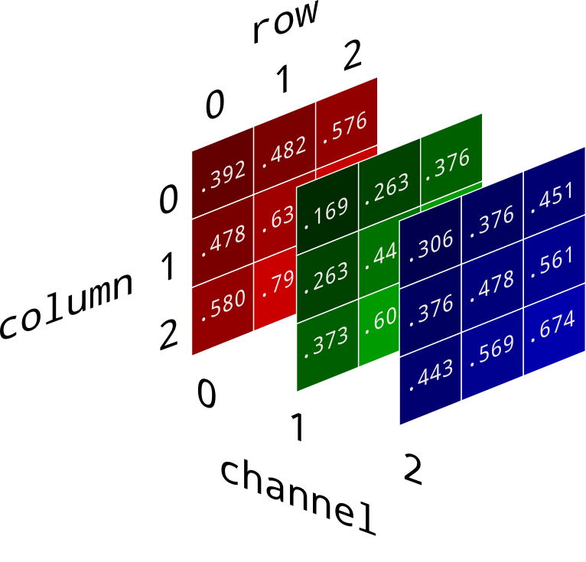
RGB colors
3D Array
>_ Code
Red, Green, Blue
Numpy Array:
R = 255
G = 0
B = 0
R = 0
G = 112
B = 192
R = 0
G = 112
B = 192
R = 255
G = 255
B = 0
Notes:
Practice
from matplotlib.image import imread # you could also use `imageio.imread()`
Draw Mario in this picture in matplotlib.pyplot.imshow()

Slide 18

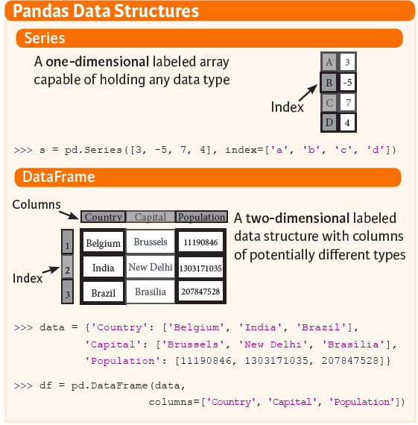
Python (Pandas)
import pandas as pd
x=pd.DataFrame({'a':['Professor','Students'],'b':[111,555]},index=[2,15])
print(x)
print(type(x))
#Slicing
x.iloc[15,]
x.loc[15,]#index-based
x.y
x['y']
x[['y']]
Notes:
x.loc[1,] should be an error since 1 is not an element in the DataFrame index
x.iloc[-1,:]
Activity: Create a pd.DataFrame and slice using the approach whe slicing text strings

Slide 19
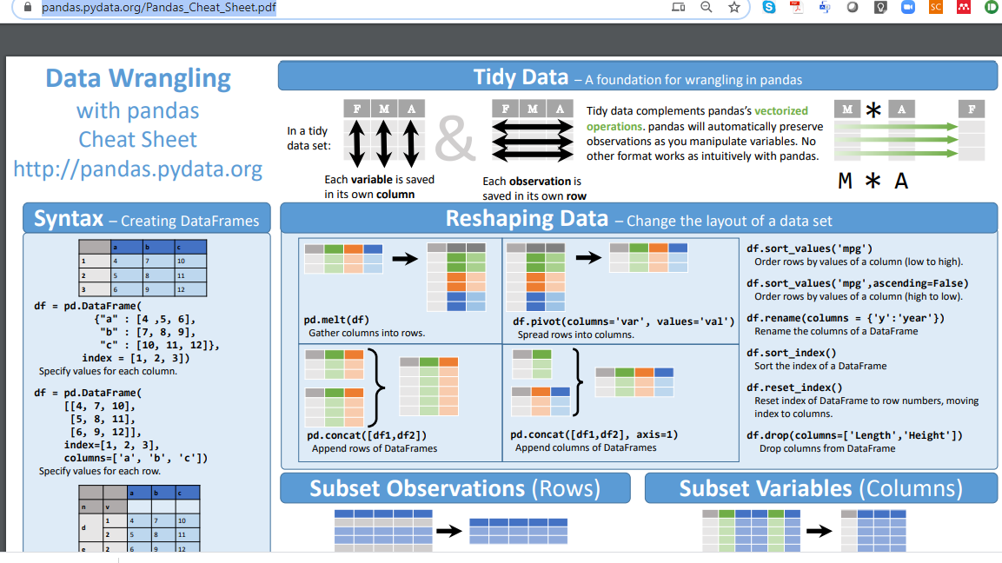
Notes:
https://pandas.pydata.org/Pandas_Cheat_Sheet.pdf
Method chaining:
Pd.melt(df).rename().astype()
Show how to see the full documentation using Zeal VSCode extension, for instance
pd.melt()

Slide 20
import pandas as pd
import numpy as np
import matplotlib.pyplot as plt
timestamp=pd.date_range("2020-02-01","2020-02-25",freq="d")
n=len(timestamp)
x=np.random.randn(n)
y=np.random.randn(n)
a = np.random.choice(['N', 'Y'],size=n)
df=pd.DataFrame(data={'x':x,'y':y,'a':a},index=timestamp)
df['y'].plot(kind='hist')
plt.show()
df['y'].plot()
plt.show()
df.plot(x='x',y='y',kind='scatter')
plt.show()

Slide 21
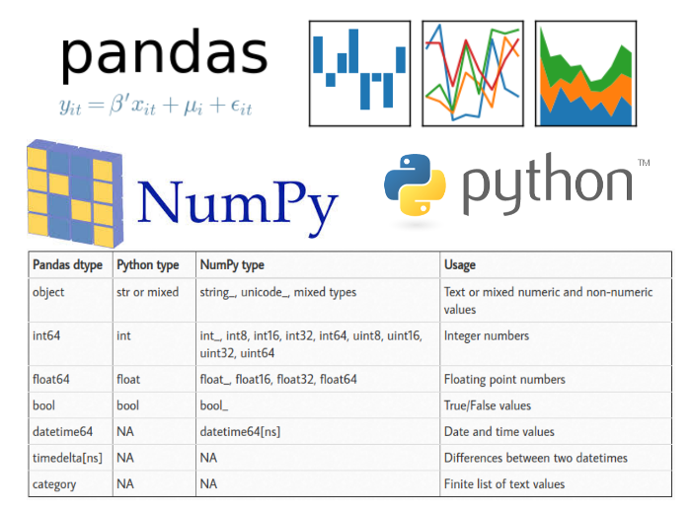
Notes:
https://pbpython.com/pandas_dtypes.html

Slide 22

Jupyter Lab Notebooks
Notes:
Show cells (MarkDown with equations and titles, Python Code and matplotlib plots)

Slide 23
VSCode Extensions
Markdown
Python
Dash/Zeal
Ctrl+H
Notes:
Show snippets
Show how to access Zeal documentation for help

Slide 24
Homework assignment 01
Notes:
Due date = 2 classes forward

