Slide 1
Data types and Distance Definitions
By Francisco Mendoza
mentofran@gmail.com

Slide 2
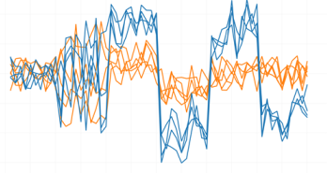
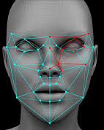
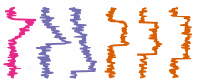

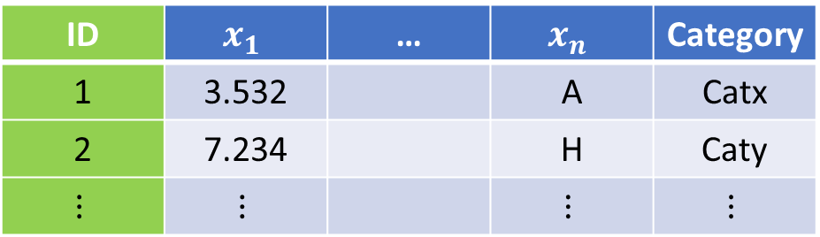


Data types
Signals (speech recognition)
Images
(Face recognition)
$$x→y$$
$$(x_{1},x_{2},…,x_{n})→y$$
$$(x_{1},x_{2},…,x_{n})→(y_{1},y_{2},…,y_{k})$$
Signals (well logs)
ID | $$x_{1}$$ | … | $$x_{n}$$ | Category
1 | 3.532 |  | A | Catx
2 | 7.234 |  | H | Caty
$$⋮$$ | $$⋮$$ |  | $$⋮$$ | $$⋮$$
Notes:
Continuous, Ordinal (likert as example), categorical (a.k.a. nominal) dichotomous and binary as example of categorical.
Ordinal: bad, regular, good, excellent
Categorical: Red, Green, Blue
ordinal = ordered "categorical" interval = equally spaced ordinal vars. ratio = interval variables with zero
Truncated, censored, compositional
Truncated data is data with intervals removed. Censored is data in which data falling in a given interval are grouped.
https://www.theanalysisfactor.com/the-difference-between-truncated-and-censored-data/

Slide 3

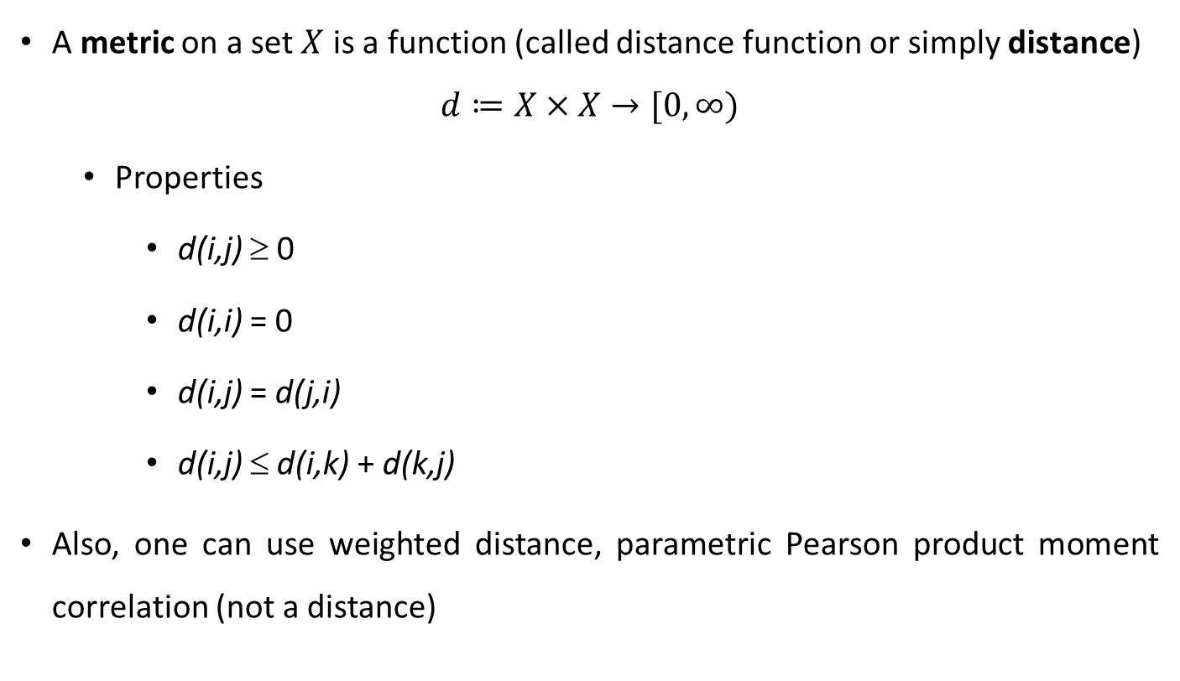







Distance function definition
A metric on a set $X$ is a function (called distance function or simply distance)
$$d≔X×X→[0,∞)$$
Properties
d(i,j) ≥ 0
d(i,i) = 0
d(i,j) = d(j,i)
d(i,j) ≤ d(i,k) + d(k,j)
Also, one can use weighted distance, parametric Pearson product moment correlation (not a distance)
$$y$$
$${\left\|x−y\right\|}_{2}$$
$$j$$
$$x$$
$$i$$
$$x=\left(x_{1}, x_{2}\right)$$
Eucledian distance in $ℝ^{2}$:=
$$\sqrt{{\left(x_{2}−x_{1}\right)}^{2}+{\left(y_{2}−y_{1}\right)}^{2}}={\left\|x−y\right\|}_{2}$$
Notes:
Non-negativity, Symmetry, triangle inequality
Similarity functions which are positive definite will be called kernel functions (cf. Sections 13.4 and 14.2.3 of Mardia et al., 1979)
https://pure.mpg.de/rest/items/item_3183921/component/file_3183922/content
In this slide each point belongs to $ℝ^{2}$.
Metric spaces are defined by this slide properties of distance functions. In mathematics, a metric space is a set together with a metric on the set. (Wikipedia)

Slide 4

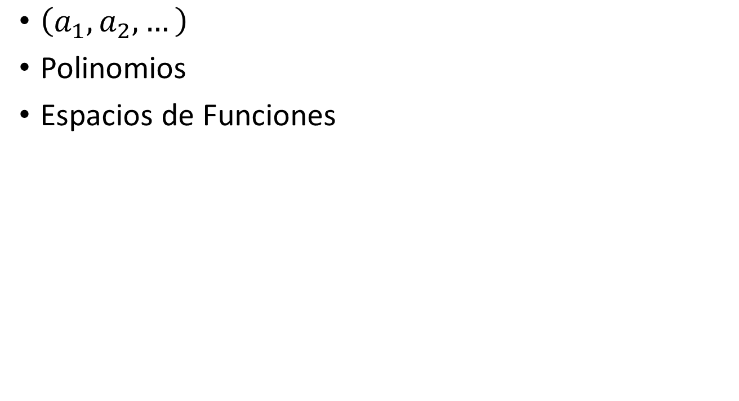



Vector Spaces (Espacios Vectoriales)
$\left(a_{1}, a_{2},…\right)$
Polinomios
Espacios de Funciones
$$y$$
$$j$$
$$x$$
$$i$$

Slide 5

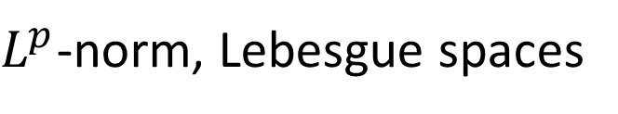


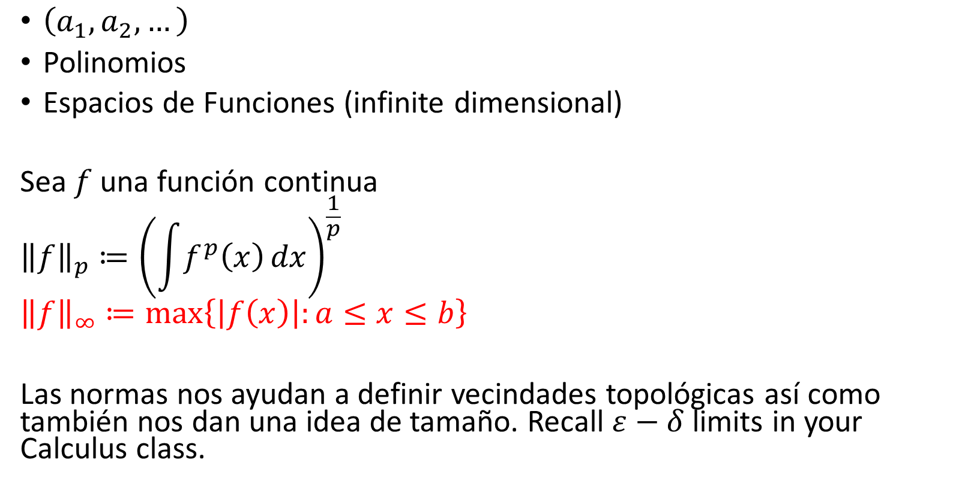
Espacios Vectoriales Normados $\left\|∙\right\|$
$\left(a_{1}, a_{2},…\right)$
Polinomios
Espacios de Funciones (infinite dimensional)
Sea $f$ una función continua
$${\left\|f\right\|}_{p}≔{\left(\int{f^{p}\left(x\right)}dx\right)}^{\frac{1}{p}}$$
$${\left\|f\right\|}_{∞}≔\max\left\{\left|f\left(x\right)\right|:a≤x≤b\right\}$$
Las normas nos ayudan a definir vecindades topológicas así como también nos dan una idea de tamaño. Recall $ε−δ$ limits in your Calculus class.
$${\left\|∙\right\|}_{2}$$
$${\left\|∙\right\|}_{∞}$$
$L^{p}$-norm, Lebesgue spaces
Notes:
Las normas nos ayudan a definir vecindades topológicas así como también nos dan una idea de tamaño.
Limits. For every $ε>0$ there exists a $δ$ …
In mathematics, more specifically in functional analysis, a Banach space (pronounced [ˈbanax]) is a complete normed vector space. Thus, a Banach space is a vector space with a metric that allows the computation of vector length and distance between vectors and is complete in the sense that a Cauchy sequence of vectors always converges to a well defined limit that is within the space.
A Banach space is a vector space X over any scalar field K, which is equipped with a norm {\displaystyle \|\cdot \|_{X}} and which is complete with respect to the distance function induced by the norm, that is to say, for every Cauchy sequence {x_{n}} in X, there exists an element x in X such that
{\displaystyle \lim _{n\to \infty }x_{n}=x,}or equivalently:

Slide 6

Problema de mínimos cuadrados
$$\left\|f−f^{∗}\right\|$$

Slide 7
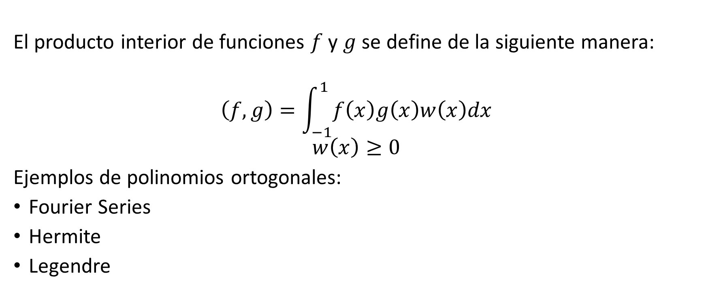

Espacios de Hilbert $<∙>$
El producto interior de funciones $f$ y $g$ se define de la siguiente manera:
$$\left(f,g\right)=\int_{−1}^{1}{f\left(x\right)g\left(x\right)w\left(x\right)dx}$$
$$w\left(x\right)≥0$$
Ejemplos de polinomios ortogonales:
Fourier Series
Hermite
Legendre

Slide 8

Mínimos cuadrados discretos
$$\left\|f−f^{∗}\right\|$$
$$f^{∗}=\sum_{n=1}^{n}{{c_{n}b}_{n}}$$
Regresión lineal:
$$\hat{y}=f^{∗}={\hat{β}}_{0}+{\hat{β}}_{1}x$$
$$\left(\begin{matrix}y_{1} \\ ⋮ \\ y_{p}\end{matrix}\right)=\left(\begin{matrix}1 & x_{1} \\ ⋮ & ⋮ \\ 1 & x_{p}\end{matrix}\right)\left(\begin{matrix}β_{0} \\ β_{1}\end{matrix}\right)$$

Slide 9
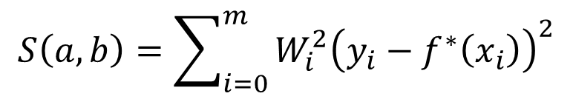
Mínimos cuadrados discretos
Mínimos cuadrados ponderados
$$S\left(a,b\right)=\sum_{i=0}^{m}{{W_{i}^{2}\left(y_{i}−f^{∗}\left(x_{i}\right)\right)}^{2}}$$

Slide 10
Data Structures
Data matrix
Dissimilarity matrix

Slide 11
Similarity and Dissimilarity Between Objects
Distances are normally used to measure the dissimilarity between two data objects
Some popular ones include: Minkowski distance
where i = (x_{i1}, x_{i2}, …, x_{ip}) and j = (x_{j1}, x_{j2}, …, x_{jp}) are two
p-dimensional data objects, and q is a positive integer
If q = 1, d is Manhattan distance
Notes:
https://en.wikipedia.org/wiki/Statistical_data_type

Slide 12
Data types
Interval-scaled variables
Binary variables
Nominal, ordinal, and ratio variables
Variables of mixed types
https://en.wikipedia.org/wiki/Statistical_data_type
Notes:
https://www.dummies.com/education/math/statistics/types-of-statistical-data-numerical-categorical-and-ordinal/
https://www.freecodecamp.org/news/types-of-data-in-statistics-nominal-ordinal-interval-and-ratio-data-types-explained-with-examples/
https://www.formpl.us/blog/interval-data#:~:text=Examples%20of%20interval%20data%20includes,grading%2C%20scientific%20studies%20and%20probability.

Slide 13
Interval-valued variables
Standardize data
Calculate the mean absolute deviation:
where
Calculate the standardized measurement (z-score)
Using mean absolute deviation is more robust than using standard deviation

Slide 14
Binary variables
Sample ID | Clay minerals | Quartz | Feldspar | Carbonate minerals | Calcite | Dolomite | Organic matter, hematite, & others
2 | Yes | No | No | No | yes | No | Yes
3 | Yes | No | Yes | Yes | Yes | Yes | Yes
Notes:
Most sedimentary rocks contain either quartz (especially siliciclastic rocks) or calcite (especially carbonate rocks).
Carbonate rocks dominantly consist of carbonate minerals such as calcite, aragonite or dolomite.
Clay minerals: kaolinite, illite or smectite
http://www.tulane.edu/~sanelson/eens212/sedrxintro.htm

Slide 15

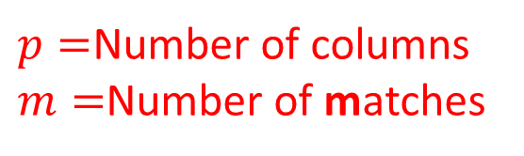

Binary data
$$d\left(i,j\right)=\frac{p−m}{p}$$
$p=$Number of columns
$m=$Number of matches
$$p=2$$
ID | A | B
1 | 1 | N
2 | 1 | Y
3 | 1 | N
4 | 0 | Y
Notes:
Binary data: Yes/No, True/False, On/Off, ….

Slide 16

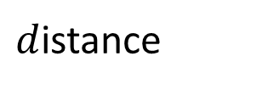



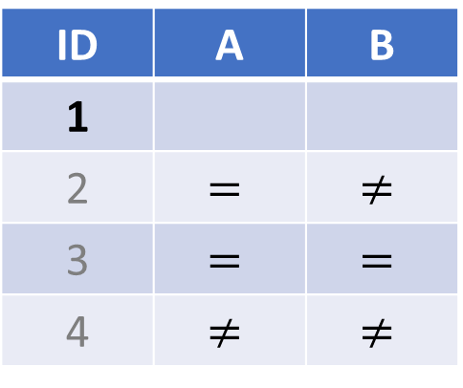
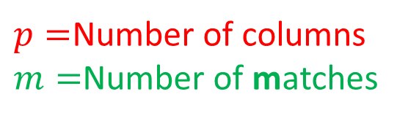
Binary data
$$d\left(i,j\right)=\frac{p−m}{p}$$
$p=$Number of columns
$m=$Number of matches
$$p=2$$
ID | A | B
1 | 1 | N
2 | 1 | Y
3 | 1 | N
4 | 0 | Y
$d$istance
ID | A | B
1
2 | $$=$$ | $$≠$$
3 | $$=$$ | $$=$$
4 | $$≠$$ | $$≠$$
$$m=1$$
$$m=2$$
$$m=0$$
Notes:
$p=$Number of columns
$m=$Number of matches
$i,j=$ Row ID

Slide 17

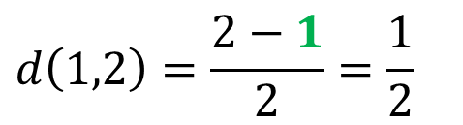
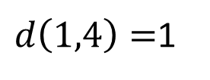
Binary data
$$d\left(i,j\right)=\frac{p−m}{p}$$
$p=$Number of columns
$m=$Number of matches
$$d\left(1,2\right)=\frac{2−1}{2}=\frac{1}{2}$$
$$p=2$$
ID | A | B
1 | 1 | N
2 | 1 | Y
3 | 1 | N
4 | 0 | Y
$$d\left(1,3\right)=0$$
$d\left(1,4\right)=$1
$d$istance
ID | A | B
1
2 | $$=$$ | $$≠$$
3 | $$=$$ | $$=$$
4 | $$≠$$ | $$≠$$
$$m=1$$
$$m=2$$
$$m=0$$
Notes:
$p=$Number of columns
$m=$Number of matches
$i,j=$ Row ID

Slide 18
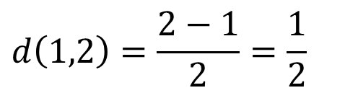

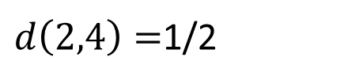
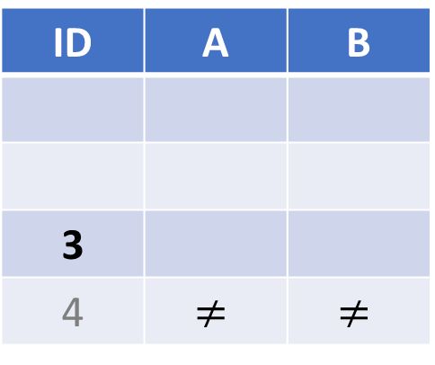
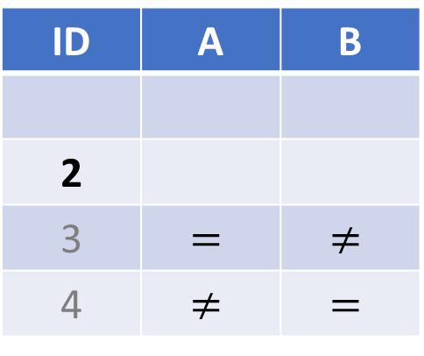
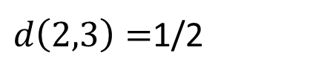
Binary data
$$d\left(i,j\right)=\frac{p−m}{p}$$
$p=$Number of columns
$m=$Number of matches
$$d\left(1,2\right)=\frac{2−1}{2}=\frac{1}{2}$$
$$p=2$$
ID | A | B
1 | 1 | N
2 | 1 | Y
3 | 1 | N
4 | 0 | Y
$$d\left(1,3\right)=0$$
$d\left(2,3\right)=$1/2
$d\left(1,4\right)=$1
$d\left(2,4\right)=$1/2
$$d\left(3,4\right)=1$$
$d$istance
ID | A | B
1
2 | $$=$$ | $$≠$$
3 | $$=$$ | $$=$$
4 | $$≠$$ | $$≠$$
ID | A | B
2
3 | $$=$$ | $$≠$$
4 | $$≠$$ | $$=$$
ID | A | B
3
4 | $$≠$$ | $$≠$$
$$m=1$$
$$m=2$$
$$m=0$$
Notes:
$p=$Number of columns
$m=$Number of matches
$i,j=$ Row ID

Slide 19
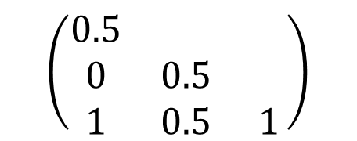
Binary data (Dissimilarity Matrix)
$$d\left(1,2\right)=\frac{2−1}{2}=\frac{1}{2}$$
$$p=2$$
ID | A | B
1 | 1 | N
2 | 1 | Y
3 | 1 | N
4 | 0 | Y
$$d\left(1,3\right)=0$$
$d\left(2,3\right)=$1/2
$d\left(1,4\right)=$1
$d\left(2,4\right)=$1/2
$$d\left(3,4\right)=1$$
$$\left(\begin{matrix}0.5 & & \\ 0 & 0.5 & \\ 1 & 0.5 & 1\end{matrix}\right)$$
Notes:
$p=$Number of columns
$m=$Number of matches
$i,j=$ Row ID

Slide 20
Binary variables
A contingency table for
binary data
Distance measure for symmetric binary variables:
Distance measure for asymmetric binary variables:
Jaccard coefficient (similarity measure for asymmetric binary variables):
Object j
Object i

Slide 21
Dissimilarity between Binary Variables
Example
gender is a symmetric attribute
the remaining attributes are asymmetric binary
let the values Y and P be set to 1, and the value N be set to 0

Slide 22
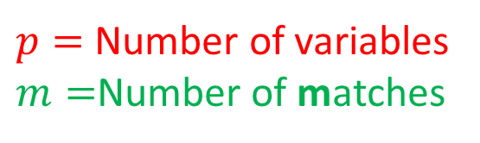

Nominal Variables
A generalization of the binary variable in that it can take more than 2 states, e.g., red, yellow, blue, green
Method 1: Simple matching
Method 2: use a large number of binary variables. One-hot encoding approach
creating a new binary variable for each of the M nominal states
$$d\left(i,j\right)=\frac{p−m}{p}$$
$p=$ Number of variables
$m=$Number of matches

Slide 23
Ordinal Variables
An ordinal variable can be discrete or continuous
Order is important, e.g., rank
Can be treated like interval-scaled
replace x_{if} by their rank
map the range of each variable onto [0, 1] by replacing i-th object in the f-th variable by
compute the dissimilarity using methods for interval-scaled variables
Notes:
1st ,2nd, 3rd

Slide 24
Ratio-Scaled Variables
Ratio-scaled variable: a positive measurement on a nonlinear scale, approximately at exponential scale, such as Ae^{Bt} or Ae^{-Bt}
Methods:
treat them like interval-scaled variables—not a good choice! (why?—the scale can be distorted)
apply logarithmic transformation
y_{if} = log(x_{if})
treat them as continuous ordinal data treat their rank as interval-scaled

Slide 25
Mixed-type data
A database may contain all the six types of variables
symmetric binary, asymmetric binary, nominal, ordinal, interval and ratio
One may use a weighted formula to combine their effects
f is binary or nominal:
d_{ij}^{(f)} = 0 if x_{if} = x_{jf} , or d_{ij}^{(f)} = 1 otherwise
f is interval-based: use the normalized distance
f is ordinal or ratio-scaled
compute ranks r_{if} and
and treat z_{if} as interval-scaled
https://pyclustering.github.io/
Python package Gower
Notes:
https://www.thinkdatascience.com/post/2019-12-16-introducing-python-package-gower/

Slide 26
Mixed-type data
ID | A | B
1 | 100 | N
2 | 50 | Y
3 | 0 | N
4 | 25 | Y
Notes:
Binary data: Yes/No, True/False, On/Off, ….

Slide 27
Sequence similarity
Edit distance
Hamming distance
https://en.wikipedia.org/wiki/Levenshtein_distance
Strig/Text similarity
Similarity search/alignment
Homology
Notes:
https://www.lives-nccr.ch/sites/default/files/pdf/publication/33_lives_wp_studer_sequencedissmeasures.pdf
https://forscenter.ch/wp-content/uploads/2018/09/presentation-lausanne-2.pdf
R package. http://traminer.unige.ch/doc/seqdist.html
Time series distances. https://cran.r-project.org/web/packages/TSdist/TSdist.pdf
Approximate string matching. http://users.csc.calpoly.edu/~dekhtyar/570-Fall2011/papers/navarro-approximate.pdf

Slide 28
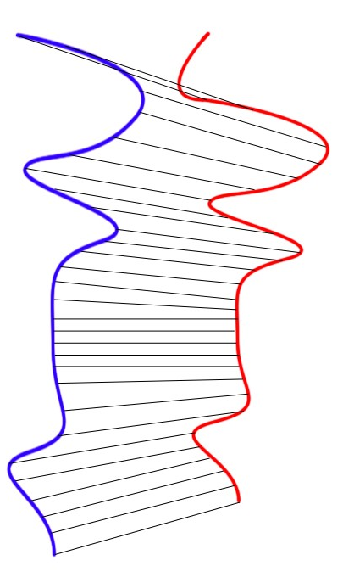



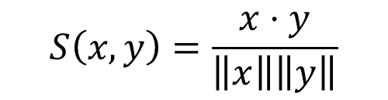
Vector objects
Cosine similarity
Sequences. Dynamic Time Warping
$$y=\left(y_{1},…,y_{p}\right)$$
$$θ$$
$$x=\left(x_{1},…,x_{p}\right)$$
$$S\left(x,y\right)=\frac{x⋅y}{\left\|x\right\|\left\|y\right\|}$$
Notes:
What is the definition of the dot product of two vectors?
$$x⋅y=\left\|x\right\|\left\|y\right\|cos\left(θ\right)$$
Time series disntance TraMineR R package

Slide 29
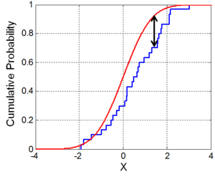
Measures between probability distribution functions
Kolmogorov-Smirnov
Chi squared statistic

Slide 30
Code >_
sklearn.neighbors.DistanceMetric()
https://scikit-learn.org/stable/modules/generated/sklearn.neighbors.DistanceMetric.html

Slide 31
See also
http://www.uco.es/users/ma1fegan/Comunes/asignaturas/vision/Encyclopedia-of-distances-2009.pdf
Similarity Search The Metric Space Approach
2018 Slawomir Wierzchoń- Modern Algorithms of Cluster Analysis.pdf
2017 Alboukadel Kassambara - Practical Guide to Cluster Analysis in R. Unsupervised Machine Learning.pdf
http://37steps.com/1617/non-euclidean-and-non-metric-dissimilarities/
https://cs.uni-paderborn.de/fileadmin/informatik/fg/cuk/Forschung/Publikationen/ClusteringForMetricAndNonmetricDistanceMeasures.pdf
A Comparison Study on Similarity and Dissimilarity Measures in Clustering Continuous Data
2015 Time-series clustering – A decade review.pdf
2017 Finding an optimal well-log correlation sequence using coherence-weighted graphs. DTW.pdf
2014 Lin_Probabilistic sequence alignment of stratigraphic records.pdf
An Empirical Comparison of Dissimilarity Measures for Recommender Systems
http://faculty.juniata.edu/rhodes/ml/simdissim.htm
Measures between probability distribution functions
https://www.ncbi.nlm.nih.gov/pmc/articles/PMC6659240/
1999 Metrics and similarity measures for hidden Markov models.pdf
2018 Augustine Oppong. Clustering Mixed Data: An Extension of the Gower Coefficient with Weighted L2 Distance
Gower with directional data

