Slide 1
Supervised vs Unsupervised Learning
By Francisco Mendoza
mentofran@gmail.com
Notes:
https://dashee87.github.io/data%20science/general/Clustering-with-Scikit-with-GIFs/

Slide 2


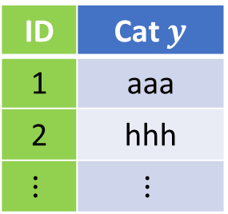

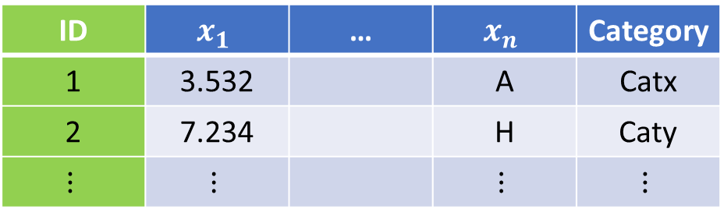


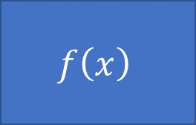

Type of problems, data types
Model
$$f\left(x\right)$$
$$x→y$$
Supervised
$$x$$
$$y$$
$$(x_{1},x_{2},…,x_{n})→y$$
$$(x_{1},x_{2},…,x_{n})→(y_{1},y_{2},…,y_{k})$$
$$f:X→Y$$
Unsupervised
ID | $$x_{1}$$ | … | $$x_{n}$$ | Category
1 | 3.532 |  | A | Catx
2 | 7.234 |  | H | Caty
$$⋮$$ | $$⋮$$ |  | $$⋮$$ | $$⋮$$
ID | Cat $y$
1 | aaa
2 | hhh
$$⋮$$ | $$⋮$$
Notes:
Continuous, Ordinal, categorical (a.k.a. nominal) binary as example of categorical, likert.
Ordinal: bad, regular, good, excellent
Categorical: Red, Green, Blue
ordinal = ordered "categorical" interval = equally spaced ordinal vars. ratio = interval variables with zero
Truncated, censored, compositional
Truncated data is data with intervals removed. Censored is data in which data falling in a given interval are grouped.
https://www.theanalysisfactor.com/the-difference-between-truncated-and-censored-data/

Slide 3
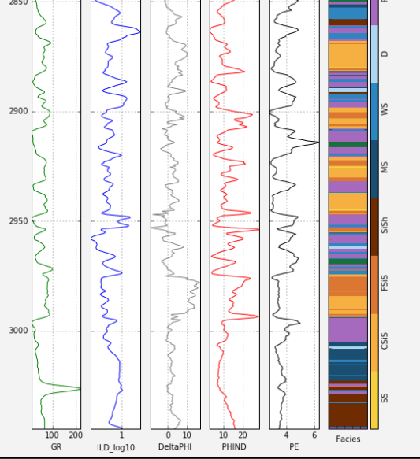
Supervised Vs Unsupervised learning
https://www.leouieda.com/talks/tgif2018.html

Slide 4
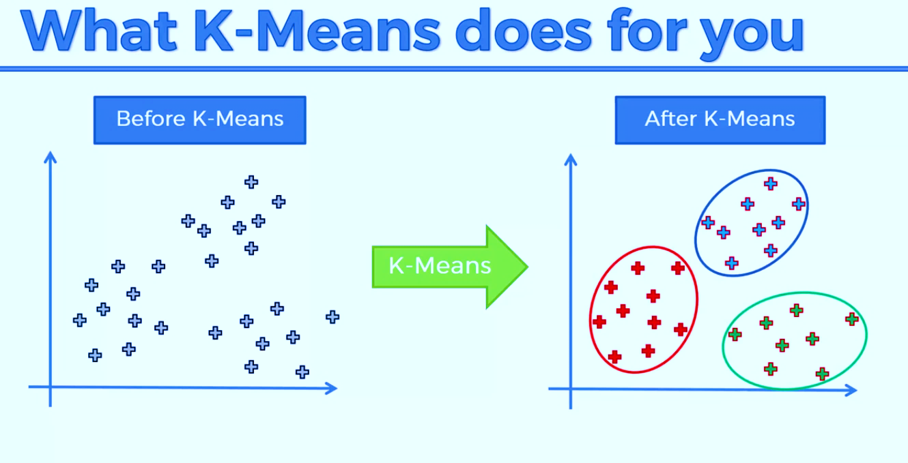
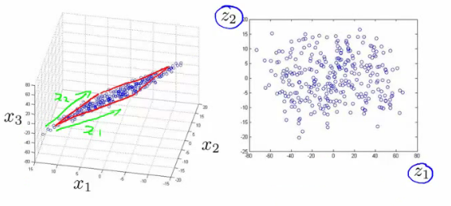
Unsupervised learning
Clustering
K-means
DBSCAN
Hierarchical Cluster Analysis
Visualization and dimensionality reduction
Principal Component Analysis (PCA)
Locally-Linear Embedding (LLE)
t-distributed Stochastic Neighbor Embedding (t-SNE)
Clustering

Slide 5
K-means

Slide 6
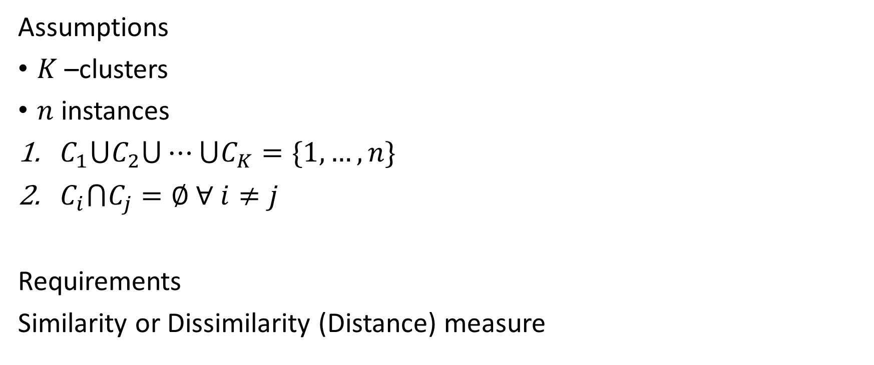

K-means
$K$-means
Assumptions
$K$ –clusters
$n$ instances
$C_{1}⋃C_{2}⋃⋯⋃C_{K}=\{1, …,n\}$
$C_{i}⋂C_{j}=∅$ $∀ i≠j$
Requirements
Similarity or Dissimilarity (Distance) measure
Notes:
1. Each observation belongs to at least one of the K clusters.
2. The clusters are nonoverlapping: no observation belongs to more than one cluster.

Slide 7

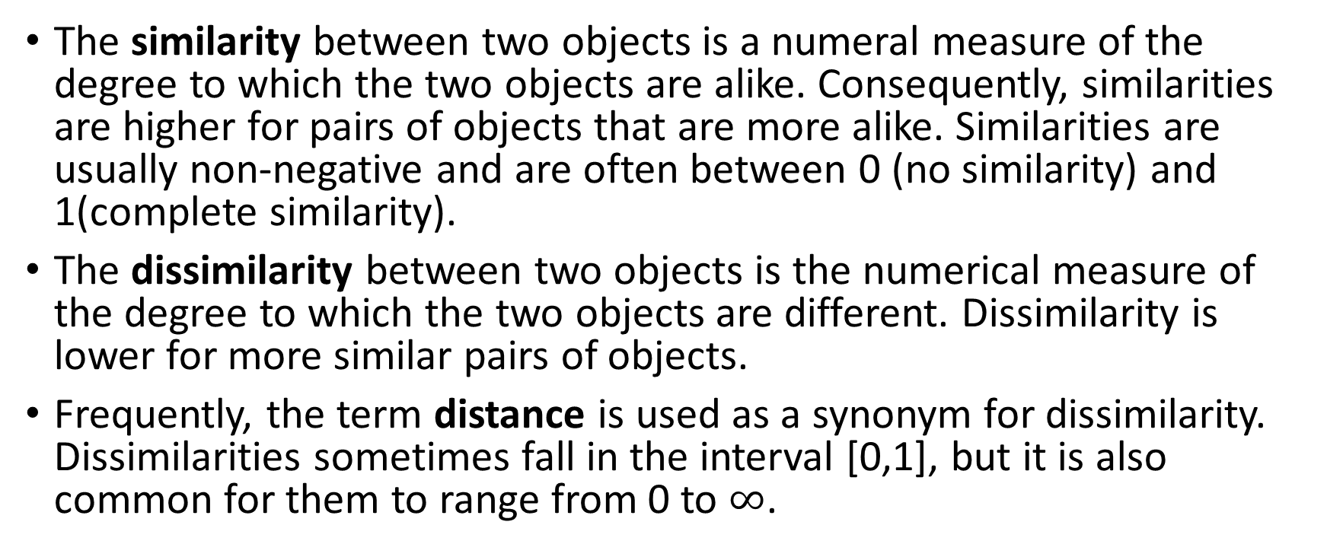


Similarity vs Dissimilarity
The similarity between two objects is a numeral measure of the degree to which the two objects are alike. Consequently, similarities are higher for pairs of objects that are more alike. Similarities are usually non-negative and are often between 0 (no similarity) and 1(complete similarity).
The dissimilarity between two objects is the numerical measure of the degree to which the two objects are different. Dissimilarity is lower for more similar pairs of objects.
Frequently, the term distance is used as a synonym for dissimilarity. Dissimilarities sometimes fall in the interval [0,1], but it is also common for them to range from 0 to $∞$.
$$b$$
$$a$$
$$c$$
Notes:
Ask:
What is the formula for the Eucledian distance between 2 points in $ℝ^{2}$

Slide 8
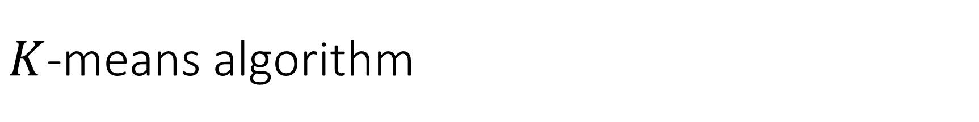
$K$-means algorithm
Bishop, 2007. Fig. 9.1

Slide 9
$K$-means algorithm
Bishop, 2007. Fig. 9.1
Notes:
Cómo se calcula el centro de masa/centroide/media de los puntos?
X Y
1 4
3 6
4 9

Slide 10
$K$-means algorithm
Bishop, 2007. Fig. 9.1

Slide 11
$K$-means algorithm
Bishop, 2007. Fig. 9.1

Slide 12
$K$-means algorithm
Bishop, 2007. Fig. 9.1

Slide 13
$K$-means algorithm
Bishop, 2007. Fig. 9.1

Slide 14
$K$-means algorithm
Bishop, 2007. Fig. 9.1

Slide 15
$K$-means algorithm
Bishop, 2007. Fig. 9.1

Slide 16
$K$-means algorithm
Bishop, 2007. Fig. 9.1

Slide 17


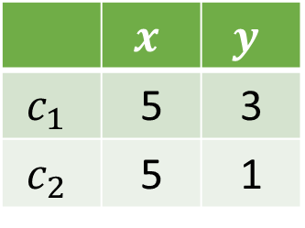
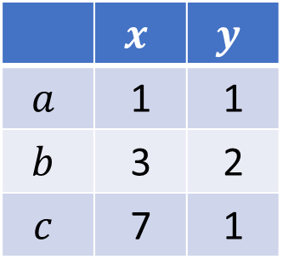


Exercise
Data
Initial Centroids
 | $$x$$ | $$y$$
$$a$$ | 1 | 1
$$b$$ | 3 | 2
$$c$$ | 7 | 1
 | $$x$$ | $$y$$
$$c_{1}$$ | 5 | 3
$$c_{2}$$ | 5 | 1
$$b$$
$$a$$
$$c$$
>_ Code
Notes:
Como se calcula la distancia entre puntos?
$$\left\|P_{2}−P_{1}\right\|=d\left(P_{2},P_{1}\right)=\sqrt{{\left(x_{2}−x_{1}\right)}^{2}+{\left(y_{2}−y_{1}\right)}^{2}}$$

Slide 18

Homework assignment
Generate a bivariate dataset with $K=$3 groups and then use sklearn.cluster.Kmeans() to get clusters of the dataset.
Plot the scatterplot identifying each cluster with a different color.
sklearn.cluster.KMeans()
https://blog.floydhub.com/introduction-to-k-means-clustering-in-python-with-scikit-learn/

Slide 19
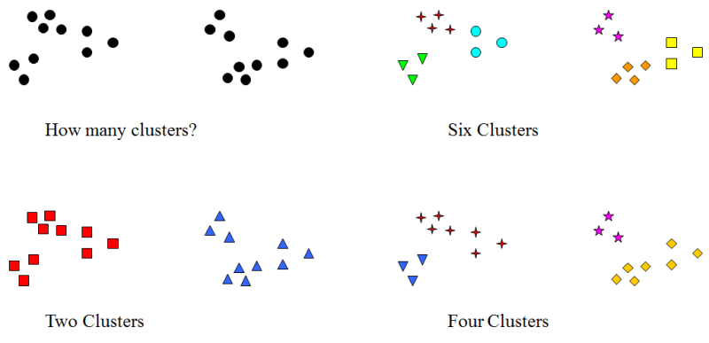
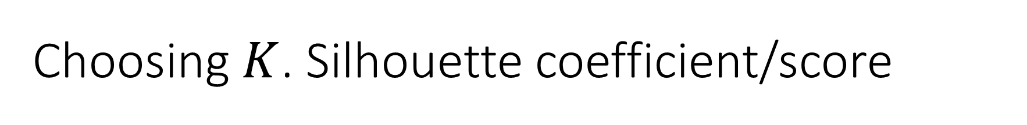
Choosing $K$. Silhouette coefficient/score
https://visibledata.wordpress.com/visible-data/cluster-analysis/
Notes:
https://www.youtube.com/watch?v=AtxQ0rvdQIA

Slide 20
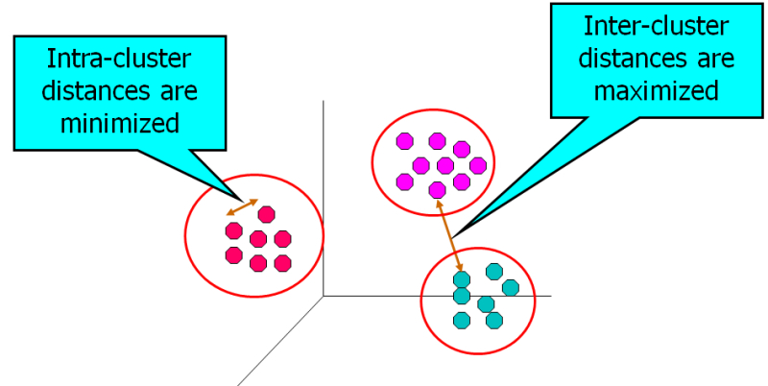
Choosing $K$. Silhouette coefficient/score
https://visibledata.wordpress.com/visible-data/cluster-analysis/
Notes:
Clustering is optimizing the cohesion within the cluster while maximizing the separation between cluster and datapoints outside of the cluster:
https://www.youtube.com/watch?v=AtxQ0rvdQIA

Slide 21
Distortion
Intuitively, “compact” clusters good
Depends on data and K, which are given
And depends on centroids and assignment of x_{i} to clusters (which we can control)
How to measure this “goodness”?
Define distortion = Σ d(x_{i},centroid(x_{i}))
Where d(x,y) is a distance measure
Given K, let’s try to minimize distortion

Slide 22
Distortion
Consider this 2-d data
Choose K = 3 clusters
Same data for both
Which has smaller distortion?
How to minimize distortion?
Good question…

Slide 23
Distortion
Note, distortion depends on K
So, should probably write distortion_{K}
Typically, larger K, smaller distortion_{K}
Want to minimize distortion_{K} for fixed K
Best choice of K is a different issue
Briefly considered later
Also consider other measures of goodness
For now, assume K is given and fixed

Slide 24
How to Minimize Distortion?
Given m data points and K …
Min distortion via exhaustive search?
Try all m choose K different cases?
Too much work for realistic size data set
An approximate solution will have to do
Exact solution is NP-complete problem
Important Note: For minimum distortion…
Each x_{i} grouped with nearest centroid
Centroid must be center of its group
Notes:
The penultimate point is obvious. The last point is not so obvious, but can be verified using some basic calculus (minimize distortion function by taking partial derivatives and set to 0)

Slide 25
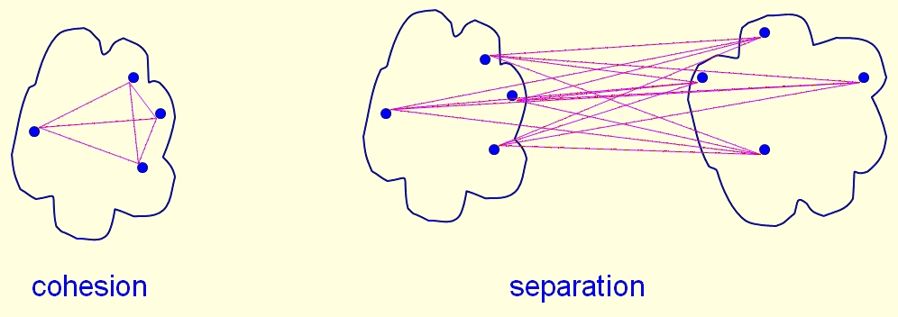
Cohesion and Separation
Cluster cohesion
How tightly packed is a cluster
More cohesive clusters is more better
Cluster separation
Distance between clusters
The more separation, the better
Can we measure these things?
Yes

Slide 26
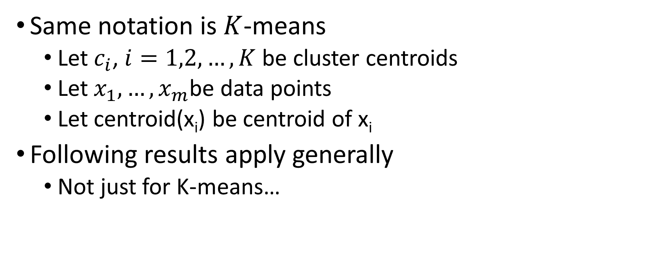
Notation
Same notation is $K$-means
Let $c_{i}$, $i=1,2,…,K$ be cluster centroids
Let ${x_{1},…, x}_{m}$be data points
Let centroid(x_{i}) be centroid of x_{i}
Following results apply generally
Not just for K-means…

Slide 27
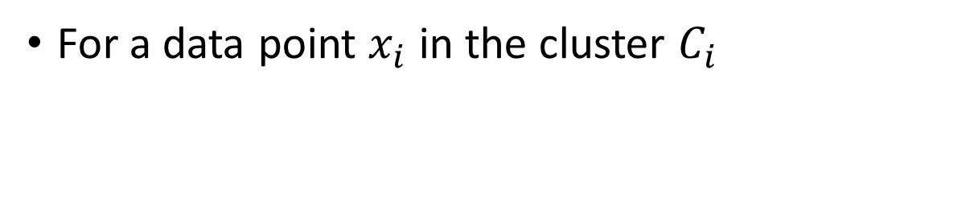
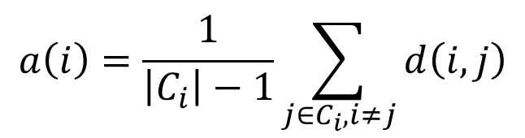
Cohesion (intra-cluster)
For a data point $x_{i}$ in the cluster $C_{i}$
$$a\left(i\right)=\frac{1}{\left|C_{i}\right|−1}\sum_{j∈C_{i}, i≠j}{d\left(i,j\right)}$$
Notes:
The formula stands for the mean distance between $i$ and all other data points in the same cluster, where $d(i,j)$ is the distance between data points $i$ and $j$ in the cluster $C_{i}$ (we divide by $\left|C_{i}\right|−1$ because we do not include the distance in the sum). We can interpret $a\left(i\right)$ as a measure of how well $i$ is assigned to its cluster (the smaller the value, the better the assignment).
https://en.wikipedia.org/wiki/Silhouette_(clustering)

Slide 28



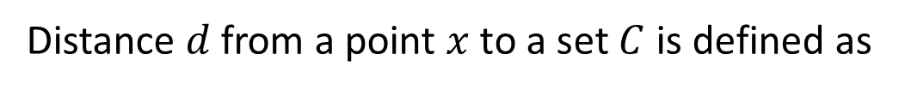
Separation (inter-cluster)
Distance $d$ from a point $x$ to a set $C$ is defined as
$$≔d\left(x,C\right)$$
$$x$$
$$C$$
Notes:
Lantuejoul sec. 5.3 Hausdorff distance

Slide 29
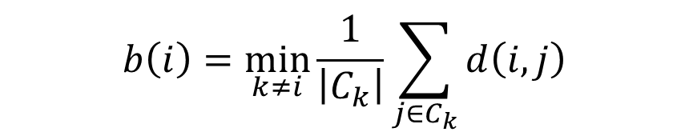

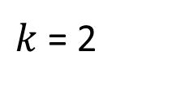
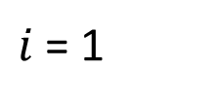
Separation (inter-cluster)
$K$ = 2
$k$ = 2
$i$ = 1
$$b\left(i\right)=\min_{k≠i}{\frac{1}{\left|C_{k}\right|}\sum_{j∈C_{k}}{d\left(i,j\right)}}$$
Notes:
Lantuejoul sec. 5.3 Hausdorff distance

Slide 30
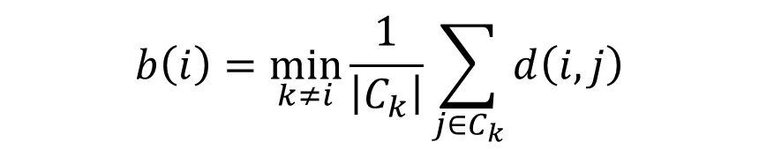


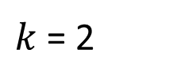
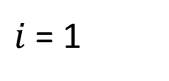
Separation (inter-cluster)
$K$ = 3
$k$ = 2
$k$ = 3
$i$ = 1
$$b\left(i\right)=\min_{k≠i}{\frac{1}{\left|C_{k}\right|}\sum_{j∈C_{k}}{d\left(i,j\right)}}$$
Notes:
Lantuejoul sec. 5.3 Hausdorff distance

Slide 32
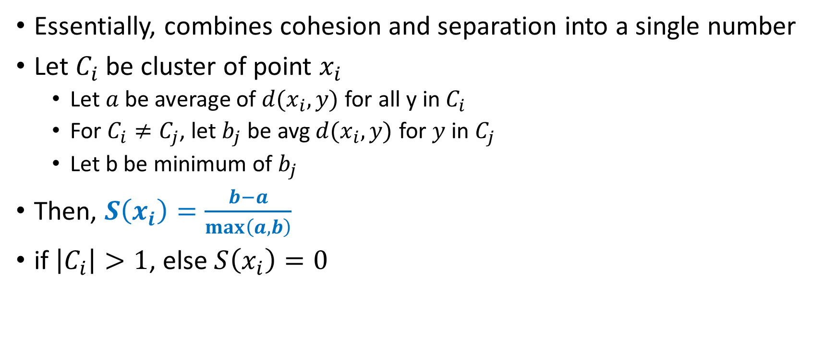
Silhouette Coefficient
Essentially, combines cohesion and separation into a single number
Let $C_{i}$ be cluster of point $x_{i}$
Let $a$ be average of $d(x_{i},y)$ for all y in $C_{i}$
For $C_{i}≠C_{j}$, let $b_{j}$ be avg $d(x_{i},y)$ for $y$ in $C_{j}$
Let b be minimum of $b_{j}$
Then, $S\left(x_{i}\right)=\frac{b−a}{\max\left(a,b\right)}$
if $\left|C_{i}\right|>1$, else $S\left(x_{i}\right)=0$

Slide 33
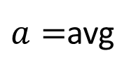


Silhouette Coefficient
The idea...
$a=$avg
$$x_{i}$$
avg
$$b=\min{}$$
avg

Slide 35
Practice
Compute the Silhouette coefficient for
>_ Code

Slide 36

Homework assignment
Using Scikit learn, find the Silhouette coefficient for of the dataset in the previous homework assignment $K=2, 3,4,5,6$. Plot the Silhoute coefficient as function of $K$.

Slide 37
DBSCAN
Density-Based Spatial Clustering of Applications with Noise
Notes:
https://www.naftaliharris.com/blog/visualizing-dbscan-clustering/

Slide 38


DBSCAN
Key Concepts:
$ε=$ radious
$ε$-neighborhood
Core points (minPoints = 3)
$$ε$$
Notes:
https://en.wikipedia.org/wiki/DBSCAN
https://www.naftaliharris.com/blog/visualizing-dbscan-clustering/ DBSCAN Rings & Pimpled Smiley

Slide 39
DBSCAN
Key Concepts:
$ε=$ radious
$ε$-neighborhood
Core points (minPoints = 3)
$$ε$$
Notes:
https://en.wikipedia.org/wiki/DBSCAN
https://www.naftaliharris.com/blog/visualizing-dbscan-clustering/ DBSCAN Rings & Pimpled Smiley

Slide 40
DBSCAN
Key Concepts:
$ε=$ radious
$ε$-neighborhood
Core points (minPoints = 3)
$$ε$$
Notes:
https://en.wikipedia.org/wiki/DBSCAN
https://www.naftaliharris.com/blog/visualizing-dbscan-clustering/ DBSCAN Rings & Pimpled Smiley

Slide 41
DBSCAN
Key Concepts:
$ε=$ radious
$ε$-neighborhood
Core points (minPoints = 3)
$$ε$$
Notes:
https://en.wikipedia.org/wiki/DBSCAN
https://www.naftaliharris.com/blog/visualizing-dbscan-clustering/ DBSCAN Rings & Pimpled Smiley

Slide 42
DBSCAN
Key Concepts:
$ε=$ radious
$ε$-neighborhood
Core points (minPoints = 3)
$$ε$$
Notes:
https://en.wikipedia.org/wiki/DBSCAN
https://www.naftaliharris.com/blog/visualizing-dbscan-clustering/ DBSCAN Rings & Pimpled Smiley

Slide 43
DBSCAN
Key Concepts:
$ε=$ radious
$ε$-neighborhood
Core points (minPoints = 3)
$$ε$$
Notes:
https://en.wikipedia.org/wiki/DBSCAN
https://www.naftaliharris.com/blog/visualizing-dbscan-clustering/ DBSCAN Rings & Pimpled Smiley

Slide 44
DBSCAN
Key Concepts:
$ε=$ radious
$ε$-neighborhood
Core points (minPoints = 3)
$$ε$$
Notes:
https://en.wikipedia.org/wiki/DBSCAN
https://www.naftaliharris.com/blog/visualizing-dbscan-clustering/ DBSCAN Rings & Pimpled Smiley

Slide 45
DBSCAN
Key Concepts:
$ε=$ radious
$ε$-neighborhood
Core points (minPoints = 3)
Anomaly
$$ε$$
Notes:
https://en.wikipedia.org/wiki/DBSCAN
https://www.naftaliharris.com/blog/visualizing-dbscan-clustering/ DBSCAN Rings & Pimpled Smiley
$D_{ε}(x_{i})$ From vector calculus class (Marsden ch. 2.2)

Slide 46
DBSCAN
Key Concepts:
$ε=$ radious
$ε$-neighborhood
Core points (minPoints = 3)
Anomaly
$$ε$$
https://www.naftaliharris.com/blog/visualizing-dbscan-clustering/
Notes:
https://en.wikipedia.org/wiki/DBSCAN
https://www.naftaliharris.com/blog/visualizing-dbscan-clustering/ DBSCAN Rings & Pimpled Smiley
$D_{ε}(x_{i})$ From vector calculus class (Marsden ch. 2.2)

Slide 47
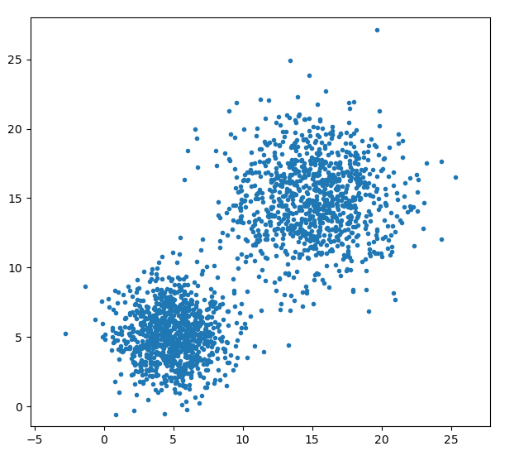
Practice
>_ Code
Get and plot the clusters using k-means and DBSCAN
# Generate synthetic clusters
import numpy as np
import matplotlib.pyplot as plt
np.random.seed(844)
clust1=np.random.normal(5, 2, (1000,2))
clust2=np.random.normal(15, 3, (1000,2))
dataset1=np.concatenate((clust1, clust2))
Notes:
https://dashee87.github.io/data%20science/general/Clustering-with-Scikit-with-GIFs/

Slide 48
Homework assignment
See class GitHub https://github.com/mathphysmx/teaching-ml/blob/master/assigments/homework_assigment_03_clustering.md
Notes:
Theoretical Exercises
https://www.dbs.ifi.lmu.de/Lehre/KDD/SS16/uebung/blatt08.pdf

Slide 49
Hierarchical clustering

Slide 50
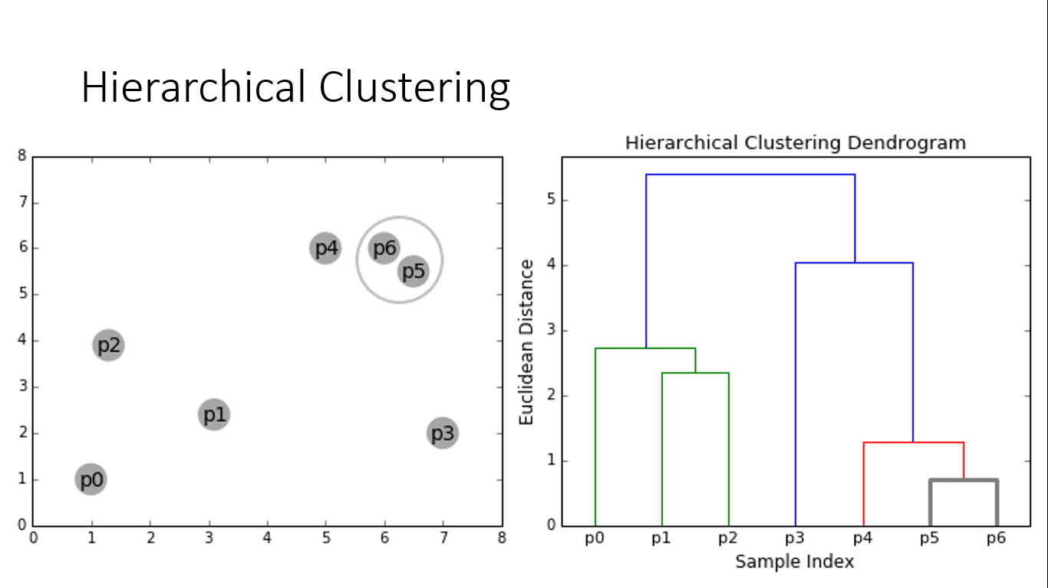
Todo: Add distance matrix

Slide 51
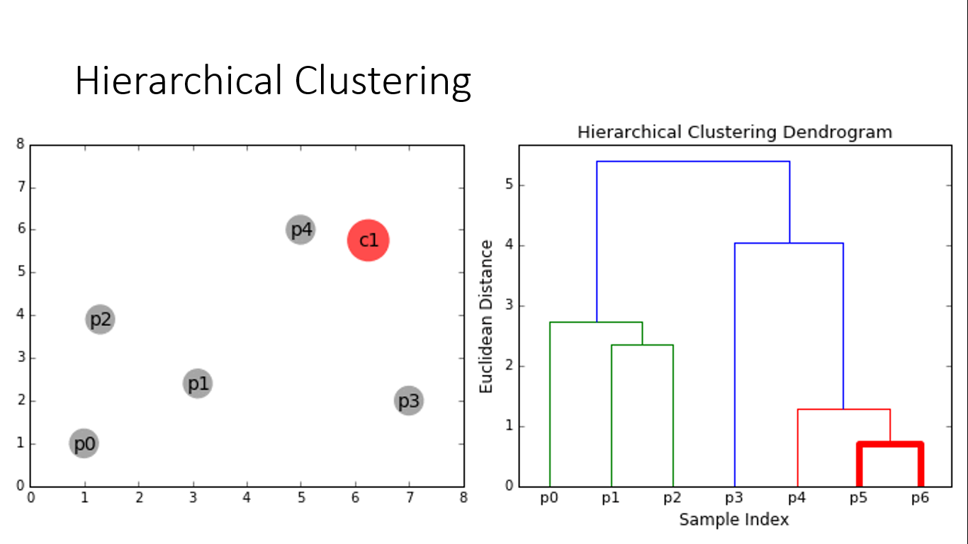

Slide 52
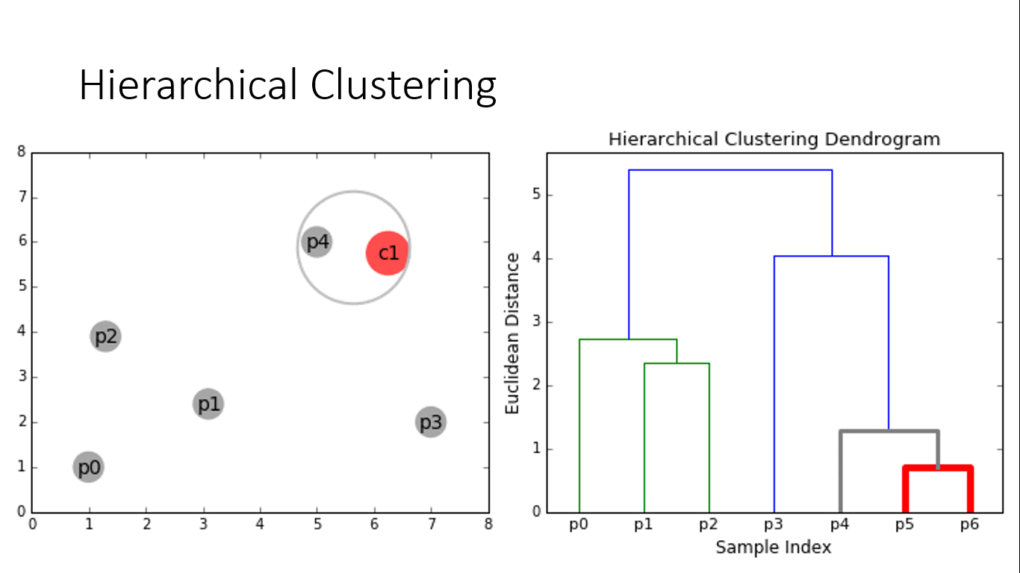

Slide 53
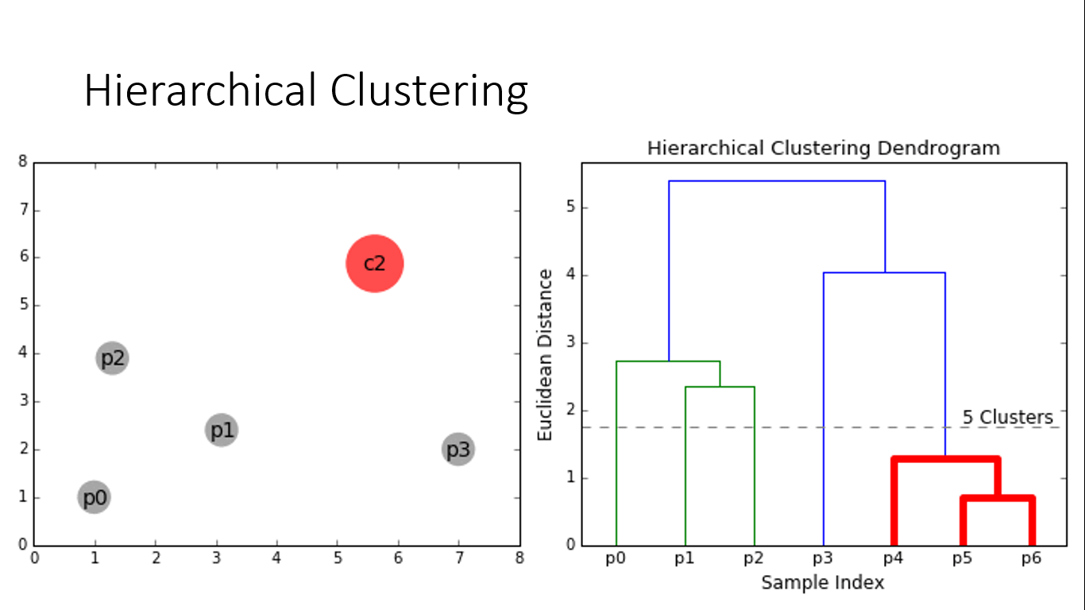

Slide 54
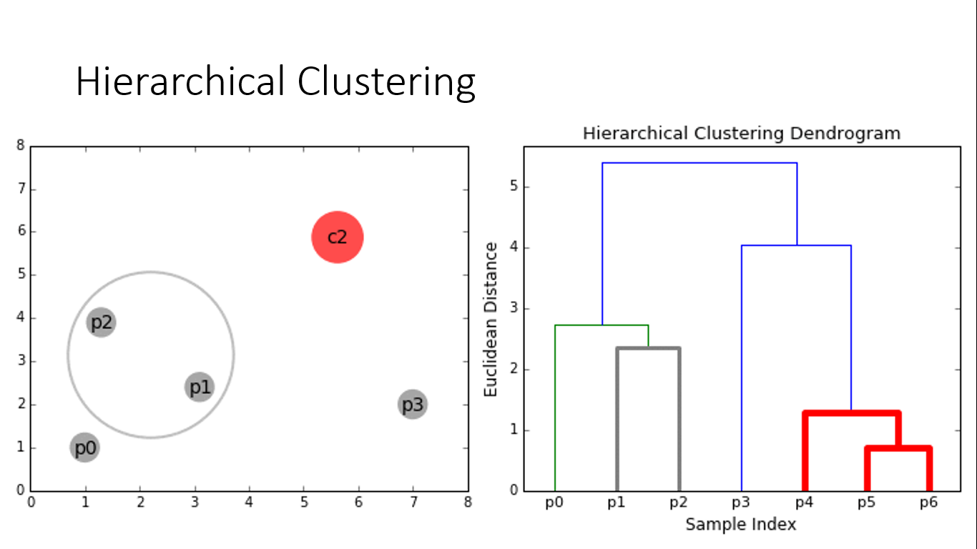

Slide 55
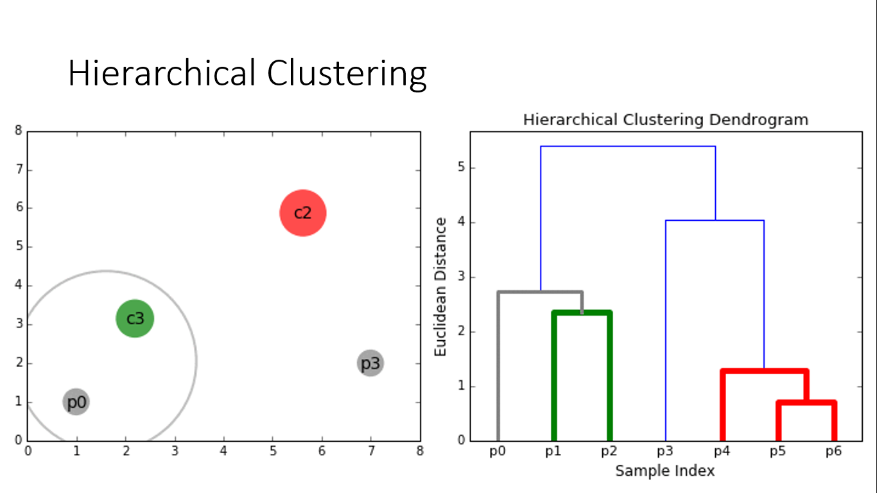

Slide 56
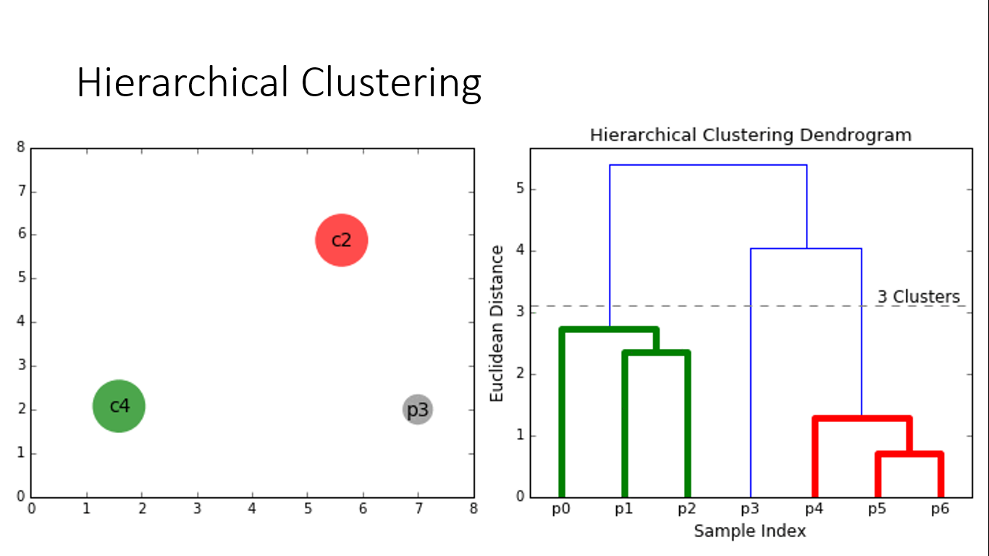

Slide 57
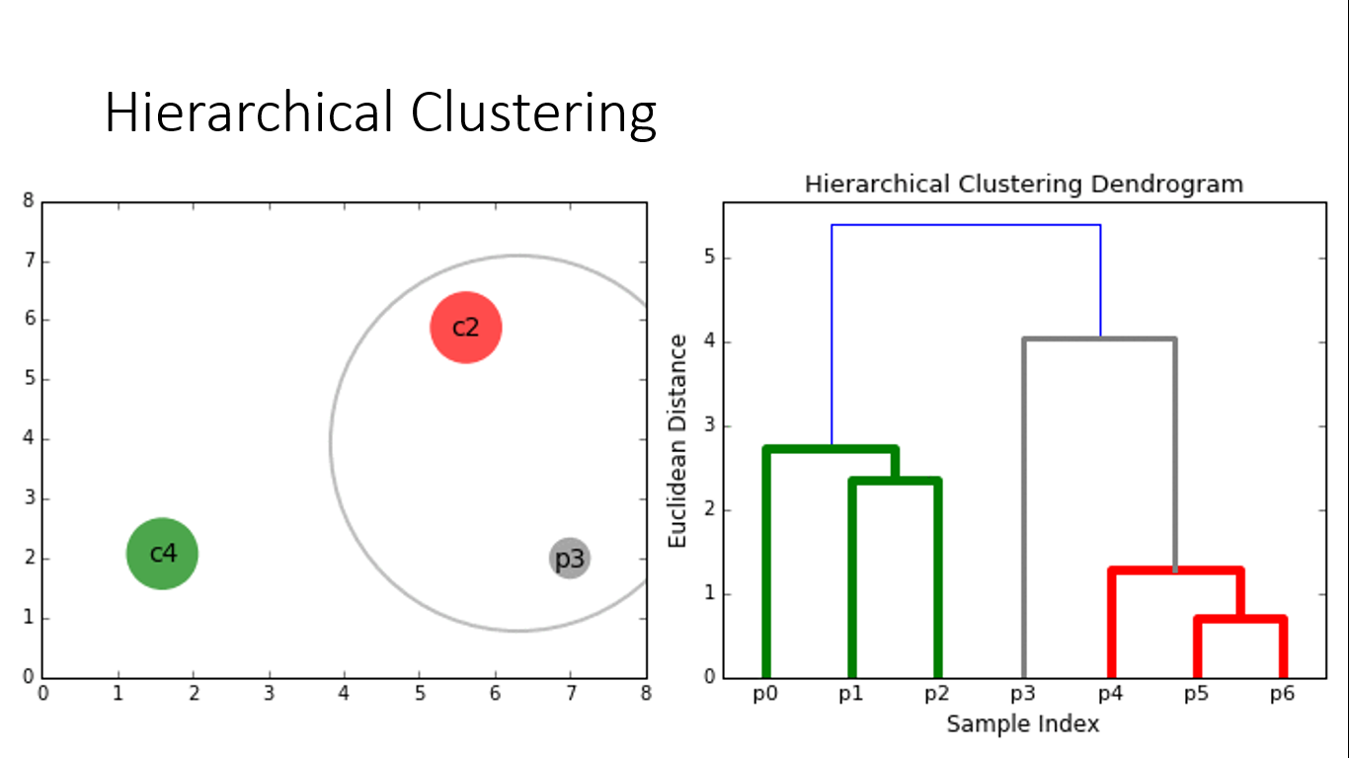

Slide 58
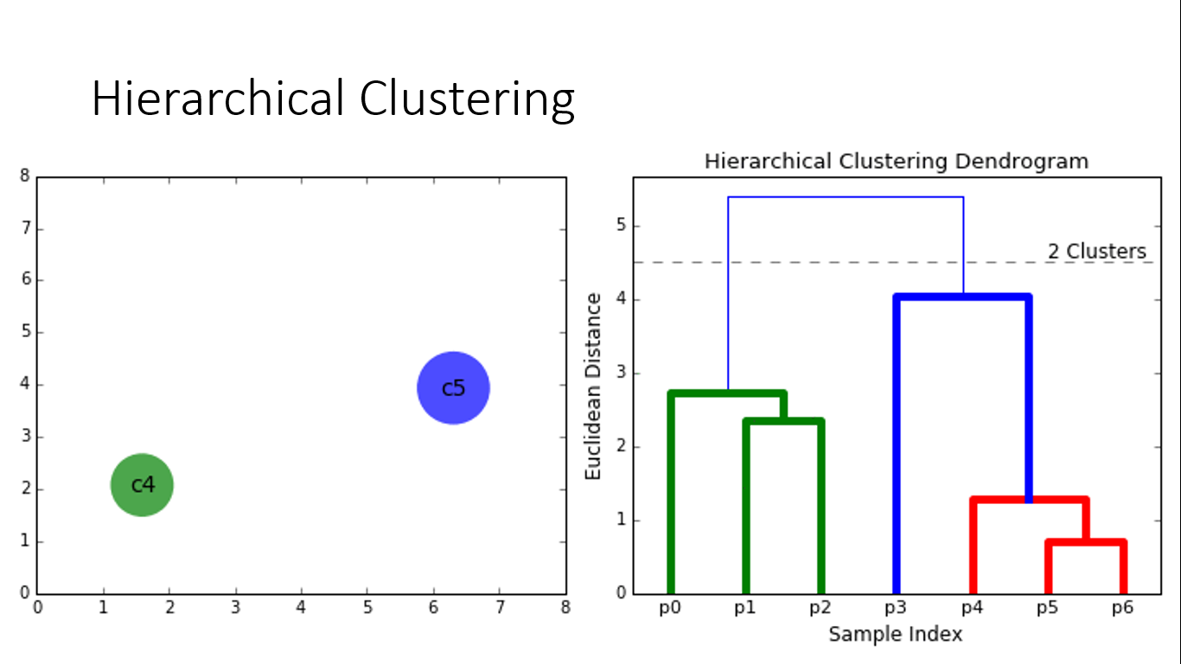

Slide 59
Gower Distance
https://www.thinkdatascience.com/post/2019-12-16-introducing-python-package-gower/

Slide 60
Hierarchical Clustering

Slide 61
See also
Strategies and Algorithms for Clustering Large Datasets: A Review
https://stackoverflow.com/questions/45307370/memory-issues-cluster-analysis-with-very-large-multi-scaled-data-in-r-using-gow
https://spark.apache.org/docs/latest/ml-clustering.html
K-means
Latent Dirichlet allocation (LDA)
Bisecting k-means
Gaussian Mixture Model (GMM)

