Slide 1
Statistics of continous data
Francisco Mendoza
mentofran@gmail.com

Slide 2
Univariate probability

Slide 3
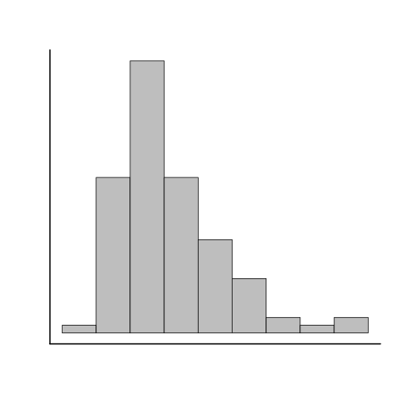
Univariate Probability

Slide 4
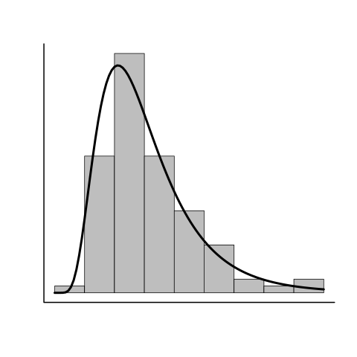
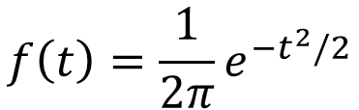
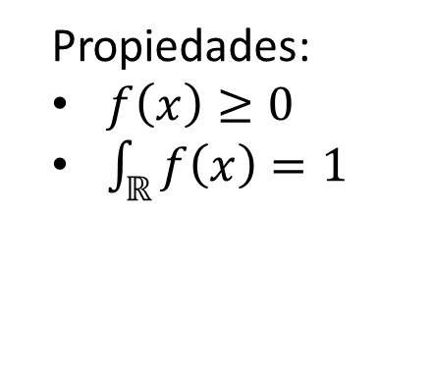
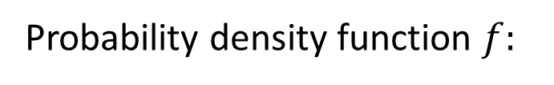
Univariate Probability
Propiedades:
$f\left(x\right)≥0$
$\int_{ℝ}{f\left(x\right)=1}$
Probability density function $f:$
$$f\left(t\right)=\frac{1}{2π}e^{−t^{2}/2}$$

Slide 5
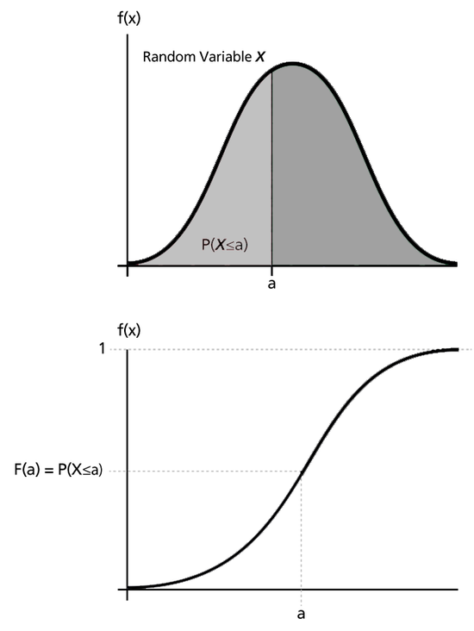
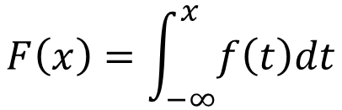
Univariate Probability
$$F\left(x\right)=\int_{−∞}^{x}{f\left(t\right)dt}$$

Slide 6
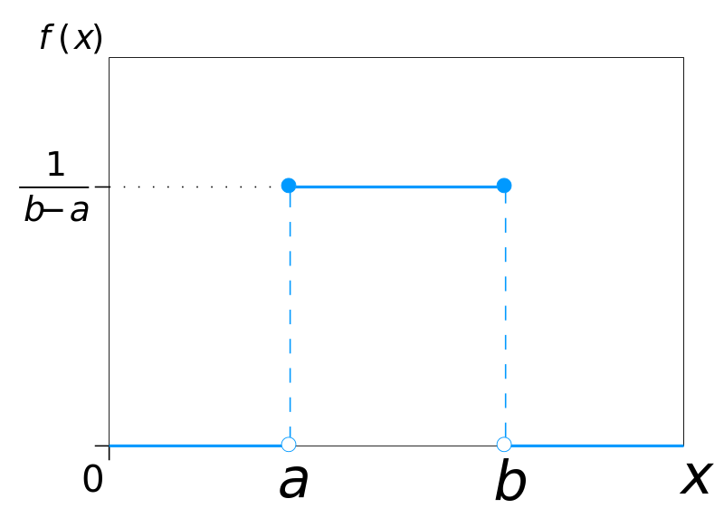
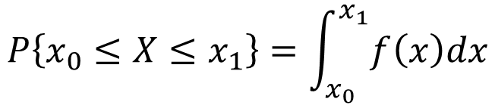
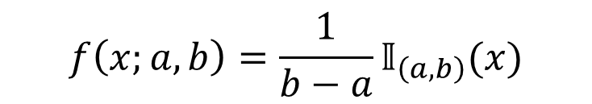
Univariate probability
$$P\left\{x_{0}≤X≤x_{1}\right\}=\int_{x_{0}}^{x_{1}}{f\left(x\right)dx}$$
$$f\left(x;a,b\right)=\frac{1}{b−a}𝕀_{\left(a,b\right)}(x)$$

Slide 7
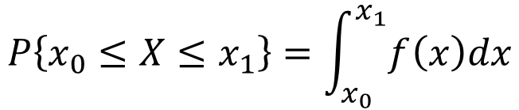
Univariate Probability. The uniform distribution
$$f\left(x;a,b\right)=\frac{1}{b−a}𝕀_{\left(a,b\right)}(x)$$
$$P\left\{x_{0}≤X≤x_{1}\right\}=\int_{x_{0}}^{x_{1}}{f\left(x\right)dx}$$

Slide 8
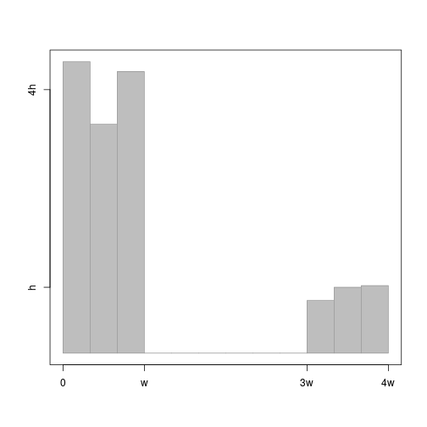
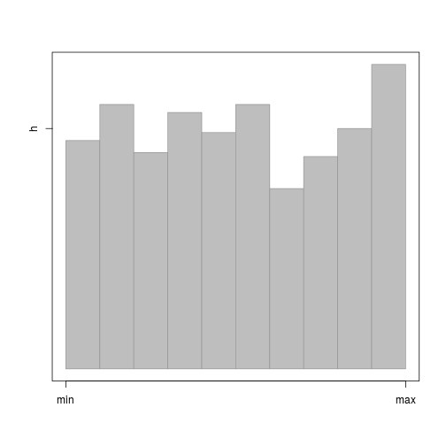
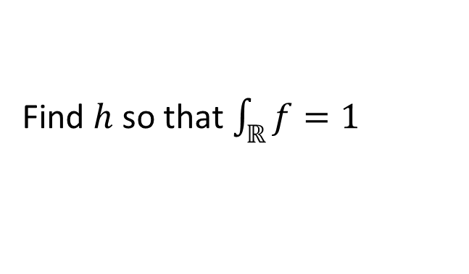
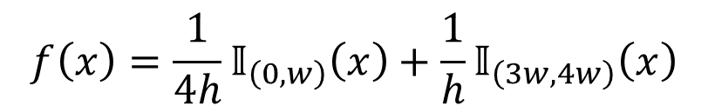
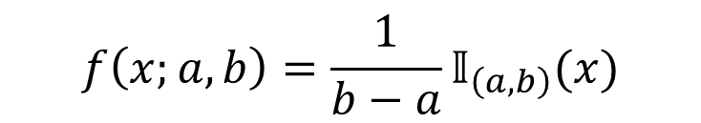
Examples
$$f\left(x;a,b\right)=\frac{1}{b−a}𝕀_{\left(a,b\right)}(x)$$
$$f\left(x\right)=\frac{1}{4h}𝕀_{\left(0,w\right)}\left(x\right)+\frac{1}{h}𝕀_{\left(3w,4w\right)}\left(x\right)$$
Model
Find $h$ so that $\int_{ℝ}{f}=1$
Notes:
Exercise: Algebraically, demonstrate that $\int_{ℝ}{f}=1$

Slide 9
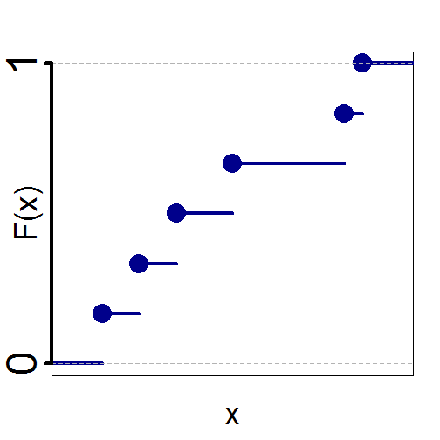
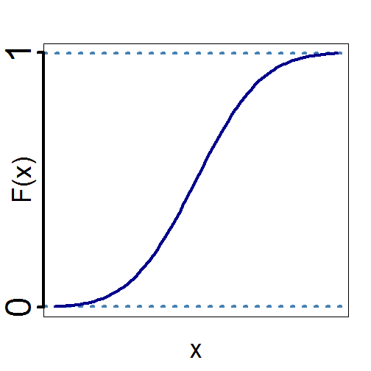
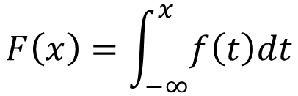
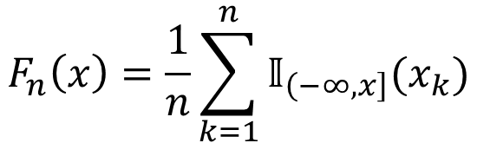
Univariate Probability
$$F_{n}\left(x\right)=\frac{1}{n}\sum_{k=1}^{n}{𝕀_{\left(−∞,x\right]}(x_{k})}$$
$$F\left(x\right)=\int_{−∞}^{x}{f\left(t\right)dt}$$

Slide 10
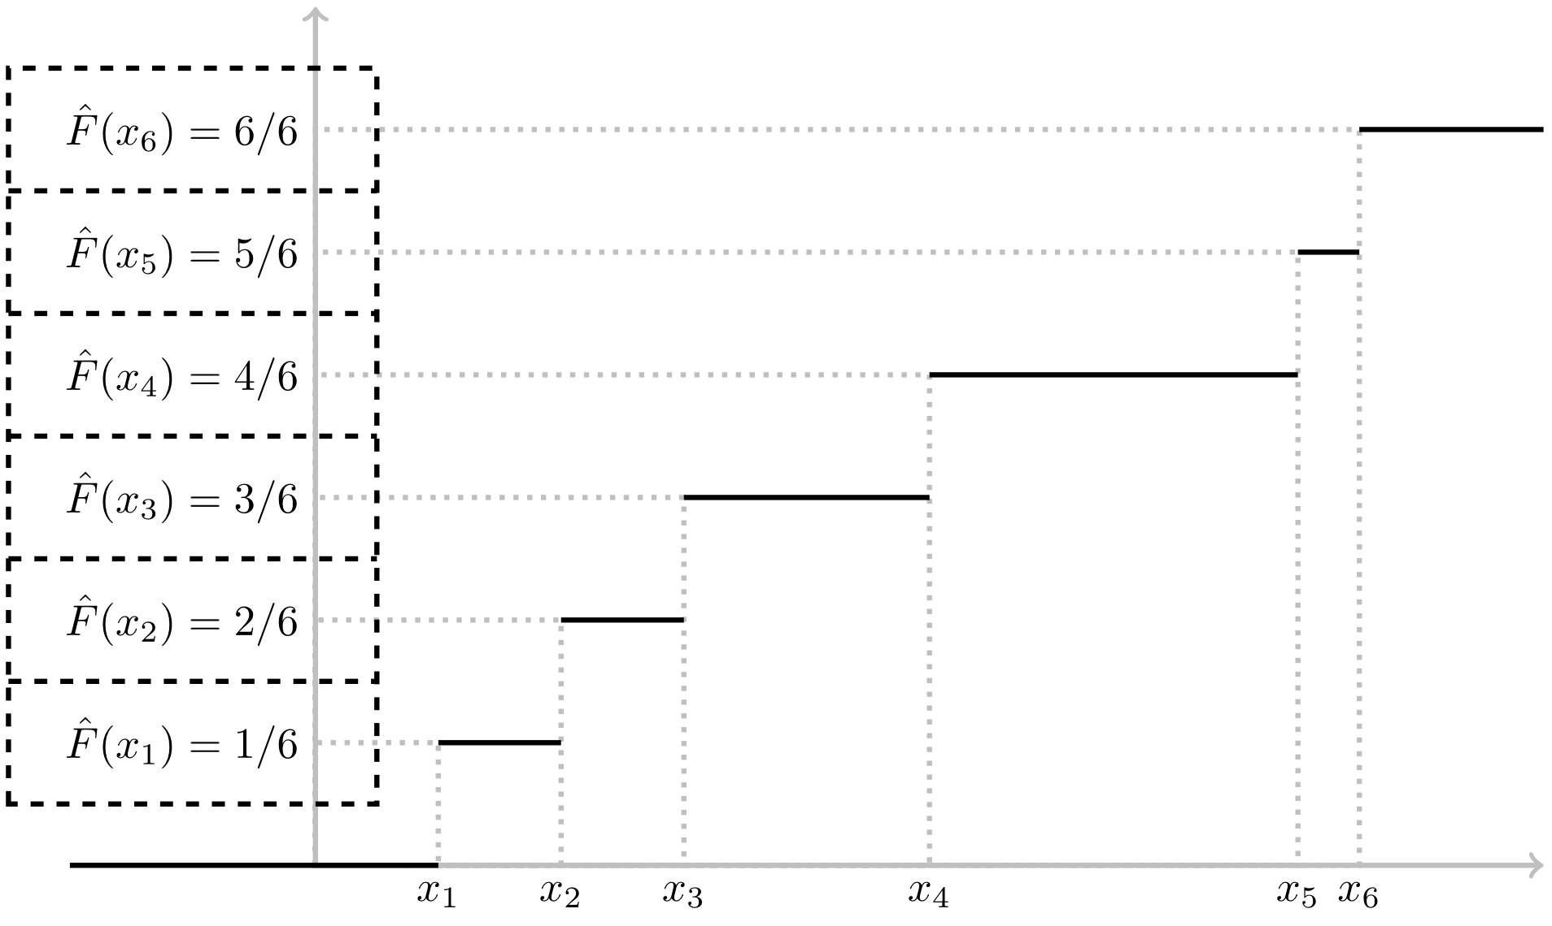
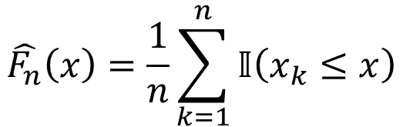
$$\hat{F_{n}}\left(x\right)=\frac{1}{n}\sum_{k=1}^{n}{𝕀\left(x_{k}≤x\right)}$$

Slide 11
Bivariate probability

Slide 12



Bivariate probability ($X⊥Y$)
Joint probability density function $h$:
$$h\left(x,y\right)=f\left(x\right)g\left(y\right)$$
It’s a function of 2 variables, so it can be visualized as in 3D

Slide 13
Example 1

Slide 14
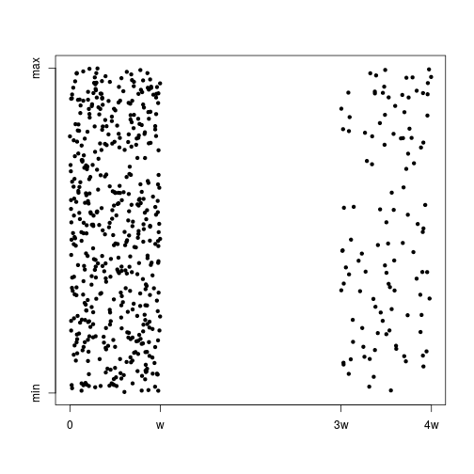
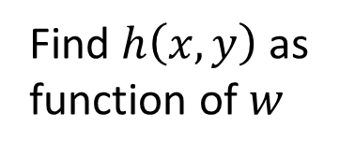
Example 1
Find $h\left(x,y\right)$ as function of $w$

Slide 15
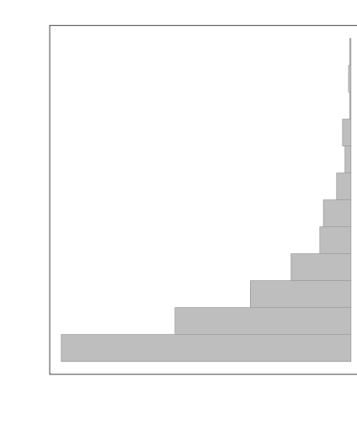
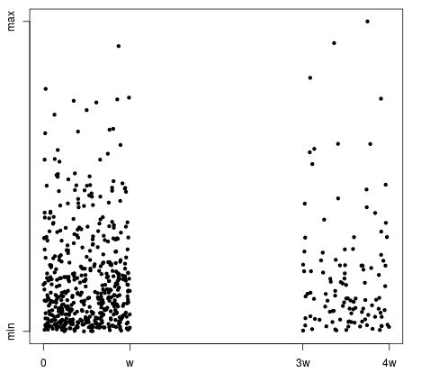
Example 2

Slide 16
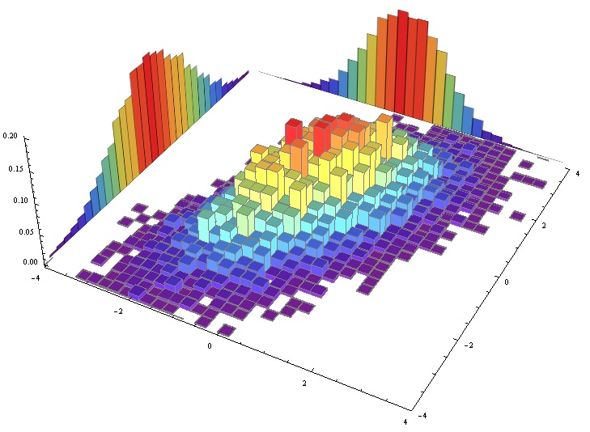

Caso bivariado (independiente)
$$h\left(x,y\right)=f\left(x\right)g\left(y\right)$$

Slide 17
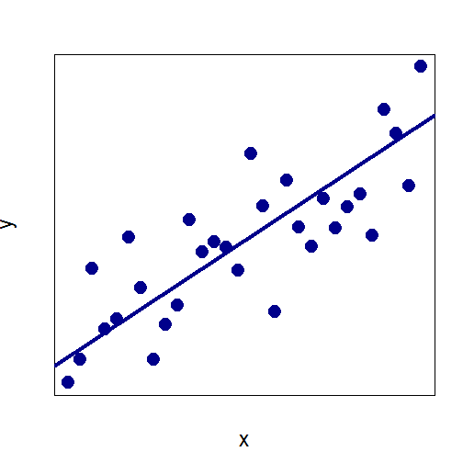
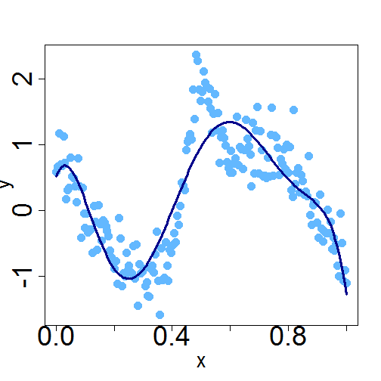
Dependence modeling

Slide 18
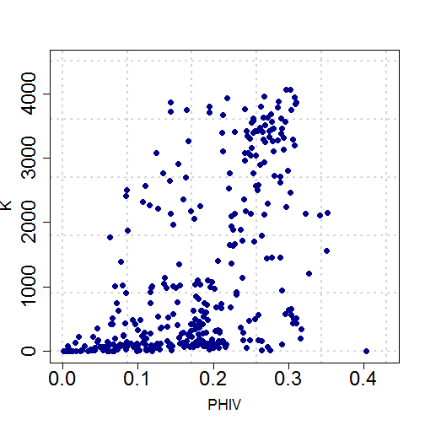
Regression?

Slide 19
Regression? R:Copulas

Slide 20
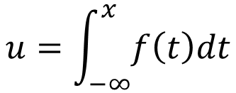

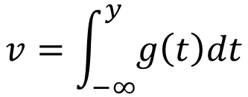
Bivariate case (copulas)
$$h\left(x,y\right)=f\left(x\right)g\left(y\right)c\left(u,v\right)$$
$$u=\int_{−∞}^{x}{f\left(t\right)dt}$$
$$v=\int_{−∞}^{y}{g\left(t\right)dt}$$

Slide 21
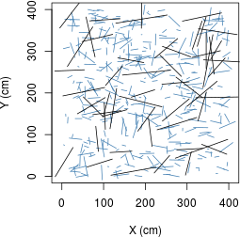
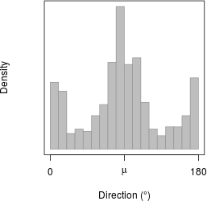
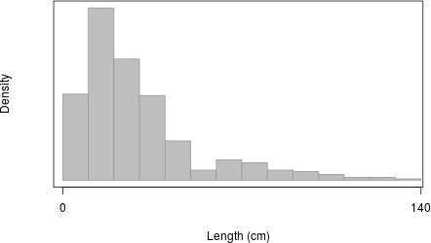
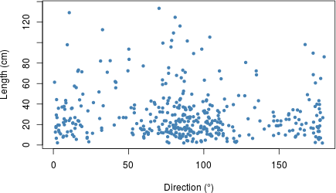
Palillos de Poisson

Slide 22
Palillos de Poisson

Slide 23
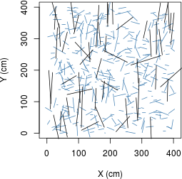
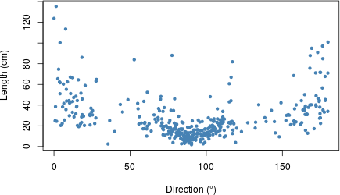
Palillos de Poisson

Slide 24
Comparación

Slide 25
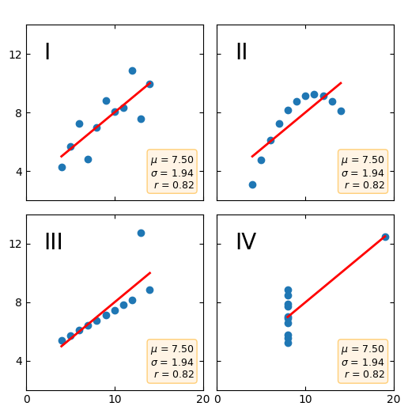
Anscombe’s quartet
Same Pearson Correlation Coefficient in all datasets
https://matplotlib.org/3.2.1/gallery/specialty_plots/anscombe.html

