Slide 1
Supervised vs Unsupervised Learning
By Francisco Mendoza
mentofran@gmail.com

Slide 2


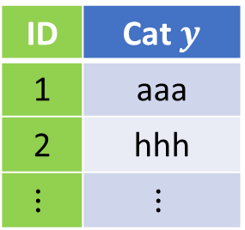

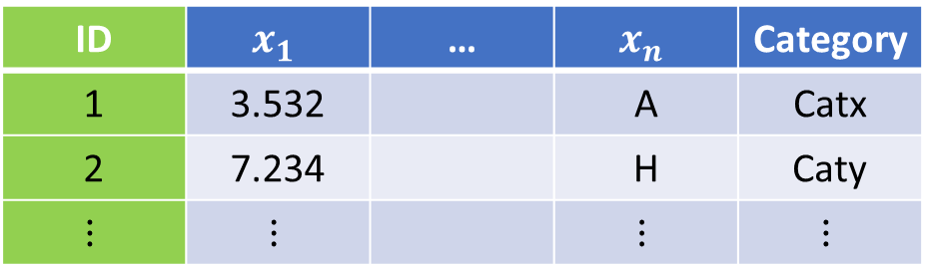


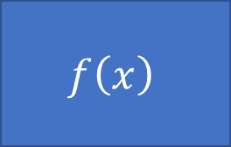

Type of problems, data types
Model
$$f\left(x\right)$$
$$x→y$$
Supervised
$$x$$
$$y$$
$$(x_{1},x_{2},…,x_{n})→y$$
$$(x_{1},x_{2},…,x_{n})→(y_{1},y_{2},…,y_{k})$$
$$f:X→Y$$
Unsupervised
ID | $$x_{1}$$ | … | $$x_{n}$$ | Category
1 | 3.532 |  | A | Catx
2 | 7.234 |  | H | Caty
$$⋮$$ | $$⋮$$ |  | $$⋮$$ | $$⋮$$
ID | Cat $y$
1 | aaa
2 | hhh
$$⋮$$ | $$⋮$$
Notes:
Continuous, Ordinal, categorical (a.k.a. nominal) binary as example of categorical, likert.
Ordinal: bad, regular, good, excellent
Categorical: Red, Green, Blue
ordinal = ordered "categorical" interval = equally spaced ordinal vars. ratio = interval variables with zero
Truncated, censored, compositional
Truncated data is data with intervals removed. Censored is data in which data falling in a given interval are grouped.
https://www.theanalysisfactor.com/the-difference-between-truncated-and-censored-data/

Slide 3
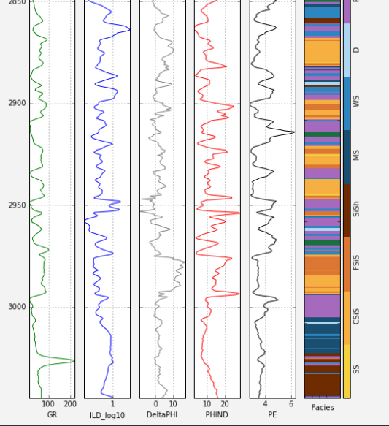
Supervised Vs Unsupervised learning
https://www.leouieda.com/talks/tgif2018.html

Slide 4
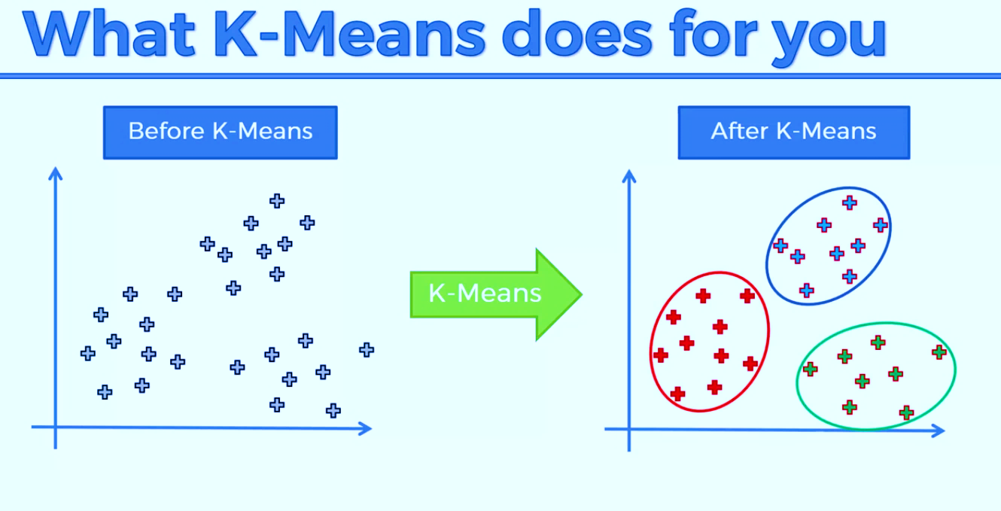
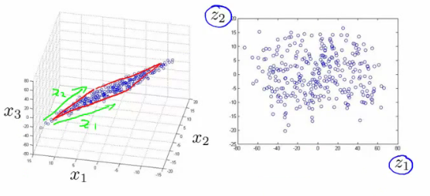
Unsupervised learning
Clustering
K-means
DBSCAN
Hierarchical Cluster Analysis
Visualization and dimensionality reduction
Principal Component Analysis (PCA)
Locally-Linear Embedding (LLE)
t-distributed Stochastic Neighbor Embedding (t-SNE)
Clustering

Slide 5
K-means

Slide 6
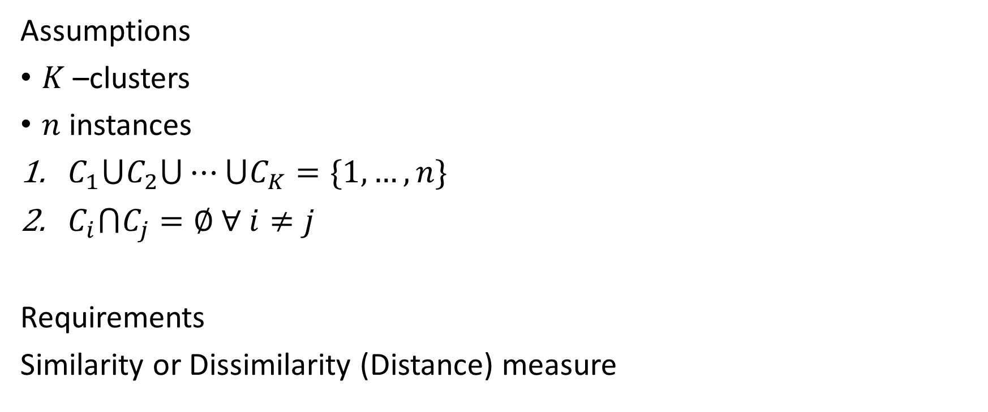

K-means
$K$-means
Assumptions
$K$ –clusters
$n$ instances
$C_{1}⋃C_{2}⋃⋯⋃C_{K}=\{1, …,n\}$
$C_{i}⋂C_{j}=∅$ $∀ i≠j$
Requirements
Similarity or Dissimilarity (Distance) measure
Notes:
1. Each observation belongs to at least one of the K clusters.
2. The clusters are nonoverlapping: no observation belongs to more than one cluster.

Slide 7


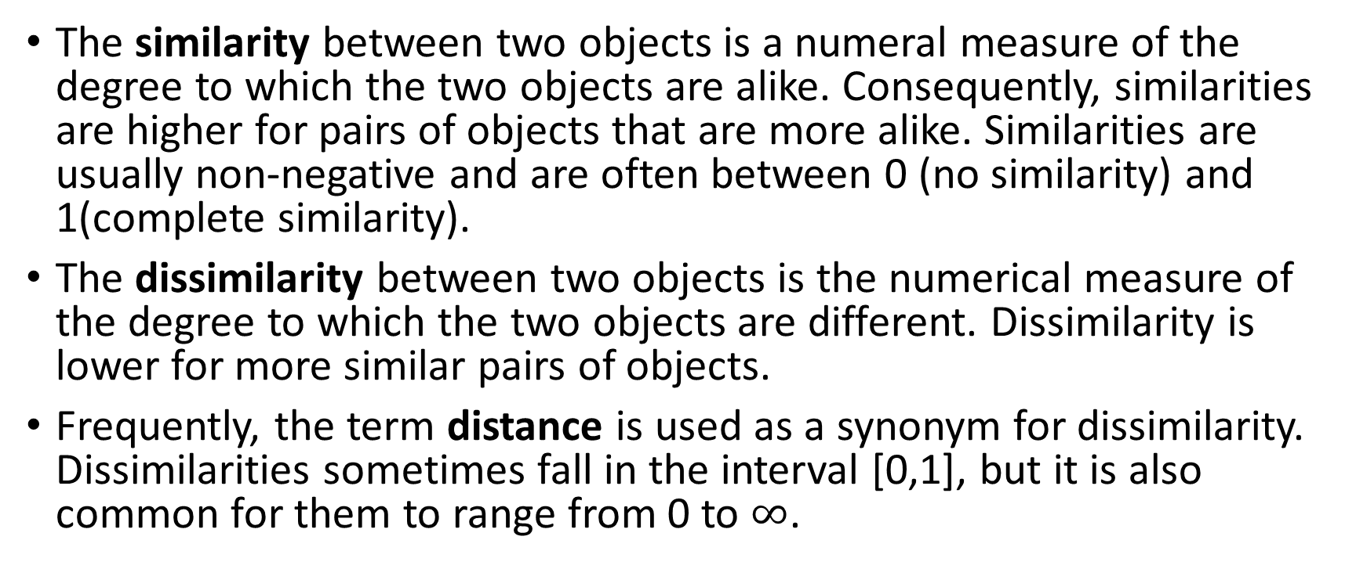

Similarity vs Dissimilarity
The similarity between two objects is a numeral measure of the degree to which the two objects are alike. Consequently, similarities are higher for pairs of objects that are more alike. Similarities are usually non-negative and are often between 0 (no similarity) and 1(complete similarity).
The dissimilarity between two objects is the numerical measure of the degree to which the two objects are different. Dissimilarity is lower for more similar pairs of objects.
Frequently, the term distance is used as a synonym for dissimilarity. Dissimilarities sometimes fall in the interval [0,1], but it is also common for them to range from 0 to $∞$.
$$b$$
$$a$$
$$c$$

Slide 8
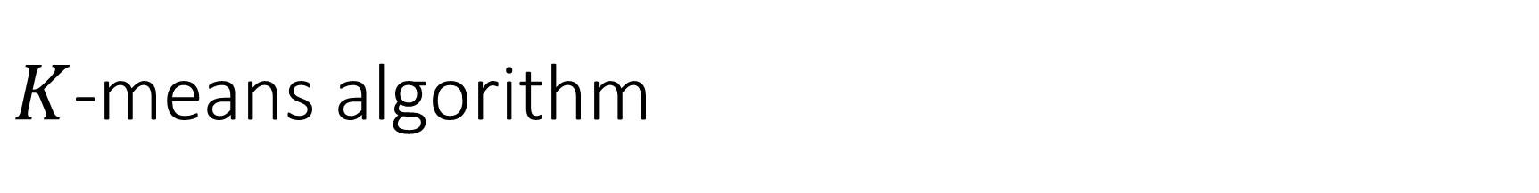
$K$-means algorithm
Bishop, 2007. Fig. 9.1

Slide 9
$K$-means algorithm
Bishop, 2007. Fig. 9.1

Slide 10
$K$-means algorithm
Bishop, 2007. Fig. 9.1

Slide 11
$K$-means algorithm
Bishop, 2007. Fig. 9.1

Slide 12
$K$-means algorithm
Bishop, 2007. Fig. 9.1

Slide 13
$K$-means algorithm
Bishop, 2007. Fig. 9.1

Slide 14
$K$-means algorithm
Bishop, 2007. Fig. 9.1

Slide 15
$K$-means algorithm
Bishop, 2007. Fig. 9.1

Slide 16
$K$-means algorithm
Bishop, 2007. Fig. 9.1

Slide 17
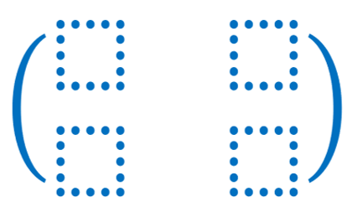


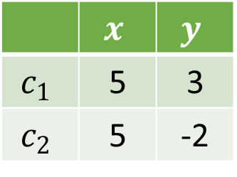
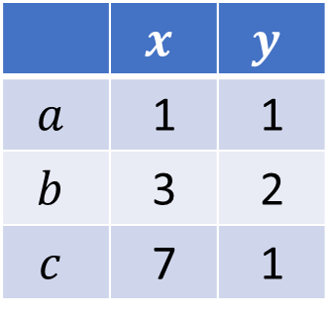

Exercise
Data
Initial Centroids
 | $$x$$ | $$y$$
$$a$$ | 1 | 1
$$b$$ | 3 | 2
$$c$$ | 7 | 1
 | $$x$$ | $$y$$
$$c_{1}$$ | 5 | 3
$$c_{2}$$ | 5 | -2
$$b$$
$$a$$
$$c$$
>_ Code

Slide 18
Homework assignment
Generate a dataset with 3 groups and then use sklearn.cluster.Kmeans() to get clusters of the dataset.
sklearn.cluster.KMeans()
https://blog.floydhub.com/introduction-to-k-means-clustering-in-python-with-scikit-learn/

