Slide 1
Generative AI from First Principles
Lecture 2: Language Modeling
From Counts to Neural Networks
Notes:
Title.

Slide 2
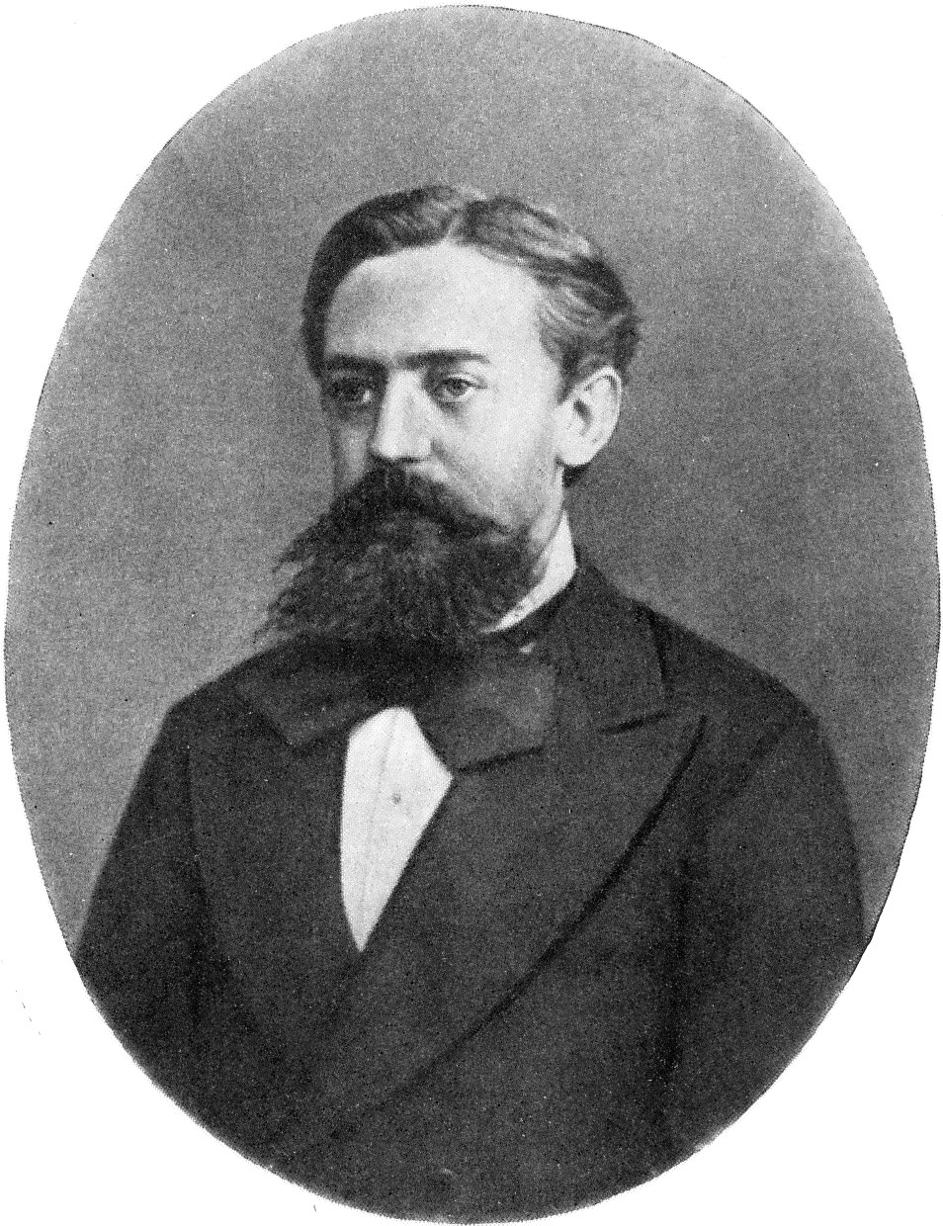
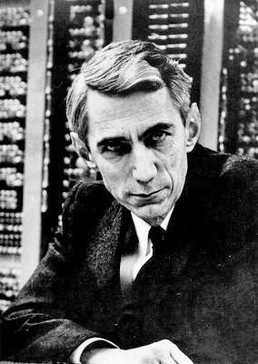
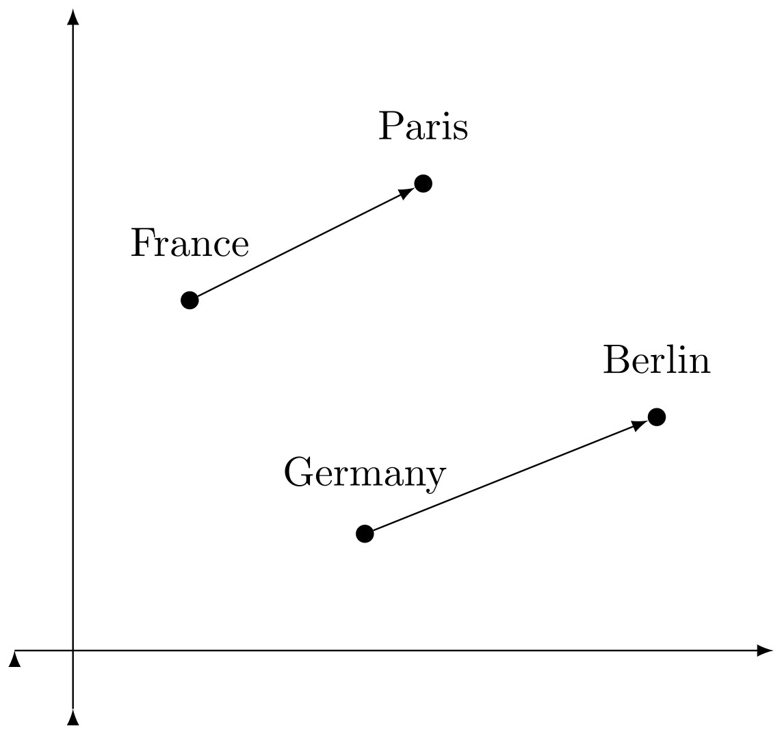
Language Modeling: From Counts to Neural Networks
Two ideas, older than neural networks
Text is a random source
Markov (1913), Shannon (1948): count what follows what, and measure how predictable text is
→ n-gram models: speech recognition and translation for decades
Words are points in a space
a word is known by the company it keeps: similar contexts, nearby vectors
→ semantic search, recommendation, vector databases
Andrey Markov
Claude Shannon
Neural language models join the two
predict the next token, as counting does, but from learned vectors
Notes:
What the lecture is about. A language model assigns probabilities to strings; Lecture 1 defined it, today we build it, first by counting and then with neural networks. Two ideas older than neural networks run through it. Text as a random source: Markov (1913) and Shannon (1948) treated text as the output of a random process whose statistics can be counted and whose predictability can be measured; counting what follows each context gives the n-gram models that ran speech recognition and machine translation for decades. Their obstacle: almost every long context is new. Words as points in a space: a word is characterized by the company it keeps, so words used in similar contexts get nearby vectors; these embeddings power semantic search, vector databases, and recommendation. Neural language models join the two: they predict the next token, as n-gram models do, but from learned vectors, so what is learned about one context carries over to similar ones. Pictures, Wikimedia Commons: AAMarkov.jpg (public domain); ClaudeShannon MFO3807.jpg (Konrad Jacobs, CC BY-SA 2.0 de); Word embedding illustration.svg (Fschwarzentruber, CC BY-SA 4.0).

Slide 3
Lecture 2: Language Modeling: From Counts to Neural Networks
1. Counting: text as a random source
Markov and Shannon; tokens; the language model as a tree
n-gram models; measuring a model; smoothing
2. Word embeddings: words as points in a space
why vectors, and where they are used
vectors from counts and from prediction (word2vec), and why they meet
what similarity captures, and what it misses
3. Neural language models: from the bigram network to the LSTM
the bigram network; Bengio's fixed window
recurrent networks: backpropagation through time, vanishing gradients
the additive path; the LSTM
Notes:
Part 1: counting, quickly (about 25 minutes, with the first notebook stop).

Slide 4
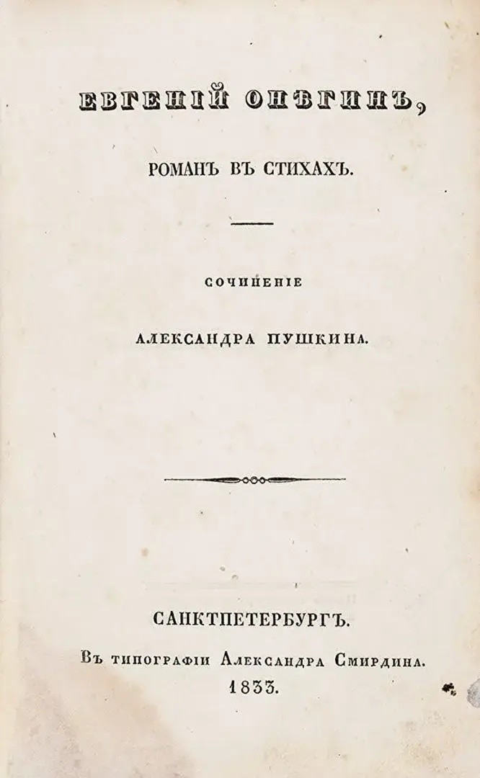
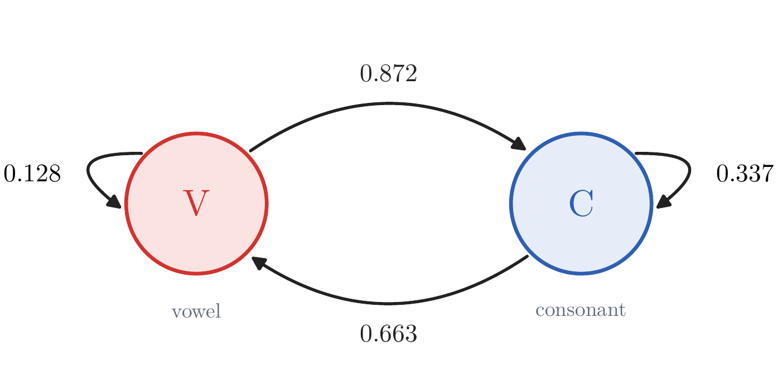
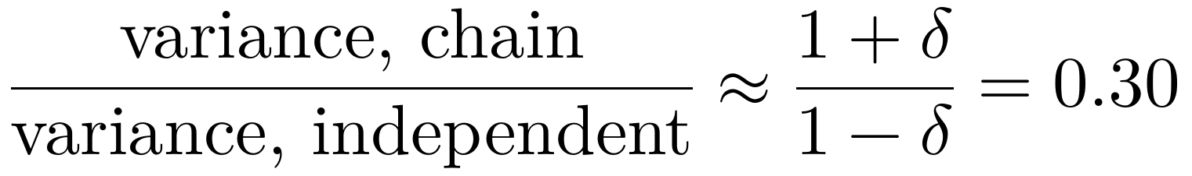
Text as a Random Source
Markov, 1913: text as a chain
1906: the law of large numbers holds for chains, not only for independent trials
1913: a test on Eugene Onegin: 20,000 letters, each a vowel or a consonant
vowel pairs: 1,104, where independent letters give ≈ 3,730
the next letter depends on the last
a prediction: vowels per 100-letter block vary less than coin tosses
A. A. Markov
Eugene Onegin
poem: 0.21
Notes:
Notes §1 and §A.1. Markov was answering Nekrasov, who claimed the law of large numbers needs independent trials; Markov proved in 1906 that a chain suffices and in 1913 used the poem as a test. Ask first: if letters were independent, how many vowel pairs? 20,000 × 0.432² ≈ 3,730. He counted 1,104. The chain built from these counts predicts how much the vowel count varies across 100-letter blocks: 0.30 of the independent value, observed 0.208 (a chain on two letters: 0.195). Pictures, Wikimedia Commons: AAMarkov.jpg (public domain); Eugene Onegin book edition.jpg (JohnnysNewCar, CC0).

Slide 5
Text as a Random Source
Shannon, 1948: more context, better text
letters, n = 1 ari ef o eheiowamna wactifp oe nu,laoo.smnse
letters, n = 3 saw heir he up boalk. stim. her frod their wore
letters, n = 5 once upon a tim. the pot. john and warned the
letters, n = 7 once upon a time for you are going to eat her smile.
words, n = 3 ben liked to eat some bread, cheese and ate their delicious desserts
Claude Shannon
letters or words?
Notes:
Notes §1. Shannon (1948) generated text from approximations to English with more and more context; here the same with character and word models of TinyStories. Order n: the next symbol is chosen from the previous n − 1. Shannon used letters and words; which units to use is the next slide. Pictures, Wikimedia Commons: ClaudeShannon MFO3807.jpg (Konrad Jacobs, CC BY-SA 2.0 de).

Slide 6
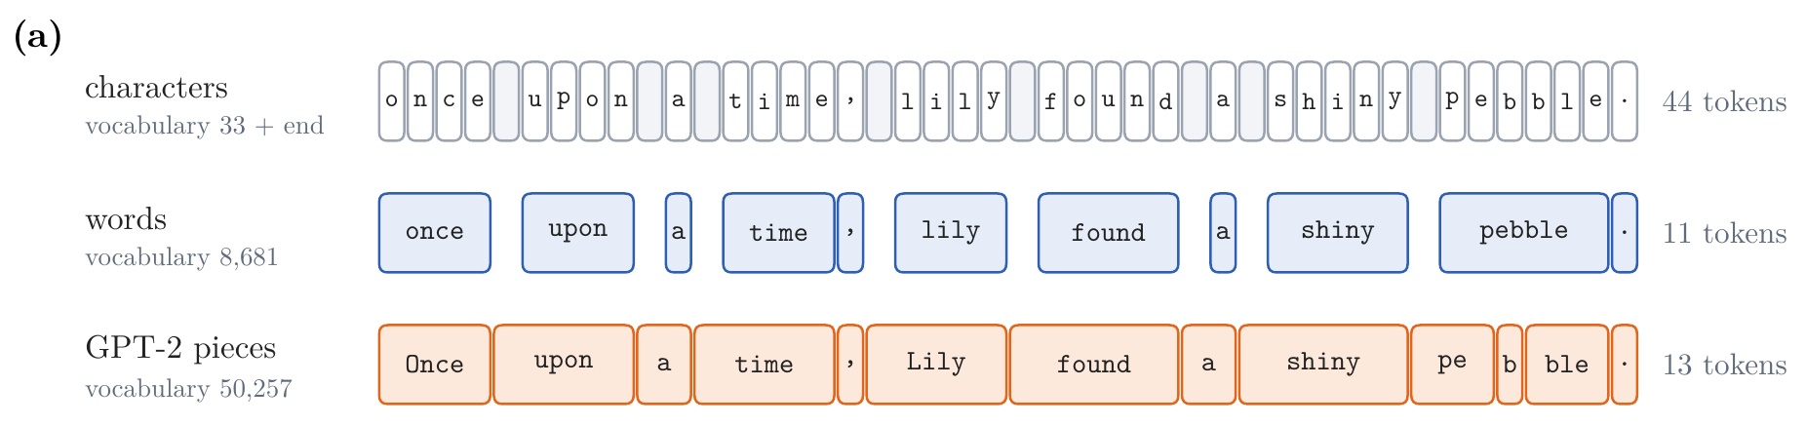
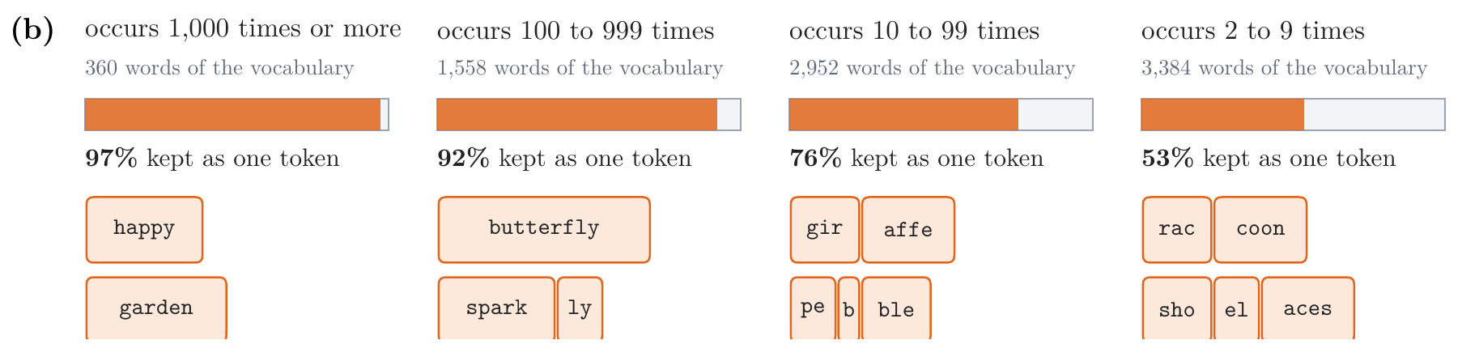
Text as a Random Source
Tokens: characters, words, or pieces
Notes:
Notes §1, 'Tokens: characters, words, or pieces', Figure 1. Shannon used letters and words; models choose a vocabulary of tokens. Characters: 33 plus the end symbol. Words: 8,681 with <unk> and EOS. GPT-2: 50,257 byte-level pieces (Week 4). Frequent words stay whole, rare words are split.

Slide 7
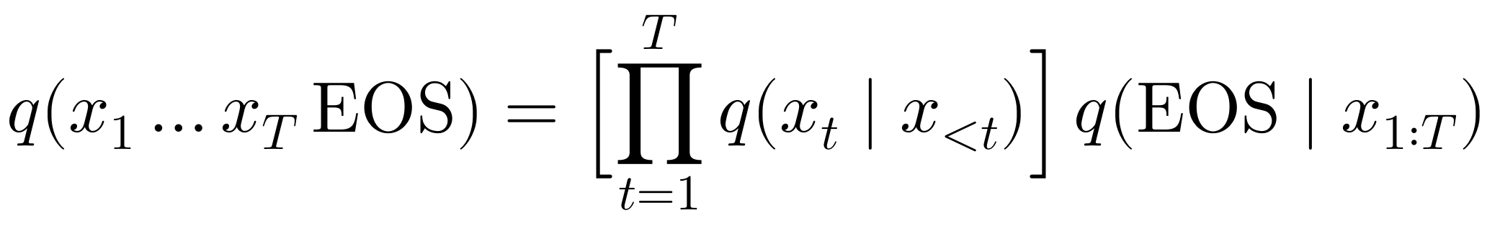
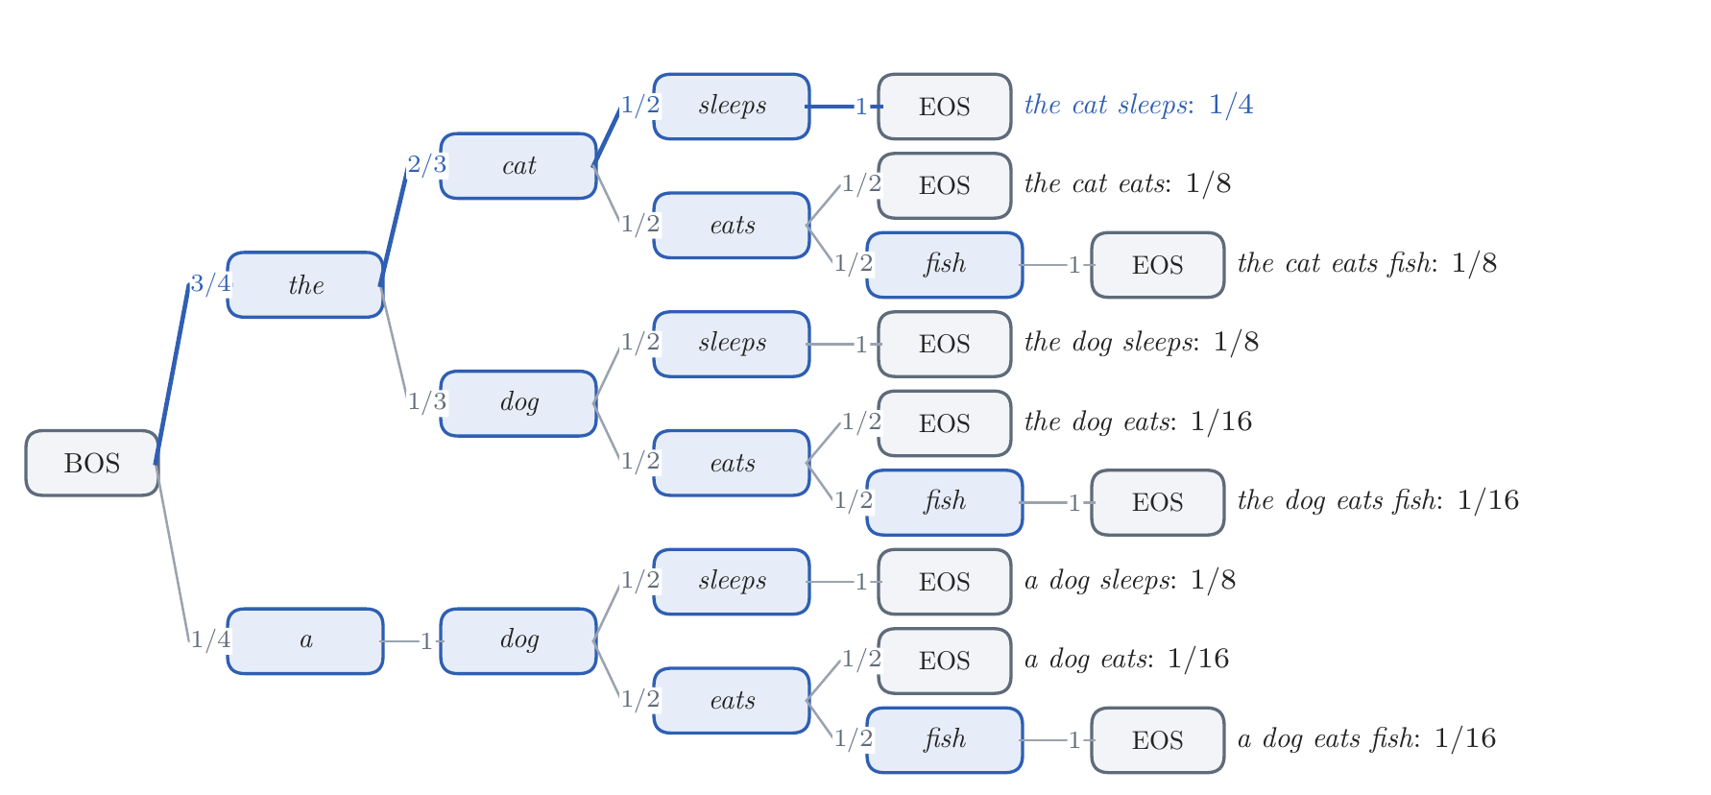
Text as a Random Source
The language model, one token at a time
BOS: the start, given
EOS: the stop, predicted
corpus
the cat sleeps
the cat eats fish
the dog sleeps
a dog eats
the bigram model of the corpus: every sentence is a path, and the paths' probabilities sum to one
Notes:
Notes §1, the chain rule, BOS and EOS, Figure 2a. The chain rule is an identity. BOS is the context of the first prediction; EOS is predicted and ends the string, so complete strings get their own probabilities. The tree is the bigram model of the four sentences: every complete sentence is a path, leaves at different depths, total one.

Slide 8
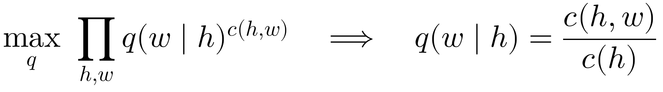
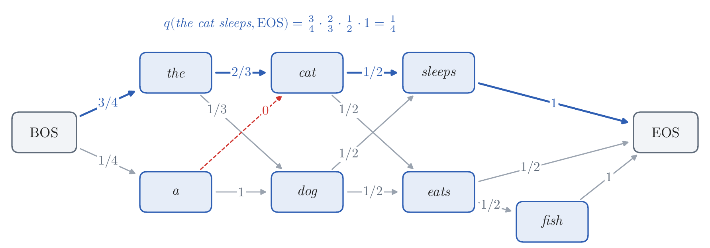
n-gram Language Models
Count and divide: maximum likelihood
keep only the last n − 1 tokens
maximum likelihood = relative frequencies
Notes:
Notes §2, Figure 2b. Board work: the Lagrange derivation of c(h,w)/c(h): maximize the sum of c(h,w) log q(w|h) subject to each row summing to one. The chain is the same model as the tree, with the nodes that end in the same word merged.

Slide 9
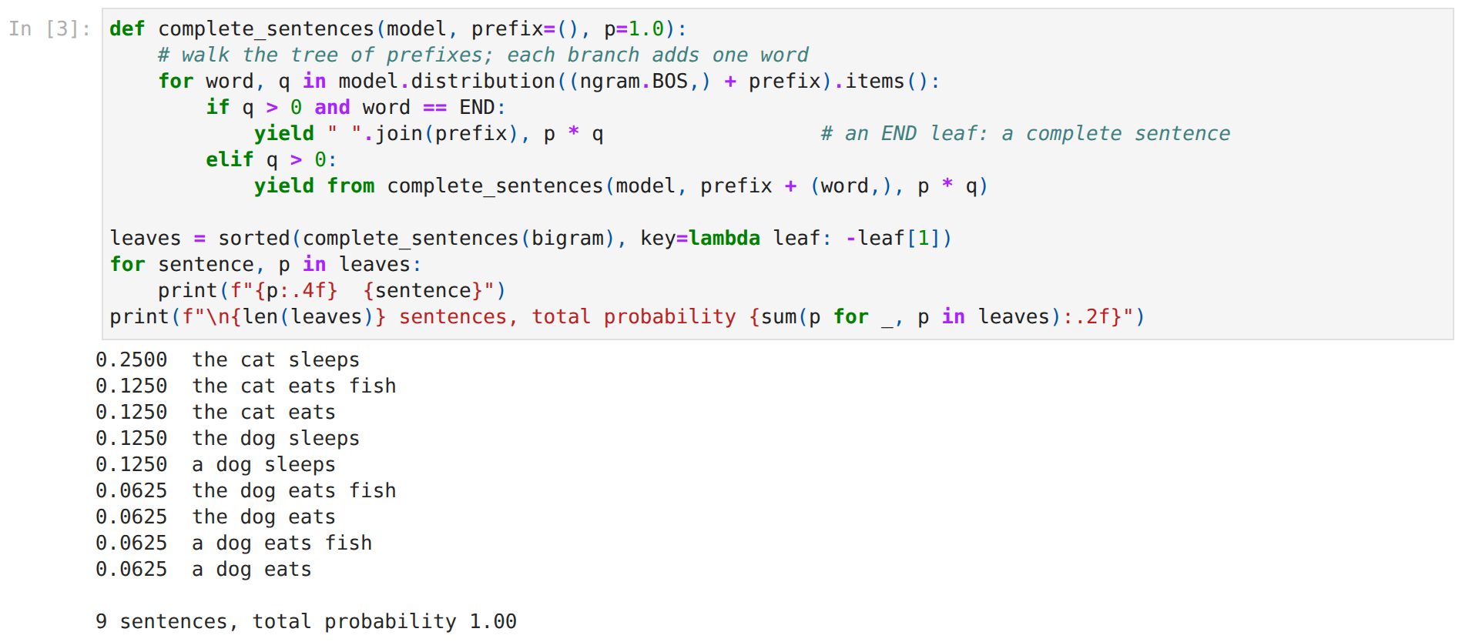
Hands-on: Counting
week02_handson.ipynb, stop 1
watch: a cat sleeps is not in the tree
Notes:
Stop 1 of the in-class notebook: the count table (ask for the word after 'the' first), the tree of nine complete sentences, sampling, Shannon's experiment (n = 1, 2, 3, 5, 7).

Slide 10
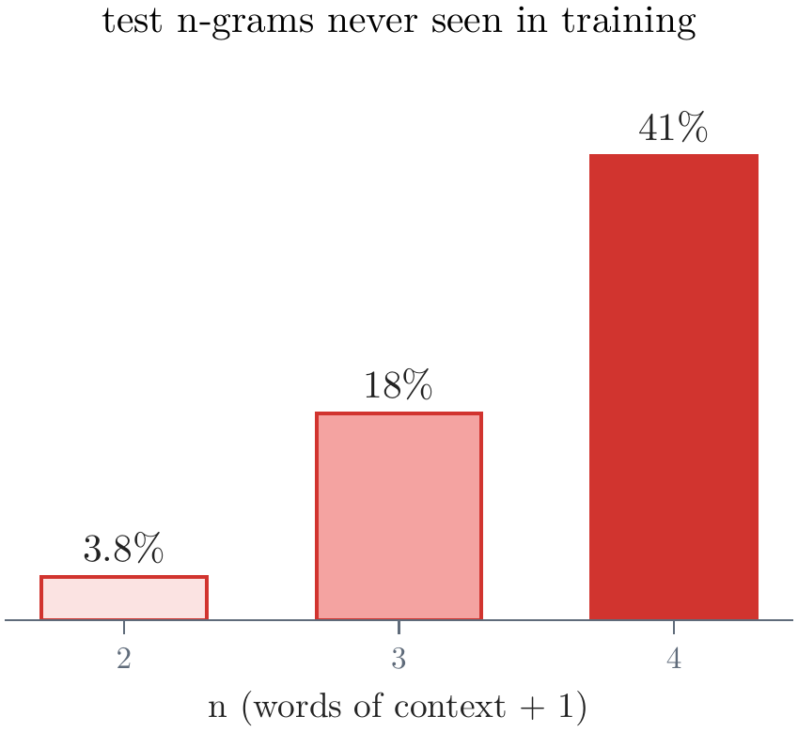
n-gram Language Models
Sparsity: the trouble with counting
a cat sleeps: probability 0
longer context: better guesses, fewer counts
which wins? we need a score
Notes:
Notes §2, 'Sparsity'. 6.5 × 10¹¹ possible trigrams over 8,681 words; 3.6 million training words. Smoothing only helps; the real question is which effect wins, more context or fewer counts: we need a score.

Slide 11
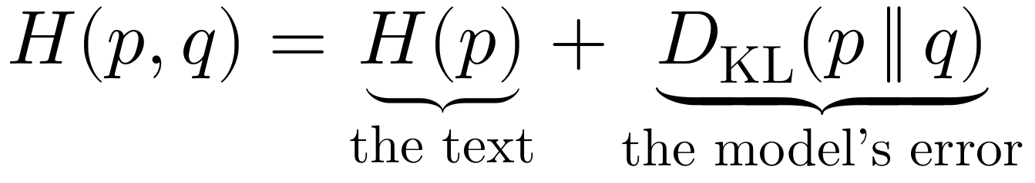
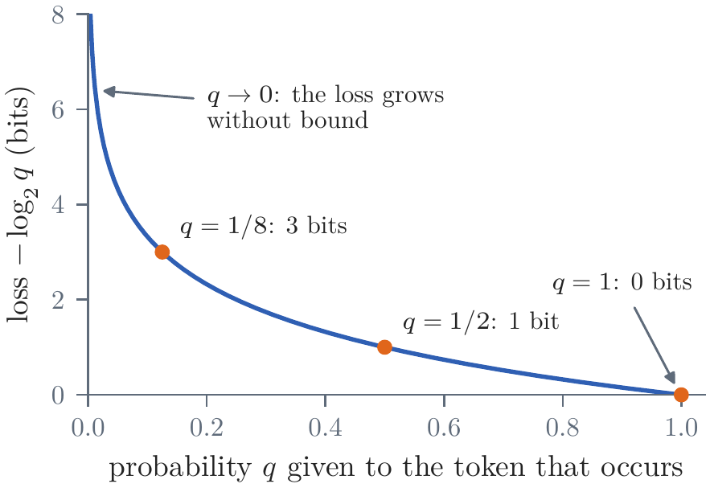
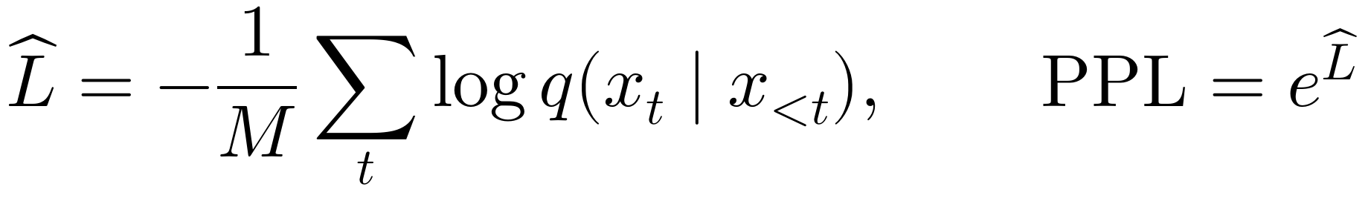
Measuring a Language Model
Log loss, cross-entropy, perplexity
on held-out text
perplexity: as uncertain as a fair K-sided die
words: unigram 300 → Kneser–Ney 4-gram 25
bits per character: the average loss in bits, per character
Notes:
Notes §3, Figure 3. Log loss of a prediction: −log₂ of the probability given to the token that occurred; of a text, the sum, −log₂ q(text) by the chain rule. Measure on held-out text: on its training text the count table is the best model. Cross-entropy = entropy + KL: training and evaluation minimize the same thing. Perplexity e^(average loss): a uniform choice among K tokens has perplexity K. TinyStories words: unigram 300, Kneser–Ney 4-gram 25. Bits per character for different tokenizers: uniform over 34 symbols 5.09, best character n-gram 1.26.

Slide 12
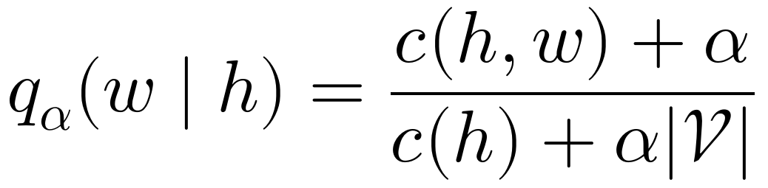
Smoothing
Never give probability zero
add α to every count
TinyStories words
test perplexity | bigram | trigram | 4-gram
no smoothing | ∞ | ∞ | ∞
add-one | 110 | 421
add-α, tuned | 52 | 59
Kneser–Ney | 47 | 28 | 25
α chosen on validation data
Kneser–Ney (1995): borrow from shorter contexts, the best version
Notes:
Notes §4 and §A.2–A.3, very brief: the idea, one formula, the results. Never give probability zero: add α to every count (add-one is α = 1: 'a cat sleeps' gets 1/900 instead of 0), with α chosen on validation data. Better: borrow from shorter contexts (if 'the purple dog' was never seen, 'purple dog' or 'dog' may have been). Kneser–Ney (1995), the best count method, does this; it subtracts a fixed discount of about 0.75 from every count and asks of a word, for the shorter context, after how many different words it occurs (upon: 10,921 times but after only 14 words; toy: 3,223 times after 200). Add-one makes the trigram worse than the bigram (421 against 110); with the same counts, the trigram ranges from infinite to 28 depending on the smoother.

Slide 13
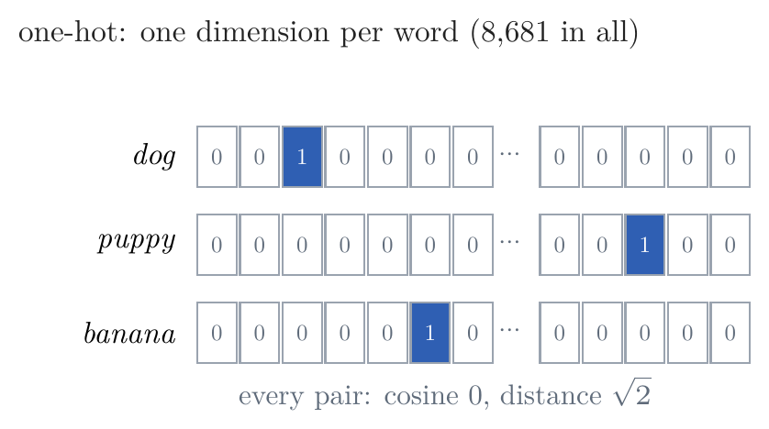
Smoothing
What counting cannot do
the dog barked
the puppy barked
nothing shared
to a table, every word is its own dimension
Notes:
Notes §4, 'What counting cannot do'; the picture is the left panel of Figure 5. To a table a word is an index: two indices are equal or unrelated, so what is learned about 'the dog barked' says nothing about 'the puppy barked'. We need a representation in which words can be similar: part 2.

Slide 14
Lecture 2: Language Modeling: From Counts to Neural Networks
1. Counting: text as a random source
Markov and Shannon; tokens; the language model as a tree
n-gram models; measuring a model; smoothing
2. Word embeddings: words as points in a space
why vectors, and where they are used
vectors from counts and from prediction (word2vec), and why they meet
what similarity captures, and what it misses
3. Neural language models: from the bigram network to the LSTM
the bigram network; Bengio's fixed window
recurrent networks: backpropagation through time, vanishing gradients
the additive path; the LSTM
Notes:
Part 2: word embeddings, the big block (about 30 minutes, with the second notebook stop).

Slide 15
Word Embeddings
The company a word keeps
A bottle of tezgüino is on the table.
Everybody likes tezgüino.
Tezgüino makes you drunk.
We make tezgüino out of corn.
What is tezgüino?
Harris, 1954: similar contexts, similar meanings
Firth, 1957: “You shall know a word by the company it keeps.”
Notes:
Notes §5 and Lecture 1, Section 6. The tezgüino example is Lin (1998), after Nida (1975). Nobody defined the word, yet everyone knows it is an alcoholic drink made from corn. Harris (1954): differences of meaning correlate with differences of distribution. Firth (1957): 'You shall know a word by the company it keeps.'

Slide 16
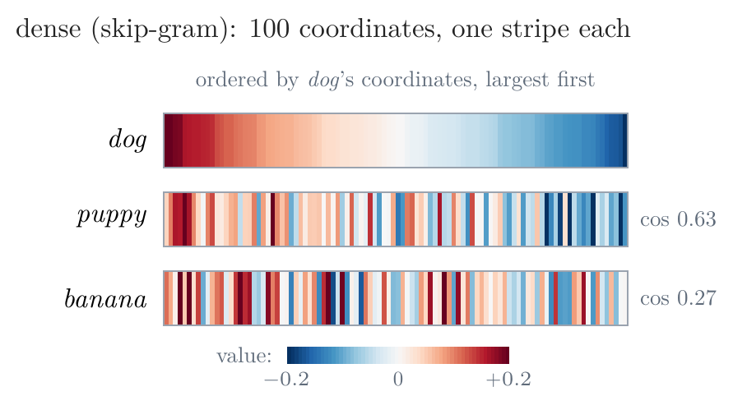
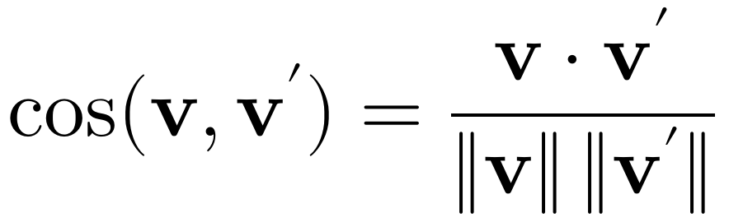
Word Embeddings
Why vectors
one-hot: all words equally far apart
dense: similar words point the same way
Notes:
Notes §5, 'Why vectors', Figure 5. One-hot vectors are all orthogonal, sqrt 2 apart. Dense vectors: 50 to 1,000 numbers; nearness by cosine (the angle; length mostly tracks frequency). In the stripes, dog's coordinates are ordered from largest to smallest; puppy follows the trend (cosine 0.63), banana does not (0.27).

Slide 17
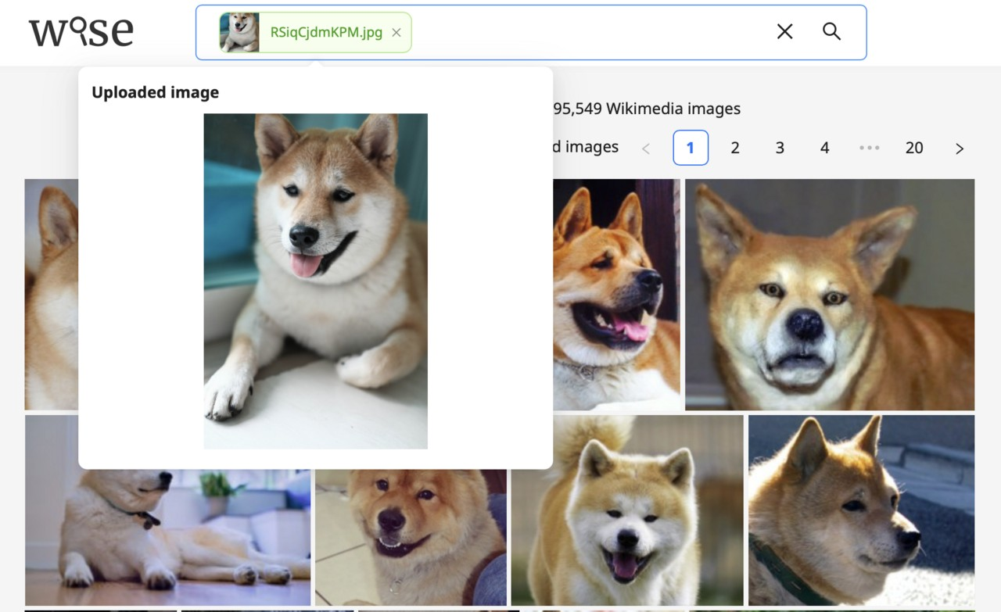

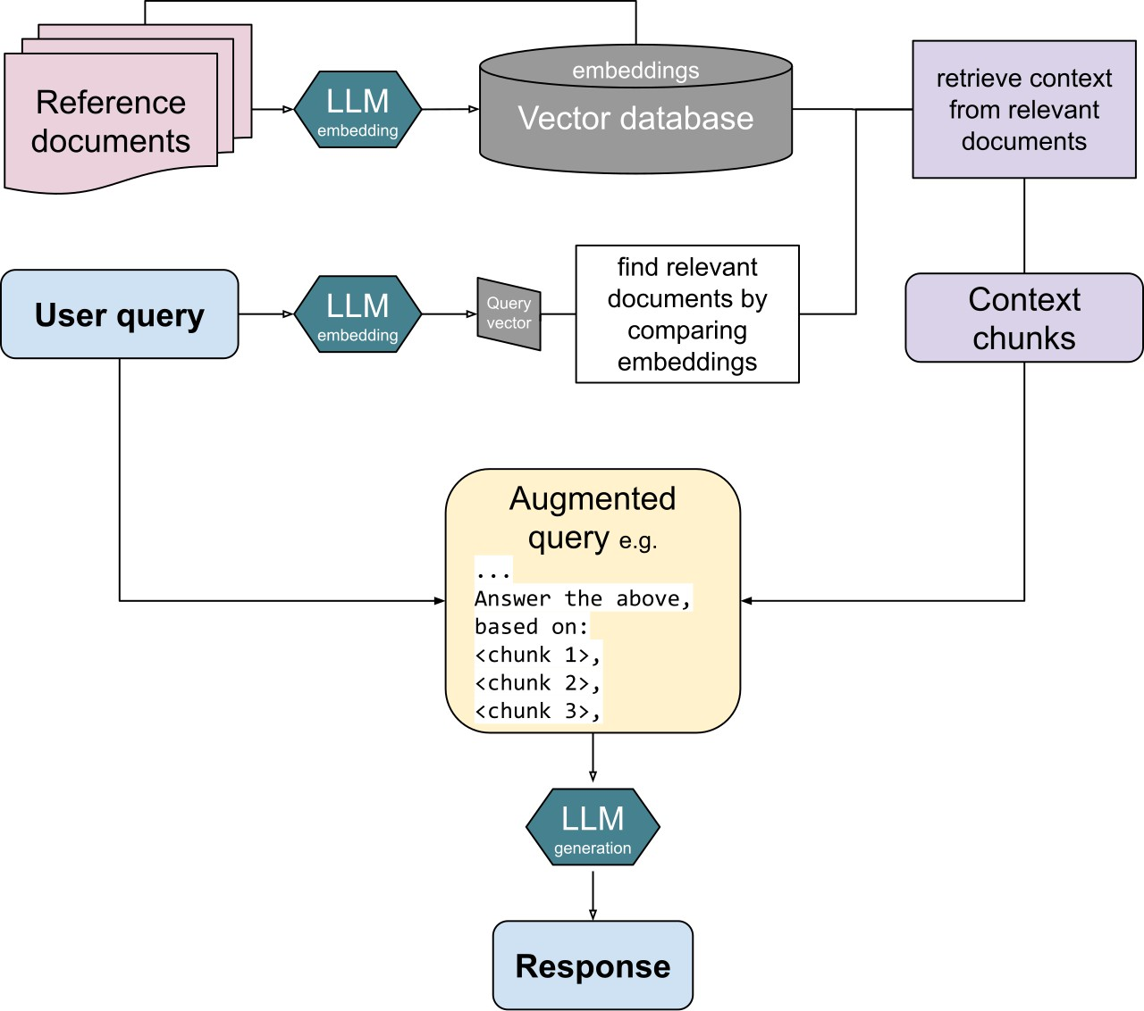
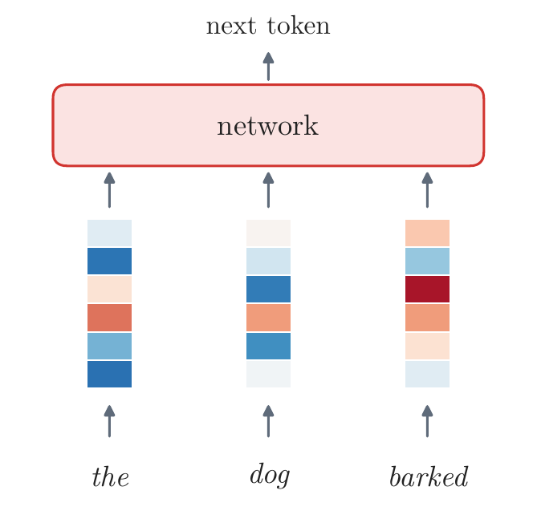
Word Embeddings
Where embeddings are used
search
recommendation
retrieval
language models
by meaning, not keywords
items as words
nearest passages for an assistant
a vector per token, the first layer
one recipe: objects in similar contexts get nearby vectors
Notes:
Notes §5, 'Where embeddings are used'. Search: dense retrieval, sentence embeddings; the picture is WISE, an image search engine of Oxford's VGG. Recommendation: sessions as sentences, items as words (Airbnb listings, Grbovic and Cheng 2018). Vector databases: approximate nearest neighbors (hashing, quantization, graphs); retrieval-augmented generation. Language models: every one starts with a table of token vectors. Pictures, Wikimedia Commons: Wise-search-engine-visual similarity search.png (Sridhar, Lee, Dutta, and Zisserman, Apache License 2.0); Woman online shopping concept (Artem Beliaikin, CC BY 2.0); RAG diagram.svg (Turtlecrown, CC BY-SA 4.0).

Slide 18
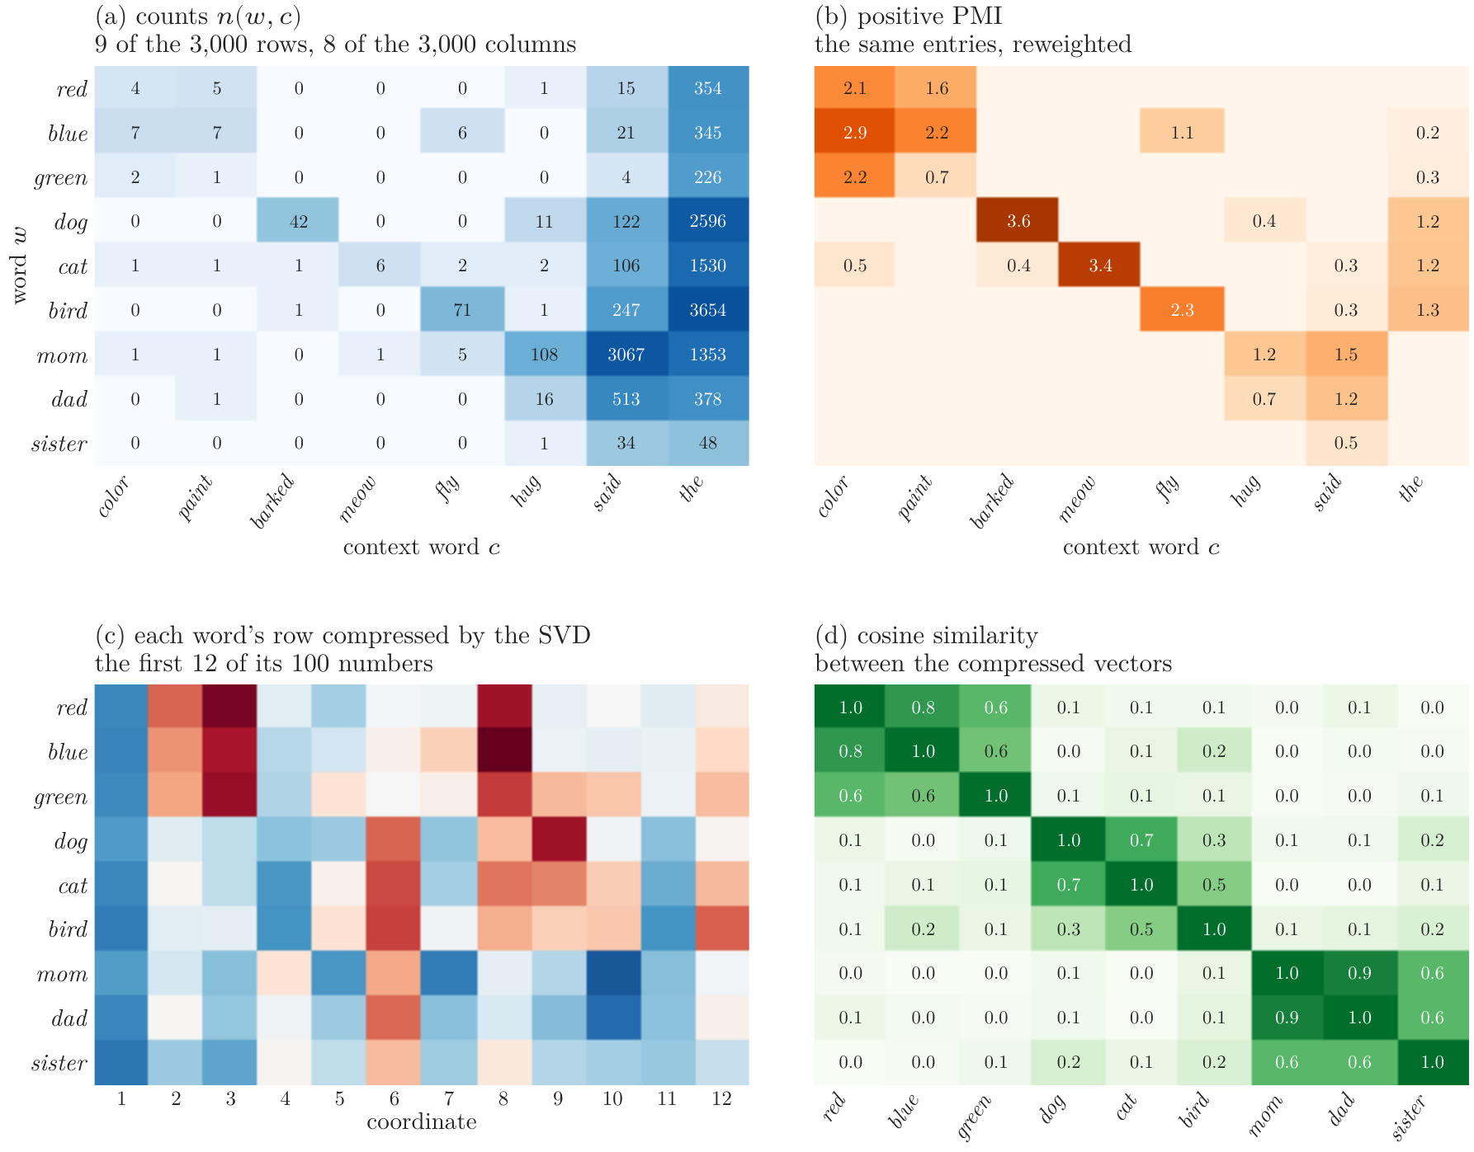
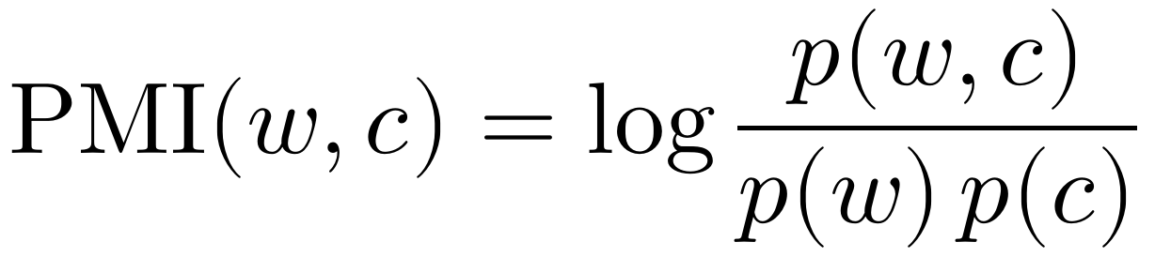
Word Embeddings
Vectors from counts
count: who occurs near whom
reweight by PMI
compress by SVD
mom → dad, mommy, mother
Notes:
Notes §5, 'Vectors from counts', Figure 6. Count how often c occurs within two words of w (3,000 × 3,000); reweight by PMI (ice cream 6.7, the dog 1.2 despite 2,596 pairs, happy sad −2.2); keep 100 numbers per word by a truncated SVD. Neighbors: mom → dad, mommy, mother; red → blue, yellow, green.

Slide 19
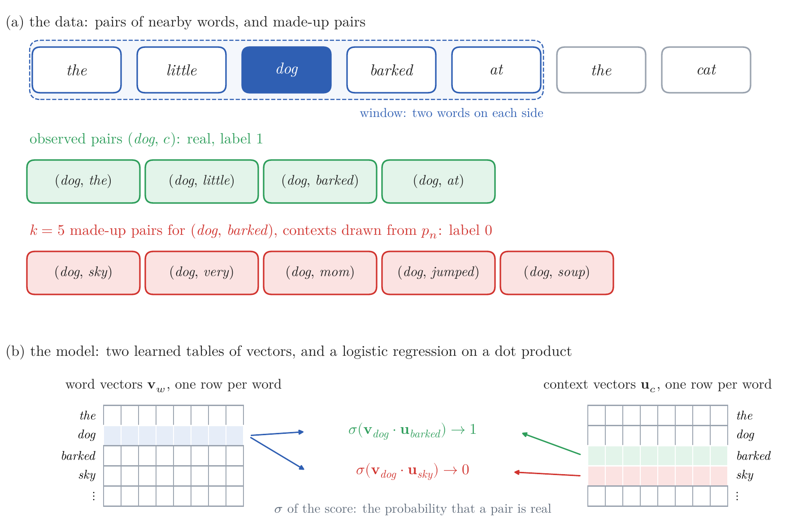
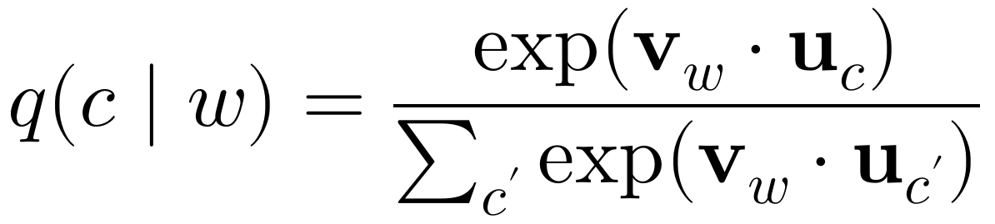
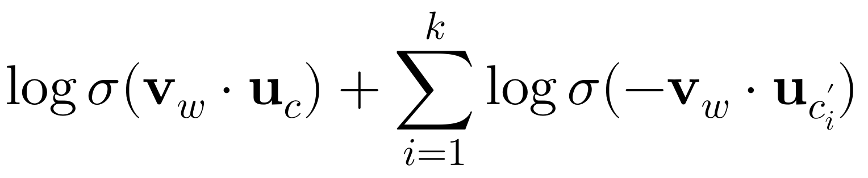
Word Embeddings
Vectors from prediction: word2vec
predict the neighbors of each word
a sum over the whole vocabulary: slow
instead: real pair or made up?
Notes:
Notes §5, word2vec, Figure 7. Two papers and a program from Google (Mikolov et al. 2013a, b): skip-gram predicts the neighbors of each word; negative sampling replaces the softmax over the vocabulary by 'real pair or made up?' for the real pair and k random ones: logistic regression whose features are learned too.

Slide 20
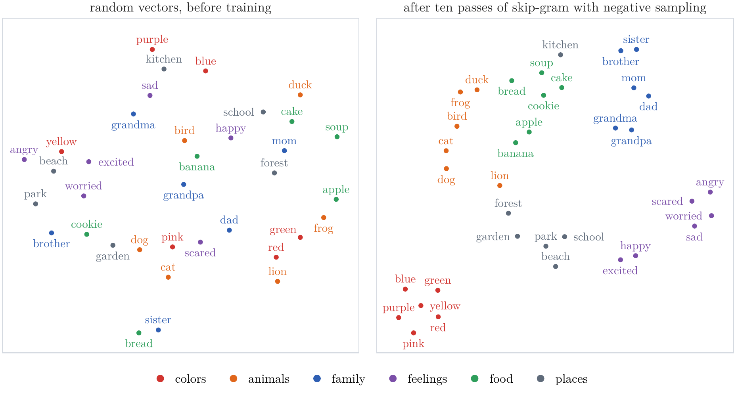
Word Embeddings
Before and after training
Notes:
Notes §5, Figure 8 (t-SNE on cosine distance). The only signal was which words occur near which.

Slide 21
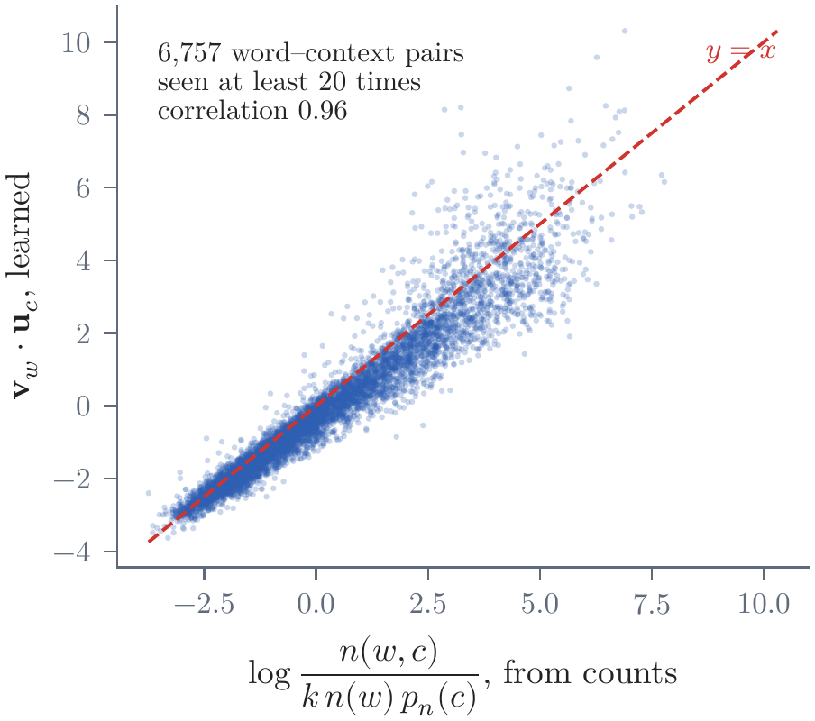
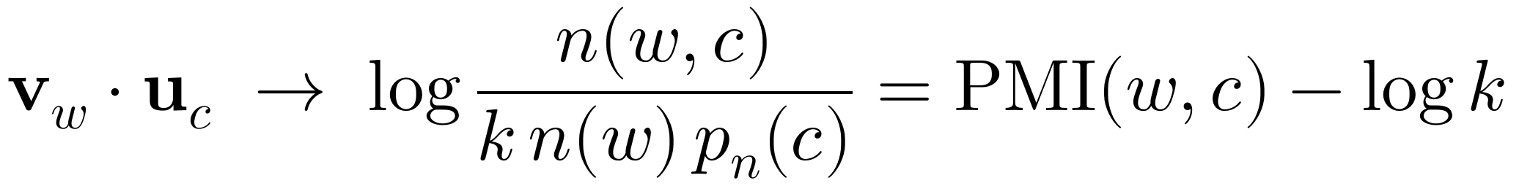
Word Embeddings
Counting and prediction meet
same raw material: pairs of nearby words
best score = shifted PMI
checked: correlation 0.96
Notes:
Notes §5, 'Counting and prediction meet', §A.5, Figure 10. Levy and Goldberg (2014): a pair (w, c) is shown as real n(w,c) times and as made up about k n(w) p_n(c) times; logistic regression's best score is the log of the ratio, PMI shifted by log k. Skip-gram factorizes shifted PMI; the count route factorizes PPMI with an SVD. On TinyStories: correlation 0.96.

Slide 22
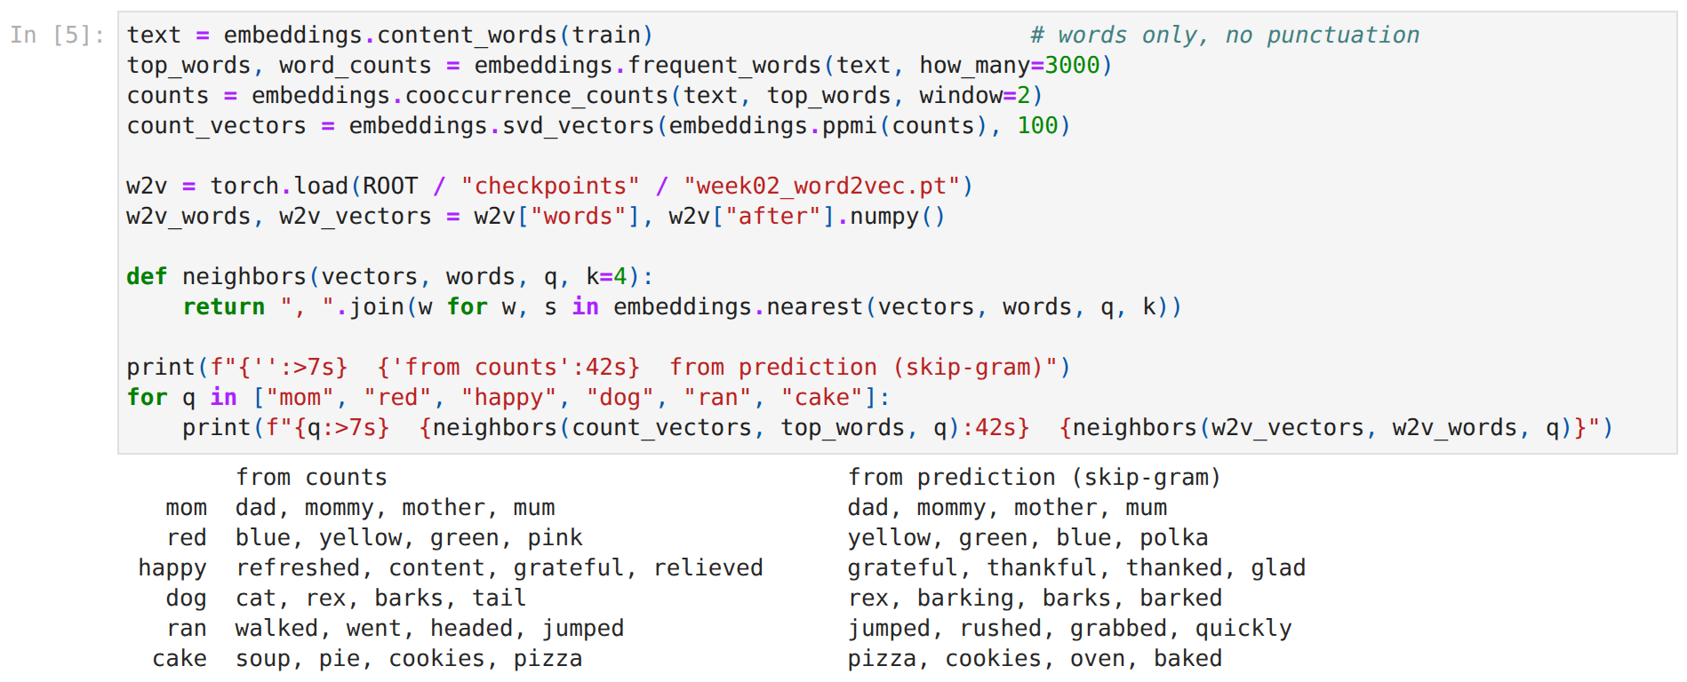
Hands-on: Word Vectors
week02_handson.ipynb, stop 2
watch: both routes give nearly the same neighbors
Notes:
Stop 2 of the in-class notebook: neighbors from counts (built live, 20 s) and from skip-gram (loaded); the 36 words before and after; then the analogies and the shifted-PMI scatter.

Slide 23
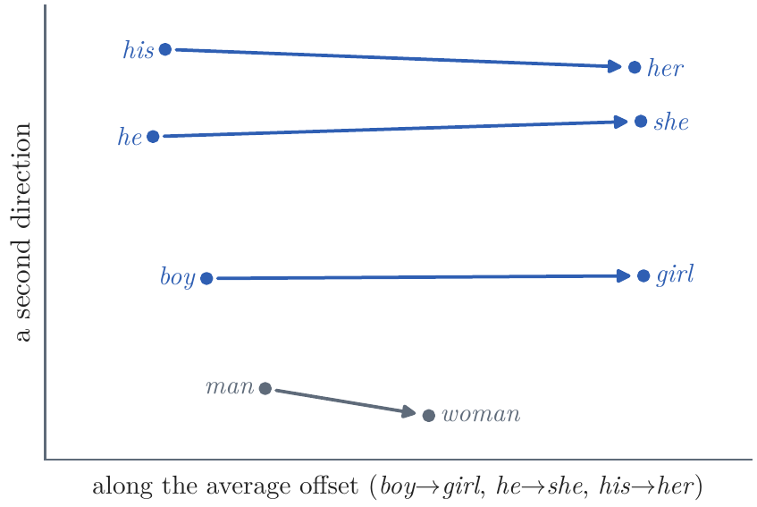
Word Embeddings
What similarity captures: relations as directions
relations are directions
girl − boy + he → she
walk + (ran − run) → walked
and so are stereotypes
Notes:
Notes §5, Figure 9. Analogy query: the word nearest to v_b − v_a + v_c, leaving out a, b, c. On TinyStories: girl − boy + he → she; walk + (ran − run) → walked; brother → sister barely. Directions absorb the text's associations: in Google News vectors, man : computer programmer :: woman : homemaker (Bolukbasi et al. 2016; partly because the query words are excluded, Nissim et al. 2020).

Slide 24
Word Embeddings
What similarity misses: one vector per word
we sat on the bank of the river
→ one vector
the bank raised its rates
hot / cold: cosine 0.64 — antonyms keep the same company
fix: a vector per occurrence, from its context
→ attention, next week
Notes:
Notes §5, 'What similarity captures, and what it misses'. Antonyms keep the same company (hot/cold 0.64 > happy/glad 0.38). One vector per word type: bank blends the river and the money. The fix is a vector per occurrence, computed from the context: ELMo (2018) with LSTMs; attention in the Transformer (Week 3). Break after this slide.

Slide 25
Break
Notes:
Break, five minutes.

Slide 26
Lecture 2: Language Modeling: From Counts to Neural Networks
1. Counting: text as a random source
Markov and Shannon; tokens; the language model as a tree
n-gram models; measuring a model; smoothing
2. Word embeddings: words as points in a space
why vectors, and where they are used
vectors from counts and from prediction (word2vec), and why they meet
what similarity captures, and what it misses
3. Neural language models: from the bigram network to the LSTM
the bigram network; Bengio's fixed window
recurrent networks: backpropagation through time, vanishing gradients
the additive path; the LSTM
Notes:
Part 3: neural language models (about 35 minutes, with two notebook stops). The LSTM block is optional.

Slide 27
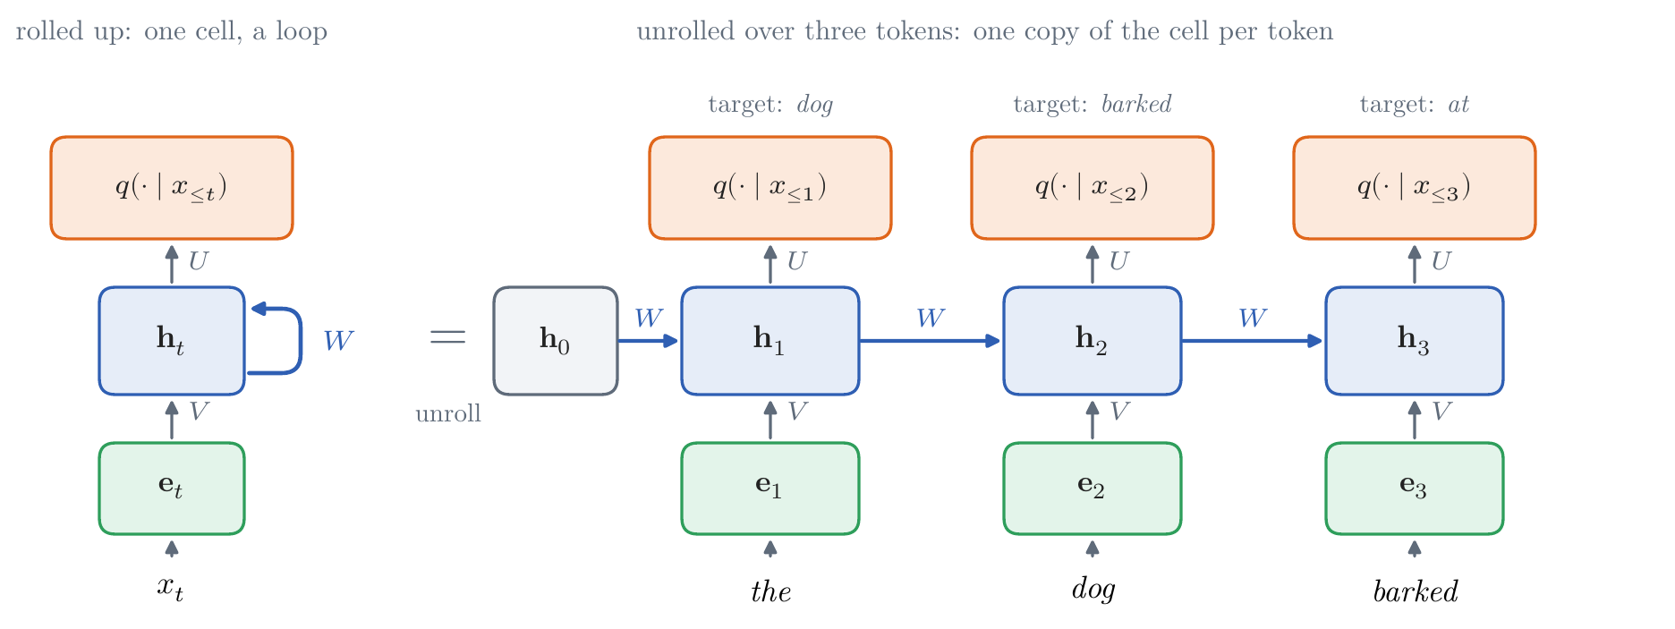
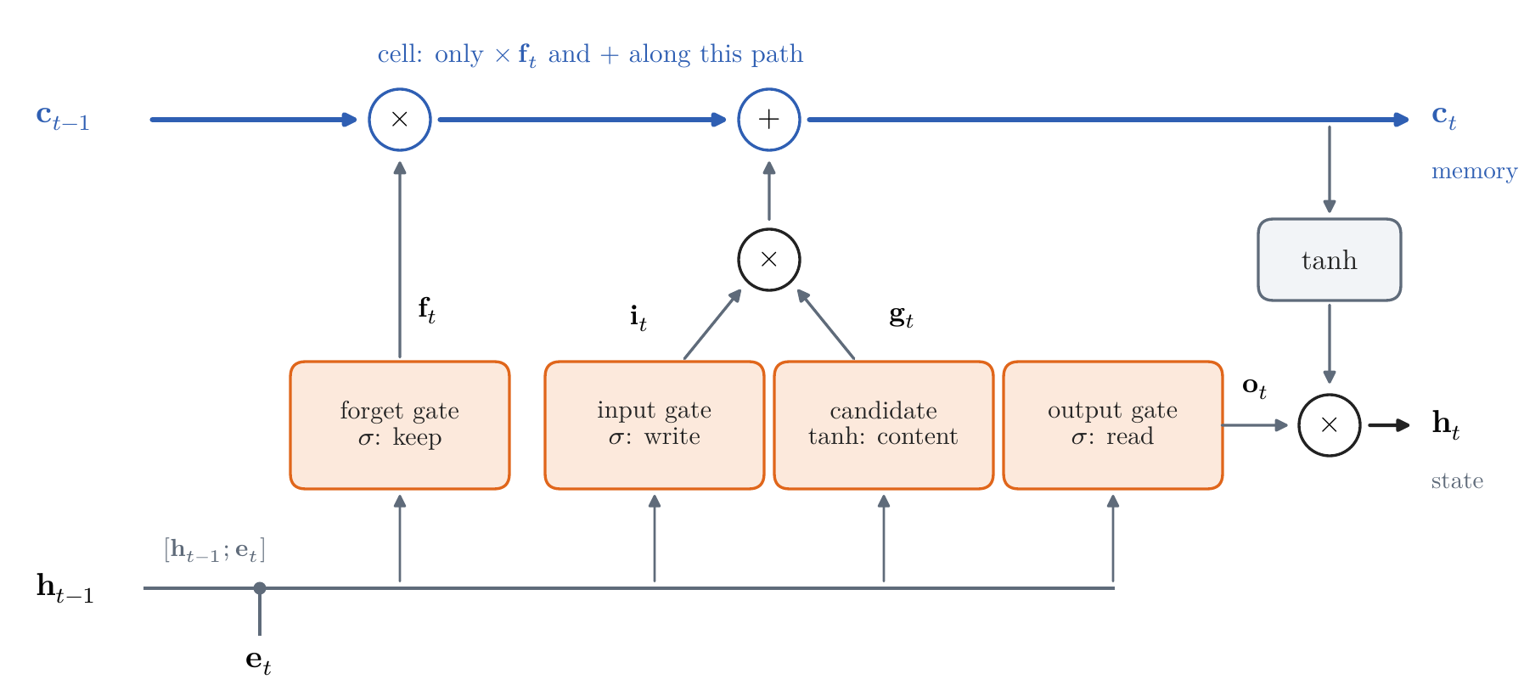
Neural Language Models
A timeline of landmark results
1948–2007 counting: Shannon to Google's 2 trillion words
1990 Elman: a recurrent network
1997 Hochreiter and Schmidhuber: the LSTM
a recurrent network (Elman, 1990)
the LSTM cell (1997)
Notes:
History, one step per slide as in Lecture 1. Counting dominated until about 2010 (Brants et al. 2007, 'Large Language Models in Machine Translation': n-gram counts from 2 trillion words). Elman (1990), 'Finding Structure in Time'. Hochreiter analyzed vanishing gradients in his 1991 thesis; the LSTM (1997) was the fix, the end of today. Both pictures are today's figures.

Slide 28
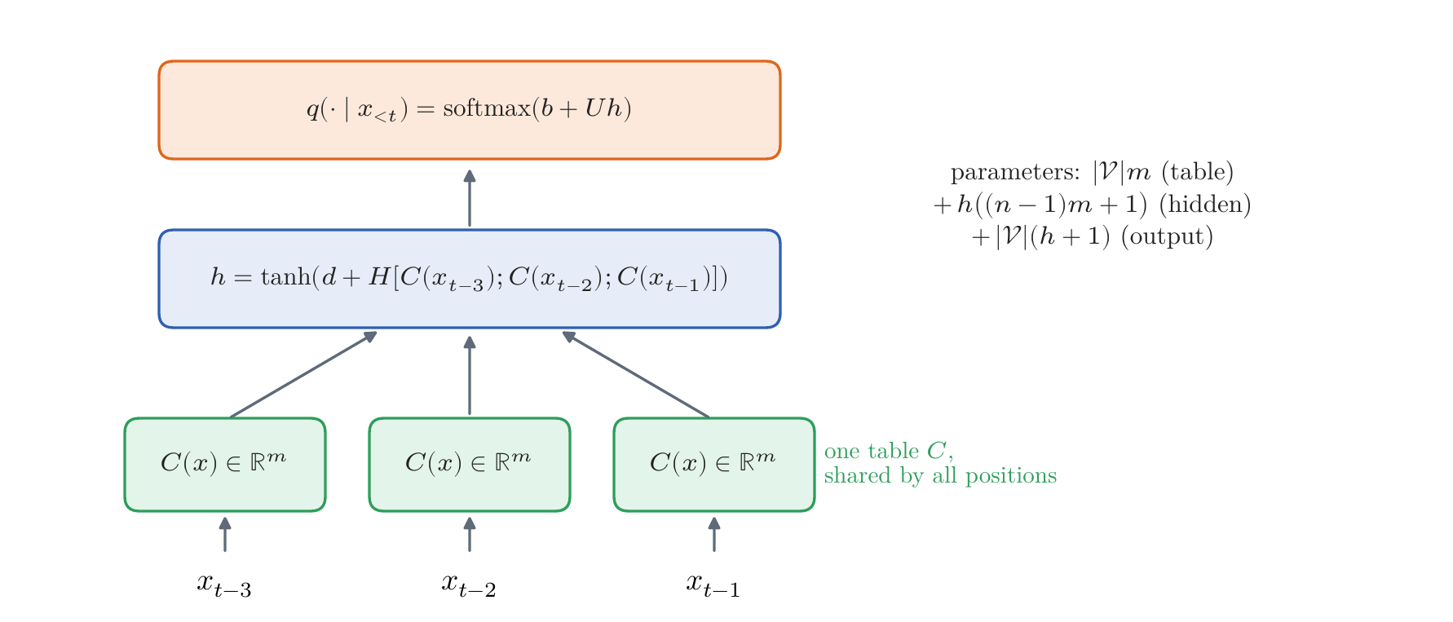
Neural Language Models
A timeline of landmark results
1948–2007 counting: Shannon to Google's 2 trillion words
1990 Elman: a recurrent network
1997 Hochreiter and Schmidhuber: the LSTM
2003 Bengio et al.: a neural language model
learned word vectors, a hidden layer, a softmax
Notes:
History, one step per slide as in Lecture 1. Bengio, Ducharme, Vincent, and Jauvin (2003): learned word vectors, a hidden layer, a softmax; Brown corpus perplexity 252 against 312; three weeks on 40 CPUs.

Slide 29
Neural Language Models
A timeline of landmark results
1948–2007 counting: Shannon to Google's 2 trillion words
1990 Elman: a recurrent network
1997 Hochreiter and Schmidhuber: the LSTM
2003 Bengio et al.: a neural language model
2010 Mikolov: recurrent LMs beat n-grams
2013 word2vec
word2vec vectors of TinyStories, before and after training
Notes:
History, one step per slide as in Lecture 1. RNN language models beat tuned n-grams in speech recognition (Mikolov et al. 2010); word2vec (2013) made word vectors cheap: 1.6 billion words in a day. NeurIPS Test of Time Award 2023.

Slide 30
Neural Language Models
A timeline of landmark results
1948–2007 counting: Shannon to Google's 2 trillion words
1990 Elman: a recurrent network
1997 Hochreiter and Schmidhuber: the LSTM
2003 Bengio et al.: a neural language model
2010 Mikolov: recurrent LMs beat n-grams
2013 word2vec
2014 translation with two LSTMs; attention
2015 Karpathy's char-rnn
once upon a time, there was an intelligent bear. he was a wisd carefully trusted the flashith. he was a bear and a fish. at the party, they started to walk outside and laughed you today. max had talked to her daughter. it felt something…
an LSTM writing, one character at a time (trained on TinyStories, as in Karpathy's char-rnn)
Notes:
History, one step per slide as in Lecture 1. Sutskever, Vinyals, and Le (arXiv September 2014, NeurIPS 2014): encoder and decoder LSTMs translate; Bahdanau, Cho, and Bengio (arXiv September 2014, ICLR 2015): attention. Karpathy (2015): character LSTMs write Shakespeare, Wikipedia markup, LaTeX, and C. The sample is from the 512-unit LSTM of the notes.

Slide 31
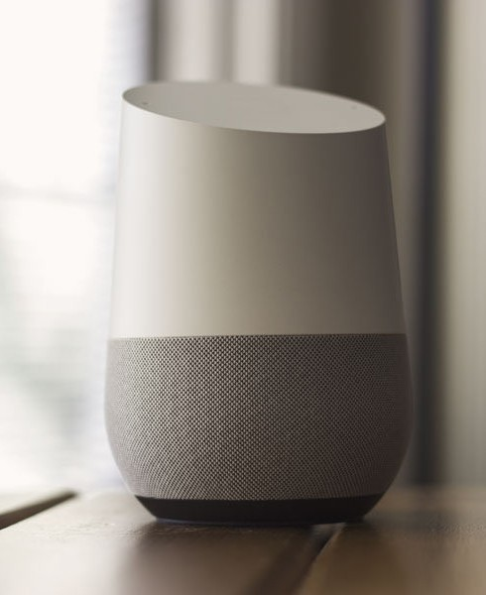
Neural Language Models
A timeline of landmark results
1948–2007 counting: Shannon to Google's 2 trillion words
1990 Elman: a recurrent network
1997 Hochreiter and Schmidhuber: the LSTM
2003 Bengio et al.: a neural language model
2010 Mikolov: recurrent LMs beat n-grams
2013 word2vec
2014 translation with two LSTMs; attention
2015 Karpathy's char-rnn
2015–17 LSTMs in speech and translation products
a voice assistant
Notes:
History, one step per slide as in Lecture 1. Google voice search moved to LSTMs in 2015; Google Translate used 8 + 8 LSTM layers in 2016 (60% fewer errors); Facebook served 4.5 billion LSTM translations a day in 2017. Pictures, Wikimedia Commons: Google Home sitting on table.jpg (NDB Photos, CC BY-SA 2.0).

Slide 32
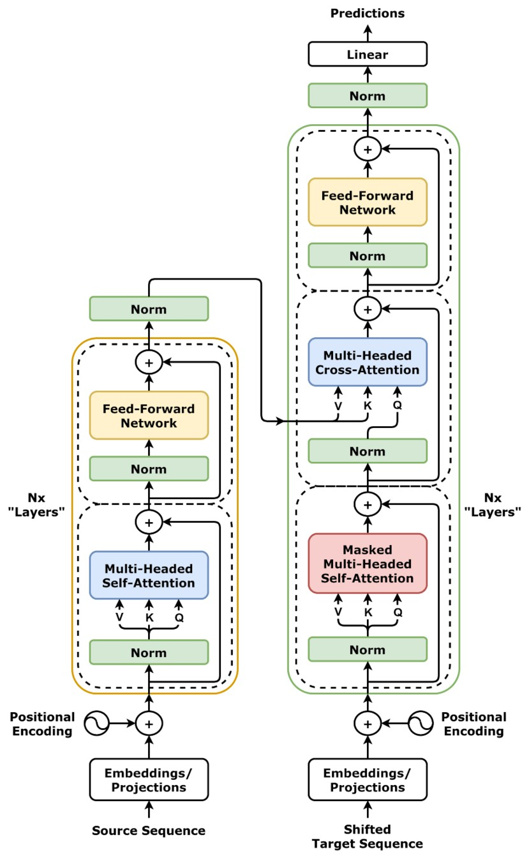
Neural Language Models
A timeline of landmark results
1948–2007 counting: Shannon to Google's 2 trillion words
1990 Elman: a recurrent network
1997 Hochreiter and Schmidhuber: the LSTM
2003 Bengio et al.: a neural language model
2010 Mikolov: recurrent LMs beat n-grams
2013 word2vec
2014 translation with two LSTMs; attention
2015 Karpathy's char-rnn
2015–17 LSTMs in speech and translation products
2017 the Transformer
the Transformer
Notes:
History, one step per slide as in Lecture 1. Vaswani et al. (2017). GPT and BERT (2018) are Transformers; Google Translate's encoder became one in 2020. Week 3. Pictures, Wikimedia Commons: Transformer, full architecture.png (dvgodoy, CC BY 4.0).

Slide 33
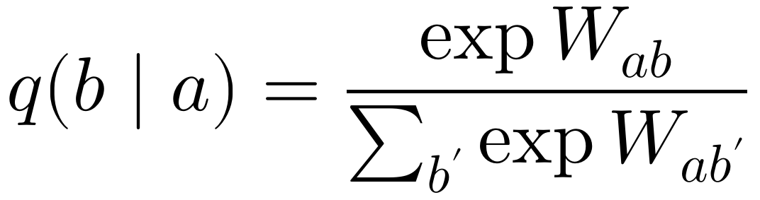
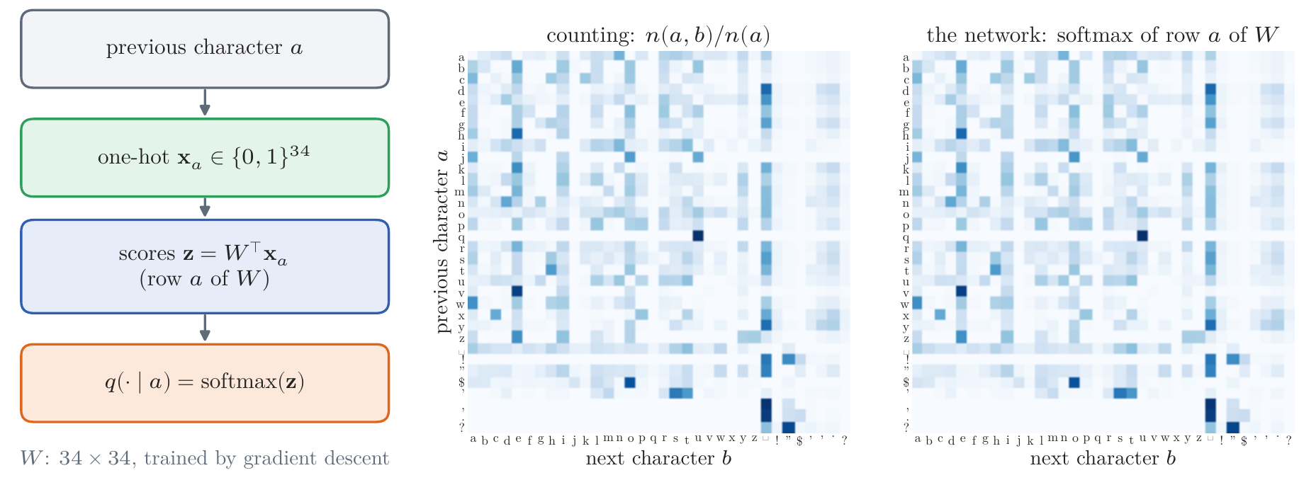
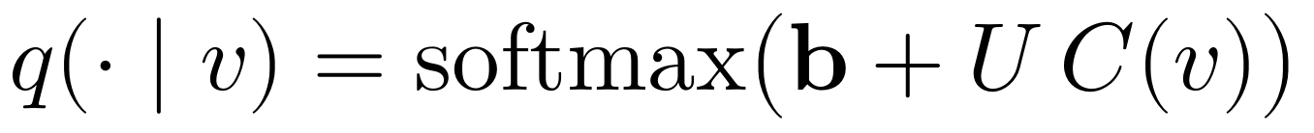
Neural Language Models
The bigram model as a network: counting becomes optimization
gradient descent finds the counts
now the table is a function we can change
factor it through word vectors:
Notes:
Notes §6, Figure 11. Warm-up, after Karpathy's makemore part 1: one-hot previous character times W gives scores; softmax gives probabilities. Gradient descent on the log loss from W = 0 must arrive at the counts, since each row's minimum is the relative frequency: 3.26 bits per character, the same as counting. A penalty λΣW² plays the role of smoothing. What changed: the table is now a differentiable function, which can be changed.

Slide 34
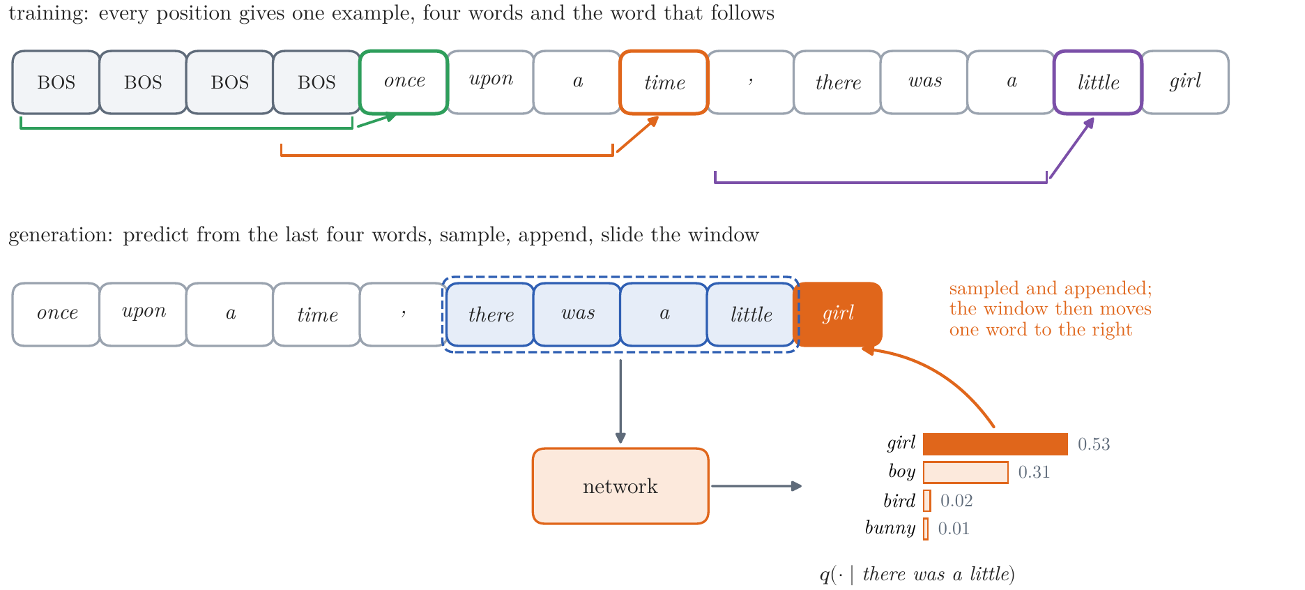
Neural Language Models
The fixed-window model (Bengio et al., 2003)
word vectors, shared by all positions
parameters grow linearly in n
Notes:
Notes §6, Figures 12–13. Bengio, Ducharme, Vincent, and Jauvin (2003): keep the n-gram assumption, compute the distribution with a network. One table C of word vectors for all positions (the embeddings of part 2, learned by predicting); concatenate four vectors; tanh hidden layer; softmax. Parameters linear in n. Train on 3.56 million windows; generate by sliding the window. Test perplexity 26.9 against Kneser–Ney's 24.6; averaged, 21.4.

Slide 35
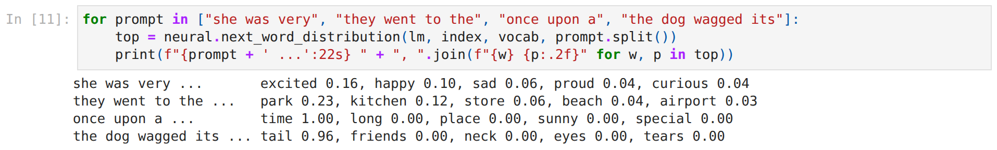
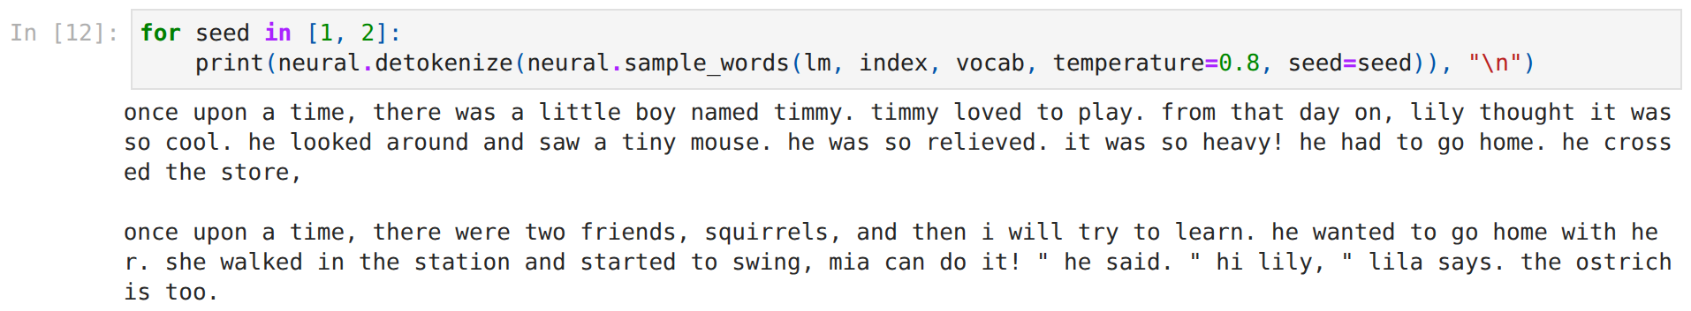
Hands-on: Neural Language Models
week02_handson.ipynb, stop 3
watch: the names in the samples
Notes:
Stop 3 of the in-class notebook: first the bigram network converging to the counts (a few seconds), then the fixed-window model loaded: its class, next words, samples. Ask the class for four-word contexts.

Slide 36
Neural Language Models
What the window cannot see
once upon a time, there was a little boy named timmy. timmy loved to play. from that day on, lily thought it was so cool.
four words of memory
share the weights across positions
carry a state
Notes:
Notes §6, 'What the window cannot see'. Timmy is gone by the time lily is chosen. Widening the window does not share: what is learned about dog one word back says nothing about dog three words back. Both problems have one fix: the same weights at every position, and a state carried along.

Slide 37
Recurrent Neural Networks
The recurrence: a machine with a state
h = h0
for x in text:
h = tanh(W @ h + V @ C[x] + d) # read
q = softmax(b + U @ h) # predict
Notes:
Notes §7, Figure 15. A state machine: fixed learned rules, a vector state, one token read per step (with unbounded precision an RNN can simulate a Turing machine, Siegelmann and Sontag 1995; in practice the state holds a limited amount). Same W, V, U at every step; the parameter count does not depend on the context length. Elman 1990. Characters from here on, as in Karpathy's essay.

Slide 38
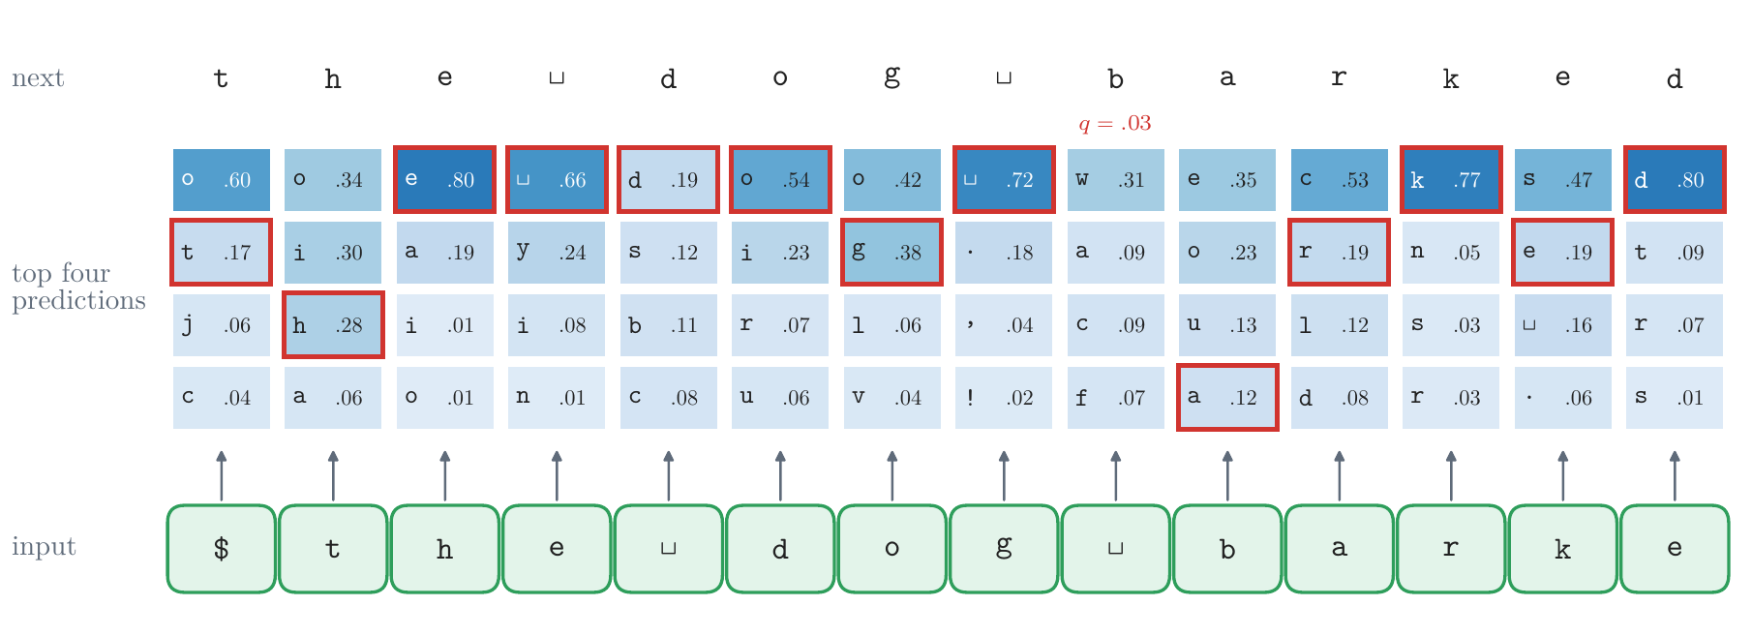
Recurrent Neural Networks
One character at a time
Notes:
Notes §7, Figure 16. After Karpathy's 'hello' example, with the real plain RNN: within a word the choices narrow (after th: e 0.80); at the start of a word it must guess the story (barked begins with b at 0.03).

Slide 39
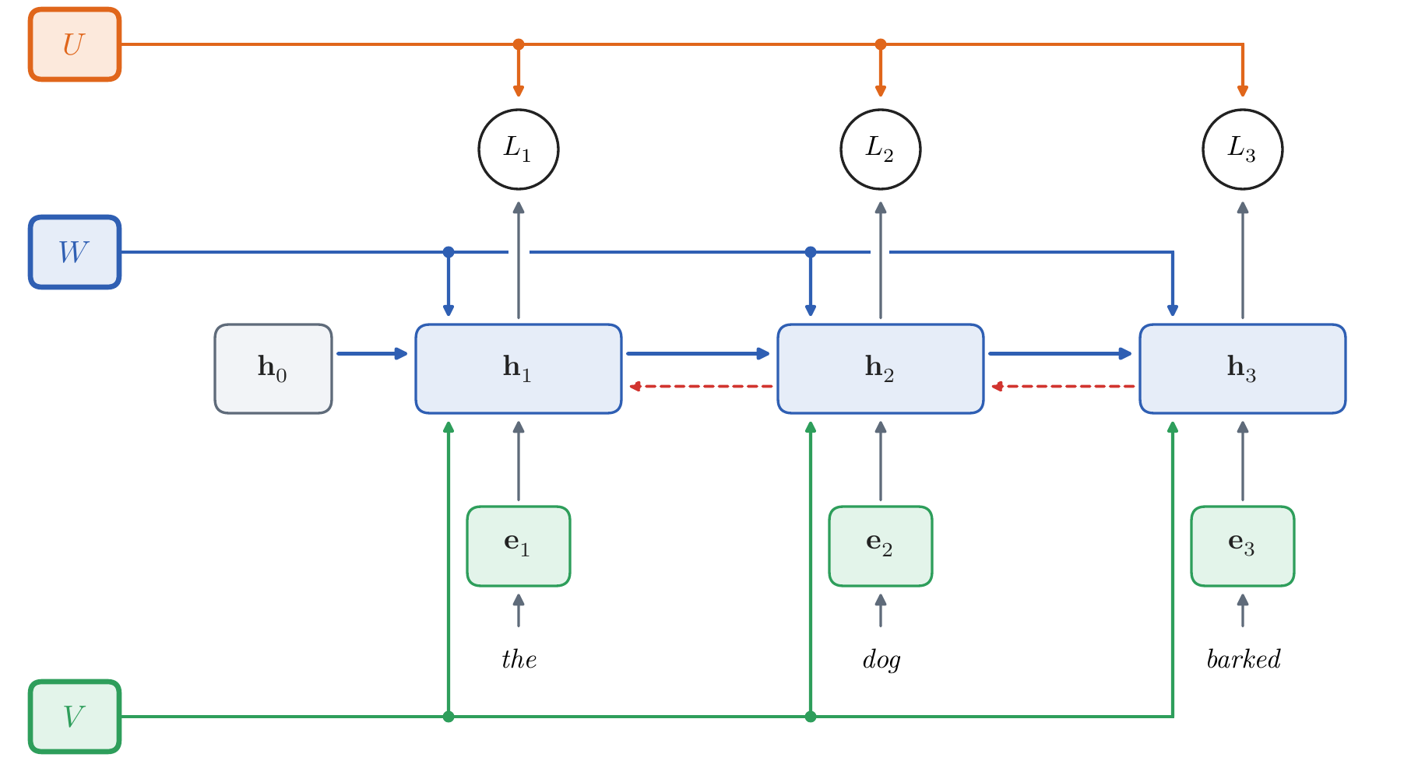
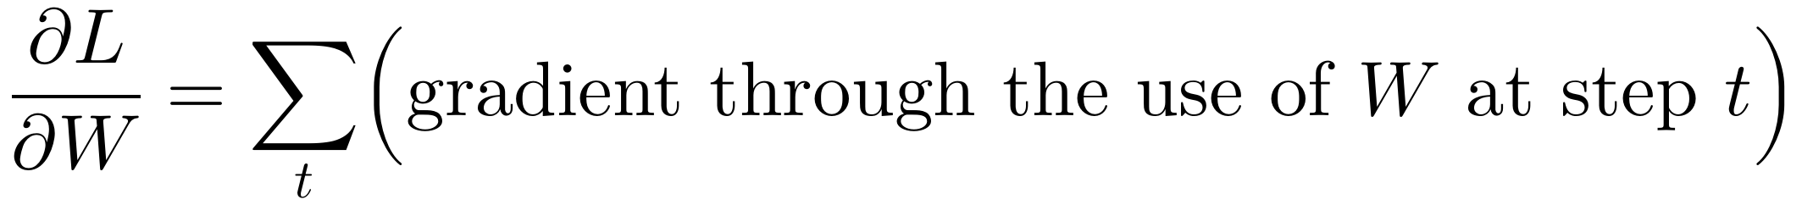
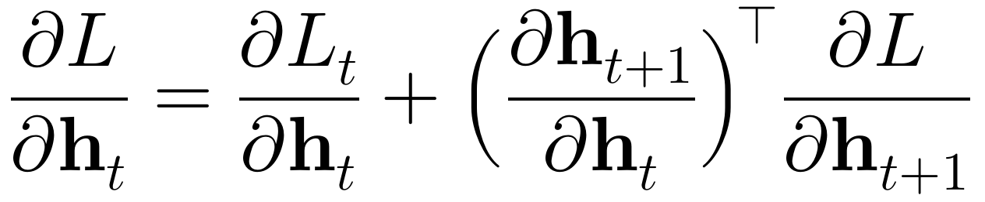
Recurrent Neural Networks
Training: backpropagation through time
shared leaves: gradients add
backwards in time
Notes:
Notes §7, BPTT, Figure 17. The unrolled network is an ordinary computation graph; W, V, U are its shared leaves; gradients add over the uses (Lecture 1's engine does this). Backwards in time: a state's gradient is its own loss's plus what flows back from the next state. Teacher forcing; truncated BPTT; no parallelism over time.

Slide 40
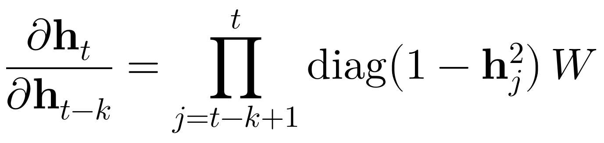

Recurrent Neural Networks
Why the plain network forgets
exploding: clip the gradient
vanishing: no signal from far back
Notes:
Notes §7, 'Why the plain network falls short'; §A.7. Board: h_t = w h_{t−1} + x_t gives ∂h_t/∂h_{t−k} = w^k: 0.5^10 ≈ 0.001, 1.5^10 ≈ 58. In the network a product of k Jacobians, each W times the tanh slopes 1 − h². Exploding: clip. Vanishing: no signal from an early token to a late prediction. Hochreiter 1991; Bengio et al. 1994. The plain RNN stalls at 1.47 bits per character; the best n-gram reaches 1.26.

Slide 41


Recurrent Neural Networks
Seeing the gradient vanish
white: saturated unit, slope ≈ 0
gradient reaching each earlier character
Notes:
Notes §7, Figure 18. (a) Rows: the 256 hidden units; columns: 120 characters of a held-out story; white: saturated, |h| > 0.99, slope below 0.02. Half the pixels are white, and which units saturate changes every character. W is not small (largest singular value 6.8). (b) Rows: 24 windows of 160 characters; columns: characters back; shade: the gradient of the last prediction's loss with respect to each earlier input, relative to the latest (log scale). 0.11 at 10, 0.01 at 20, 10⁻¹¹ at 100: about tenfold every ten characters.

Slide 42

Recurrent Neural Networks
A memory test
5 12 9 14 11 8 15 13 10 ? → 5
store the key, keep it, read it
plain RNN: chance from T = 20
Notes:
Notes §7, the memory test at the end of 'Why the plain network falls short', Figure 19. Each sequence: a key from eight symbols, T noise symbols, a query; output the key. Chance 1/8. Plain RNN, 64 units: right at T = 5, 24% at T = 10, chance from T = 20; four times the training does not help. It could represent the answer; it never gets the gradient. The LSTM curve is the next slides.

Slide 43

Recurrent Neural Networks
The fix: an additive path
add, don't rewrite: the gradient passes through
highway networks, ResNet, every Transformer layer
a residual block
Notes:
The fix that recurs across deep learning. LSTM (Hochreiter and Schmidhuber 1997), whose cell had no forget gate: c_t = c_{t−1} + i_t ⊙ g_t, the 'constant error carousel'. Highway networks (Srivastava, Greff, and Schmidhuber, May 2015): LSTM-style gates across layers. ResNet (He, Zhang, Ren, and Sun, December 2015): x + F(x), 152 layers, won ImageNet 2015. Every Transformer layer has two residual connections (Week 3). Pictures, Wikimedia Commons: ResBlock.png (LunarLullaby, CC BY-SA 4.0).

Slide 44

Hands-on: Recurrent Networks
week02_handson.ipynb, stop 4
watch: plain RNN at chance, LSTM always right
Notes:
Stop 4 of the in-class notebook: the saved models' scores (RNN 1.47, LSTM 1.31, LSTM-512 1.12; best n-gram 1.26), reading 'the dog barked', LSTM samples at three temperatures, the memory test at T = 20 (half a minute).

Slide 45
Long Short-Term Memory
Gated memory: write, keep, read
write: input gate
keep: forget gate
read: output gate
each gate: a sigmoid per unit, between 0 and 1
Notes:
Notes §8, Figure 20. OPTIONAL BLOCK (to 'Words instead of characters'). Write, keep, read: input gate, forget gate (added by Gers, Schmidhuber, and Cummins 2000), output gate; gates are sigmoids between 0 and 1, per unit. Long-term memory is the weights, short-term the state; the LSTM's short-term memory lasts long.

Slide 46

Long Short-Term Memory
Why it trains
forget gates near 1: the gradient survives
start them near 1
Notes:
Notes §8, 'Gated memory' (why it trains), Figure 19. Along the cell the Jacobian is diag(f_t): no weight matrix, no saturating slope. Forget gates start at 1/2 in PyTorch, and (1/2)^20 ≈ 10⁻⁶; start the forget bias at 3 (95% kept per step). 0.95^160 ≈ 3 × 10⁻⁴: the LSTM fails at T = 160 too.

Slide 47

Long Short-Term Memory
The LSTM against counting
same size: far better
keeps improving
512 units: 1.12 bits per character
Notes:
Notes §8, Figure 21. Equal storage: LSTM 307,000 parameters 1.31 bits per character; 6-gram 399,000 counts 1.43. Counting needs ten times the storage to match it, then stops. 512 units, twice the training: 1.12. One Billion Word benchmark: Kneser–Ney 67.6, LSTM 30.0 (2016).

Slide 48
Long Short-Term Memory
Watching it learn
0 steps
100 steps
1,000 steps
3,000 steps
512 units
yuj?nvfaslgt"ykzir hfd
yucind as gome, in the pupptle in the too ba ont cougerte a saw hwaws
yucked as here, in the park. every happy, back to the barras and when
once upon a time, there was an incredible back to the barras away.
once upon a time, there was an intelligent bear. he was a wisd carefully tr
Notes:
Notes §8, 'Watching it learn'. One sample, drawn with the same random numbers, as training goes on; last line from the 512-unit LSTM.

Slide 49

Long Short-Term Memory
What the cells track: a quotation cell
Notes:
Notes §8, 'What the cells track', Figure 22. A cell unit is one of the 256 numbers of the cell; correlate each with a 0/1 inside-a-quotation mark over 175,000 held-out characters: unit 28 has 0.79, next best 0.58. Nobody told it about quotations.

Slide 50
Long Short-Term Memory
Words instead of characters
test perplexity
Kneser–Ney 4-gram three words
fixed window four words
LSTM the whole story so far
24.6
26.9
23.1
Notes:
Notes §8, 'Words instead of characters'. The same LSTM on words, 1.8 million parameters, half an hour on two CPU cores. End of the optional block.

Slide 51
Long Short-Term Memory
What recurrence leaves unsolved
one vector holds everything
one step at a time
→ attention, the Transformer (Week 3)
Notes:
Notes §8, last subsection. Encoder–decoder LSTMs (2014) squeezed a sentence into one vector and got worse on long sentences; Bahdanau, Cho, and Bengio (2015) let the decoder look back at all encoder states: attention. And h_t waits for h_{t−1}: no parallelism over time. Week 3: attention without recurrence.

Slide 52
What Carries Forward
Two ideas
text is a random source
chain rule, log loss on held-out text
words are points in a space
every model starts with a table of vectors
next: attention and the Transformer
Notes:
Close: return to the two ideas of the opening, with their pictures. Text as a random source became the objective (maximum likelihood, log loss on held-out text) and the chain rule with EOS. Words as vectors became the input of every model: the embedding table. What made the networks work: sharing across words and positions, and paths for gradients. Pictures, Wikimedia Commons: Word embedding illustration.svg (Fschwarzentruber, CC BY-SA 4.0).

