Slide 1
Generative AI from First Principles
Lecture 4: Transformers
Architecture, Computation, and Language Modeling
Notes:
Title. Lecture 4: Transformers. Last week ended with the Transformer's diagram and the promise that this lecture builds it.

Slide 2
Lecture 4: Transformers
Previously: attention, through translation; a toy translator built from attention alone
Today: the Transformer, part by part, and the language model it became
1. Building the Transformer
from Lecture 3's toy translator to the encoder–decoder of 2017, one part at a time
2. The language model
the decoder alone, trained on children's stories; positions as rotations
3. Strengths, limitations, and variants
every weight and its cost; the key–value cache; what it does well and where it falls short; variants
Notes:
[On the slide] Previously: Lecture 3 followed attention through machine translation and ended with a toy translator built from attention alone. Today: we build the Transformer from that toy, one part at a time, then turn it into a language model. [click ×3] Three parts, as in the notes: building the Transformer (§§1–7), about an hour, to the break; the language model (§§8–9); strengths, limitations, and variants (§§10–11). [click] Part 1. One question to keep in mind: for each part, what goes wrong without it?

Slide 3
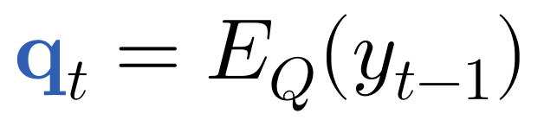
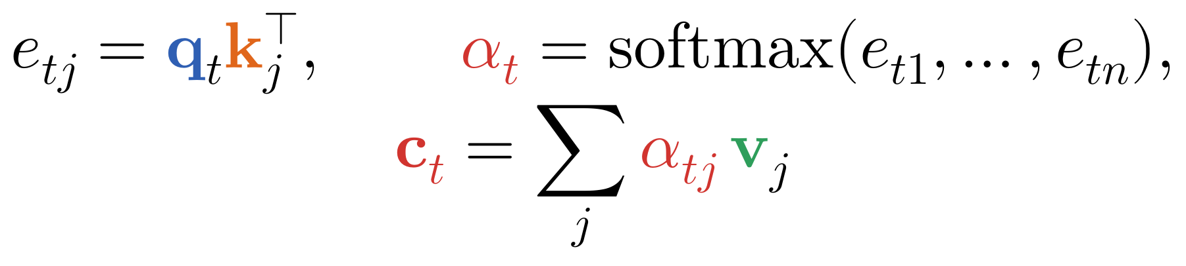
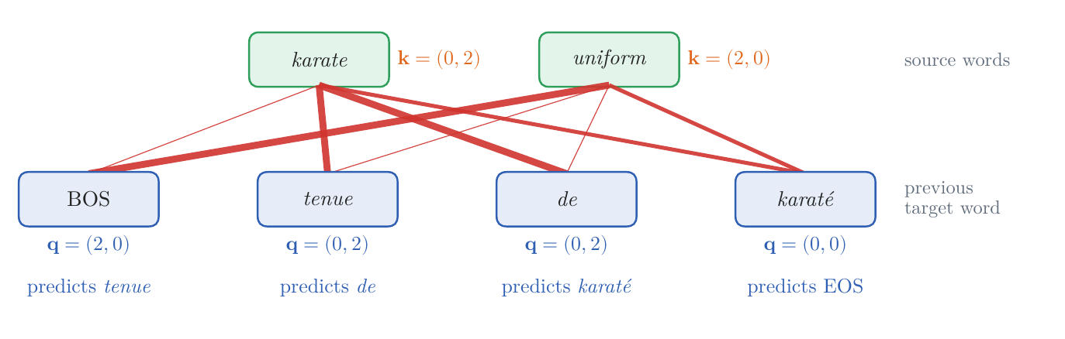
A Translator Built from Attention Alone
Lecture 3's toy: one read per target word, and nothing else
1. query: from the previous target word alone
2. read: score every source word, softmax, average the values
3. predict: from the previous word and the read
Figure 1: on karate uniform, each target position (bottom) reads the source words (top); line width is weight
Notes:
Notes §1, Figure 1. Lecture 3's toy (its §9) translates one target word at a time with exactly one operation, a read of the source. [click] Its query comes from the previous target word alone. [click] It scores every source word by a dot product with that word's key, turns the scores into weights with the softmax, and reads the weighted average of the values; in the picture, line width is weight. [click] It predicts the next word from the previous word's vector and the read, side by side. That is all: no line joins two target positions, or two source words.

Slide 4
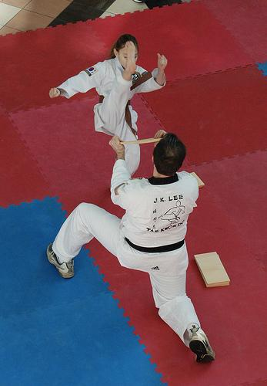
A Translator Built from Attention Alone
Every translator of Part 1: the same data, training, and measures
the data: Multi30k, English captions of photographs with French translations; 29,000 pairs to train, 1,014 to validate, 1,000 to test
the training: 3,000 steps of 64 caption pairs; vectors of d = 192; Adam, with a warmup
two measures: cross-entropy on the validation captions (nats per French word); BLEU on the test captions, translated greedily
the bar: Lecture 3's LSTMs, 19.5 BLEU without attention and 49.2 with
a girl in karate uniform breaking a stick with a front kick .
une fille en tenue de karaté brisant un bâton avec un coup de pied .
Photograph: Flickr30k image 101362133 (Young et al., 2014), with its Multi30k caption
Notes:
Notes §1, 'The toy, trained'. The setting every translator of Part 1 shares. [click] Lecture 3's data: Multi30k, captions of Flickr photographs with French translations made by people; 29,000 pairs to train, 1,014 to validate, 1,000 to test. The photograph is Lecture 3's karate caption; the models read only the text. [click] Training: 3,000 steps of 64 caption pairs, vectors of d = 192, Adam with a warmup (the paper's recipe, next week's subject). [click] Two measures: cross-entropy on the validation captions, in nats per French word (Lecture 2, §3), and BLEU on the test captions, translated greedily (Lecture 3, §2). [click] The bar: Lecture 3's LSTMs, 19.5 BLEU without attention and 49.2 with it. Each translator is trained once, so small differences may not survive another random seed.

Slide 5
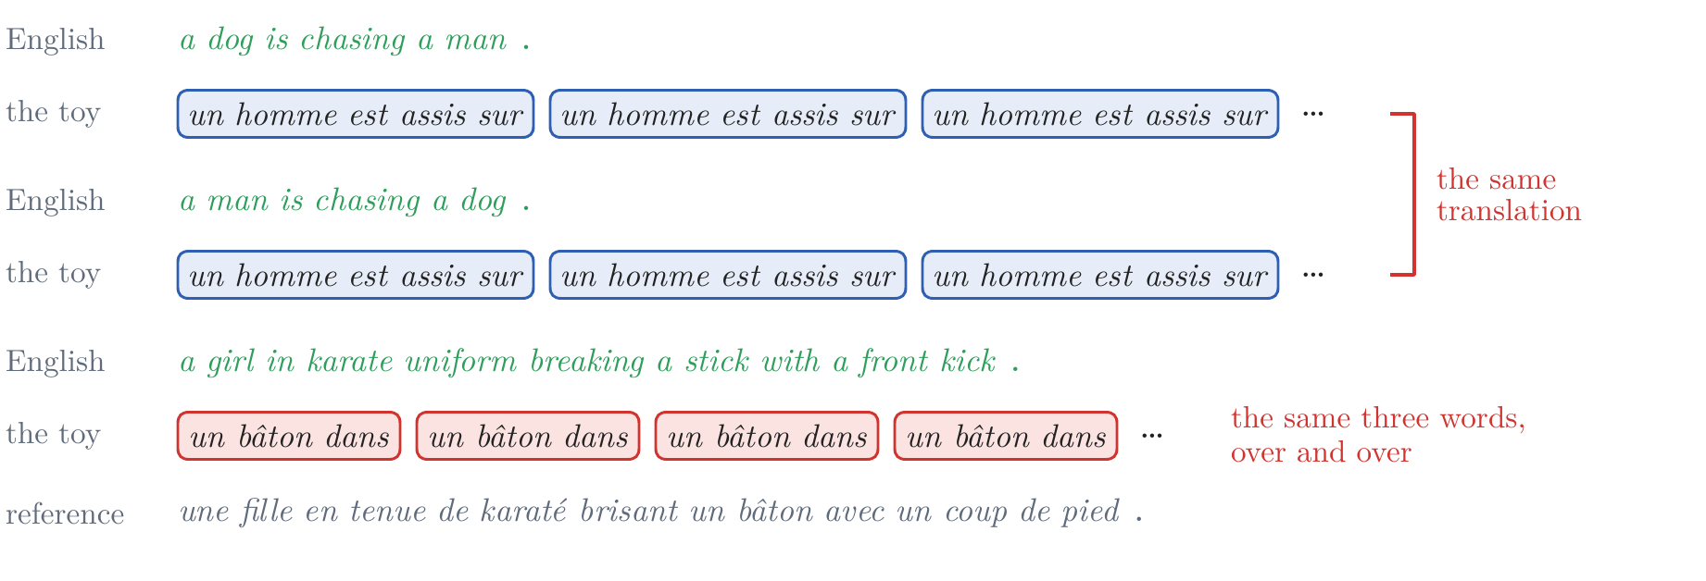
A Translator Built from Attention Alone
The toy, trained: 1.7 BLEU
the toy: cross-entropy 3.04, 1.7 BLEU (the LSTM without attention, 19.5)
word order: the same words in another order give the same translation
a loop: once a word recurs, the same read, the same next word
why: nothing tells it where a word stands, or what it has written beyond the last word
Figure 3: the toy's greedy output; the reference in gray
Notes:
Notes §1, Figure 3. [click] The toy: cross-entropy 3.04 and 1.7 BLEU, far below even the LSTM without attention. Ask: why so bad? [click] A dog is chasing a man and a man is chasing a dog get the same translation: its reads see the source words as a set. [click] And it loops on the karate caption, un bâton dans un bâton dans …: its query depends only on the previous French word, so each un brings the same read and the same next word. [click] Nothing tells it where it is in the sentence, or what it has written beyond the last word.

Slide 6
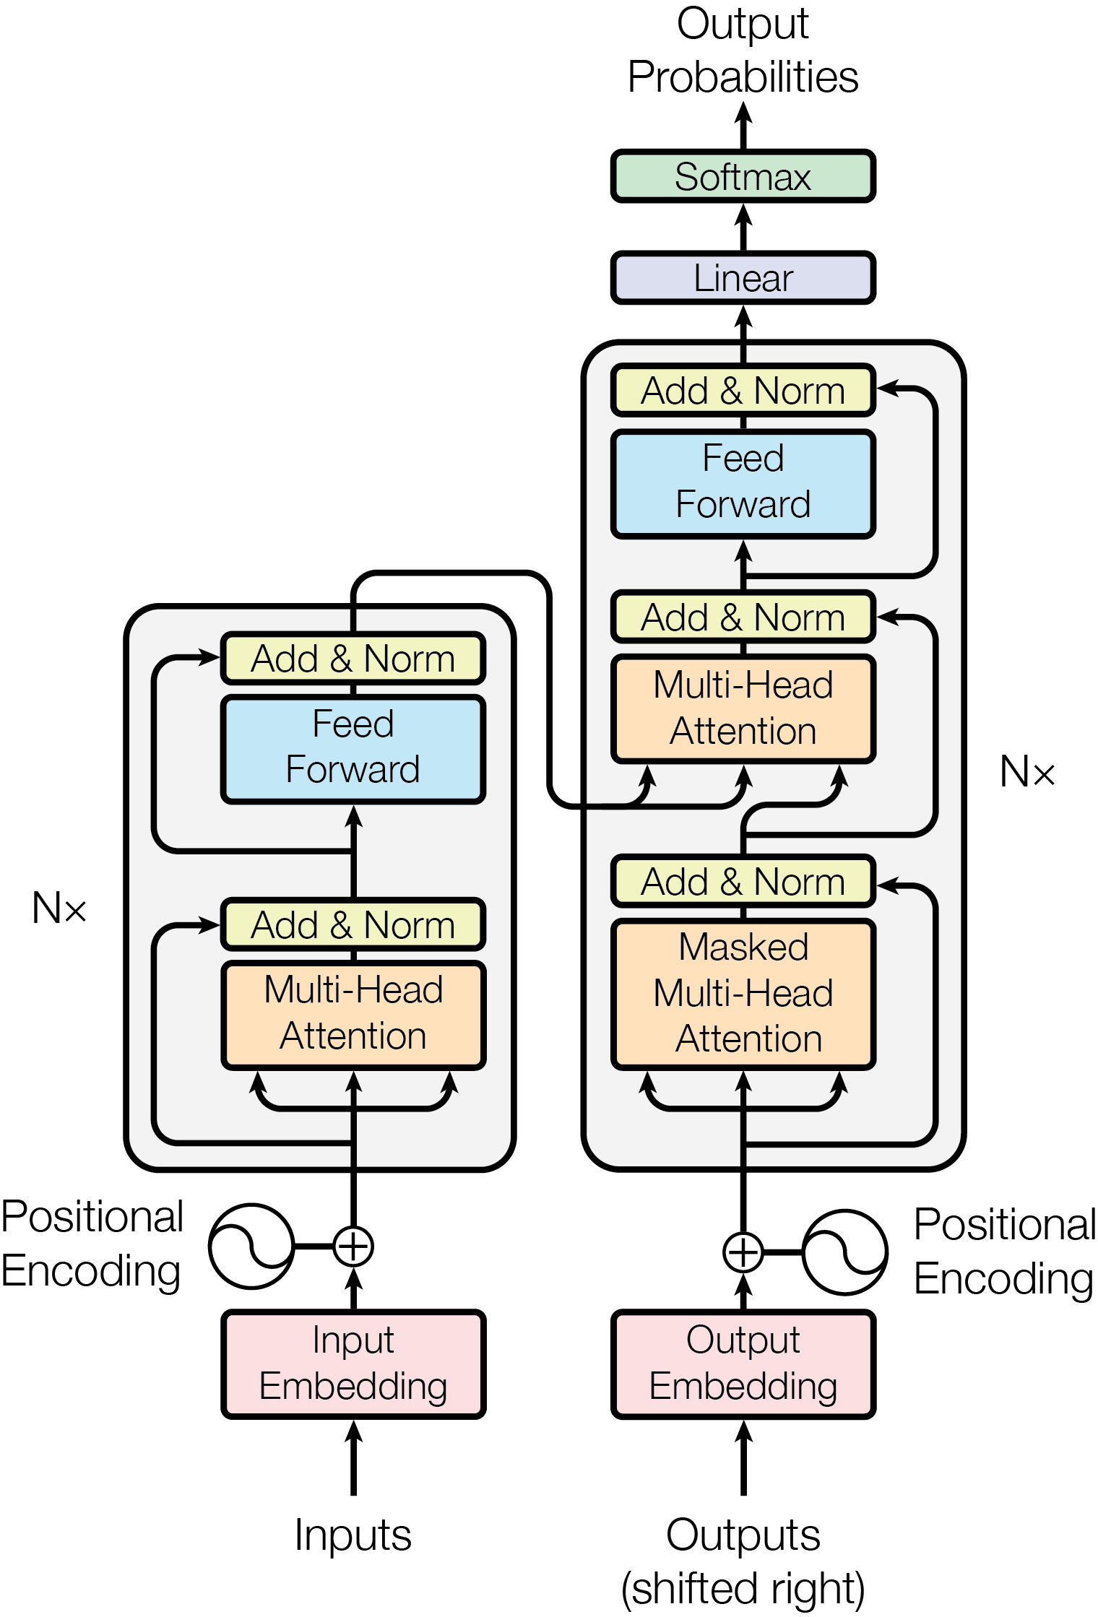
A Translator Built from Attention Alone
What the toy lacks, and the part of the Transformer that supplies it
the toy's read: the decoder's cross-attention (queries from the decoder, keys and values from the encoder)
1. where a word stands: word orders, the loop → position vectors (§2)
2. a word's neighbors: each source word read alone → self-attention (§3), a stack of blocks (§4)
3. what it has written: only the last word → masked self-attention (§3)
4. one kind of read, no computation → several heads, and an MLP at each position (§4)
Figure 2: Vaswani et al. (2017), Fig. 1
Notes:
Notes, opening; Vaswani et al. (2017), Figure 1, reproduced with attribution (Figure 2 of the notes). The destination, and the plan of Part 1. [click] The toy's read is already in the Transformer: the decoder's cross-attention, queries from the decoder, keys and values from the encoder. The toy fails in four ways, and a part of the Transformer answers each. [click] 1. It cannot tell where a word stands: position vectors, added at the bottom (§2). [click] 2. It reads each source word without its neighbors: self-attention in the encoder (§3), in a stack of blocks (§4). [click] 3. It knows only the last word it wrote: masked self-attention in the decoder (§3). [click] 4. One weighted average per word gathers one kind of information and transforms none of it: several heads, and an MLP at each position, the feed-forward boxes (§4). The Add & Norm boxes (§§5–6) make a deep stack trainable; §7 adds one shared table, and the paper's training recipe is next week.

Slide 7
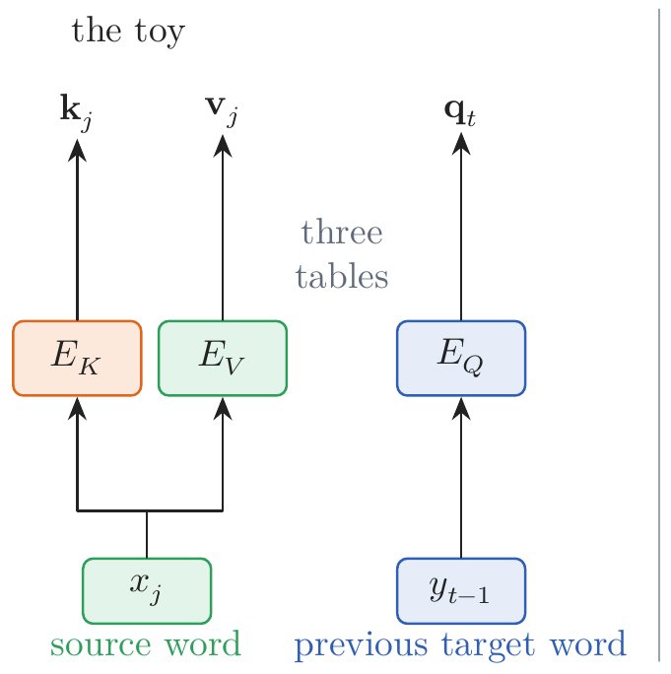
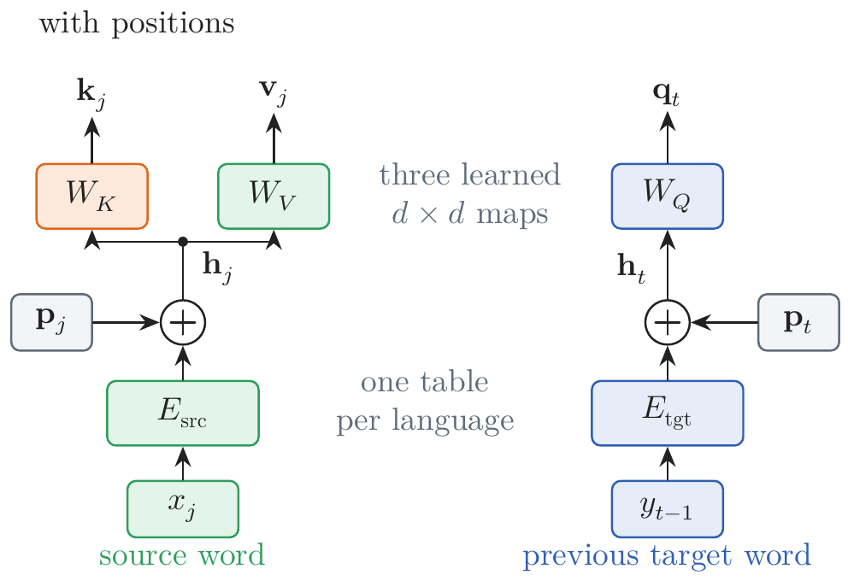
Word Order: Positions
A vector for each word, and maps to queries, keys, and values
the problem: the reads see the source as a set; each query depends only on the previous word → the fix here: mark each position with a vector
recall: a query says what a position looks for, a key what it is found by, a value what it passes on
one vector per word, plus its position's: one table per language
three learned maps: query, key, and value from that one vector
Notes:
Notes §2, Figure 4. [click] Recall Lecture 3's three roles: a query says what a position looks for, a key what it is found by, a value what it passes on. The toy looks each up in a table of its own (first picture). [click] A position vector must be added to something, and the toy has no vector for a source word, only its key and its value. So give each word one vector, from one table per language, and add a vector p that depends only on the position. [click] Then compute query, key, and value from that sum by three learned d × d maps (second picture). Without positions this is the toy with its tables factored, E_K = E_src W_K. The scores are also divided by √d, explained in §3.

Slide 8
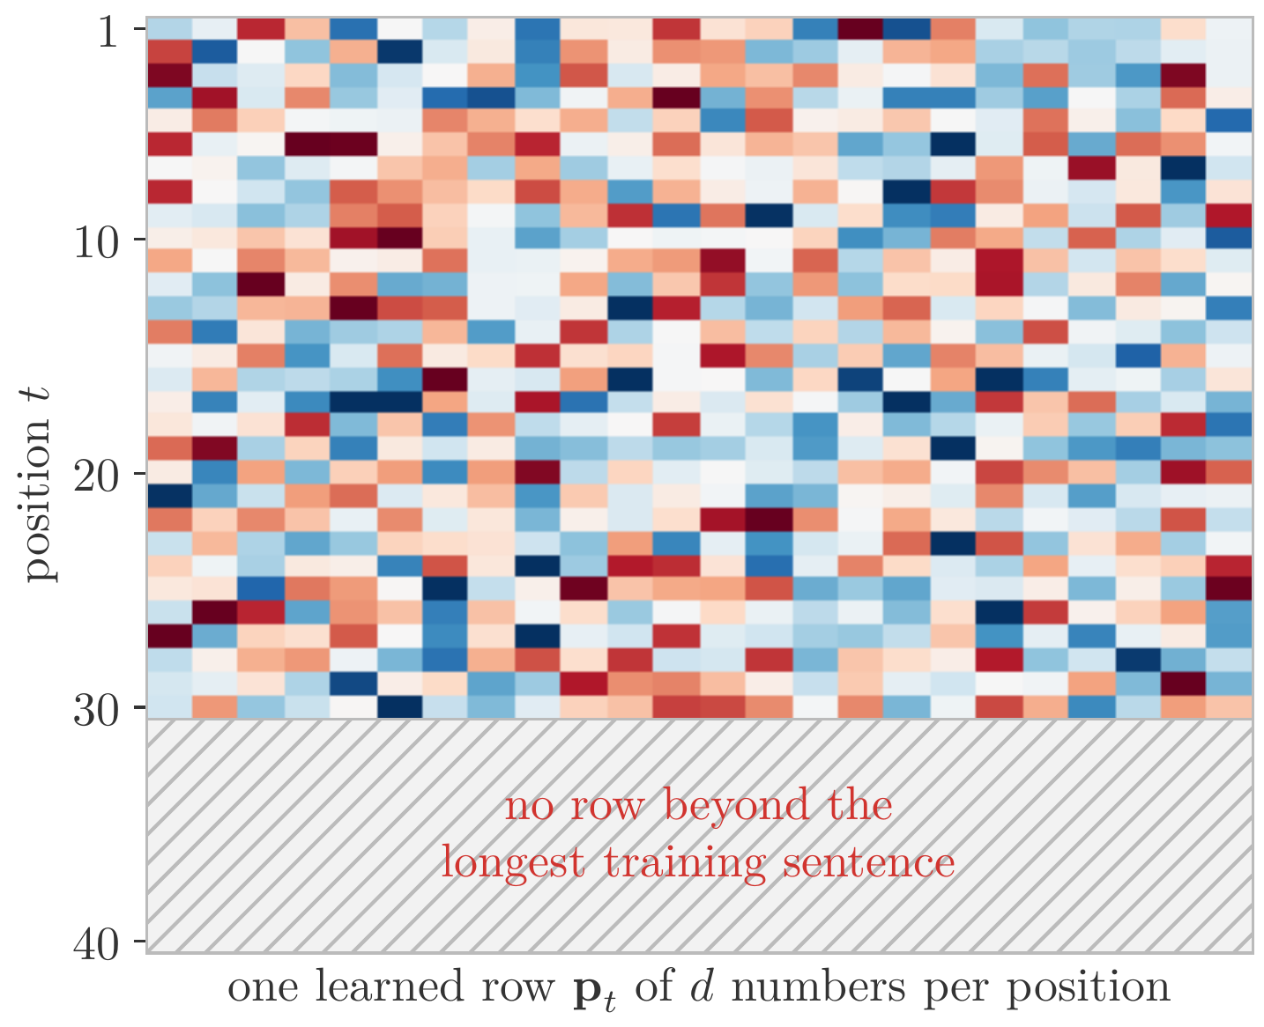
Word Order: Positions
What a position vector should be
distinct: the third word is not the fifth
fixed: position 3 is the same in every sentence
bounded: it must not drown the word's vector
defined for every position: even beyond the longest training sentence
relative: t → t + u changes it the same way for every t, so “two words back” works everywhere
learned vectors, one row per position: the first three, not the last two
Slide figure: an illustrative learned table of position vectors
Notes:
Notes §2, 'What a position vector should be'. Source position j adds p_j to the vector of the English word x_j; target position t adds p_t to the vector of the French word before it. Five requirements, one per click. [click] Distinct: the third word is not the fifth, and two target positions after the same French word ask different questions. [click] Fixed: position 3 means the same in every sentence. [click] Bounded: late positions must not drown the word's vector. [click] Defined for every position, even beyond the longest training sentence. [click] Relative: moving from t to t + u changes the vector the same way for every t, so 'two words back' is learned once. [click] Learned vectors, one row of a table per position (the picture is illustrative), meet the first three but not the last two: no row exists beyond the longest training sentence, and nothing relates rows by offset.

Slide 9
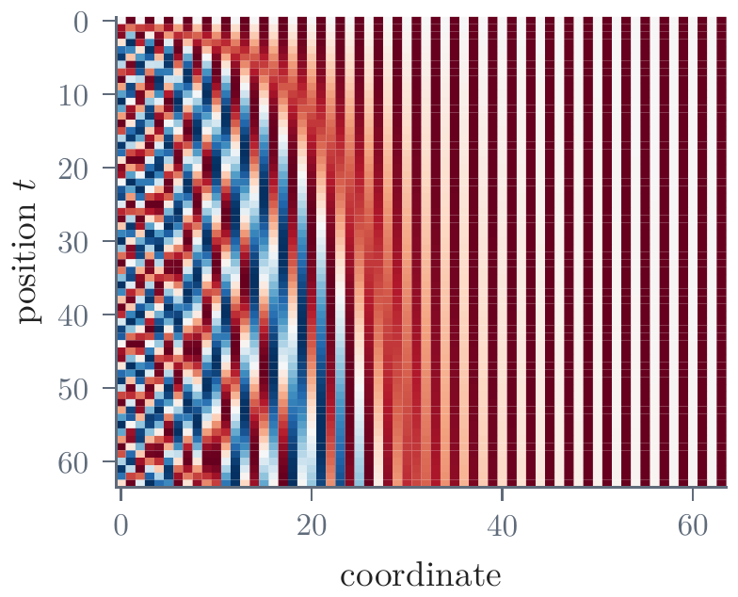
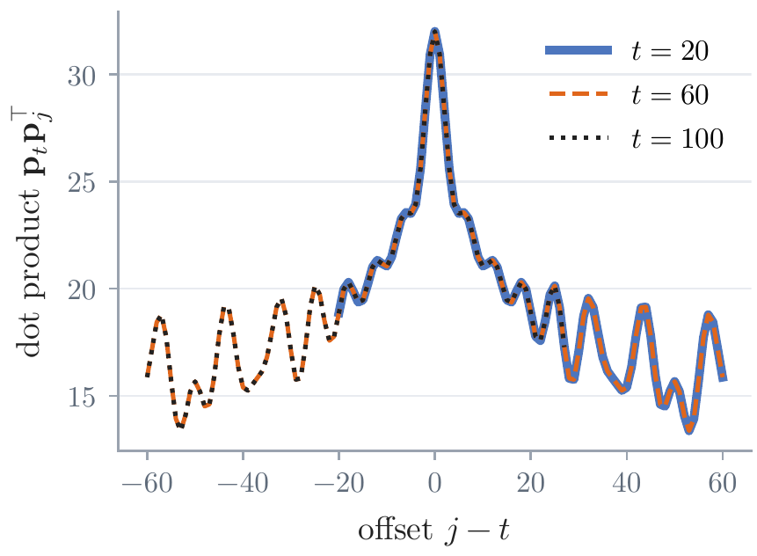
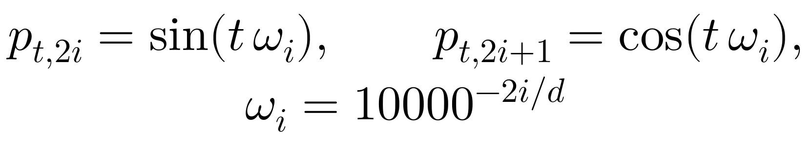
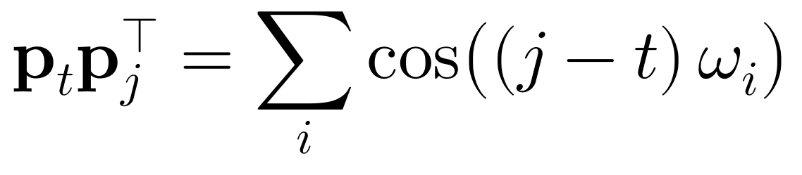
Word Order: Positions
Sinusoids: a clock with many hands
pairs of sines and cosines: each pair turns at its own rate as t grows
an offset is a rotation: t → t + u turns every pair by u ω_{i}, the same for every t
why this design: the paper's two hopes, attending by relative position and reading longer sentences; §9 gives the deeper reason
Figure 5b: the dot product depends only on the offset
Figure 5a: 64 positions (rows), d = 64; from −1 (blue) to 1 (red)
Notes:
Notes §2, Figure 5. Vaswani et al. chose fixed sines and cosines. [click] Pairs of coordinates, the sine and cosine of t ω_i, with frequencies falling geometrically from 1 to 1/10,000 radian per position. Each pair is a point on a circle that turns at its own rate: a clock with many hands, from one radian per position to one turn in about 57,000 positions when d = 192. The picture: 64 positions with d = 64, every coordinate between −1 and 1. [click] Moving from t to t + u turns every pair by u ω_i, the same for every t, so the dot product of two position vectors depends only on their offset: one curve for three starting positions. Requirements 4 and 5, for the vectors themselves. [click] The paper's reasons are two hopes: attending by relative position, and reading longer sentences. The frequencies and the base 10,000 are a choice; §9 gives the deeper reason, rotations.

Slide 10
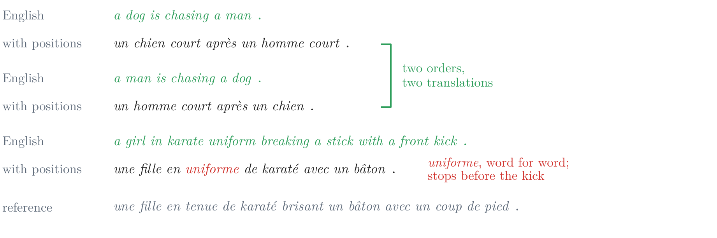
Word Order: Positions
What positions change: 1.7 → 39.3 BLEU
the experiment: the toy, with positions and the learned maps, trained as before; cross-entropy 3.04 → 1.42, BLEU 1.7 → 39.3
both failures gone: two orders, two translations; the karate caption no longer loops
two gaps remain: uniforme for uniform, word for word; and it stops before the kick (§3)
Figure 6: greedy output with positions; the reference in gray
Notes:
Notes §2, 'What positions change', Figure 6. [click] The experiment: the toy plus position vectors and the learned maps, trained as before. Cross-entropy falls from 3.04 to 1.42, BLEU rises from 1.7 to 39.3. [click] Both failures are gone: the sentences of the toy's slide, translated greedily. The two chases get two translations, and the karate caption no longer loops. [click] But two gaps remain, in red: uniforme translates uniform word for word, where Lecture 3's translators wrote tenue, and the translation stops before the kick. §3 takes them up.

Slide 11
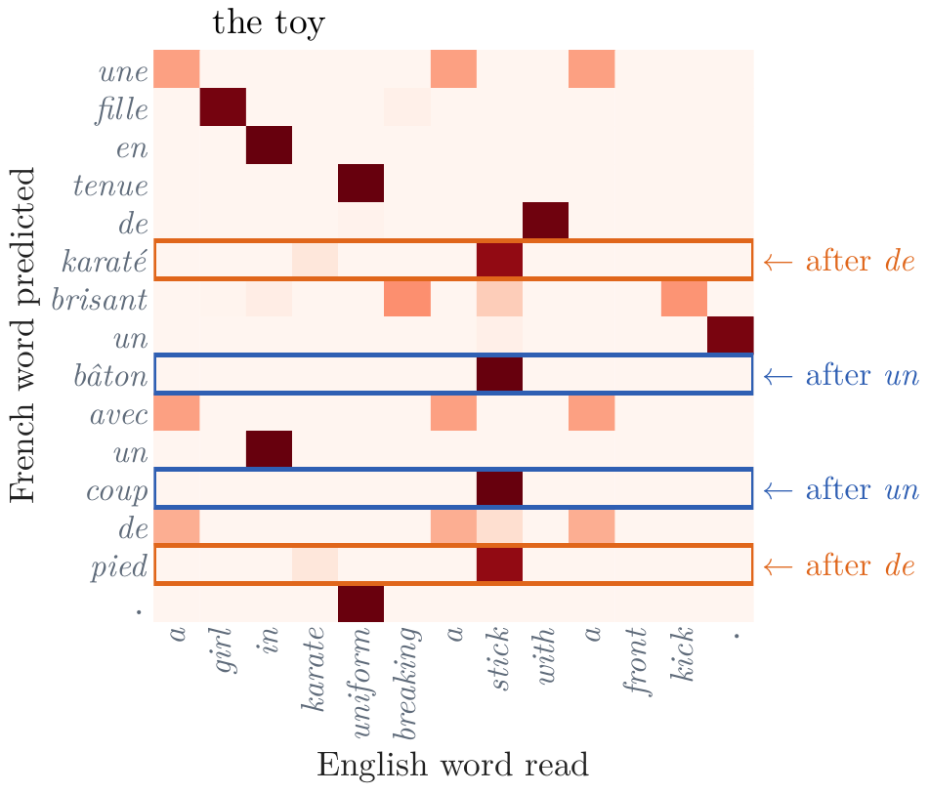
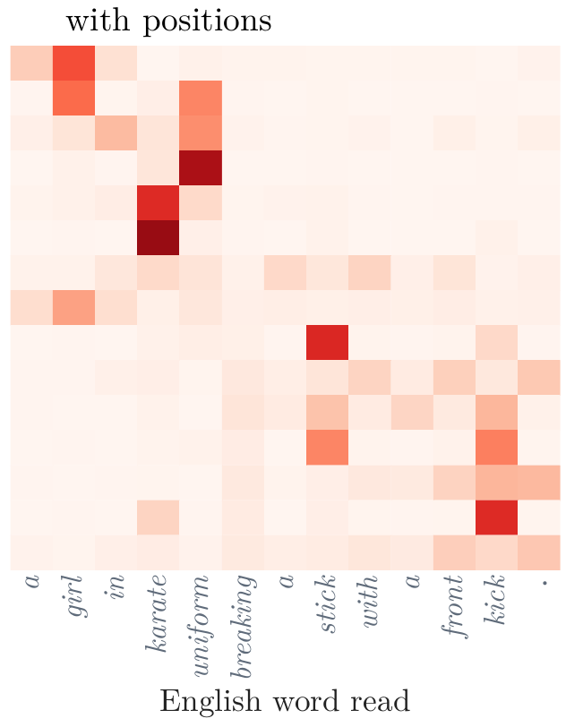
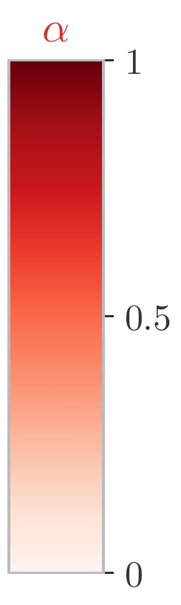
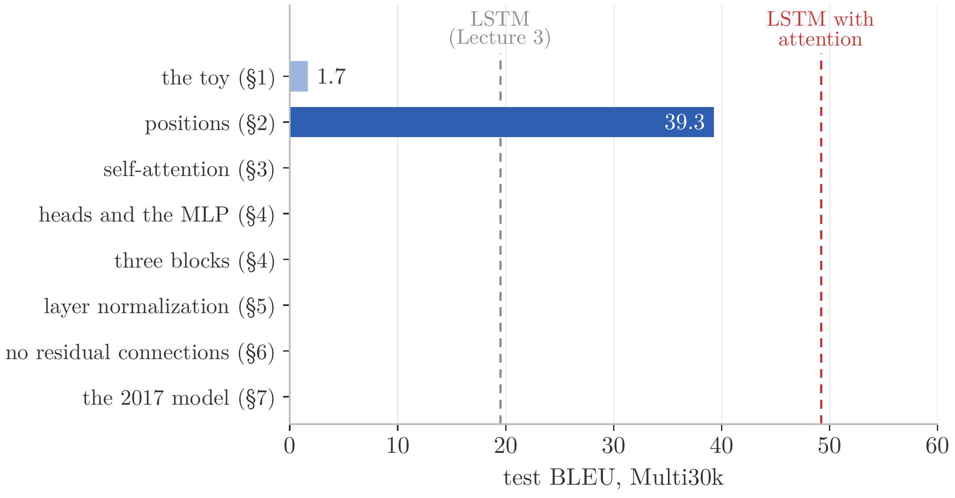
Word Order: Positions
What positions change: the reads
the toy's reads: rows after the same French word are identical
with positions: each French position has its own query; the reads follow the caption
learned or sinusoidal: learned 42.9 against 39.3 here (one run); 25.7 against 25.8 in the paper
the build so far: the largest step of the lecture
Figure 7a: each square is the weight α of the English word (column) in the read for the French word (row)
Figure 7b: each square is the weight α of the English word (column) in the read for the French word (row)
Notes:
Notes §2, 'What positions change', Figure 7. [click] Why the failures are gone, in the reads. Each square is a weight between 0 and 1: row, the French word being predicted; column, the English word read; each row sums to 1. In the toy, the query depends only on the previous French word, so rows that follow the same French word are identical: after de, karaté and pied; after un, bâton and coup. [click] With positions, every French position has its own query, and the reads move along the caption as the translation advances. [click] Learned position vectors instead of sinusoids gave 42.9 in one run; the paper found the two nearly identical (25.7 against 25.8) and kept sinusoids for longer sentences. [click] The ladder of BLEU scores: the largest step of the lecture.

Slide 12
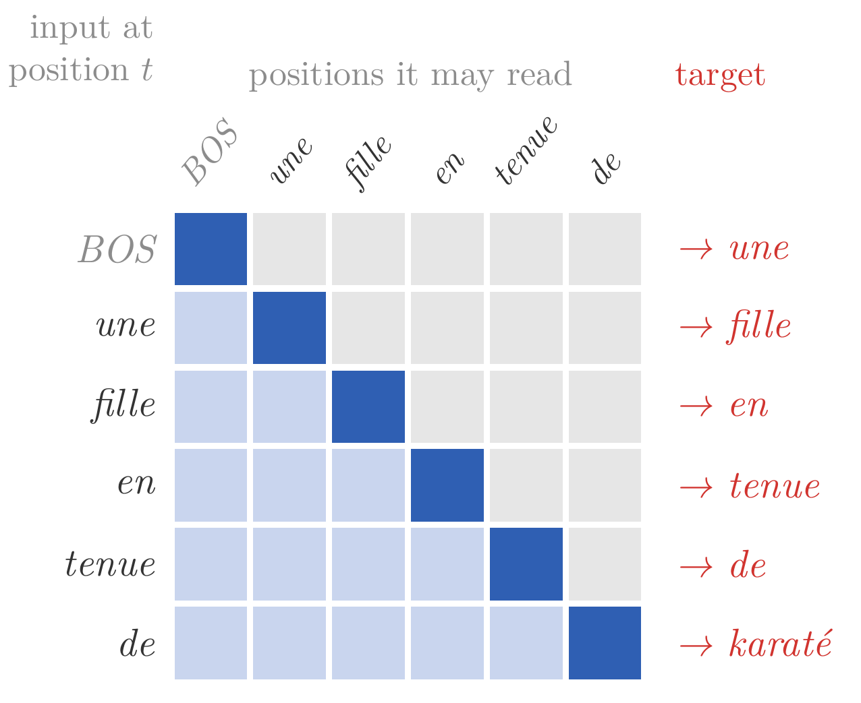
Context: Self-Attention
Reading one's own sentence
the problem: uniforme for uniform, since each source word is read alone; each French position knows only its place and the last word → the fix here: the positions of one sentence read one another
a sentence: T positions, the rows h₁, …, h_{T} of a T × d matrix X
in the encoder: every English position may read every other
in the decoder: position t holds y_{t−1} and predicts y_{t}, so it may read only j ≤ t, the translation so far
each read: c_{t}, a weighted average of the vectors t may read; how should the weights be chosen?
Slide figure: the decoder; each row reads the blue squares (dark, its own input)
Notes:
Notes §3, 'Reading one's own sentence'. Two gaps remain in the karate translation (Figure 6): uniforme translates uniform word for word, because each English word is read without its neighbors; and the translation stops before the kick, because each French position knows its place and the previous word, but not what the earlier positions have read or written. One remedy for both: the positions of one sentence read one another. [click] Write the sentence's vectors, one per position, as the rows of a T × d matrix X, T the length of the sentence. In the first layer each row is a word's vector plus its position's (§2). [click] In the encoder, every English position may read every other. [click] In the decoder, position t holds the French word written before it, y_(t−1), with y_0 = BOS, and predicts y_t, so it may read only itself and the positions before it: the translation so far. The picture: each row a position, its input on the left, the positions it may read in blue (dark, its own), its target in red. From here on, t is the position that reads and j a position it reads. [click] Each position's read c_t is a weighted average of the vectors it may read. The question is how to choose the weights; two simple choices show what is needed, next slide.

Slide 13
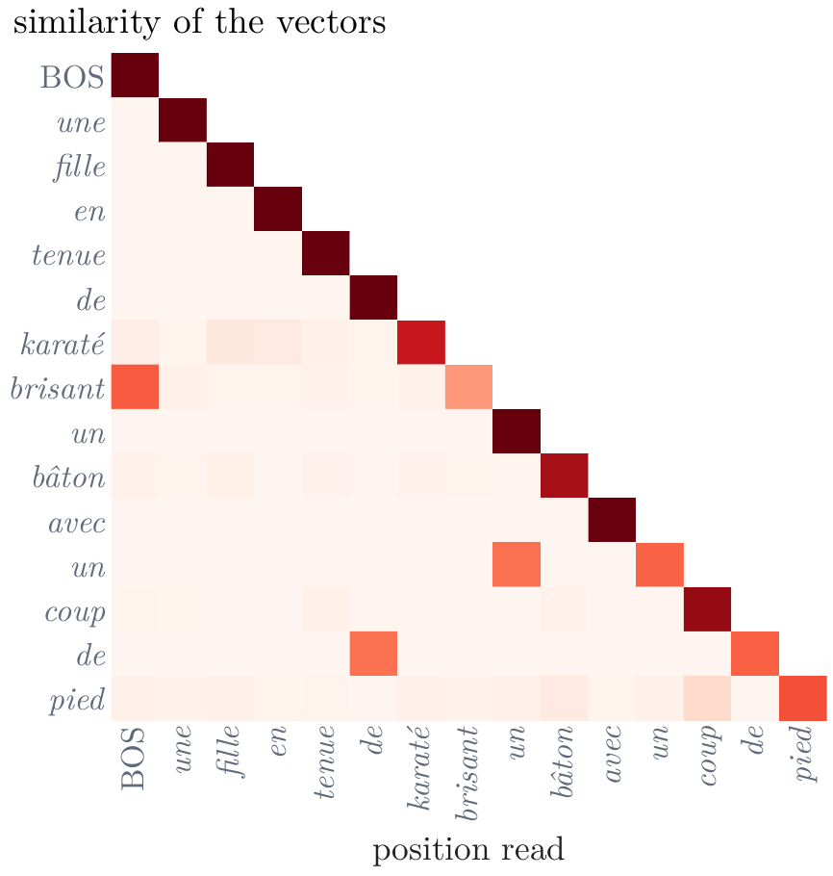
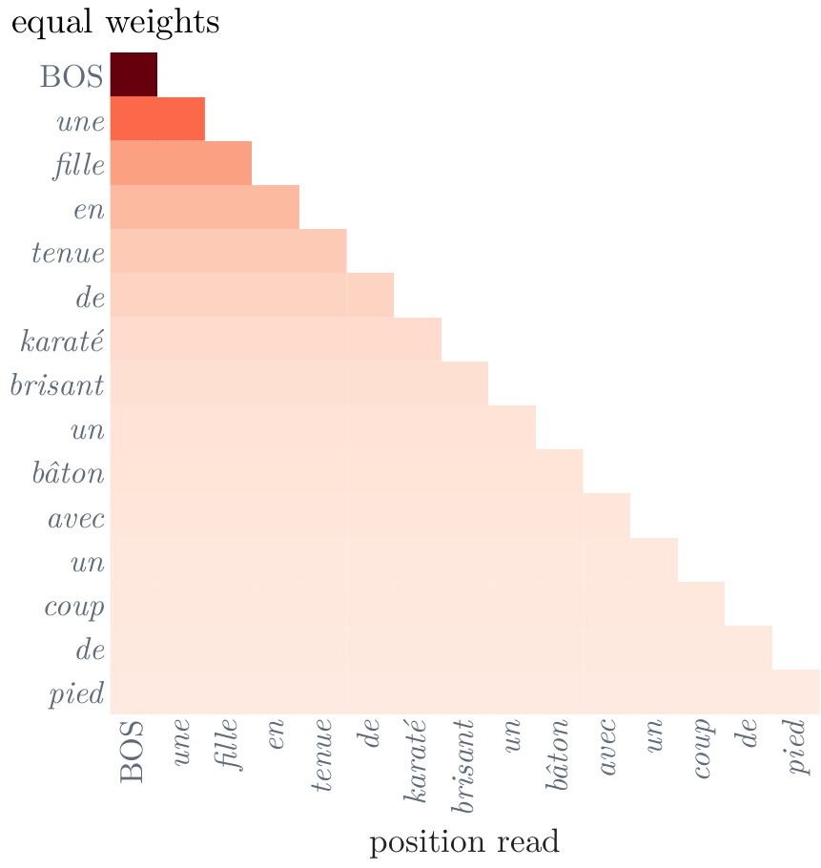
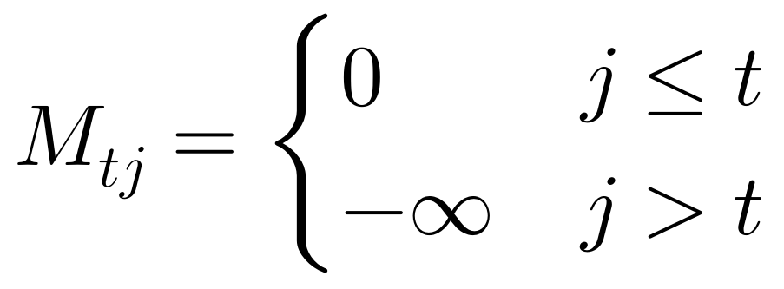
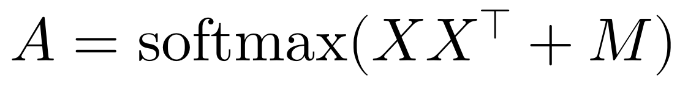
Context: Self-Attention
Choosing the weights
equal weights: c_{t} averages h₁, …, h_{t}
as matrices: a mask of −∞ above the diagonal
weights from similarity: dot products of the vectors
each word mostly reads itself: 0.82 of its weight; and a pronoun looks for its noun, not the reverse
the remedy of §2: learned queries, keys, and values
Figure 8a: equal weights; rows read, columns are read, darker is more weight
Figure 8b: dot products of the vectors; each row sums to 1
Notes:
Notes §3, 'Reading one's own sentence', Figure 8. Two simple choices of the weights, on the reference translation as the decoder of §2 holds it. In both pictures each row is a reading position and divides one unit of weight over the positions up to its own; darker is more. [click] Equal weights: in the decoder, c_t is the average of h_1 to h_t. [click] In matrix form, C = AX with A the softmax, row by row, of a mask M that is 0 where j ≤ t and −∞ above the diagonal: a score of −∞ gets weight e^(−∞) = 0, and the other positions share the weight equally. The encoder leaves out M. This read ignores what the words are. [click] Weights from similarity: score each readable position by the dot product of its vector with the reader's. Now the weights depend on the words, but in the wrong way. [click] A vector is usually most similar to itself, so each word mostly reads itself, 0.82 of the weight on average; and the dot product is symmetric, while a pronoun looks for its noun and the noun has no reason to look for the pronoun. [click] Both failures have the remedy of §2: look with a query, be found through a key, pass on a value, each computed from the vector by a learned map.

Slide 14
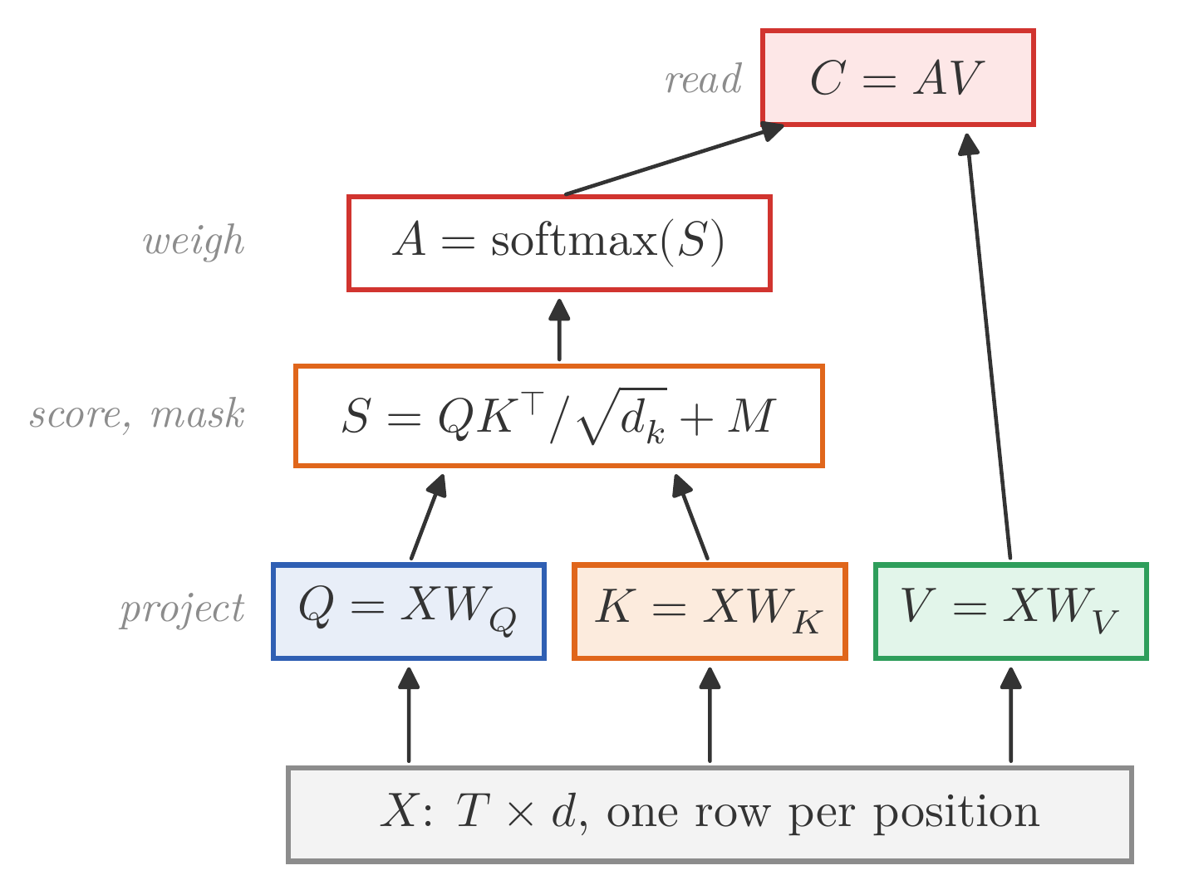
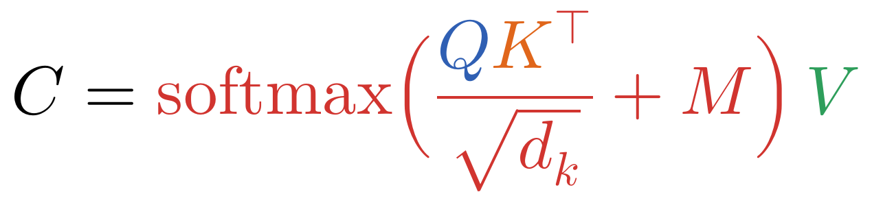
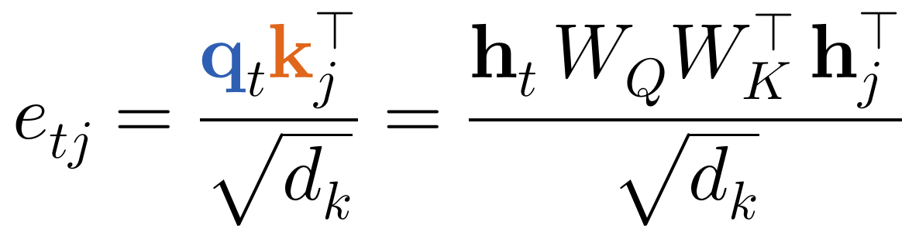
Context: Self-Attention
Self-attention: queries, keys, and values from one sentence
three maps of the same sentence
the read: softmax of the scaled scores, masked, times the values
not symmetric: W_{Q} W_{K}^{T} need not be, so a pronoun can look for its noun, not the reverse
found by one thing, passes on another: the value need not be the key
Slide figure: one head of self-attention, step by step
Notes:
Notes §3, the formula; a figure made for the slides. [click] Self-attention computes queries, keys, and values from the same sentence, by the maps of §2: Q = XW_Q, K = XW_K, V = XW_V. [click] The read: the softmax, row by row, of the scaled scores plus the mask, times V. The picture is one head: project, score, mask, weigh, read. [click] The score is Lecture 3's bilinear score with its matrix factored as W_Q W_K^T, which need not be symmetric: the pronoun can look for its noun without the noun looking back. [click] And what a position passes on, its value, can differ from what it is found by, its key.

Slide 15
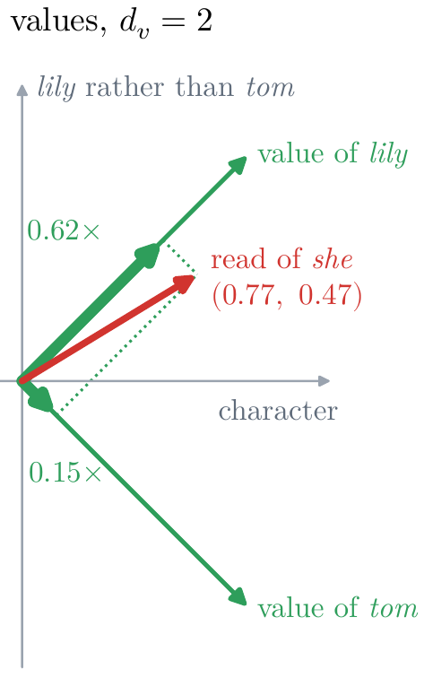
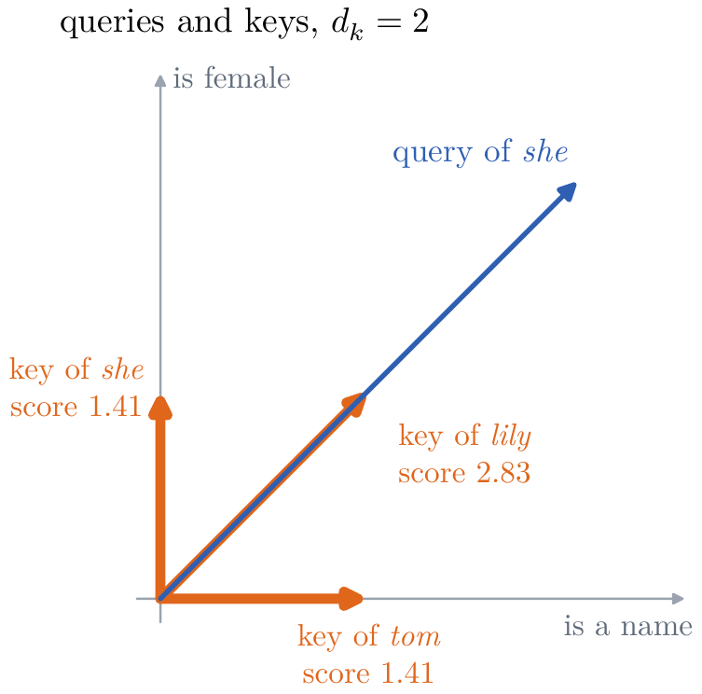
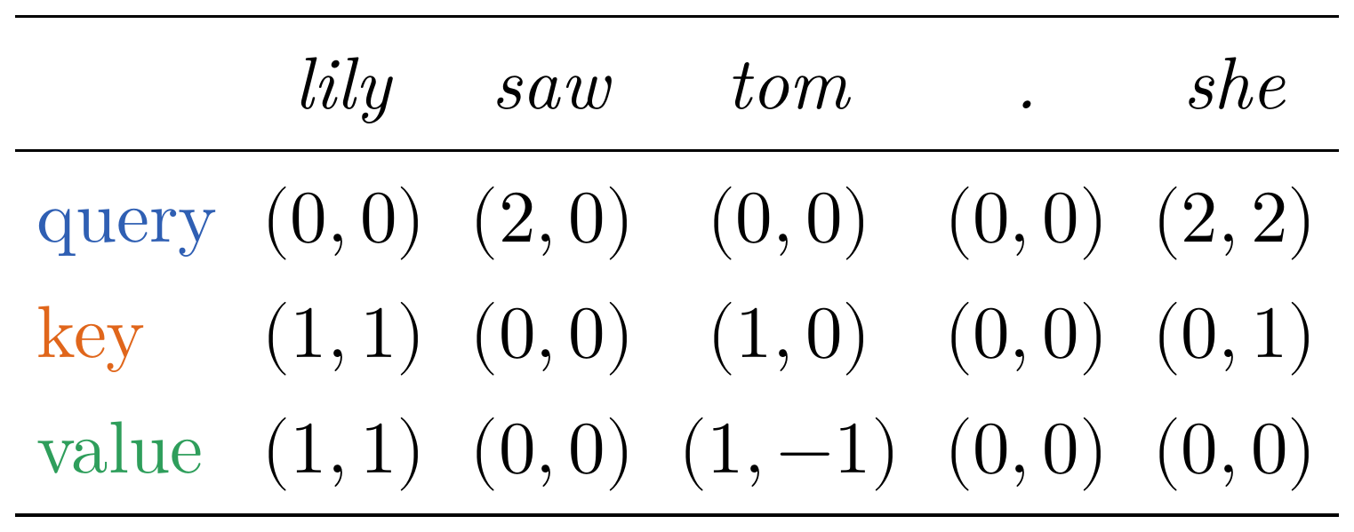
Context: Self-Attention
One head by hand: lily saw tom . she
hand-chosen maps: a key says (is a name, is female), a query (wants a name, wants a female), a value (is a character, lily rather than tom)
she scores the keys: lily's key reaches furthest along its query
the read: a weighted sum of the values, about lily, by content, not position
Notes:
Notes §3, 'One head by hand', Figure 9 (after Sanderson, 2024b). The sentence lily saw tom . she, one masked head, hand-chosen features. Board work. [click] A key says (is a name, is female); a query says (wants a name, wants a female); a value says (is a character, lily rather than tom), +1 for lily and −1 for tom. The table gives the rows of Q, K, and V. [click] The query of she, (2, 2), scores the five keys (4, 0, 2, 0, 2)/√2; the softmax gives (0.62, 0.04, 0.15, 0.04, 0.15): lily's key reaches furthest along the query. [click] The read is the weighted sum of the values, 0.62 (1, 1) + 0.15 (1, −1) = (0.77, 0.47): about a character, and pointing to lily. Tom stands nearer, but lily matches both coordinates of the query: the read goes by content, not position. In a trained model the features are learned directions, rarely this clean.

Slide 16
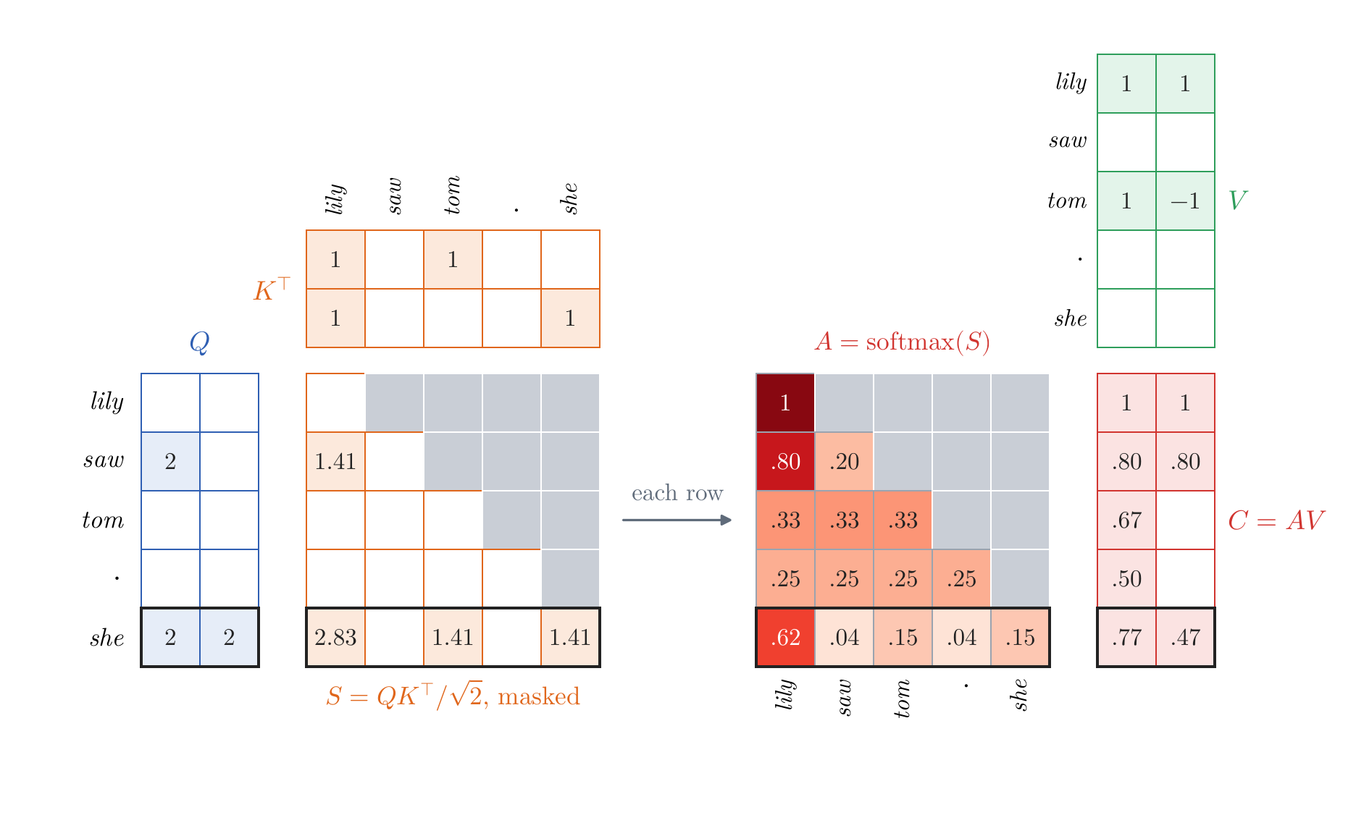
Context: Self-Attention
The matrix form: one head in five steps
1. project: Q and K are T × d_{k}, V is T × d_{v}
2. score: S = QK^{T}/√d_{k}, which is T × T
3. mask: −∞ above the diagonal
4. weigh: A, the softmax of each row
5. read: C = AV, which is T × d_{v}
all matrix products: only steps 2 and 5 mix positions; parallel hardware does them fastest
Figure 10: the example above; the row of she outlined
Notes:
Notes §3, 'The matrix form', Figure 10. The same head for all positions at once, one step per click; the picture is the example above. [click] Project: Q and K are T × d_k, V is T × d_v. [click] Score: S = QK^T/√d_k, T × T; entry (t, j) compares query t with key j. [click] Mask: −∞ above the diagonal (gray). [click] Weigh: the softmax of each row gives A, zero above the diagonal. [click] Read: C = AV; row t is the weighted average of the values position t may read. The row of she is outlined. [click] Only steps 2 and 5 mix positions, and every step is a matrix product or acts entry by entry, which parallel hardware does fastest: why Vaswani et al. chose the dot product over Bahdanau's additive score.

Slide 17
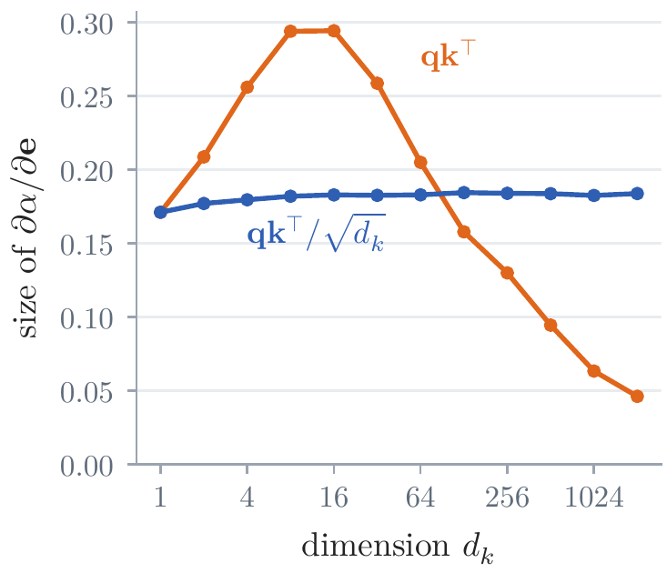
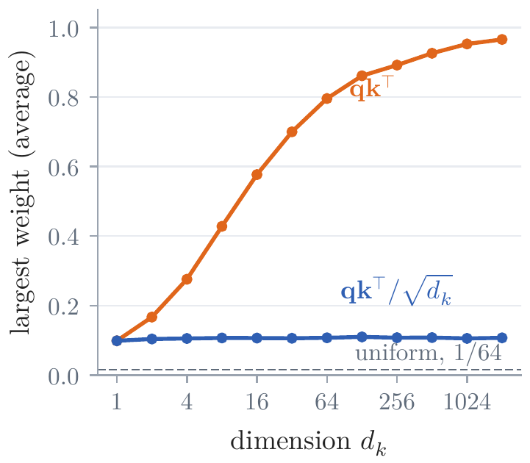
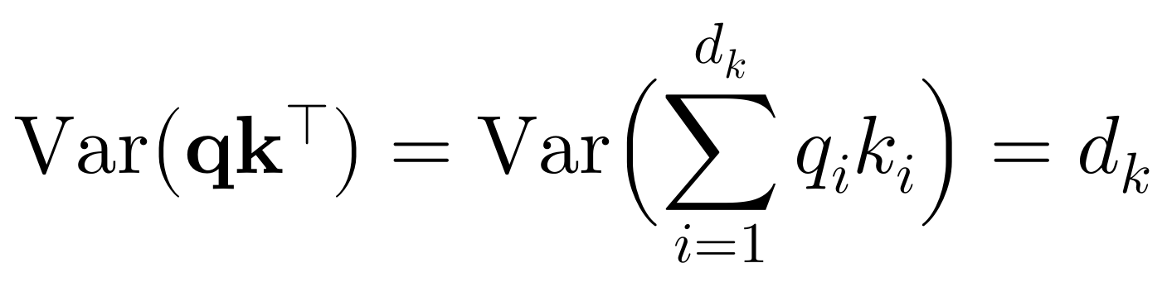
Context: Self-Attention
Why divide by √d_{k}
the experiment: random queries and keys, as at initialization; one query, 64 keys, 2,000 trials
the dot product has variance d_{k}: with d_{k} = 256 the scores spread by 16; almost 90% of the weight on one key
one weight near 1: the softmax's derivatives near zero, so no gradient
divide by √d_{k}: variance 1 for every d_{k}, Lecture 2's temperature
Notes:
Notes §3, 'Why divide by √d_k', Figure 11; Appendix A.1. Ask first: why the √d_k? [click] The experiment: random queries and keys with standard normal coordinates, as at initialization; one query, 64 keys, 2,000 trials. [click] q k^T is a sum of d_k terms of variance 1, so its variance is d_k. With d_k = 256 the scores spread by 16, and the softmax puts almost 90% of its weight on the largest (orange, first picture). [click] With one weight near 1, the derivatives of the weights with respect to the scores are near zero: the gradient vanishes (second picture). [click] Dividing by √d_k gives variance 1 for every d_k (blue): Lecture 2's temperature, fixed at √d_k. It holds at initialization; training can grow the scores again. The paper gave this argument in a footnote, citing Britz et al. (2017): unscaled dot products fell behind additive scores as the dimension grew.

Slide 18
Context: Self-Attention
The causal mask: every prediction in one pass
teacher forcing: the input at position t is the reference's previous word, y_{t−1}
reading ahead is reading the answer: position t + 1 holds y_{t}
the mask is enough
1. within a position, q_{t}, k_{t}, v_{t} come from h_{t}
2. within a layer, c_{t} depends only on h₁, …, h_{t}
3. through the stack, everything else acts on one position or reads the source
one pass trains every prediction: a recurrent decoder needed one step per word
the encoder needs no mask: the whole English caption is known
Slide figure: the decoder in training; blue may be read (dark, its own input), gray is masked
Notes:
Notes §3, 'The causal mask: every prediction in one pass'; a figure made for the slides. [click] In training, the decoder sees the whole reference translation at once (teacher forcing, Lecture 3): its input at position t is the reference's previous word, y_(t−1), and its output there is a distribution over y_t. [click] If position t could read position t + 1, whose input is y_t, it would read the very word it must predict. [click] The causal mask forbids exactly this, and it is enough, for three reasons; board work, one line each. Within a position: the query, key, and value of t are h_t times a matrix. Within an attention layer: the weight on j > t is zero, and the weights on j ≤ t depend only on q_t and k_1 … k_t, so c_t depends only on h_1 … h_t. Through the stack: every other operation acts on each position separately, or reads the source, which is known in full; so by induction over the layers, the output at t depends only on the source and y_0 … y_(t−1). [click] So one forward pass over a caption pair predicts every French word, each from its own prefix, and one backward pass trains them all; a recurrent decoder needed one step per word. [click] The encoder needs no causal mask: the whole English caption is known before the translation starts.

Slide 19
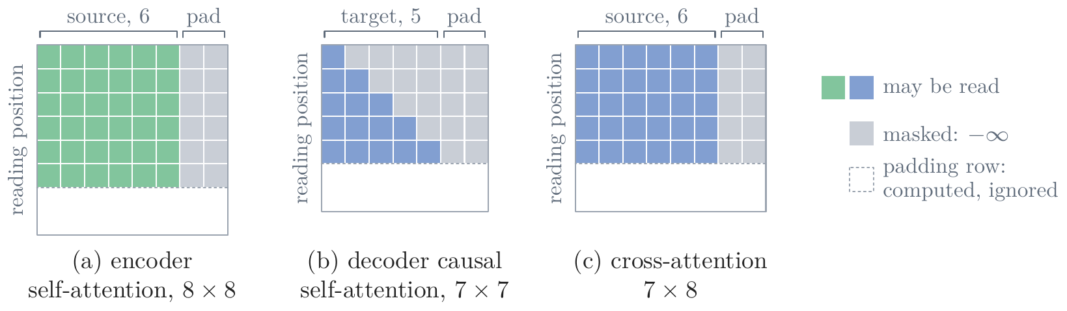
Context: Self-Attention
Sentences of any length
T is not built into the model: W_{Q}, W_{K}, W_{V} act on one position at a time; only the T × T weights change size
source and target: T = n for the caption, m for BOS, y₁, …, y_{m−1}; the read of the source is m × n
a batch: pad each caption to the batch's longest; a padding mask adds −∞ for the filler, and the loss ignores it
in generation: one word at a time; T grows by one with each word
Figure 12: which positions (columns) each position (row) may read, for one padded caption pair
Notes:
Notes §3, 'Sentences of any length', Figure 12. [click] The length T is not built into the model. The maps W_Q, W_K, and W_V act on one position at a time, so the same weights serve a sentence of any length; only the T × T matrices of scores and weights change size with T. [click] For the source, T is the caption's length n; for the target, the number m of positions BOS, y_1, …, y_(m−1); and the decoder's read of the source compares m queries with n keys, an m × n matrix. [click] To train on many caption pairs at once, the captions of a batch are padded with a filler token to the longest one, so that they stack into one array. A padding mask adds −∞ to the score of every padding position, so no real word reads the filler, and the loss ignores the predictions at padding positions. The picture: one pair from a batch whose longest source has 8 words and longest target 7 positions; this source has 6 and this target 5. (a) encoder self-attention, 8 × 8; (b) decoder self-attention, 7 × 7; (c) the read of the source, 7 × 8, not square. Padding rows are computed and then ignored. [click] In generation, the decoder still writes one word at a time, and its T grows by one with each word.

Slide 20
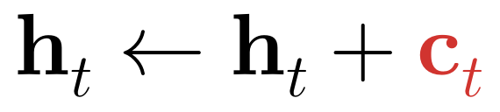
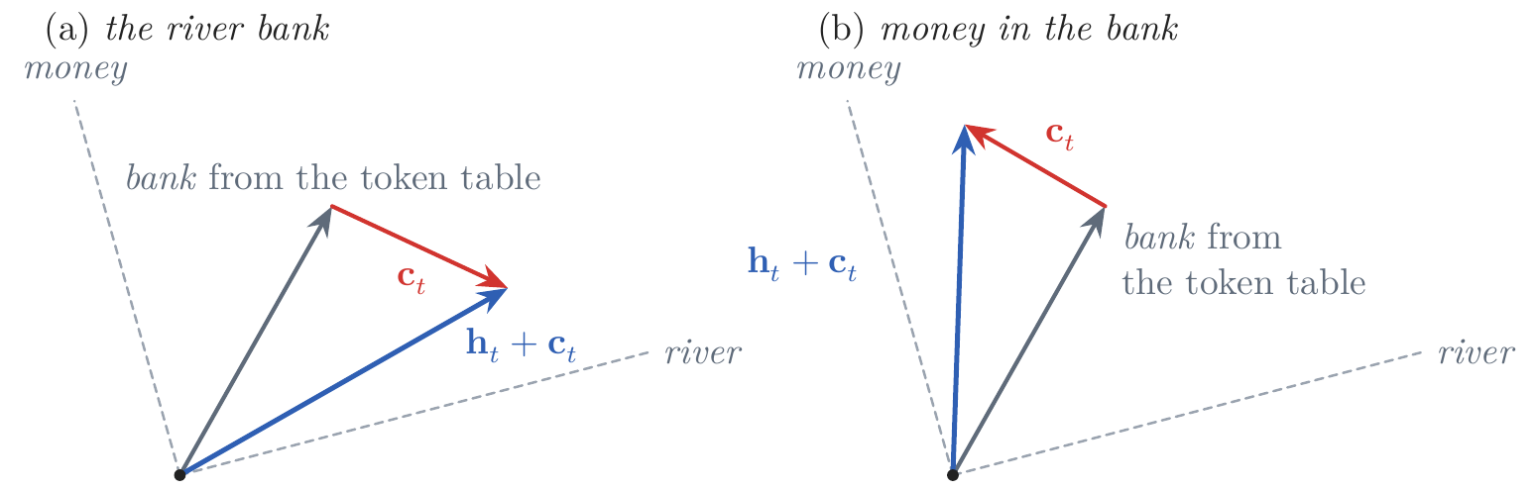
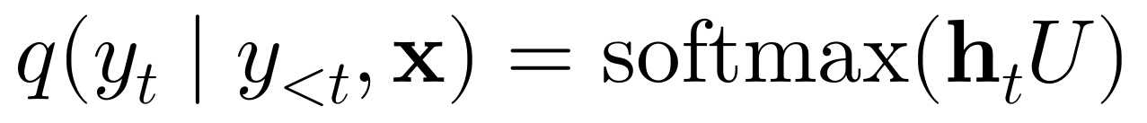
Context: Self-Attention
Adding the read to the vector
add, do not replace: each read is added to the vector it came from, a residual connection (§6)
the logits: from the decoder's last vector at t
a word in context: bank moves toward river, or toward money
Figure 13: schematic, in two of the d directions; gray, bank from the token table; red, the read; blue, the sum
Notes:
Notes §3, 'Adding the read to the vector', Figure 13 (after Sanderson, 2024b). [click] Each read is added to the vector it was computed from, h_t ← h_t + c_t, in all three attentions; without the addition the word would be replaced by an average of values. The addition is a residual connection; §6 shows why it matters. [click] The output layer computes the logits, one number per French word, from the decoder's last vector at t alone. [click] So a word's vector now depends on its neighbors. Lecture 2 gave bank one vector for the river and the money. After self-attention, bank in the river bank moves toward what river passes on, and in money in the bank toward money: two uses, two vectors (schematic).

Slide 21
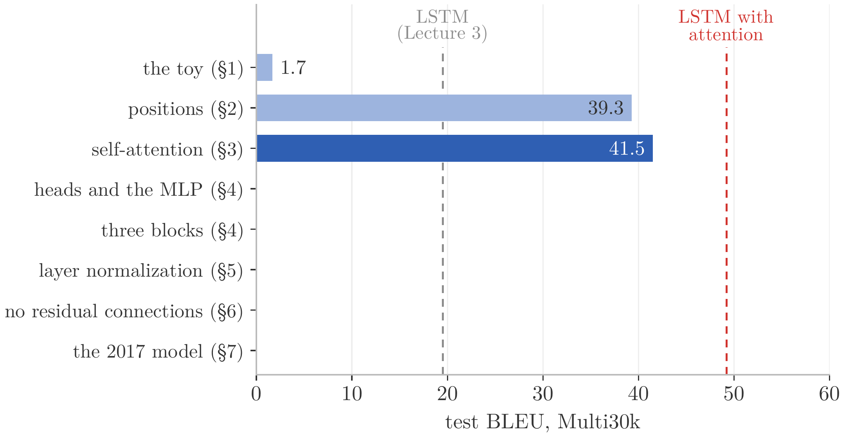
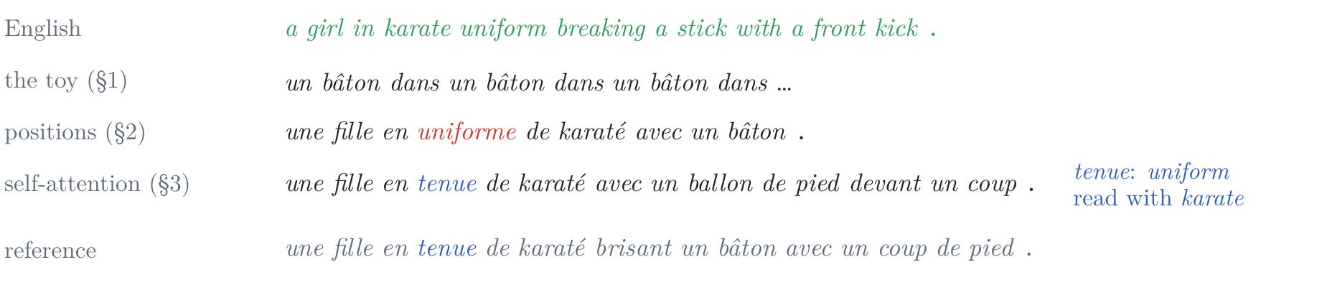
Context: Self-Attention
What self-attention changes: 39.3 → 41.5 BLEU
the experiment: one self-attention layer a side, trained as before; cross-entropy 1.42 → 1.40, BLEU 39.3 → 41.5
uniform becomes tenue: read with karate; the end of the caption is still wrong
a smaller gain than positions: one read per layer, of one kind, which can only average (§4)
Figure 14: greedy output for the karate caption; the reference in gray
Notes:
Notes §3, end, Figure 14. [click] The experiment: one layer of self-attention in the encoder and one of causal self-attention in the decoder, trained as before: cross-entropy 1.42 → 1.40, BLEU 39.3 → 41.5, with fewer weights, since the output layer now reads one vector instead of two. [click] The karate caption: uniform now becomes tenue (blue), read together with karate, though the end of the caption is still wrong. [click] A smaller gain than positions: each position still makes one read per layer, of one kind, and a read can only average what it reads. That is §4.

Slide 22
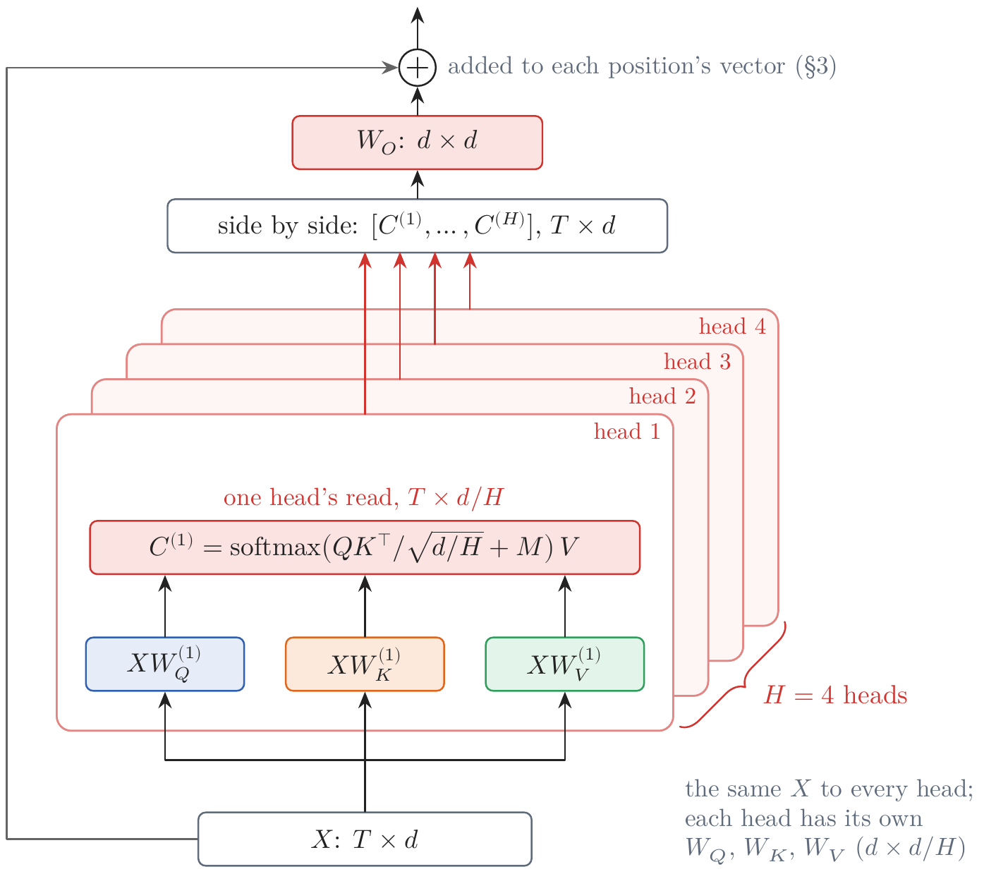
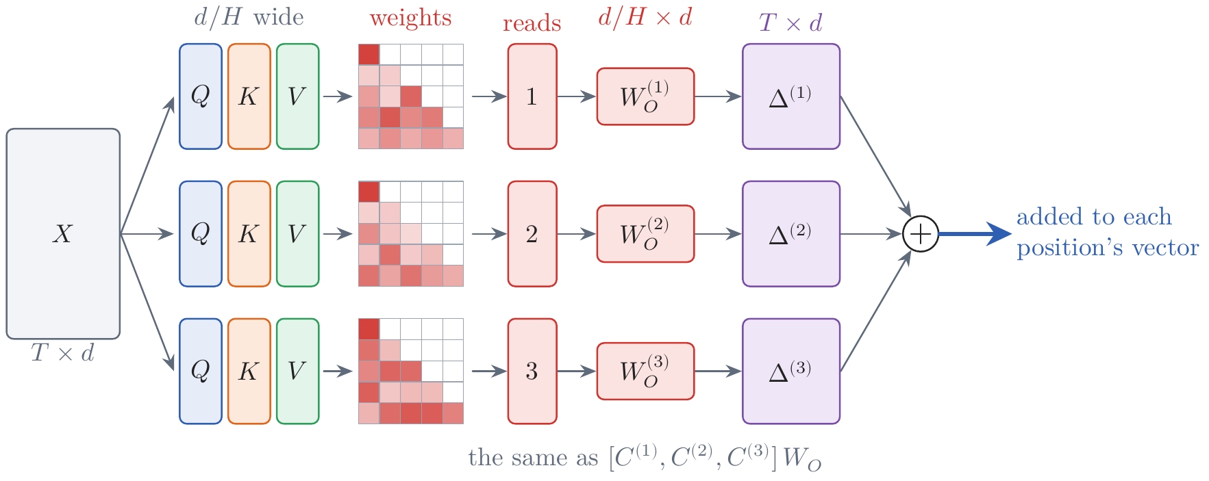
Heads, the MLP, and a Stack of Blocks
Several heads
the problem: one read per layer gathers one kind of information → the fix here: several reads side by side
tenue needs uniform and karate: one set of weights blurs them
H heads: each a whole attention with its own maps to d/H coordinates; W_{O} mixes their reads
the same cost as one head: 4d² weights and T²d multiplications, whatever H is
what they buy: one head of 512 scores 0.9 BLEU below eight of 64; in BERT, heads specialize in the previous token, next token, punctuation (Clark et al., 2019)
Figure 16: three heads; their changes (purple) are added
Figure 15: H heads, one behind another, after Vaswani et al. (2017), Fig. 2
Notes:
Notes §4, 'Several heads', Figures 15 (after Vaswani et al. 2017, Fig. 2) and 16. [click] To write tenue, a French position needs both uniform and karate; one set of weights cannot pick out both without blurring them. [click] Multi-head attention runs H heads side by side. The picture draws them one behind another: each head is a whole attention of its own, with its own maps W_Q, W_K, W_V from the same X to d/H coordinates, and its own read, T × d/H. The H reads are put side by side into a T × d matrix, W_O mixes them, and the result is added to each position's vector. [click] Several heads cost no more than one head of full width: 4d² weights, and T²d multiplications for the scores, whatever H is. [click] What they buy is several weightings at once (Figure 16: three heads, each with its own weights, each proposing its own change, and the changes added). In Vaswani et al.'s ablation, one head of 512 dimensions scored 0.9 BLEU below eight heads of 64. In BERT some heads read the previous token, some the next, some punctuation (Clark et al., 2019); in a translation model 38 of 48 encoder heads could be removed for 0.15 BLEU (Voita et al., 2019).

Slide 23
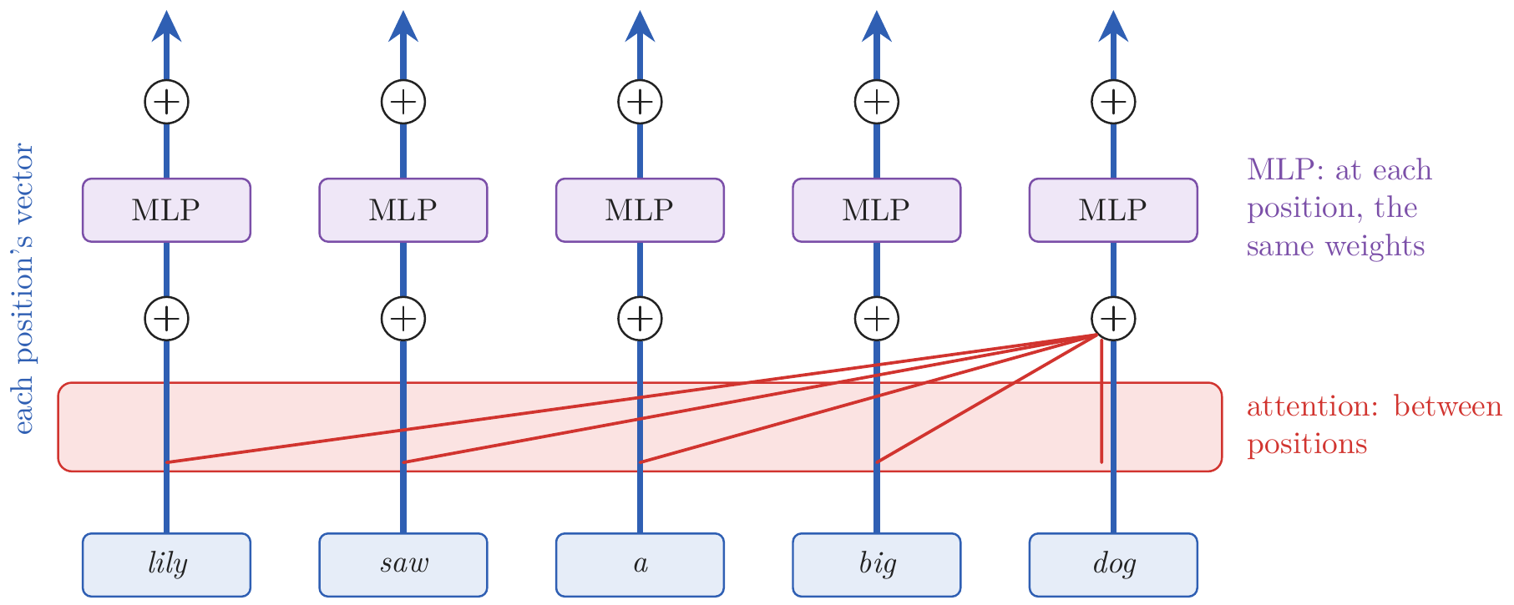
Heads, the MLP, and a Stack of Blocks
Why an MLP: communication and computation
the problem: attention only averages what it reads, linearly → the fix here: a network at every position
tenue needs karate AND uniform: a new feature, present only when both words are
an AND is not linear: 0 for neither word and for each alone forces 0 for both; it needs a threshold
attention is communication: it moves information between positions
the MLP is computation: one small network at every position, separately
one hidden layer, 4d wide: ReLU (2017), GELU later; two thirds of a block's weights
Figure 17: one block over five positions
Notes:
Notes §4, 'Why an MLP', Figure 17. Attention gathers information; it does not compute with it. A read is a weighted average of values, each a linear map of a vector; the only nonlinearity is in the weights, which decide where to read, not what to make of it. [click] But a translator needs new features made from old ones. To write tenue, a French position needs a feature that marks the pair karate uniform: uniform alone is uniforme, karate alone is karaté. [click] Such a feature is an AND, and an AND is not linear: a linear function that is 0 for neither word, 0 for karate alone, and 0 for uniform alone is also 0 for both. Making it takes a threshold, a nonlinearity. [click] So attention is communication, the only place where information moves between positions (red, drawn for the last position). [click] What a position does with what has arrived needs computation, a nonlinear function of its vector: each block applies a network with one hidden layer to every position separately, with the same weights everywhere and no access to other positions (purple). [click] The hidden layer is four times as wide as the vector, ReLU in 2017 and GELU later; the paper calls it the position-wise feed-forward network. Its 8d² weights are two thirds of an encoder block's.

Slide 24
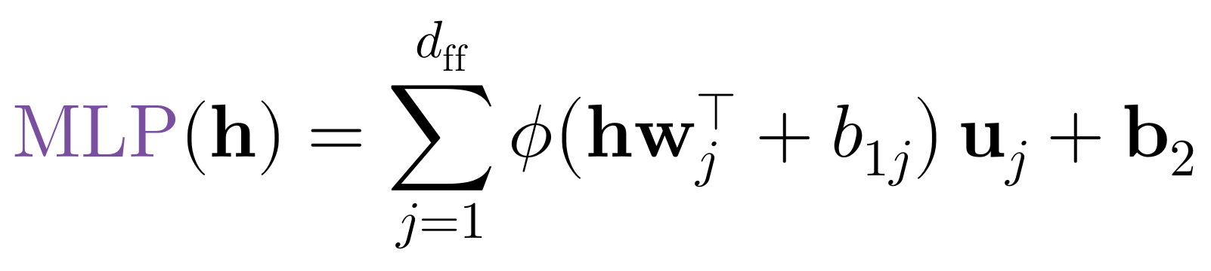
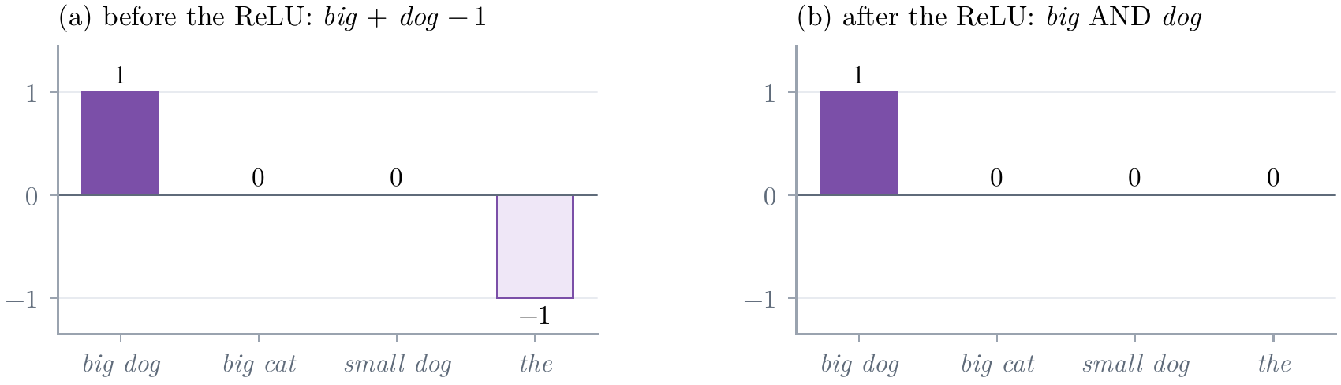
Heads, the MLP, and a Stack of Blocks
One hidden unit at a time
a sum over hidden units: column w_{j} of W₁ asks; row u_{j} of W₂ writes
a threshold makes an AND: only big and dog together pass the ReLU; so too karate and uniform
a key–value memory in the weights: Michael + Jordan → basketball (Sanderson, 2024c)
Figure 18: a toy hidden unit, bias −1
Notes:
Notes §4, Figure 18 (after Sanderson, 2024c). The MLP one hidden unit at a time. [click] Column w_j of W_1 asks a question of the vector; row u_j of W_2 is what the unit writes. The MLP is a sum over its units. [click] The dot product h·w_j measures how far the vector points along w_j; the bias sets a threshold; the ReLU passes only what exceeds it. A unit with 1 at big and at dog and a bias of −1 gives 1 for big dog, 0 for one word, −1 for neither: after the ReLU, only big dog passes. An AND, the kind of feature tenue needs from karate and uniform. [click] The unit's value scales u_j, what it adds to the vector. So the MLP acts like a memory of keys and values stored in its weights (Geva et al., 2021). Sanderson's example: once attention has brought Michael to the position of Jordan, a unit for both names can add a direction pointing to basketball.

Slide 25
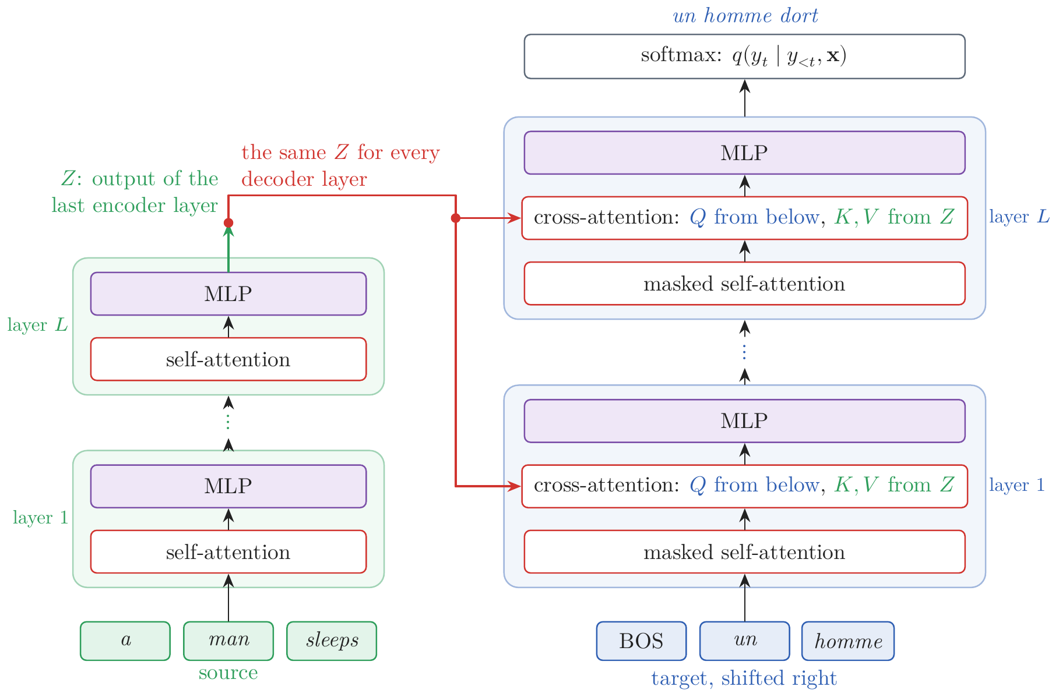
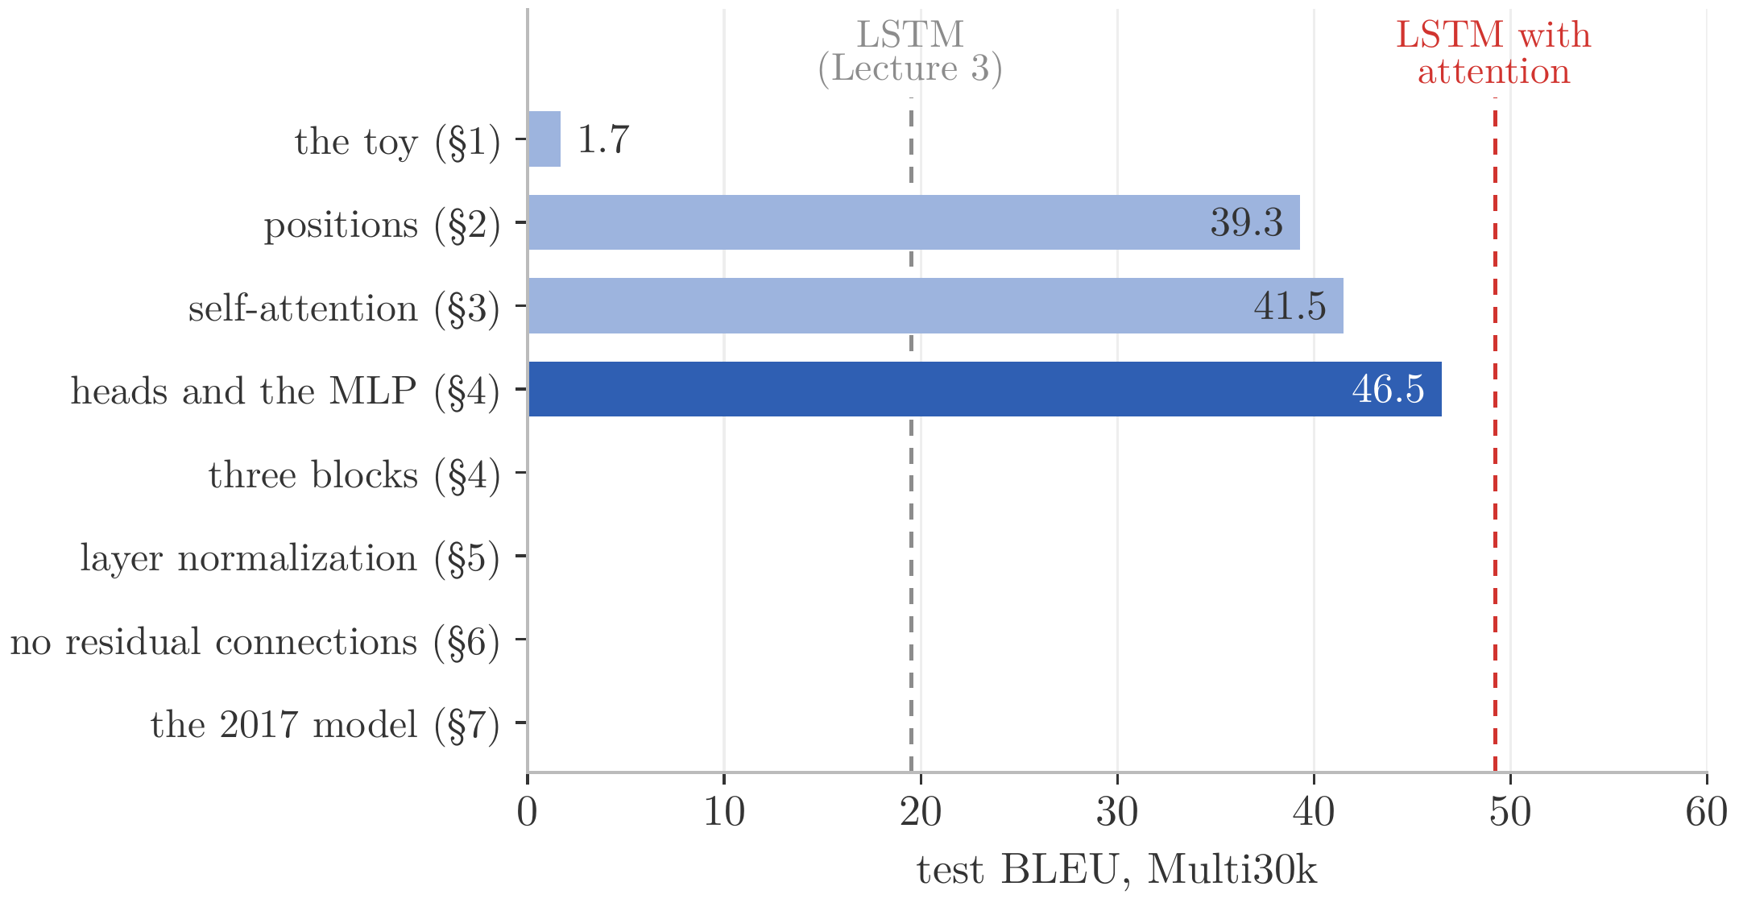
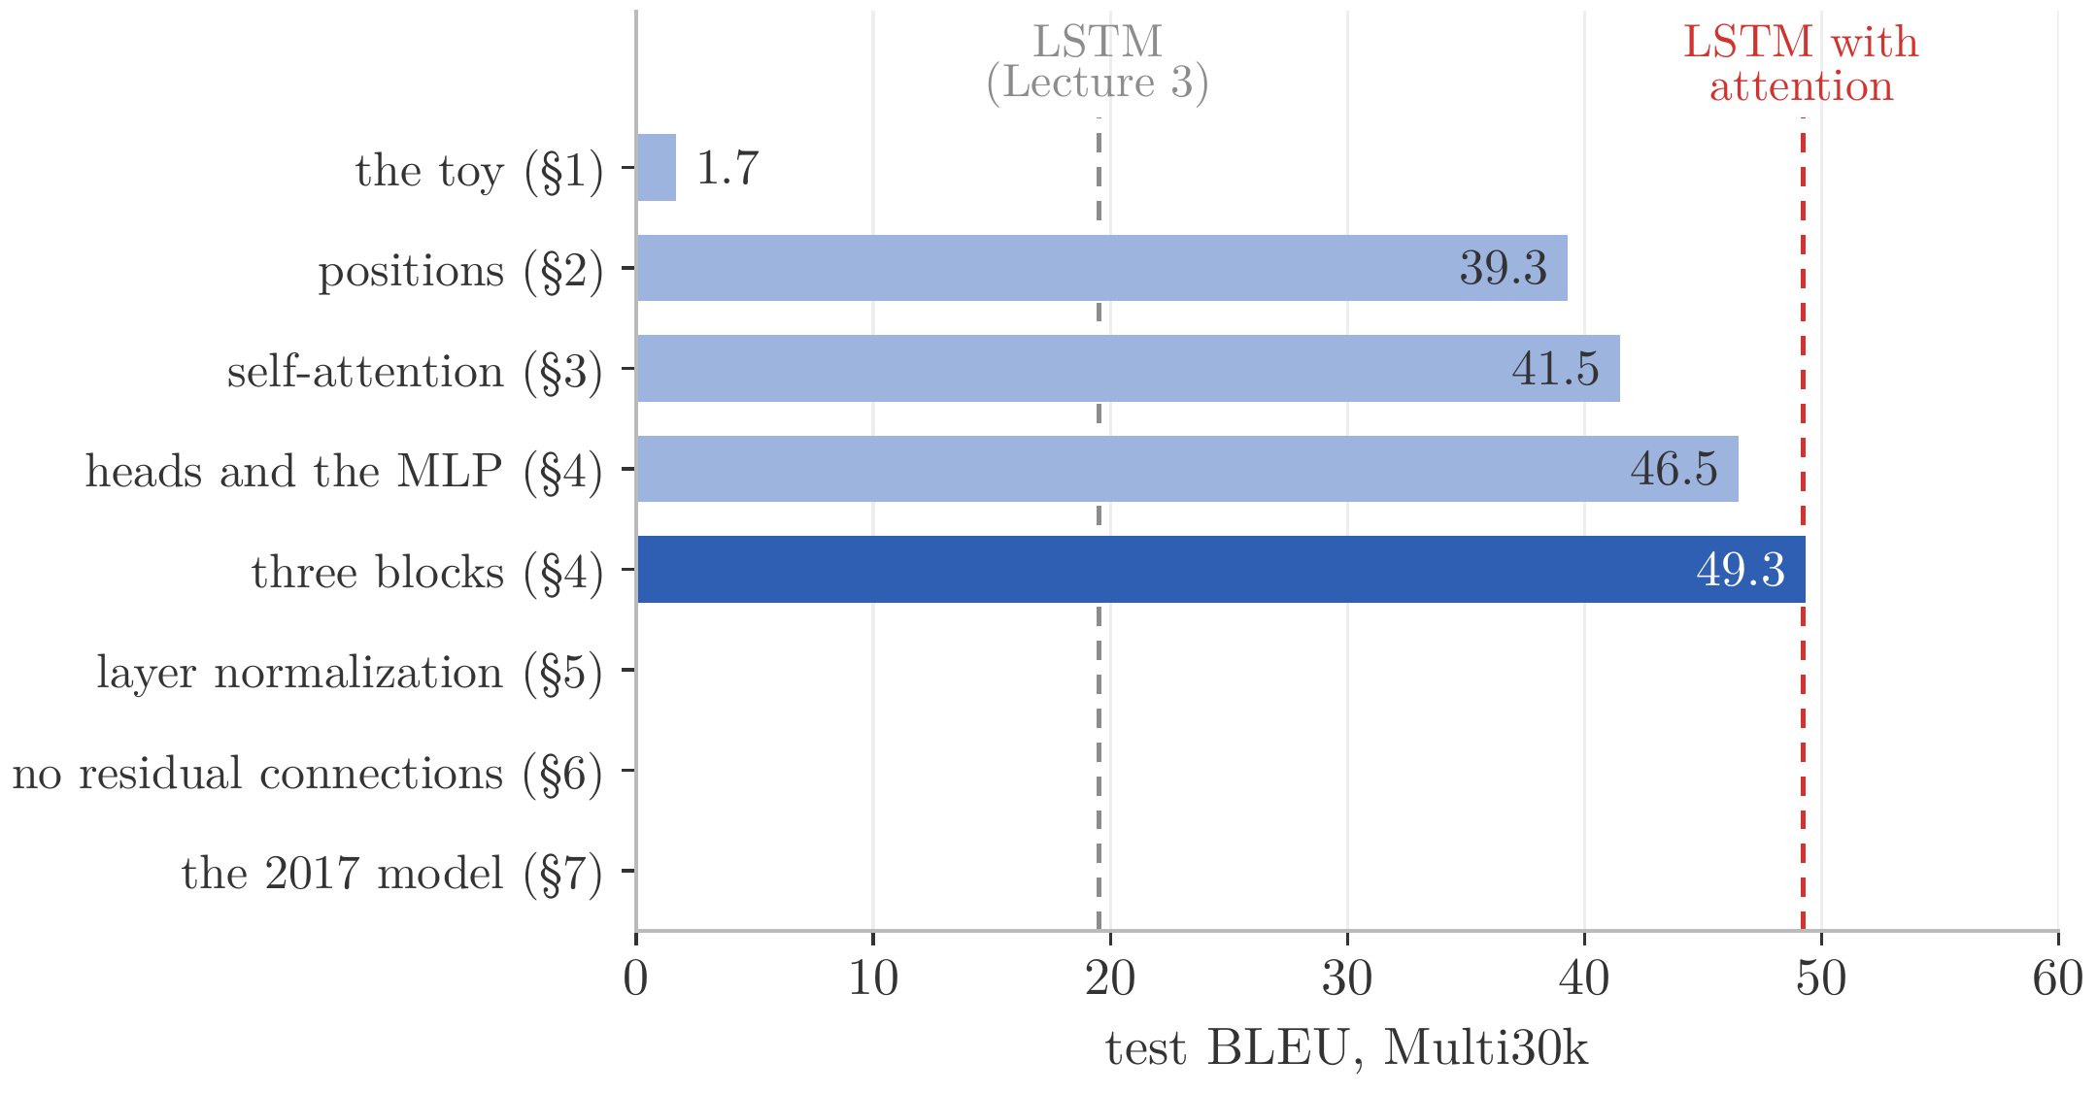
Heads, the MLP, and a Stack of Blocks
The block, and a stack of blocks
the problem: one block reads each sentence once → the fix here: a stack of blocks, each reading the one below
a block: attention, then the MLP, each added to the vector it read
heads and the MLP: cross-entropy 1.40 → 1.26, BLEU 41.5 → 46.5
a stack of blocks: later reads use what earlier ones found; every decoder block reads the encoder's last, Z
three blocks a side: cross-entropy 1.16, BLEU 49.3, past the LSTM with attention (49.2)
Figure 19: L = 3 blocks a side; normalizations and residual connections not drawn
Notes:
Notes §4, 'The block, and a stack of blocks', Figure 19. [click] A block is attention, then the MLP, each added to the vector it read. The experiment: four heads in each attention and an MLP on each side, trained as before: cross-entropy 1.40 → 1.26, BLEU 41.5 → 46.5. Two changes in one run. [click] With one block a side, the encoder reads the caption once, and the decoder its translation once. Stack three blocks on each side, each reading what the block below wrote. The picture: the encoder (green) applies L blocks of self-attention and an MLP to the source; the decoder (blue) applies L blocks of masked self-attention, the read of the source, and an MLP; every decoder block takes its keys and values from Z, the encoder's last block (red). This is the architecture of the Transformer of 2017 (§7). [click] Cross-entropy 1.16, BLEU 49.3: narrowly past Lecture 3's LSTM with attention, 49.2. Ask: is anything wrong with this stack?

Slide 26
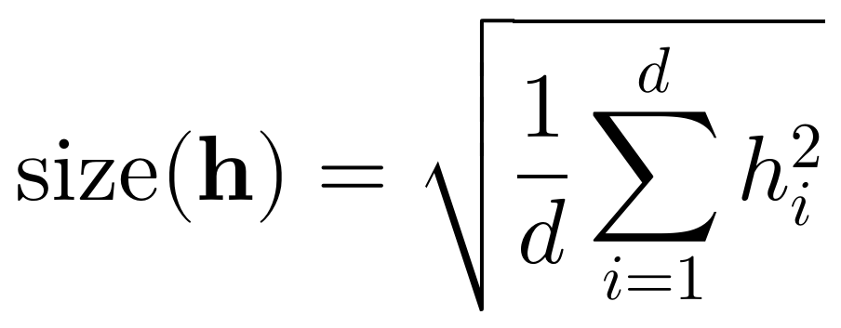
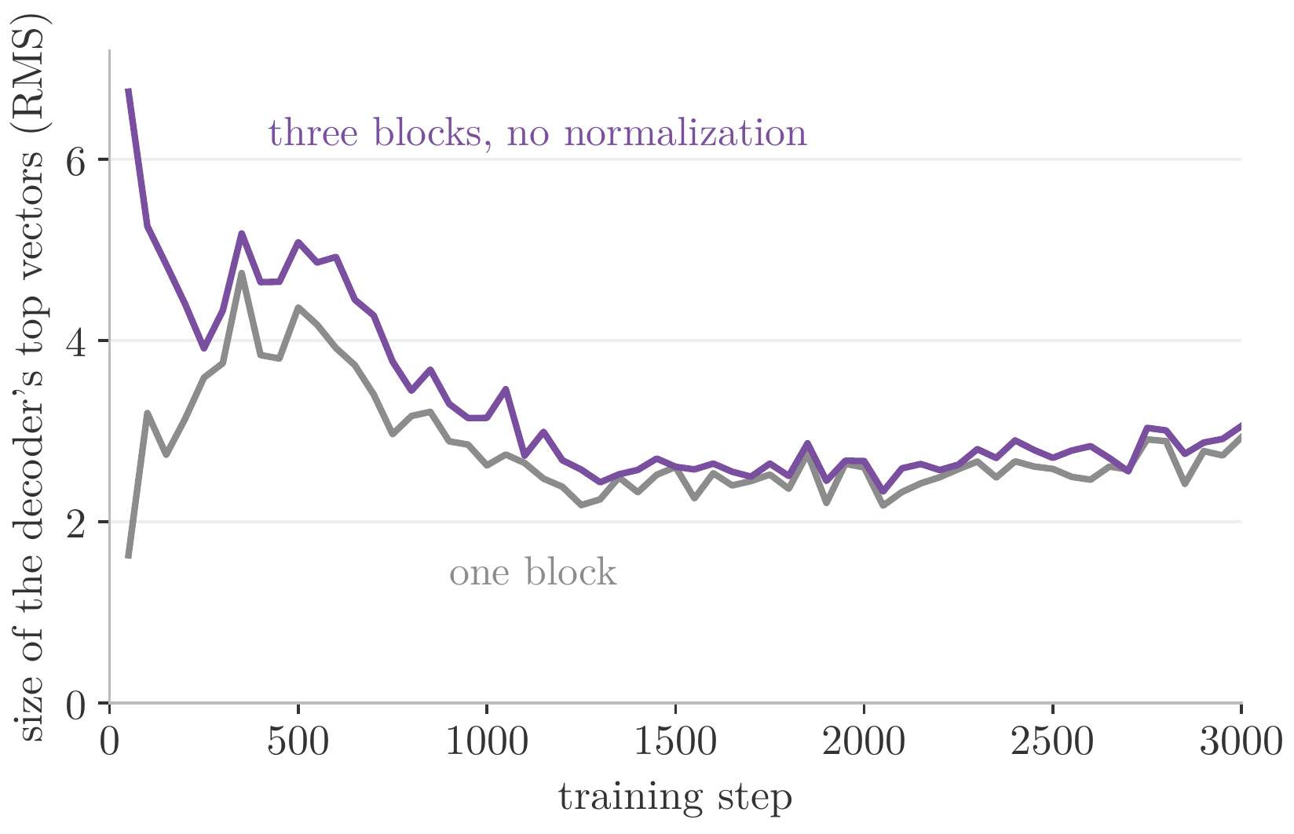
Heads, the MLP, and a Stack of Blocks
Nothing controls the size of the vectors
the size of a vector: the root mean square of its d numbers; about 1 if they are about ±1, whatever d
the measurement: the size of the decoder's top vectors, every 50 steps
three blocks: 6.7 after 50 steps, 3.1 at the end; one block, 1.6 and 2.9
it drifts as the weights change: every block reads vectors whose size the blocks below set
Notes:
Notes §4, end; a figure made for the slides from the runs of Figure 20. [click] First, what size means: the root mean square of a vector's d numbers. A vector whose numbers are about ±1 has size about 1, whatever d is. [click] The measurement: the size of the decoder's top vectors, every 50 training steps. [click] In the three-block stack, 6.7 after 50 steps and 3.1 at the end; with one block, 1.6 and 2.9. [click] Nothing in a block controls the size of its vectors: every block reads vectors whose size the blocks below set, and it drifts as the weights change. Why that matters: next slide.

Slide 27
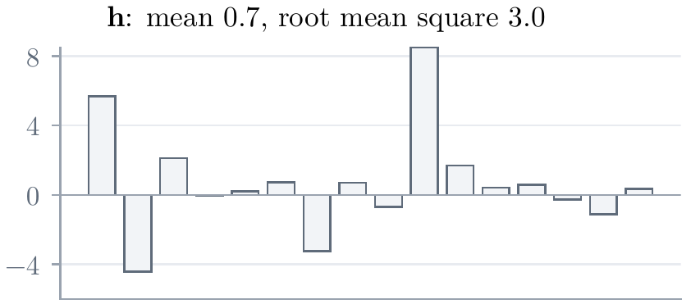


Keeping the Vectors in Check: Layer Normalization
Layer normalization: one vector at a time
the problem: the size of the vectors drifts, and much depends on it → the fix here: rescale each vector by itself
the size matters: in the scores (§3), the MLP's thresholds, and the step sizes
layer normalization: μ and σ² are the mean and variance of the vector's own d numbers
mean 0, size 1, whatever h was: the pattern is kept; γ and β, learned, rescale it
one vector at a time: the same in training and in use; any length; batches of one
Notes:
Notes §5, 'Layer normalization', Figure 21. [click] The size matters in three places. The scores are dot products of two maps of the vector, so they grow with the square of its size and push the softmax toward a single key, where it stops learning (§3). The MLP's hidden units compare their inputs with thresholds, their biases, that do not scale with the input. And one learning rate has to suit every weight, while the effect of a step scales with the size of the vectors a weight multiplies. [click] Layer normalization (Ba et al., 2016) rescales each vector by itself: subtract the mean of its d coordinates, divide by their standard deviation, apply a learned scale γ and shift β. [click] Before γ and β, the result has mean 0 and size 1 whatever the size of h: the pattern of its numbers is kept, only its center and scale change (the bars: 16 numbers before and after). γ and β let the model choose another size and center, as parameters that training sets, not as a side effect of the weights below. [click] It uses only the vector itself, so it computes the same thing in training and in use, for sentences of any length and batches of one, unlike batch normalization, which normalizes each coordinate over the examples of a batch and is the usual choice for images.

Slide 28



Keeping the Vectors in Check: Layer Normalization
Normalizing after each addition
after each addition: every sublayer reads a vector whose size γ and β set
the experiment: the three-block translator, normalized after each of its 15 additions; the size now grows smoothly
cross-entropy 1.16 → 1.08, BLEU 49.3 → 52.7
but why does the stack train at all? That depends on the additions of §3
Figure 20: the size of the decoder's top vectors
Notes:
Notes §5, 'Normalizing after each addition', Figure 20. [click] The Transformer of 2017 normalizes after each addition: every sublayer F, attention or MLP, updates the vector as LayerNorm(h + F(h)), so every sublayer reads a vector whose size γ and β set. [click] The experiment: a normalization after each of the fifteen additions of the three-block translator. The size of the top vectors now grows smoothly, from 1.0 to 2.1 (blue). [click] Cross-entropy 1.16 → 1.08, BLEU 49.3 → 52.7. [click] But normalization does not explain why the stack trains at all. Ask: what happens without the additions of §3?

Slide 29



Depth: Residual Connections
Why the stack trains: the additions of §3
the question: why does the stack of §4 train at all? → the answer: the additions of §3, from residual networks
without the additions, three normalized blocks a side give 0.0 BLEU (un un un …)
deeper is worse (He et al., 2016a): deeper plain networks fit their training data worse
our repeat on the digits: 44 plain layers still misclassify 60% of the training images
their remedy, our §3: learn a change, not a replacement
every depth fits: 44 layers reach a test error of 3.2%
Figure 22a: plain networks of 8, 20, 32, 44 layers; steps on a logarithmic scale
Figure 22b: residual networks of the same depths; the error axis stops at 35%
Notes:
Notes §6, opening and 'Where residual connections came from', Figure 22. No new part on this slide: the question is why the stack of §4 trains at all, and the answer is the additions of §3. [click] The experiment: the three-block translator, normalized, with the additions removed, so that each sublayer's output replaces its input. It does not learn to translate: cross-entropy 4.64, where word frequencies alone give 5.39, and 0.0 BLEU; the karate caption comes out as un un un … [click] Where the additions came from. A deeper network can compute everything a shallower one does, since extra layers could pass their input on; yet He et al. (2016a) found that deeper plain networks for images fit their training data worse, and not by overfitting or vanishing gradients. [click] Our repeat on the digits, single runs: plain networks of 8 (green), 20 (blue), 32 (orange), and 44 layers (red), steps on a logarithmic scale; the 44-layer one still misclassifies 60% of its training images after 3,000 steps (first picture). [click] Their remedy, the one §3 used: each block adds its output to its input, h ← h + F(h), and so learns a change instead of a replacement; a block that should do nothing drives F to zero. [click] Residual networks of every depth fit (second picture, whose error axis stops at 35%, not 100%); 44 layers reach a test error of 3.2%.

Slide 30



Depth: Residual Connections
The gradient's path through the additions
the top is the bottom plus what was added
so the gradient has an identity term: it reaches every block unchanged
the LSTM's memory cell, turned to depth: an additive path, along the layers instead of the positions (Lecture 2)
Notes:
Notes §6, the gradient; a figure made for the slides. [click] In a stack of residual blocks, write h^(i) for a position's vector after i blocks. The vector at the top is the vector after block ℓ plus what the later blocks added. [click] Differentiate: the gradient at block ℓ is the gradient at the top times (I + …). The identity term passes the gradient at the top to every block unchanged (He et al., 2016b): the dashed red path. [click] It is the additive path of the LSTM's memory cell (Lecture 2, §8), turned from time to depth.

Slide 31

Depth: Residual Connections
Averages of averages become alike
attention alone collapses: stacked averages converge to identical rows (Dong et al., 2021)
our translator, no additions: every head gives every word the same weight, 1/13
a character model: 8 blocks, children's stories; without additions, two positions' vectors reach cosine 0.99 at initialization
it learns only the frequencies: 4.22 bits per character; with additions 1.76
Figure 23: (a) held-out bits per character; (b) cosine similarity of two positions' vectors, by block
Notes:
Notes §6, Figure 23. Attention gives a second reason. [click] A read is a weighted average over positions, and averages of averages become alike: in stacks of attention layers alone, the rows converge, doubly exponentially fast in depth, to one row (Dong et al., 2021), and skip connections prevent it. [click] Our translator without additions fits this: in its last decoder layer every head gives every word of the karate caption the same weight, 1/13. [click] A second experiment: a character model of Lecture 2's children's stories, eight blocks of width 64, rotary positions (§9), 600 steps, scored in bits per character; frequencies alone give 4.22 bits. Without additions, two positions' vectors reach cosine 0.92 after block 1 and 0.99 after block 8, at initialization (right). [click] And it never beats 4.22 bits; with additions, 1.76 (left). The addition gives each position back its own vector, which the averages would wash out.

Slide 32



Depth: Residual Connections
Pre-norm and post-norm
post-norm (2017): a normalization on the residual path
pre-norm (GPT-2 on): only additions on the residual path
post-norm needs a warmup: without one, 8.5 BLEU against about 34 (Xiong et al., 2020); our character model never gets past the frequencies
trained, post-norm can end ahead: 27.6 against 26.8 BLEU (Nguyen and Salazar, 2019)
Notes:
Notes §6, 'Pre-norm and post-norm', Figures 24 and 25. [click] The normalization of §5 sits after each addition, as in the paper: post-norm. The residual path (purple) crosses a normalization in every sublayer. [click] GPT-2 and nearly every model since normalize each sublayer's input instead, with one more normalization at the top: pre-norm. Only additions lie on the residual path (blue), so the expansion of the previous slide holds exactly. [click] Post-norm needs care at the start: its gradients near the output are large at initialization (Xiong et al., 2020), so it needs the paper's warmup, a learning rate rising from zero; without it, 8.5 BLEU on a translation task against about 34. Our eight-block character model shows the same: post-norm without warmup, at the larger peak rate, stays at the frequencies, 4.22 bits; with warmup it trains. [click] Once trained, post-norm can end slightly ahead: 27.6 against 26.8 BLEU (Nguyen and Salazar, 2019); on our character model, 1.70 against 1.76 bits, in single short runs.

Slide 33

Depth: Residual Connections
The residual stream
a shared workspace: d numbers at each position; every sublayer reads it and adds to it (Elhage et al., 2021)
in pre-norm, the top is the sum: the token's vector, plus one change per head and per MLP
L blocks, at most L moves: only attention moves information between positions
Figure 26: gray the token's vector, red each attention's change, purple each MLP's, blue the sum
Notes:
Notes §6, 'The residual stream', Figure 26 (after Sanderson, 2024a). [click] The vector at a position starts as its token's vector, and every sublayer reads it and adds to it. Elhage et al. (2021) call it the residual stream: a workspace of d numbers at each position, which attention updates with information from other positions and the MLP with computation at the position. [click] In pre-norm, the vector at the top is exactly the starting vector plus the changes: one per head of each attention, one per MLP (schematic, head to tail). [click] Only attention moves information between positions, so a model with L blocks moves it at most L times on any path. This view returns in Part 2 and in Lecture 5.

Slide 34

The Transformer of 2017
The translator so far: every part in place
positions (§2): each word's vector plus its position's
self-attention (§3), four heads (§4): each read added to the vector it came from
an MLP, three blocks a side (§4): every decoder block reads Z, the encoder's output
add, then normalize (§§5–6): after every sublayer; the stack trains
Vaswani et al.'s encoder–decoder, at d = 192: 52.7 BLEU; §7 adds a shared table
Figure 27: the translator at the end of §6; gray arrows, the additions
Notes:
Notes §7, opening, Figure 27. Before the paper's last additions, the translator we have built, every part drawn. [click] Bottom: each word's vector from its language's table, plus its position's vector, the sinusoids of §2. [click] In each block, every read is added to the vector it came from (the gray arrows, §3), self-attention in the encoder and masked self-attention in the decoder (§3), each with four heads (§4). [click] After the attention, an MLP at each position, and three such blocks on each side; every decoder block reads Z, the encoder's output, through cross-attention, the toy's read of §1 (§4). [click] A normalization after each addition, the Add & Norm of the paper (§5), which, with the additions, lets the stack train (§6). [click] This is Vaswani et al.'s encoder–decoder at a small size: d = 192, four heads, three blocks a side, 52.7 BLEU. What §7 adds is one shared table; the paper's training recipe, Adam, the warmup, dropout, and label smoothing, is next week's subject.

Slide 35


The Transformer of 2017
Three attentions
encoder self-attention: every source position reads every source position
masked decoder self-attention: every target position reads those up to its own
cross-attention: queries from the decoder; keys and values from Z, the encoder's last layer
Figure 19: normalizations and residual connections not drawn
Notes:
Notes §7, 'Three attentions', Figure 19, the stack of §4 again. With three blocks a side, every part of Vaswani et al.'s figure is in place: the translator has the architecture of 2017, at a smaller size. It has used attention three ways since §3, under the paper's names. [click] Encoder self-attention: every source position reads every source position. [click] Masked decoder self-attention: every target position reads those up to its own. [click] Cross-attention: queries from the decoder, keys and values from Z, the encoder's last layer; the toy's read, now from vectors that carry their context. Every decoder layer reads the same Z, and its weights form an m × n matrix. [click] The equations: MultiHead(Y, Z) has queries from the target vectors Y, keys and values from the source vectors Z. Each encoder layer is self-attention and an MLP; each decoder layer is masked self-attention, cross-attention, and an MLP; all post-norm.

Slide 36


The Transformer of 2017
One table for the input and the output
the problem: the stack starts to fit its training captions too closely; a third of its weights are two French tables → the fix here: share one table
the output layer is a table of word vectors: the logit of word v is h_{t} · column v
tie them: better and smaller, perplexity 74.3 tied (51M), 78.4 untied (66M) (Press and Wolf, 2017)
here: the French table is also the output layer, 1,241,762 fewer weights
Figure 28: one table, at the input and, transposed, at the output
Notes:
Notes §7, 'One table for the input and the output', Figure 28. Two signs at the end of §6: the stack fits its training captions better than new ones (validation cross-entropy rose from 1.07 to 1.08 over its last 250 steps), and more than a third of its parameters sit in two French tables learned separately. [click] The output layer is a table of word vectors too: the logit of word v is the decoder's last vector dotted with column v of U. [click] Use one table for both (Inan et al., 2017; Press and Wolf, 2017): smaller and better, perplexity 74.3 tied with 51 million parameters against 78.4 untied with 66 million. The paper shares one table three ways, with one vocabulary of about 37,000 pieces for both languages. [click] Here only the French table can be shared: 1,241,762 fewer weights. At the input the paper multiplies the table's vectors by √d, which brings entries of size about 1/√d to about one, like the sinusoids'.

Slide 37

The Transformer of 2017
The paper's result
two sizes: base, 6 layers a side, d = 512, 8 heads, 65 million parameters; big, d = 1,024, 16 heads, 213 million
trained on WMT 2014: English–German, 4.5 million pairs; one machine with eight GPUs, 12 hours (base), 3.5 days (big)
better and cheaper: base 27.3 BLEU, above every earlier system, at a third of the cheapest's cost; big 28.4
Figure 29: from Vaswani et al. (2017), Table 2; higher and further left is better
Notes:
Notes §7, 'The paper's result', Figure 29, from the paper's Table 2. [click] Two sizes: base, six layers a side, d = 512, eight heads, about 65 million parameters; big, d = 1,024, sixteen heads, 213 million. [click] Trained on WMT 2014 English–German, 4.5 million sentence pairs, on one machine with eight GPUs: twelve hours for base, three and a half days for big. [click] The result was about cost as much as quality. The picture: BLEU against estimated training FLOPs; gray the best earlier systems, ensembles included; blue the two Transformers. Base 27.3, above every earlier system, at about a third of the cheapest's cost; big 28.4, two points above the best ensemble.

Slide 38

The Transformer of 2017
What each part contributed
the 2017 model: BLEU 52.7 → 53.2, ahead of the LSTM with attention (49.2); cross-entropy 1.08 → 1.12
positions with the learned maps mattered most; each later part lowered the cross-entropy
single runs, in one order: what each step of this build did, not what each part is worth alone
removing one part from a complete model: residual connections cost the most, the MLPs the least
Notes:
Notes §7, 'What each part contributed', Figure 30. [click] With the shared table, and dropout and label smoothing from the paper's recipe (next week), the three-block translator is a small Transformer of 2017, 5,475,840 parameters: BLEU 52.7 → 53.2, ahead of Lecture 3's LSTM with attention, 49.2; cross-entropy rises from 1.08 to 1.12, an effect of label smoothing. [click] The whole build: left validation cross-entropy, right test BLEU; dashed, Lecture 3's LSTMs without and with attention; the gray bar is the stack without additions. [click] Positions with the learned maps mattered most; each later part lowered the cross-entropy, up to the last step, which traded a little of it for BLEU. [click] Single runs in one order, and some steps make more than one change, so this records what each step of this build did, not what each part is worth alone. [click] Removing one part at a time from a complete model measures each part with all the others present (notes, end of §7, Figure 32). On our eight-block character model, removing the residual connections costs the most, back to the frequencies; removing the MLPs, two thirds of its weights, costs the least.

Slide 39

The Transformer of 2017
The karate caption at every step
Figure 31: greedy output of each translator of §§1–7; the reference in gray
one caption improves unevenly: positions end the loop, self-attention finds tenue, later steps trade one error for another
the average rises at every step: BLEU over the 1,000 test captions
Notes:
Notes §7, 'What each part contributed', Figure 31. [click] One caption need not improve at every step, and the karate caption does not: each translator of the build, greedily, with its test BLEU; uniforme in red, tenue in blue. Positions end the loop; self-attention finds tenue; later steps trade one error for another, switching between tenue and uniforme and never getting the kick right. [click] Yet BLEU over the 1,000 test captions rises at every step: a single caption improves unevenly, the average does not.

Slide 40
Break
Notes:
Break, five minutes. After the break: the translator learns only from sentences paired with their translations, and most text comes without one.

Slide 41
Lecture 4: Transformers
1. Building the Transformer
from Lecture 3's toy translator to the encoder–decoder of 2017, one part at a time
2. The language model
the decoder alone, trained on children's stories; positions as rotations
3. Strengths, limitations, and variants
every weight and its cost; the key–value cache; what it does well and where it falls short; variants
Notes:
[click] Part 2, the language model (notes §§8–9), about 20 minutes. A translator learns only from paired sentences; a model that learns from text alone can use far more of it.

Slide 42


The Decoder Alone: a Language Model
Decoders, encoders, and their uses
the problem: most text comes without a translation → the fix here: drop the encoder, and predict the next token of plain text
the decoder alone is a language model: Lecture 2's model, trained on plain text
GPT (2018), GPT-2 (2019): 12 blocks and 512 tokens; then pre-norm, 48 blocks, 1.5 billion parameters
encoders fill in blanks: BERT reads both ways and predicts 15% hidden tokens, which do not make a distribution over texts
Figure 33: which positions (columns) each position (row) may read
since about 2020: nearly every large language model is a decoder
Notes:
Notes §8, 'Decoders, encoders, and their uses', Figure 33. The problem line: most text has no translation, so drop the encoder. [click] Remove the encoder and the cross-attention from the decoder of §7: a stack of masked self-attention and MLPs that computes q(x_t | x_<t) at every position, Lecture 2's language model, trained on the next token of plain text. [click] It became the standard language model with OpenAI's GPT (2018): twelve blocks, d = 768, a context of 512 tokens, trained on about 7,000 books and adapted to twelve tasks, the best published model on nine. GPT-2 (2019): pre-norm, 48 blocks, 1.5 billion parameters. [click] Without the causal mask (the picture: which positions each row may read), predicting the next token is trivial, so encoders fill in blanks: BERT hides 15% of the tokens and predicts them. Fine-tuned encoders led classification and tagging for years, but their predictions do not combine by the chain rule into a distribution over texts. [click] Since about 2020 nearly every large language model is a decoder.

Slide 43

The Decoder Alone: a Language Model
The word model
a decoder-only Transformer: GPT-2's layout, pre-norm; trained on Lecture 2's children's stories
small: L = 4 blocks of d = 128; 4 heads of 32; MLPs of 512; 8,682 tokens; 1.9 million parameters
positions: none added to the vectors; Q and K are rotated by their positions (§9)
a batch: 16 chunks of 256 tokens; position t holds x_{t−1} and predicts x_{t}
Figure 34: the decoder, pre-norm
Notes:
Notes §8, 'One batch, step by step', Figure 34. [click] The word model of Part 2: a decoder-only Transformer with GPT-2's layout, trained on Lecture 2's children's stories. The picture: token vectors enter the residual stream (blue); each block normalizes it, applies masked multi-head attention (red) and adds the result, then does the same with the MLP (purple); a final normalization and the token table in reverse give the logits. No position vector is added at the bottom: the queries and keys are rotated by their positions inside attention (§9), the note beside the token table. [click] Small: 4 blocks of width 128, 4 heads of 32, MLPs of 512, rotary positions (§9), 8,682 tokens (Lecture 2's words and BOS); 1.9 million parameters, 1.1 million of them in the token table, which is also the output layer. [click] Positions: none is added to the vectors; each head rotates its queries and keys by their positions, which §9 derives. [click] A batch: 16 chunks of 256 tokens. Each position holds the previous token and predicts the next; each story starts with BOS.

Slide 44

The Decoder Alone: a Language Model
One batch, step by step
Figure 34: the decoder
Notes:
Notes §8, 'One batch, step by step', the table and Figure 34. One group per click; the matching part of the decoder is outlined. [click] Embed: token ids, 16 × 256, become rows of the token table, 16 × 256 × 128. [click] The attention sublayer of each block: normalize; project to queries, keys, and values in 4 heads of 32, rotating Q and K by their positions; score, one 256 × 256 matrix per head plus the mask; softmax along each row; read; put the heads side by side and write back with W_O. [click] The MLP sublayer: normalize, expand to 512 with GELU, write back. [click] Output: normalize and multiply by the token table transposed, 8,682 logits at each of the 4,096 positions; the loss is the average log loss of the 4,096 next-token predictions, Lecture 2's objective. Every step except score and read acts on each vector separately.

Slide 45


The Decoder Alone: a Language Model
Training: every prediction in one pass
one pass, every prediction: each from its own prefix (§3)
Figure 35: inputs (rows), the causal mask, each target and its probability
the word model: 4,000 steps, the 16 million words Lecture 2's LSTM read; 54 minutes on two processor cores
against Lecture 2: test perplexity 9.9, the LSTM 23.1; two setups, not attention against recurrence
Notes:
Notes §8, 'Training' and 'Against Lecture 2's models', Figure 35. [click] One pass over a chunk computes every next-token prediction, each from its own prefix (§3). The picture, on the running sentence lily saw a big dog in the park …: left the inputs, one per row; middle the causal mask, each row reading the blue squares, never its gray target; right each target and the trained model's probability for it. [click] The algorithm, line by line: sample 16 chunks of 256 tokens; forward to the logits at every position; the loss; backward, by backpropagation (Lecture 1, §8); clip the gradient and take an Adam step (next week). Repeat, and keep the weights that do best on held-out stories. [click] The word model: 4,000 steps, the 16 million words Lecture 2's LSTM read; a learning rate rising over 200 steps to 0.003, then a cosine decay; 54 minutes on two processor cores. [click] Ask first: what perplexity do you expect? On the test stories, scored on Lecture 2's prediction events, every word and every end-of-story token: Kneser–Ney 4-gram 24.6, fixed-window network 26.9, Lecture 2's LSTM 23.1, the Transformer 9.9, with about the same number of parameters as the LSTM. The two differ in more than the architecture: four blocks against one recurrent layer, and chunks of 256 words against 64, which reach back over most of a story. A comparison of two setups, not of attention against recurrence.

Slide 46


The Decoder Alone: a Language Model
Generation
a sample from BOS, temperature 0.7
“once upon a time, there was a little girl named lily. she loved to play outside in the sun. one day, she went to the park with her mommy and daddy. they were having so much fun! …”
sharp where the story allows few words: the five most probable next words after three prompts
Figure 36: the five most probable next words, with their probabilities
Notes:
Notes §8, 'Generation', Figure 36. [click] Generation is Lecture 2's loop, one token at a time: start from BOS, run the model, sample a token from the last position's distribution at temperature τ, append, and repeat until the end-of-story token or a length limit. Each step reruns the whole prefix and uses only its last output; §10 fixes that. [click] The next-word distributions look like Lecture 2's, only sharper: the five most probable words after she was very, they went to the, and she gave it a. [click] A story sampled from BOS at temperature 0.7 (the beginning; the full sample is in the notes): read it aloud.

Slide 47


The Decoder Alone: a Language Model
Checking the mask
a leak copies the answer: teacher-forced perplexity 1.08 against the honest model's 10.0
test 1, change the future: no earlier output may change; leaky, up to 9.2 nats, four positions back
test 2, one pass against one prefix at a time: honest, within 3 × 10⁻⁷; leaky, 0.09 against 5.85
test 2 is the definition: in use, a model sees only prefixes
Figure 37a: she → he, the largest change in any log-probability, by position (blue honest, gray leaky)
Figure 37b: log loss, one pass against one prefix at a time
Notes:
Notes §8, 'Checking the mask', Figure 37. [click] A correct implementation is causal, but an implementation can be wrong: a mask shifted by one, padding that leaks. A leak lets position t read its own answer at t + 1, and the model learns to copy it. Our leaky word model reaches a teacher-forced perplexity of 1.08, against the honest model's 10.0, and held-out text fed the same way does not reveal it. Two tests do. [click] Change the future: replace one input (she → he) and check every earlier output. Honest: none changes. Leaky: the position just before changes by 9.2 nats, and the leak reaches four positions back, one per block (first picture). [click] One pass against one prefix at a time: honest, they agree within 3 × 10^−7 nats per token; leaky, 0.09 in one pass and 5.85 prefix by prefix (second picture). [click] The second test defines what the model should compute, since in use it only sees prefixes. The word model passes both; the Week 4 notebook, to come, asks for them.

Slide 48


Positions Revisited: Rotations
What a relative position must be
the problem: added position vectors mix where a word stands with what it is; they did not extend beyond the training length → the fix here: put the positions into the scores
the score mixes words and positions
ask for scores that depend only on the offset: linear, offsets only, nothing at zero, continuous (Su et al., 2021; Puranik, 2026)
a one-parameter group
Figure 38: what a one-parameter group does to a pair of coordinates, by offset u
so rotate, decay, or both: only the frequencies remain to choose
Notes:
Notes §9, 'What a relative position must be', Figure 38; Appendix A.2. The problem line: added position vectors mix where a word stands with what it is, and did not extend beyond the training length (Press et al., 2022). [click] Expanded, a score has a term in the two words, one in the two positions, and two that mix a word with the other's position; nothing makes the position terms depend on the offset alone. [click] Su et al. (2021) asked for scores that depend on positions only through their offset. Under four assumptions (linear, offsets only, nothing at offset zero, continuous) there are essentially no other solutions (Puranik, 2026). [click] From the first three, B(a + b) = B(a) B(b): a one-parameter group, like a clock hand turned by u steps; every continuous one is exp(uX). [click] Its eigenvalues give the options: a rotation, a rotation with decay, or decay alone (the picture). So positions rotate pairs of coordinates by angles proportional to the offset; only the frequencies remain to choose.

Slide 49

Positions Revisited: Rotations
Rotary position embeddings
rotate the query and the key: pair i of position t turned by t ω_{i}; nothing added to the word vectors
the score sees only the offset
“two positions back” is the same everywhere: the values carry no positions
Figure 39: query at 3 and key at 1, then at 7 and 5; the same angle
Notes:
Notes §9, 'Rotary position embeddings', Figure 39. [click] Rotary embeddings (Su et al., 2021) add nothing to the word vectors. In every head they rotate pair i of the query at position t by the angle t ω_i, and of the key at position j by j ω_i, with the sinusoids' frequencies. [click] A dot product does not change when both vectors turn by the same angle, so the score depends only on the offset: R_t R_j^T = R_(t−j). The picture: query at 3 and key at 1, then at 7 and 5, turned further, the same angle between them. [click] A head can then express 'two positions back' the same way everywhere. Positions enter only the scores; the values carry none.

Slide 50

Positions Revisited: Rotations
Without positions, and beyond the training length
the experiment: a four-block character model, 750 steps, with no positions, learned vectors, or rotary positions
rotary did best: 1.57 bits per character; learned 1.93; none 2.19
no positions still beats the bigram (3.26): a uniform head reads 1/t of BOS, so the mask gives the position away
beyond the training length: unseen angles; rescale the rotations and train briefly on longer texts
Figure 40: held-out bits per character; dashed, Lecture 2's character bigram model
Notes:
Notes §9, Figure 40. [click] The experiment: a four-block character model of the children's stories, 750 steps, with no positions, learned position vectors, or rotary positions (short single runs). [click] Bits per character: 2.19 with none, 1.93 learned, 1.57 rotary. For characters the few just before matter most, and rotations make 'just before' the same everywhere. [click] Even without positions it beats Lecture 2's character bigram model (3.26). Under the causal mask, position t reads exactly t positions, so a head that spreads its weight evenly reads 1/t of BOS's value, which gives the position away (Haviv et al., 2022). [click] Rotations alone do not let a model read beyond its training length: unseen angles give scores it never learned to use. Models are extended by rescaling the rotations and training briefly on longer texts (Chen et al., 2023; Peng et al., 2024).

Slide 51
Lecture 4: Transformers
1. Building the Transformer
from Lecture 3's toy translator to the encoder–decoder of 2017, one part at a time
2. The language model
the decoder alone, trained on children's stories; positions as rotations
3. Strengths, limitations, and variants
every weight and its cost; the key–value cache; what it does well and where it falls short; variants
Notes:
[click] Part 3, strengths, limitations, and variants (notes §§10–11), about 15 minutes. First the costs: a language model is a set of weight matrices, whose shapes fix its size and its training cost, and, with the length of the text, the memory it needs to write. Then what the design does well, where it falls short, and, briefly, two families of variants.

Slide 52

Every Weight, and What It Costs
Every weight matrix
the token table: |V| × d, a vector per token; in reverse, the logits
attention, in each block: W_{Q} and W_{K} choose where each head reads, W_{V} and W_{O} what it writes
the MLP, in each block: W₁ holds its units' questions, W₂ what each adds
the normalizations: a scale and a shift; nothing else has parameters
Notes:
Notes §10, 'Every weight matrix', Figure 41: the word model of §8, with GPT-2 small's counts in parentheses. [click] The token table, |V| × d: a vector per token; in reverse, the logits. [click] In each block, W_Q and W_K, d × d cut into H heads, decide where each head reads; W_V and W_O decide what it writes, down to d/H numbers and back. [click] W_1 and W_2: the questions of the MLP's hidden units, and what each adds. [click] The scale and shift of the normalizations. The softmax, the mask, the rotations, and the additions have no parameters. The frame repeats L times, with its own weights each time.

Slide 53



Every Weight, and What It Costs
Parameters: N ≈ 12Ld²
per block: 4d² in attention, 8d² in the MLP
GPT-2 small
Figure 42: parameter shares of the token table, attention, and the MLPs
as models grow, the blocks take over: GPT-3 has 1.74 × 10¹¹ in its blocks, 0.6 billion in its token table
Notes:
Notes §10, 'Parameters', Figure 42 (after Sanderson's tally of GPT-3). [click] A block has 4d² weights in attention, whatever the number of heads, and 8d² in its MLP; so a decoder of L blocks has about 12Ld² parameters in its blocks, plus |V|d in its token table and, with learned positions, T_max d. [click] GPT-2 small: L = 12, d = 768, |V| = 50,257, T_max = 1,024, so 124,439,808, exactly the table (the paper said 117 million, later corrected). Board work: 12 × 12 × 768² = 84,934,656 in the blocks. [click] A third of GPT-2 small is its token table; as models grow, the blocks take over: GPT-3 has about 1.74 × 10^11 parameters in its blocks and 0.6 billion in its table. Our word model is the opposite: 786,432 in its blocks, 1.1 million in its table.

Slide 54


Every Weight, and What It Costs
Computation: C ≈ 6N
forward: a multiplication and an addition per weight, so 2N FLOPs per token
backward, twice as much: the input's gradient and the weights'
a check: the base Transformer took 9.5 × 10¹⁷ FLOPs over 100,000 steps; the paper estimated 3.3 × 10¹⁸, so its GPUs ran at about 30%
Notes:
Notes §10, 'Computation'; Appendix A.3; a figure made for the slides. [click] Multiplying a vector by a matrix of n weights costs n multiplications and n additions, and every weight is used once per token: a forward pass costs about 2N FLOPs per token. [click] The backward pass costs twice that, for the gradients with respect to the input and to the weights: training costs about 6N FLOPs per token, the rule of the scaling laws (Kaplan et al., 2020). [click] A check against the Transformer paper: per batch of the base model, about 6 × 63 million weights × 25,000 tokens ≈ 9.5 × 10^12 FLOPs, and 9.5 × 10^17 over 100,000 steps. The paper estimated 3.3 × 10^18 from the training time and the GPUs' rated speed: they ran at about 30% of it.

Slide 55


Every Weight, and What It Costs
The quadratic term
attention's own work: 4Td FLOPs per token and block, with T positions in view
it grows with the context
GPT-2 small: about 4,600 tokens, beyond its 1,024
and memory: T × T weights per head, 67 million numbers at 8,192 tokens; FlashAttention never stores them
Figure 43: forward FLOPs per token in one block of GPT-2 small; purple the weights, red attention
Notes:
Notes §10, 'The quadratic term', Figure 43. [click] Attention adds work the parameter count does not see: with T positions in view, a token's scores cost Td multiplications per block, and its weighted average another Td; 4Td FLOPs per token and block. [click] Over T tokens and L blocks, 4LT²d against the weights' 24LTd²: equal at T = 6d. For GPT-2 small that is about 4,600 tokens, beyond its context of 1,024 (the picture); for d = 4,096 and 128,000 tokens, attention dominates. [click] Memory too: a straightforward implementation stores every head's T × T weights for the backward pass, 67 million numbers per head at 8,192 tokens. FlashAttention (Dao et al., 2022) computes exact attention in blocks and never stores the full matrix.

Slide 56



Every Weight, and What It Costs
The key–value cache
generation recomputes the prefix: at every step, to use only its last position
earlier keys and values never change: so keep them
a state that grows: 2LdT numbers; Llama 7B at 4,096 tokens holds 2.1 GB per sequence, beside 13.5 GB of weights
Figure 44a: without a cache, every step recomputes the prefix
Figure 44b: with one, each step computes one new column
Notes:
Notes §10, 'The key–value cache', Figure 44. [click] Generation as in §8 recomputes the whole prefix at every step and uses only its last position (first picture: rows are steps, filled squares the positions computed). [click] But appending a token changes nothing at earlier positions (§3): their keys and values, in every block and head, stay the same. So keep them, the key–value cache, and each step follows the algorithm: in each block, compute the query, key, and value of the new position only; append the key and value; read the cache with the query (second picture). [click] For each token and block it holds a key and a value of d numbers: 2LdT numbers for T tokens. Board work: GPT-2 small at 1,024 tokens, 2 × 12 × 768 × 1,024 ≈ 18.9 million numbers. Llama 7B at 4,096 tokens: 2.1 GB per sequence, beside 13.5 GB of weights; servers run out of memory for caches before they run out of arithmetic.

Slide 57

Every Weight, and What It Costs
Shrinking the cache
share keys and values among heads: the largest Llama 2 has 64 query heads and 8 key–value heads, eight times smaller
compress, window, or recur: a latent vector per token (DeepSeek); the last W tokens; a fixed state (§11)
one to two orders of magnitude: Llama 3.1 405B at 131,072 tokens keeps 68 GB instead of 1.1 TB
Figure 45: numbers cached per token; light bars, full multi-head attention
Notes:
Notes §10, Figure 45. [click] Share keys and values among heads: all query heads share one key head and one value head (multi-query attention, Shazeer, 2019), or groups of them share one (grouped-query attention, Ainslie et al., 2023). The largest Llama 2 has 64 query heads and 8 key–value heads: an eighth of the cache. [click] Most changes to attention since 2019 shrink the cache further: DeepSeek-V2 caches one compressed vector per token and block; a sliding window reads only the last W tokens; Qwen3.5 replaces three of every four attention layers by a recurrence (§11). [click] The chart: numbers cached per token, light bars full multi-head attention, logarithmic scale. Llama 3.1 405B at 131,072 tokens keeps 68 GB of cache instead of 1.1 TB.

Slide 58
Strengths, Limitations, and Variants
Strengths
parallel training: one pass computes every prediction of a text
any position reads any other in one step: copying and retrieval come easily (Jelassi et al., 2024)
the context is the memory: every token keeps its own vector; no fixed-size summary
Figure 35: one pass computes every prediction; each row reads every earlier position
Notes:
Notes §11, 'Strengths', Figure 35. Reading every earlier position in one step let the Transformer replace recurrent networks; it is also the source of its limits. [click] Training is parallel over positions: one pass computes every prediction of a text as matrix products, with a fixed number of dependent steps whatever its length (the picture: every row at once). This made training on trillions of tokens practical. [click] Any position reads any other in one step, by content: copying and retrieval come easily, and trained Transformers copy far better than models of the same size with a fixed-size state (Jelassi et al., 2024). [click] Every token keeps its own vector: the context is the memory, with no fixed-size summary, the limit of Lecture 3's first encoder–decoders.

Slide 59

Strengths, Limitations, and Variants
Limitations
long contexts are costly: work grows with T², the cache with T
a fixed computation per token: L blocks for every token, easy or hard; intermediate tokens escape it
lengths beyond training: unseen angles or offsets; trained on short examples, models often fail on long ones (Anil et al., 2022)
using a long context well: documents in the middle are used worst (Liu et al., 2024)
no memory beyond the context: the weights are fixed after training
Figure 43: attention's FLOPs per token grow with the context
Slide figure: one pass, the same depth for every token
Notes:
Notes §11, 'Limitations'. [click] Long contexts are costly: attention's work grows with the square of the context and its cache with the context (§10). [click] A fixed computation per token: one pass applies L blocks to every token, easy or hard. With fixed depth and limited precision, one pass can be simulated by circuits of constant depth, widely believed unable to track long sequences of state changes (Merrill and Sabharwal, 2023; Appendix B). Writing intermediate tokens escapes the fixed depth, since each token is a further pass. [click] Lengths beyond training: unseen angles or offsets (§9); models trained on short examples of a task often fail on longer ones (Anil et al., 2022). [click] Using a long context well: models used documents in the middle of a long context worst (Liu et al., 2024). [click] No memory beyond the context: what the model knows is in its fixed weights and its context.

Slide 60

Strengths, Limitations, and Variants
Variants
the problem: the cost grows with the context, and the depth is fixed → the fix here: a state of fixed size, or a loop
a state of fixed size: replace the exponential by a product, and attention becomes a recurrence
a bottleneck again: so hybrids, Jamba with 1 attention block in 8 and Qwen3.5 with 1 in 4
a loop: one block applied several times; k layers looped L times nearly match kL layers (Saunshi et al., 2025)
open: loops, recurrence, or written reasoning; which spends computation at test time best?
Figure 46: (a) attention, (b) a fixed state, (c) a loop
Notes:
Notes §11, 'Variants', Figure 46. The problem line: the first two limitations, attention's work and cache growing with the context, and the same fixed depth for every token. Two families of variants answer them, briefly. [click] A state of fixed size: replace the exponential in the attention weights by a product of feature vectors, φ(q) φ(k)^T; then φ(q_t) moves out of the sums, and causal attention becomes a recurrent network whose state is updated by addition, with constant memory and work per token, still trained in parallel (Katharopoulos et al., 2020). In the picture, (a) attention reads a cache that grows, (b) such a layer updates a state of fixed size. Later layers let the state decay (RetNet) or let the input decide what to keep, as an LSTM's gates did (Mamba, the gated delta rule). [click] A fixed state brings back Lecture 3's bottleneck: a state of b bits can copy at most about b / log2 |V| tokens. So recent large models mix the two: in Jamba one block in eight is attention, in Qwen3.5 one in four. [click] A loop (c): apply one block several times, which lifts the fixed depth (the Universal Transformer, 2019); a block of k layers looped L times nearly matches kL distinct layers on reasoning tasks (Saunshi et al., 2025). [click] Open: loops, recurrence, or longer written reasoning, which is the better way to spend computation at test time?

Slide 61

What Carries Forward
From a toy translator to a language model
§7
§4
§§5–6
§§5–6
§4
§7
§3
§3
Slide figure: the build of Part 1, test BLEU on Multi30k
§2
§2
the decoder alone is a language model: two tests check its mask
§7
what it costs: about 12Ld² parameters and 6N FLOPs per token; attention's work grows with T², the cache with T
Figure 2: Vaswani et al. (2017), Fig. 1
next week, a base model: tokens, data, the training recipe, scaling laws (C ≈ 6ND); then a chat assistant, by supervised fine-tuning
Notes:
Close; notes §12. [click] Part 1 in two pictures. Left, Vaswani et al.'s figure, each part outlined in the color of the section that added it: positions §2; self-attention and the mask §3; heads, the MLP, and the stack §4; Add & Norm §§5–6; the cross-attention and the shared table §7. Right, what each step bought: from the toy's 1.7 BLEU to 39.3 with positions, 49.3 with three blocks, 52.7 with normalization, nothing without the additions, and 53.2 for the 2017 model. [click] The decoder alone is a language model, and a correct one passes two tests: changing the future changes nothing earlier, and one pass agrees with one prefix at a time. [click] What it costs: about 12Ld² parameters and 6N FLOPs per token in training; attention's work grows with the square of the context, the cache with the context. [click] Next week, Lecture 5: the decoder becomes a base model trained on a large corpus. Tokens, data, the training recipe (Adam and its schedule, dropout, label smoothing), the optimizer at scale, how large a model should be for a budget C ≈ 6ND, and what a base model can do without further training. A base model continues text; it does not answer. So we will also turn it into a small chat assistant, by supervised fine-tuning on conversations between a user and an assistant. The Week 4 notebook, to come, assembles the decoder and runs the two tests.

