Slide 1
Generative AI from First Principles · Lecture 5
Optimizers for Deep Learning
Each optimizer fixes a failure of the one before it
one step size for everything: gradient descent, stochastic gradients, momentum
a step size for each parameter: AdaGrad, RMSProp, Adam; why Adam trains language models
a step for each matrix: Muon
no gradient at all: zeroth-order methods
Notes:
Title of the optimizer deck. The notes' §6 in full, after the companion tutorial, Optimizers for Deep Learning. Each optimizer answers a failure of the one before it, shown on a small example; the optimizer explorer runs them side by side. About 15 minutes; then back to the main deck, at the rest of the recipe.

Slide 2
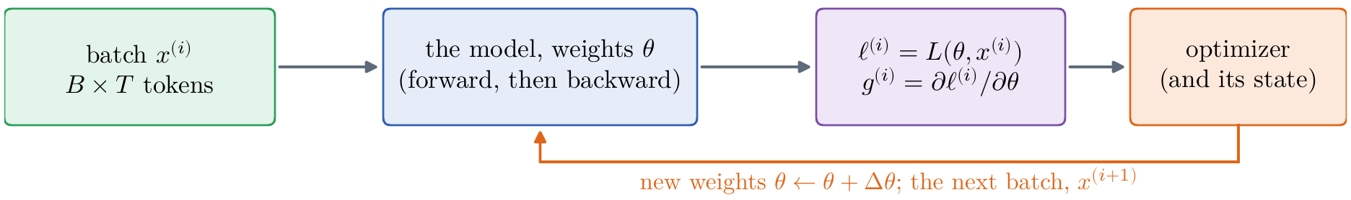
Optimizers for Deep Learning
An optimizer sees a loss and its gradient, batch by batch
what is left: the architecture and the input are fixed; for the optimizer they are abstracted away
one step: a batch of B × T tokens; forward, its loss; backward, its gradient, by backpropagation (the picture)
the whole story: the tutorial, Optimizers for Deep Learning; try them in the optimizer explorer
Optimizers tutorial, Figure 1: the optimizer's view of training
Notes:
Notes §6, opening; the optimizer tutorial, Figure 1. [click] Where we are: the architecture is fixed (Lectures 2–4), and so is the input, tokens and a stream of chunks (§§2–5). What is left is the optimization, and for it the model and the data can be abstracted away. [click] One step (the picture): a batch x(i) of B chunks of T tokens, a B × T × d tensor once embedded; the forward pass gives its loss, ℓ(i) = L(θ, x(i)), the average log loss of its next tokens; the backward pass gives its gradient, g(i) = ∂ℓ(i)/∂θ, by backpropagation as in Lecture 1. An optimizer turns these gradients, one batch after another, into steps, and that is all it ever sees. [click] This deck follows the companion tutorial, Optimizers for Deep Learning, about a dozen pages: each optimizer from the failure of the one before, with the theory. The optimizer explorer runs six of them, gradient descent to Adam, side by side on losses of two parameters, with noise; one learning rate drives them all, so tune η for the one you are watching. Both are on the course page.

Slide 3
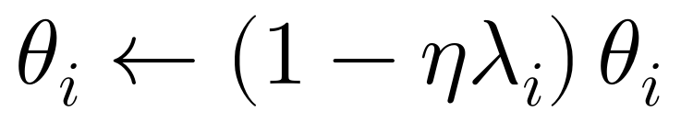
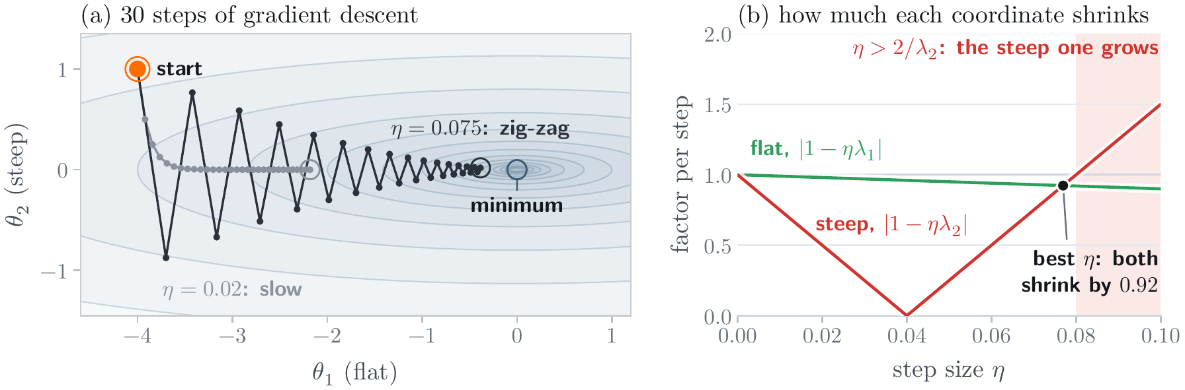
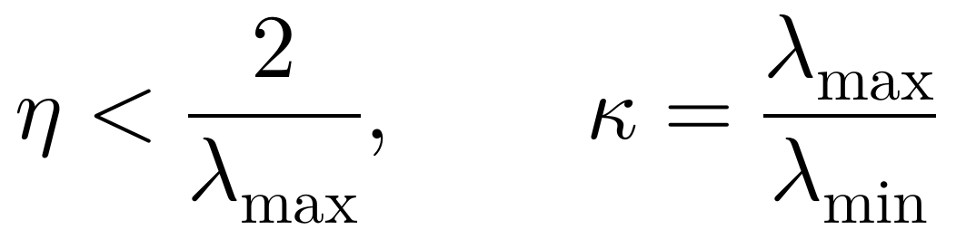
Optimizers for Deep Learning
Gradient descent and the condition number
the question: how large may a step be? → the answer: below 2/λmax, so the flat directions crawl
a quadratic bowl: each coordinate shrinks by its own factor per step
the steep direction: sets the limit; past it, the step overshoots and grows
the flat direction: crawls; κ sets the pace, 87 steps for a millionfold at κ = 25
Optimizers tutorial, Figure 2: gradient descent on ½(θ₁² + 25θ₂²), and each coordinate's factor
Notes:
The tutorial, §1, Figure 2. The question line: how large may a step be? [click] The simplest loss, a quadratic bowl with curvature λ1 = 1 along θ1 and λ2 = 25 along θ2. Gradient descent multiplies each coordinate by its own factor, 1 − ηλ, every step. [click] A coordinate shrinks only if |1 − ηλ| < 1, so the steepest direction sets the limit: η < 2/λmax = 0.08. Near the limit the steep coordinate zig-zags (the picture, η = 0.075). [click] And the flat one then shrinks by only 1 − 0.08 = 0.92 a step. The ratio of the curvatures, the condition number κ, sets the pace: each factor of e takes about κ/2 steps, a millionfold lower loss 87 at κ = 25. A deep network has millions of directions, whose curvatures can differ by orders of magnitude.

Slide 4
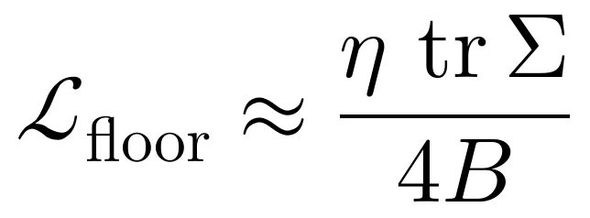
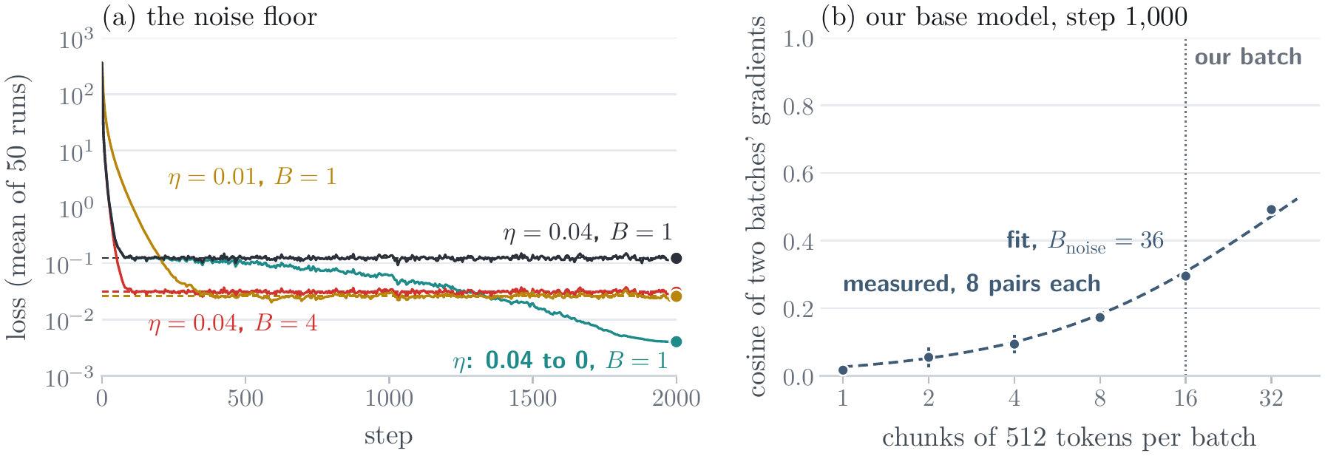
Optimizers for Deep Learning
Stochastic gradients: the noise floor
the problem: each step's gradient comes from one batch, and is noisy → the fix here: a step that decays, and a large enough batch
a noisy gradient: right on average; its variance falls as 1/B
a fixed step stops at a floor: a smaller step or a larger batch lowers it equally
decay the step: a decaying η reaches the minimum; on our base model, the noise scale is about 18,000 tokens
Optimizers tutorial, Figure 3: (a) the noise floor; (b) two batches' gradients on our base model
Notes:
The tutorial, §2, Figure 3. The problem line: each step sees one batch, not the whole text. [click] The batch's gradient is right on average, with a variance that falls as 1/B. [click] With a fixed step the loss stops at a noise floor of about η tr(Σ)/(4B): the curvature drops out, and a smaller step and a larger batch lower it equally. In panel a, at η = 0.04 and B = 1 the run settles at 0.123, against 0.124 predicted; a quarter of the step gives 0.026; four times the batch 0.031, at four times the cost. [click] The fix: let η decay; a decaying step reaches 0.0045. That is the recipe's schedule. And how large a batch? On our base model at step 1,000, two batches of 16 chunks agree with cosine 0.30 (panel b); the fit gives a noise scale of about 18,000 tokens. Below it, doubling the batch nearly halves the steps; our 8,192 is below it.

Slide 5
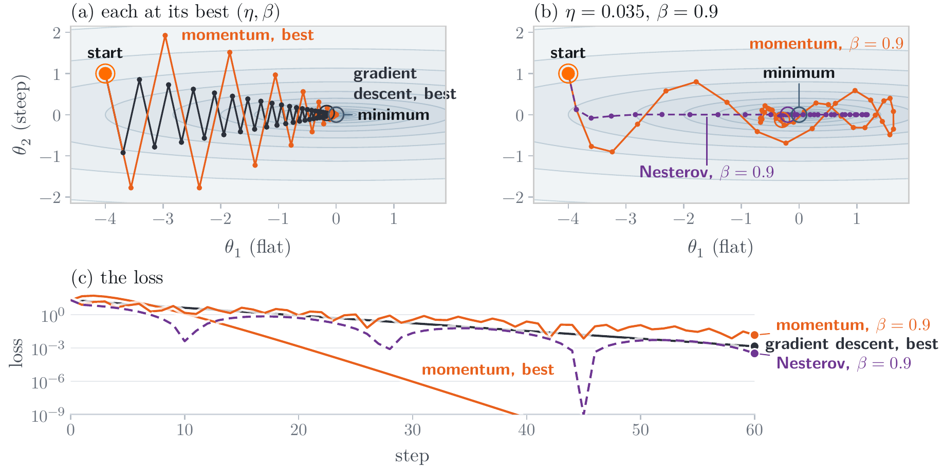
Optimizers for Deep Learning
Momentum and Nesterov's method
the problem: gradient descent zig-zags across steep directions and crawls along flat ones → the fix here: remember recent gradients
momentum: a running sum of gradients; the zig-zags cancel, steady pulls add up
κ becomes √κ: a millionfold in 26 steps instead of 87
Nesterov's look-ahead: with β = 0.9 the ball overshoots; the gradient ahead brakes it
Optimizers tutorial, Figure 4: gradient descent, momentum, and Nesterov on the bowl of Figure 2
Notes:
The tutorial, §3, Figure 4. The problem line: gradient descent forgets each step at once; the flat coordinate's gradient keeps its sign, the steep one's flips. [click] Momentum (Polyak, 1964), the heavy ball: a velocity, a running sum of gradients that decays by β per step. Where the gradient keeps its sign the velocity grows to g/(1 − β), ten times the step for β = 0.9; where it alternates, the terms cancel. [click] At its best η and β the error shrinks by (√κ − 1)/(√κ + 1) per step: gradient descent's factor with √κ in place of κ, 0.67 instead of 0.92 here; a millionfold in 26 steps instead of 87 (panel a). [click] In practice β = 0.9, far more than this bowl's best, 0.44, and the ball overshoots and circles the minimum (panel b). Nesterov (1983) takes the gradient where the velocity is about to carry the weights; if it is about to overshoot, that gradient already points back, and the step brakes: below a millionth from step 91, against 126 for momentum (panel c). Momentum helps with the curvature, not with the noise.

Slide 6
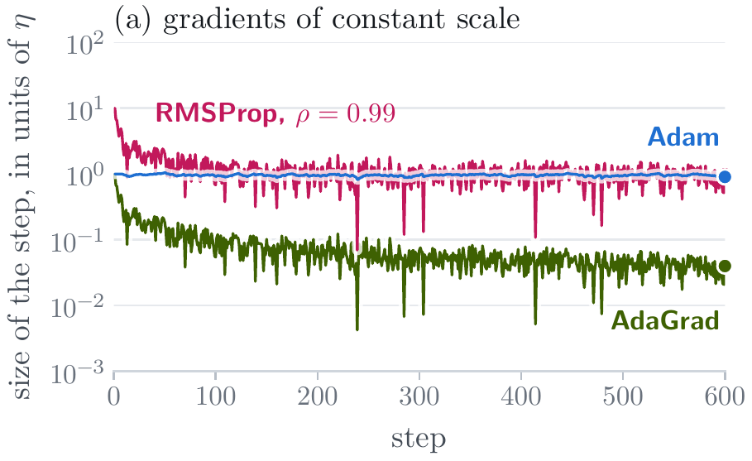
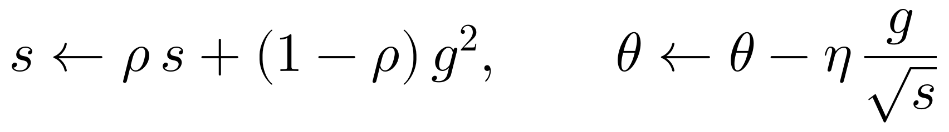
Optimizers for Deep Learning
A step size for each parameter: AdaGrad and RMSProp
the problem: one step size for gradients that differ in size by orders of magnitude → the fix here: divide each gradient by its own typical size
AdaGrad (2011): divide by the root of all past squares; the steps shrink forever
RMSProp (2012): a moving average of the squares; the step stays near η
what still fails: the first steps are too large, and each follows one batch's noise
Optimizers tutorial, Figure 6a: step sizes, in units of η
Notes:
The tutorial, §4, Figure 6a. The problem line: one step size for parameters whose gradients differ in size by orders of magnitude; four orders in our base model (Figure 21, two slides on). [click] AdaGrad (Duchi et al., 2011): divide each parameter's gradient by the root of the sum of all its past squares. The sum only grows, so its steps shrink forever (the olive curve, at the bottom of the picture). [click] RMSProp (Tieleman and Hinton, 2012): a moving average of the squares instead, over about 1/(1 − ρ) steps, so the step stays near η (magenta). [click] What still fails: the average starts at zero, so the first step is η/√(1 − ρ), ten times η for ρ = 0.99, and each step follows one batch's noisy gradient.

Slide 7
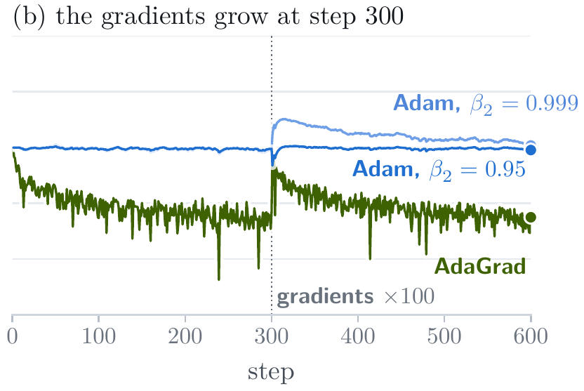
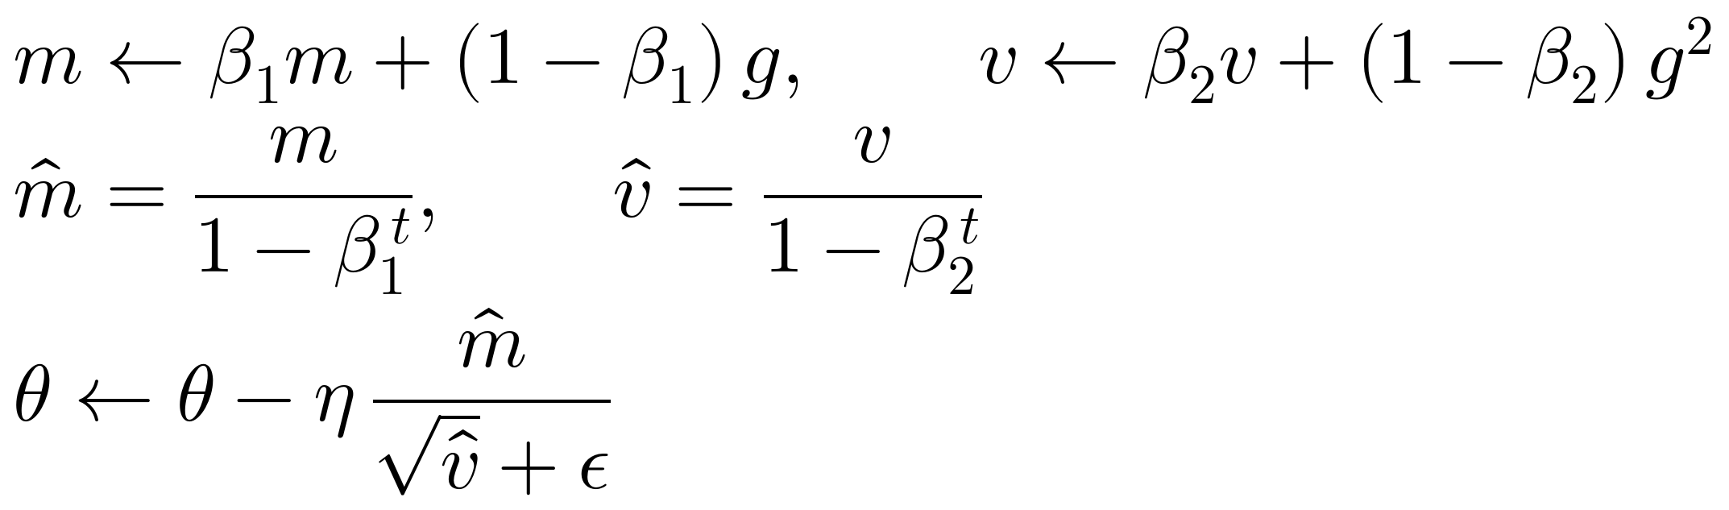
Optimizers for Deep Learning
Adam
the problem: RMSProp's first steps are too large, and each follows one batch's noise → the fix here: average the gradients too, and correct both averages
Adam (2015): momentum's average over RMSProp's scale; a step of about η in every coordinate
its settings: β₁ = 0.9 and β₂ = 0.95 average about 10 and 20 steps; ε avoids dividing by zero
β₂ = 0.999 remembers too long: when the gradients grow, it overshoots for hundreds of steps
Optimizers tutorial, Figure 6a: Adam (blue) steps about η from the start
Optimizers tutorial, Figure 6b: the gradients grow a hundredfold at step 300
Notes:
The tutorial, §4, Figure 6. The problem line, from the last slide. [click] Adam (Kingma and Ba, 2015): both fixes at once, momentum's average of the gradients m divided by RMSProp's scale √v, each corrected for starting at zero by dividing by 1 − β^t. Its step is about η in every coordinate, whatever the gradient's size: gradients of 0.01 and 2 give first steps of exactly η each (the blue curve, panel a). [click] Its settings: β1 = 0.9 and β2 = 0.95, the values of language models, average over about the last 10 and 20 steps; ε = 10^-8 keeps a parameter whose gradient is zero from being divided by zero. [click] Why not β2 = 0.999, the paper's default? It remembers 1,000 steps: when the gradients grow a hundredfold at step 300 (panel b), its average lags, and it takes steps of up to 3.3η for hundreds of steps; with 0.95 it is back near η within 6. Weight decay, kept apart from Adam's step, is AdamW, in the recipe.

Slide 8
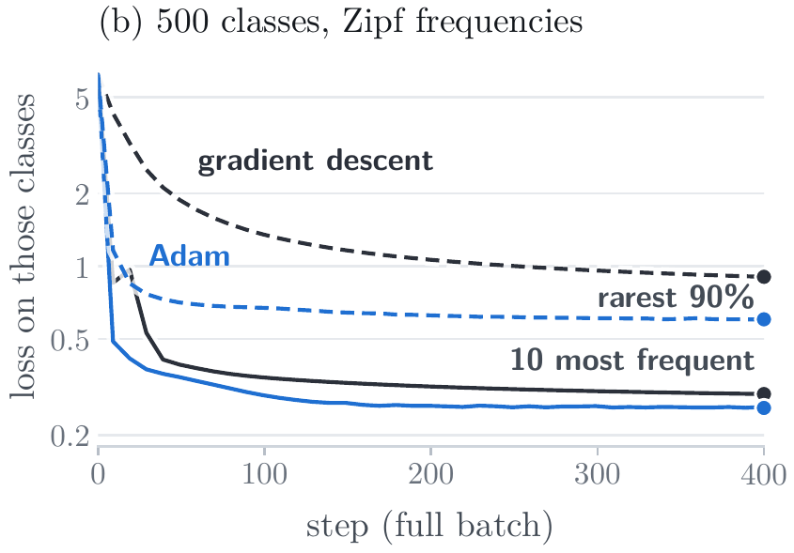
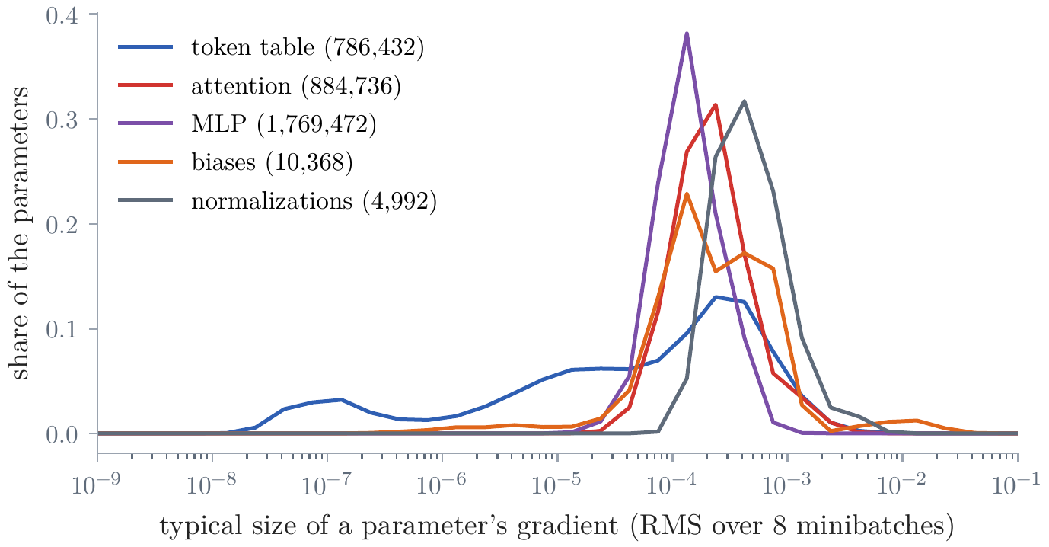
Optimizers for Deep Learning
Why Adam, not momentum, for language models
the question: momentum can beat Adam on a bowl; why does Adam win on Transformers? → the answer: their gradients differ in size by orders of magnitude
our base model: gradient sizes from 7.7 × 10⁻⁸ (rare tokens' rows) to 1.5 × 10⁻³; one step size cannot fit them all
rare words: gradient descent learns rare classes slowly; Adam does not
Figure 21: gradient sizes in our base model, by kind of parameter
Optimizers tutorial, Figure 5b: rare classes, gradient descent against Adam
Notes:
Notes §6, Figure 21; the optimizer tutorial, §5, Figure 5. The question line: on a two-parameter bowl momentum can beat Adam; on Transformers Adam wins by far. Why? [click] The answer is in the gradients. For each parameter of our base model at step 1,000, the typical size of its gradient over eight batches: from 7.7 × 10⁻⁸ for the smallest 1%, mostly rows of rare tokens, to 1.5 × 10⁻³ for the largest 1%, more than four orders of magnitude. A step small enough for the largest barely moves the rest. Only a step scaled to each parameter moves them all. [click] The rare rows are rare words: on a full-batch toy with many classes of very different frequencies, gradient descent leaves the rare classes far behind, and Adam does not (Kunstner et al., 2024; the tutorial's panel b).

Slide 9
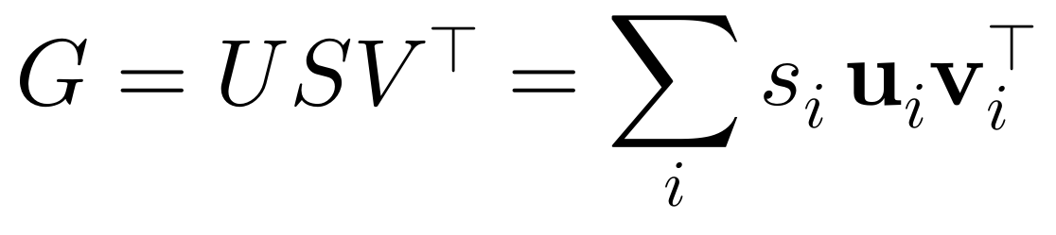
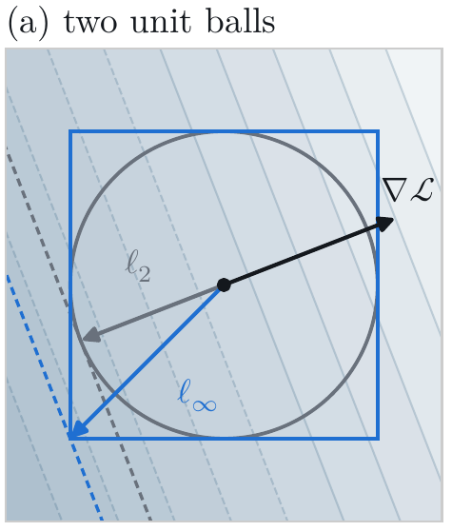
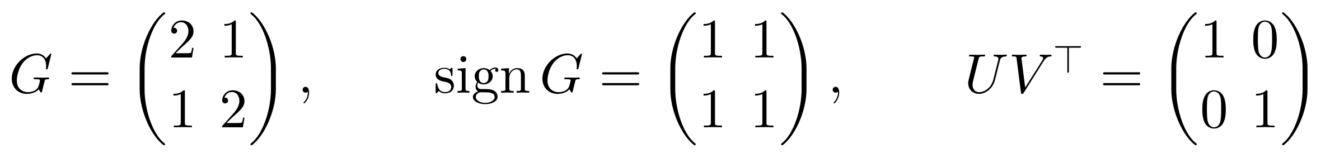
Optimizers for Deep Learning
A step for each matrix
the problem: a matrix's gradient pushes hard along a few directions and barely along the rest → the fix here: a step of the same size along every direction
a gradient's directions: our query gradient's singular values span a factor of about 40,000
Adam on a matrix: every entry moves by η, and the weaker direction is lost
steepest in the spectral norm: UVᵀ, every singular value set to 1
Optimizers tutorial, Figure 7a: two unit balls and their steepest steps
Notes:
The tutorial, §6, Figure 7a. The problem line: most of a Transformer's parameters sit in weight matrices, and a matrix's gradient pushes hard along a few directions and barely along the rest. [click] Write the gradient by its singular value decomposition: each term pairs an input direction with an output direction, and its singular value says how hard the gradient pushes along that pair. In our base model, the first block's query gradient spans a factor of about 40,000. [click] Adam cannot even them out, since each direction mixes many parameters. By hand: the 2 × 2 gradient with rows (2, 1) and (1, 2) pushes three times harder along (1, 1) than along (1, −1); its singular values are 3 and 1. On a gradient that stays the same, Adam moves every entry by η: its step is the sign matrix, all ones, which moves along (1, 1) alone, singular values 2 and 0. The weaker direction is lost. [click] The best step depends on how its size is measured (panel a): by Euclidean size, the gradient's direction; by the largest entry, the sign, Adam's step; by the spectral norm, the most a step can change any input's output, UVᵀ, every singular value set to 1. For the 2 × 2 gradient, the identity: both directions equally.

Slide 10
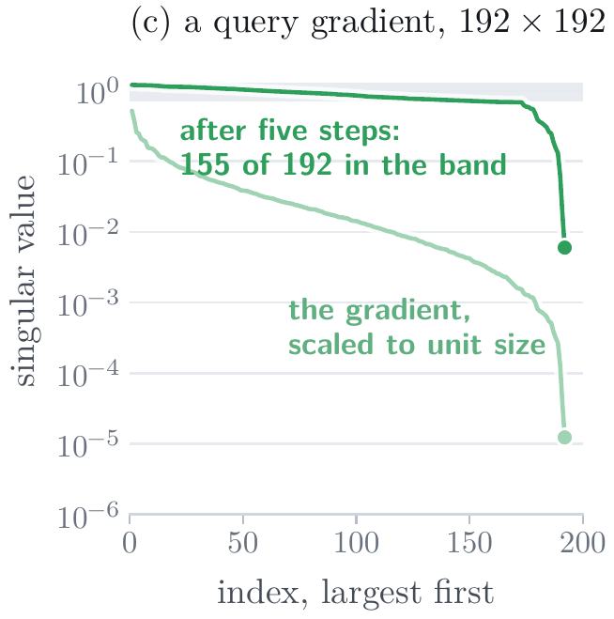
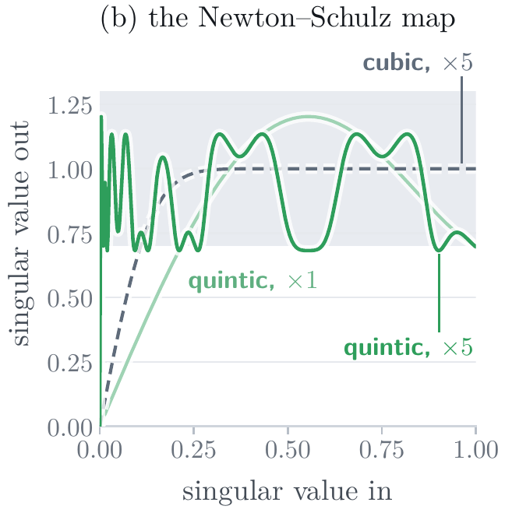
Optimizers for Deep Learning
Muon
Muon (2024): the momentum's UVᵀ without an SVD, by five Newton–Schulz steps
a quintic, not the cubic: it lifts small singular values about 480-fold, into 0.7 to 1.3
our query gradient: 155 of 192 singular values in that band after five steps
the rest keeps AdamW: the token table, the output layer, and the vectors
Optimizers tutorial, Figure 7b: the Newton–Schulz map
Optimizers tutorial, Figure 7c: a query gradient's singular values
Notes:
The tutorial, §6, 'Muon', Figure 7b and c. [click] Muon (Jordan et al., 2024): for each weight matrix inside the blocks, the momentum (in its Nesterov form, β = 0.95), scaled to unit size, then five Newton–Schulz steps, X ← aX + b(XXᵀ)X + c(XXᵀ)²X. Each step leaves the directions alone and maps every singular value s to a polynomial in s, which carries it toward 1 (panel b). [click] The classic cubic lifts a small singular value only 7.6-fold in five steps; Jordan et al.'s quintic about 480-fold, at the price of landing the values anywhere in about 0.7 to 1.3, which they found does not hurt. [click] Our query gradient (panel c): after five steps 155 of its 192 singular values lie in that band, against 15 for the cubic; the other 37 are the smallest. In large runs the iteration costs under 1% of a step. [click] The token table, the output layer, and the vectors keep AdamW. The evidence: Liu et al. (2025) found Muon matched AdamW with about 52% of the computation, and Kimi K2, about a trillion parameters, trained with a variant of it.

Slide 11
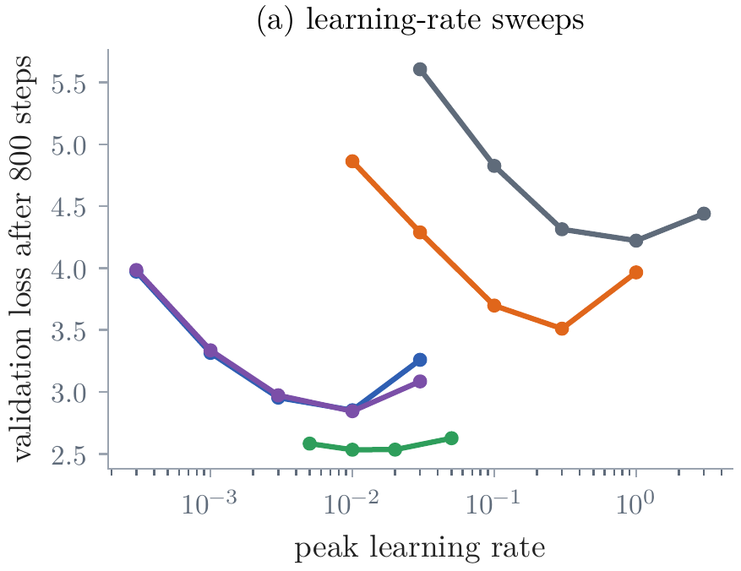
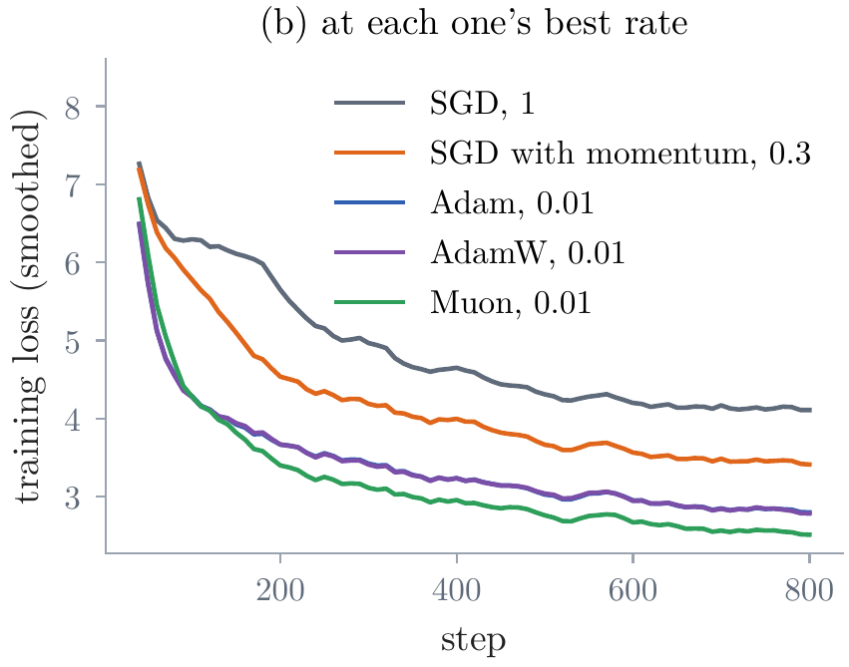
Optimizers for Deep Learning
Our model, five optimizers
our own experiment: Lecture 4's shape (4 blocks, d = 128), our 4,096 tokens; 800 steps of 16 × 256 tokens; each optimizer at several peak rates
each fix lowers the loss: Muon 0.3 nats below Adam
best rates a hundredfold apart: 1 for SGD, 0.01 for Adam; Adam's step is about η
Muon: it separates from Adam within about 100 steps, and is the least sensitive to its rate
Figure 22a: validation loss after 800 steps
Figure 22b: training loss at each one's best rate
Notes:
Notes §6, Figure 22. [click] The experiment: Lecture 4's word-model shape, 4 blocks of d = 128, with our 4,096 tokens, trained for 800 steps of 16 × 256 tokens with the same schedule (§7), by SGD, momentum (β = 0.9), Adam (β = (0.9, 0.95)), AdamW (decay 0.1), and Muon (AdamW at 0.01 for the other parameters), each at several peak rates; no run diverged. Panel a: validation loss after 800 steps against the peak rate. Ask: how much does the optimizer matter? [click] At each one's best rate: SGD 4.22, momentum 3.51, Adam 2.85, AdamW 2.84, Muon 2.53 nats per token. Momentum gains 0.7 nats over SGD, Adam another 0.7. [click] The best rates differ a hundredfold, 1 for SGD and 0.01 for Adam: Adam's step is about η whatever the gradient, SGD's is η times gradients far smaller than 1. [click] Muon is another 0.3 nats below Adam; its training curve (panel b) separates from Adam's after about a hundred steps, and it is the least sensitive to its rate, within 0.1 nats from 0.005 to 0.05. Over 800 steps, AdamW's weight decay changes little. Single runs on a small model; they agree in direction with Liu et al. (2025a), who found Muon reached AdamW's loss with about half the computation. An optimizer with a fixed rate is still not the whole recipe: that is §7.

Slide 12
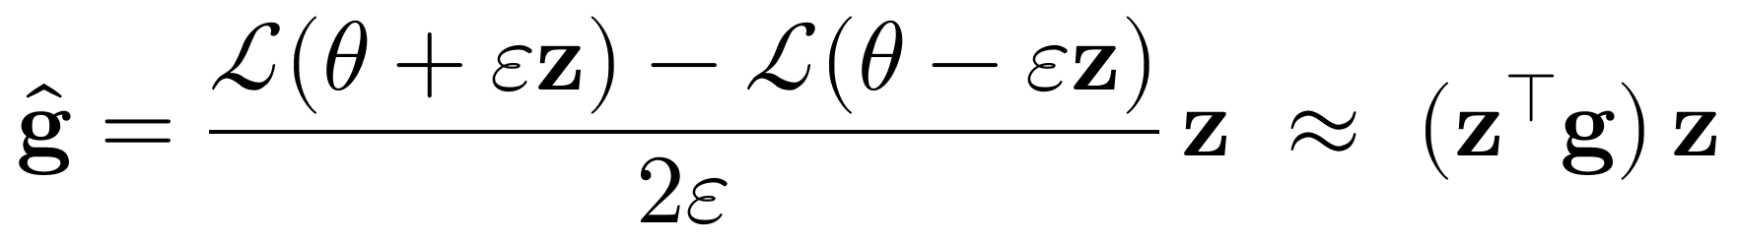
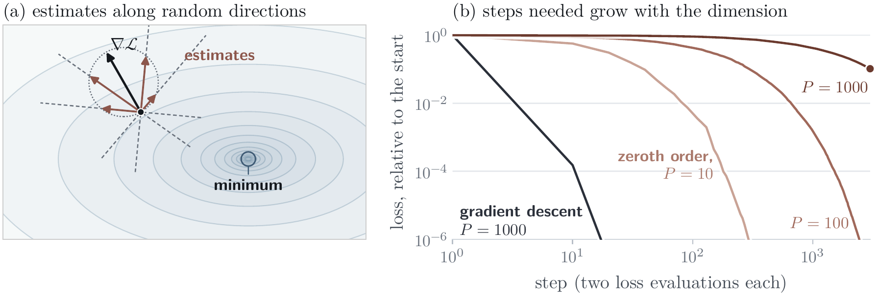
Optimizers for Deep Learning
No gradient at all: zeroth-order methods
the problem: a gradient and Adam's state cost about 16 bytes per parameter, running the model 2 → the fix here: estimate the gradient from forward passes alone
the slope along a random direction: two forward passes; right on average
about P times the steps: all but 1/P of each estimate is noise
MeZO (2023): fine-tuning in the memory of inference; 30 billion parameters on one GPU
evolution strategies: perturbed models scored by any reward; ahead of PPO and GRPO on Countdown
Optimizers tutorial, Figure 8: (a) the estimate's directions; (b) steps against the number of parameters
Notes:
The tutorial, §7, Figure 8. The problem line: a gradient needs the backward pass, which stores the forward pass's activations, and AdamW in mixed precision keeps about 16 bytes per parameter, where running the model takes 2: for 30 billion parameters, 480 GB against 60 GB. [click] Zeroth order: pick a random direction z, one standard normal number per parameter; two forward passes give the slope along it, and the estimate is the slope times the direction (Spall, 1992). Right on average, since E zzᵀ is the identity. [click] But any one estimate points along z (panel a); all but about 1/P of it is noise, so a stable step must be about P times smaller, and a given loss takes about P times the steps (panel b). For our 3.5 million parameters, millions of times: no pretraining. [click] MeZO (Malladi et al., 2023) regenerates z from a seed instead of storing it, so it fits in the memory of inference: 30 billion parameters on one 80 GB A100, where backpropagation fit 2.7 billion. It needs about a hundred times the steps when fine-tuning a pretrained model with a good prompt, not P times. [click] Evolution strategies: many random directions, each perturbed model scored by any reward, a step toward the better ones. Qiu et al. (2025) fine-tuned models of up to 8 billion parameters with a population of 30, and on the puzzle Countdown beat PPO and GRPO, the reinforcement learning of Weeks 6 and 7.

Slide 13
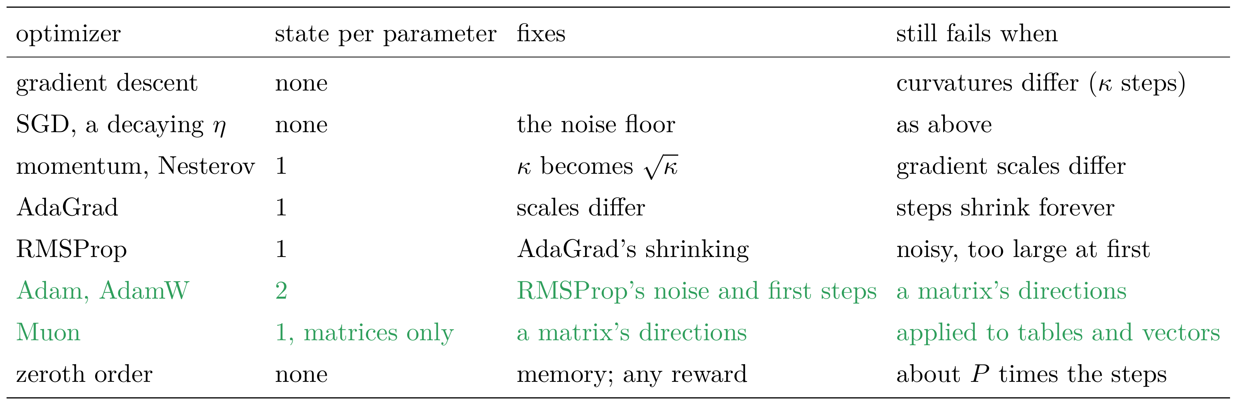
Optimizers for Deep Learning
Which optimizer when
Optimizers tutorial, §8
in 2026: AdamW, β = (0.9, 0.95), with a warmup and a decay; or Muon for the matrices inside the blocks
Notes:
The tutorial, §8. Each method up to Muon fixed a failure of the one before it; zeroth-order methods instead give up the gradient to save memory. [click] In 2026 a typical language model is pretrained with AdamW, β = (0.9, 0.95), ε = 10^-8, weight decay 0.1 on the matrices, a warmup and a decay to a tenth of the peak or less, or with Muon for the matrices inside the blocks and AdamW for the rest.

Slide 14
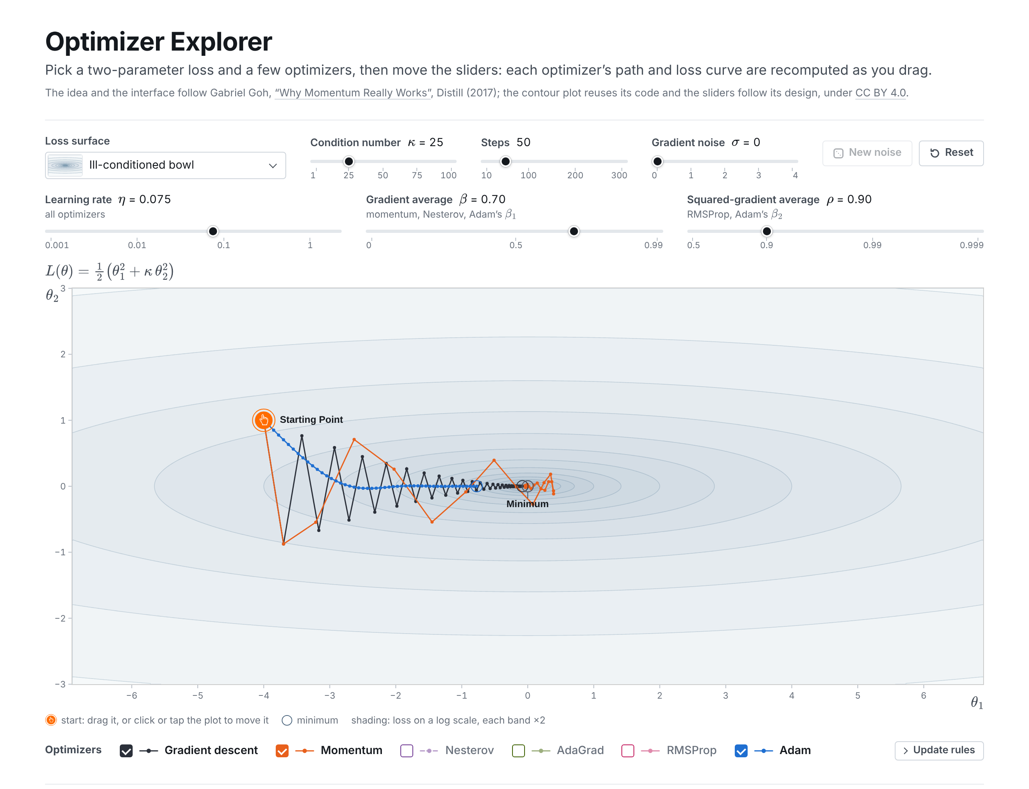
Optimizers for Deep Learning
Try them: the optimizer explorer
six optimizers: gradient descent to Adam, side by side; one η, one β, and one ρ for all
what to try: η just above 2/κ; the noise floor; gradients of very different sizes; the rotated bowl
Slide figure: the optimizer explorer, materials/week-05/optimizer-explorer.html
Notes:
The optimizer explorer, after Goh (2017), on the course page. [click] Six of today's optimizers, gradient descent to Adam, side by side on losses of two parameters, with one learning rate for all, so tune η for the one you are watching. [click] What to try, as the tutorial suggests: on the bowl, η just below and just above 2/κ; raise the noise, and watch the floor; gradients of very different sizes, AdaGrad against RMSProp; the rotated bowl, where Adam loses its advantage. Then back to the main deck.

