Slide 1
Generative AI from First Principles
Lecture 5: Pretraining and Chat Models
Tokens, Optimizers, Scale, and Fine-Tuning
Notes:
Title. Lecture 5: Pretraining and Chat Models. Last week ended with a small decoder that continues children's stories, and the promise that this week makes it a model you can talk to.

Slide 2
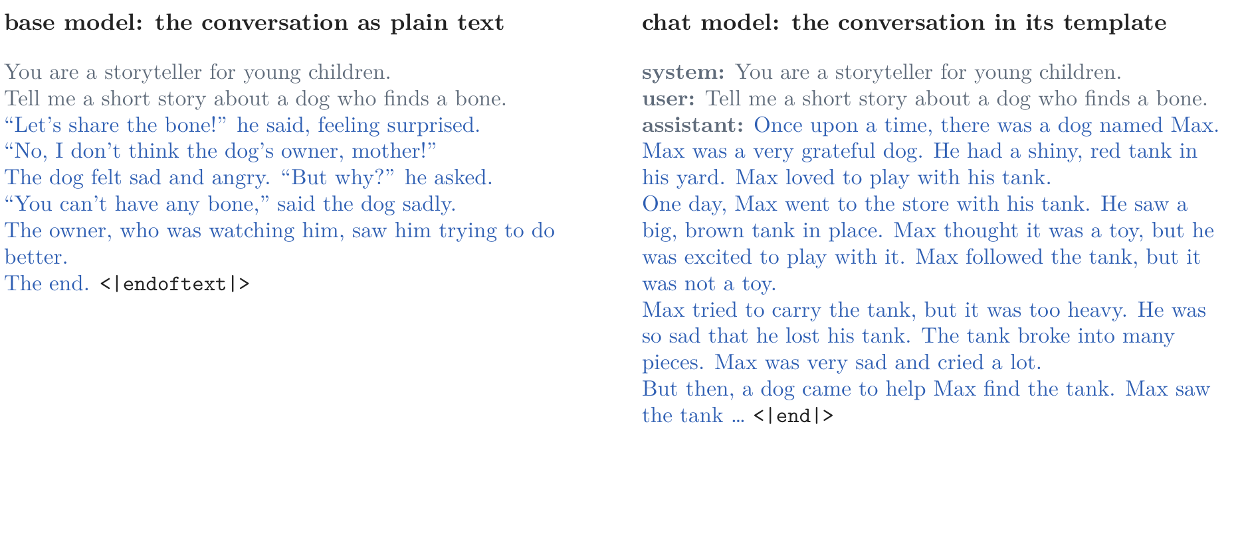
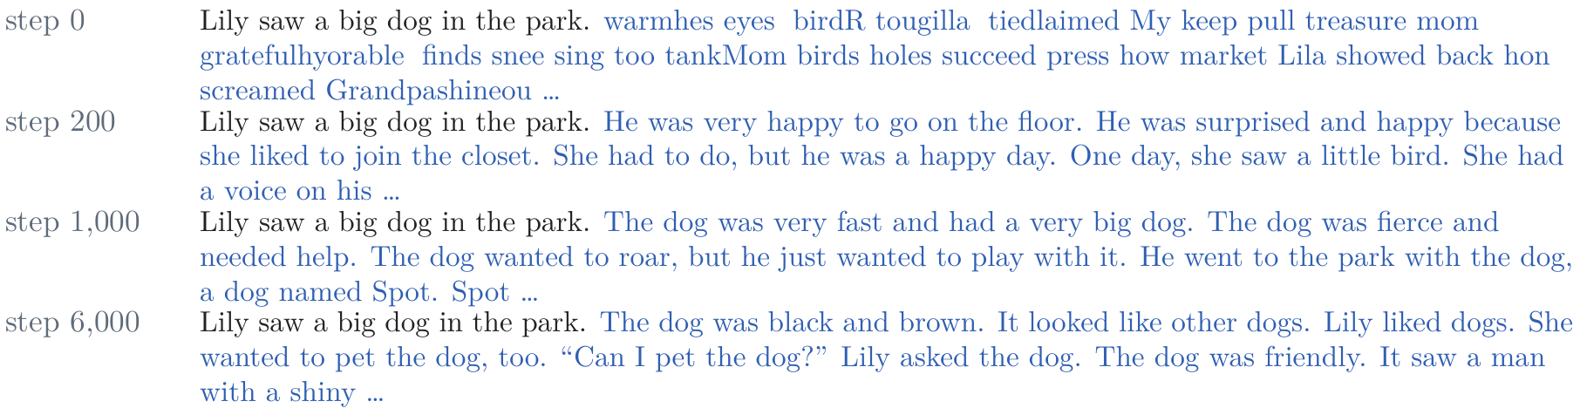
Lecture 5: Pretraining and Chat Models
From a decoder that continues stories to a model you can talk to
pretraining: predict the next token of a large amount of text; the result, a base model, continues any document
a chat model: write a conversation as tokens, and train on conversations; it answers in its turn, and stops
Figure 32c: the running prompt (black), continued by our base model at four points of training
Figure 47: the base model continues the document; our chat model answers and stops
Notes:
Notes, opening; Figures 32c and 47. The lecture's two ideas. [click] Pretraining: predict the next token of a large amount of text. What comes out is a base model, which continues any document. The picture: our base model continuing Lecture 4's running sentence at four points of its training, from random pieces of words at step 0 to a consistent scene at step 6,000. [click] A chat model: write a conversation as one sequence of tokens, with a system message, the user's turns, and the assistant's turns, and train on conversations. The picture: the same request given to the base model as plain text (left), which continues the document, and to our chat model in its template (right), which answers and stops. Both models are ours: 3.5 million parameters, trained on an ordinary CPU, with no GPU.

Slide 3
Lecture 5: Pretraining and Chat Models
Previously: the Transformer, part by part; a decoder that continues children's stories, word by word
Today: from that decoder to a small chat model, made the way ChatGPT's was before its rewards
1. After the Transformer
pretrain, then fine-tune; prompting; scale; ChatGPT's recipe of 2022
2. Tokens
bytes and Unicode; byte-pair encoding; special tokens, bits per byte, and what tokenizers get wrong
3. Pretraining
data; optimizers, in brief; the recipe, its configuration, and what runs cost; scaling laws; the base model
4. A chat model
conversations as tokens, chat templates, and system prompts; midtraining; supervised fine-tuning; what it changes, and what it does not
Notes:
[On the slide] Previously: Lecture 4 built the Transformer part by part and turned its decoder into a language model that continues children's stories, word by word. Today: from that decoder to a small chat model, made the way ChatGPT's was made before its rewards. [click ×4] Four parts, as in the notes: what happened after the Transformer (§1), a few minutes; tokens (§§2–4); pretraining (§§5–10), the longest part, to the break; and the chat model (§§11–14) after the break. [click] Part 1: a short history, from one model per task to ChatGPT's recipe.

Slide 4
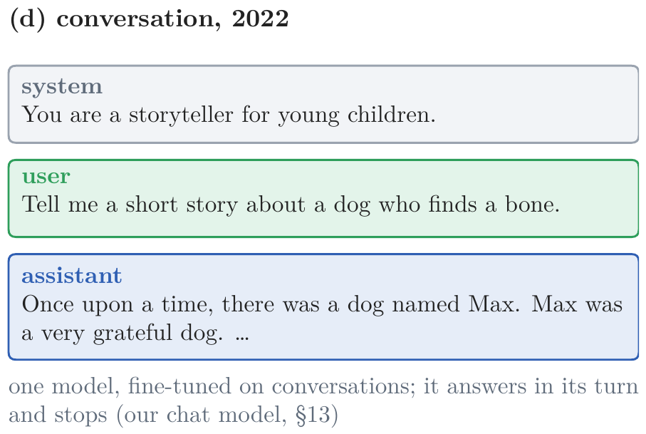
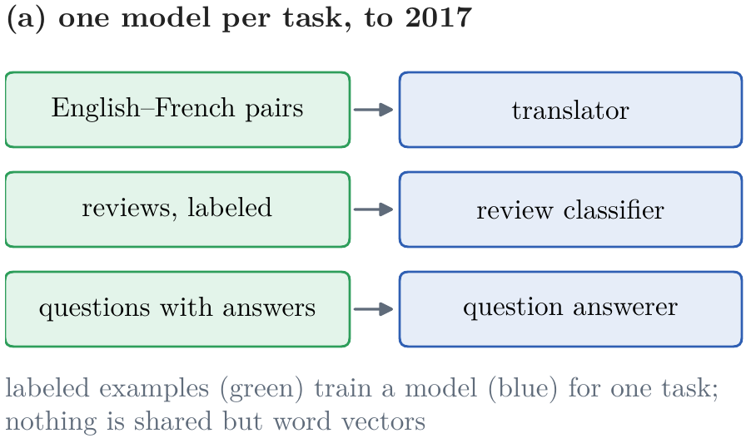
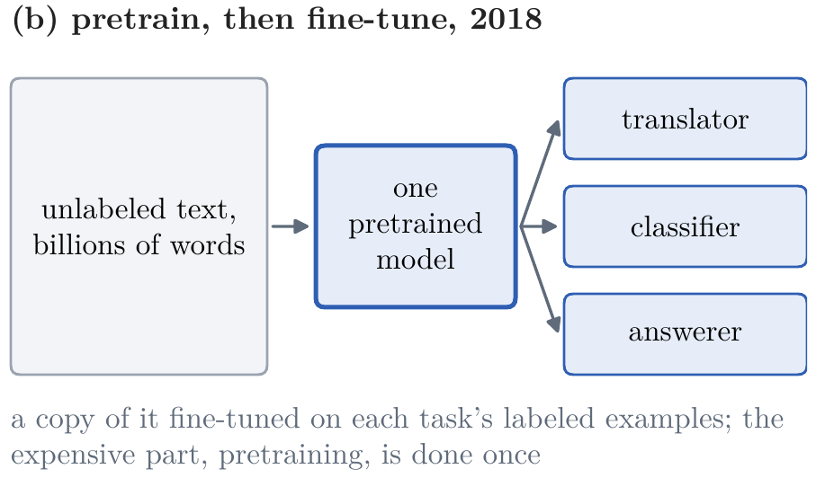
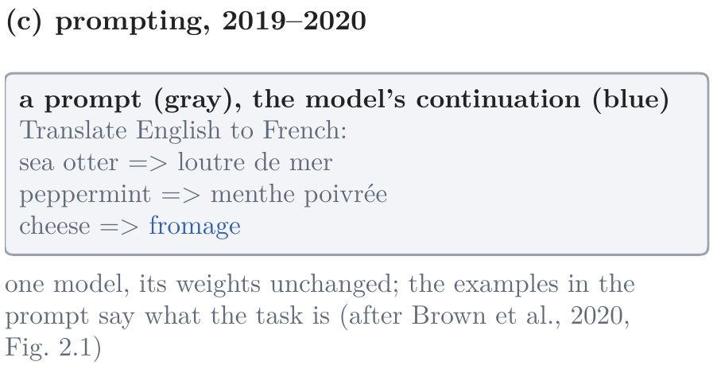
After the Transformer: Pretrain, then Adapt
Four ways of getting a task done, 2017 to 2022
one model per task: trained from scratch on that task's labeled examples
pretrain, then fine-tune: one model learns from unlabeled text; a copy of it is fine-tuned for each task
prompting: one model, its weights unchanged; examples in the prompt say what the task is
conversation: one model fine-tuned on conversations answers in its turn and stops
Figure 1c: after Brown et al. (2020), Fig. 2.1
Figure 1b: one pretrained model, a copy per task, 2018
Figure 1a: a model per task, to 2017
Figure 1d: our chat model (§13)
Notes:
Notes, opening, and §1, Figure 1. How a task got done, in four steps over five years. [click] Until 2017, one model per task: a translator trained on English–French pairs, a classifier on labeled reviews, each from scratch; only word vectors were shared. [click] 2018: pretrain one model on unlabeled text, billions of words, then fine-tune a copy of it on each task's labeled examples; the expensive part is done once. [click] 2019–2020: prompting. One model, its weights unchanged; the examples written in the prompt say what the task is. GPT-3's paper, Figure 2.1: English to French, two examples, then cheese, and it continues with fromage. [click] 2022: conversation. One model, fine-tuned on conversations, answers in its turn and stops. The answer shown is our own chat model's, from §13, to the request we follow all lecture.

Slide 5
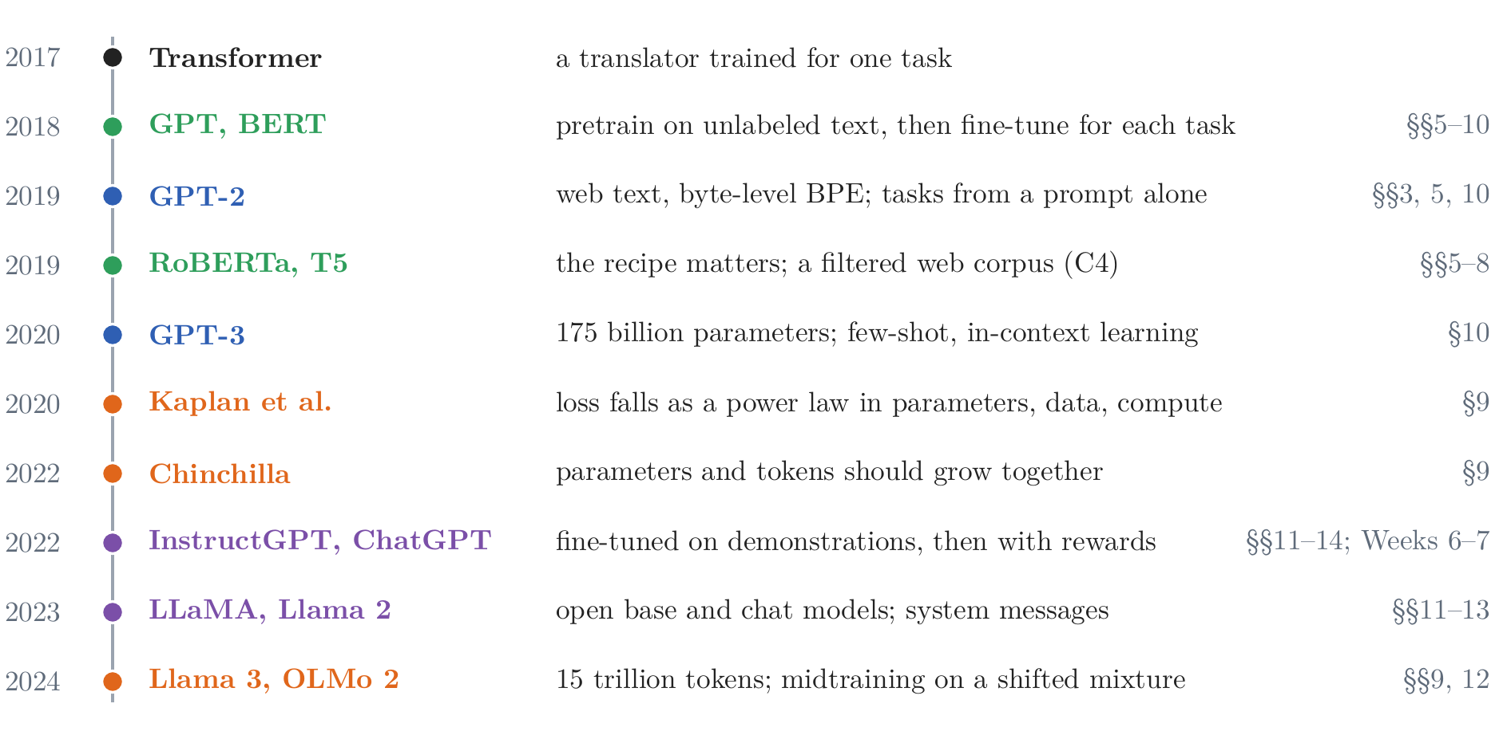
After the Transformer: Pretrain, then Adapt
From one model per task to one model for every task
Figure 2: selected steps, 2017–2024, with the section of this lecture that develops each
pretrain, then fine-tune: the expensive part, learned once from unlabeled text, shared by every task
data and the recipe: web text, byte-level BPE, a filtered web corpus; how a model is trained matters as much as its design
prompting: 175 billion parameters on 300 billion tokens; a task from a few examples in the prompt
scale: the loss falls as a power law; Chinchilla, 70B on 1.4T tokens, beats Gopher, 280B on 300B
conversation: fine-tuned on demonstrations, then with rewards; open chat models with system messages
stages: pretraining; midtraining on a shifted mixture; post-training
Notes:
Notes §1, Figure 2. The whole span at once: selected steps from the Transformer (2017) to the open models of 2024, each with the section of this lecture that develops it. Colors: pretraining green, prompting blue, scale orange, conversation purple. Until 2017, one model per task: a translator learned from translations, a review classifier from labeled reviews; only word vectors were learned from unlabeled text and reused. [click] 2018: pretrain on unlabeled text, where predicting the next word forces a model to learn whatever helps predict, then fine-tune on one task's labeled examples. Dai and Le (2015) did it with LSTMs; ELMo (2018) reused a pretrained LSTM's states as features, and ULMFiT (2018) fine-tuned one; GPT did it with the Transformer's decoder, BERT with its encoder, trained to fill in blanks (Lecture 4, §8). [click] 2019: data and the recipe. GPT-2 read WebText, about 8 million web pages linked from Reddit, split by a byte-level BPE (§3); T5 built C4 from Common Crawl with simple filters (§5); RoBERTa found BERT undertrained: the same model, longer, larger batches, ten times the text, did much better (§§6–7). [click] 2020: GPT-3, 175 billion parameters on 300 billion tokens, did tasks from a few examples in its prompt, with no change to its weights: in-context learning (§10). [click] Scale: Kaplan et al. (2020), the loss falls as a power law in parameters, data, and computation; Hoffmann et al. (2022): models of the time were too large for their data. Chinchilla, 70 billion parameters on 1.4 trillion tokens, beat Gopher, 280 billion on 300 billion, at the same cost (§9). [click] 2022: InstructGPT and ChatGPT turned a base model into an assistant (next slide); 2023: LLaMA trained on public text only, its 13B model beating GPT-3 on most benchmarks, and Llama 2's chat models begin each conversation with a system message (§11). [click] 2024: training in stages. Pretraining on trillions of tokens (Llama 3: 15 trillion, far more per parameter than §9's rule); midtraining, a shorter continuation on a shifted mixture while the rate decays (§12); post-training, fine-tuning and then rewards.

Slide 6
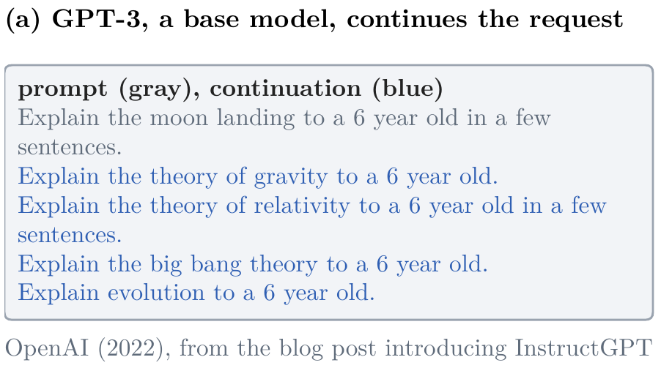
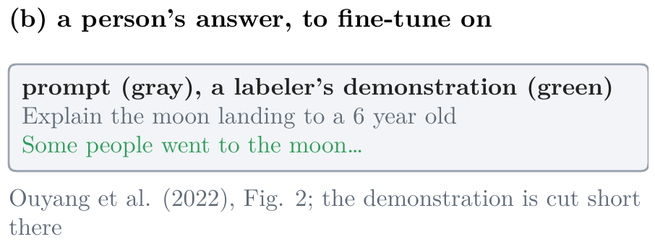
After the Transformer: Pretrain, then Adapt
A base model continues a request
a base model: treats a request as the start of a document, and continues it, often with more requests
fine-tuning: shows it an answer to the request, written by a person
Figure 3b: Ouyang et al. (2022), Fig. 2
Figure 3a: OpenAI (2022), GPT-3's continuation
Notes:
Notes §1, 'Conversation (2022)', Figure 3. Ask the room first: what does a base model do with a request? [click] It treats the request as the start of a document, and writes what such a document might contain next. OpenAI's own example, from the post that introduced InstructGPT in January 2022: asked to explain the moon landing to a six-year-old, GPT-3 writes four more requests of the same kind. [click] Supervised fine-tuning shows it an answer instead: a labeler's demonstration for the same kind of prompt, as in Figure 2 of the InstructGPT paper, where it is cut short.

Slide 7
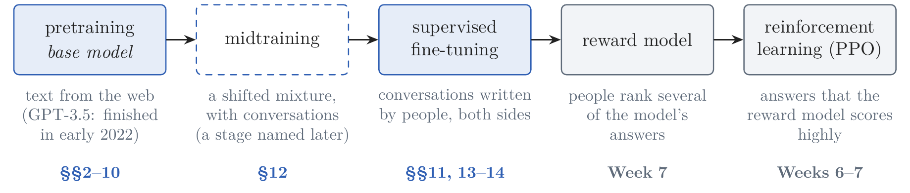
After the Transformer: Pretrain, then Adapt
ChatGPT's recipe of 2022: a base model, then three steps
Figure 4: after Ouyang et al. (2022), Fig. 2
InstructGPT (2022): labelers wrote answers to about 13,000 prompts; a reward model learned their rankings; reinforcement learning (PPO) trained against it
people preferred: the answers of a 1.3-billion-parameter InstructGPT to those of the 175-billion-parameter GPT-3
ChatGPT, 30 November 2022: the same steps on conversations, people writing both the user's turns and the assistant's
this lecture: pretraining, midtraining, and supervised fine-tuning, at our scale; the rewards are Weeks 6 and 7
Notes:
Notes §1, Figure 4, after Ouyang et al. (2022), Fig. 2. A base model continues text (previous slide). [click] InstructGPT (Ouyang et al., 2022) turned GPT-3 into a model that follows instructions in three steps: supervised fine-tuning on answers that labelers wrote to about 13,000 prompts; a reward model trained on the labelers' rankings of several answers to the same prompt; and reinforcement learning (PPO) against that reward model. [click] People preferred the answers of a 1.3-billion-parameter InstructGPT to those of the 175-billion-parameter GPT-3: a model more than a hundred times smaller. [click] ChatGPT, released on 30 November 2022, used the same steps on conversations, starting from a GPT-3.5 model that finished training in early 2022: people wrote both the user's turns and the assistant's, mixed with InstructGPT's data rewritten as dialogues, and then ranked its answers. [click] This lecture builds the first stages at our scale: pretraining gives the base model (§§2–10), midtraining (§12), a stage named later, and supervised fine-tuning on conversations in a chat template (§§11, 13–14). The last two, rewards, are Weeks 6 and 7.

Slide 8
Lecture 5: Pretraining and Chat Models
1. After the Transformer
pretrain, then fine-tune; prompting; scale; ChatGPT's recipe of 2022
2. Tokens
bytes and Unicode; byte-pair encoding; special tokens, bits per byte, and what tokenizers get wrong
3. Pretraining
data; optimizers, in brief; the recipe, its configuration, and what runs cost; scaling laws; the base model
4. A chat model
conversations as tokens, chat templates, and system prompts; midtraining; supervised fine-tuning; what it changes, and what it does not
Notes:
[click] Part 2, tokens (notes §§2–4), about 15 minutes. A model must be able to read and write any text: what should its tokens be?

Slide 9
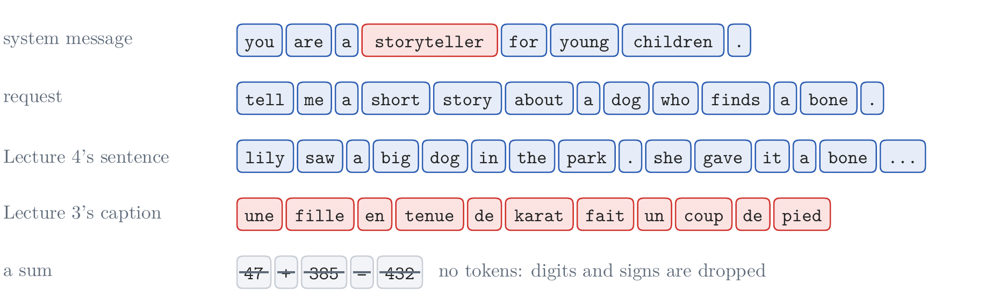
Text as Bytes
A fixed list of words
the running conversation: system You are a storyteller for young children. user Tell me a short story about a dog who finds a bone.
Lecture 4's word model: 8,682 lowercase words; anything else is <unk>, 0.2% of the validation words
outside the stories, it fails: storyteller is lost; the French caption is eleven <unk>s; the sum disappears
characters never fail, but: a story is 875 characters against 204 words, 4.3 times as many; attention's work, 4.3² ≈ 18 times
Figure 5: five texts as Lecture 4's word model reads them; unknown words in red
Notes:
Notes §2, Figure 5. [On the slide] The running conversation of the lecture: a system message and a request; the chat model of §13 will answer it. [click] Lecture 4's word model reads the lowercase words and punctuation that occur at least twice in its training stories, 8,682 tokens with <unk> and the EOS and BOS tokens. On stories like its training stories, unknown words are rare: 0.2% of the validation words, many of them names. [click] Outside them it fails at once (the picture): the system message loses storyteller; Lecture 3's French caption becomes eleven <unk>s; the sum 47 + 385 = 432 disappears, since the word tokenizer keeps only letters and punctuation. And it writes in lowercase only. Ask: what would never fail? [click] Characters cannot be unknown. But a validation story is 875 characters against 204 word tokens, 4.3 times as many positions; attention's work grows with the square of the positions (Lecture 4, §10), so about 18 times as much, and the cache is 4.3 times as long.

Slide 10
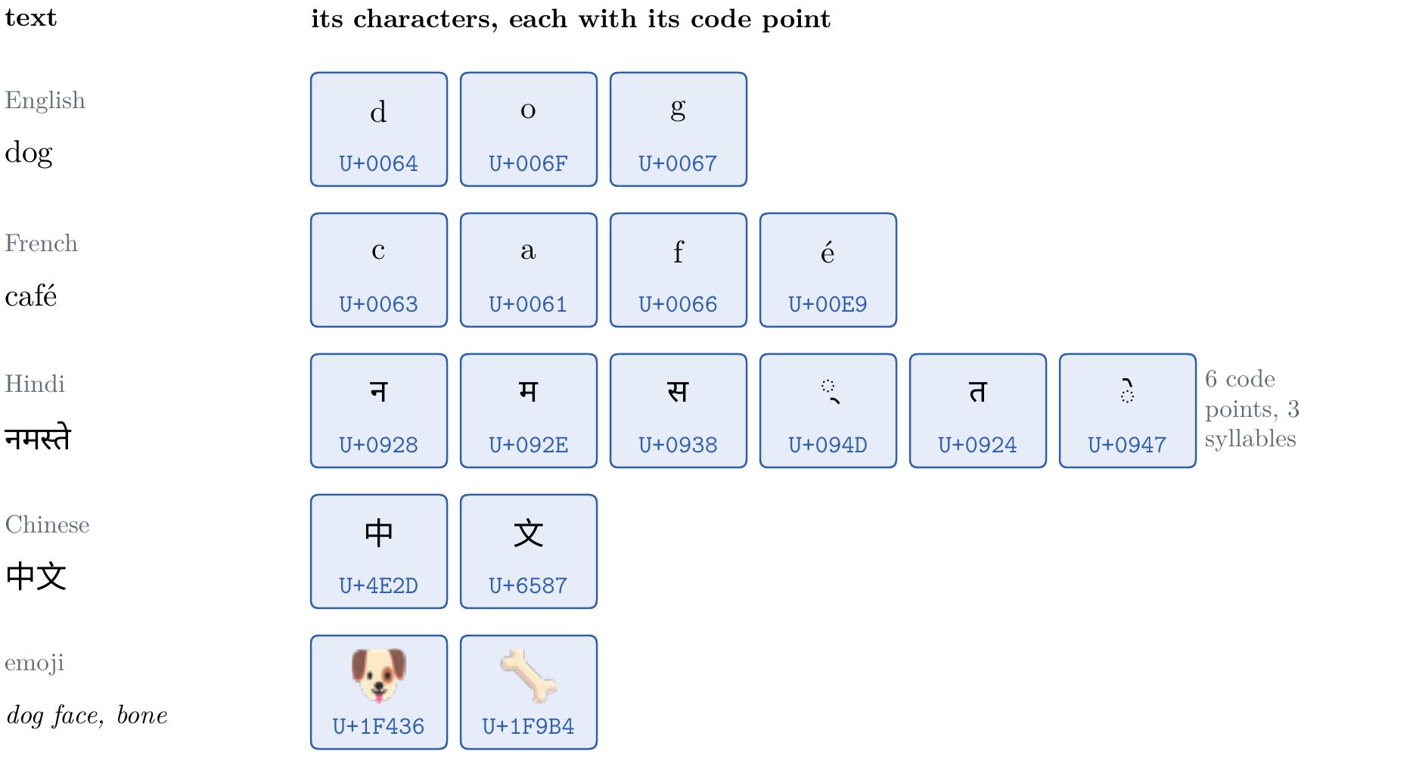
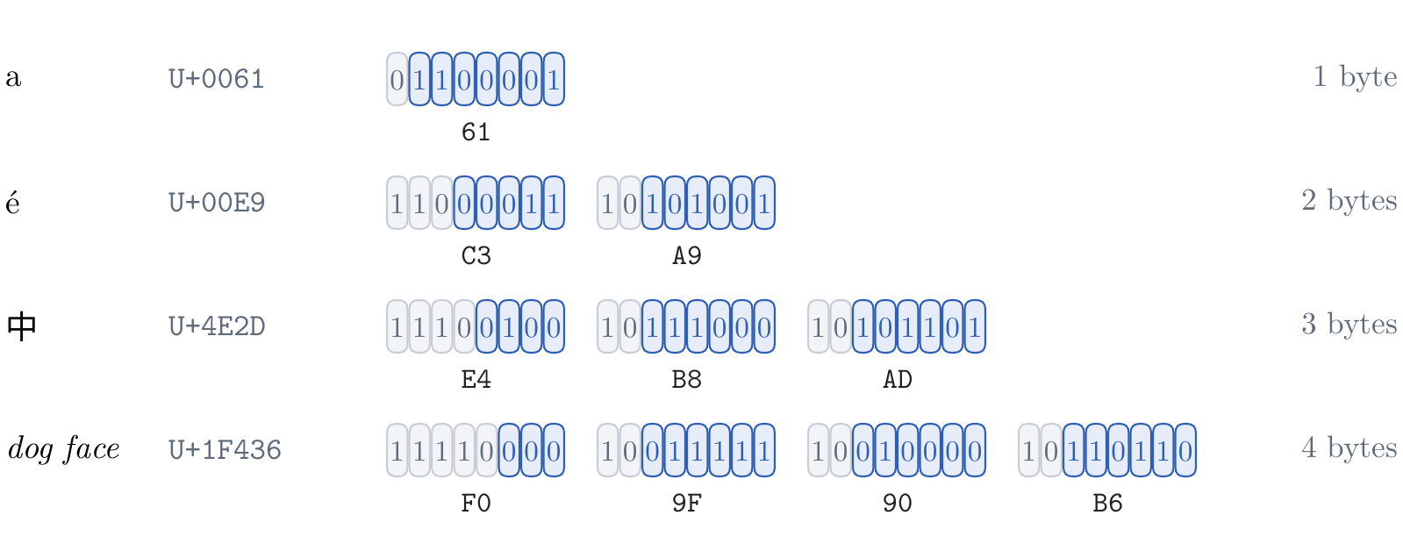
Text as Bytes
Characters, code points, and bytes
ASCII (1963): 128 characters in 7 bits; the other 128 byte values, incompatible code pages
Unicode (1991): a code point for every character of every script, 172,808 of them in 2026
UTF-8 (1992): one to four bytes per code point; ASCII is one byte, unchanged; UTF-16 and UTF-32 use two to four, and four
self-synchronizing: the first byte's leading 1s count the bytes; every following byte starts with 10
Figure 7: a code point's bits (blue) in the free positions of one to four bytes
a byte model: 256 tokens, every text in every language; English about one byte a character, Chinese about three
Figure 6: five texts and the code points of their characters
Notes:
Notes §2, 'Characters, code points, and bytes', Figures 6 and 7. How does a computer store text at all? As numbers, one per character. [click] ASCII, 1963: 128 characters, the English letters, digits, punctuation, in 7 bits. Bytes have 8, and the other 128 values were filled by incompatible code pages, Latin-1 for Western Europe, others for Greek, Cyrillic, Arabic, Hebrew; byte 233 was é in one and a Cyrillic letter in another. [click] Unicode, 1991: one numbering for every character of every script, a code point written U+ and hexadecimal. Room for 1,114,112; Unicode 18.0, this September, assigns 172,808. A code point is not always a letter you see: namaste is three syllables and six code points (the picture). A table of 172,808 rows would be mostly unused. [click] Files store bytes, and an encoding writes each code point as bytes. UTF-32: four bytes each. UTF-16, inside Windows, Java, JavaScript: two, or four for emoji. UTF-8, Ken Thompson and Rob Pike, 1992, the encoding of 99% of the web: one to four bytes; below 128, ASCII, one byte, its own number. The picture: one character of each length, the code point's bits (blue) in the free positions after fixed prefix bits (gray). [click] The first byte begins with as many 1s as the character has bytes, then a 0; every following byte begins with 10. So no byte of a long character looks like ASCII, and a reader dropped in the middle finds the next character at the next byte that does not start with 10. [click] A byte model has 256 tokens, plus special tokens, and can read and write every text. The running conversation is 41 bytes of system message and 51 of request. The cost is length: about one byte per character for English, three for Chinese.

Slide 11
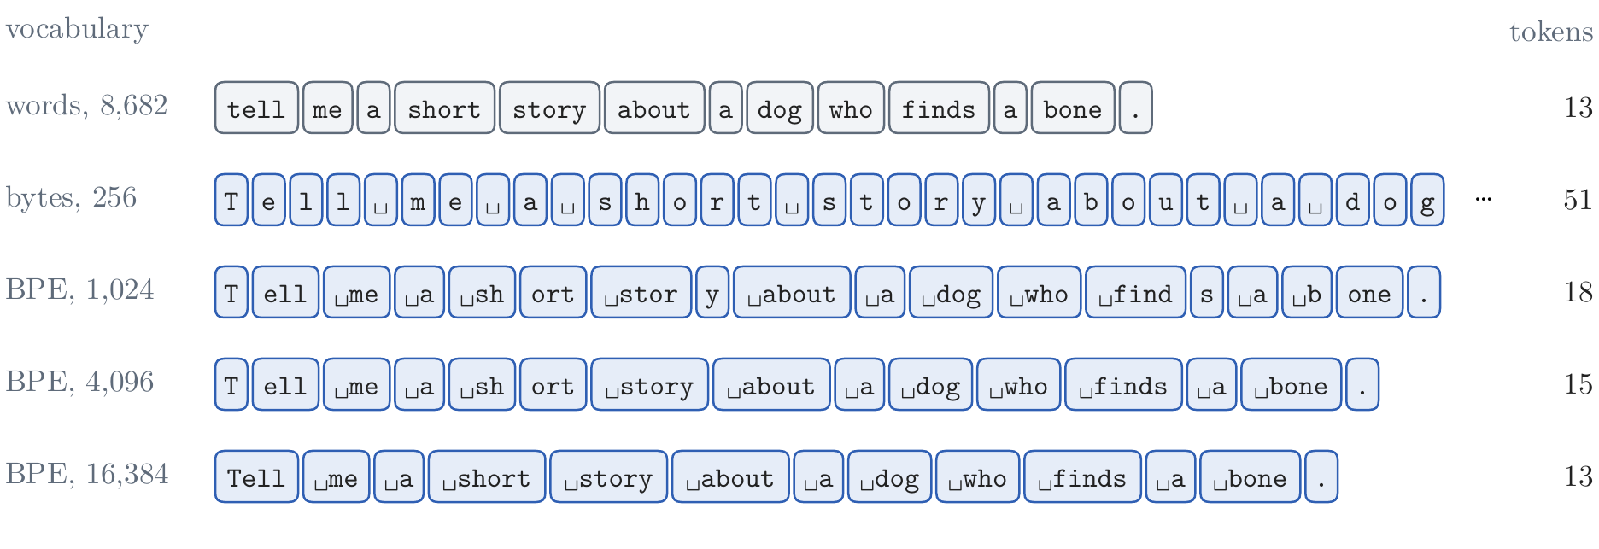
Text as Bytes
Tokens: the table against the length
the vocabulary fixes the table: |V| × d numbers, at the input and, tied, at the output, |V| logits at every position
the tokens per text scale everything else: every token costs computation and memory, and a fixed context holds less text
in between: words are short but fail; bytes never fail but are long; learn the pieces from the text
Figure 8: the running request in five vocabularies; tokens at the right
Notes:
Notes §2, 'Tokens: the table against the length', Figure 8. The picture: the running request split five ways, from Lecture 4's words (13 tokens) to bytes (51) to byte-pair encodings of 1,024, 4,096, and 16,384 tokens (18, 15, 13). Two parts of Lecture 4's model depend on the choice. [click] The vocabulary fixes the token table, |V| × d numbers, used at the input and, tied, at the output, where every position computes |V| logits at 2|V|d operations; and every token must occur often enough for its row to be learned. [click] The number of tokens a text needs scales everything else: the model's computation and memory grow with the tokens, attention's faster than the rest, and a fixed context holds less text when tokens are short. [click] Words are short and fail on new words; bytes never fail and are long. Next: a vocabulary in between, learned from the text.

Slide 12
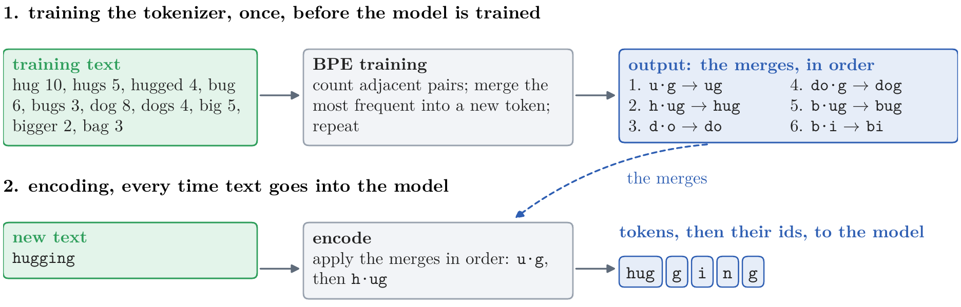
Byte-Pair Encoding
A tokenizer has two jobs
training the tokenizer, once: from a sample of text, learn the vocabulary and the order of its merges
encoding, every time: apply the merges, in order, to any text; the tokens' ids go to the model
Figure 9: training writes the merges; encoding applies them
Notes:
Notes §3, opening, Figure 9. Before the algorithm, its two jobs, done at different times. [click] Training the tokenizer: once, before the model is trained. From a sample of training text, BPE learns the vocabulary and the order of its merges; the next slide does it by hand on ten words. [click] Encoding: every time text goes into the model, during its training and whenever it is used. The learned merges, applied in that order, turn any text into tokens, here hugging, which the training text never contained. The training text is used only by the first job; the merges are all the second needs. Decoding writes each token's bytes back out.

Slide 13
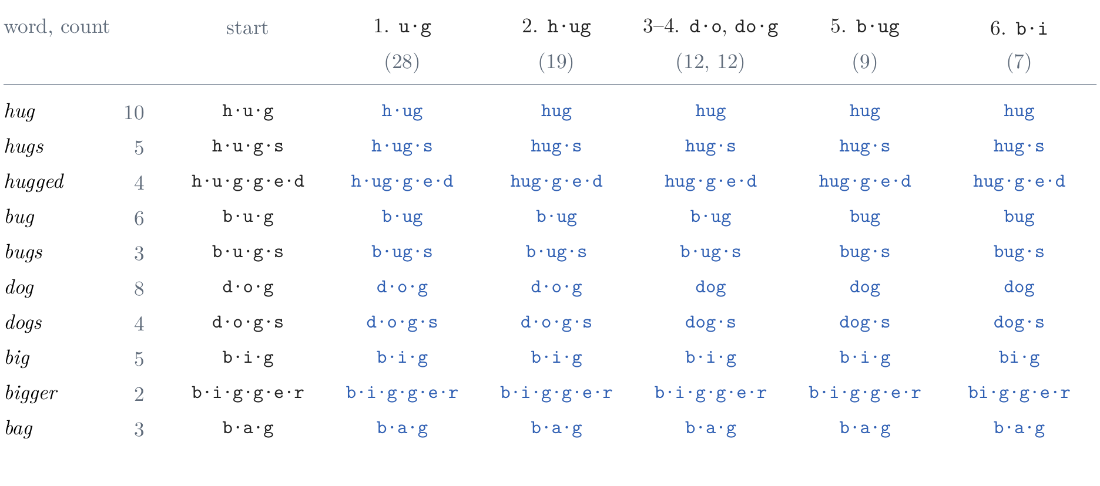
Byte-Pair Encoding
By hand: merge the most frequent adjacent pair
the problem: words fail on new words, and bytes make texts long → the fix here: learn the pieces from the text, by merging
the corpus: ten words with their counts, 50 words, 180 characters; after six merges, 93 tokens
Figure 10: one merge per column; each pair's count in parentheses
Notes:
Notes §3, 'Training the tokenizer, by hand', Figure 10. The problem line: words fail on new words, bytes make texts long. Byte-pair encoding (BPE) learns the pieces from the text: frequent words become single tokens, rare words stay spelled. The corpus: ten words with their counts, 50 words, 180 characters; each row of the table is a word, each column a merge. [click] Count every adjacent pair inside the words, weighted by the word's count: u·g occurs in hug, hugs, hugged, bug, bugs, 10 + 5 + 4 + 6 + 3 = 28 times, more than any other. Merge it into a new token, ug, in every word. [click] Count again: h·ug, 19 times. [click] Merges 3 and 4 build dog; merge 3 breaks a tie between d·o and o·g, 12 each, by the alphabet. [click] Merge 5, b·ug, 9. [click] Merge 6, b·i, 7, a tie with i·g, also broken by the alphabet. After six merges the 180 characters are 93 tokens.

Slide 14
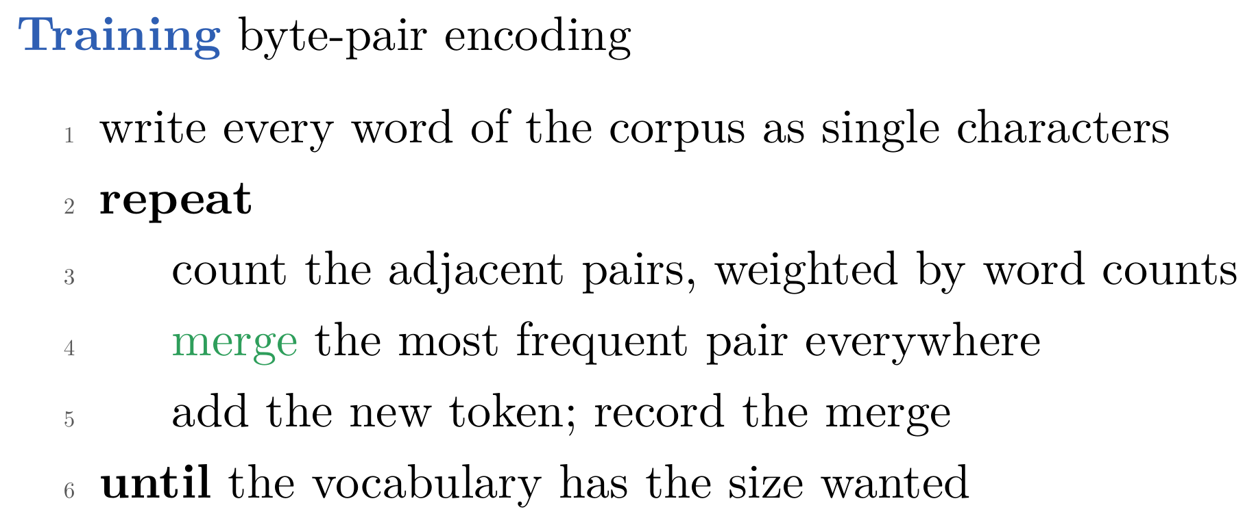
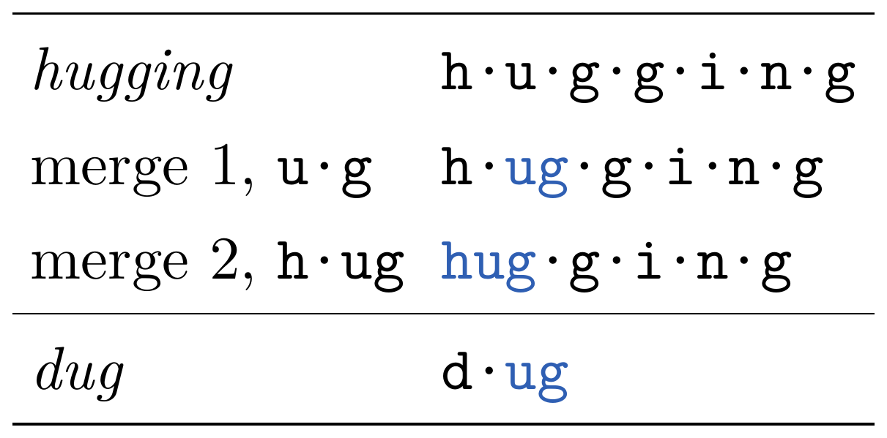
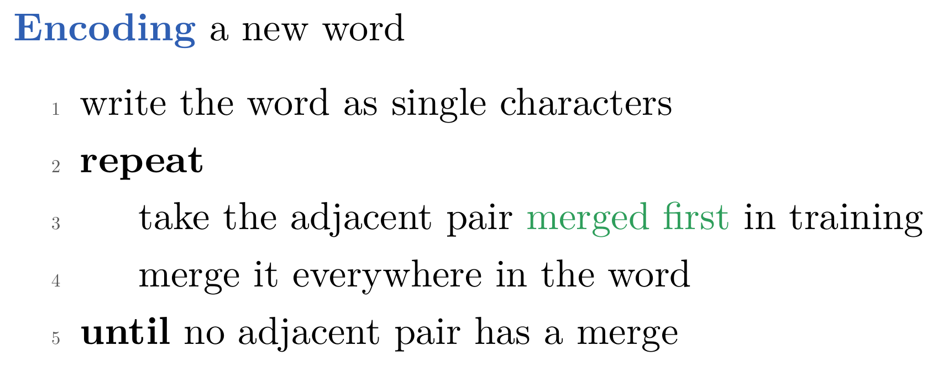
Byte-Pair Encoding
Training and encoding
Slide figure: two words encoded with the learned merges
greedy compression: each merge removes the most occurrences it can; Gage (1994) compressed files this way
for language: Sennrich et al. (2016), rare words as pieces; the 37,000 pieces of Lecture 4's Transformer
not optimal: no merge is undone; a vocabulary chosen all at once could be shorter
Notes:
Notes §3, 'Training the tokenizer, by hand' and 'Greedy compression'. [On the slide] Training, as an algorithm: start from single characters, and repeat: count the adjacent pairs, weighted by the words' counts; merge the most frequent pair everywhere; record the merge; until the vocabulary has the size wanted. The result is an ordered list of merges. [click] Encoding a new word applies the merges in the order they were learned: take the pair whose merge came first, merge it everywhere, repeat. hugging becomes hug·g·i·n·g: the frequent part is one token, the rest is spelled; dug, never in the corpus, becomes d·ug. [click] Each merge removes the most occurrences it can, so BPE is a greedy compressor; it was introduced for compressing files by Gage (1994), who replaced the most frequent pair of bytes by an unused byte. [click] Sennrich et al. (2016) brought it to translation, so that rare words are translated as pieces; the 37,000 shared pieces of Lecture 4's Transformer came from it. [click] Greedy is not optimal: no merge is undone, and a vocabulary chosen all at once could encode the corpus in fewer tokens (how far, Appendix A, not today).

Slide 15
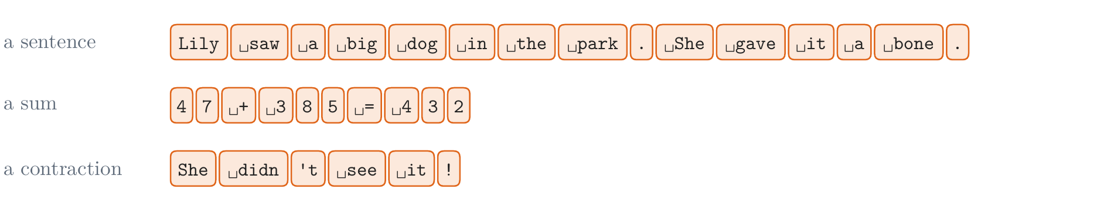
Byte-Pair Encoding
Byte-level BPE, inside pre-tokens
the problem: a character never seen in training has no token → the fix here: start from the 256 bytes
GPT-2 (2019): 256 bytes + 50,000 merges + one end-of-text token = 50,257; every text can be encoded
merges stay inside pre-tokens: a regular expression splits the text first, so no dog. or dog! beside dog
GPT-2's pre-tokens: letters with at most one space before them; 's 't 'll; runs of punctuation; runs of spaces
ours, one difference: every digit is its own pre-token, as in Llama, so 432 is always 4·3·2
Figure 11: our pre-tokens; BPE merges bytes only inside a box
Notes:
Notes §3, 'Byte-level BPE', Figure 11. The problem line: starting from characters brings back §2's problem, a character never seen in training has no token. [click] GPT-2 started from the 256 bytes instead: its 50,257 tokens are the 256 bytes, 50,000 merges, and one end-of-text token, and every text can be encoded. A merge may form half a character; only the whole text need be valid UTF-8. [click] Run over raw text, merges would cross word boundaries and make dog. and dog! beside dog. So a regular expression first splits the text into pre-tokens, and merges happen only inside one (the boxes in the picture). [click] GPT-2's pre-tokens, which ours follow: a run of letters with at most one space before it, so that a word and its space become one token; the endings 's, 't, 'll; runs of punctuation; runs of spaces. [click] Ours differs in one place: every digit is its own pre-token, as in Llama's tokenizer, so a number is always written digit by digit (§4).

Slide 16
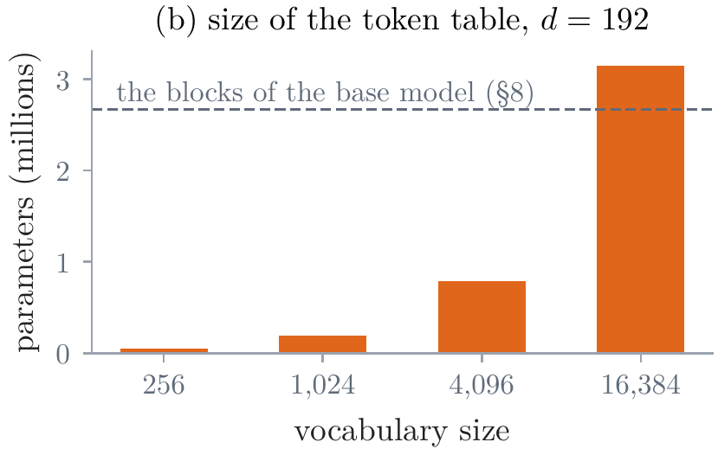
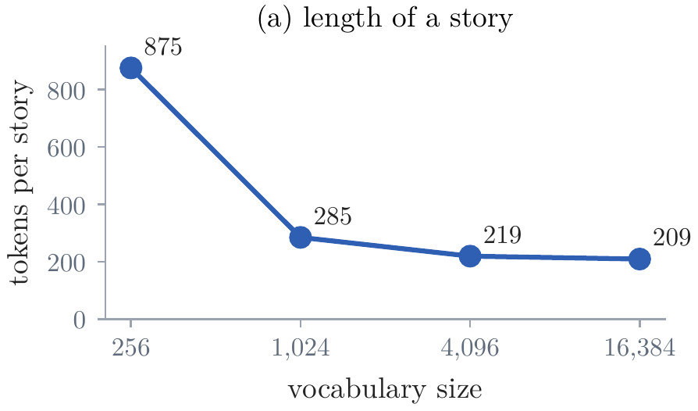
Byte-Pair Encoding
Our tokenizer
4,096 tokens: 256 bytes, 3,832 merges, 8 special tokens; trained on 100,000 stories in about 20 seconds
the first merges: he ␣t ␣a ␣s ␣w nd ␣the ed ␣and ␣to; 3.99 bytes a token
the vocabulary's size: a story is 875 tokens as bytes, 285 with 1,024, 219 with 4,096, 209 with 16,384
the table grows with every token: 49,152 numbers for the bytes, 3.1 million for 16,384, against 2.7 million in the blocks
Figure 12a: tokens per validation story
Figure 12b: the token table at d = 192
You·␣are·␣a·␣story·t·ell·er·␣for·␣young·␣children·.
T·ell·␣me·␣a·␣sh·ort·␣story·␣about·␣a·␣dog·␣who·␣finds·␣a·␣bone·.
the running conversation, in our tokens
Notes:
Notes §3, 'Our tokenizer', Figure 12. [click] Our tokenizer: a byte-level BPE trained on the first 100,000 stories of our training text with their share of sums, in plain Python; 3,832 merges in about 20 seconds. 4,096 tokens: 256 bytes, 3,832 merges, 8 special tokens (next slide). [click] The first merges join frequent letters and attach spaces: he, space-t, space-a, ..., space-the, ed, space-and, space-to. On the validation stories it writes 3.99 bytes per token. [click] The size of the vocabulary is a choice (panel a): a validation story is 875 tokens as bytes, 285 with 1,024 tokens, 219 with 4,096, 209 with 16,384. TinyStories uses a small vocabulary, and the first few hundred merges bring most of the gain. [click] The table grows in proportion (panel b): 49,152 numbers at d = 192 for the bytes, 3.1 million for 16,384 tokens, more than the 2.7 million in the rest of the base model. [click] The running conversation in our 4,096 tokens: storyteller, short, and an imperative Tell at the start of a sentence are rare in children's stories, so they are split. A tokenizer fits the text it was trained on. Lecture 4's running sentence, by contrast, is one token per word.

Slide 17
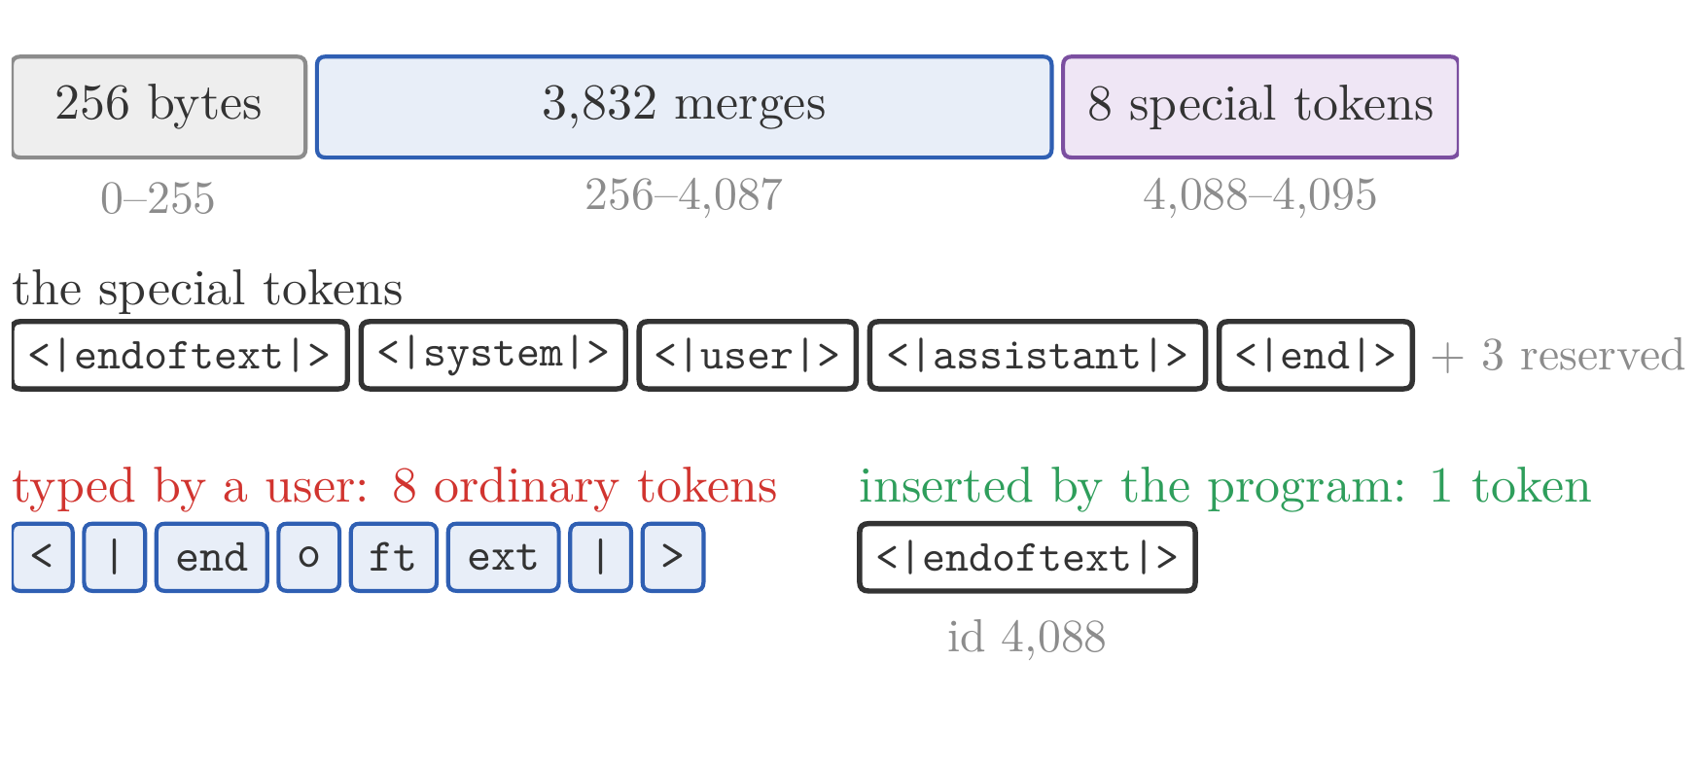
What a Tokenizer Fixes
Special tokens
structure, not text: eight tokens that no merge produces, at the end of the vocabulary
<|endoftext|> separates documents in the training stream, as Lecture 4's BOS did
the turns of a conversation: <⁠|⁠s⁠y⁠s⁠t⁠e⁠m⁠|⁠>, <⁠|⁠u⁠s⁠e⁠r⁠|⁠>, <⁠|⁠a⁠s⁠s⁠i⁠s⁠t⁠a⁠n⁠t⁠|⁠>, <⁠|⁠e⁠n⁠d⁠|⁠> (§11); three more are reserved
cannot be typed: the characters give 8 ordinary tokens; only the program inserts the token
so: text from outside, a web page or a user's message, cannot pose as the structure around it
Slide figure: our 4,096 tokens, and the special token typed as text
Notes:
Notes §4, 'Special tokens'. A tokenizer is trained once, before the model, and every later stage inherits it: the table has one row per token, the training text is stored as token ids, every loss or context length is counted in its tokens. [click] Some tokens mark structure rather than text: our vocabulary ends with eight special tokens, ids 4,088 to 4,095, which no merge produces. [click] <|endoftext|> separates documents in the training stream (§5), so that every document follows one: Lecture 4's BOS. [click] <|system|>, <|user|>, <|assistant|>, and <|end|> mark the turns of a conversation, unused until §11; three more are reserved, so that later uses need no new rows. [click] The encoder never produces a special token from text: a user who types the characters of <|endoftext|> gets 8 ordinary tokens (the picture: <, |, end, o, ft, ext, |, >). Only the program that builds the model's input can insert the token itself. [click] So text from outside, a web page or a user's message, cannot pose as the structure around it. Keep this in mind for §11.

Slide 18
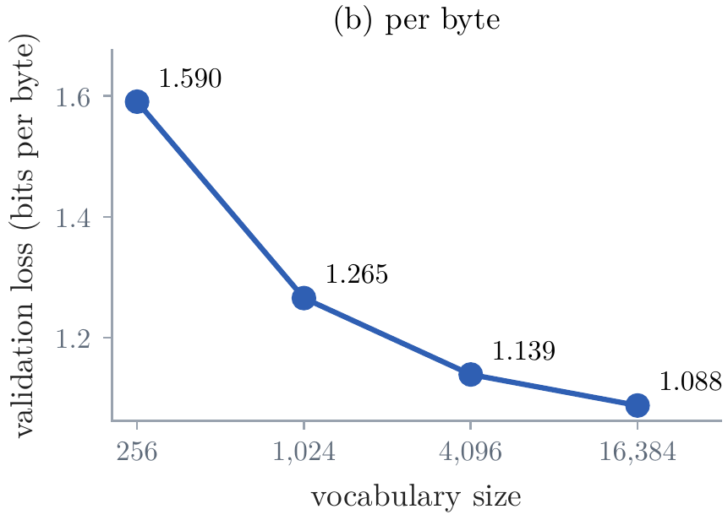
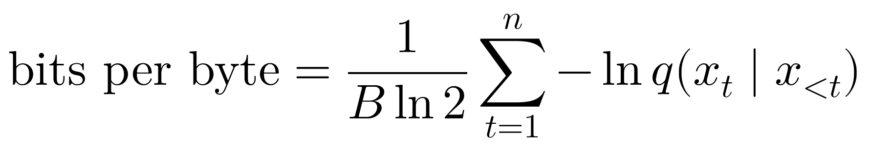
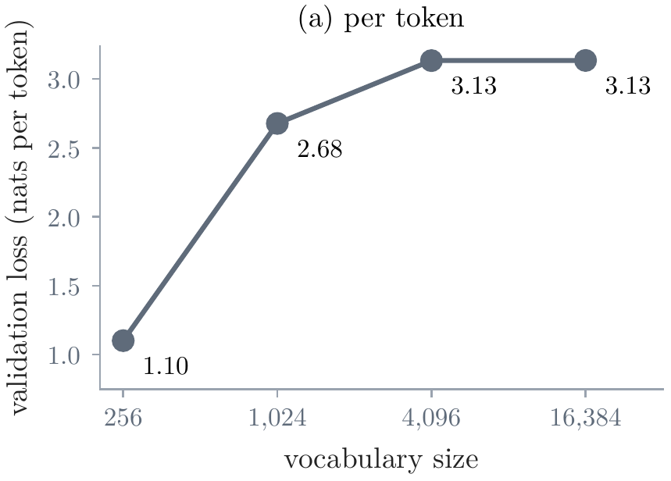
What a Tokenizer Fixes
Bits per byte
the problem: with longer tokens the loss per token rises, even if the text is predicted better → the fix here: measure per byte
what a compressor pays: per byte of text, whatever the split
our own experiment: four blocks, d = 128, the same 10 million bytes, tokenizers of 256 to 16,384 tokens
per token: the bytes look best, 1.10 nats against 3.13 for 4,096 tokens
per byte: every larger vocabulary does better, with shrinking gains
Figure 13b: validation loss per byte
Figure 13a: validation loss per token
not between equals: the 16,384-token table adds 2.1 million parameters
Notes:
Notes §4, 'Bits per byte', Figure 13. The problem line: a model whose tokens are longer makes fewer predictions on a text, each harder, so its loss per token is larger even if it predicts the text better. Fix: measure per byte. [click] The formula: the total log loss of the text's n tokens, in nats, divided by its B bytes and by ln 2. It is what a compressor driven by the model would pay per byte, whatever the split. From a loss per token: divide by ln 2 and by the bytes per token. Lecture 2's bits per character is the same measure for one byte per character. [click] The experiment: models with the same four blocks, d = 128, trained on the same first 10 million bytes of our text with tokenizers of 256, 1,024, 4,096, and 16,384 tokens, each reading 1,024 bytes of context. Ask: which looks best per token? [click] Per token (panel a) the bytes look best, 1.10 nats against 3.13 for 4,096 tokens, since a token of the 4,096 carries about four bytes. [click] Per byte (panel b) the order reverses: 1.59, 1.27, 1.14, 1.09 bits per byte, every larger vocabulary better, with shrinking gains. [click] Not between equals: the table of 16,384 tokens adds 2.1 million parameters against 0.8 million in the blocks, and each model reads the same 1,024 bytes in fewer positions. Single runs.

Slide 19
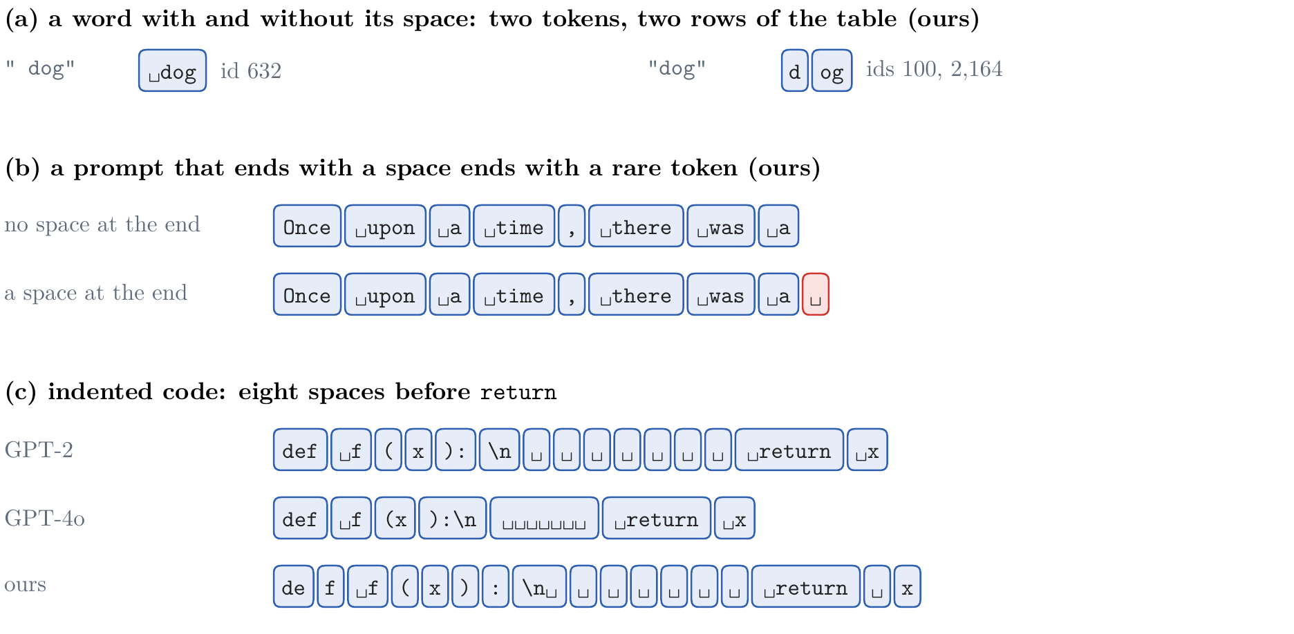
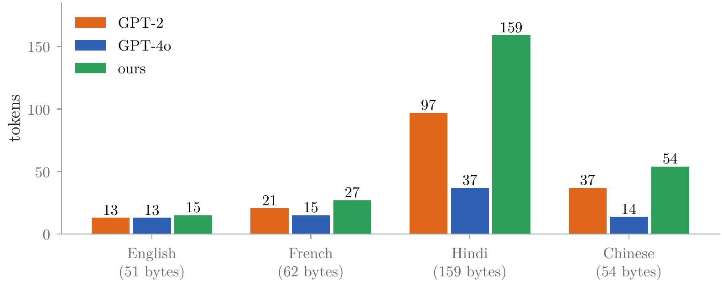
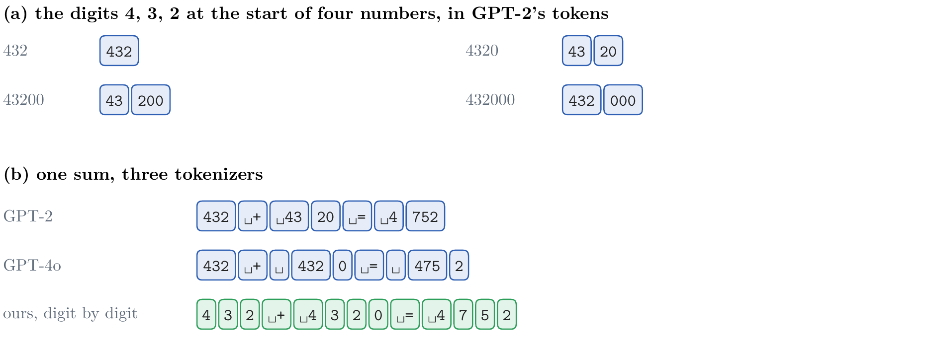
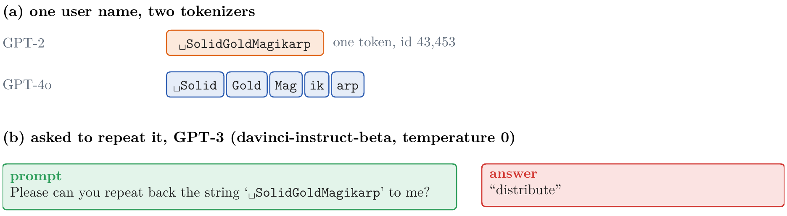
What a Tokenizer Fixes
What tokenizers get wrong
numbers: cut by frequency, not by place; ours writes 4·3·2
spaces: ␣dog and dog are different tokens; a run of spaces, one token each
rare strings: ␣SolidGoldMagikarp, one GPT-2 token, barely trained
other languages: the same request, 13 GPT-2 tokens in English, 97 in Hindi
Figure 16: after Rumbelow and Watkins (2023)
Figure 14: GPT-2's, GPT-4o's, and our tokens for numbers
Figure 17: tokens for the running request in four languages
Figure 15: spaces, in ours and in code
Notes:
Notes §4, 'What tokenizers get wrong', Figures 14 to 17. The tokenizer decides what the model sees, and some of what it hides is hard to recover later. Four kinds of text, each with real tokenizers: GPT-2's (50,257 tokens, which GPT-3 reused), GPT-4o's (about 200,000), and ours. [click] Numbers. To add 432 and 4320 by hand you line them up by place. GPT-2 keeps a run of digits together and cuts it by frequency: 432 is one token, 4320 is 43·20, 43200 is 43·200. In the sum, the answer's 4 is a token of its own and 752 another; no token says which places its digits hold. GPT-4o caps pieces at three digits, counted from the left (432·0); ours writes every digit alone, so the ones digit is always a number's last token. [click] Spaces belong to the next word: in ours, space-dog is one token and dog at the start is d·og, other rows. A prompt that ends with a space ends with a token that training text almost never has there. Eight spaces of indentation: seven tokens in GPT-2 and ours, one in GPT-4o, which saw much more code. [click] Rare strings: SolidGoldMagikarp, a Reddit user's name, is one GPT-2 token; the model rarely read it, its row was barely trained, and asked to repeat it, GPT-3 answered distribute (Rumbelow and Watkins, 2023). [click] Other languages: the running request takes 13 GPT-2 tokens in English, 21 in French, 37 in Chinese, 97 in Hindi; GPT-4o writes the Hindi in 37. Up to 15 times the tokens across a parallel corpus (Petrov et al., 2023). Ours writes Hindi byte by byte: 159 tokens for 159 bytes.

Slide 20
Lecture 5: Pretraining and Chat Models
1. After the Transformer
pretrain, then fine-tune; prompting; scale; ChatGPT's recipe of 2022
2. Tokens
bytes and Unicode; byte-pair encoding; special tokens, bits per byte, and what tokenizers get wrong
3. Pretraining
data; optimizers, in brief; the recipe, its configuration, and what runs cost; scaling laws; the base model
4. A chat model
conversations as tokens, chat templates, and system prompts; midtraining; supervised fine-tuning; what it changes, and what it does not
Notes:
[click] Part 3, pretraining (notes §§5–10), about 40 minutes, to the break: the data, the optimizer and the rest of the recipe, a configuration read line by line, how large a model should be, and what the base model can do.

Slide 21
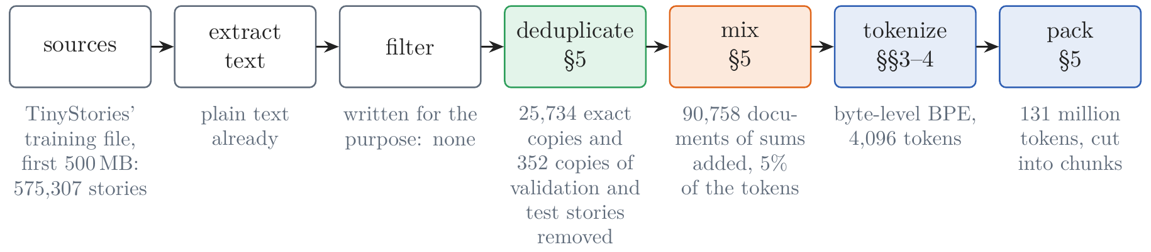
Data
A corpus is made in steps
Figure 18: from raw sources to the stream of token ids; below each step, what it did to our corpus
scale: our slice, 549,221 stories and 131 million tokens; Llama 3, 15.6 trillion tokens, about 300,000 times what our base model reads
duplicates: 25,734 exact copies (4.5%) removed by hashing; near copies by MinHash; in our slice, none
TinyStories: written by GPT-3.5 and GPT-4 in words a three-year-old knows; it needs no filter
Notes:
Notes §5, Figure 18. The picture: the steps that make a corpus, with what each did to ours. [click] Scale: Lecture 4's word model read 3.5 million words of stories four and a half times. Our base model reads a slice of TinyStories' training file: 549,221 stories and 131 million tokens after the steps. Llama 3 read 15.6 trillion tokens, about 300,000 times the 49 million our base model reads. The steps are the same at both scales; the next slide is the first three. [click] Duplicates: the web repeats itself, and a text read many times is memorized (deduplicating C4 cut memorized output tenfold, Lee et al., 2022). Exact copies are found by hashing each document: 25,734 of our 575,307 stories, 4.5%. Near copies by MinHash on 5-word shingles: in a random order of the shingles, two documents keep the same first one with probability equal to their Jaccard similarity, the share of shingles they have in common (notes §5; slide 23, hidden in the show); in our slice it found none. [click] TinyStories needs neither: GPT-3.5 and GPT-4 wrote it for the purpose, in words a three-year-old knows.

Slide 22
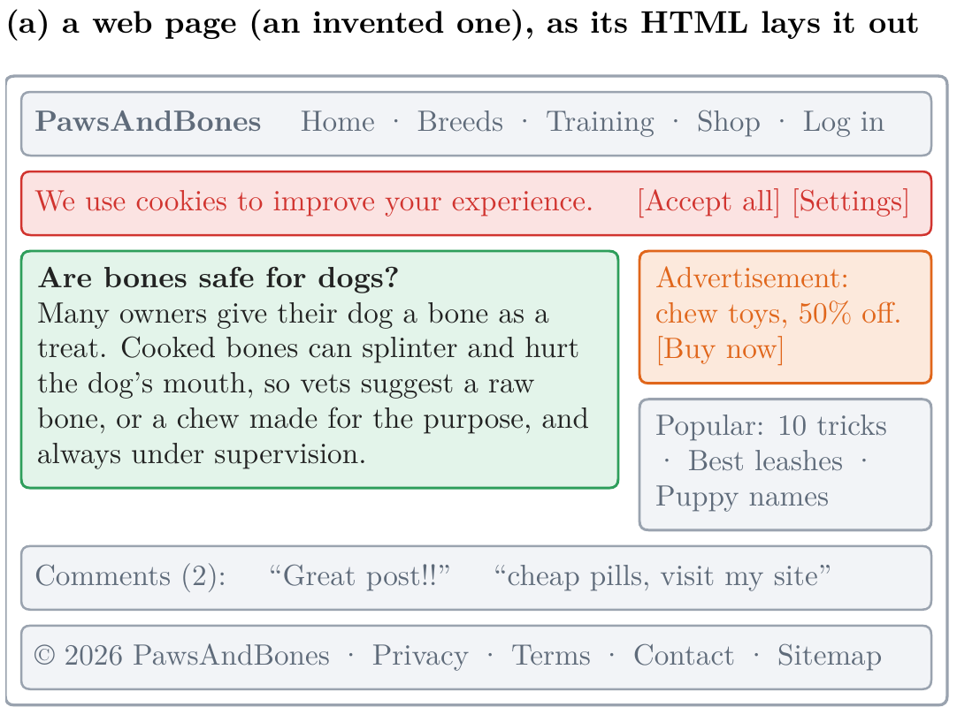
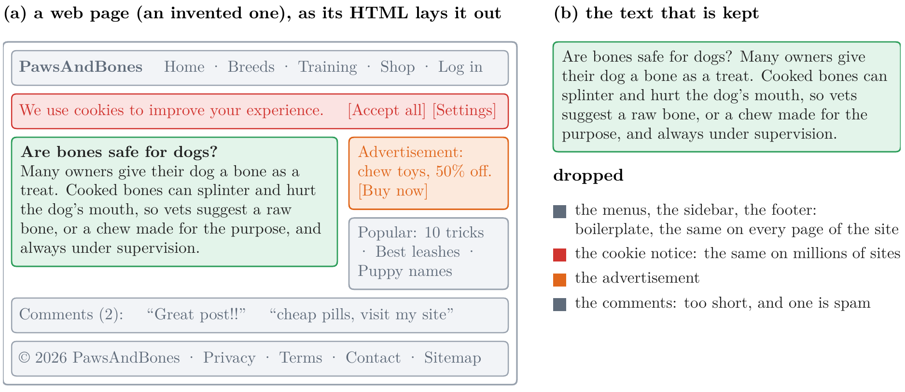
Data
Sources and filters
sources: mostly the web, through Common Crawl; a page is mostly not text worth predicting
extraction: keep the page's main text; drop menus, notices, advertisements, links
filters by rules: too short, too few dictionary words, too many symbols; C4 kept lines that end in punctuation
filters by classifiers: FineWeb-Edu kept the 1.3 trillion of 15 trillion tokens judged most educational
Figure 19: what extraction keeps, and what it drops
Figure 19a: an invented page, as its HTML lays it out
Notes:
Notes §5, 'Sources and filters', Figure 19. [click] Most pretraining text comes from the web, through Common Crawl, a public archive of several billion pages collected each month since 2008, with books, encyclopedias, code, and papers added in smaller amounts. A web page is mostly not text worth predicting. The picture: an invented page about dogs, as its HTML lays it out: a menu, a cookie notice, the article (green), an advertisement, links, comments, a footer. [click] Extraction keeps the main text and drops the rest; FineWeb ran the extractor trafilatura over Common Crawl's raw HTML. [click] Filters by rules drop documents that are too short, have too few dictionary words, too many symbols or repeated lines, or a bad source; C4 kept only lines that end in punctuation. [click] Filters by classifiers: small models trained to recognize text like a reference set; FineWeb-Edu kept the 1.3 trillion tokens, of 15 trillion, that a classifier trained on a large model's ratings judged most educational, and models trained on it learned faster.

Slide 23
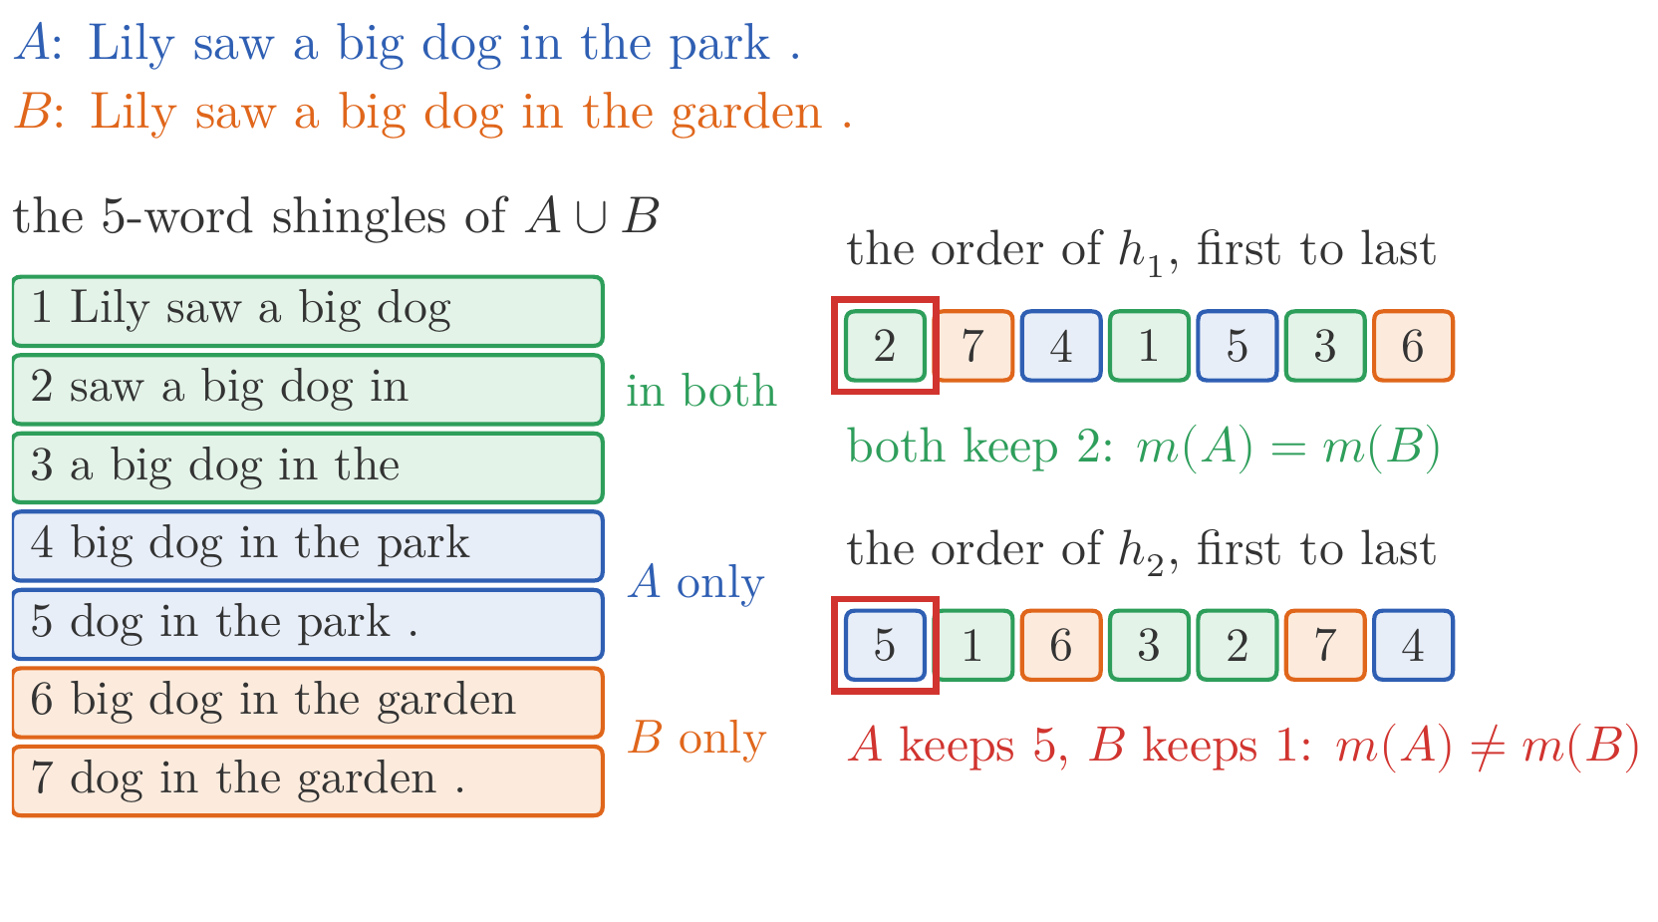
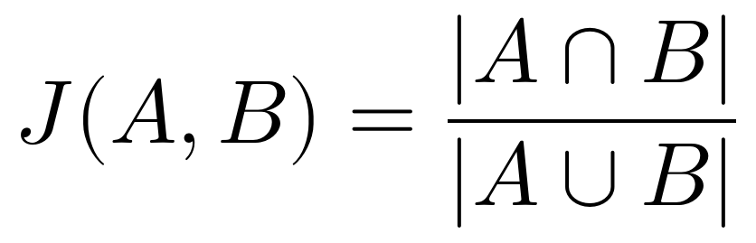
Data
Duplicates
the web repeats itself: deduplicating C4 cut memorized output tenfold, at no cost in accuracy (Lee et al., 2022)
exact duplicates: hash each document; 25,734 of our 575,307 stories, 4.5%, were exact copies
near duplicates: documents as sets of 5-word shingles; every pair would take 1.7 × 10¹¹ comparisons
MinHash: each document keeps its first shingle in a random order
Slide figure: two sentences' shingles, and two random orders of their union
128 hash functions: a signature of 128 numbers; banding finds similar pairs in one pass; ours had none
Notes:
Notes §5, 'Duplicates'. [click] The web repeats itself: the same page under several addresses, the same license on millions of pages. Duplicates waste computation, and a model trained on a text many times tends to memorize it: deduplicating C4 cut the rate at which a model emitted memorized training text tenfold, at no cost in accuracy (Lee et al., 2022). [click] Exact duplicates: hash each document after normalizing its whitespace. In our slice, 25,734 of 575,307 stories, 4.5%, were exact copies of an earlier one. [click] Near duplicates differ by a few words. Write each document as the set of its shingles, its runs of five consecutive words; the Jaccard similarity is the share of shingles they have in common, 1 for identical documents. Comparing every pair of 575,307 documents would take 1.7 × 10^11 comparisons. The picture: two sentences that differ in their last words share 3 of the 7 shingles of their union, J = 3/7. [click] MinHash (Broder, 1997): choose a random hash function, which puts all shingles in a random order, and keep each document's first shingle. The two documents keep the same one exactly when the first shingle of the union lies in both, and every shingle of the union is equally likely to come first: probability J. In the picture, order h1 puts a shared shingle first, order h2 one of A's alone. [click] 128 independent hash functions give each document a signature of 128 numbers; the share of positions where two signatures agree estimates J. Banding, a locality-sensitive hash of pieces of the signatures, finds the similar pairs in one pass (Appendix C). In our slice, once the exact copies were gone, it found no candidate pair: TinyStories' duplicates are exact copies.

Slide 24
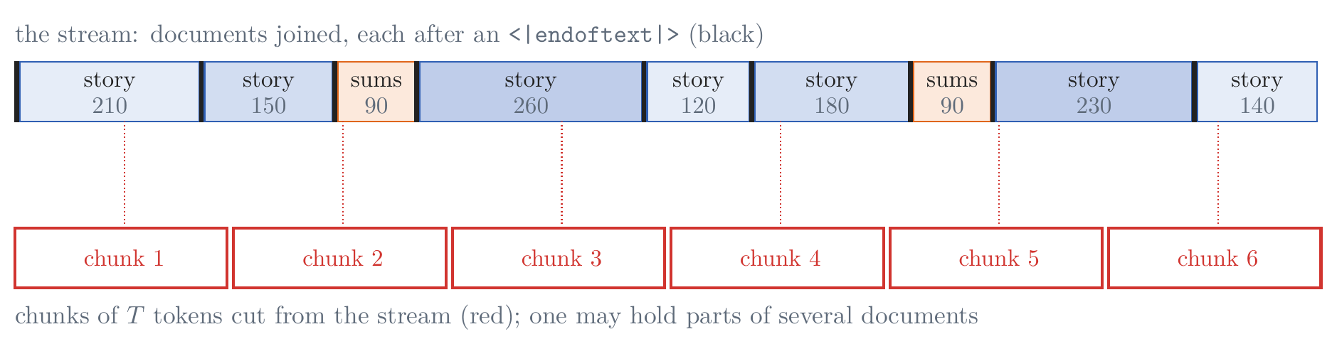
Data
Mixtures, contamination, and packing
a mixture: Llama 3, about half general knowledge, a quarter mathematics and reasoning, 17% code, 8% other languages
ours: stories, and documents of eight sums (47 + 385 = 432), 5.3% of the tokens
contamination: 352 of our 4,398 validation and test stories, 8.0%, were in the training slice; removed from it
packing: documents joined with <⁠|⁠e⁠n⁠d⁠o⁠f⁠t⁠e⁠x⁠t⁠|⁠>, cut into chunks of T + 1 (T inputs, T targets); no padding
Figure 20: documents joined into one stream and cut into chunks of T tokens
Notes:
Notes §5, 'Mixtures and contamination' and 'Packing', Figure 20. [click] A corpus is a mixture of sources, and the share of each is a choice: Llama 3's final mixture was about half general knowledge, a quarter mathematics and reasoning, 17% code, and 8% other languages, set by training small models on candidate mixtures. [click] Ours has two sources: the stories, and short documents of eight sums each, 47 + 385 = 432, operands of one to three digits, 5.3% of the tokens. They give the base model digits and the form of a sum, which the chat model of §13 and Week 7 will use. [click] Contamination is test text inside the training text: a model that has read its test set is evaluated on memory. Our validation and test stories come from TinyStories' validation file, the training stories from its training file, which should be disjoint. They are not: 352 of our 4,398 validation and test stories, 8.0%, appear word for word in the training slice. We removed those 352 training stories. Benchmarks are checked the same way, by overlaps of long n-grams. [click] Packing: a batch is B chunks of T tokens, and documents have different lengths. Join the tokenized documents into one stream with <|endoftext|> between them, and cut chunks of T + 1 tokens at random places; the first T are the inputs, the last T the targets. Nothing is wasted on padding; a chunk may hold the end of one story and the start of the next, which the model learns are unrelated. Our stream: 131 million tokens, 549,221 stories and 90,758 documents of sums.

Slide 25
Optimization, in Brief
In the optimizer deck
now: the optimizer deck, lecture-05-optimization.pptx, following the tutorial Optimizers for Deep Learning
then: back here for the rest of the recipe
Notes:
Switch here to the optimizer deck, lecture-05-optimization.pptx: 14 slides, about 15 minutes, from the optimizer's view of training to which optimizer when, following the companion tutorial. Then come back to the next slide, From 2017's recipe to pretraining's.

Slide 26
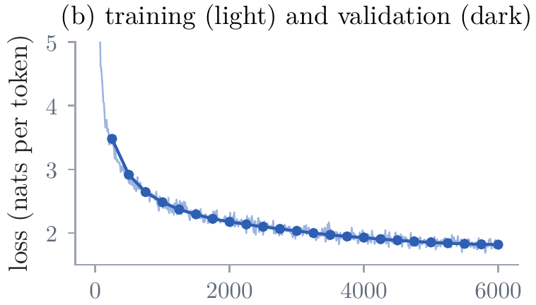
The Training Recipe
From 2017's recipe to pretraining's
the question: what else does a run need, beyond the optimizer's step? → the answer: a recipe, each part a line of a configuration (§8)
kept from 2017: Adam, now AdamW, and a learning rate that warms up and then decays
dropped: dropout and label smoothing, which answer a model that reads its data many times
our base model: Lecture 4's decoder, 6 blocks of 192, 3.5 million parameters, 49 million tokens; the optimizer sweeps use a smaller one, 4 blocks of 128
why: it reads its text about once; its training and validation losses stay together
added: a batch of 0.5 to 16 million tokens, weight decay, an initialization scaled for depth, clipping, 16-bit arithmetic
Figure 32b: our base model's training (light) and validation (dark) loss
Notes:
Notes §7, opening and 'Dropout and label smoothing', Figure 32b. The question line: an optimizer's step is not a training run. The Transformer of 2017 was trained with four parts, used as given in Lecture 4: Adam, a rate that warms up and decays, dropout, and label smoothing. [click] Pretraining keeps the first two, Adam now as AdamW, sometimes Muon. [click] And drops the last two. Dropout (Srivastava et al., 2014) zeroes each activation with probability p in training; label smoothing (Szegedy et al., 2016) spreads ε of the target over all tokens; Vaswani et al. used 0.1 for both. Both answer a model that reads its training data many times. [click] Our base model, used from here on: Lecture 4's decoder made deeper and wider, 6 blocks of 192, 3.5 million parameters, trained on 49 million tokens (§8 has its configuration); the optimizer sweeps of §§6–7 use a smaller one, Lecture 4's shape, 4 blocks of 128. A pretrained model reads most of its text about once and cannot overfit what it has not seen: our base model reads 49 million of the stream's 131 million tokens, and its training and validation losses stay together to the end (the picture). So pretraining uses neither (PaLM, Llama 3, OLMo 2); fine-tuning on a few examples read many times can overfit, and some fine-tuning recipes use dropout again. [click] It adds five parts: a batch counted in tokens, hundreds of thousands to millions per step; weight decay; an initialization scaled for depth (every matrix drawn with a standard deviation of 0.02, and the two of each block that write into the residual stream with 0.02/√(2L), so that the stream does not grow with depth); clipping; 16-bit arithmetic. Each answers a failure, and each is a line of the configuration that §8 reads.

Slide 27
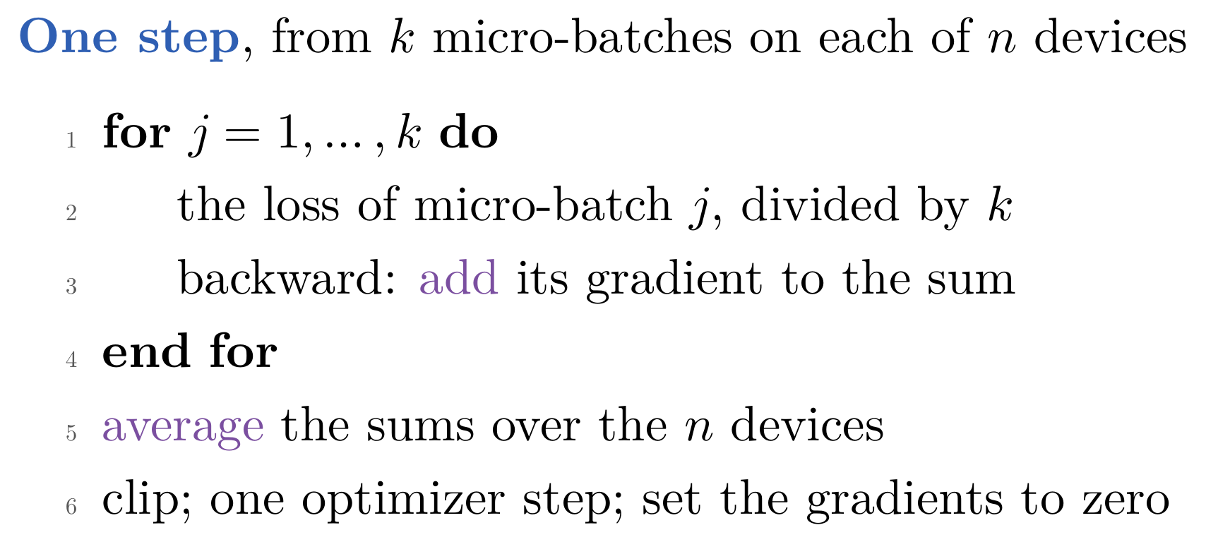
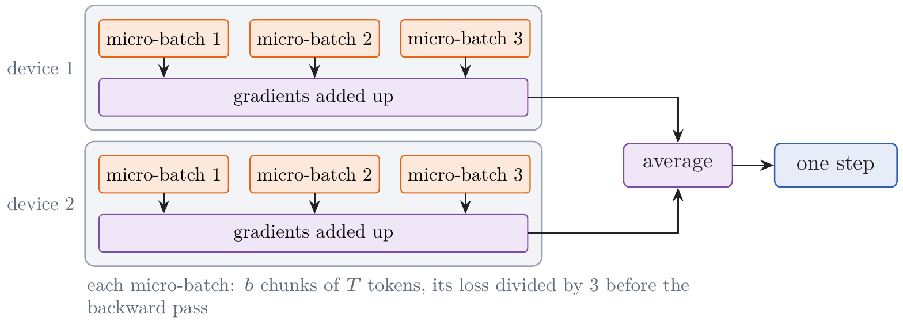
The Training Recipe
The batch: tokens per step
the problem: a large batch's activations do not fit in memory at once → the fix here: micro-batches whose gradients add up, on n devices
Figure 23: two devices, three micro-batches each
ours: 16 chunks of 512 tokens, 8,192 a step, on one CPU
the same gradient: nothing in a Transformer mixes a batch's chunks, so k micro-batches give one batch's gradient
how large: below B_{noise} ≈ 18,000 tokens a larger batch saves steps; large models use 0.5 to 16 million, some ramping up
Notes:
Notes §7, 'The batch: tokens per step', Figure 23. A step's batch is counted in tokens: B chunks of T tokens, 16 × 512 = 8,192 for our base model. The problem line: a large model cannot hold the activations of a large batch at once, since the backward pass needs every layer's activations for every token. [click] So a batch is computed in pieces (the algorithm and the picture): split it into k micro-batches of b chunks, as many as fit; for each, compute the loss, divide it by k, backpropagate, and the gradients add up in place, gradient accumulation; then clip, take one step, and zero the gradients. Data parallelism does the same across n devices, each with a copy of the model, which average their gradients before every step, so all copies take the same step. [click] Tokens per step = b × T × k × n; ours, 16 chunks of 512 on one CPU, 8,192 (a real configuration's, in §8). [click] It is the whole batch's gradient, up to rounding, because nothing in a Transformer mixes the chunks of a batch; dividing by k assumes equal token counts, as packed chunks have; with the padded, masked batches of §13, sum the token losses and divide by the batch's total. [click] How large? Below the noise scale of §6, doubling the batch nearly halves the steps needed; well above it, it doubles the cost of a step and saves few. Our 8,192 is below our 18,000. The noise scale grows as the loss falls, one reason large models use 0.5 to 16 million tokens, some ramping up: GPT-3 over its first 4 to 12 billion tokens, Llama 3 from 4 to 8 to 16 million. A larger batch tolerates a larger rate; the two are tuned together.

Slide 28
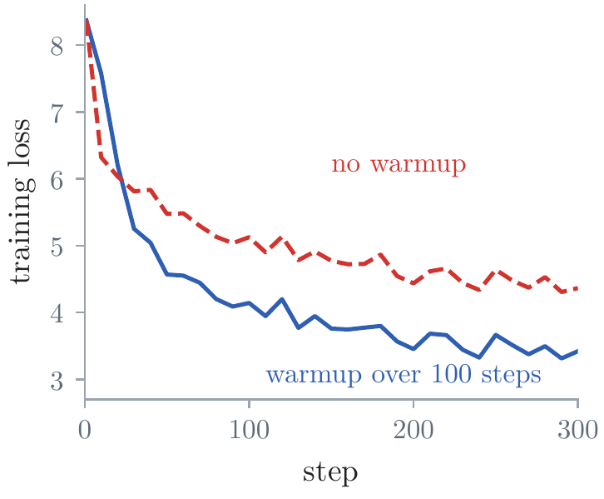
The Training Recipe
Learning-rate schedules
the problem: a fixed η throws Adam off at the start and leaves the loss stalled at the end → the fix here: warm up, then decay
a schedule: a warmup from zero to a peak, then a decay to a final rate; “cosine to 10%” ends at a tenth of the peak
warmup: a linear rise from zero; in our own runs, 3.95 nats per token without one, against 2.85
Figure 25: our own runs, the first 300 steps
Notes:
Notes §7, 'Learning-rate schedules', Figure 25. The problem line: two weaknesses of Adam at a fixed rate. Its first averages rest on a few large gradients, and near the minimum it keeps stepping by about η, so the loss stalls at a noise floor (§6). The fix: let the rate change over training. [click] A schedule is set by four numbers: the peak; the warmup's length, a linear rise from zero; where the decay ends; and the rate it ends at (§8 reads them in nanoGPT's configuration). Between, half a cosine from the peak to the final rate: slow at first, fastest halfway, slow into the end. 'Cosine to 10%' in a table of runs means exactly this, with the final rate a tenth of the peak. [click] Warmup: in its first steps Adam divides by averages built from a few gradients, and a random model's gradients are large and changing; a full step can throw it where it does not recover. Our own runs, the sweep's model with Adam at its best peak, 0.01: without a warmup, 3.95 nats per token after 800 steps against 2.85 with a warmup of 100 steps; the picture is the first 300 steps.

Slide 29
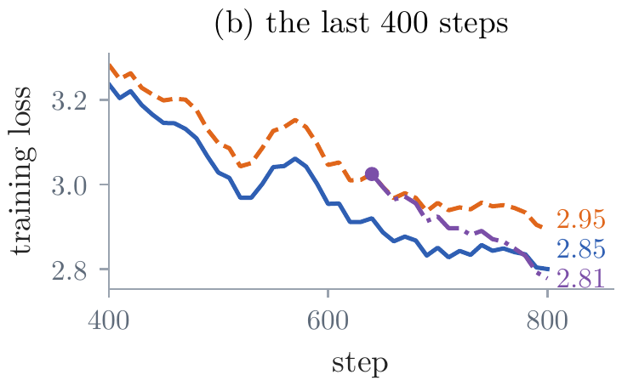
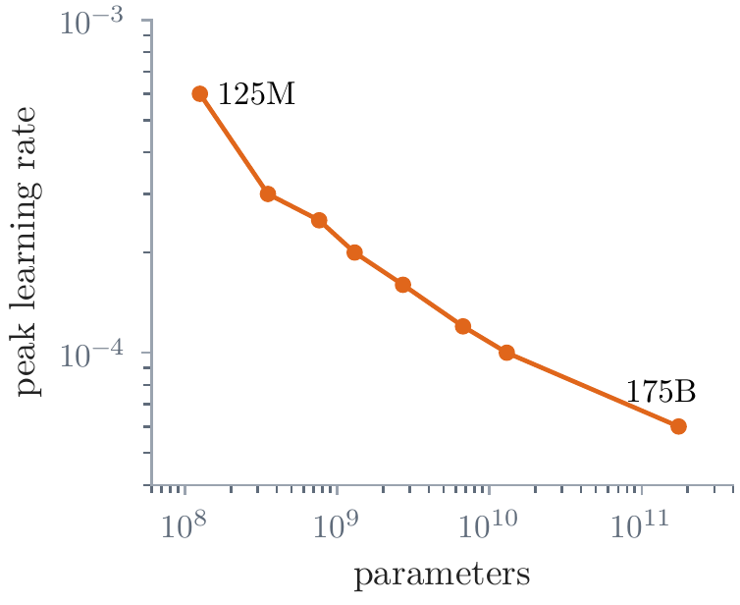
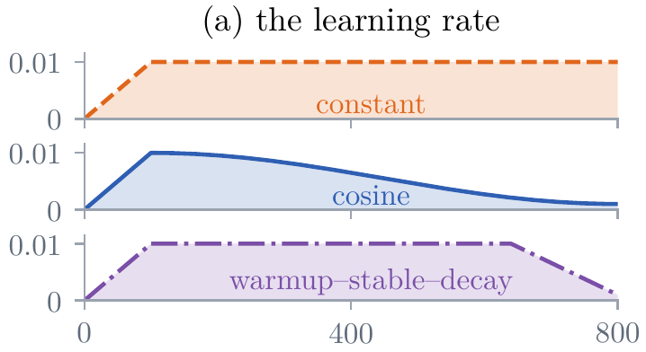
The Training Recipe
Learning-rate schedules: the decay, and the peak
three schedules, one peak: constant; a cosine to a tenth; warmup–stable–decay
decay: constant 2.95; cosine to a tenth 2.85; warmup–stable–decay 2.81
warmup–stable–decay: decay any stable checkpoint, and change the data then (§12)
the peak falls as models grow: 6 × 10⁻⁴ for GPT-3's 125M, 0.6 × 10⁻⁴ for its 175B
Figure 26a: three schedules, one peak
Figure 26b: our own runs, the last 400 steps
Figure 27: GPT-3's peak rates, Brown et al. (2020), Table 2.1
Notes:
Notes §7, 'Learning-rate schedules', Figures 26 and 27. [click] The decay: three schedules with the same peak (panel a): constant; half a cosine to a tenth; warmup–stable–decay, constant and then decayed at the end. [click] At a constant rate the loss stalls, at 2.95; the cosine to a tenth ends at 2.85; warmup–stable–decay at 2.81 (panel b, the last 400 steps, with the validation losses at the right). [click] The cosine needs the number of steps in advance. Warmup–stable–decay (Hu et al., 2024) keeps the rate constant and decays only over the last tenth or fifth, so any checkpoint of the stable phase can be decayed when a model is wanted, and the decay alone brings most of the gain. The decay is also the moment to change the data: midtraining, §12. [click] The peak is the number most worth tuning, and its best value falls as models grow: GPT-3 used 6 × 10^-4 for 125 million parameters and 0.6 × 10^-4 for 175 billion. One reason is width: a wider matrix sums more terms, so the same change to each weight changes its output more.

Slide 30
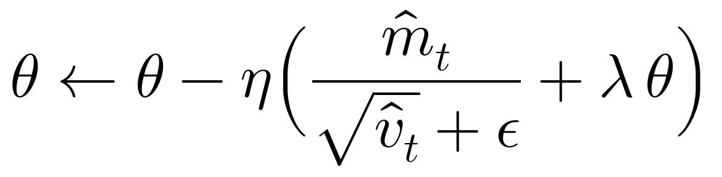
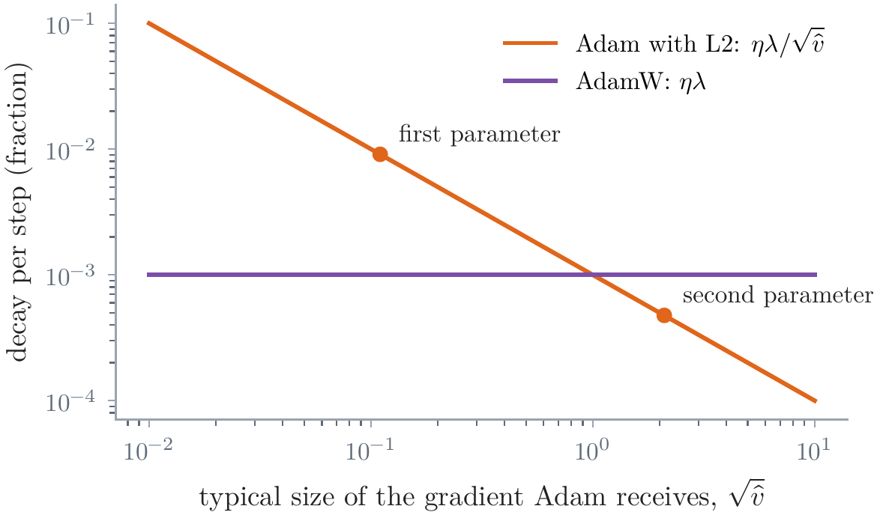
The Training Recipe
Weight decay: AdamW
the problem: inside Adam, L2's λθ is divided by √v, so weights with tiny gradients are decayed hardest → the fix here: decay apart from the gradient step
AdamW: every weight shrinks by 1 − ηλ a step, whatever its gradients
decayed: weight matrices, λ = 0.1; not biases or scales
in one pass: it acts on the optimization (D'Angelo et al., 2024); ours, no visible difference
Figure 28: the decay per step, Adam with L2 against AdamW
Notes:
Notes §7, 'Weight decay', Figure 28. The problem line: L2 regularization adds λθ to the gradient; in gradient descent that is the same as shrinking every weight by 1 − ηλ per step, weight decay. Inside Adam it is not: the added λθ is divided by √v̂ like the rest of the gradient, so a weight with large gradients is barely decayed and one with tiny gradients is decayed hard (Loshchilov and Hutter, 2019). [click] AdamW applies the decay apart from the gradient step: every weight shrinks by the same factor 1 − ηλ per step, whatever its gradients; and since η follows the schedule, so does the decay. The picture: the decay per step against the gradient's typical size, with L2 (orange) and AdamW (purple). By hand, if asked: two weights equal to 1, with gradients of typical size 0.01 and 2, η = 0.01, λ = 0.1. AdamW decays each by 0.001. Adam with L2 receives gradients 0.11 and 2.1, and once v̂ has settled the decay is ηλθ/√v̂: 0.0091 and 0.00048, nineteen times harder on the first. [click] What is decayed: the weight matrices, usually λ = 0.1; not biases, or the normalizations' scales and shifts, which set each feature's size; in code, every tensor of two or more dimensions. Configurations differ on the token table: nanoGPT and ours decay it, OLMo 2 stopped for stability. [click] Why decay a model that reads its text once? D'Angelo et al. (2024) found it acts on the optimization, a lower training loss and more stable training, not against overfitting. In our 800-step runs it made no visible difference: 2.84 against 2.85.

Slide 31
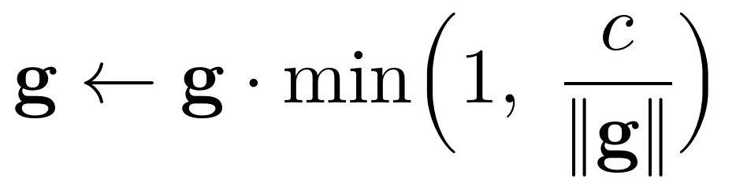
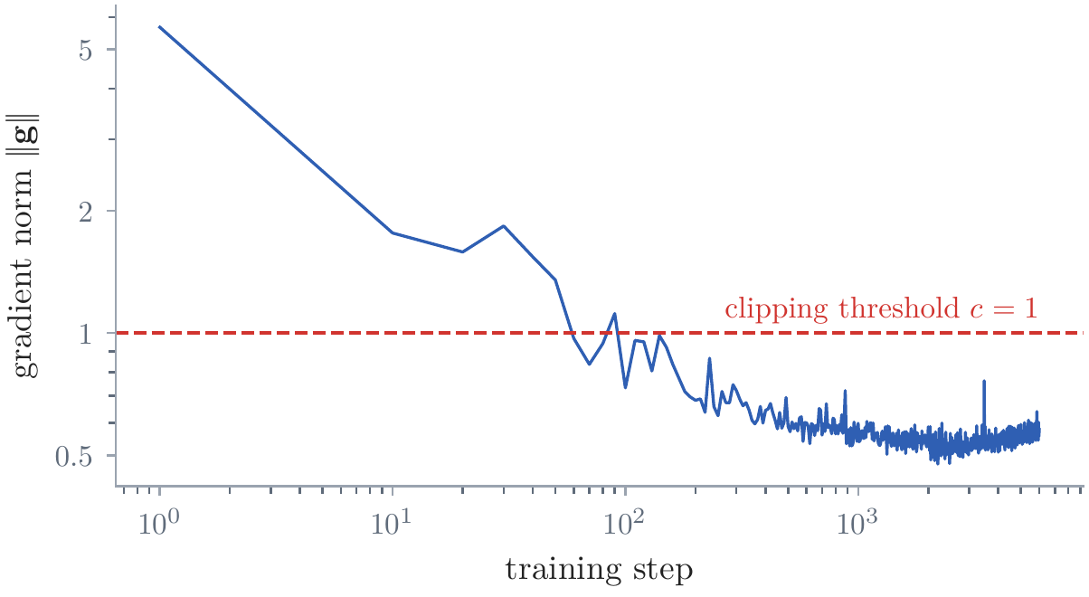
The Training Recipe
Clipping and loss spikes
the problem: a rare batch can give a gradient many times larger than usual → the fix here: rescale the gradient when its norm exceeds c
gradient clipping: the whole gradient, keeping its direction; c = 1 is usual
our base model: clipping acted only at the start; the last norm above 1 at step 90, then 0.48 to 0.99
loss spikes: PaLM's largest run spiked about twenty times; restarted from a checkpoint, batches skipped
Figure 29: the gradient's norm before clipping, every 10 steps
Notes:
Notes §7, 'Clipping and loss spikes', Figure 29. The problem line: a rare batch can give a gradient many times larger than usual, and one step along it can undo many. [click] Gradient clipping rescales the whole gradient when its norm exceeds c, keeping its direction, as for Lecture 2's recurrent networks; c = 1 is usual. [click] In our base model's training it acted only at the start (the picture, logarithmic axes): the last norm above 1 was at step 90, and afterwards the norm stayed between 0.48 and 0.99. [click] Large runs still see loss spikes, sudden jumps of the loss: PaLM's largest run spiked about twenty times and was restarted each time from an earlier checkpoint, with some batches skipped (Lecture 4, Appendix E.1). PaLM also added a z-loss, 10^-4 log² Z on the softmax's normalizer Z, which keeps the output scores from drifting to large values; some configurations keep it.

Slide 32
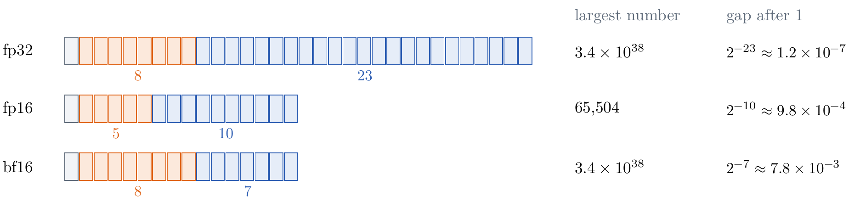
The Training Recipe
Precision and memory
the problem: fp32 is slow, and 16-bit numbers lose range or precision → the fix here: 16-bit products, fp32 sums, and an fp32 master copy
Figure 30: sign (gray), exponent (orange), mantissa (blue)
16-bit numbers: fp16, 5 exponent bits, largest 65,504; bf16, fp32's range with 7 mantissa bits
mixed precision: 16-bit products, fp32 sums; a master copy in fp32, since bf16 loses an update of 10⁻⁴
16 bytes per parameter: bf16 weights and gradients + fp32 master, m, v; 112 GB for 7B
Notes:
Notes §7, 'Precision and memory', Figure 30. The problem line: every number so far has been fp32: a sign, 8 bits of exponent (range), 23 of mantissa (precision). Hardware computes far faster in 16 bits. [click] Two formats (the picture): fp16, 5 bits of exponent, largest number 65,504, small gradients round to zero; bf16, fp32's 8 bits of exponent and only 7 of mantissa, fp32's range with two to three decimal digits. [click] Mixed precision (Micikevicius et al., 2018): matrix products in 16 bits with sums accumulated in fp32, reductions such as the softmax's sum in fp32; and a master copy of the weights in fp32, to which the updates are added, since an update of 10^-4 of a weight's size is lost entirely in bf16, where the gap after 1 is 2^-7, about 0.008. In fp16 only, loss scaling: multiply the loss before the backward pass so that small gradients do not round to zero, divide before the step, lower the factor on overflow; bf16 needs none. A configuration's dtype chooses. [click] Which format holds what? Today's runs use bf16, supported since the A100 and the usual choice since. Two layouts, both 16 bytes per parameter: ZeRO's (Rajbhandari et al., 2020), bf16 weights and gradients, 2 bytes each, plus an fp32 master copy, m, and v, 4 each; or PyTorch's autocast, as nanoGPT's dtype = 'bfloat16' does, fp32 weights only, cast to bf16 for each matrix product, so fp32 gradients, 4 + 4 + 4 + 4. 112 GB for a model of 7 billion, more than one GPU holds, so it is split across devices. Activations come on top, and grow with a micro-batch's tokens; activation checkpointing keeps some and recomputes the rest in the backward pass, at about a third more computation. (Ours: 3.5 million parameters, 55 MB of weights and optimizer state, trained in fp32, as on the line above.)

Slide 33
Reading a Pretraining Configuration
nanoGPT's configuration for GPT-2 (124M)
batch_size = 12 # micro-batch size
block_size = 1024
gradient_accumulation_steps = 5 * 8
max_iters = 600000
learning_rate = 6e-4 # max learning rate
warmup_iters = 2000
lr_decay_iters = 600000 # should be ~= max_iters per Chinchilla
min_lr = 6e-5 # should be ~= learning_rate/10 per Chinchilla
weight_decay = 1e-1
beta1 = 0.9
beta2 = 0.95
grad_clip = 1.0
dropout = 0.0 # for pretraining 0 is good, for finetuning try 0.1+
bias = False
dtype = 'bfloat16'
n_layer = 12
n_head = 12
n_embd = 768
tokens per step: 12 chunks × 1,024 tokens × 5 × 8 GPUs = 491,520 (§7)
tokens in all: 600,000 steps, 295 billion tokens, about 2,400 per parameter (§9)
the schedule: peak 6 × 10⁻⁴; warmup of 2,000 steps; cosine to a tenth, ending when training stops (§7)
AdamW: λ = 0.1 on tensors of two or more dimensions; β = (0.9, 0.95); clipping at 1 (§§6–7)
no dropout, no biases, bf16: mixed precision (§7)
the shape: 12 blocks of 768, 12 heads; in the code, the initialization and a table of 50,304 rows
Notes:
Notes §8, 'nanoGPT's configuration for GPT-2'. Ask the room: what does a real configuration say, and could we have written it from §§6–7? nanoGPT (Karpathy, 2022) is a short, widely read implementation of GPT-2; this is its configuration for GPT-2's smallest model, 124 million parameters, on OpenWebText, the training fields in effect, from config/train_gpt2.py and train.py's defaults (two comments shortened; dtype as it resolves on a GPU with bf16). Ask the class to read it first. [click] The batch: micro-batches of 12 chunks of 1,024 tokens, accumulated 5 times on each of 8 GPUs: 12 × 1,024 × 5 × 8 = 491,520 tokens per step (§7). [click] 600,000 steps of 491,520 tokens: 295 billion tokens for 124 million parameters, about 2,400 tokens per parameter, far more than the compute-optimal 20 of §9; it trains GPT-2's architecture on about as many tokens as GPT-3's models read (GPT-2's own count was not published). [click] The schedule: peak 6 × 10^-4, a linear warmup of 2,000 steps (0.3% of the run), a cosine to min_lr, a tenth, at lr_decay_iters. That is a separate field because the cosine is defined by the step where it ends; the comment says to make it equal max_iters, so the rate reaches its floor when training stops. [click] AdamW: decay 0.1, applied in the code to exactly the tensors of two or more dimensions; β = (0.9, 0.95), the 10- and 20-step averages of §6; ε not listed, PyTorch's default 10^-8; clipping at 1. [click] No dropout in pretraining, as its own comment says; no biases; bf16 mixed precision. [click] The shape, 12 blocks of 768 with 12 heads (Lecture 4, §8). Not in the file but in the model's code: the initialization of §7, and a table of 50,304 rows, GPT-2's 50,257 tokens padded to a multiple of 64 because such matrix products run faster on GPUs.

Slide 34
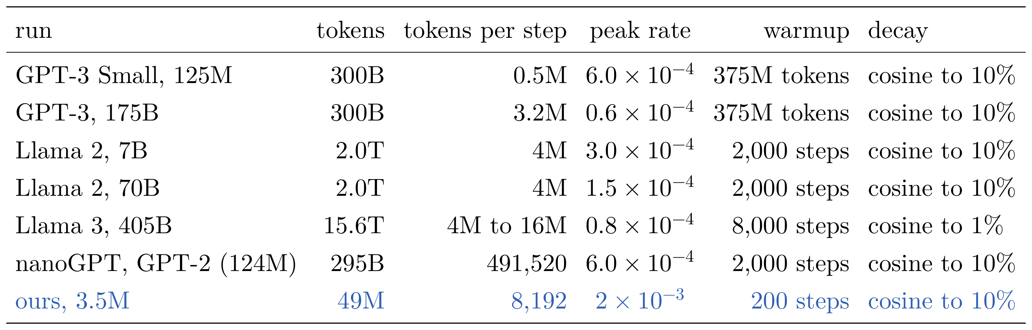
Reading a Pretraining Configuration
Published runs, and ours
Published configurations (Brown et al., 2020; Touvron et al., 2023b; Llama Team, 2024), nanoGPT's, and ours
the optimizer hardly changes: AdamW, β = (0.9, 0.95), λ = 0.1, clipping at 1; a cosine to a tenth
tokens per parameter vary a thousandfold: 1.7 for GPT-3's largest, 2,400 for its smallest; ours 14 (§9)
nanochat (2025): Muon on the blocks' matrices, AdamW for the rest, 20 tokens per parameter
Notes:
Notes §8, 'Published runs', and the table of our base model's configuration. The published configurations of large runs (Brown et al., 2020; Touvron et al., 2023b; Llama Team, 2024) differ from one another in a few fields only; nanoGPT's and ours added for comparison. The peak rate falls as models grow, and the batch grows (both said in §7). [click] The optimizer's other settings hardly change: AdamW with β = (0.9, 0.95), λ = 0.1, and clipping at 1 in GPT-3, Llama 2, and ours (the Llama 3 paper does not list them), and the cosine to a tenth in most. [click] Tokens per parameter vary more than a thousandfold: 1.7 for GPT-3's largest model, 2,400 for its smallest, both on 300 billion tokens; about 290 for Llama 2's 7B; ours 14. §9 asks what the right number is. [click] A newer configuration changes the optimizer: nanochat (Karpathy, 2025), a small complete implementation of this lecture's pipeline, trains the matrices inside the blocks with Muon and the rest with AdamW, each group at its own rate, and instead of a number of steps reads 20 tokens per parameter, the rule of §9 (its other settings are in the notes' Appendix B.3, not today). What a run costs (the next slide, hidden in the show): C ≈ 6ND operations, at about 40% of a GPU's peak, at $2 to $3 a GPU-hour; nanochat's 3.3 hours predicted against about 3 reported. Our base model's other fields: micro-batch 16 chunks of 512, one CPU, 6,000 steps, weight decay 0.1, β = (0.9, 0.95), clipping 1, no dropout, biases, fp32, 6 blocks of 192 with 6 heads.

Slide 35
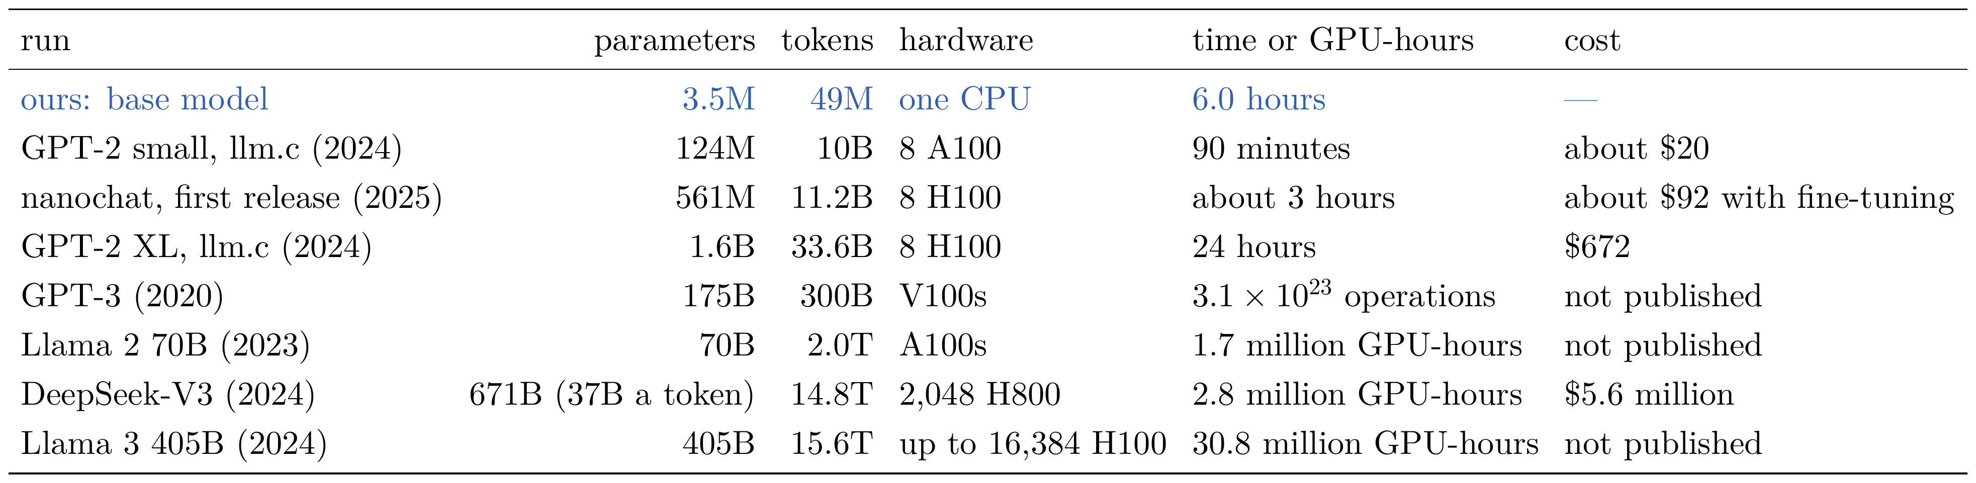
Reading a Pretraining Configuration
What a run costs
Karpathy (2024c, 2024d; 2025), Brown et al. (2020), Touvron et al. (2023b), DeepSeek-AI (2024), the Llama 3.1 model card
a first estimate: C ≈ 6ND operations, at about 40% of a GPU's peak, at $2 to $3 a GPU-hour
it checks: nanochat, 3.3 hours predicted, about 3 reported; Llama 3 405B, 26 million GPU-hours predicted, 30.8 million reported
six orders of magnitude: llm.c's GPT-2 (7 × 10¹⁸) to Llama 3 (4 × 10²⁵); ours, 10¹⁵; final runs only
fine-tuning is cheap: InstructGPT's, about 0.1% of GPT-3's pretraining; Alpaca, 3 hours on 8 GPUs, under $100
Notes:
Notes §8, 'What a run costs'. How long does a run take, on how many GPUs, for how much? [click] A first estimate needs only C ≈ 6ND operations (§9). Divide by what a GPU really delivers, about 40% of its peak: an H100 peaks near 10^15 bf16 operations a second, so about 4 × 10^14. That gives GPU-seconds; at $2 to $3 a GPU-hour, dollars. [click] Two checks. nanochat's first model, 561 million parameters on 11.2 billion tokens: 3.8 × 10^19 operations, 3.3 hours on 8 H100s; Karpathy reports about 3 hours of pretraining, and $92 for the whole pipeline to a fine-tuned chat model. Llama 3's 405B on 15.6 trillion tokens: 3.8 × 10^25 operations, the paper's own figure, 26 million H100-hours at that rate; the model card reports 30.8 million, and the paper 38 to 43% utilization. [click] The table: the published runs span more than six orders of magnitude in computation, from about 7 × 10^18 operations for llm.c's GPT-2 to about 4 × 10^25 for Llama 3; ours, 10^15, is nearly four orders below the smallest. DeepSeek's $5.6 million counts only the final run, at $2 a GPU-hour, excluding prior research; most published figures do the same. Epoch AI estimates about $53 million for Llama 3's 405B, and frontier costs growing about 2.4 times a year since 2016. [click] Fine-tuning is cheap beside pretraining: InstructGPT's supervised fine-tuning of the 175B GPT-3 took 4.9 petaflop/s-days against 3,640 for its pretraining, about 0.1%; Alpaca fine-tuned the 7B LLaMA in 3 hours on 8 A100s for under $100; QLoRA, 65 billion parameters on one 48 GB GPU in 24 hours. Ours: 56 minutes of midtraining and 36 of fine-tuning, against 6 hours of pretraining.

Slide 36
Reading a Pretraining Configuration
Our base model
Lecture 4's decoder, deeper and wider: 6 blocks of 192, 6 heads, MLPs of 768, rotary positions, 512 tokens; 3,456,000 parameters
training: 6,000 steps, 49 million tokens, 6.0 hours on an ordinary CPU
peak 0.002: a fifth of the sweep's best, since the model is larger; argued, not tuned
validation: 1.818 nats per token, 0.661 bits per byte
Figure 32c: the running prompt (black), continued by the model (blue)
Notes:
Notes §8, 'Our base model', Figure 32. [click] Our base model is Lecture 4's decoder made deeper and wider: 6 blocks of width 192, 6 heads of 32, MLPs of 768, rotary positions, a context of 512 tokens, our 4,096-token table tied to the output layer; 3,456,000 parameters. [click] Trained with our configuration, the last row of the runs table, 6,000 steps, 49 million tokens, 6.0 hours on an ordinary CPU (its loss curve was on the recipe slide, Figure 32b). [click] Its peak rate, 0.002, is a fifth of the sweep's best, 0.01, because the base model is wider and deeper and the best rate falls as models grow; chosen by that argument, not tuned. [click] It reaches a validation loss of 1.818 nats per token, 0.661 bits per byte. [click] The running prompt, at four points of training: at step 0 random pieces of words; by step 200, the words and punctuation of stories, sentences that do not fit together; by step 1,000, sentences about the prompt's dog that contradict each other ('The dog was very fast and had a very big dog.'); at the end, a consistent scene: 'The dog was black and brown. It looked like other dogs. Lily liked dogs.' One choice remains: we chose its size, and its tokens, before training it. How large should it be?

Slide 37




How Large a Model: Scaling Laws
Power laws
a budget: 6 operations per parameter per token; a large model reading little, or a small one reading much
power laws: the loss falls as a straight line on log axes, in parameters, data, and computation (Kaplan et al., 2020)
Hoffmann et al. (2022): E, the entropy of text; one term a larger model reduces, one more data reduces
along a budget: D = C/6N; at the minimum (above), both grow about as √C, about 20 tokens per parameter
Figure 33: the predicted loss along three budgets (Besiroglu et al.'s constants)
Notes:
Notes §9, opening and 'Power laws', Figure 33. [click] For a budget of computation, how many parameters and how many tokens? Training costs about 6N operations per token for N parameters (Lecture 4, §10), so a run on D tokens costs C ≈ 6ND. A budget can buy a large model that reads little or a small one that reads much. Which is better is an empirical question. [click] Kaplan et al. (2020) trained Transformers from about a thousand to a billion parameters on web text: the loss falls as a power law, a straight line on logarithmic axes, in parameters, in data, and in computation, over several orders of magnitude. [click] Hoffmann et al. (2022) fitted the loss of N parameters trained on D tokens: E, the irreducible loss, the entropy of text itself, plus one term a larger model reduces and one more data reduces. Their fit, α = 0.34, β = 0.28; Besiroglu et al. (2024), refitting the same runs, found an error and got E = 1.82, α = 0.35, β = 0.37. [click] Along a budget, D = C/6N: a larger model reads fewer tokens, one term falls and the other rises, and their sum has a minimum. The picture: the predicted loss for three budgets, the minimum dotted; on Gopher's budget, Chinchilla sits at the minimum and Gopher to its right. At the minimum, found with a Lagrange multiplier (the notes' §9; the next slide, hidden in the show), αA/N^α = βB/D^β: the last operation spent on parameters and on data lowers the loss equally. So N* ∝ C^(β/(α+β)): both grow about as √C, ten times the budget buys a model about three times larger on three times the tokens, about 20 tokens per parameter. Chinchilla, 70 billion parameters on 1.4 trillion tokens, beat the 280-billion-parameter Gopher trained on 300 billion with the same computation. (Kaplan et al. had found N* ∝ C^0.73, and GPT-3 was sized that way.)

Slide 38
How Large a Model: Scaling Laws
The compute-optimal model
at the minimum: the last operation spent on parameters and on data lowers the loss equally
both grow as √C when α ≈ β: ten times the budget, a model three times larger on three times the tokens
about 20 tokens per parameter: Chinchilla, 70B on 1.4T tokens, beat Gopher, 280B on 300B, at the same cost
Kaplan et al. had found N* ∝ C^{0.73}: GPT-3 was sized that way; parameter counts and schedules explain most of the gap
Figure 33: on Gopher's budget, Chinchilla at the minimum
Notes:
Notes §9, 'The compute-optimal model', Figure 33. [click] Minimize L(N, D) subject to 6ND = C, with a Lagrange multiplier: the conditions, multiplied by N and by D, give α A/N^α = β B/D^β. At the optimum, the last unit of computation spent on parameters and on data lowers the loss equally. (Board: the two derivatives, two lines; the derivation in full is Appendix D.) [click] Substituting D = C/6N gives N* ∝ C^(β/(α+β)) and D* ∝ C^(α/(α+β)). When α ≈ β both grow as √C: ten times the budget buys a model about three times larger, trained on about three times the tokens. [click] Hoffmann et al. measured the allocation three ways, exponents 0.50, 0.49, 0.46; the first two and the corrected fit put the optimum near 20 tokens per parameter. Chinchilla, 70 billion parameters on 1.4 trillion tokens, did better than the 280-billion-parameter Gopher trained with the same computation on 300 billion. [click] Kaplan et al. had concluded the opposite, N* ∝ C^0.73, a larger budget mostly to a larger model, and GPT-3 was sized that way. Later work traced most of the difference to their counting of parameters, without the token table, and to their warmup and schedule.

Slide 39


How Large a Model: Scaling Laws
Our models on three budgets
our own experiment: five sizes, 155,648 to 3,440,640 parameters, on each of three budgets, 10¹³ to 10¹⁴ operations
a best size for each budget: smaller models cannot use their data; larger ones read too little
the best size grows as C^{0.52}: about 17 tokens per parameter, near Hoffmann et al.'s 0.5 and 20
our base model: 14 tokens per parameter; the fit puts the best size at 3.4 million
past the optimum: a model is used many times, 2N a token; Llama 3's 8B read about 1,900 tokens per parameter
Figure 34a: validation loss against size, per budget
Figure 34b: the best size against the budget
Notes:
Notes §9, 'Our models on three budgets' and 'Past the optimum, and out of data', Figure 34. [click] The same experiment at our scale: models from 155,648 to 3,440,640 parameters (counting every weight used in a matrix product, the table included), each trained with the recipe of §§7–8 on D = C/6N tokens, for three budgets, 10^13, 3 × 10^13, and 10^14 operations; the longest run, 69 minutes on one core. Panel a: validation loss against size, a parabola in log N fitted per budget. [click] For each budget the loss is lowest at an intermediate size: smaller models have too few parameters to use their data, larger ones read too little of it. [click] Panel b: the best sizes grow as C^0.52, about 17 tokens per parameter, close to Hoffmann et al.'s exponent of about 0.5 and their 20. [click] Our base model, 49 million tokens for 3.5 million parameters, is 14 tokens per parameter: its budget, 1.0 × 10^15, is ten times our largest, and the fit extrapolated there puts the best size at 3.4 million. [click] But a model is trained once and used many times, at about 2N operations per token of use. A smaller model trained past the optimum costs more to train for the same loss and less to use, so most models since 2023 are: Llama 3's 8B read over 15 trillion tokens, about 1,900 per parameter, its loss still falling. Text is the other limit: a few hundred trillion tokens of public human text, which the largest runs could use up within a few years (Villalobos et al., 2024); reading data again helps less than new data, but up to four passes were nearly as good as four times the new text (Muennighoff et al., 2023).

Slide 40



The Base Model
Completion and prompting
a prompt is a condition: it selects, among the documents the model could continue, those that begin this way
zero-shot: GPT-2, an article followed by “TL;DR” is continued with a summary
few-shot, in-context learning: GPT-3 learned a task from examples in its prompt, with no change to its weights
our base model: 200 held-out sums in its own format, 49% right; with one to four examples, 76% to 81%
Figure 35: GPT-2 after “TL;DR”, Radford et al. (2019), Table 14
a task it never read: opposites, none of 20; One dog, two is continued with three, four
Figure 36b: with two examples, the base model's greedy continuation (blue)
Figure 36a: held-out sums, plurals, and opposites, against the examples in the prompt
Notes:
Notes §10, 'Completion and prompting', Figure 36. What can a model trained only to continue text do? It computes q(x_t | x_<t) for text like its training text, nothing else; everything it does is a continuation of its prompt. [click] A prompt works as a condition: it selects, among all the documents the model could continue, those that begin this way. [click] GPT-2 used this for tasks no one trained it for, zero-shot: on the web, 'TL;DR:' is followed by a summary of what came before, so an article followed by 'TL;DR:' is continued with a summary. The picture: GPT-2's continuation of a news article about Yemen, and the summary a person wrote. Rough: by shared words they did barely better than three random sentences of the article, and they mixed up details; but no one trained GPT-2 to summarize. [click] GPT-3 wrote a few solved examples before the new instance, few-shot, and its accuracy rose with the number of examples and with its size: the model learns the task from its context, with no change to its weights, in-context learning. [click] Our base model knows only stories and sums: given '237 + 682 =' in the format of the sums it read, it writes the right sum for 49% of 200 held-out pairs of three-digit numbers, and with one to four solved sums before it, 76% to 81%: the examples tell it that it is reading a document of sums. [click] Tasks it never read fare worse: opposites, none of 20 with any number of examples; plurals, 4 of 20 with none and none once examples are added. After 'The opposite of wet is dry. The opposite of day is night. The opposite of big is' it writes 'the best day of the day.'; after 'One duck, two ducks. One flower, two flowers. One dog, two' it counts on, ', three, four.' (panel b). At 3.5 million parameters a model continues the formats it has read.

Slide 41

The Base Model
Induction heads
copying: if a sequence occurred earlier in the context, predict that it continues the same way
a previous-token head: in an earlier block, each position reads the one before it
an induction head: in a later block, the token Tom finds the key “previous token Tom” and reads saw
our own experiment: an invented name, Fuzak, costs 25.7 nats the first time and 5.2 the second; a head of block 4 copies it
Figure 37: two heads in two blocks copy what followed
Notes:
Notes §10, 'Induction heads', Figure 37. [click] The simplest in-context learning is copying: if a sequence occurred earlier in the context, predict that it continues the same way. Elhage et al. (2021) and Olsson et al. (2022) found the mechanism in trained Transformers, the program of two heads that Lecture 4 (Appendix B.1) pointed to. It completes … a b … a → b. [click] A previous-token head, in an earlier block, makes every position read the one just before it and add it to its own vector: the position of saw now carries 'previous token: Tom' (panel a). [click] An induction head, in a later block, lets the current position, whose token is Tom, use it as a query and find the key 'previous token was Tom': the position of saw. It reads that position's value, saw, and adds it to the prediction (panel b). Two heads need two blocks, since the second reads what the first wrote; Olsson et al. found such heads form abruptly in training. [click] Our own experiment: our base model has them. In a short story, an invented name, Fuzak, which it has never read, costs 25.7 nats the first time (the log loss of its pieces, summed) and 5.2 the second; from the second occurrence one head of block 4 attends to the piece that followed the same piece the first time, while a head of block 2 attends to the previous token.

Slide 42



The Base Model
What a base model is not
the running conversation, as plain text: the base model writes the middle of a story
a prompt that is a conversation: a large base model can act as an assistant this way (Askell et al., 2021); ours writes the dialogue of a story
with two example exchanges: it copies their characters and objects into its reply
on 100 held-out requests: it never hands the turn back, and uses 1% to 2% of the words asked for
so: train on conversations, written so that whose turn it is, and where it ends, are marked
Figure 38a: the running conversation as plain text
Figure 38b: a prompt that is a conversation
Figure 38c: with two example exchanges first
Notes:
Notes §10, 'What a base model is not', Figure 38. [click] Give the base model the running conversation as plain text, the system message and the request on two lines, temperature 0.8: it writes the middle of a story about a dog and a bone, with no beginning (the picture); its other two samples copy the form of the request ('Tell me two arms, one twice') or start a story about children building a house. It has no notion of a request, a turn, or an answer. [click] Could the right prompt make it an assistant? A large base model that has read conversations on the web can be made to act as one by a prompt that is itself a conversation: Askell et al. (2021), example conversations between a person and a helpful, honest, and harmless assistant, ending with the new request and the assistant's label. Ours, given a preamble ('The following is a conversation between a user and an assistant…'), then 'User:' and the request, then 'Assistant:', writes the dialogue of a story (panel b). [click] With two example exchanges before the request, it copies their characters and objects, Tom and the green plant (orange, panel c). [click] On 100 held-out requests, with or without the examples, it never wrote 'User:' to hand the turn back; it ended the document with <|endoftext|> in 98 and 99 of them; it used 2% and 1% of the words the requests listed. A transcript of a conversation is not a format it has read. [click] So the model must be trained on conversations, written in a form that marks whose turn it is. After the break.

Slide 43
Break
Notes:
Break, five minutes. After the break: the base model continues documents; we make it answer, in its turn, and stop.

Slide 44
Lecture 5: Pretraining and Chat Models
1. After the Transformer
pretrain, then fine-tune; prompting; scale; ChatGPT's recipe of 2022
2. Tokens
bytes and Unicode; byte-pair encoding; special tokens, bits per byte, and what tokenizers get wrong
3. Pretraining
data; optimizers, in brief; the recipe, its configuration, and what runs cost; scaling laws; the base model
4. A chat model
conversations as tokens, chat templates, and system prompts; midtraining; supervised fine-tuning; what it changes, and what it does not
Notes:
[click] Part 4, a chat model (notes §§11–14), about 30 minutes: how a conversation is written as tokens, midtraining, supervised fine-tuning, and what fine-tuning changes and does not.

Slide 45

A Conversation as Tokens
Messages and roles
the problem: the base model cannot tell a request from a story, and never hands the turn back → the fix here: mark who wrote each part, and where each turn ends
a list of messages: how a program holds a conversation
[{"role": "system",
"content": "You are a storyteller for young children."},
{"role": "user",
"content": "Tell me a short story about a dog who finds a bone."}]
system: instructions for the whole conversation, from the developer who deploys the model; first
user: the turns of the person talking to the model
assistant: the model's own turns, the only part it writes; its answer will be a third message
tools: models that call tools add a role for the tool's output (Week 9)
Slide figure: the running conversation's messages, and who writes each
Notes:
Notes §11, 'Messages and roles'. The problem line: a language model reads and writes one sequence of tokens, but a conversation has parts with different authors. Written as one sequence, each part must be marked with who wrote it, and the model's turns must have an end, so that the program running the model knows when to stop it and hand the turn back. The base model had neither. [click] A program that uses a chat model, such as an application calling a model's interface over the web, holds a conversation as a list of messages, each with a role and a text: the running conversation is two messages (the panel). Every chat model in use distinguishes three roles. [click] System: instructions that hold for the whole conversation, written by the developer who deploys the model, a persona, a task, a style, rules; placed first. [click] User: the turns of the person talking to the model. [click] Assistant: the model's own turns, the only part it writes; its answer will be a third message, with this role. [click] Models that call tools add a fourth role, for the tool's output (Week 9).

Slide 46

A Conversation as Tokens
The chat template
Figure 39: the running conversation in our template; the model writes after the red line
def render(messages):
ids, mask = [ENDOFTEXT], [0]
for m in messages:
body = [ROLE[m["role"]]] + encode(m["content"]) + [END]
ids += body
mask += [0] + [m["role"] == "assistant"] * (len(body) - 1)
return ids, mask
one sequence: a role's token, the text, <⁠|⁠e⁠n⁠d⁠|⁠>, for each message
the generation prompt: feed everything through <⁠|⁠a⁠s⁠s⁠i⁠s⁠t⁠a⁠n⁠t⁠|⁠>; the model writes until <⁠|⁠e⁠n⁠d⁠|⁠>
in code: a few lines, which also mark the assistant's tokens for training (§13)
cannot be typed: no user can end a turn by typing <⁠|⁠e⁠n⁠d⁠|⁠>
Notes:
Notes §11, 'The chat template', Figure 39. A chat template writes the list of messages as one token sequence by putting special tokens around each message. [click] Ours uses the special tokens of §4: the sequence begins with <|endoftext|>, as every pretraining document did, and each message is its role's token, its text, then <|end|>. The picture: the running conversation with a short answer written for the figure, the system message purple, the user's request green, the assistant's answer blue. These colors mark the roles from now on. [click] To make the model answer, the program feeds everything up to and including <|assistant|>, the generation prompt (the red line), and lets it write until it emits <|end|>. [click] The template is a few lines of code; it also returns a mask that marks which tokens the assistant wrote, for training in §13: 0 for the role token, 1 for the assistant's text and its <|end|>. [click] The special tokens are single tokens that no text can produce (§4), so a user cannot end their turn, or open one for the assistant, by typing <|end|>. Published templates differ in their markers and keep this structure: ChatML (OpenAI's models, Qwen) writes the role's name as text after <|im_start|>; Llama 3 between header tokens; every new line is a token, so a model must be used with the template it was fine-tuned on (the next slide, hidden in the show).

Slide 47

A Conversation as Tokens
Different templates, the same structure
ChatML: OpenAI's models and Qwen; <⁠|⁠i⁠m⁠_⁠s⁠t⁠a⁠r⁠t⁠|⁠>, the role's name as text, a new line, <⁠|⁠i⁠m⁠_⁠e⁠n⁠d⁠|⁠>
Llama 3: the role's name between header tokens, two new lines, <⁠|⁠e⁠o⁠t⁠_⁠i⁠d⁠|⁠>
every character counts: new lines and spaces are tokens; an unfamiliar template is an unfamiliar document
stored with the tokenizer: a small program; Qwen 2.5's adds a system message when there is none
so: use a model with the template it was fine-tuned on
Figure 40: the running conversation's first two messages in three templates
Notes:
Notes §11, 'The chat template', Figure 40. Published templates differ in their markers and keep the same structure. [click] ChatML, introduced by OpenAI and used by Qwen, opens a message with <|im_start|>, then the role's name as ordinary text and a new line, and closes it with <|im_end|>. [click] Llama 3 writes the role's name between <|start_header_id|> and <|end_header_id|>, follows it with two new lines, and closes a message with <|eot_id|> (Appendix F). [click] Every character counts, the new lines and spaces included: they become tokens, and a template that writes them differently from the one used in fine-tuning gives the model a slightly unfamiliar document. [click] Libraries therefore store each model's template with its tokenizer, as a small program that renders a list of messages; a template may add text no message contains: Qwen 2.5's inserts the system message 'You are Qwen, created by Alibaba Cloud. You are a helpful assistant.' when a conversation has none. [click] A model must be used with the template it was fine-tuned on.

Slide 48


A Conversation as Tokens
Generating a reply, turn by turn
Figure 41: each turn's prompt is the conversation so far (answers sketched)
Lecture 4's generation loop: with a particular prompt and a particular stop
the program decides when the turn ends: it stops at <⁠|⁠e⁠n⁠d⁠|⁠>; a model that never writes it runs on to the length limit
each turn's prompt: the whole conversation so far; the cache of keys and values is kept, so a turn costs only its new tokens
the context fills: at 512 tokens for our model, the oldest turns are dropped or summarized
Notes:
Notes §11, 'Generating a reply, turn by turn', Figure 41. [click] Using the model is Lecture 4's generation loop with a particular prompt and a particular stop (the algorithm): render the messages with the template and append <|assistant|>; generate until <|end|>, or a length limit; show the user the text between them and store it as an assistant message; when the user replies, append their message and a new <|assistant|>, and go on. [click] The program, not the model, decides when the turn ends: it stops sampling at <|end|>. A model that has not learned to write <|end|> keeps writing past its answer until the limit (§13 has one). [click] Each turn's prompt is the whole conversation so far (the picture, over two turns). The key–value cache of Lecture 4 built during one turn is kept for the next, so a turn costs only its new tokens. [click] A conversation grows with every turn, and when it no longer fits the context, 512 tokens for our model, the oldest turns must be dropped or summarized.

Slide 49

A Conversation as Tokens
System messages
the developer's lever: the same model becomes a storyteller, a tutor, or an agent by its first lines
what it sets: a persona and a task; a style or format; rules; facts such as the date, or the tools it may call
followed as far as training taught: from conversations in which the system message and the answer agree (§13)
nothing enforces it: a later turn, or a document's text, competes with it; indirect prompt injection (Greshake et al., 2023)
an instruction hierarchy: system above user above tools and documents (Wallace et al., 2024); the risk lowered, not removed
Slide figure: who may instruct the model, from the system message down
Notes:
Notes §11, 'System messages'. [click] The system message, often called the system prompt, is the developer's lever: the same model becomes a storyteller, a tutor, or a customer-service agent by its first few lines. [click] It can set a persona and a task; a style or format ('Your stories have a sad ending.', 'Answer in one sentence.'); rules, what to refuse, what to keep private; facts the model needs, today's date, the user's name, the tools it may call. The system prompts of deployed assistants run to many paragraphs; Anthropic publishes those of its Claude applications. [click] A model follows a system message only as far as its training taught it to, from conversations in which the system message and the assistant's turns agree; §13 measures how far ours does. [click] What it cannot do follows from what it is: tokens at the start of the context. Nothing enforces it. A user's later turn that contradicts it, or text inside a document the model reads, competes with it; text planted in a web page or an email can carry instructions of its own: indirect prompt injection (Greshake et al., 2023). The picture: the red line in the gray box. [click] Models are therefore fine-tuned to rank their instructions, system above user above the text of tools and documents (Wallace et al., 2024): the risk is lowered, not removed.

Slide 50
Midtraining
The base model in the template
special tokens, never read: as inputs, the rows of <⁠|⁠s⁠y⁠s⁠t⁠e⁠m⁠|⁠>, <⁠|⁠u⁠s⁠e⁠r⁠|⁠>, <⁠|⁠a⁠s⁠s⁠i⁠s⁠t⁠a⁠n⁠t⁠|⁠>, <⁠|⁠e⁠n⁠d⁠|⁠> were never trained
<⁠|⁠e⁠n⁠d⁠o⁠f⁠t⁠e⁠x⁠t⁠|⁠><⁠|⁠s⁠y⁠s⁠t⁠e⁠m⁠|⁠>You are a storyteller for young children.<⁠|⁠e⁠n⁠d⁠|⁠><⁠|⁠u⁠s⁠e⁠r⁠|⁠>Tell me a short story about a dog who finds a bone.<⁠|⁠e⁠n⁠d⁠|⁠><⁠|⁠a⁠s⁠s⁠i⁠s⁠t⁠a⁠n⁠t⁠|⁠>
s are really useful to him, and he can do tricks on his mom. Every morning, the family in the story watches him go into the story. One morning, they went to the door of the sea. …
never written: through the tied table, <⁠|⁠e⁠n⁠d⁠|⁠> was never the target, so its score was pushed down everywhere
in the template: the base model continues the middle of a story; it ends 0 of 100 held-out requests
its loss on the assistant's tokens: 1.90 nats per token on story conversations, against 1.818 on stories
Slide figure: the base model's first sample after the generation prompt (temperature 0.8)
two stages teach it: midtraining, pretraining continued with conversations (§12); fine-tuning on demonstrations (§13)
Notes:
Notes §11, last paragraph, and §12, opening. The base model of §10 has never seen a special token, or a conversation. [click] As inputs, the rows of <|system|>, <|user|>, <|assistant|>, and <|end|> in the token table were never read. [click] As outputs, through the tied table, they were never the target, so at every position of pretraining their scores were pushed down: <|end|> is now among the tokens the model is least likely to write. [click] Given the running conversation in the template, our base model does not answer: it continues with the middle of a story, here starting inside a word (the panel); on 100 held-out requests it never ends its turn with <|end|>. [click] Its loss on the assistant's tokens of held-out conversations is 1.90 nats per token, against 1.818 on ordinary stories. [click] It must learn a new format, new tokens, and, for anything beyond stories and sums, new tasks. Fine-tuning on a few thousand demonstrations could try to teach all of this at once; many recent runs teach much of it earlier, and more cheaply, in a stage of its own: midtraining, then fine-tuning.

Slide 51
Midtraining
Pretraining continued, on a shifted mixture
the problem: a new format, new tokens, and new tasks to learn → the fix here: continue pretraining on a mixture that includes them, while the rate decays
midtraining: the same loss on every token, packed chunks, and optimizer, on a mixture shifted toward use
toward better text: Llama 3 annealed on math and code, with GSM8K's and MATH's training sets; its 8B model gained 24.0% and 6.4% on them
OLMo 2's mid-training: 5 to 10% of its computation
toward the formats of use: nanochat (2025), the chat template, multiple choice, and a calculator, from half a million conversations
Figure 4: midtraining, between pretraining and fine-tuning
Notes:
Notes §12, 'Pretraining continued, on a shifted mixture', Figure 4. The problem line, from the last slide. [click] Midtraining is pretraining continued: the same loss on every token, the same packed chunks, the same optimizer, but on a mixture shifted toward what the model will be used for, usually while the learning rate decays to zero. The picture: the stage between pretraining and fine-tuning. Published runs shift the mixture in two directions. [click] Toward higher-quality and specialized text: Llama 3 decayed its rate to zero over its last 40 million tokens while reading more of its best sources; on its 8B model, a short anneal on a little mathematics and code, which included the training sets of GSM8K and MATH, raised its scores on their validation sets by 24.0% and 6.4%. [click] OLMo 2 spent 5 to 10% of its computation on such a stage. Extending the context, 8K to 128K tokens for Llama 3, is often done here too. [click] Toward the formats of use: nanochat's midtraining, in late 2025, taught the chat template, multiple-choice questions, and the use of a calculator from more than half a million conversations, packed as in pretraining. Why a stage of its own: packed chunks read many examples at pretraining's cost; the pretraining text in the mixture keeps the model from forgetting; and it is the decay of warmup–stable–decay, on the new mixture.

Slide 52
Midtraining
Why a stage before fine-tuning?
volume: a new format and task take many examples; packed chunks read them at pretraining's cost, no padding
forgetting: pretraining text in the mixture keeps the model close to what it knew (Liu et al., 2025b)
the decay: warmup–stable–decay leaves a model unsettled; midtraining is its decay, on the new mixture
a line drawn by the loader: nanochat moved its mixture into fine-tuning in January 2026, once whole conversations fit its rows
Figure 26a: warmup–stable–decay (purple); the decay at the end
Notes:
Notes §12, 'Pretraining continued, on a shifted mixture', second half; Figure 26a. Why a stage before fine-tuning, rather than more fine-tuning? Each of midtraining's choices answers a problem. [click] Volume: a new format and a new task take many examples to learn; packed chunks and pretraining's large batches read them at pretraining's cost per token, with nothing spent on padding. [click] Forgetting: a model trained only on new data drifts away from what it knew; mixing in pretraining text keeps it close (Liu et al., 2025b). [click] The decay: warmup–stable–decay's stable phase (purple in the picture) leaves a model that has not settled; midtraining is that model's decay, on the shifted mixture, and what comes out is a finished, annealed model. [click] The line between midtraining and fine-tuning is drawn by how the data is fed as much as by what it is: nanochat removed its midtraining stage in January 2026 and moved the mixture into fine-tuning, once its loader fitted whole conversations into each row.

Slide 53

Midtraining
Our midtraining run
1,000 steps of 16 chunks of 512 tokens: 8 from the pretraining stream, 8 from a stream of conversations, packed alike
46,000 conversations, 11.0 million tokens: story requests, sums, and a new task, summarizing a story in one sentence
the loss on every token: the system's and the user's included
AdamW, continued: a warmup of 50 steps to 4 × 10⁻⁴, constant, then a linear decay to zero over the last 30%
Figure 42: one step's 16 chunks; right, the conversations by kind
56 minutes: on a CPU
Notes:
Notes §12, 'Our midtraining run', Figure 42. [click] We midtrained the base model for 1,000 steps, each of 16 chunks of 512 tokens: 8 cut from the pretraining stream, stories and sums, and 8 cut from a stream of conversations in the chat template, packed as pretraining documents are, so that a chunk can start or end inside a conversation (the picture). [click] 46,000 conversations, 11.0 million tokens, from TinyStories-Instruct stories that fine-tuning's conversations do not use: story requests built as in §13, sums, and a task fine-tuning never shows, summarizing: the user gives a story and asks 'Summarize this story in one sentence.', and the assistant answers with TinyStories-Instruct's summary. None of the held-out sums occurs in it. Right of the picture: the share of each kind, by number. [click] The log loss on every token, the system's and the user's included, on packed chunks. [click] AdamW as in pretraining, continued from its two averages; the rate warms up over 50 steps to 4 × 10^-4, a fifth of pretraining's peak and twice the rate at which pretraining ended, stays there, and decays linearly to zero over the last 30% of the steps. [click] 56 minutes on a CPU.

Slide 54



Midtraining
What midtraining changed
the format: a story about Spot and a bone, then <⁠|⁠e⁠n⁠d⁠|⁠>; 85 of 100 held-out answers ended, against none
the assistant's turns: down to what fine-tuning the base model directly gives, 1.90 → 1.63 nats per token on 300 story conversations
the stories kept: 1.818, up to 1.858 by step 100, then 1.813 after the decay
a new task: summaries of unseen stories; ROUGE-1, the F1 of shared words, 0.27 against 0.15 for the first sentence
Figure 44a: the running conversation
not the sums: 7% of unseen sums right; a sixth of the conversations, but 2.7% of their tokens, and a mixture is weighted by tokens
Figure 43b: 150 other held-out conversations, 1.84 to 1.48; dashed, fine-tuning
Figure 43c: the 500 validation stories
Notes:
Notes §12, 'Our midtraining run', Figure 43. It changed the model in four ways, and failed at one thing. [click] The format: given the running conversation in the template, the midtrained model answers with a story about a dog and a bone (the picture), and on 100 held-out requests it ends its turn with <|end|> in 85, against none for the base model. [click] Its loss on the assistant's tokens of 300 held-out story conversations is 1.63 nats per token, the same as fine-tuning the base model directly (§13), against 1.90. The picture, panel b, on 150 held-out conversations: the run ends at about the dashed line, the value fine-tuning the base model reaches. [click] The stories are kept (panel c): the loss on the validation stories rose from 1.818 to 1.858 by step 100, stayed near 1.85 while the rate was constant, and fell to 1.813 during the decay, slightly below the base model's. [click] A new task: it summarizes stories it has not read, and ends 97 of 100 summaries with <|end|>; they score 0.27 against 0.15 for the story's first sentence, on a measure of shared words (the next slide). [click] What it did not learn: the sums. 7% of unseen three-digit sums right; for 237 + 682 it writes 137 + 282 = 429. Sums were a sixth of the conversations but, being short, 2.7% of their tokens, and packed chunks weigh a conversation by its tokens: about 3,000 conversations of sums in 1,000 steps. A mixture is set in tokens, and a skill shown in few tokens needs more weight than its share of examples; fine-tuning, one conversation per row, gives sums a fifth of its rows (§13).

Slide 55

Midtraining
A new task: summarizing
a held-out story: the midtrained model's summary, and the dataset's
ROUGE-1: precision and recall of shared words, and their harmonic mean (Lin, 2004)
on 100 held-out stories: 0.27, against 0.15 for the first sentence and 0.08 for the base model
Figure 44b: a held-out story, the midtrained model's summary, and TinyStories-Instruct's
Notes:
Notes §12, 'Our midtraining run', Figure 44b. The new task, up close. [click] A held-out story, the request to summarize it in one sentence, the midtrained model's summary (greedy), and TinyStories-Instruct's. The model's summary gets the TV and the park right and the lesson wrong. [click] To score summaries we use ROUGE-1 (Lin, 2004), which counts shared words: precision, the share of the summary's words found in the reference; recall, the share of the reference's words found in the summary; ROUGE-1 is their harmonic mean, 1 for the same words and 0 for none in common (we leave out function words such as the and a). [click] On 100 held-out stories: the midtrained model 0.27; the story's first sentence 0.15; another story's summary 0.06; the base model 0.08. And 97 of 100 summaries end with <|end|>.

Slide 56

Midtraining
What a mixture's weights mean
the sums are not learned: for 237 + 682 it writes 137 + 282 = 429.; 7% of unseen sums right
a sixth of the conversations: but, being short, 2.7% of their tokens; packed chunks weigh a conversation by its tokens
in 1,000 steps: about 3,000 conversations of sums; fine-tuning gives them a fifth of its rows
so: a mixture is set in tokens; a skill shown in few tokens needs more weight than its share of examples
Slide figure: the sums' share in midtraining and in fine-tuning
Notes:
Notes §12, the end of 'Our midtraining run'. [click] The fourth change is one that did not happen: the sums are not learned. The midtrained model writes them in the right form but copies the operands wrongly and adds them wrongly too: for 237 + 682 it writes '137 + 282 = 429.', and it gets 7% of the unseen three-digit sums right. [click] The sums show what a mixture's weights mean. Our sums conversations are a sixth of the conversations but, being short, 2.7% of their tokens, and packed chunks weigh a conversation by its tokens (the picture). [click] In 1,000 steps the model read about 3,000 of them. Fine-tuning, which gives every conversation a row of its own, gives the sums a fifth of its rows. [click] So a midtraining mixture is set in tokens, and a skill that takes few tokens to show needs a larger weight than its share of the examples suggests. What midtraining leaves for fine-tuning, the content of the answers rather than their format, is §13.

Slide 57


Supervised Fine-Tuning
The loss on the assistant's tokens
the problem: midtraining reads conversations as text, cut anywhere, every token predicted → the fix here: whole conversations, and the loss on the assistant's tokens only
only the assistant's tokens: A, the positions whose target is in an assistant turn; <⁠|⁠e⁠n⁠d⁠|⁠> is in A, the role tokens are not
Figure 45, in two rows: inputs (top) and targets (bottom); in the loss, blue
every position reads all before it: the mask leaves targets out of the loss, not inputs out of attention
Notes:
Notes §13, opening and 'The loss on the assistant's tokens', Figure 45. The problem line: midtraining read conversations as text, every token predicted, conversations cut wherever a chunk ended. Supervised fine-tuning (SFT), the first of InstructGPT's and ChatGPT's three steps: the same next-token training once more, continued from the midtrained weights, on conversations whose assistant turns show what the model should write; each conversation read whole, as the model will meet it in use. [click] The difference is which predictions count. The system message and the user's turns are given, not written by the model, so predicting them is not its job. The loss averages the log loss over A, the positions whose target belongs to an assistant turn, including the <|end|> that closes it. [click] The picture: a conversation of two turns, each position's input (top) and target (bottom); the targets in the loss are blue, the others outlined in gray. [click] Every position still reads everything before it, the system message and the user's turns included; only the targets outside A are left out of the loss, by the mask that the template's code returns (§11). The closing <|end|> is in A because it teaches the model to stop; in a conversation of several turns every assistant turn is in A, each predicted from the whole conversation before it. The role tokens that open the assistant's turns are not in A, since the program writes them.

Slide 58

Supervised Fine-Tuning
Demonstrations
written by people: InstructGPT, answers to about 13,000 prompts; ChatGPT, conversations with people on both sides
generated by a model: from a few examples written by people, then filtered (Self-Instruct)
distilled from a larger model: Alpaca, LLaMA 7B on 52,000 answers of text-davinci-003
ours, from TinyStories-Instruct: a storyteller's system message, a sentence per feature; a request; the story
Figure 46a: one of our fine-tuning conversations, a summary as the request and one feature, dialogue
24,179 conversations, 5.3 million tokens: one in ten with a second turn; sums; no summaries
Notes:
Notes §13, 'Demonstrations', Figure 46. The conversations of SFT are demonstrations, examples of the behavior wanted, from three sources. [click] Written by people: InstructGPT's were answers to about 13,000 prompts by paid labelers; ChatGPT's, conversations in which people wrote both the user's turns and the assistant's. [click] Generated by a model from a few examples written by people, then filtered (Self-Instruct, Wang et al., 2023). [click] Distilled from a larger model: Alpaca fine-tuned the 7-billion-parameter LLaMA on 52,000 answers from OpenAI's text-davinci-003 (Taori et al., 2023). Before chat models, instruction tuning fine-tuned on many existing tasks rewritten as instructions, and the models then followed instructions for unseen tasks (FLAN, T0). [click] Ours are built from TinyStories-Instruct, which gives each story a one-sentence summary, often a list of words it uses, and features such as a sad ending or dialogue. Each becomes a conversation (the picture): system, 'You are a storyteller for young children.' with one sentence per feature, and in a fifth of those without features no system message; user, a request from the summary or from the word list, in one of several phrasings; assistant, the story. [click] One conversation in ten has a second request and story (one in fourteen after the length limit); sums such as 'What is 37 + 48?' answered '37 + 48 = 85.', half under an arithmetic system message. Within the 512-token context: 24,179 conversations, 5.3 million tokens. None contains the running conversation, and none asks for a summary.

Slide 59

Supervised Fine-Tuning
The recipe of fine-tuning
one conversation per row: whole, from <⁠|⁠e⁠n⁠d⁠o⁠f⁠t⁠e⁠x⁠t⁠|⁠>, as in use; padded to the longest of 16 similar ones
the loss mask: the assistant's tokens; padding left out too
a smaller rate: a peak of 3 × 10⁻⁴, a seventh of pretraining's; 5% warmup; cosine to a tenth
one pass: 1,512 steps; reading a few examples many times memorizes them
Slide figure: (a) midtraining's packed chunks, (b) fine-tuning's padded rows
the optimizer: AdamW, β = (0.9, 0.95), weight decay 0.1, clipping at 1; started afresh
Notes:
Notes §13, 'The recipe of fine-tuning'. Fine-tuning changes four of midtraining's choices, each for a reason. [click] One conversation per row: each row of a batch is one whole conversation starting with <|endoftext|>, as in use; the 16 conversations of a batch have similar lengths and are padded to the longest, and no conversation is cut (the picture, b, against midtraining's packed chunks, a). [click] The loss mask of slide 63; the padding is left out of the loss like the user's tokens. [click] A smaller learning rate: a peak of 3 × 10^-4, about a seventh of pretraining's, a warmup over the first 5% of the steps, a cosine to a tenth. The model starts close to what is wanted and the demonstrations are few; a large rate would move it far from what pretraining taught. [click] One pass over the demonstrations, 1,512 steps: reading the same few examples many times makes a model memorize them, as the smallest run below does. [click] The optimizer is pretraining's, AdamW with β = (0.9, 0.95), weight decay 0.1 on the matrices, clipping at 1, started afresh.

Slide 60

Supervised Fine-Tuning
Training fewer parameters: LoRA
the problem: full fine-tuning needs pretraining's 16 bytes per parameter again, for a small change → the fix here: train a low-rank change beside each frozen matrix
LoRA (Hu et al., 2022): W frozen; A and B trained, r(d_{in} + d_{out}) numbers instead of d_{in}d_{out}
one of our attention matrices, r = 8: 3,072 numbers instead of 36,864
A random, B zero: training starts from the base model; then AB is added into W
in memory: frozen weights in bf16, 2 bytes and no state; 7B needs about 14 GB, not 112
Figure 31: a frozen W (gray) and the trained path xAB (purple)
Notes:
Notes §7, 'Training fewer parameters: LoRA', Figure 31. The problem line: fine-tuning every weight, as the recipe just did, needs pretraining's 16 bytes per parameter again (§7), for the whole model, however small the change. [click] LoRA (Hu et al., 2022) freezes each chosen weight matrix W and trains a low-rank change beside it: the layer computes x(W + AB), A of d_in × r and B of r × d_out, with a small rank r. Only A and B are trained, r(d_in + d_out) numbers instead of d_in d_out, and the optimizer's state shrinks with them. (Hu et al. use column vectors; ours are the transposes, in the same roles.) [click] For one of our 192 × 192 attention matrices and r = 8: 3,072 numbers instead of 36,864. [click] A starts random and B at zero, so training starts exactly from the base model; afterwards AB is added into W, and the model runs at its original cost. That so few can be enough is an observation, not a theorem: fine-tuning large models was found to change their weights in a few directions only (Aghajanyan et al., 2021). What LoRA leaves frozen matters too, the token table, whose rows for new special tokens may need to change: the next slide. [click] In memory: the frozen weights are stored once, usually in bf16, 2 bytes each, with no gradient and no optimizer state; QLoRA (Dettmers et al., 2023) stores them in 4 bits and fine-tuned 65 billion parameters on one 48 GB GPU. A and B are usually fp32 with their gradients and AdamW's m and v, 16 bytes per trained number, but they are 1% of the model or less: a 7-billion-parameter model needs about 14 GB plus under a gigabyte, against 112 GB for full fine-tuning. Ours ran in fp32, on a CPU.

Slide 61


Supervised Fine-Tuning
Our chat model
our own experiment: the chat model, midtrained and fine-tuned on all 24,179 conversations (99 of 100 answers end, 73% of sums right), against the base model fine-tuned four ways
midtraining did most of the work: fine-tuning from it starts where fine-tuning the base model ends
the mask matters little here: our prompts are a quarter of the tokens; with long prompts it matters more
LoRA must change the new tokens: with the table frozen, it almost never ends its turn; with the four rows trained, it does
Figure 31: LoRA's trained path beside a frozen matrix; the table stays frozen
Figure 45: only the assistant's tokens in the loss
a task left out is lost: fine-tuning has no summaries, and asked for one, the chat model tells a story
Slide figure: asked to summarize Figure 44b's story, the chat model tells a story (greedy, cut at 80 tokens)
Figure 43b: midtraining reaches fine-tuning's value (dashed)
Notes:
Notes §13, 'Our chat model'. [click] Our chat model: the midtrained model fine-tuned with this recipe on all 24,179 conversations, 1,512 steps, 36 minutes on a CPU. On held-out requests it ends 99 answers of 100 with <|end|>, and gets 73% of unseen three-digit sums right. To see what each choice does, we also fine-tuned the base model four ways: as the chat model was, with the loss on every token, with LoRA, and with LoRA plus the new tokens' rows (all seven models side by side are in the notes' Appendix G). Four results. [click] Midtraining did most of the work: on the assistant's tokens of held-out conversations, fine-tuning from the midtrained model starts where fine-tuning the base model ends (the dashed line in the picture is that end), and ends a little better. [click] The mask matters little here, and more with long prompts: with the loss on every token, our short prompts are a quarter of the tokens, and the answers come out about as good; the model also learns to write the user's side, and with long prompts, a story to summarize, the prompt would dominate the loss. [click] LoRA must be able to change the new tokens: with the token table frozen, LoRA learned the stories but almost never ended its turn. Ask why before revealing: the table is tied to the output layer, so the row of <|end|> is also the vector that scores it, and pretraining, where <|end|> was never a target, pushed that score down everywhere. Training those four rows as well fixed it. [click] A task that fine-tuning leaves out is lost: our fine-tuning conversations contain no summaries, and after them the chat model no longer summarizes; asked to summarize the held-out story of Figure 44b (the picture, its saved greedy answer, cut at 80 tokens), it tells a story of its own, ROUGE-1 0.13 against 0.27 after midtraining. So fine-tuning mixtures carry midtraining's tasks along.

Slide 62
Supervised Fine-Tuning
The running example, answered
Figure 47: the base model continues the document; the chat model answers and stops
our chat model: a story about a dog, and the end of its turn; it follows the request loosely
on 100 held-out requests: 99 ended, 189 tokens on average, 36% of the requested words
Notes:
Notes §13, 'The running example, answered', Figure 47. The running conversation given to the base model as plain text (left, §10) and to our chat model, midtrained and fine-tuned, in its template (right): the prompt gray, what each writes blue, temperature 0.8, first sample of each, and the special token it ends with. [click] Our chat model answers with a story about a dog and ends its turn. It follows the request loosely: its greedy answer and one of its three samples are about a dog who finds a bone; the first sample, in the figure, is about a dog and a toy tank, the second about a dog and a bird. [click] On 100 held-out requests it ends its turn in 99, writes 189 tokens on average, and uses 36% of the words that the word-list requests ask for.

Slide 63

Supervised Fine-Tuning
Following the system message
in the fine-tuning stories: 95% under “the characters talk to each other” contain dialogue, against 34%
the chat model: with or without the sentence, about the same (64% vs 62%)
within chance: 100 stories in each condition; a few points is noise
why: the requests come from the stories' summaries, and already say most of what the story will be
so: train on conversations whose system message varies on its own and decides the answer
Figure 48: stories with dialogue, without (light) and with (dark) the sentence
Notes:
Notes §13, 'Following the system message', Figure 48. Does our chat model follow its system message? One feature can be measured: dialogue, a quotation mark in the story. [click] In the fine-tuning data, 95% of the stories under 'In your stories, the characters talk to each other.' contain dialogue, against 34% of the others (the right pair of bars). [click] We gave the chat model 100 held-out requests under the storyteller's message alone and with that sentence added. Ask first: how much will the sentence move it? With it, 64% of its stories contain dialogue; without, 62%. Fine-tuned from the base model, 71% against 60%. [click] With 100 stories each, a difference of a few points is within chance: the sentence moves our models far less than it moved the training stories. [click] The request explains why. Our requests are written from the stories' summaries, and the held-out stories behind them contain dialogue 60% of the time, about what the model writes untold. The request already says most of what the story will be; the dialogue sentence adds information only where it disagrees with the request, which in our data it rarely does. [click] A model learns to follow a system message as far as its training conversations make the system message decide the answer. Models meant to follow varied system messages are fine-tuned on conversations where it varies independently of the request, and the answer depends on it.

Slide 64



Supervised Fine-Tuning
How many conversations?
the format, from 100: 95 of 100 answers end, about as many as 1,000 give (99)
the words need more: 10%, 21%, 35% from the base model; after midtraining, 1,000 suffice (37%)
the sums need all of them: 70% right, from the base model, only after all 24,179
LIMA (LLaMA 65B, 1,000 examples): its authors propose that fine-tuning mostly teaches the format
Figure 49a: answers ended with <|end|>
Figure 49b: requested words used
Figure 49c: unseen three-digit sums right; dark, from the midtrained model
Notes:
Notes §13, 'How many conversations?', Figure 49. The experiment: chat models fine-tuned on the first 100 conversations of the training set (96 within the length limit, read 30 times, 180 steps), the first 1,000 (969, read 3 times, 183 steps), and all 24,179 (read once, 1,512 steps), from the base model (blue) and from the midtrained model (dark blue). Ask: how many does it take to learn to stop? [click] From the base model, 100 conversations already make it end 95 of 100 held-out answers, about as often as 1,000 (99) and all of them (98): panel a. [click] The content needs more: requested words used, 10%, 21%, 35% (panel b). From the midtrained model, which already used 26%, 1,000 conversations suffice: 37%, as many as the full set gives from the base model. [click] Unseen three-digit sums (panel c) are right 70% of the time only after the full set, which holds 5,000 conversations of sums against 206 in the first thousand. Reading 100 conversations 30 times overfits them: the loss on held-out answers rises (the notes' Appendix G.2 has the numbers). [click] This is the pattern Zhou et al. (2023) reported at a far larger scale: LLaMA 65B fine-tuned on only 1,000 carefully chosen examples, LIMA, gave answers people preferred to those of models fine-tuned on far more, which led them to propose that knowledge and abilities come from pretraining and fine-tuning mostly teaches the format.

Slide 65

What Fine-Tuning Changes, and What It Does Not
Every stage, built
Figure 50: from text to a chat model; each stage with its section, and the running conversation as each stage sees it
ChatGPT's recipe before its rewards: in a model 50,000 times smaller than GPT-3
Notes:
Notes §14, Figure 50. The chat model is complete, and every stage that made it has been built: text to bytes and tokens (§§2–4), a corpus (§5), an optimizer and its configuration (§§6–8), a size for the budget (§9), the base model (§10), a template (§11), midtraining (§12), fine-tuning on conversations (§13). The right column follows the running conversation through every stage. [click] These are the stages of ChatGPT's recipe of 2022 that come before its rewards, in a model with 50,000 times fewer parameters than GPT-3.

Slide 66


What Fine-Tuning Changes, and What It Does Not
What changed, and what did not
changed, the format: it answers in its turn with a story or a sum, and stops, 99 of 100
the format, not the skill: unseen sums, 73% with no examples, about the base model's 76–81% with a few, and more than its 49% without
no new knowledge: asked for the capital of France, it tells a story; new facts in fine-tuning add hallucinations (Gekhman et al., 2024)
no skill beyond the data: four-digit sums, never right
Figure 51d: a sum longer than any it was shown (greedy)
imitation compounds its errors: it never practiced recovering from its own mistakes (behavior cloning)
Figure 51a: a question no story answers (temperature 0.8)
nothing says which answer is better: only how close it is to the demonstration; that needs rewards (Weeks 6–7)
Notes:
Notes §14, Figure 51. What did midtraining and fine-tuning change? [click] The format: the model writes in the assistant's turn, answers with the kind of text asked for, a story or a sum (it no longer summarizes, §13), and stops, in 99 of 100 held-out requests. [click] The sums: on three-digit sums in neither pretraining nor fine-tuning, the chat model is right 73% of the time with no examples in its prompt. That is about what the base model gets with one to four solved sums before the question, 76% to 81% (§10), and more than it gets without them, 49%. Fine-tuning put the format in the weights, not the skill. What did they not change? [click] Knowledge comes from pretraining. Asked about what no story contains, the chat model answers with what it knows, a story: after 'What is the capital of France?' a story about 'a capable named Freddy'; after 'How many legs does a spider have?' a story about Spot and a spider stuck in the mud. Asked 'What is 12 + 7?', it answers '12 + 7 = 19.' Fine-tuning cannot add what the base model never read, and fine-tuning on facts the base model does not know can teach it to state things it does not know: such examples were learned slowly and increased hallucinations (Gekhman et al., 2024). Probable is not true (Lecture 1, §7). [click] Skills beyond what the data showed: every stage showed sums of up to three digits. On two four-digit numbers it is never right: for 3194 + 5775 it answers '41 + 575 = 616.' The form transfers, the skill does not. [click] Imitation compounds its errors: fine-tuning shows only good continuations of good prefixes. When the model writes, its own tokens become its prefix, and a mistake takes it where no demonstration went, where its next prediction is less reliable. This is behavior cloning (Ross et al., 2011), and Lecture 3's teacher forcing: it never practiced recovering. [click] Nothing says which answer is better: the loss rewards reproducing the demonstration's tokens; two plausible answers, one correct, one not, are scored only by their closeness to the demonstration. A signal of quality needs comparisons or rewards on the model's own answers: ChatGPT's last two steps, Weeks 6 and 7.

Slide 67
What Carries Forward
From text to a chat model, and what comes next
Figure 4: this lecture built the first three stages (green); Weeks 6 and 7, the rest
tokens: bytes, merged by BPE into 4,096 tokens; special tokens for structure; bits per byte
pretraining: AdamW or Muon, a batch in tokens, warmup and decay; about 20 tokens per parameter; a base model continues documents
a chat model: system, user, and assistant turns in a template; midtraining and fine-tuning on demonstrations teach the format, and add no knowledge
next week, reinforcement learning: rewards for what the model does; Week 7, ChatGPT's last two steps
Notes:
Close; notes §15. [click] ChatGPT's recipe of 2022, the picture of §1 again: this lecture built its first stages at our scale, and a stage between them. Tokens: text is bytes in UTF-8, and byte-pair encoding merges the most frequent adjacent pair until the vocabulary is full: 4,096 tokens, special tokens for structure, and models compared in bits per byte. [click] Pretraining: a corpus filtered, deduplicated, and packed; AdamW or Muon, a batch counted in tokens, warmup and decay, an initialization scaled for depth, clipping, mixed precision, all lines of one configuration; about 20 tokens per parameter for a budget. A base model continues documents. [click] A chat model: a template with system, user, and assistant turns between special tokens; midtraining, pretraining continued on a shifted mixture, and fine-tuning on demonstrations, the loss on the assistant's tokens, teach the format: it answers in its turn and stops; it adds no knowledge, and nothing in imitation says which answer is better. [click] Next week: reinforcement learning, how a model learns from rewards for what it does rather than from examples of what to do. A language model writing an answer is a policy choosing actions, one token at a time; Week 6 derives the policy gradient and the methods that keep its updates stable (PPO). Week 7 applies them to this chat model: rewards from people's preferences, direct preference optimization, and rewards a program can check, such as the correctness of a sum. For home: the Week 5 notebook, which builds BPE, Adam's step, and the chat template by hand.

