Slide 1
Generative AI from First Principles
Lecture 3: Sequence Modeling
Translation and Attention
Notes:
Title.

Slide 2
Lecture 3: Sequence Modeling, Translation, and Attention
Previously: language modeling, before attention. Today: attention, through machine translation
1. Sequence tasks and translation
sequence modeling; machine translation, how it is learned, decoded, and scored
2. Recurrent encoder–decoders
the encoder–decoder framework; models improved one after another; their drawbacks
3. Attention
its inception and its variants
4. Beyond recurrence
convolutional sequence models, translation from attention alone, self-attention and the Transformer
Notes:
Open with the line at the top. Last lecture: language modeling before attention (counts, word vectors, recurrent networks). This lecture introduces the attention mechanism by following how machine translation was done, a special case of sequence transduction; language modeling, transduction, and many other tasks fall under sequence modeling, so we start with an overview of the tasks. The four parts are the notes' four parts; Parts 2 and 3 are the core. Part 1 (notes §§1–2), about 20 minutes. The question to leave the audience with: what does a translator need that a language model does not?

Slide 3
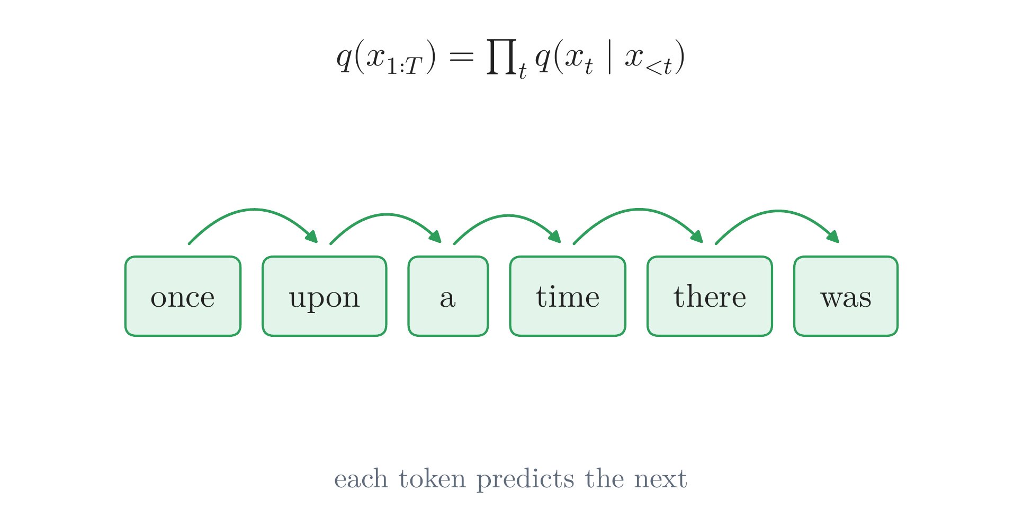
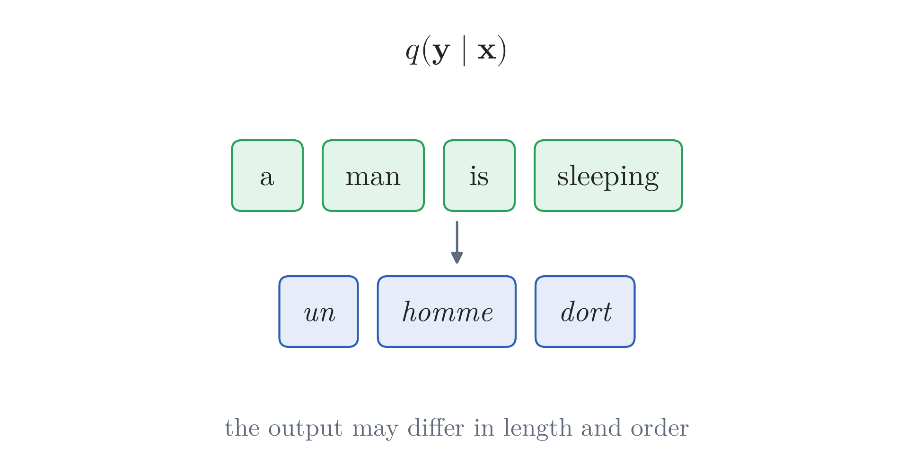
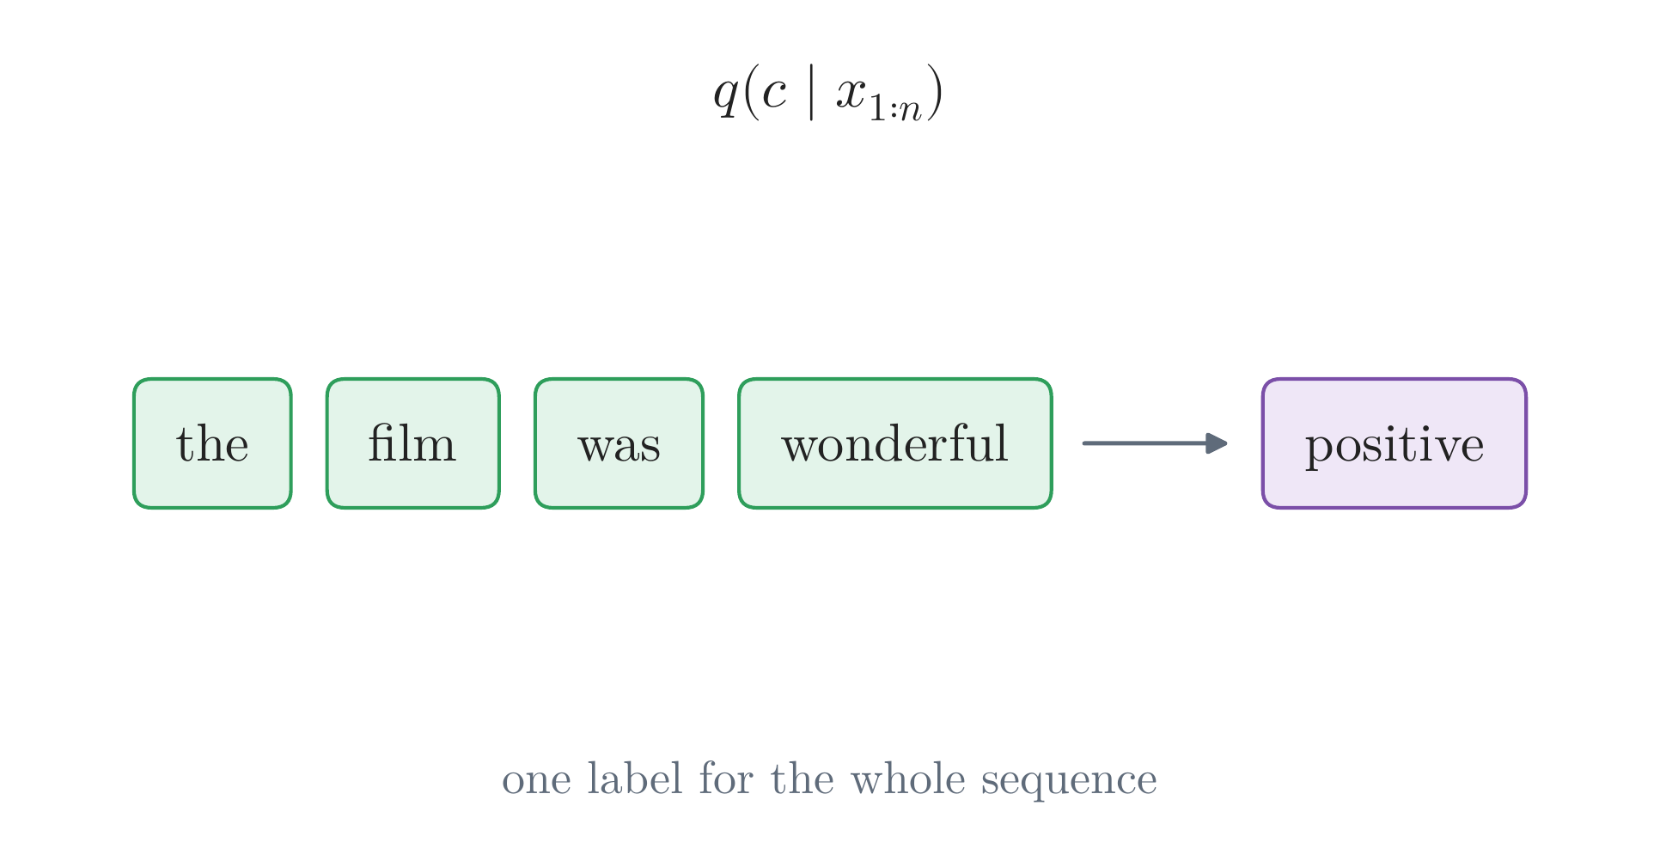
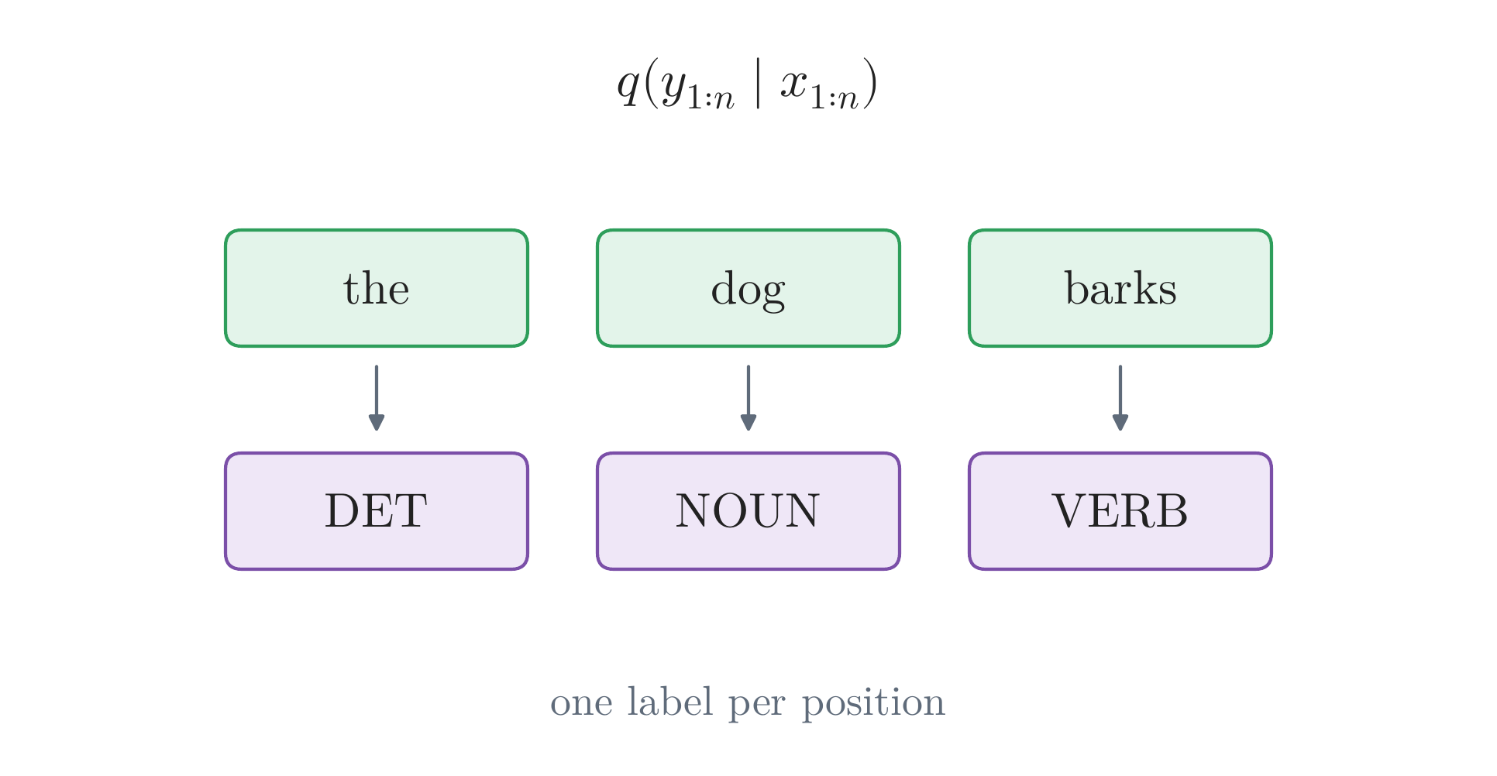
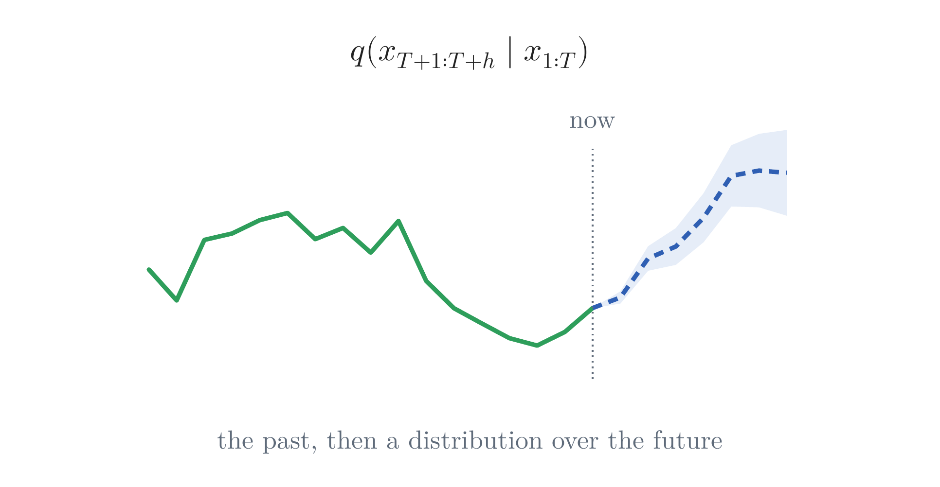
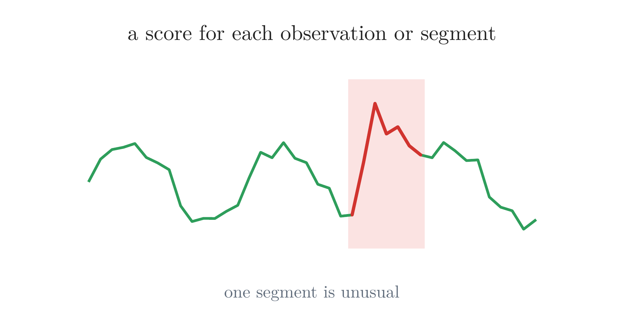
From Language Modeling to Sequence Modeling
Sequence tasks
sequences: text, speech, sensor readings; the length varies, and order matters: dog bites man ≠ man bites dog
language modeling: a distribution over sequences, one next token at a time
transduction: a sequence in, another out, of a different length and order
classification: one label for the whole sequence
labeling: one label for every position
forecasting: the future of a series, from its past
anomaly detection: how unusual each part is
This lecture: translation, a transduction
the categories overlap: labeling and forecasting are transductions too; a forecaster flags anomalies
Notes:
Notes §1, 'Sequence tasks', Figure 1 (one panel per click). A sequence is an ordered list whose length varies, so a sequence model applies one computation, with the same parameters, at every position (dog bites man is not man bites dog). The elements need not be words: a thermometer read every hour, an accelerometer on the wrist, a weather model's maps. Then the tasks, in the order of the notes' table: language modeling (Lecture 2: a probability for every sequence, from next-token predictions); transduction (translation, speech recognition, summarization); classification (the sentiment of a review; the activity in an accelerometer recording); labeling (parts of speech; names; events in a sensor stream); forecasting (temperature, electricity demand, traffic, weather); anomaly detection (monitoring machines). The categories overlap: labeling and forecasting can be read as transductions; a language model continuing a prompt does a transduction; a forecaster flags anomalies by low probability. Today many language tasks are written as a prompt and handed to one language model (Lectures 5 and 7). This lecture: translation.

Slide 4
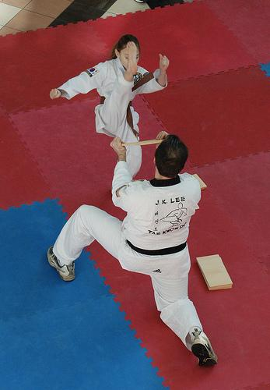
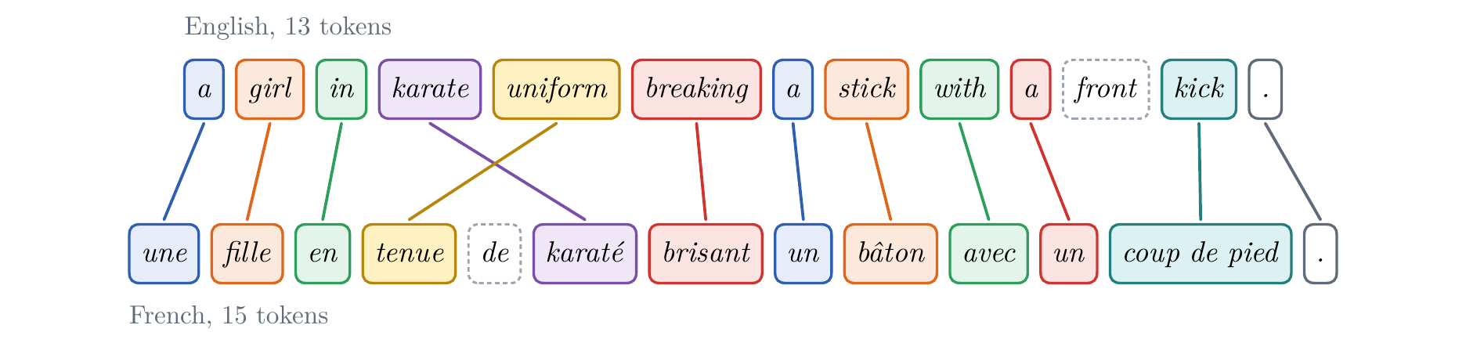
From Language Modeling to Sequence Modeling
Translation
English a girl in karate uniform breaking a stick with a front kick .
French une fille en tenue de karaté brisant un bâton avec un coup de pied .
translating one sequence into another is hard
• the lengths differ: 13 tokens become 15
• the alignment is unknown: nothing says which word comes from which
• the order changes: karate uniform becomes tenue de karaté
Flickr30k image 101362133
the alignment, drawn by hand: nothing in the data gives it
Notes:
Notes §1, 'Translation', Figure 2. A Multi30k test pair: an English caption of a Flickr photograph and its French translation, made by a person. Translation contains, in one task, the main difficulties of producing one sequence from another. Thirteen English tokens (counting the full stop) become fifteen French ones. The alignment (which French word comes from which English word) was drawn by hand: nothing in the data gives it. The order changes: karate uniform becomes tenue de karaté, noun first (the crossing lines); kick becomes three words, coup de pied; front and de (dashed) have no counterpart. This pair returns throughout the lecture. Photograph: Flickr30k image 101362133 (Young et al., 2014), with its Multi30k caption.

Slide 5
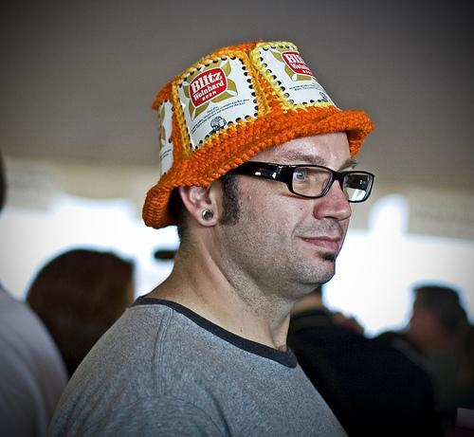
From Language Modeling to Sequence Modeling
Learning from a parallel corpus
a parallel corpus: sentences paired with their translations, made by people
only the pairs: never which word comes from which
Multi30k: English captions of Flickr photographs, translated into French
29,000 pairs to train, 1,014 to validate, 1,000 to test
our models read the text only; the photographs show what a caption is
A man in an orange hat starring at something.
Un homme avec un chapeau orange regardant quelque chose.
Flickr30k image 1007129816, with its Multi30k caption
Notes:
Notes §1, 'Translation'. A translator learns from a parallel corpus: sentences paired with their translations, made by people. The pairs say nothing about which word comes from which: a translator has to learn such correspondences from the pairs alone. These notes use Multi30k (Elliott et al., 2016; 2017): English descriptions of Flickr photographs (the Flickr30k collection, Young et al., 2014), translated into French; 29,000 pairs for training, 1,014 for validation, 1,000 for testing. Our models see only the text; the photographs show what a caption is. The example on the right is a test pair, as it is in the corpus (its English has the typo 'starring'). Photograph: Flickr30k image 1007129816 (Young et al., 2014), with its Multi30k caption.

Slide 6
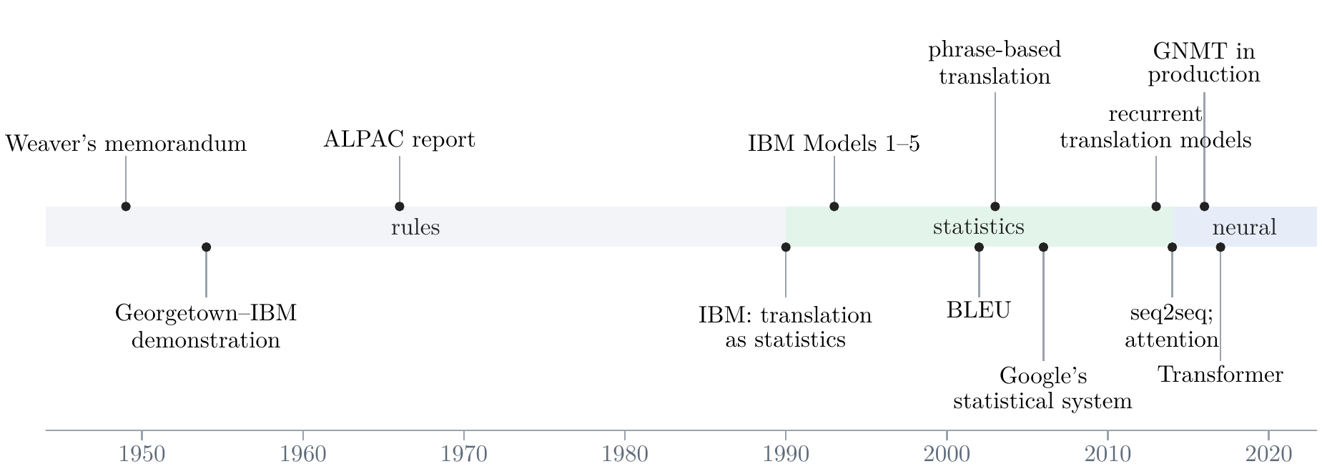
From Language Modeling to Sequence Modeling
Machine translation: rules, statistics, neural networks
Notes:
Notes Appendix B.1, Figure 30. Flash the whole timeline first: seven decades in three eras. Weaver's memorandum (1949); the first public demonstration (1954); the ALPAC report (1966); IBM's statistical systems from 1990; phrase-based translation from 2003; Google's statistical system online in 2006; recurrent translation models 2013, sequence to sequence and attention 2014; GNMT in production 2016; the Transformer 2017. Next slide: the timeline moves aside and the three eras come one at a time.

Slide 7
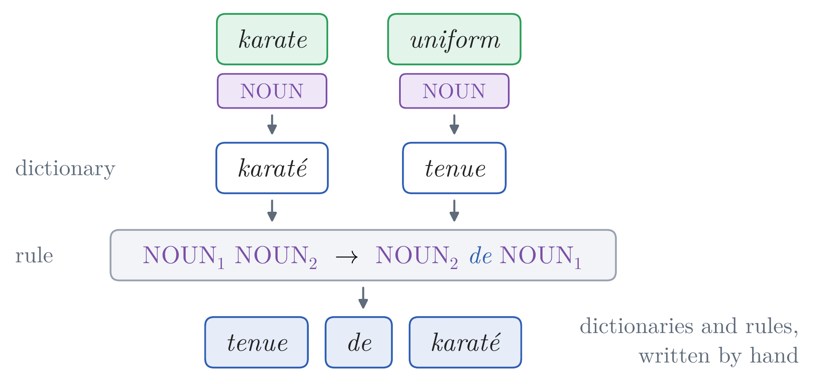
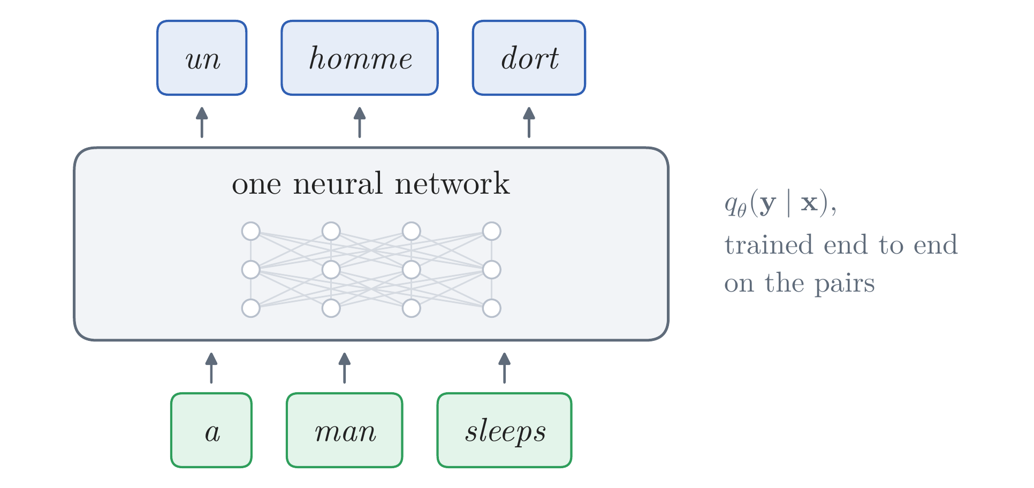
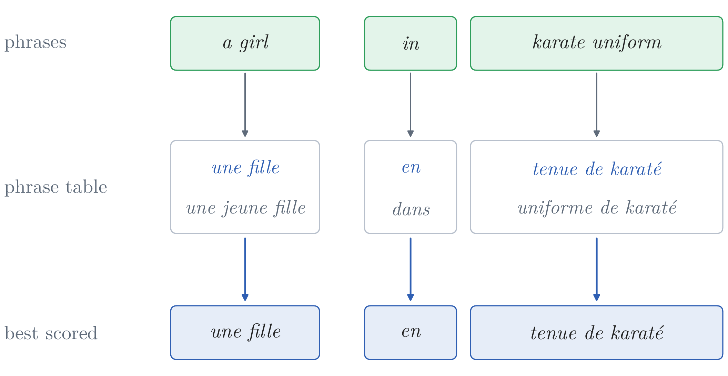
From Language Modeling to Sequence Modeling
Machine translation: rules, statistics, neural networks
rules (1949 on): dictionaries and grammar rules, written by hand; kept for narrow uses, such as weather bulletins
statistics (1990 on): learned from parallel corpora: which words translate which (the alignment, a hidden variable) and a language model of the target language; from 2003, phrase by phrase
neural networks (2014 on): one network for q(y | x), trained end to end on the pairs; in production from 2016
Notes:
The timeline contracts to the right (Morph transition in PowerPoint; a fade elsewhere); the eras come one at a time, each with a picture to talk over, then move on. Rules: dictionaries and rules written by hand; the 1954 demonstration translated Russian sentences with a vocabulary of 250 stems and endings and six rules; ALPAC (1966) found 'no immediate or predictable prospect of useful machine translation'; such systems continued in narrow uses, such as weather bulletins and technical manuals. The picture: a dictionary and one reordering rule, written by hand, for karate uniform (illustrative). Statistics: from 1990 IBM's systems learned from parallel corpora, with an approach from speech recognition: which words translate which, the alignment a hidden variable estimated by EM, and an n-gram language model of the target language; phrase-based systems (Koehn et al., 2003), built on these alignments, translated in units of a few words; Moses (2007) was the baseline every neural translator of 2014 was compared with. The picture is illustrative: plausible table entries, no probabilities; three clicks frame its phrases one at a time (a girl → une fille; in → en; karate uniform → tenue de karaté, two words reordered as one entry of the table). Neural networks: from 2013–2014, first as parts of statistical systems, then as whole translators (Part 2); in production from 2016. Contrast for later: the statistical systems' alignment is an explicit hidden variable; attention (Part 3) learns soft correspondences as a by-product.

Slide 8
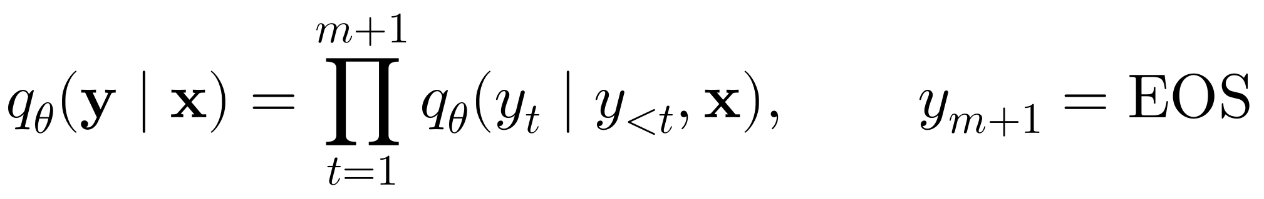
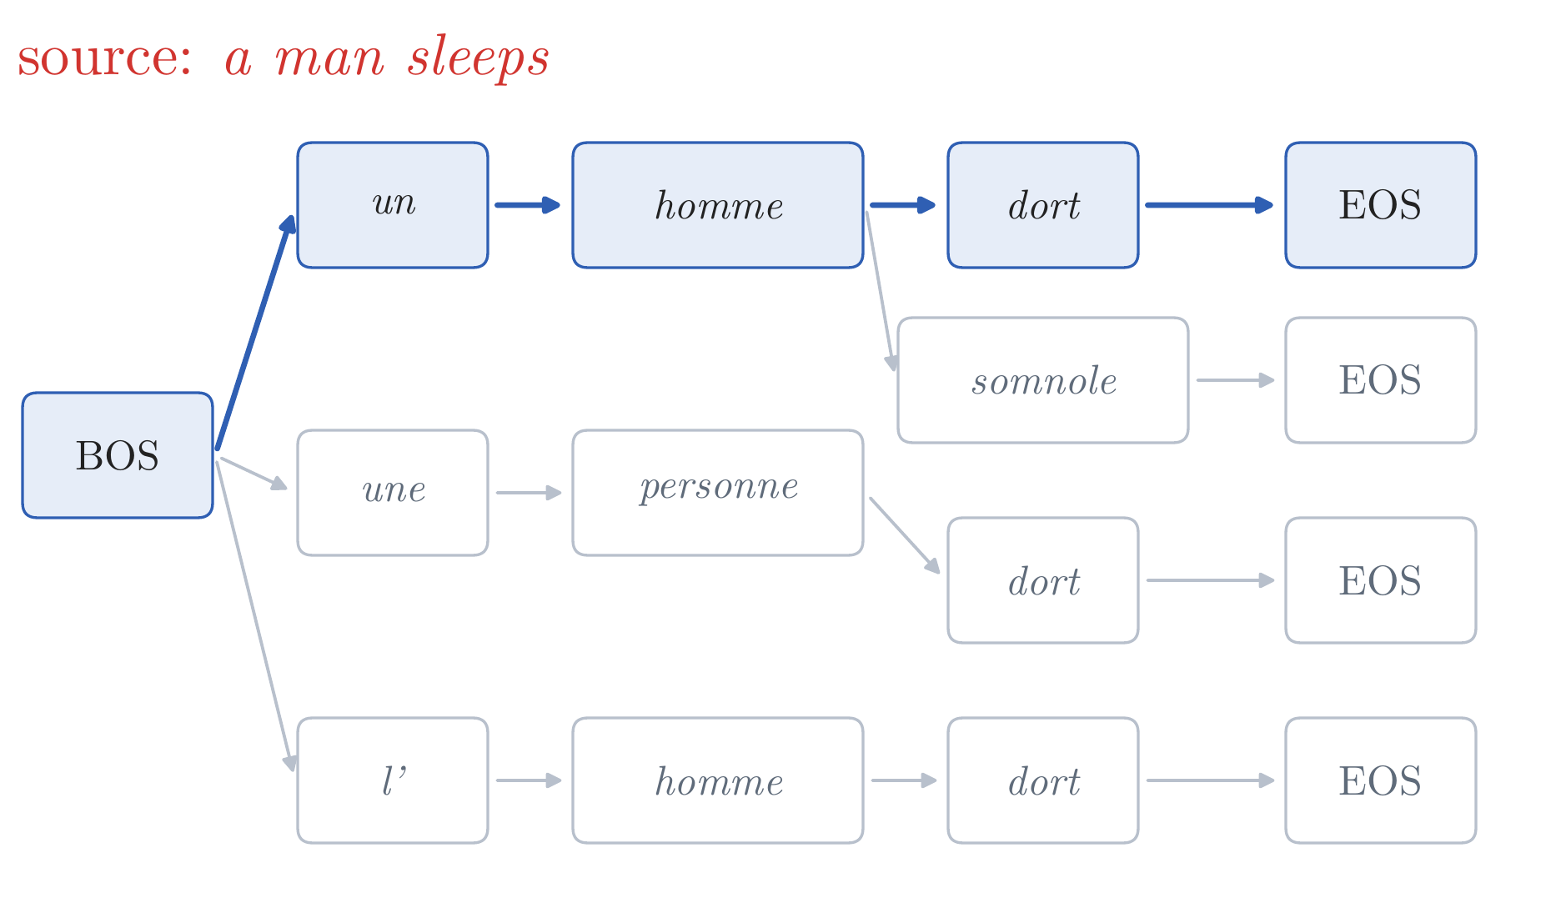
Translation as Conditional Sequence Prediction
The model
translation as a conditional language model: the chain rule of Lecture 2, with the source as extra context
EOS: the model decides where the translation stops
a tree of translations: every path from BOS to EOS is one; its probability is the product along the path
Notes:
Notes §2, 'The model and its training'. The chain rule of Lecture 2, with the source as extra context: a conditional language model. EOS lets the model decide where the translation stops. As in Lecture 2, the model defines a tree: every path from BOS to EOS is a translation, and its probability is the product of the probabilities along it. The tree in the picture is illustrative (no probabilities are shown): un homme dort, un homme somnole, une personne dort, l'homme dort are all paths in it, for the one source a man sleeps. Decoding (two slides on) searches this tree.

Slide 9
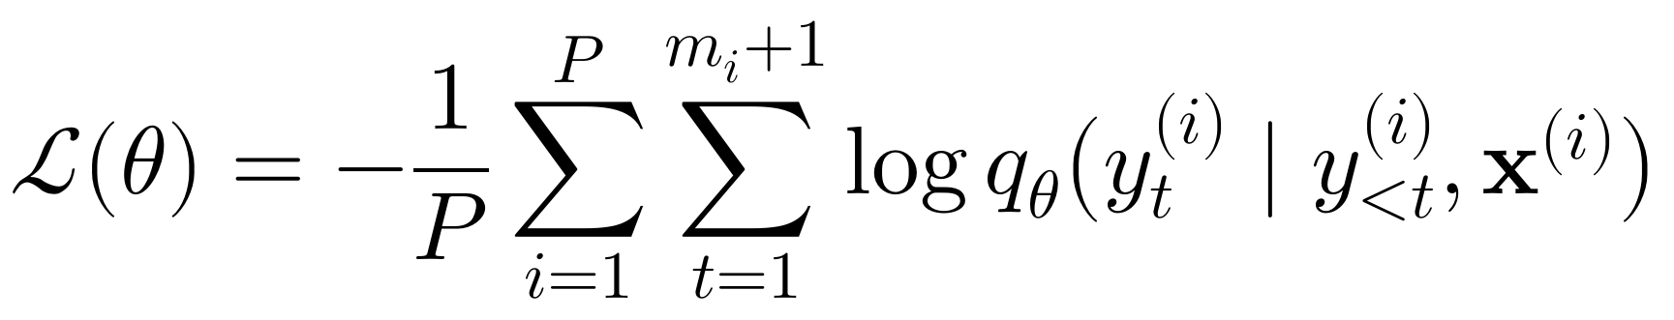
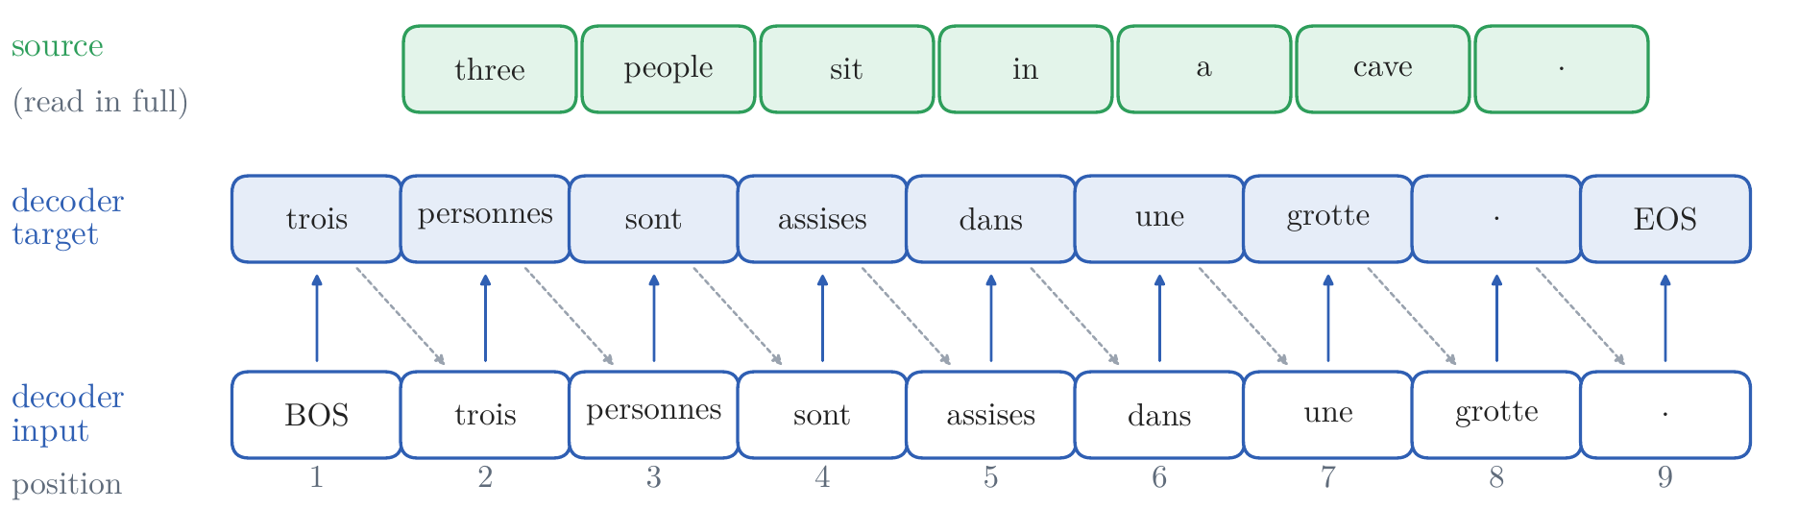
Translation as Conditional Sequence Prediction
Training
negative log-likelihood: the log loss of Lecture 2, over the target tokens
teacher forcing: in training the decoder reads BOS and the reference, shifted by one, and predicts the next token at every position
training: all inputs known · generation: each input is the word just chosen
Notes:
Notes §2, 'The model and its training', Figure 3. Training: minimize the negative log-likelihood, Lecture 2's log loss summed over the target tokens of each pair and averaged over the P pairs. Teacher forcing: the decoder reads BOS and the reference, shifted right by one position, and is asked for the next token at every position. Two consequences that return in Part 4: in training all inputs are known, so whether the positions can be computed at once depends only on the architecture; in generation each input is the word just chosen, so every model writes one word at a time.

Slide 10
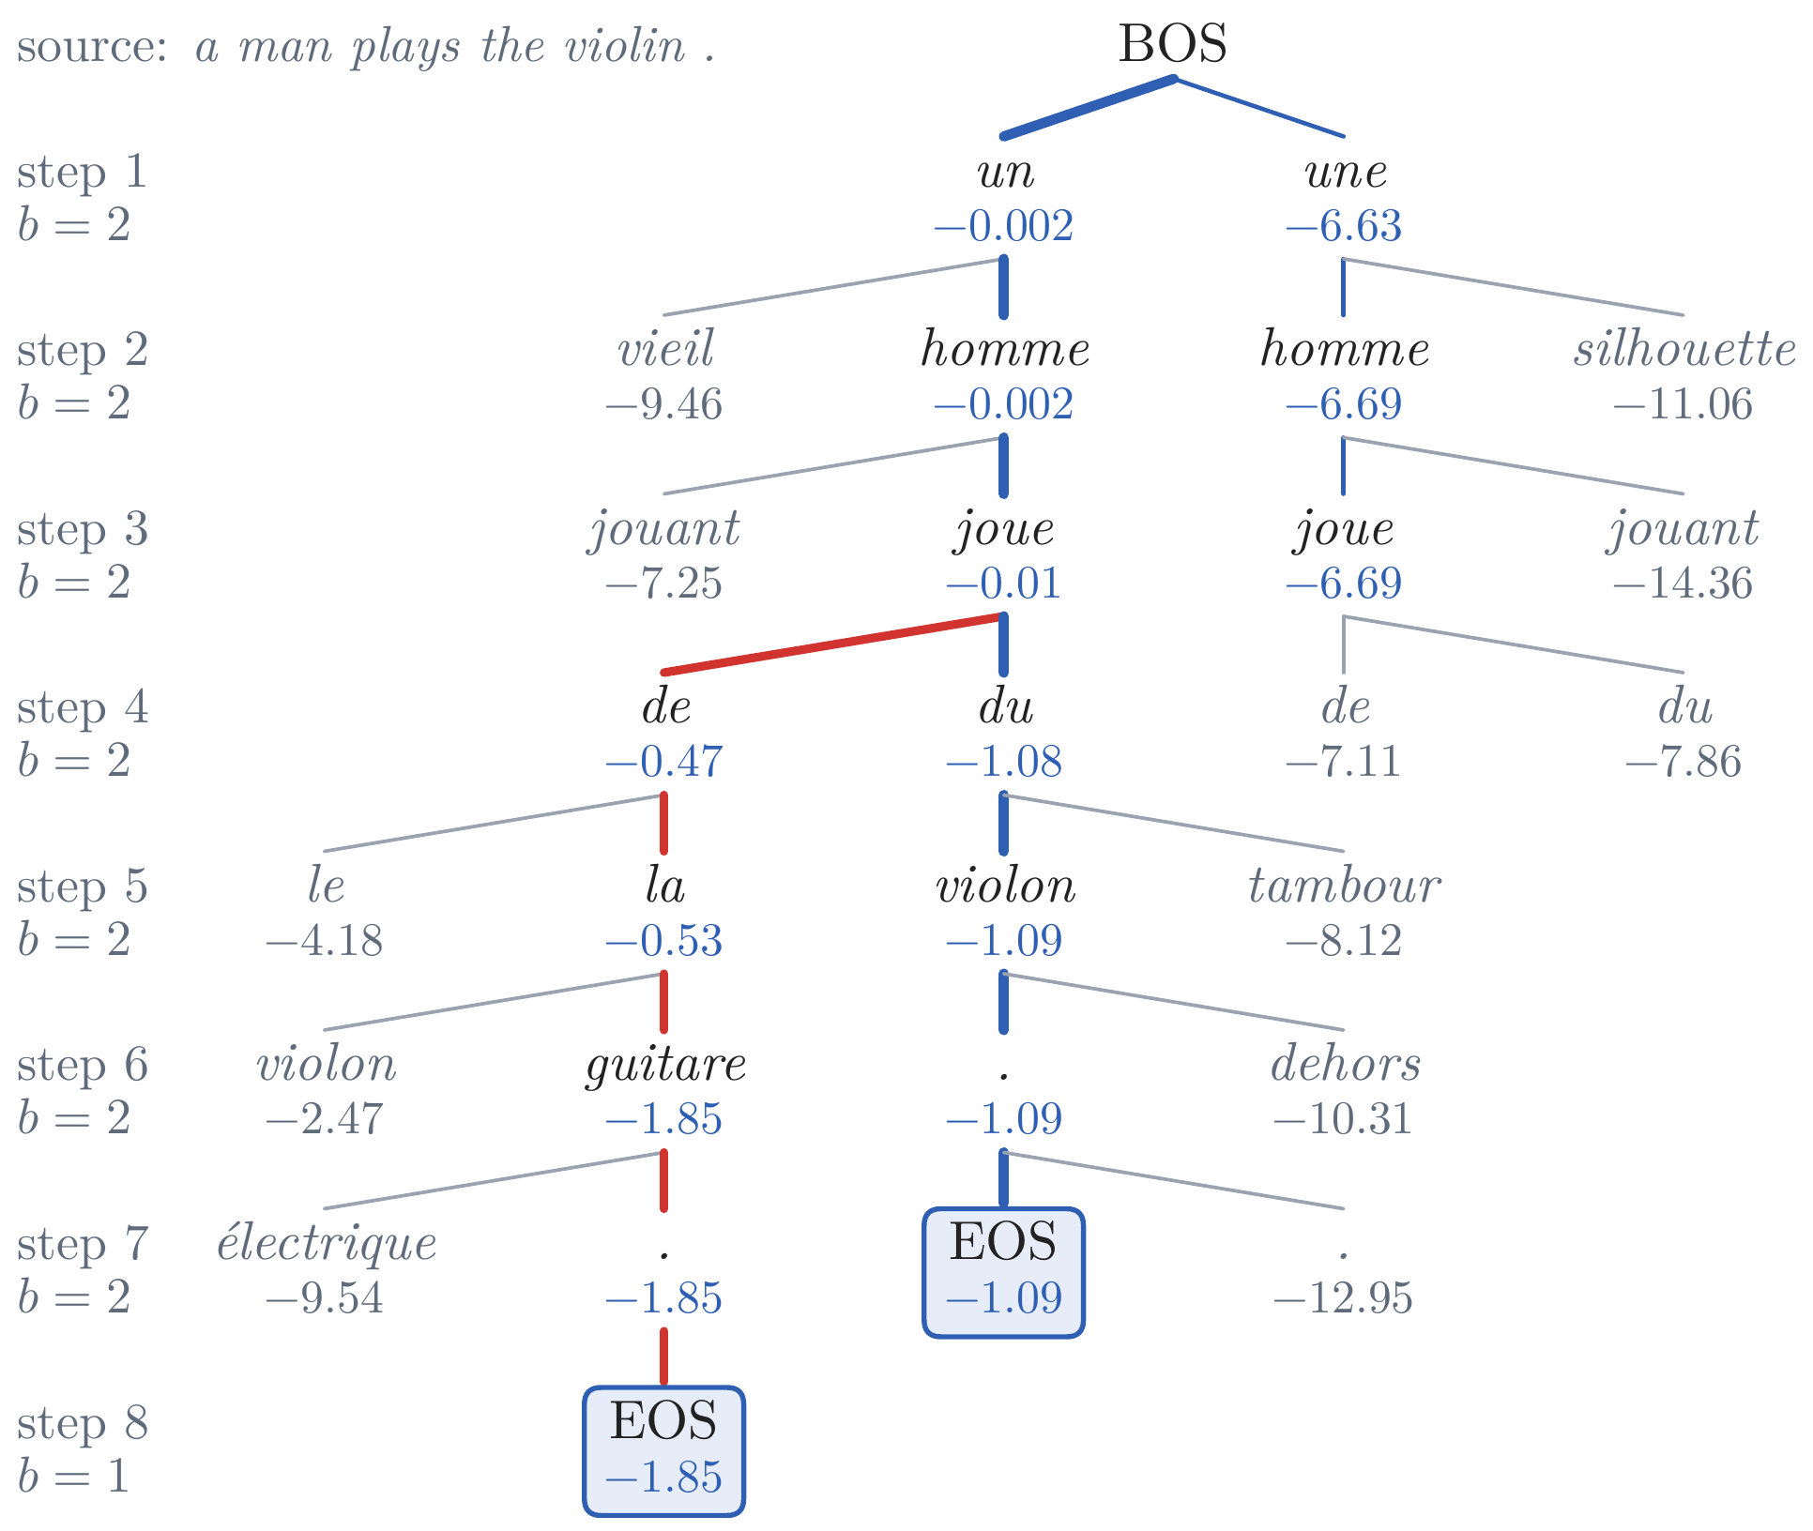
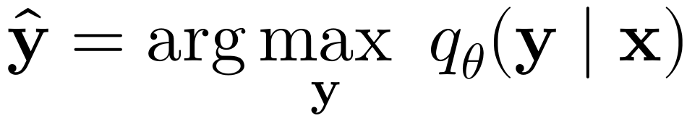
Translation as Conditional Sequence Prediction
Decoding: greedy and beam search
the best translation: the most probable one
too many to try: |V| choices of word at each of m steps, |V| to the power m outputs
greedy: the most probable word at each step; a likely word now can lead to an unlikely sentence
step 4: de (−0.47) beats du (−1.08); greedy ends with de la guitare, −1.85
beam search: keep the B best partial translations, scored by total log-probability; greedy is B = 1
the beam keeps du and finishes du violon, −1.09: the right translation
the attention model of Part 3 on a man plays the violin ., a beam of two
Notes:
Notes §2, 'Decoding', Figure 4 (drawn top to bottom here). A trained model gives a probability to every translation; translating means searching for a probable one. The most probable cannot be found by trying every output: |V|^m outputs of length m (our small models have 6,430 French words). Ask first: why not take the most probable word at every step? Greedy decoding: after un homme joue it takes de (prefix log-probability −0.47, against −1.08 with du), continues with la guitare, and ends at −1.85: 'a man plays the guitar'. Beam search keeps the B best partial translations (hypotheses), each scored by its total log-probability; here B = 2, so du is kept, and du violon . finishes at step 7 with −1.09, the higher score and the right translation. Greedy is beam search with B = 1. Numbers are the prefixes' log-probabilities.

Slide 11
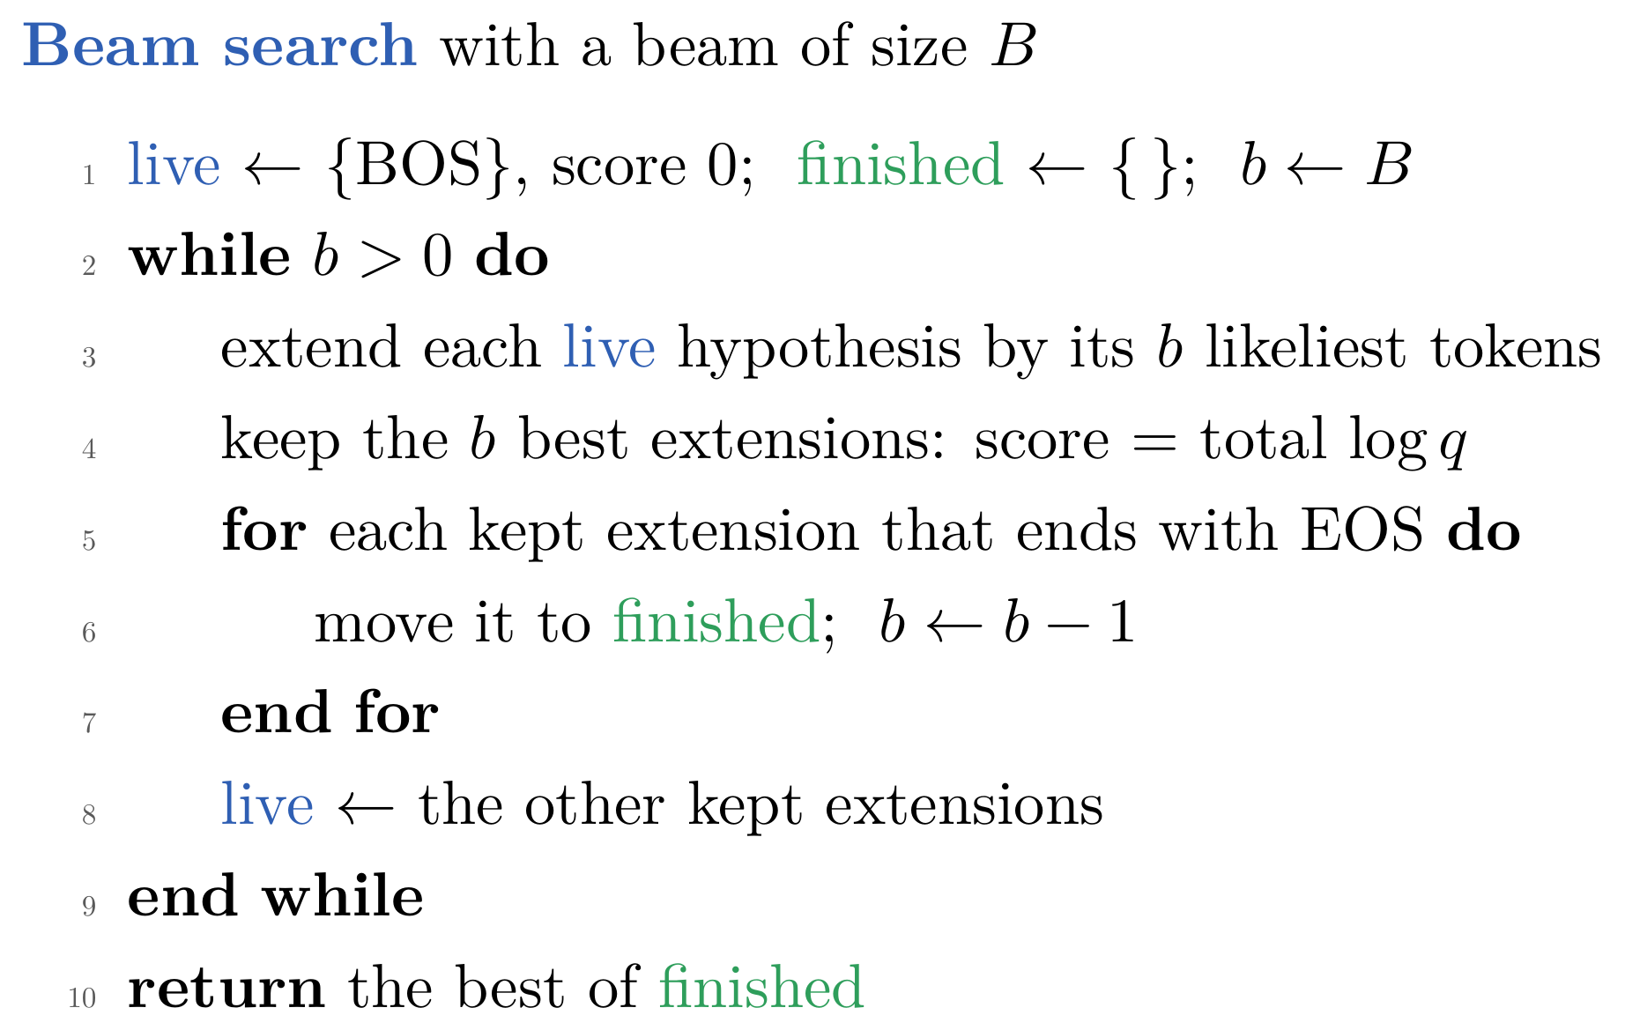
Translation as Conditional Sequence Prediction
Beam search: the algorithm
the attention model of Part 3 on a man plays the violin ., a beam of two
Notes:
Notes §2, 'Decoding' (the numbered steps). Walk through the algorithm on the tree. Every finished translation uses up one place in the beam: the width b starts at B and drops by one each time a translation finishes. Extend: only a hypothesis's b best extensions can survive pruning, so each is extended by its b most probable tokens; at most b × b extensions per step. Keep the b best overall, finished or not. Move those ending in EOS to the finished list. Repeat until b = 0 (at a maximum length, the live hypotheses join the finished list). Output the best finished translation. In the tree: b = 2 until step 7, where du violon . finishes; b = 1 at step 8, where the greedy translation finishes; b = 0, stop; output du violon. The search ends with B finished translations. On the 1,000 test captions a beam of three changes 480 greedy translations, 432 to more probable ones and 48 to less probable ones (the greedy path was pruned), and BLEU goes from 49.2 to 51.2. Length normalization (dividing by |y|^α) changes only the final choice; here it would not change it (−0.16 against −0.23 per token). Lecture 8 returns to search and sampling.

Slide 12
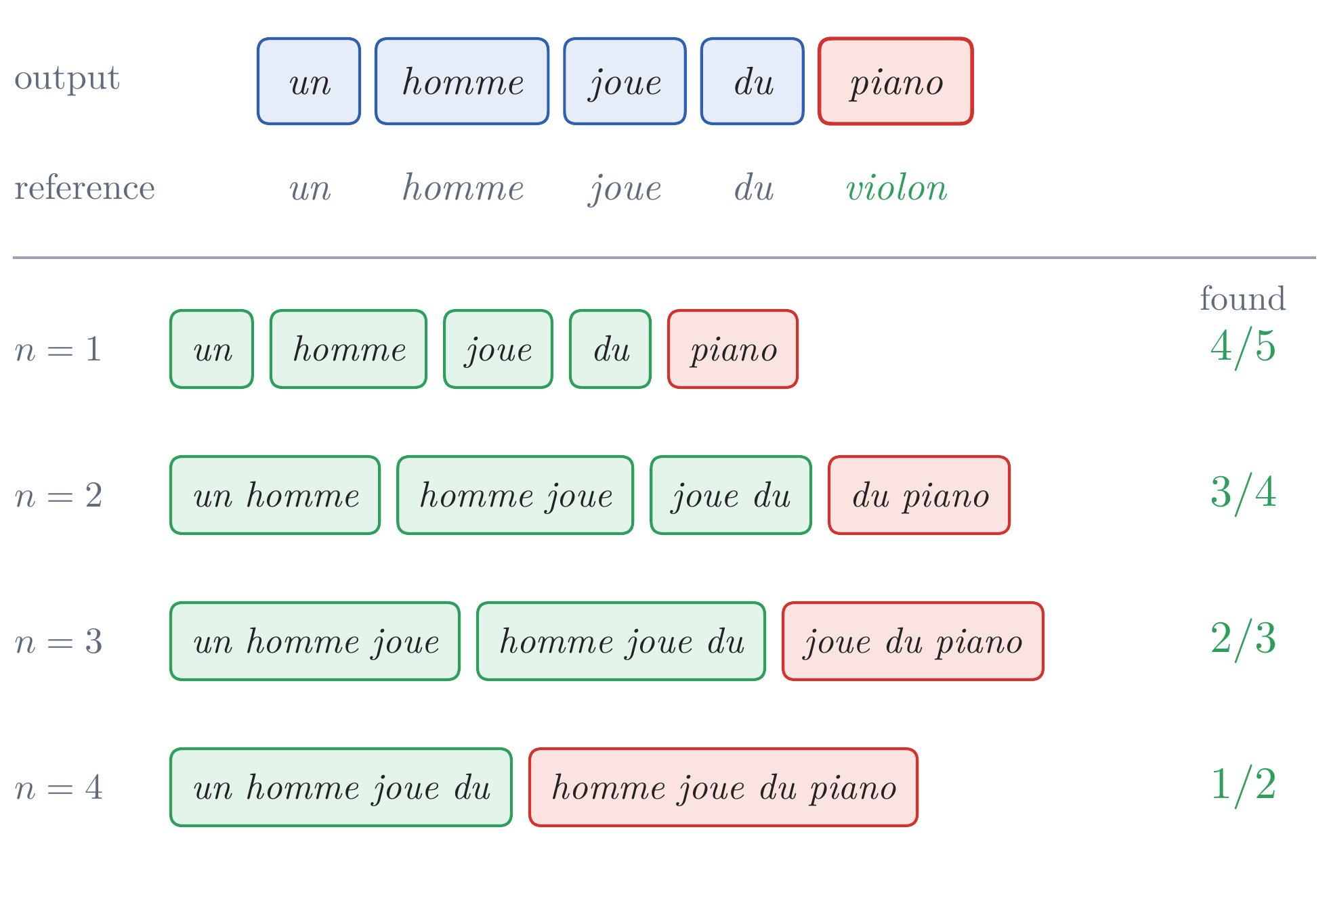
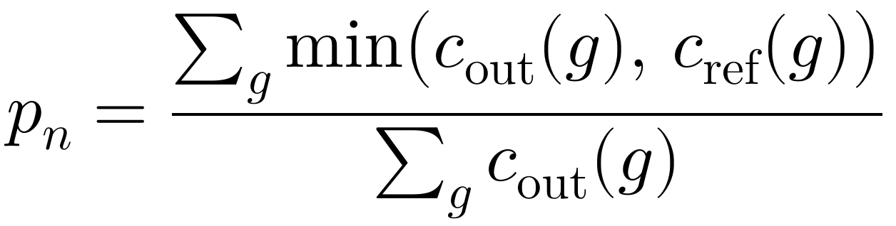
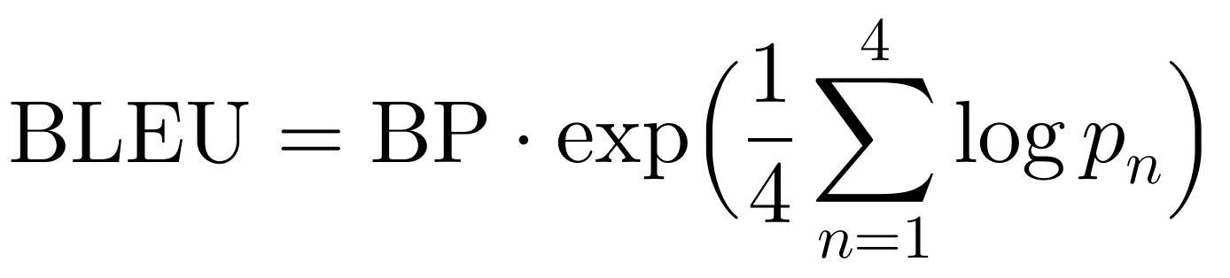
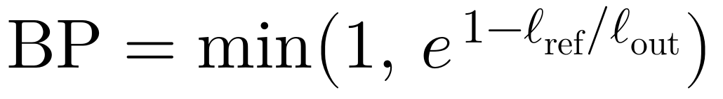
Translation as Conditional Sequence Prediction
Evaluation: BLEU
BLEU (Papineni et al., 2002) compares the output with the reference:
1. modified precision for n = 1 to 4: the share of the output's n-grams found in the reference, each counted at most as often as there
2. their geometric mean: each order weighs the same
3. a brevity penalty: no reward for writing less
illustrative: a man plays the violin, with one wrong word
Notes:
Notes §2, 'Evaluation'. BLEU (Papineni et al., 2002) in three steps. (1) For each n from 1 to 4, the modified precision p_n: the share of the output's n-grams (runs of n tokens) that also occur in the reference, each counted at most as many times as it occurs there; the picture: the the the earns one match against a reference with one the (illustrative reference). (2) The four precisions fall roughly exponentially with n, so they are combined by their geometric mean, which averages their logarithms. (3) A brevity penalty lowers the score of outputs shorter than the references; precision alone would reward a system that writes only the words it is sure of. Counts and lengths are summed over all the sentences of a test set before dividing; BLEU is reported from 0 to 100 (say it: the counts are summed over the test set) and is comparable only on the same test set with the same tokenization. Unigrams measure the right words, longer n-grams a fluent order. Why 4: Papineni et al. found that n-grams up to 4 agreed best with human judgments (3 and 5 comparable).

Slide 13
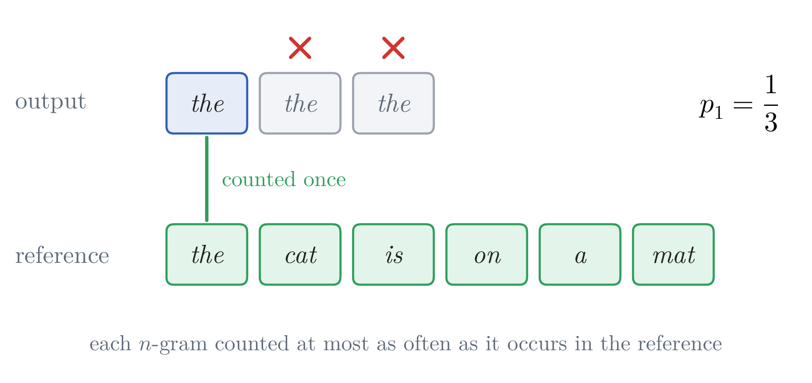
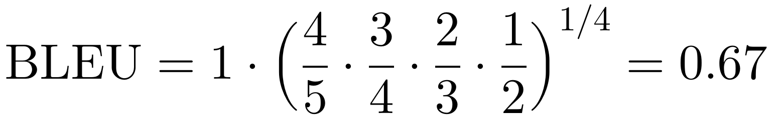
Translation as Conditional Sequence Prediction
Evaluation: the example worked
precisions: 4/5, 3/4, 2/3, 1/2; one wrong word spoils every n-gram that contains it
same length: BP = 1
reported as 66.9
clipping: each n-gram counted at most as often as in the reference: the the the earns one match
a real output: our attention model on the karate caption, faisant for brisant: 14/15, 12/14, 10/13, 8/12, BLEU 80.0
illustrative: a man plays the violin, with one wrong word
counts are summed over a whole test set before dividing
Notes:
Notes §2, 'Evaluation'. The same five-word example, worked to the end (illustrative: the source of the beam slides, a man plays the violin, with one wrong word in the output). The wrong word spoils every n-gram that contains it: 4 of 5 unigrams, 3 of 4 bigrams, 2 of 3 trigrams, 1 of 2 four-grams are found in the reference. Same length, so BP = 1; the geometric mean of 0.8, 0.75, 0.67 and 0.5 is 0.67, reported as 66.9. Clipping: each n-gram counts at most as many times as it occurs in the reference, so the the the earns one match against a reference with one the (illustrative reference). On a real output: for the karate caption, our attention model (Part 3) writes faisant (‘doing’) where the reference has brisant (‘breaking’); 14 of 15 unigrams, 12 of 14 bigrams, 10 of 13 trigrams and 8 of 12 four-grams match; BLEU 80.0 (notes §2). On a single short sentence BLEU is fragile (one wrong word in the middle of five leaves no matching four-gram, and BLEU 0); that is one reason the counts are summed over a whole test set before dividing.

Slide 14
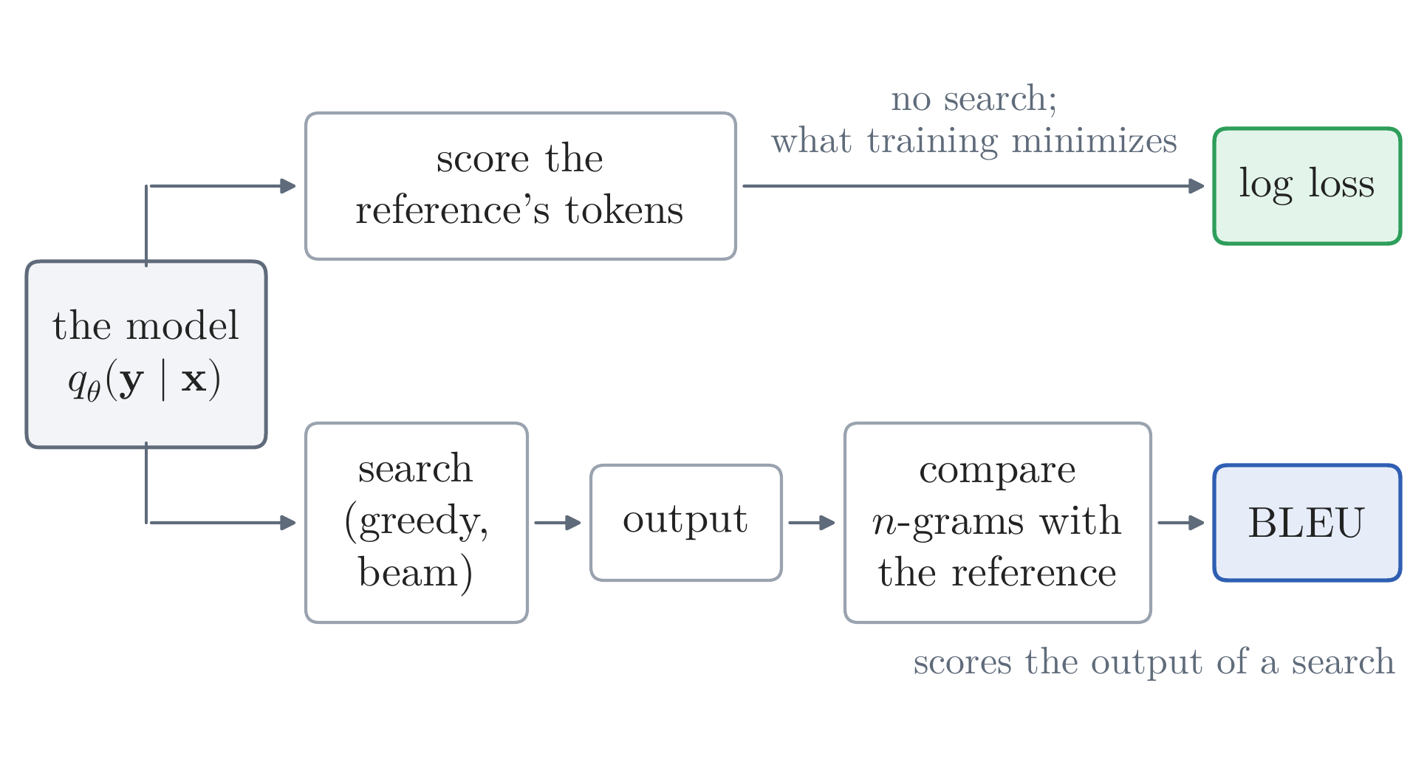
Translation as Conditional Sequence Prediction
Evaluation: what BLEU measures
the log loss: the model's probabilities of the reference's tokens; no search
BLEU: the output of a search; a better search raises it, the model unchanged
it rewards matching words, not meaning: une jeune fille for une fille loses points
today: learned metrics such as COMET agree far better with people; BLEU stays here to compare the papers of 2014–2017
Notes:
Notes §2, 'Evaluation' (last paragraphs). BLEU and the held-out log loss measure different things. The log loss scores the probabilities the model gives to the reference's tokens, with the reference prefix given; it needs no search, and it is what training minimizes. BLEU scores the output of a search. They can disagree: a better search raises BLEU without changing the model (the beam: 49.2 → 51.2); raising the probability of a reference token ranked second, without making it first, lowers the log loss and changes no greedy choice. BLEU also rewards matching words, not meaning: a correct une jeune fille for the reference's une fille loses points. BLEU today: the standard from 2002 through the years of this lecture, so every published result here is in BLEU; no longer the standard for judging translation. Learned metrics such as COMET (Rei et al., 2020) agree with human judgments much better ('Stop Using BLEU – Neural Metrics Are Better and More Robust', WMT 2022); WMT 2024 ranked systems by human judgments and two learned metrics, 'not using BLEU nor ChrF on purpose'.

Slide 15
Lecture 3: Sequence Modeling, Translation, and Attention
1. Sequence tasks and translation
sequence modeling; machine translation, how it is learned, decoded, and scored
2. Recurrent encoder–decoders
the encoder–decoder framework; models improved one after another; their drawbacks
3. Attention
its inception and its variants
4. Beyond recurrence
convolutional sequence models, translation from attention alone, self-attention and the Transformer
Notes:
Part 2 (notes §§3–5), about 25 minutes. First the framework every neural translator of this lecture shares, the encoder and the decoder; then the models one after another, as in the notes, each fixing a drawback of the one before, each paper cited where its model comes in; then the three drawbacks that remained. They worked; the point of this part is what they could not do.

Slide 16
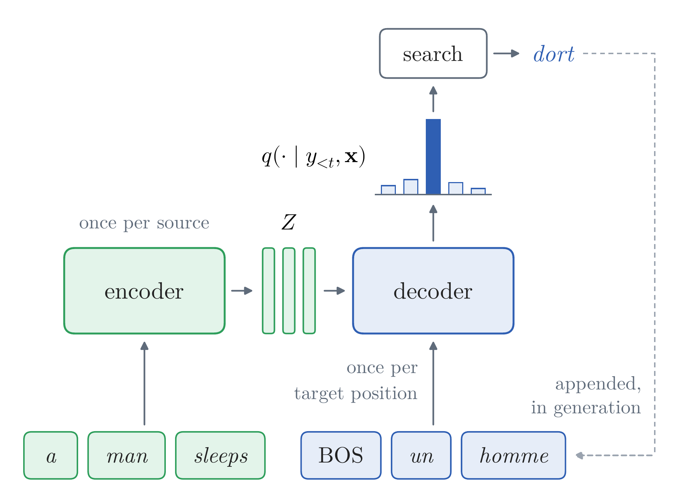
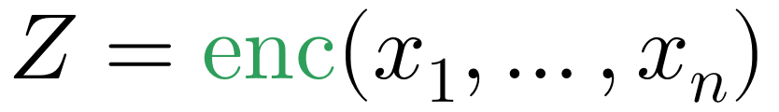
Encoder–Decoders
Two roles
every translator of this lecture splits the work between two networks
encoder: reads the source once and returns its states Z
decoder: from Z and the target prefix, the distribution of the next word; a search picks the word
roles, not architectures: each can be recurrent, convolutional, or attention
every landmark translator of 2013–2017 has these two roles, from Cho et al. (2014a) to the Transformer (2017); we meet each where its model comes in
Notes:
Notes §3, 'Two roles', Figure 5 (redrawn for the slide). The neural translators of 2013–2014 divided the computation of q(y_t | y_<t, x) between two networks with different jobs. The encoder runs once per source and returns states Z (one vector, or one vector per source position); the decoder, a conditional language model of the target, runs once per target position and turns its state into a distribution over the next word; a search turns the distributions into words; in generation the chosen word is appended to the prefix. The names say what each part computes, not how: an encoder or a decoder can be recurrent, convolutional, or built from attention, as long as the decoder's prediction at step t depends only on Z and the prefix y_<t. The rest of the lecture keeps the roles and changes how they are computed: the landmark translators of 2013–2017 all have them (Kalchbrenner and Blunsom, 2013, a convolutional encoder and a recurrent decoder; Cho et al., 2014a; Sutskever et al., 2014; Bahdanau et al., 2015; ConvS2S, 2017; the Transformer, 2017), and each paper is cited where its model comes in.

Slide 17
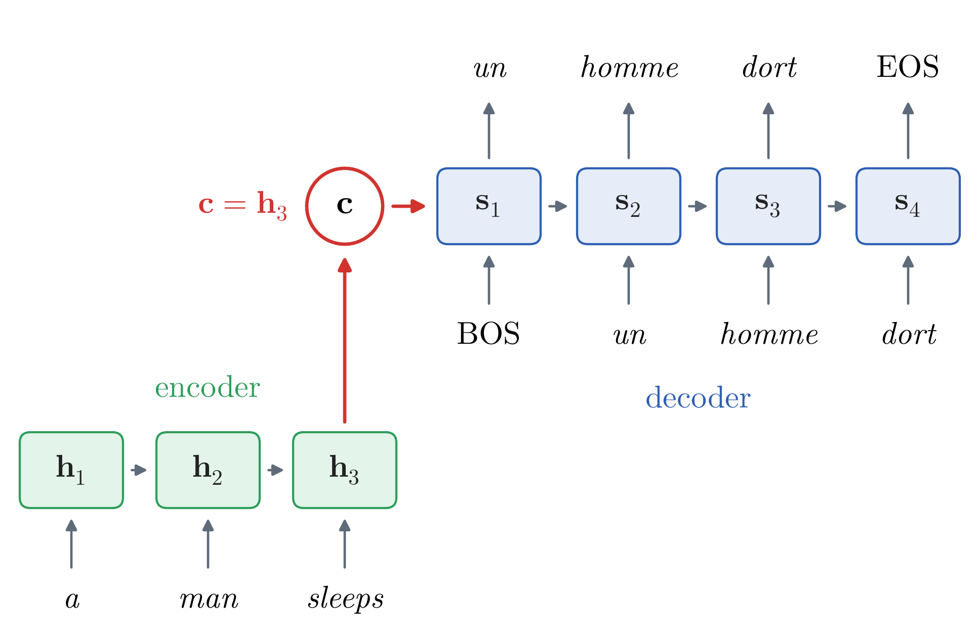
Encoder–Decoders
The recurrent encoder–decoder
1. the encoder reads the source one token at a time; its last state is the context c
2. the decoder starts from c and reads the target prefix
3. each decoder state gives the next word's distribution
trained end to end: the encoder learns to put into c what the decoder needs
Notes:
Notes §3, 'The recurrent encoder–decoder', Figure 6a (redrawn for the slide). In the notation of Lecture 2: (1) the encoder, a recurrent network, reads the source one token at a time; (2) its last state is the context c, here the representation Z is this one vector; (3) the decoder, a recurrent language model of the target, starts from the context, s_0 = c (through a learned matrix, a bridge, when the sizes differ), and reads the target prefix; (4) each state gives the next token's distribution through a matrix U. Training backpropagates the loss through both networks at once, so the encoder learns to put into c what the decoder needs. Started from c, the decoder sees the source once, and must carry it through every update. Ask: what is the size of c for a 5-word sentence, and for a 50-word one?

Slide 18
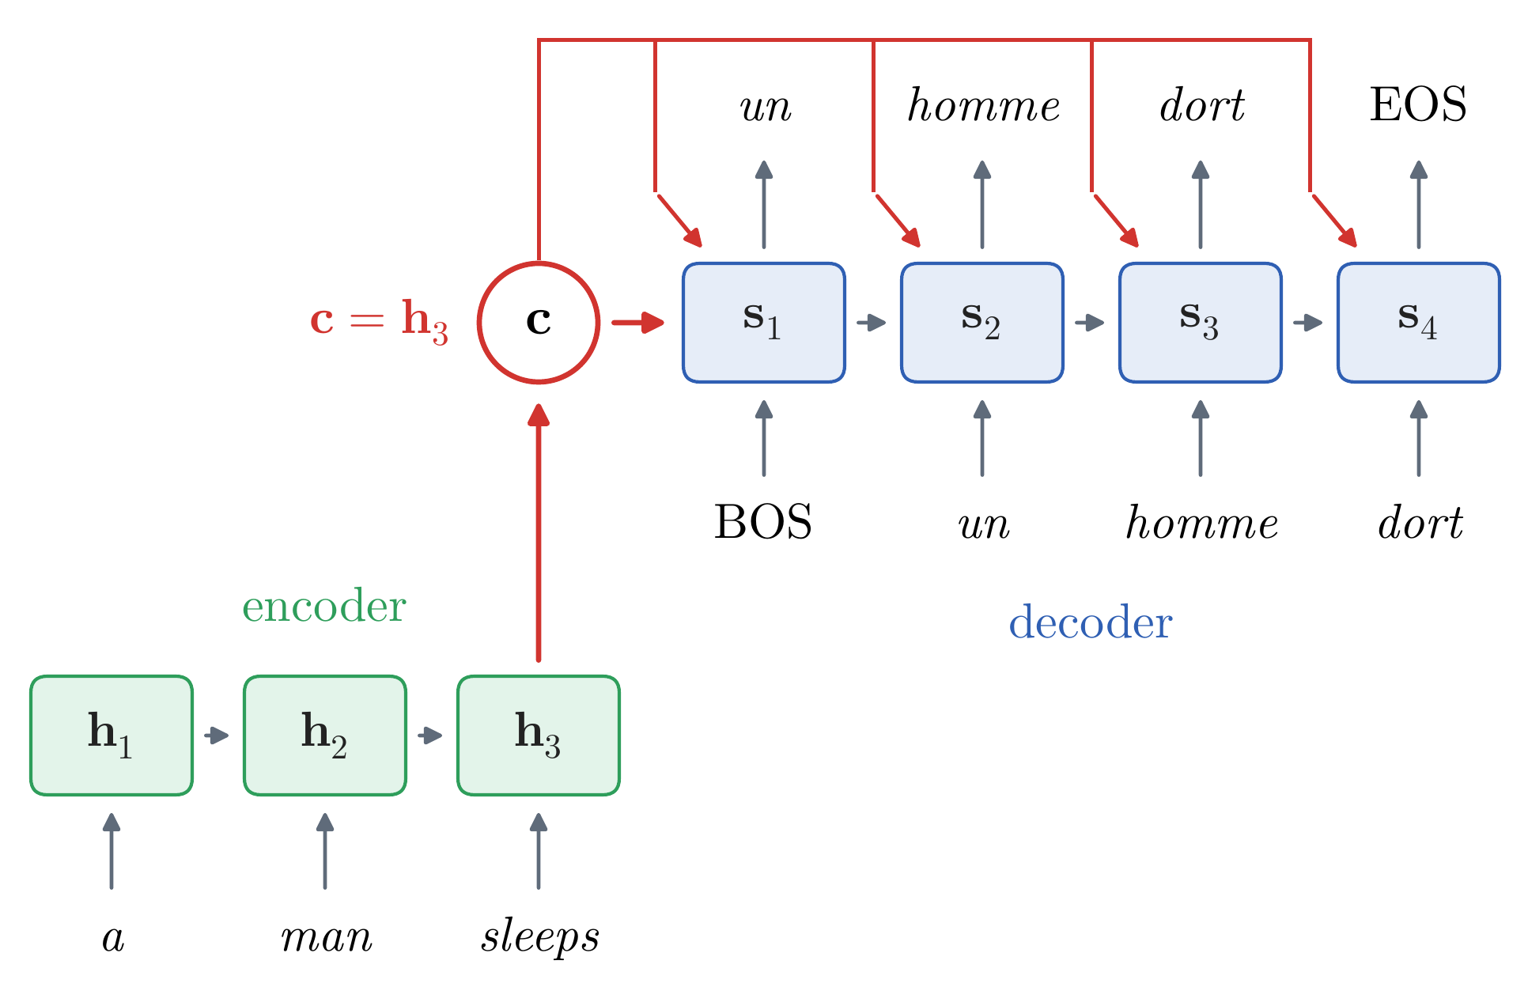
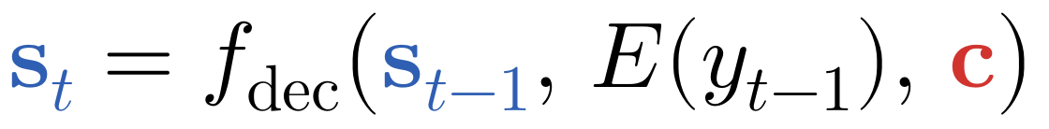
Encoder–Decoders
The context at every step
the problem: the decoder sees the source once, at the start → the fix here: give c to every step
Cho et al. (2014a), the “RNN Encoder–Decoder”: c enters every decoder update and the output
every prediction is one step from c, however long the prefix
used to score phrase pairs in a phrase-based system: BLEU 33.30 → 33.87
still one summary for the whole source: 5 words or 50, the same number of numbers (Part 3 removes it)
Notes:
Notes §3, 'The recurrent encoder–decoder' (the context at every step), Figure 6b, and 'The first encoder–decoders'. Cho et al. (2014a), posted in June 2014, called their model the RNN Encoder–Decoder: one recurrent network 'encodes a sequence of symbols into a fixed-length vector representation, and the other decodes the representation into another sequence of symbols'. They gave the context to every update and to the output layer, so every prediction is one step from c, however long the prefix (they placed one more layer before the softmax; the linear map here is the simplest choice). They used it on phrases of a few words, to score the phrase pairs of a phrase-based system: one more feature, which raised its BLEU on the 2014 English–French test set from 33.30 to 33.87. They also introduced the GRU (next slide). Neither version gives the decoder the separate source positions: the whole source passes through c, of fixed size.

Slide 19
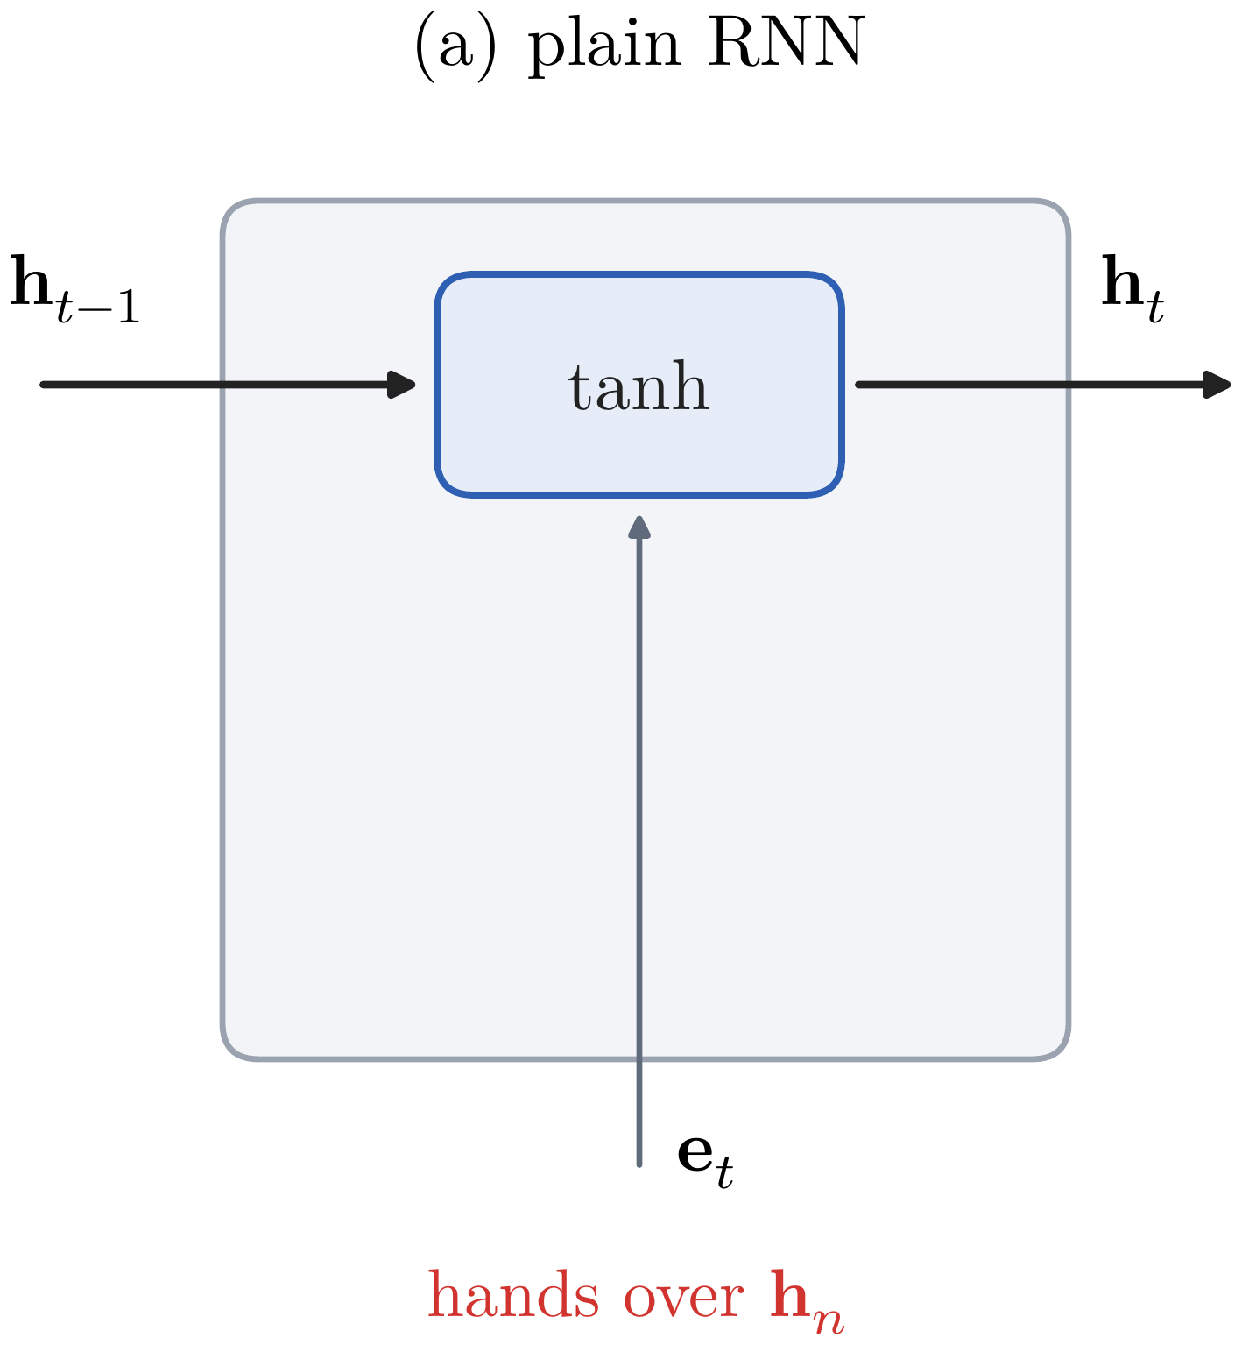
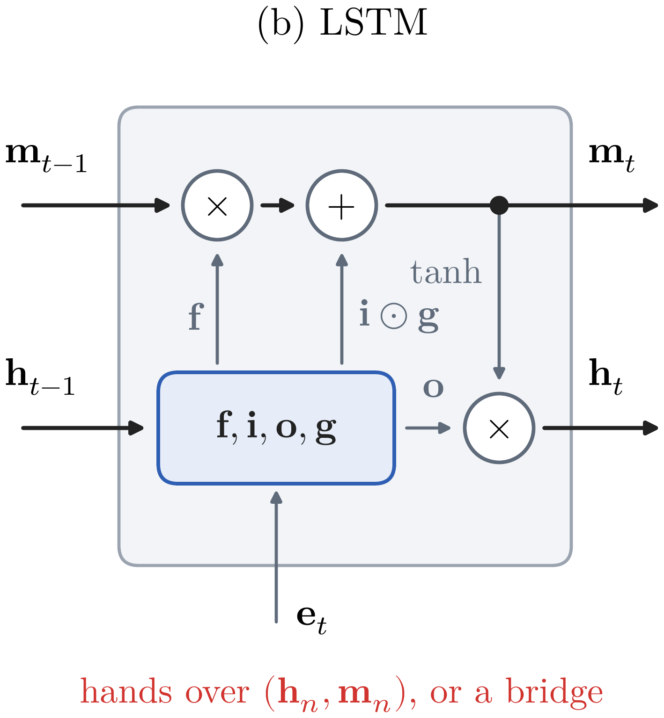
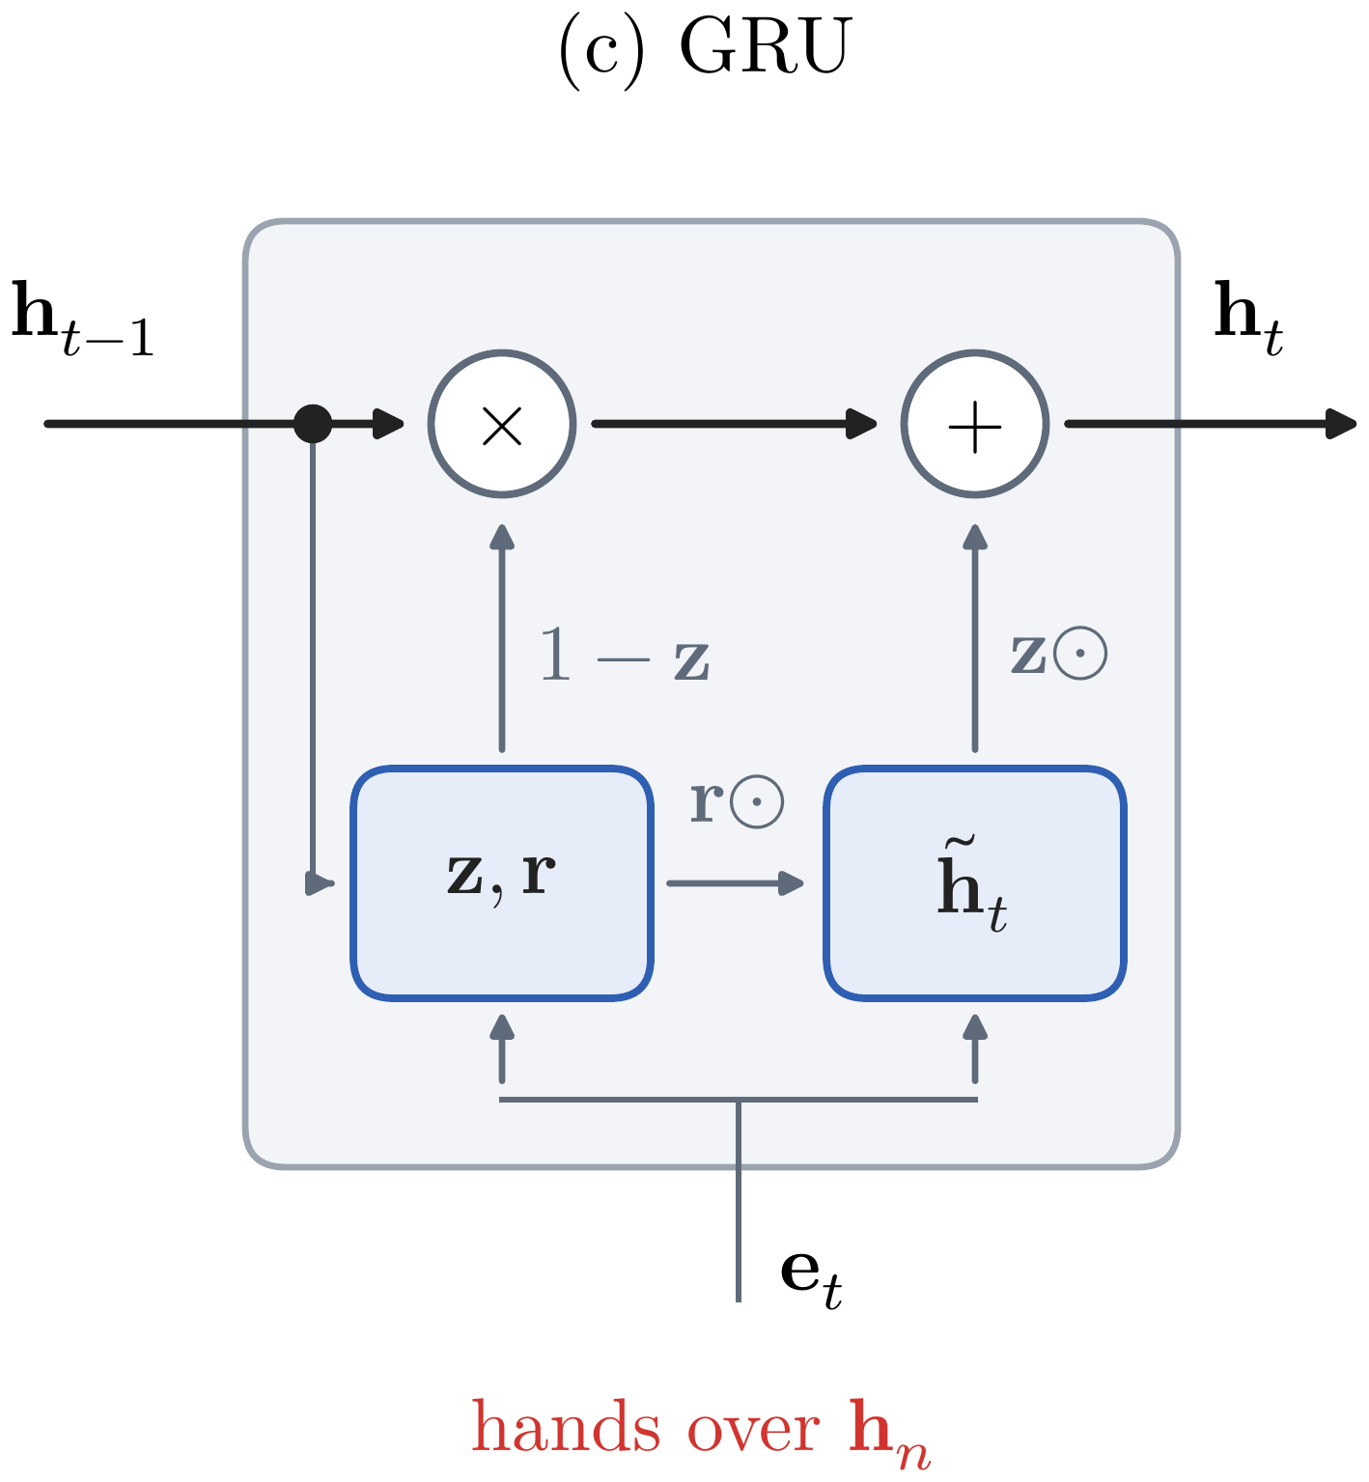
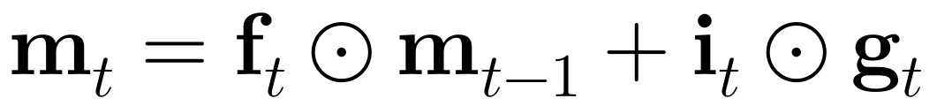
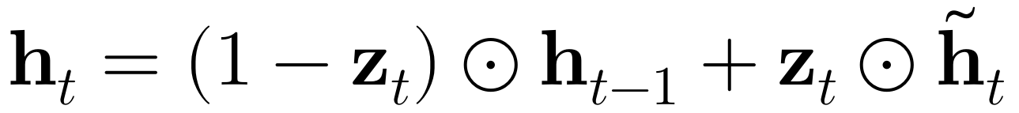
Encoder–Decoders
Recurrent cells
the problem: a plain RNN forgets along a long sentence → the fix here: gated cells, LSTM and GRU
a plain RNN: rewrites its state through tanh at every step; information and gradients fade over a long sentence
LSTM: a memory cell only scaled by a gate and added to
GRU (Cho et al., 2014a): two gates; the state is the memory
the roles, the training and the context stay the same
Notes:
Notes §3, 'Recurrent cells', Figure 7 (one panel per click). A reminder of Lecture 2. The cell changes what each state holds and how information and gradients travel; the roles, the training, and the context stay the same. A plain RNN rewrites its state through one tanh layer at every step, and information and gradients fade along a long sentence. LSTM: besides h_t, a memory cell m_t only scaled by the forget gate and added to, with no squashing in between; an LSTM encoder hands over both h and m. GRU (Cho et al., 2014a; named by Chung et al., 2014), added because 'We were not able to get meaningful result with an oft-used tanh unit without any gating': no separate memory, the state is the memory; each unit is a weighted average of its old value and a candidate; three sets of weights where the LSTM has four. Two minutes at most.

Slide 20
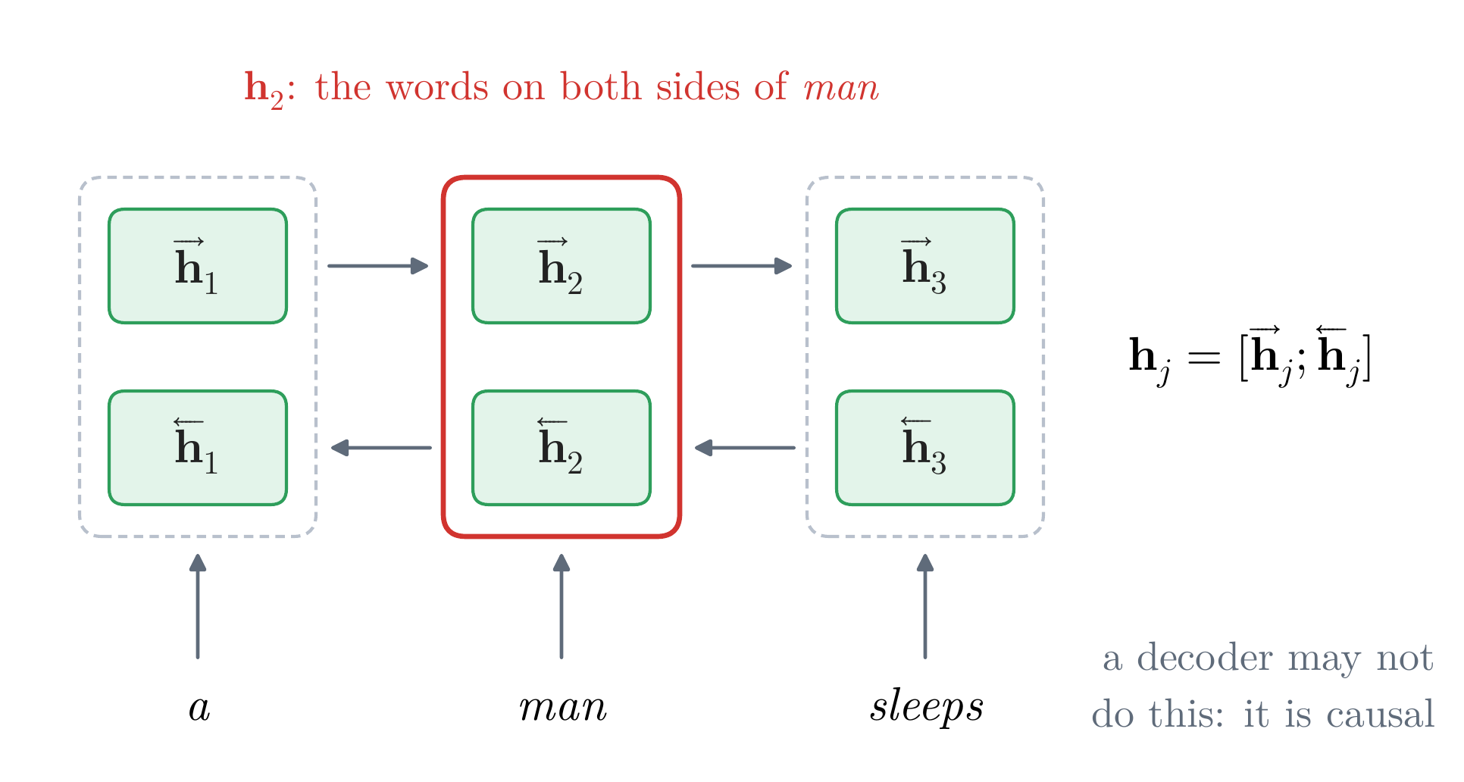
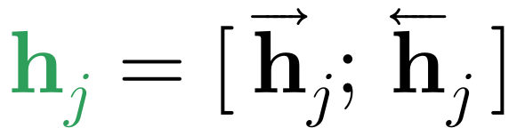
Encoder–Decoders
A bidirectional encoder, a causal decoder
the problem: a left-to-right state knows only the words before it → the fix here: read the source both ways
the source is given in full before translation begins
bidirectional encoder: one RNN left to right, one right to left; join their states
the state of each word summarizes the whole sentence around it
causal decoder: each prediction reads only the words before it; in training a decoder that read ahead would copy its answer
Notes:
Notes §3, 'The recurrent encoder–decoder' (a bidirectional encoder, a causal decoder). The source is given in full before translation begins, so the encoder may read it in both directions (Schuster and Paliwal, 1997): one recurrent network left to right, another right to left, their states joined, so that the state at position j summarizes the whole sentence around word j. The decoder may not do the same with the target: in generation the later tokens do not exist yet, and in training a decoder that read them would learn to copy its answer, since each target is the next position's input. A decoder whose prediction at each position depends only on the tokens before it is called causal or autoregressive. Bahdanau et al.'s attention (Part 3) reads exactly these states.

Slide 21
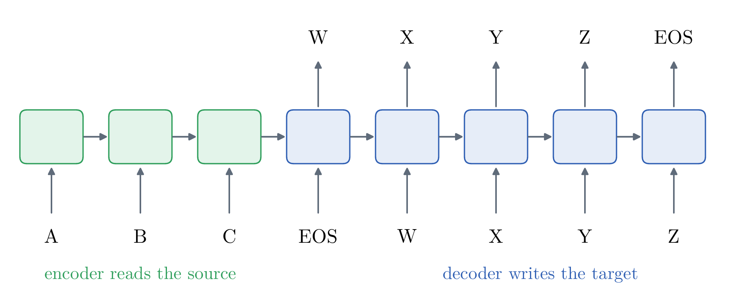
Sequence to Sequence: a Complete Neural Translator
Sutskever et al. (2014): the whole translator
one network is the whole translator, trained on sentence pairs alone
encoder and decoder: deep LSTMs
the final states of the encoder start the decoder: the only route from the source
two choices made it work: depth, and reading the source backwards
redrawn from Sutskever et al. (2014), Fig. 1: read ABC, then write WXYZ
Notes:
Notes §4, opening and 'The model'. Sutskever, Vinyals, and Le (2014) made the encoder–decoder the whole translator, trained on sentence pairs alone and decoded by beam search, with no statistical system around it. Their Figure 1, redrawn: the network reads A B C and EOS, then writes W X Y Z and EOS, each output fed back as the next input. The decoder starts from the encoder's final states; there is no other route from the source to the decoder (no context at every step, no attention). Two choices made it work: depth (next slide) and reading the source backwards.

Slide 22
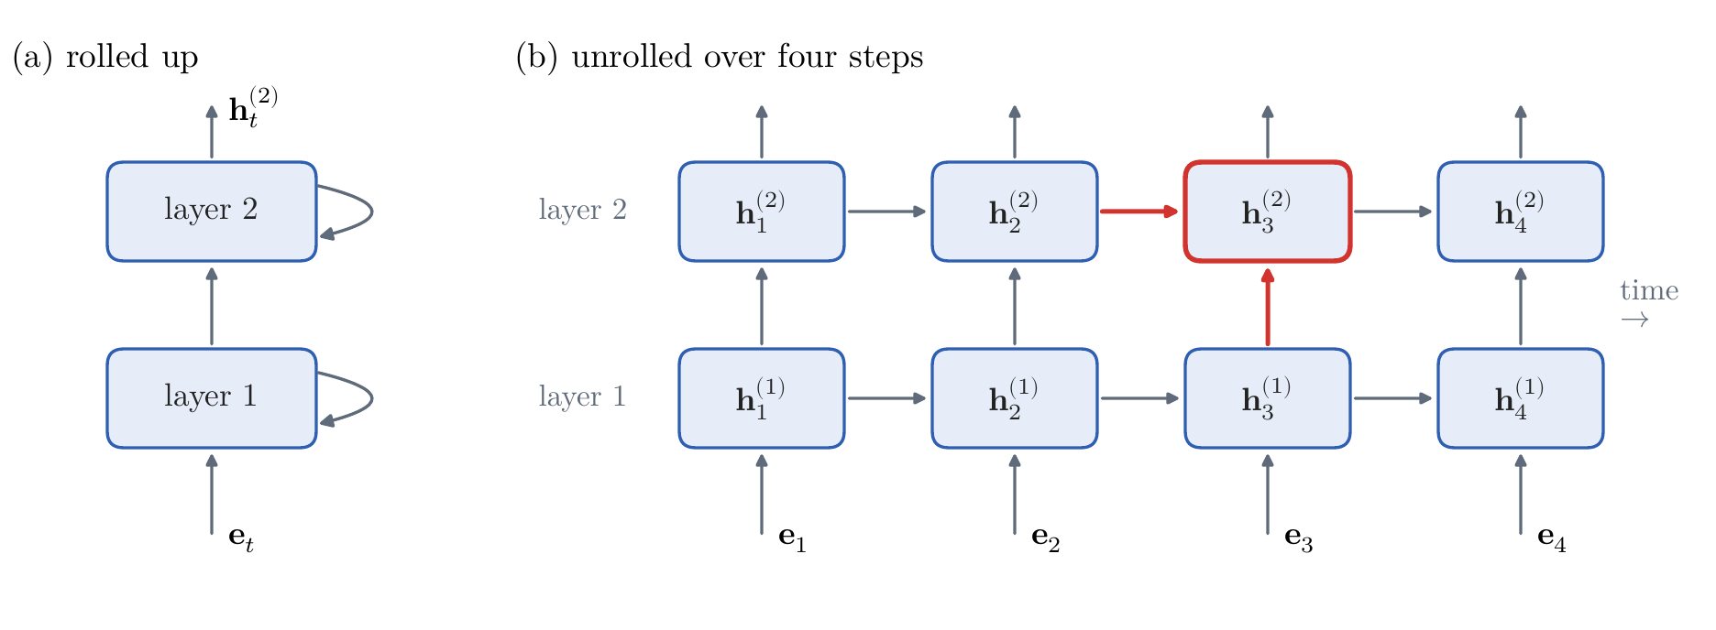
Sequence to Sequence: a Complete Neural Translator
The model: deep recurrent networks
the problem: one layer is shallow → the fix here: stack layers: four, in Sutskever et al.
layer ℓ at step t reads the layer below at step t, and itself at step t − 1
Sutskever et al.: each further layer lowered the perplexity by nearly 10%
Notes:
Notes §4, 'The model', Figure 8. Before the translator, the network it is made of. A deep (stacked) recurrent network: layer ℓ reads, at each step, the state the layer below computed at that step, and its own state from the step before. Information moves forward in time within a layer and upward through the layers; the top layer's state is the output. Stacking was not new (Graves et al., 2013, speech). Sutskever et al.: deep LSTMs 'significantly outperformed shallow LSTMs', each further layer lowering perplexity by nearly 10%.

Slide 23
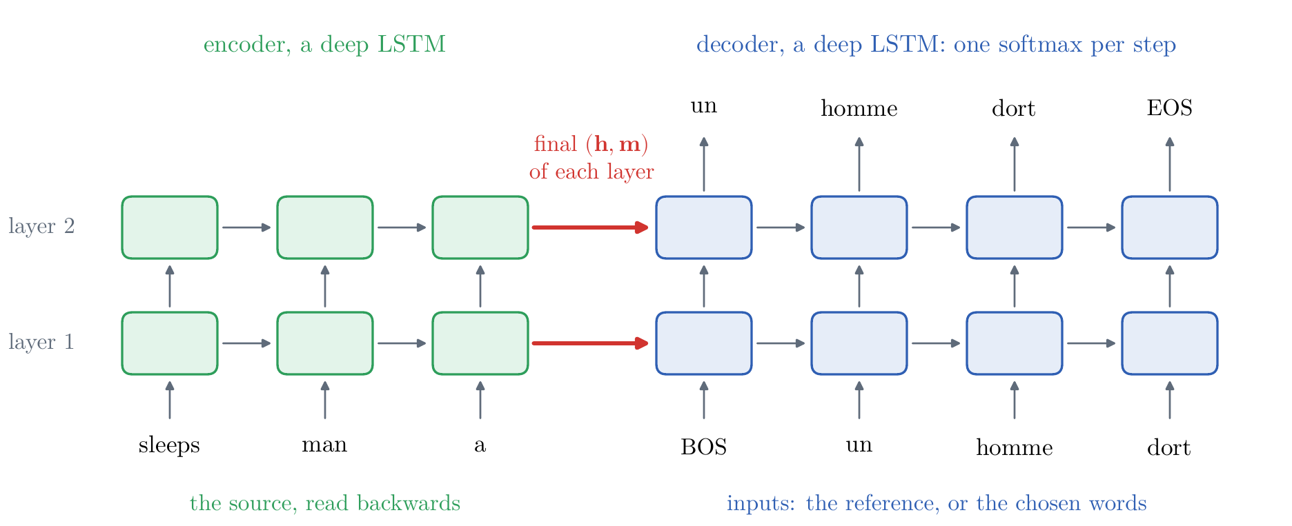
Sequence to Sequence: a Complete Neural Translator
The model: two deep LSTMs
two deep LSTMs: four layers of 1,000 units each
vocabularies: 160,000 English and 80,000 French words
the final states of the encoder start the decoder
no attention: the source arrives only through them
Notes:
Notes §4, 'The model', Figure 9. Sutskever et al. (2014): the recurrent encoder–decoder with a deep LSTM in each role, trained and decoded as in Part 1. Four layers of 1,000 units; 1,000-dimensional word vectors; 160,000 English and 80,000 French words; the decoder starts from the encoder's final states (presumably layer by layer; the paper does not say exactly). No attention: the only route from 'sleeps' to the prediction of 'dort' runs through the encoder steps after it, the final states, and the decoder steps before it.

Slide 24
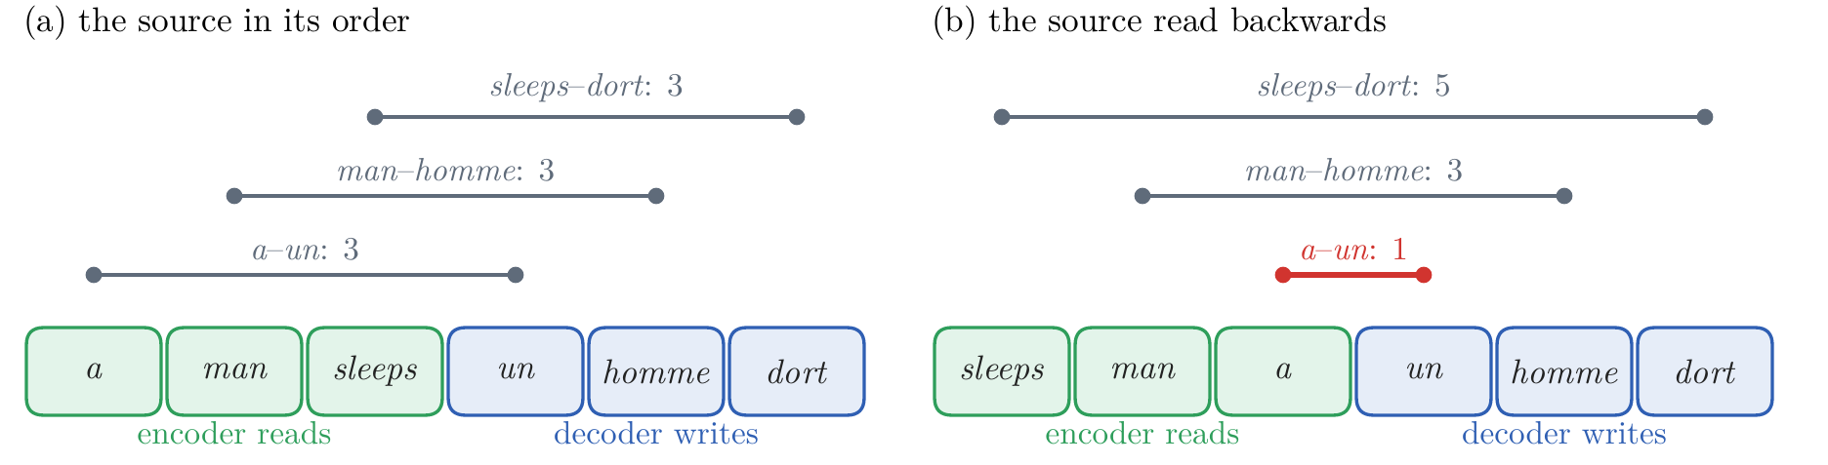
Sequence to Sequence: a Complete Neural Translator
Reading the source backwards
the problem: the first words of the two sentences are far apart → the fix here: read the source backwards
found by experiment: Sutskever et al.'s single model, source read forwards, then backwards: perplexity 5.8 → 4.7, BLEU 25.9 → 30.6
the same average distance between a word and its translation, but the first words are now adjacent
with these short paths, backpropagation “has an easier time” (Sutskever et al., 2014)
Notes:
Notes §4, 'Reading the source backwards', Figure 10. Found by experiment: a single model's perplexity 5.8 → 4.7, BLEU 25.9 → 30.6. Their explanation, offered without 'a complete explanation': each source word is far from its translation; reversing leaves the average distance unchanged but puts the first source words next to the first target words; with these short paths backpropagation 'has an easier time' establishing communication. They expected the end of the translation to suffer; long sentences improved too. Keep the idea of path length: it is the third drawback, and attention shortens the paths.

Slide 25
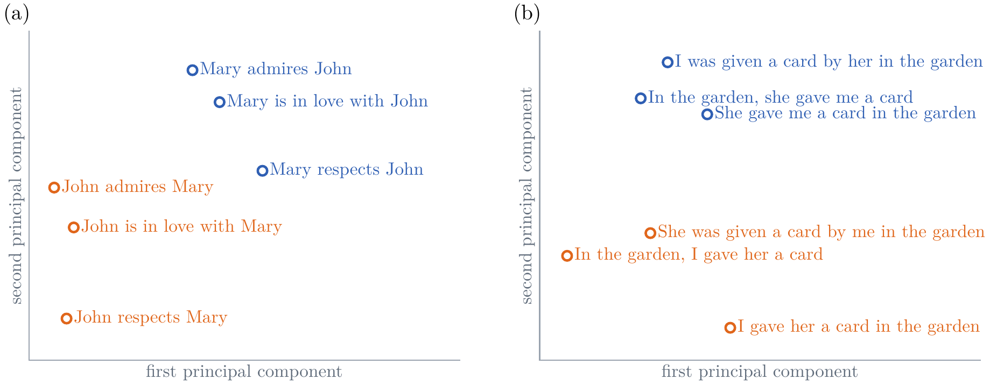
Sequence to Sequence: a Complete Neural Translator
What the summary holds
the experiment: encode a few phrases; project the final states onto two dimensions (PCA)
redrawn from Sutskever et al. (2014), Fig. 2
word order matters: John admires Mary lands far from Mary admires John
voice matters less: She gave me a card lands near I was given a card by her
Notes:
Notes §4, 'What the summary holds', Figure 11, redrawn from Sutskever et al.'s Figure 2 (their coordinates, digitized). The experiment: run a few phrases through the trained encoder, take its final state, and project the states onto their first two principal components. Phrases with the same meaning land together; phrases with the same words in another order land apart, so the summary is not a bag of words. Their words: the representations are 'sensitive to the order of words, while being fairly insensitive to the replacement of an active voice with a passive voice'.

Slide 26
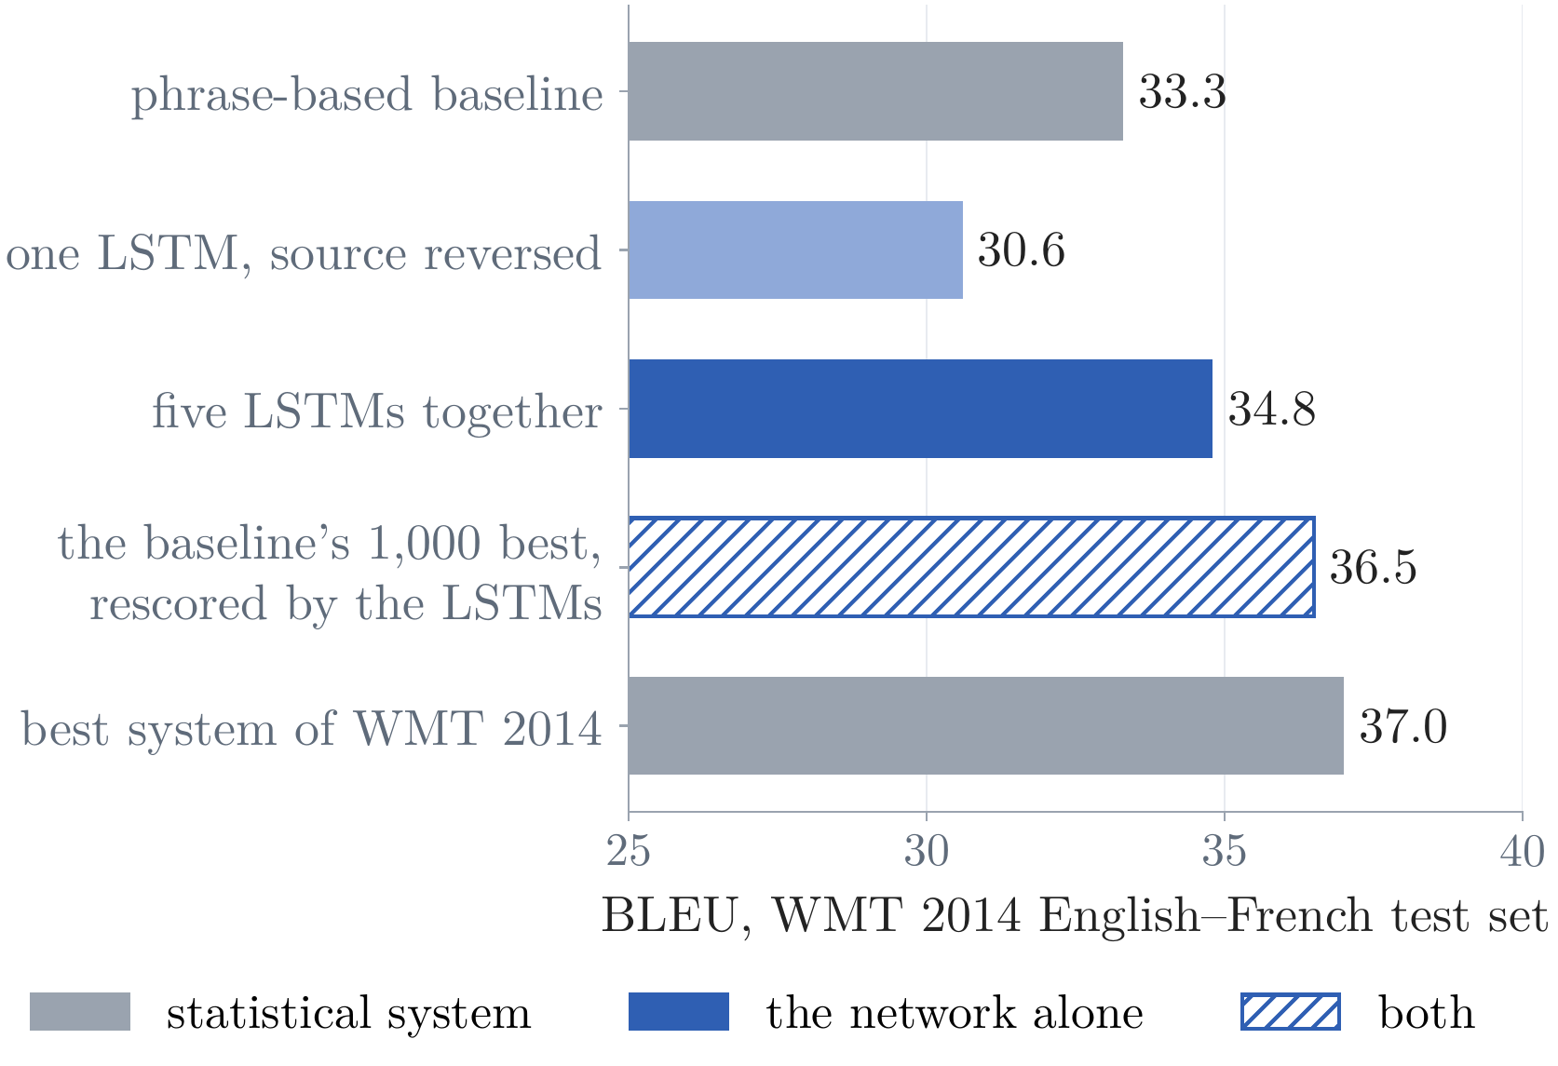
Sequence to Sequence: a Complete Neural Translator
Results
the task: WMT 2014 English–French, 12 million sentence pairs; BLEU on the test set
the model: 384 million parameters, about ten days on eight GPUs
the network alone: five LSTMs together, beam of 12: 34.8, above their phrase-based baseline's 33.3
both: the baseline's 1,000 best translations, rescored by the LSTMs: 36.5; the best system of WMT 2014, a statistical one, listed in their paper: 37.0
“did not suffer on very long sentences”
from pairs alone, it beat a phrase-based system
every number from Sutskever et al. (2014)
Notes:
Notes §4, 'Results'. WMT 2014 English–French, 12 million sentence pairs; 384 million parameters; about ten days on eight GPUs. An ensemble of five reversed models, beam 12: 34.8 BLEU against the phrase-based baseline's 33.3; a single model 30.6; rescoring the baseline's 1,000 best candidates: 36.5, against 37.0 for the best system of that year's evaluation (a statistical system, Durrani et al.'s; Sutskever et al. list it in their table for comparison; it is not theirs). 'Did not suffer on very long sentences.' A neural network trained on sentence pairs alone had beaten a phrase-based baseline. The chart: the numbers of the notes' 'Results' paragraph. Story beat: why change a design that works? The next slides.

Slide 27
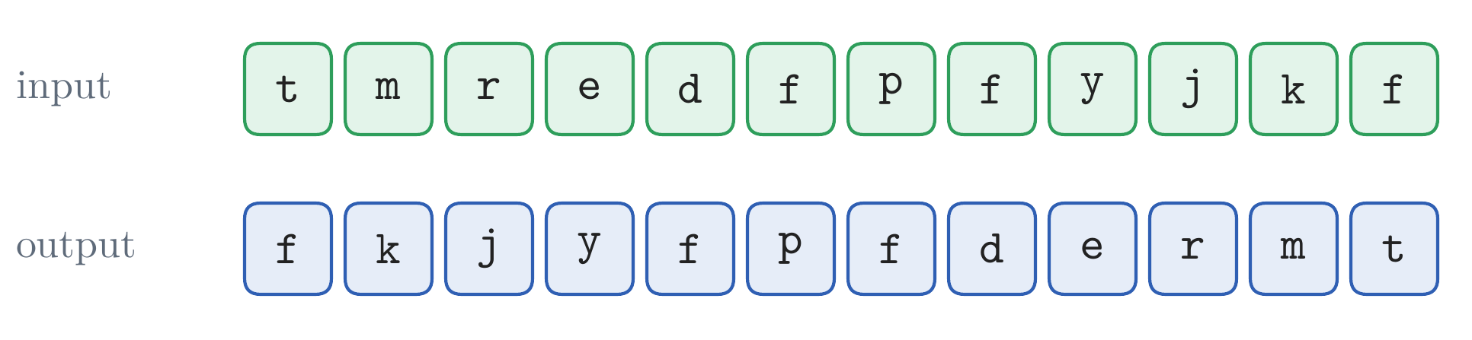
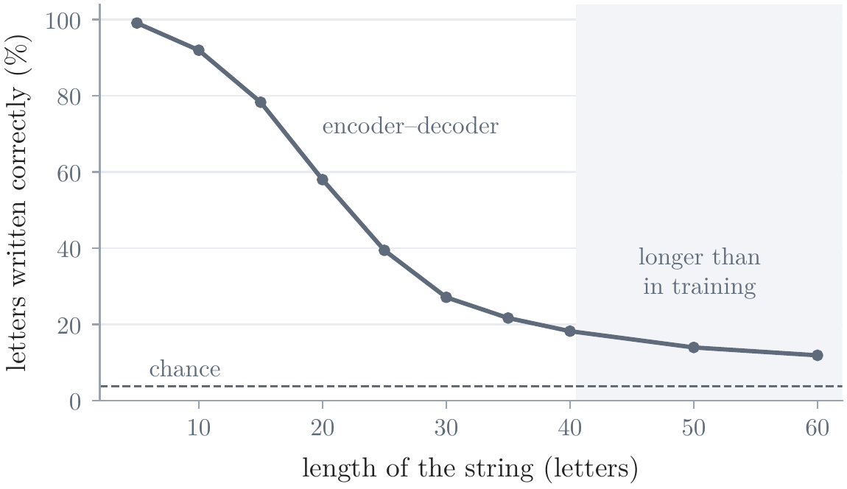
Three Drawbacks of the Recurrent Encoder–Decoder
The fixed-size summary
our own experiment (not from the papers): write a string of 1 to 40 random letters backwards
it needs memory and no knowledge of language
encoder–decoder: bidirectional LSTM encoder, LSTM decoder started from its final states; 4,000 steps of 64 random strings
measured: letters written in the right place
10 letters: 92%; 20: 58%; 40: 18%
access to the source: the longer the string, the less room per letter
ours: the encoder–decoder on the reversal task
Notes:
Notes §5, opening, and 'The fixed-size summary', Figure 12 (the gray curve; the red one comes with attention), and §4's table of the two small models. Sequence to sequence works, and at scale it works well. Its design still has three drawbacks: the fixed-size summary, sequential computation, and long paths; they are worth keeping apart, because the remedies of 2014–2017 addressed them separately. The first. The experiment, ours: reversing a string needs nothing but memory, so it isolates the limit. Strings of 1 to 40 random letters; encoder a bidirectional LSTM of 64 units each way, decoder an LSTM of 128 units started from the encoder's final states; 4,000 steps of 64 new random strings. Measured: the share of letters written in the right place. Ask before the plot: trained on strings of up to 40 letters, how well does it reverse 40 letters? 92% of letters right at 10, 58% at 20, 18% at 40. The more there is to store, the less survives the passage through a state of fixed size.

Slide 28
Three Drawbacks of the Recurrent Encoder–Decoder
The fixed-size summary in our translator
our translator, no attention: Multi30k, 4.0 million parameters, about 9 minutes of training on two processor cores
greedy decoding: 19.5 BLEU on the 1,000 test captions
source a girl in karate uniform breaking a stick with a front kick .
output une fille en tenue de bain rouge regardant un objet dans un champ .
“… in a red swimsuit looking at an object in a field”: fluent, and only its start follows the source
Flickr30k image 101362133
Notes:
Notes §4, 'Two small encoder–decoders' (the table), and §5. Our Multi30k translator without attention: a bidirectional LSTM encoder of 128 units each way, an LSTM decoder of 256 units started from the encoder's final states; 4.0 million parameters; 3,000 steps of 64 pairs; about 9 minutes on two processor cores. Decoding greedily, 19.5 BLEU on the 1,000 test captions. On the karate caption it writes 'une fille en tenue de bain rouge regardant un objet dans un champ .', 'a girl in a red swimsuit looking at an object in a field': fluent French whose first words follow the source and whose rest does not. Photograph: Flickr30k image 101362133 (Young et al., 2014), with its Multi30k caption.

Slide 29
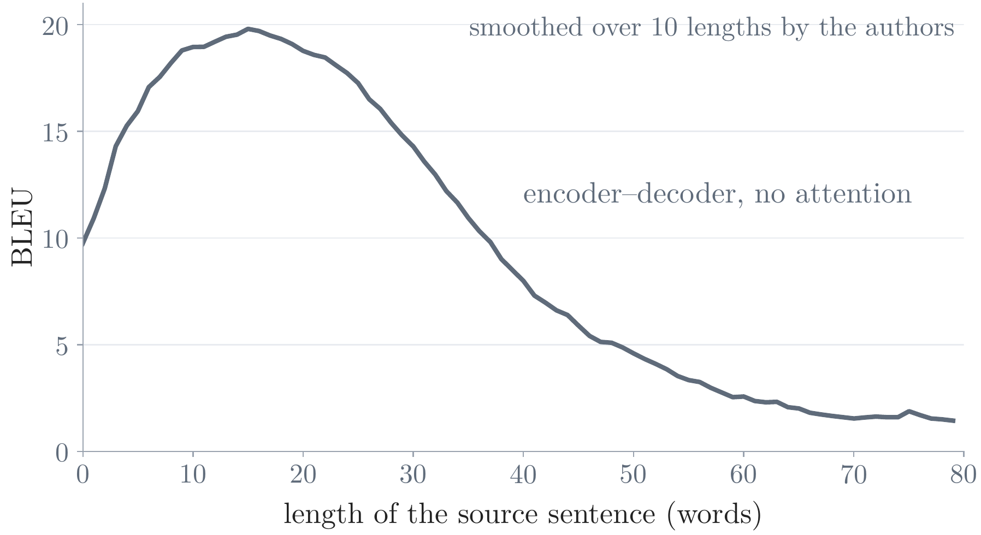
Three Drawbacks of the Recurrent Encoder–Decoder
The fixed-size summary in translation
Cho et al. (2014b): an encoder–decoder without attention, trained on English–French
the plot: its BLEU on the test sentences of each length, against the length of the source sentence
highest on short sentences; it “degrades rapidly” as they grow longer
a pressure, not a theorem: Sutskever et al.'s larger model degraded only on the longest
redrawn from Cho et al. (2014b), Fig. 4a (length counted on the source)
Notes:
Notes §5, 'The fixed-size summary'. Cho et al. (2014b), 'On the properties of neural machine translation', Fig. 4a, redrawn from the paper's vector data (scripts/cho_fig4a.json): an encoder–decoder without attention (RNNenc) trained on English–French; BLEU on the test sentences of each length, smoothed by the authors over a window of 10; their figure also counts the length on the reference or on both, with nearly the same curves (not in the notes). Read it: each point is the BLEU of the sentences of one length; short sentences score best, and the score falls steadily as the sentences grow. Their abstract: the neural model 'performs relatively well on short sentences without unknown words, but its performance degrades rapidly as the length of the sentence and the number of unknown words increase'. Sutskever et al.'s much larger model, reading reversed, found no degradation below 35 words and only a minor one on the longest: a pressure that depends on the size of the summary, the training, and the data, not a theorem. Picture: Cho et al. (2014b), Fig. 4a, reproduced with attribution.

Slide 30
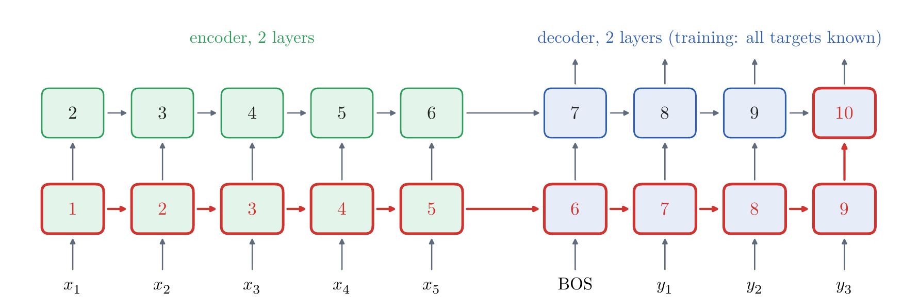
Three Drawbacks of the Recurrent Encoder–Decoder
Sequential computation and long paths
each box carries the earliest step at which it can be computed
one position at a time: each state waits for the one before, even in training, when all the inputs are known
long paths: from the first source word to the first prediction, every step in between
n source tokens, r decoder positions, L layers
GNMT (2016): about six days on 96 GPUs
Notes:
Notes §5, 'Sequential computation and long paths', Figure 13. Each box is numbered with the earliest step at which it can be computed. The state at position j waits for the state at j − 1, in the encoder and, even in training, in the decoder. With n source tokens, r = m + 1 decoder positions and L layers: n + r + L − 1 dependent steps, growing with the sentence, not with the width of the layers. GNMT (2016): about six days on 96 GPUs for one model. Long paths: the first source word reaches the first prediction through every step in between, and a gradient usually shrinks along such paths (Lecture 2). Board: n + r + L − 1 on the figure.

Slide 31
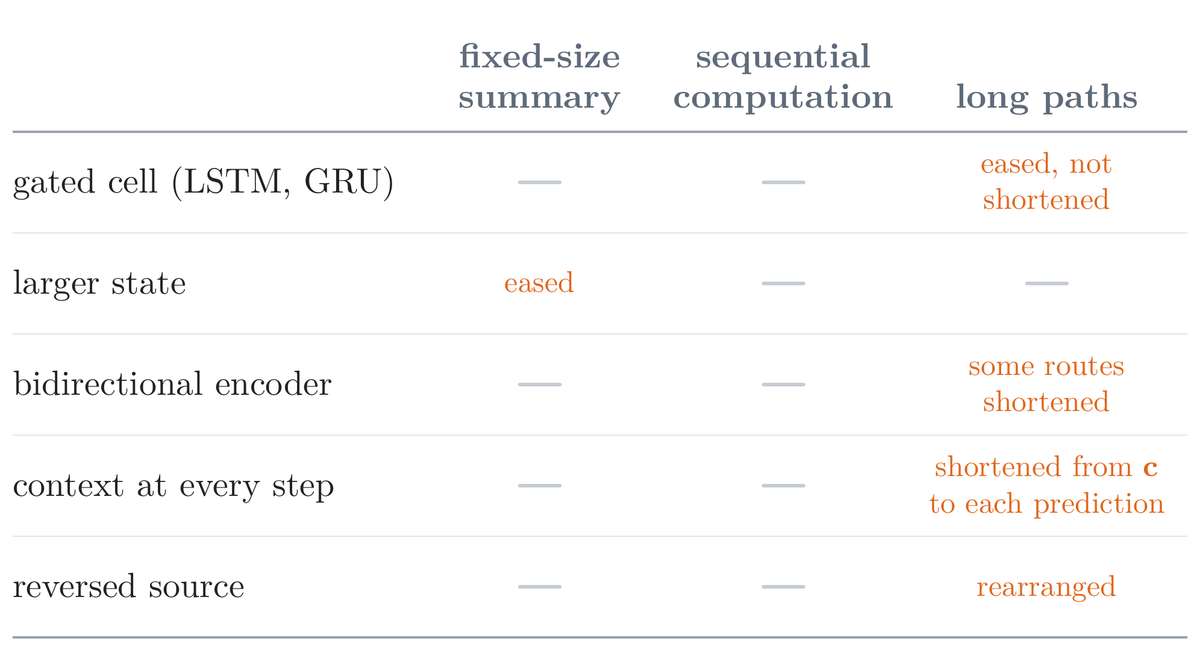

Three Drawbacks of the Recurrent Encoder–Decoder
Familiar remedies, and what fixed the drawbacks
each remedy of 2014 changed at most one of the three drawbacks
none gave the decoder more than one summary of the source, or computed a sequence at once
attention: a fresh read of the source at every step (Part 3)
convolution, then self-attention: all positions of a layer at once, in training (Part 4)
Notes:
Notes §5, 'Familiar remedies' (the table), and the openings of §§6 and 8. Each remedy available in 2014 changed at most one of the three drawbacks. Gating eases the long paths without shortening them; a larger state eases the summary; a bidirectional encoder's final states lie at both ends of the sentence, but the words in the middle are still about n/2 steps from both; the context at every step shortens the path from c to each prediction; reversal rearranges the paths. None gives the decoder more than one fixed summary of the source, or lets the states of a sequence be computed at once. The last two rows (second picture) are the answers of the rest of the lecture: attention frees the decoder from the single summary and shortens the paths from the source to the target, but leaves the computation sequential (Part 3); convolution and then self-attention compute all positions of a layer at once in training, and self-attention joins every permitted pair of positions in one step (Part 4).

Slide 32
Break
Notes:
Break, five minutes. Next: attention, the answer to the first drawback.

Slide 33
Lecture 3: Sequence Modeling, Translation, and Attention
1. Sequence tasks and translation
sequence modeling; machine translation, how it is learned, decoded, and scored
2. Recurrent encoder–decoders
the encoder–decoder framework; models improved one after another; their drawbacks
3. Attention
its inception and its variants
4. Beyond recurrence
convolutional sequence models, translation from attention alone, self-attention and the Transformer
Notes:
Part 3 (notes §§6–7), about 36 minutes: attention, the answer to the fixed-size summary. The core of the lecture.

Slide 34

Attention
The idea
the problem: one summary of fixed size for the whole source (Part 2) → the fix here: attention
“a fixed-length vector is a bottleneck”
Bahdanau, Cho, and Bengio (2015)
keep a state for every source word (Bahdanau et al.: a bidirectional encoder, each state about its word and the words around it)
before each word, read them again: a weighted average of the states
the weights: computed from the decoder's state; learned with the rest
Notes:
Notes §6, opening, and Appendix B.3. Bahdanau, Cho, and Bengio (2015; posted September 2014): 'we conjecture that the use of a fixed-length vector is a bottleneck in improving the performance of this basic encoder-decoder architecture'. The idea in three lines: keep a state for every source word (a bidirectional encoder, so each state summarizes the sentence around its word); before each target word, read them again, as a weighted average; compute the weights from the decoder's state, with a small network trained with the rest. In the picture: the forward and backward states of each word (green), the weights α_t,j (red), their sum c_t, and the decoder states s at the top. The picture is a simpler version of their Figure 1: one direction in the encoder (lower left), the decoder (upper right), and the read before writing dort: every encoder state, weighted.

Slide 35




Attention
The read
1. score each source state
2. normalize
3. average
a new context at every step, from all the source states
Notes:
Notes §6, 'The read', Figure 14. The encoder keeps a state for every source position; before predicting y_t the decoder scores every position against its previous state, normalizes the scores into weights, and averages. The context now has an index t: it is recomputed at every step, from all n states. In the picture, the read before predicting dort: weights 0.08, 0.17, 0.75 (illustrative).

Slide 36


Attention
The score, and the context in the decoder
the score: a small network with one hidden layer, trained with the rest (additive attention)
the query: the decoder's previous state; it has not read the last word written
each state: compared with the query, then returned (the variants split the two jobs: a key and a value)
the context enters the decoder's update and its output
a set: reorder the source, and the read is the same; order reaches the read only through the states
Notes:
Notes §6, 'The read'. Bahdanau et al.'s score is a small network with one hidden layer, trained with the rest (additive attention). The query is s_{t−1}: it has read the targets up to y_{t−2}, not y_{t−1}. Each h_j does two jobs: compared with the query, and returned when read; §7 separates them into a key and a value. The context enters the decoder's update and its output layer. The read sees a set: permuting the source permutes the weights the same way and leaves c_t unchanged; word order reaches the read only through the states. Remember this for Part 4.

Slide 37



Attention
Training without alignment labels
nobody labels which word matches which
the loss of the next word reaches every score through the context
weight moves between positions; it is never created
the correspondences emerge from the loss alone
the picture: our reversal network with attention, on one 12-letter string; each row sums to 1
each square: the weight on source letter j (column) when writing letter t (row)
Notes:
Notes §6, 'Training without alignment labels', Figure 16. The message: attention learns where to read from the translation loss alone; nobody labels which word corresponds to which. With γ_t the gradient reaching the context, ∂L/∂e_tj = α_tj (h_j − c_t) γ_tᵀ: the gradient pushes up the score of a position whose state lies, seen from the context, in the direction that lowers the loss; the pushes sum to zero, so weight moves between positions and is never created; each is scaled by the position's weight. To first order, training moves each read toward the positions that help predict the next word. The picture: our reversal network trained again with attention; its weights for one 12-letter string trace the anti-diagonal of a reversal, and nothing told it to read backwards. Appendix A.1 works the gradient through the example.

Slide 38

Attention
Results: Bahdanau et al. (2015)
the experiment: WMT 2014 English–French, 30,000-word vocabularies; the same encoder–decoder with and without attention, trained on sentences of up to 30 or 50 words
the plot: BLEU on the test sentences of each length; red with attention, gray without (both trained on sentences of up to 50 words)
without attention, BLEU falls as the sentences grow; with attention it stays level, “even with sentences of length 50 or more”
+8.9 BLEU with attention (26.75 against 17.82)
trained longer, it passed the phrase-based system on sentences without unknown words
redrawn from Bahdanau et al. (2015), Fig. 2 (RNNsearch-50 and RNNenc-50)
Notes:
Notes §6, 'Results' (the table). Bahdanau et al. trained on the 348 million words of the WMT 2014 English–French data, with vocabularies of the 30,000 most frequent words in each language, on one GPU for about five days per model. RNNenc is the encoder–decoder without attention, RNNsearch the attention model; -30 and -50 the longest training sentences. With the same data, vocabularies, and training, attention gained 7.57 BLEU (up to 30 words) and 8.93 (up to 50: 26.75 against 17.82); RNNsearch-50 showed 'no performance deterioration even with sentences of length 50 or more'; on sentences without unknown words, the model trained longer passed the phrase-based system (36.15 against 35.63). Do not rank these numbers against Sutskever et al.'s (larger models, ensembles): the evidence is the comparison within each study. Picture: Bahdanau et al. (2015), Fig. 2, redrawn from the paper's vector data (scripts/bahdanau_fig2.json), showing the two models trained on sentences of up to 50 words (the paper also shows the -30 models).

Slide 39


Attention
Results: our small models
the experiment: our two models of Part 2, trained again with attention; same data, sizes, steps, and decoding
reversal: over 99% of letters right up to 35, against 18% at 40 without
translation: 49.2 BLEU against 19.5, by caption length
ahead at every length: 37 against 12 even on the 56 longest captions
Notes:
Notes §6, 'Results' (Attention in the small models), Figures 12 and 17: our two small models trained again with attention, with the same data, sizes, steps, and decoding. Reversal: more than 99% of letters up to 35, 98% at 40, against 18% without; beyond the training lengths it fails too, more gradually (77% at 50, 36% at 60). Translation (4.4 million parameters, about 18 minutes of training): 49.2 BLEU against 19.5, and ahead at every length (37 against 12 on the 56 captions of 21 tokens or more): the gap is at every length, so the fixed-size summary is not only a problem of long sentences. Single runs; the attention model also feeds the source to every step, which a control would separate.

Slide 40

Attention
Reading the weights: the paper
the picture: RNNsearch-50's weights for every read of one test sentence
each square: the weight α that the read before French word t (its row) gives English word j (its column)
from 0 (white) to 1 (dark red); each row sums to 1
mostly diagonal: word for word
European Economic Area → zone économique européenne: the order reversed (outlined)
learned from the translation loss alone
redrawn from Bahdanau et al. (2015), Fig. 3a
Notes:
Notes §6, 'Results'. Bahdanau et al. (2015), Fig. 3a, redrawn from its digitized weights: the weights of RNNsearch-50 for one test sentence; each row is a French word written, each column an English word read; darker is more weight, each row summing to one. Mostly diagonal: word for word. The European Economic Area becomes la zone économique européenne (outlined): the decoder reads Area first, then goes back for Economic and European (the paper's §5.2.1; not in the notes). Nothing in the training data marked these correspondences.

Slide 41


Attention
Reading the weights: where, not why
our translator (the attention model of these slides), decoding the karate caption greedily
the read is right: at the step that should write brisant (‘breaking’), 0.73 of the weight is on breaking
the choice is not the read alone: the word comes from the context together with the decoder's state (what it has written) and the output layer
here they spoil it: the model is unsure, and its most probable word, faisant (‘doing’), has probability 0.10
the weights show where the context came from, not why the word was chosen
causes need interventions: holding for breaking gives tenant, and nothing else changes
the model's translations, with one source word changed
Notes:
Notes §6, 'Reading the weights' (last paragraph). The weights show where the context came from, not why the decoder chose its word. Translating the karate caption by greedy decoding, the model writes faisant (‘doing’) where the reference has brisant (‘breaking’). At that step it puts 0.73 of its weight on breaking, yet it is unsure what to write: faisant, its most probable word, has a probability of only 0.10. It read the right word and still chose a poor one: the choice also depends on the decoder's state, the previous word, and the output layer, and the state it read at breaking carries the words around it too. To show that a source word caused a prediction, intervene (Jain and Wallace, 2019; Wiegreffe and Pinter, 2019): replacing breaking by holding changes faisant to tenant, 'holding', and leaves the rest of the translation unchanged. The Week 3 notebook tries both kinds of intervention, at home.

Slide 42


Attention Variants
Queries, keys, and values
query: what the reader is looking for
key: what an item is found by
value: what the item returns when read
a dictionary: returns the value of the one key that matches the query
attention: compares the query with every key, turns the comparisons into weights, and returns the weighted average of the values
in Bahdanau et al., the key and the value of a position are the same h; they need not be (Part 4)
the words come from memory networks: the Neural Turing Machine (2014) looked up a row of its memory with a “key vector”; key–value memory networks (2016)
Notes:
Notes §7, 'Queries, keys, and values', Figure 19. Between 2015 and 2017 attention appeared in many forms; one vocabulary covers them all, and Lecture 4 is built on it. A dictionary returns the value stored under the key that matches the query; attention compares the query with every key, turns the comparisons into weights, and returns the weighted average of the values. In Bahdanau et al. the key and the value of a position are the same h_j; they need not be (ConvS2S, Part 4). Where the words come from (notes §7 and Appendix B.3): networks with an external memory. The Neural Turing Machine (Graves et al., 2014) found a location by emitting a 'key vector' compared with every row of its memory: a soft lookup; end-to-end memory networks (Sukhbaatar et al., 2015) stored each sentence twice, once to be compared and once to be returned; key–value memory networks (Miller et al., 2016) named the two. The Transformer: attention is 'mapping a query and a set of key-value pairs to an output'. One sentence, and move on.

Slide 43




Attention Variants
How to score
dot product: no parameters; the two sizes must match
bilinear: a dot product after learned maps
additive: a small network (Bahdanau et al.)
all queries against all keys: one matrix product, what parallel hardware does fastest (dot and bilinear)
Lecture 4: the bilinear score, factored and scaled
Notes:
Notes §7, 'How to score'. In translation the query is a decoder state s and the keys are encoder states h_j. Dot product: no parameters, needs d_s = d_h; depends on lengths, unlike the cosine. Bilinear: a learned matrix; factored as W_Q W_Kᵀ it is a dot product of projections in d_k dimensions, with (d_s + d_h) d_k parameters: the form Lecture 4 builds on. Additive: a small network whose tanh makes the score nonlinear. Dot and bilinear scores of many queries against many states are one matrix product, Q Hᵀ: what parallel hardware does fastest. Luong et al. (2015): dot best for global, bilinear for local; Britz et al. (2017): additive slightly better; the Transformer attributed the gap to large dot products and scaled them (Lecture 4).

Slide 44



Attention Variants
Where and how to read
global, soft
every position; the average under the weights
local
a window around a predicted center
hard
one sampled position; no derivative
soft and global became the standard: plain backpropagation
Notes:
Notes §7, 'Where and how to read', Figure 20. Illustrative weights over twelve source positions. Global: every position, cost proportional to n per step. Local (Luong et al., 2015): a window around a center predicted from the state, the weights multiplied by a Gaussian; still soft, still trained by backpropagation; a word outside the window cannot be read at that step. Hard (Xu et al., 2015): sample one position; no derivative, so it needs a gradient estimate of the kind Lecture 6 develops (Appendix A.3). The soft version is 'smooth and differentiable', so 'learning end-to-end is trivial by using standard back-propagation'; it became the standard. Global or local and soft or hard are independent choices.

Slide 45


Attention Variants
When to read
Bahdanau: read with the previous state, then update
Luong: update, then read with the new state
input feeding: the read joins the next step's input
the same read, placed differently
Notes:
Notes §7, 'When to read', Figure 22. Bahdanau et al.: the query is the previous state, and the read comes before the update; the query has not read y_{t−1}. Luong et al. (2015): update with the previous word first, read with s_t, combine in an attentional state s̃_t = tanh([c_t; s_t] W_c), predict from it; the read no longer enters the recurrence, so input feeding joins s̃_t to the next input. Two placements of the same read, not two kinds of attention.

Slide 46

Attention Variants
Attention beyond translation: images
a caption generator: image regions are the source; the decoder reads them before each word
Xu et al. (2015), Fig. 3: where the model read (white) when it wrote the underlined word
the same read, over image regions instead of source words
the read is everywhere; the states it reads still come one after another
Notes:
Notes §7, 'Where and how to read', Figure 21, and Appendix B.3. Xu et al. (2015), 'Show, attend and tell': a caption generator whose encoder is a convolutional network over a grid of image regions and whose recurrent decoder reads the regions with attention before each word; the white areas are where it read when it wrote the underlined word (a frisbee, a dog, a stop sign). They built both a soft and a hard (sampled) read. The read does not care what the keys and values come from: words, image regions, speech frames. Between 2014 and 2017 the read spread to parsing, speech, memory networks, and attention within one sequence (notes Appendix B.3, Figure 31). Transition to Part 4: the read is everywhere, but the states being read are still computed one after another. Picture: Xu et al. (2015), Fig. 3, reproduced with attribution.

Slide 47

Attention
Attention at scale: Google's translator (2016)
GNMT (Wu et al., 2016): the attention model, made large
8 LSTM layers in the encoder, 8 in the decoder, with residual connections; word pieces, so no unknown words
one model: 39.0 BLEU English–French
in production from September 2016, replacing the phrase-based system for Chinese–English
but slow to train: about six days on 96 GPUs for one model
redrawn and simplified from Wu et al. (2016), Fig. 1
Notes:
Notes Appendix B.3, 'Recurrence at scale', and §5. Google's Neural Machine Translation system (Wu et al., 2016), GNMT, was the attention model of §6 made large: eight LSTM layers in the encoder, the first of them bidirectional, and eight in the decoder, residual connections between the layers, attention from the decoder to the top of the encoder, and a vocabulary of word pieces, which removed the unknown words that had held back Bahdanau's model. A single model scored 39.0 BLEU on English-to-French and 24.6 on English-to-German. In September 2016 it replaced the phrase-based system for Chinese to English. About six days on 96 GPUs to train one English-to-French model (§5): recurrence at scale was slow. The picture (redrawn and simplified from the paper's Figure 1; not in the notes): attention reads all the encoder's top states, takes its query from the bottom decoder layer, and sends its context to the decoder layers above; each layer of one copy of the model on its own GPU. Its authors: without residual connections, 'simple stacked LSTM layers work well up to 4 layers, barely with 6 layers, and very poorly beyond 8 layers'. One minute; the bridge to Part 4 (slow to train); a cut candidate.

Slide 48
Lecture 3: Sequence Modeling, Translation, and Attention
1. Sequence tasks and translation
sequence modeling; machine translation, how it is learned, decoded, and scored
2. Recurrent encoder–decoders
the encoder–decoder framework; models improved one after another; their drawbacks
3. Attention
its inception and its variants
4. Beyond recurrence
convolutional sequence models, translation from attention alone, self-attention and the Transformer
Notes:
Part 4 (notes §§8–10), about 18 minutes: the second problem. Attention gave the decoder the source, but every state was still computed after the one before. Convolution, then attention alone, then self-attention and the Transformer, which Lecture 4 builds.

Slide 49



Convolutional Sequence Models
Convolution over a sequence
the problem: one position at a time, even in training (Part 2) → the fix here: convolution
each state from a small window of the layer below, not from the state before
the same weights at every position
no dependence along the layer: all outputs at once
Notes:
Notes §8, 'Convolution over a sequence'. Story beat: can the states of a sequence be computed without a chain? Networks for images never had one: each pixel's features come from a small patch of the layer below. The roles of Part 2 stay; only how the states are computed changes: each from a small window of the layer below, not from the state before. A centered window for an encoder; a causal window, ending at its own position, for a decoder (zeros in front). Two properties: the same weights at every position (Lecture 2's fixed-window model was a convolution in disguise); no dependence along the layer, so when a layer's inputs are available, all its outputs are computed at once: L layers, L steps, whatever the length.

Slide 50

Convolutional Sequence Models
A small convolutional translator: training
encoder: one centered convolution; all source states at once
decoder: two causal convolutions, then a read of the source and a softmax, at all positions at once
Notes:
Notes §8, 'A small convolutional translator', Figure 23a. a man sleeps → un homme dort. Encoder: one centered convolution of width 3; all three states at once. Decoder in training: inputs BOS, un, homme, dort (the input at position t is y_{t−1}); layer 1 from inputs t − 1 and t; layer 2 from layer 1 at t − 1 and t, so s^(2)_t never sees y_t. Each top state is the query of a dot-product read over h_1, h_2, h_3 (keys and values), which returns c_t; softmax([s^(2)_t; c_t] U) gives q(y_t | y_<t, x). Every layer, read, and softmax computes all four positions at once: one step per layer, plus the read and the prediction, however long the target.

Slide 51

Convolutional Sequence Models
A small convolutional translator: generation
one new column per word; the earlier columns are kept
one word at a time, as for every model: each input is the word chosen before
Notes:
Notes §8, 'A small convolutional translator', Figure 23b. In generation the words are not known in advance. Step 1: from BOS, compute the column, read, and choose un. Step 2: append un, compute the new column, choose homme. Step 3 (drawn): append homme; the columns of steps 1 and 2 are kept, since no position reads the positions after it; only the new column is computed, and dort is chosen. Every model generates one word at a time, because each input is the word chosen before.

Slide 52



Convolutional Sequence Models
How far a convolution reads
L layers of width k reach
with dilations 1, 2, 4, …
distance costs layers
position 16 from position 1, width 3: 15 centered layers, 8 causal
attention: one step
Notes:
Notes §8, 'How far a convolution reads', Figure 24. L layers of width k see 1 + (k − 1)L positions; a centered window reaches (k − 1)L/2 to each side, a causal one (k − 1)L back. For the output at position 16 to depend on the input at position 1 with width 3: 15 centered layers or 8 causal ones. Dilations 1, 2, 4, …: 1 + (k − 1)(2^L − 1); ten causal layers of width 3 see 21 positions undilated, 2,047 dilated. Still, reaching farther costs layers; recurrence reaches every earlier position along a chain, attention in one step.

Slide 53

Convolutional Sequence Models
ByteNet: convolution only
dilated convolutions, no recurrence, no attention
the decoder sits on the encoder, position by position
access to the source by position, not by content
23.75 BLEU, English–German, character by character
Kalchbrenner et al. (2016), Fig. 1: ByteNet
Notes:
Notes §8, 'Two convolutional translators'. ByteNet (Kalchbrenner et al., 2016): stacks of dilated convolutions and nothing else, no recurrence and no attention; the decoder (blue in their figure) sits on top of the encoder (red), position by position, so its access to the source is by position, not chosen by content. WMT 2014 English-to-German, character to character: 23.75 BLEU. Its dilated causal convolutions came from WaveNet, a model of raw audio from the same group. Picture: Kalchbrenner et al. (2016), Fig. 1, reproduced with attribution.

Slide 54


Convolutional Sequence Models
ConvS2S
ConvS2S (Gehring et al., 2017): the small translator's design, with three changes
1. gated blocks: a convolution, a gate on each number, and a residual connection
2. position vectors added to the word vectors
3. a read in every decoder layer: keys k, values k + e, what was computed and which word
WMT 2014, single models: 40.51 BLEU English–French and 25.16 English–German, above Google's recurrent 38.95 and 24.61; “an order of magnitude faster”
the limit: distant positions meet only through many layers
Notes:
Notes §8, 'Two convolutional translators', Figure 25a. ConvS2S (Gehring et al., 2017): stacks of gated convolutional blocks (a gated linear unit and a residual connection, panel b in the notes), learned position vectors, and a read of the encoder in every decoder layer, with keys the encoder outputs k_j and values k_j + e_j (what the encoder computed, plus which word was there). Single models: 25.16 BLEU English–German and 40.51 English–French, above Google's recurrent system (24.61, 38.95), and 'an order of magnitude faster'. The limit: a dependency between distant positions passes through as many layers as it takes to span the distance (Figure 24), and the weights connecting two positions depend on their offset, not on their content. The Transformer came five weeks later.

Slide 55

Translation from Attention Alone
The model
1. query from the previous target word
2. read the source: dot products, softmax, average
3. predict from the read and the previous word
no encoder computation, no decoder state: it reorders by content
Notes:
Notes §9, 'The model' and 'One translation by hand', Figure 26. Story beat: can attention alone translate, with no encoder computation and no decoder state? Four tables of vectors (keys, values, queries, word vectors) and an output layer. On 'karate uniform' with hand-chosen 2-D keys (first coordinate: a noun; second: a modifier): the query of BOS asks for the noun and reads uniform → tenue; tenue and de ask for the modifier and read karate → de, karaté; karaté asks for nothing → EOS. The reordering comes from content, not from position. In training every query is known in advance, so all reads are one matrix product: S = QKᵀ, A = softmax(S), C = AV.

Slide 56



Translation from Attention Alone
What it lacks
in training: a few matrix products; no position waits for another
word order: dog bites man reads like man bites dog
the context of a source word: the same bank, by the river or raising rates
the target so far: after each un, the same read
the answers: positions; self-attention in the encoder; causal self-attention in the decoder
Notes:
Notes §9, 'What the toy cannot do'. In training, teacher forcing supplies every previous word, so the reads of all target positions are a few matrix products; no position waits for another. What it lacks: word order (the read depends only on the unordered set of (key, value) pairs, recall 'a set' in Part 3); the context of a source word (bank by the river or raising rates); the target so far (after each un, un bâton and un coup de pied, the same query, the same read, the same word). The three answers: positions; self-attention in the encoder; causal self-attention in the decoder.

Slide 57




Self-Attention and the Transformer
Self-attention
a sequence reads itself
encoder: every position reads every position
decoder: causal, itself and the positions before
all positions at once, like convolution; any position in one step, like cross-attention
Notes:
Notes §10, 'Self-attention', Figure 27. Every position i emits a query, every position j offers a key and a value; position i's output is the read over all j (encoder) or j ≤ i (causal decoder). The Transformer paper: 'an attention mechanism relating different positions of a single sequence in order to compute a representation of the sequence'. Encoder: bank reads river in one sentence and rates in another. Decoder: the position of the second un has bâton among its earlier positions, so it can know the stick has been written. Like convolution, all outputs at once when the inputs are available; like cross-attention, any position in one step, with weights from content.

Slide 58


Self-Attention and the Transformer
Recurrence, convolution, self-attention
each box: the earliest step at which it can be computed, with one processor per state
in training: 7 steps, 2, and 2
in generation: one position at a time, for all three
the price: pairwise work, growing with the square of the length
Notes:
Notes §10, Figure 28 and the table after it: the answer to the second problem. Two layers over six positions; each number is the earliest step at which the state can be computed with one processor per state. Ask first: how many steps for each, in training? Recurrence 7, convolution 2, self-attention 2. In generation each input is the previous output, so all three take 12. Steps or layers to connect positions δ apart: δ, about δ/(k − 1) causal layers, 1. The price of self-attention: its pairwise work grows with the square of the length.

Slide 59


Self-Attention and the Transformer
The original Transformer
encoder self-attention: each source word in its context
causal decoder self-attention: what has been written
cross-attention: the decoder reads the encoder
positions added to the word vectors; several heads; six layers each
Lecture 4 builds it
Vaswani et al. (2017), Fig. 1
Notes:
Notes §10, 'The original Transformer', Figure 29 (Vaswani et al., 2017, Figure 1, reproduced with attribution). The encoder–decoder of this lecture, built from attention only, no recurrence and no convolution. Three uses of attention: encoder self-attention (each source word in its context), causal decoder self-attention (what has been written), cross-attention (the read of Part 3). Positional encodings added to the word vectors; several heads per sublayer; six layers each. Scaled dot-product attention: each row of the result is one position's read, the toy's C = AV with the scores divided by √d_k. Lecture 4 builds it.

Slide 60
What Carries Forward
Two problems, two answers
access to the source → attention
a fresh read at every step, learned from the loss
one position at a time → self-attention
all positions of a layer at once; any permitted pair in one step
next: the Transformer, built and trained
Notes:
Close: the two problems of the notes' opening, with their pictures answered (Figures 12 and 28). Access to the source: attention gives the decoder a fresh read of the encoder states at every step, learned from the loss of the next word alone; its weights show where the context came from, not what caused a prediction. One position at a time: convolution, then self-attention, compute all positions of a layer at once in training; self-attention also lets every permitted pair of positions meet in one step. Generation stays one word at a time. Next week: the Transformer, built and trained (Week 4 notebook).

