Slide 1
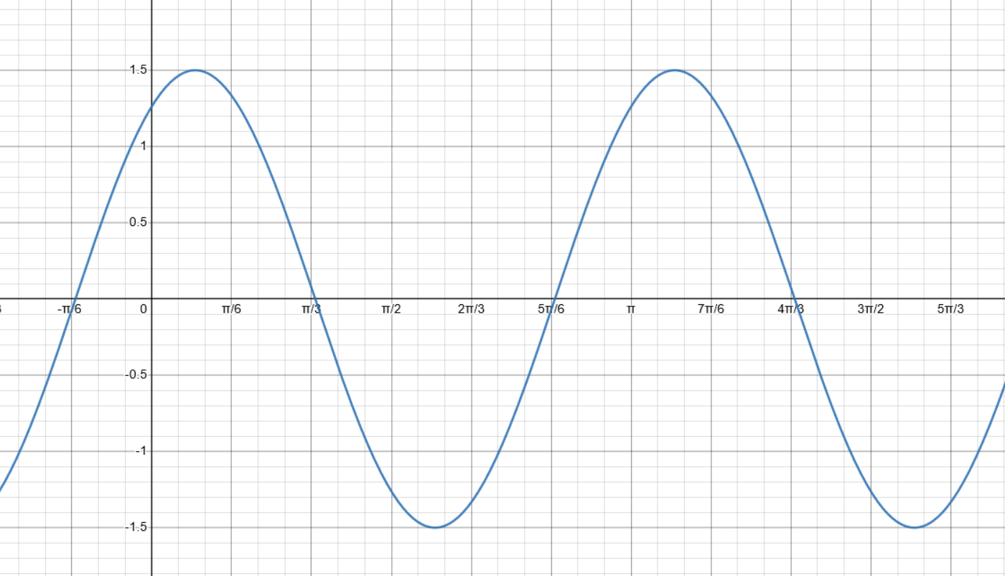



$$T$$
$$A$$
$$φ$$

