Slide 1
An Introduction to the Actuarial Profession
September 27, 2018
Erin Campbell Wagner, FCAS

Slide 2
Outline
What is an Actuary?
What is the difference – CAS and SOA?
What do Property/Casualty Actuaries do?
Why be an Actuary?
How do you become an Actuary?
How can I find out more?
Notes:
Notes to Presenter: There are 50 slides within this presentation that span across audiences with varying levels of actuarial knowledge. We recommend that you review the slides and make adjustments to the presentation based on the expected level of the audience and time allotted. There are slides that will be relevant to students with little-to-no actuarial knowledge that won’t be as relevant to actuarial majors, and vice versa. We have provided some guidance below regarding the recommended audience level for specific slides. You are welcome to update this presentation any way you see fit. You can remove slides and add additional slides of your own.
Slide Guidance:
Slides 3-10: The early slides covering the first two bullets are most appropriate for presentations to non-actuarial majors who are seeking to learn about the actuarial career. These slides can be consolidated or eliminated for students already studying actuarial science.

Slide 3
Outline
What is an Actuary?
What is the difference – CAS and SOA?
What do Property/Casualty Actuaries do?
Why be an Actuary?
How do you become an Actuary?
How can I find out more?

Slide 4
What is an Actuary?
A business professional who deals with the financial impact of risk and uncertainty
Analyzes, manages and measures the financial implications of future risk
Develops and validates models and communicate results to guide decision-making

Slide 5
Areas of Work
Insurance Industry
Property and casualty (P&C)
Life and annuities
Employee Benefit Industry
Retirement benefits
Health benefits
Financial Services Industry
Banks, investments, risk management
Mergers & Acquisitions
Government
Social Security
Regulation of insurance companies
Notes:
Most actuaries work in the insurance industry? Why do you think that is? What makes insurance a more risky business than other industries, for example technology manufacturing?
In insurance, we are selling a product (a promise to indemnify insureds when unforeseen circumstances cause them financial strain) before we know the cost of goods sold. In almost every other industry, you know how much it costs to manufacture and sell the good and can price accordingly. There is far more uncertainty in how much insurance should cost, and that’s where actuaries help out.

Slide 6
Typical Actuarial Projects
Property/Casualty: Estimating the amount of money to be set aside for insurance claims that have not been paid
Life Insurance: Designing and pricing life insurance products
Health Benefits: Setting HMO premium rates.
Retirement Systems: Pricing the cost of increasing retirement benefits
Finance & Investments: Portfolio diversification studies

Slide 7
Outline
What is an Actuary?
What is the difference – CAS and SOA?
What do Property/Casualty Actuaries do?
Why be an Actuary?
How do you become an Actuary?
How can I find out more?

Slide 8
CAS and SOA
Two learned bodies
Casualty Actuarial Society (CAS), focus on property/casualty
Society of Actuaries (SOA), traditional focus on life, health, and pensions
Very different theoretical focus
P&C – loss generation much less certain
Life – generally loss producing phenomenon reasonably known

Slide 9
Casualty Actuarial Society
World’s only actuarial organization focused exclusively on property and casualty risks
100+ year track record in training property/casualty actuaries
More than 8,000 members worldwide, and growing
20% of the overall actuarial community

Slide 10
CAS Members by Type of Employment

Slide 11
Outline
What is an Actuary?
What is the difference – CAS and SOA?
What do Property/Casualty Actuaries do?
Why be an Actuary?
How do you become an Actuary?
How can I find out more?

Slide 12

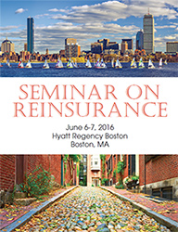
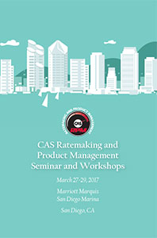

What do Property/Casualty Actuaries do?
Ratemaking
Reserving
Predictive modeling
Reinsurance
ERM

Slide 13
Ratemaking / Pricing
Are current rates meeting our objectives?
Are some classes performing better or worse than others?
How do driving patterns influence risk of loss?
How does an insured’s loss experience influence its premium?

Slide 14
The Ratemaking Equation
E(P) = E(L) + E(Exp) + Π
P = premiums
L = losses
Exp = expenses
Π = profit
A rate is an estimate of the expected value of future costs.
Notes:
Let’s talk about E(L). How would you go about coming up with an expected value of future losses for a personal auto policy? What variables do you think would factor into determining your auto premium?
(age, miles driven, make/model of vehicle, location of residence)

Slide 15
Rate Level Indication
Recall: E(P) = E(L) + E(Exp) + Π
Assume the following for Personal Auto in Illinois:
E(P) is $909
E(L) is $600
E(Exp) is $300
Π is $100
The equation above does NOT balance meaning that the expected premiums in the future are not enough to cover expected losses, expenses and leave a profit.
This would imply that premiums need to go up by 10%, across the book, to balance the equation.
In other words, there is a +10% rate level indication.
Notes:
How would you slice and dice the data to refine how this rate change should be implemented? Do you think the actuary should apply a 10% increase to everyone in the state of IL, or could they look at the data more granularly to come up with a more meaningful and fair rate change proposal?

Slide 16
Spreading the Rate Increase
One way to achieve increasing premiums by 10% is to do so by raising every policyholder’s premium by 10%.
Actuaries are equipped with skills to understand how to spread the 10% rate increase to those customers who are driving the rate need.
Assume the actuary discovered that rates for drivers in Chicago need to go up by 20% and that drivers in the rest of the state do not need a rate increase. Assume a 50/50 population split.
Spreading the rate in this way still balances back to 10% overall.

Slide 17
Spreading the Rate Increase: Additional Distinctions
10% Overall Rate Need:
20% Rate Need for Chicago Drivers:
15% Rate Need for Married Chicago Drivers
25% Rate Need for Single Chicago Drivers
0% Rate Need for Rest-of-State Drivers:
-10% Rate Need for Married Rest-of-State Drivers
10% Rate Need for Single Rest-of-State Drivers
The rate change can be spread by numerous other rating variables. The rate spread can get very complicated, but actuarial techniques help identify where the rate change should be spread.

Slide 18
Differences between Commercial and Personal Lines
Commercial products can be unique and therefore can have limited data for ratemaking.
More individual risk rating
Individual risk underwriting is more prominent in Commercial Lines, leading to more discretion.
Commercial Lines use additional rating techniques, such as schedule and experience rating.

Slide 19
Many Trends Affect our Practice
Internet of things and “big data”
Increasingly sophisticated predictive models
Emerging risk, terrorism
Globalization, international businesses and risks, such as global instability
Climate change, weather volatility
Population shifts, hazard prone areas
Social media, automated vehicles, healthcare
Drones, cyber liability, the aging population
Notes:
Replace Slide 30
There’s always new stuff to insure… and people are always coming up with new and inventive ways to sue each other!

Slide 20
Many Paths to Success
academic
regulator
stable schedule
people oriented
management
reinsurance
reserving
ERM
insurance
reserving
broking
insurance
ratemaking
reinsurance
pricing
service
agency
consulting
banking/
investment
travel and variety
data intensive

Slide 21
Outline
What is an Actuary?
What is the difference – CAS and SOA?
What do Property/Casualty Actuaries do?
Why be an Actuary?
How do you become an Actuary?
How can I find out more?

Slide 22
Why be an Actuary?
High earnings potential
Graduate school not required – no loans to repay
Advancement opportunities expand throughout career
Variety of avenues to choose
High demand – less sensitive to economic cycles
Job security
Overall, a highly ranked profession
Actuary is continually rated as one of the top jobs in America.

Slide 23
Outline
What is an Actuary?
What is the difference – CAS and SOA?
What do Property/Casualty Actuaries do?
Why be an Actuary?
How do you become an Actuary?
How can I find out more?

Slide 24
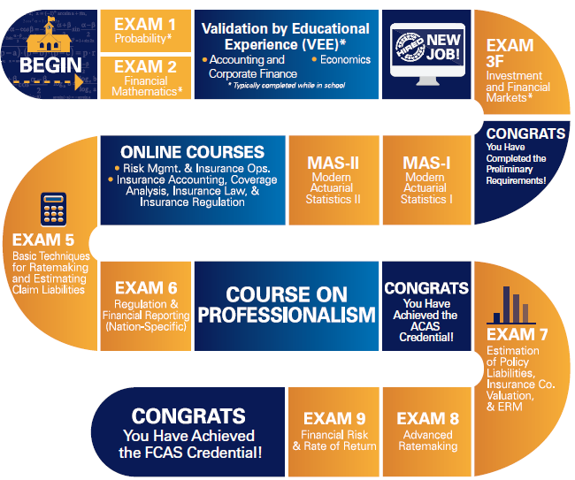
2018 CAS Syllabus

Slide 25
Study Benefits
Paid Study Time (100 – 120 hours per exam is not uncommon)
Raises or bonuses for each exam ($2,000 - $5,000 range)
Company pays for exam materials, seminars, exam fees, etc.
Notes:
Varies by co.

Slide 26
Related Professions
Does this type of work seem interesting, but you don’t want to spend years studying for exams? There are other options for you!
Predictive Modeling
usually requires Master’s degree in Statistics
Insurance Product Management
Data Science / Business Analytics
Future Teachers: Please tell your students about actuarial science and related career paths!

Slide 27
Outline
What is an Actuary?
What is the difference – CAS and SOA?
What do Property/Casualty Actuaries do?
Why be an Actuary?
How do you become an Actuary?
How can I find out more?

Slide 28

You’re Invited…
join online today at CASstudentcentral.org
Notes:
CAS launched a student member program for university students called CAS Student Central.
CAS Student Central is devoted to giving you - the next generation of casualty actuaries - the tools and expertise you will need to make the transition from classroom to career.
Your future starts here. For 100 years strong, CAS has been the bedrock of the property and casualty actuarial profession. We are now proud to offer our uncompromising standards of unmatched expertise and professional integrity to the many students around the world who have made the decision to be an actuary.
CAS Student Central exemplifies our deep commitment to you and our resolve to mentor and guide you through the maze of curricula and rigorous exams that ultimately lead to a challenging and rewarding career.
But you only have access if you join, and I encourage everyone to go online and join today at CASStudentCentral.org.
CAS cares about your career. We know you take your career seriously, and so do we. We know you’re striving for excellence and distinction now to position yourself for a strong start.
As the gold standard for casualty actuaries, CAS wants to nurture the next generation and help jumpstart your success. From skill-building and support preparing for the rigorous exams to providing networking opportunities with professionals in the field around the globe, we are here for you, and we look forward to welcoming you into our community.
Thank you!

