Slide 1
EH2745 – Assignment n°1
AKPOBOME Samuel
GAULTIER Mathieu

Slide 2
Structure of the project :
Two main classes :
The XMLtoSQL.java -> extract the data to a SQL
database
The Ymatrix.java -> compute the Ymatrix based
on the database

Slide 3
Creation of the Ymatrix:
Extract the number ‘n’ of Bus-Sections in the database
Create a Ymatrix of n x n of zero complex terms
……
1
2
n
……
1
0
0
……
2
0
0
……
……
……
n
Line 53 - 68

Slide 4
Fill it line by line of the Ymatrix:
Start with the line number 1 : so the Busbar n°1
……
1
2
n
……
Busbar n°1
1
0
0
……
2
0
0
……
……
……
n
Line 70 - 75

Slide 5
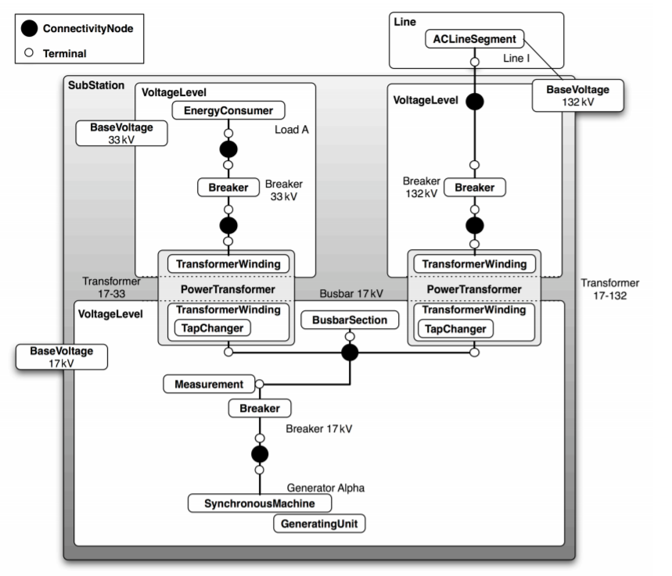
Reminder :

Slide 6
Initialisation :
1) Find the corresponding BusbarSection
2) Find the corresponding terminal to this
BusbarSection
Line 91 - 106

Slide 7
Initialisation :
1) Find the connectivity Node
Find all the terminals connected to this
connectivity Node
Line 107 - 124

Slide 8
Initialisation :
path 1
path 2
Create a path list out of all this terminals : each
one correspond to one path
Initialize each path as :
path.terminal = terminal; (String)
path.startPoint = BusbarNumber; (number)
path.admittance = 0;
Line 116 – 126 & path.java & 134 - 140

Slide 9
Solving the path : find component
Path « dead-end » :
1 terminal component
Component : Energy-Consumer, Shunt-
Compensator, Synchronous-Machine
Line 170 - 200

Slide 10
Solving the path : update the path
path.adm -> update(former_adm, component_adm);
path.test -> true;
path.endType -> 0;
Line 200 - 210

Slide 11
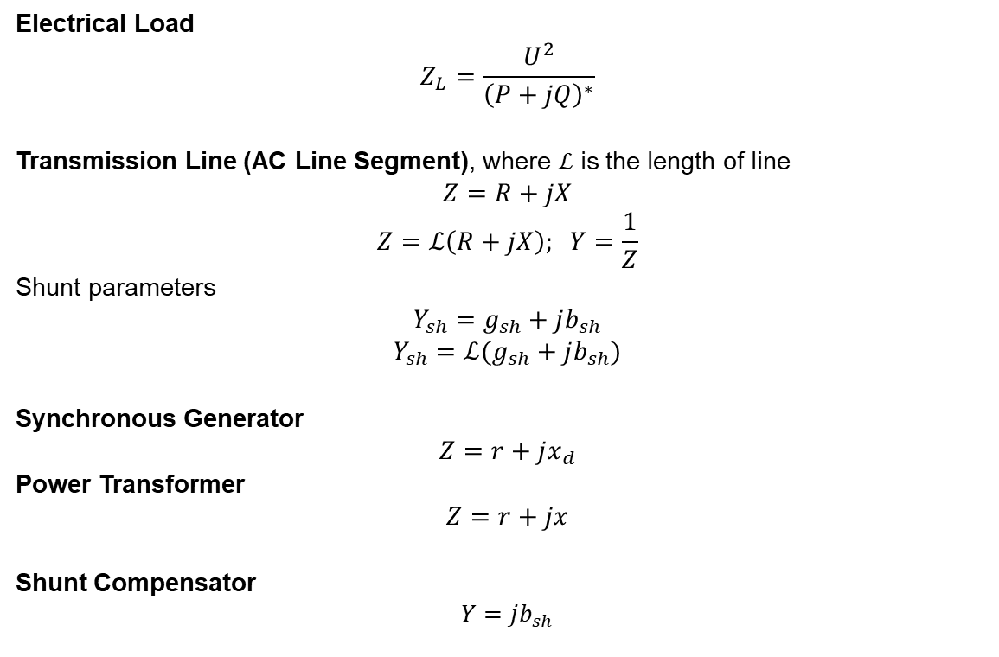
Modelling of Electrical Components
Electrical Load
$$Z_{L}=\frac{U^{2}}{{\left(P+jQ\right)}^{∗}}$$
Transmission Line (AC Line Segment), where $ℒ$ is the length of line
$$Z=R+jX$$
$$Z=ℒ\left(R+jX\right); Y=\frac{1}{Z}$$
Shunt parameters
$$Y_{sh}=g_{sh}+jb_{sh}$$
$$Y_{sh}=ℒ(g_{sh}+jb_{sh})$$
Synchronous Generator
$$Z=r+jx_{d}$$
Power Transformer
$$Z=r+jx$$
Shunt Compensator
$$Y=jb_{sh}$$
Line 351 - 510

Slide 12
Solving the path :
Path not ended yet :
2 terminals component
Component : Breaker, Transformer, ACLine
Line 217 - 246

Slide 13
Solving the path :
?
Path end test : Function isBusbar(Terminal)
If (isBubar(Terminal) != 0) {
-> it is the end of the path
} else {
-> the path is not ended yet
}
Line 272 - 280

Slide 14
Solving the path :
path.adm -> update(former_adm, component_adm);
if (isBusbar(terminal) != 0) {
path.test -> true;
path.endType -> isBusbar(terminal);
}
path.terminal -> update(terminal);

Slide 15
Solving the path :
All path solved :
path.test = true
Line 134 - 140

Slide 16
Update the Ymatrix line « j » :
j
endType
1
n
1
0
Busbar n° j
j
n
For each path {
if (path.endType != 0) {
Ymatrix[j][path.enType] = path.adm;
}
Ymatrix[j][j] += path.adm;
}
Line 128 & 511 - 519

