Slide 1

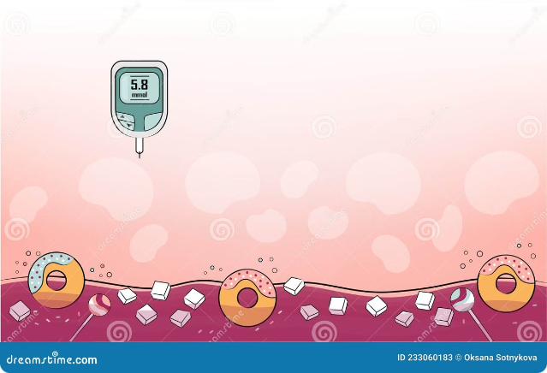
Diabetes: Analysis and Modelling
This project aims to depict the present situation of DIABETES around the globe. It uses Machine Learning algorithms on training data of several patients having diabetes to analyze the data and also predict the presence of diabetes on the basis of test data provided. The project also extends its function to depict a colour map of the world portraying the number of diabetic patients across the world, to increase the readability of data.
by Nandini and Arashrika

Slide 2

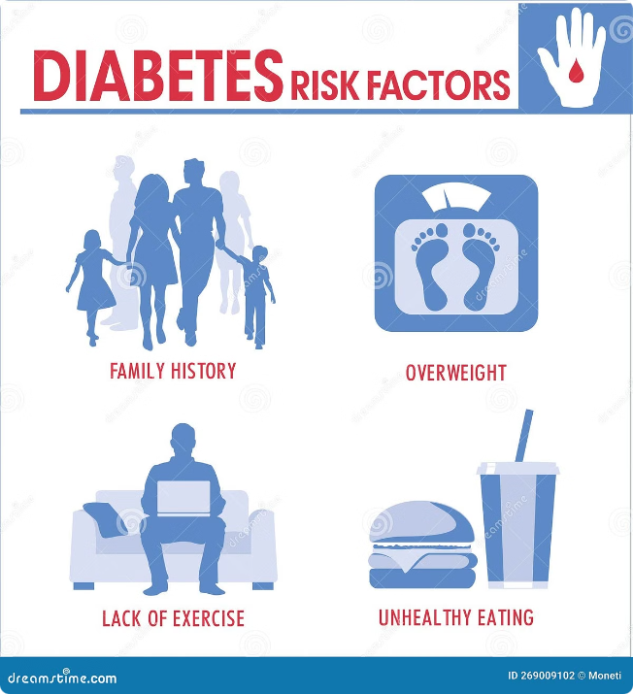
Statement of the Problems
Diabetes Factors
Diabetes is a disease that depends on several factors like Number of Pregnancies, Glucose level in body, the Blood Pressure, Skin Thickness and BMI (Body Mass Index).
1
Prediction Challenge
The problem is to analyze a given data set containing all of the above mentioned factors of Diabetes and exactly predict the presence of diabetes using a new dataset.
2
Global Comparison
The project should also make it easier to compare the number of diabetic patients in various countries globally by using coloured maps to depict them.
3

Slide 3
Project Objectives
Represent Global Diabetes
The objective of this project is to
represent the global situation of Diabetes and Diabetic patients.
Analyze and Predict
The project's objective is to analyse a data set consisting various data on the factors causing diabetes and also predict the presence of diabetes using a new data set or training data set containing unseen data on the factors causing diabetes using the concept of Machine Learning.
Improve Readability
The project also aims at improving the readability of the data on the diabetic situation around the globe by using graphical representations and map representations.

Slide 4

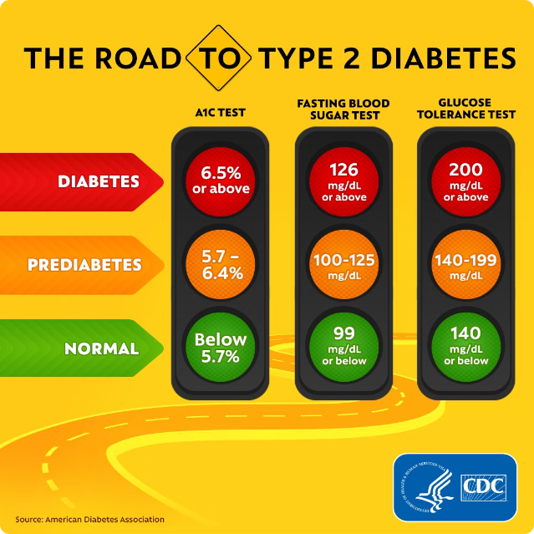
Project Scope
Machine Learning Algorithm
The Machine Learning algorithm used in the project is
configured to predict the presence of Diabetes in a person based on some data of various factors causing Diabetes.
Diabetes Factors
The Diabetes factors used in data set are - No. of Pregnancy, Glucose Level, Blood Pressure, Skin Thickness, BMI, Insulin and Age.

Slide 5

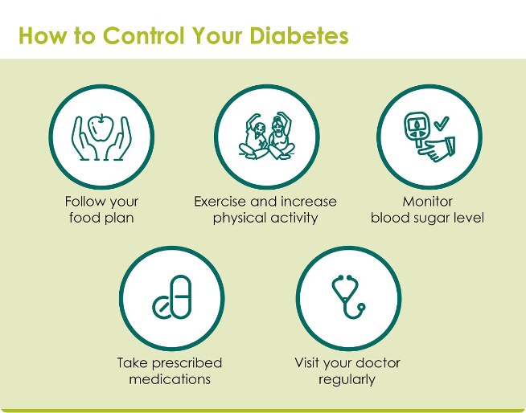
Project Applications
Classify High-Risk
1
Populations
The project can be used for classifying a dataset that describes a population that is under a high risk of the onset of diabetes.
Predict Diabetes in Patients
The project can be used by any physician or doctor to predict the presence of diabetes in a patient based on the test results.
2
Analyze Diabetes Globally
It can also be used by the researchers/scholars to predict and analyze the diabetes scenario of the world.
3
Educational Use
It can be used as a study report by students.
4

Slide 6
Project Limitations
Prediction Accuracy
The predictions is only 77.27%
accurate.
Lack of User Interface
The diabetes analysis model is
developed without using an User Interface thus reducing the readability.
Factors Considered
Our Project can diagnose the presence of diabetes based on only the given 8 factors. Involving the use of any new factor will not affect the result.

Slide 7






Development Tools
Jupyter Notebook
IDE
Python 3.6
Language
NumPy
Python Library
MatPlotLib
Python Library

Slide 8

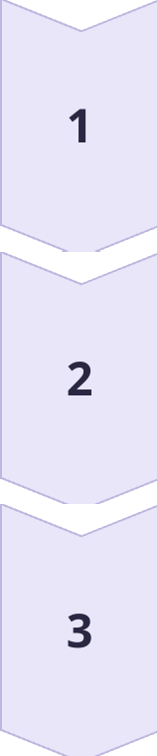
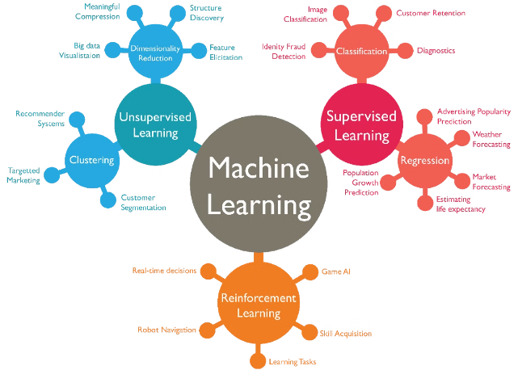
Algorithms Used
Support Vector Machine
A key algorithm used in the project.
Classification
An alternative algorithm that could be used.
Logistic Regression
Another alternative algorithm that could be used.

Slide 9

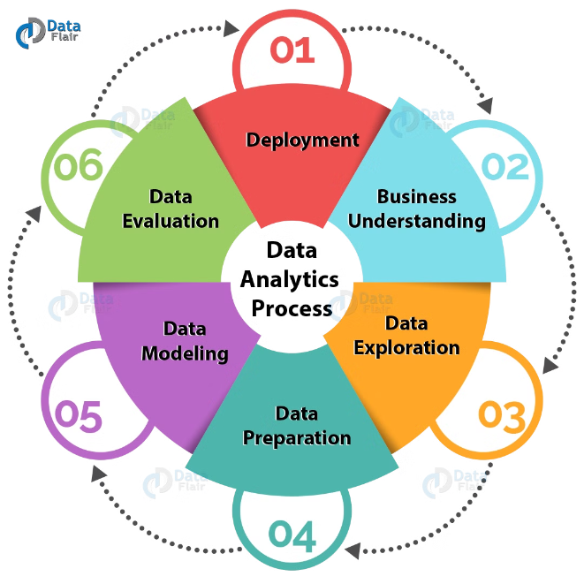
Implementation
1
Data Preparation
We used a database of 769 entries and divided it into two parts- Training Data Set and Testing Data Set with 2/3 of the data as Training and 1/3 as Test data set.
Support Vector Machine
Using Support Vector Machine we train the machine to understand the underlying structure of the data set and at the same time we determine the Accuracy Score of our algorithm.
2
Visualization
We have plotted one histogram for all the factors we have considered. With 0 and 1 representing non-diabetic and diabetic respectively.
3

Slide 10
ALGORITHM
Start
Import the models: numpy, plotly, pandas, sklearn
Read the dataset
Split the dataset into training and testing
Then we train the machine with Support Vector Machine
Test the testing dataset and check the match with training dataset to calculate the accuracy score
We represent every aspect of the data using histogram
We have calculated the accuracy score by using various algorithms to find out which one is perfect.
Stop.

Slide 11
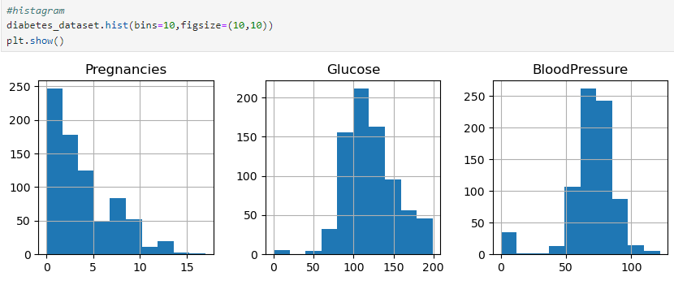
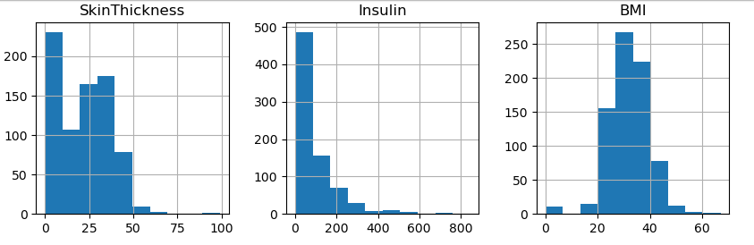
OBSERVATIONS (DIABETES ANALYSIS GRAPH)

Slide 12
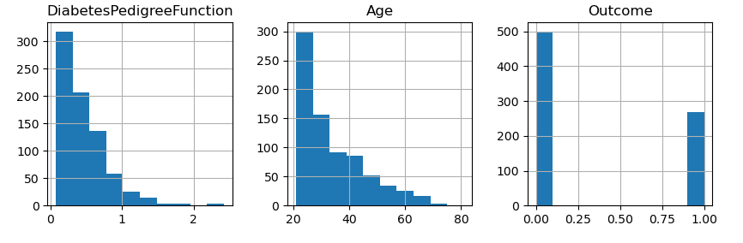
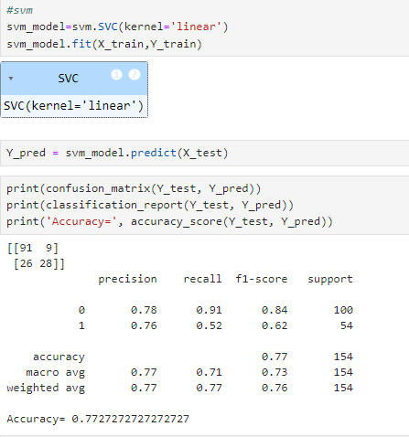
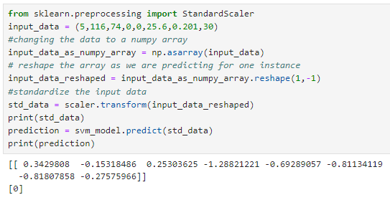

Slide 13
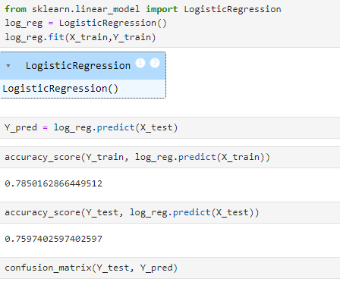
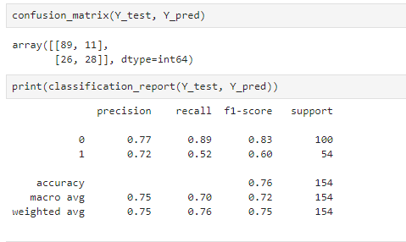
OBSERVATIONS(contd.)

Slide 14
Conclusion
Accuracy score of our model is 77.27%
Highest chances of presence of diabetes can be predicted on the basis of:
No. of pregnancies- 5-10
Age group- 40-60
Glucose- 150-200
Insulin-150-350
Skin thickness- 25-60
Diabetes Pedigree Function- 0.7-1.5

Slide 15
Bibliography
www.kaggle.com
www.slidesshare.com

Slide 16
THANK YOU!!

