Slide 1
RoomersAround Rome
Property Rental Platform with Community Focus
Connecting Property Seekers & Owners in the Eternal City
Presented by: Dolly Mathur | 2025

Slide 2
The Problem
Finding quality rental properties in Rome is challenging and time-consuming
Lack of trust between property seekers and owners
Limited community engagement in existing rental platforms
Difficulty in verifying property authenticity and owner credibility
Language barriers for international students and expats

Slide 3
Our Solution
RoomersAround Rome is a comprehensive property rental platform that creates a trusted community ecosystem connecting property seekers with verified owners in Rome.
Verified Listings:
All properties undergo authentication checks
Community Reviews:
Transparent rating system for properties and users
Cultural Integration:
Multilingual support and local area guides
Smart Matching:
AI-powered recommendations based on preferences

Slide 4
Key Features
Advanced Search & Filters
Location, price, amenities, availability
Payment Integration
Secure online rent payments
Virtual Property Tours
360° views and video walkthroughs
Community Forum
Connect with fellow renters
Secure Messaging
In-app communication between parties
Local Insights
Neighborhood guides and tips
Document Management
Digital contracts and paperwork
Favorites & Alerts
Save properties and get notifications

Slide 5
Technology Stack
Frontend
• React Native
• Redux for state management
• Tailwind CSS for styling
Backend
• Node.js with Express.js
• RESTful API architecture
• JWT authentication
Database
• MongoDB for data storage
• Redis for caching
• AWS S3 for media files
Mobile
• iOS & Android native support
• Push notifications
• Geolocation services
Infrastructure
• AWS Cloud hosting
• CI/CD with GitHub Actions
• Docker containerization

Slide 6
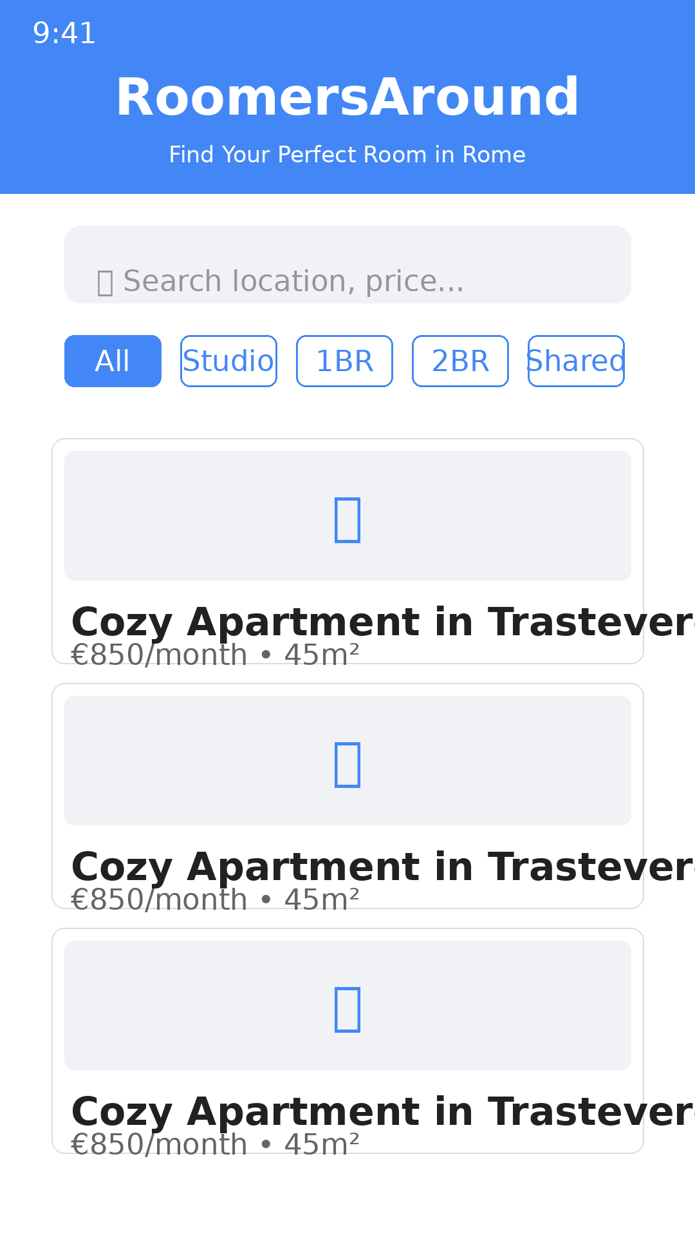
Mobile App - Home Screen
Features:
• Smart search bar
• Quick filters
• Property cards with key info
• Image previews
• Instant access to listings

Slide 7
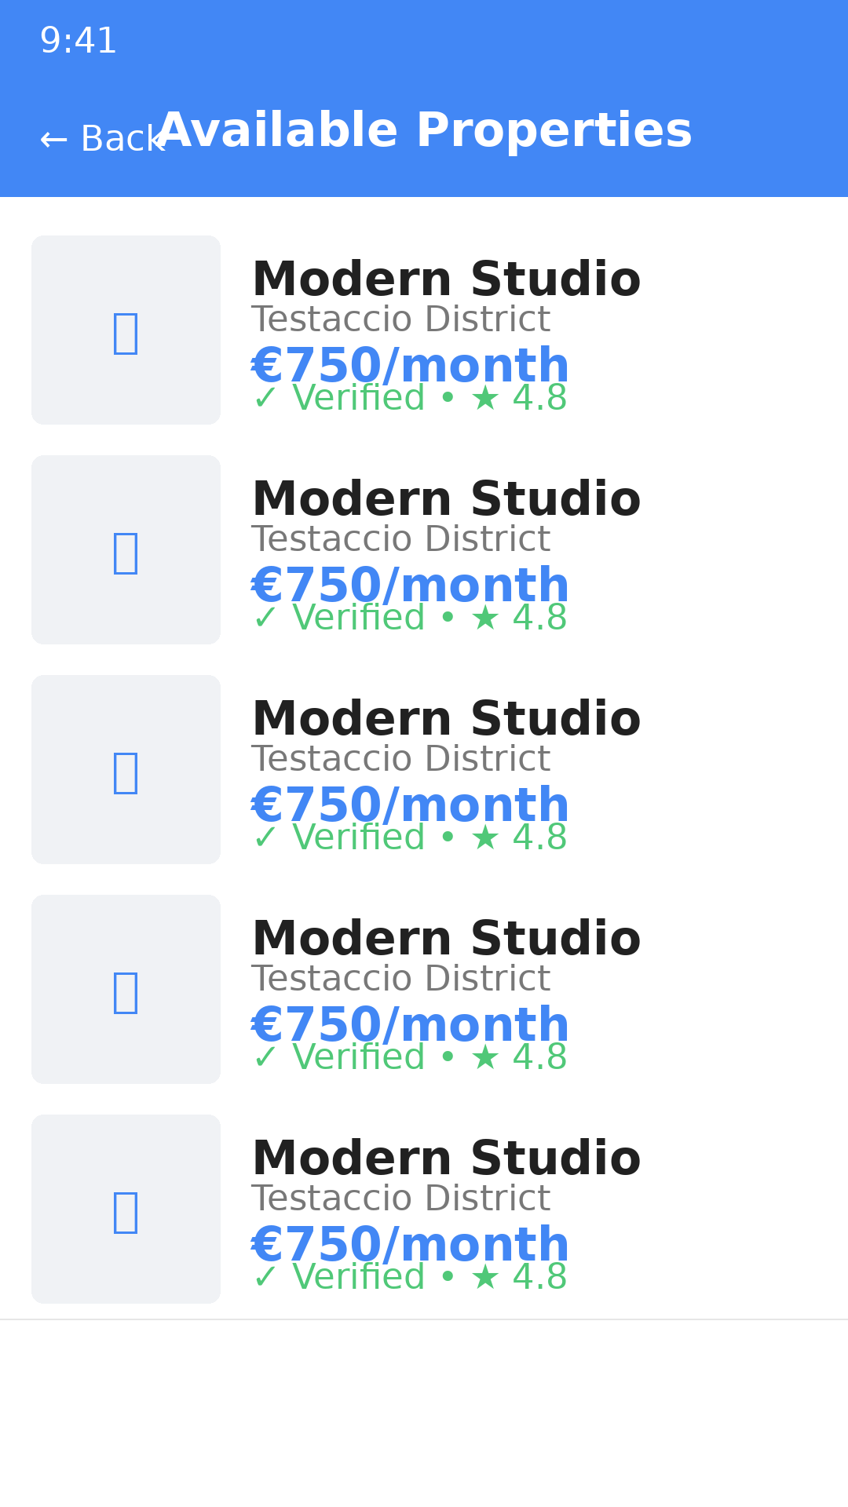
Mobile App - Property Listings
Features:
• List view of properties
• Thumbnail previews
• Key property details
• Pricing information
• Verification badges
• Rating indicators

Slide 8
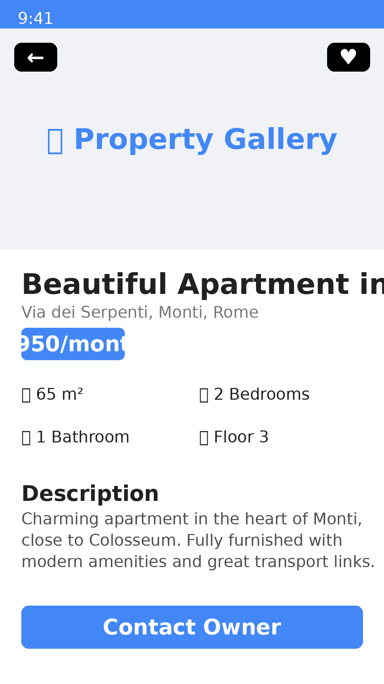
Mobile App - Property Details
Features:
• Photo gallery
• Full property details
• Room specifications
• Amenities list
• Neighborhood info
• Contact owner button
• Save to favorites

Slide 9
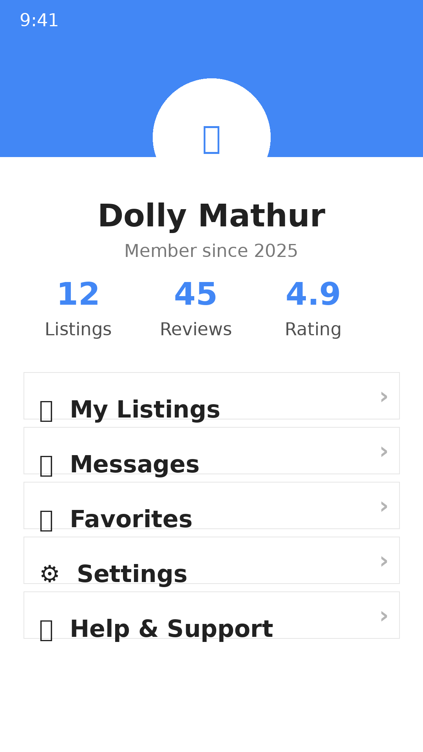
Mobile App - User Profile
Features:
• User profile
• Activity statistics
• My listings
• Messages inbox
• Saved favorites
• Account settings
• Help & support

Slide 10
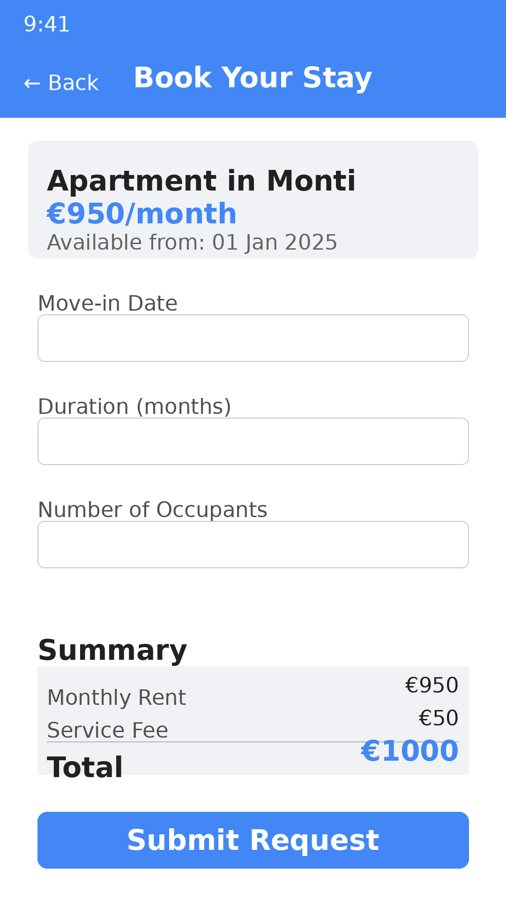
Mobile App - Booking Flow
Features:
• Booking request form
• Date selection
• Duration picker
• Cost breakdown
• Service fee display
• Total calculation
• Submit request

Slide 11
Future Roadmap
Phase 1: Q1 2025
Launch MVP for Rome • Basic search and listing features • User authentication and profiles • Property verification system
Phase 2: Q2 2025
AI-powered recommendations • Virtual property tours • Integrated payment system • Mobile app optimization
Phase 3: Q3 2025
Community forum and events • Multi-language support (Italian, English, Spanish) • Advanced analytics dashboard • Expand to other Italian cities
Phase 4: Q4 2025
AR property viewing • Blockchain-based contracts • Partner integrations (utilities, moving services) • European expansion

Slide 12
Market Opportunity
50,000+
€15B
Students in Rome
Italian rental market
30%
2.8M
Growth in expat population
Rome population
Key Insight:
Rome attracts thousands of students and young professionals annually, creating a consistent demand for quality rental housing. RoomersAround Rome bridges the gap between supply and demand with a trusted, community-driven platform.

Slide 13
Thank You!
Let's Build the Future of Property Rental Together
RoomersAround Rome
Presented by: Dolly Mathur
2025

