Slide 1

AZINHACK '26 · TEAM RED-HAT
SAME TICKET, ONE CHECKOUT
PARDARSHI पारदर्शी
Pre‑ticked insurance
+₹149
PARDARSHI पारदर्शी
Fees and charges
+₹169
Advertised price
₹1,006
AI shopper agents go through checkout like real people, stop before paying, and measure the hidden fees, fake urgency and personalised prices.
An independent consumer-protection auditor for India's online shoppers
Working product
Live on Indian sites
TinyFish on a live shop
94 tests
You pay ₹1,324
Built with TinyFish · Google ADK · Gemini · scikit-learn · Playwright
+32% between the first screen and payment
Demo video https://youtu.be/xR9-eA1mp7o · Code https://github.com/mathurojus/Pardarshi
Ground-truth demo shop with planted tricks
Notes:
Pardarshi (Hindi for 'transparent'). AI shopper agents go through a shop's checkout like real people, stop before paying, and measure hidden fees, fake urgency and personalised prices. Built and tested: on our ground-truth demo shop the price rose from Rs 1,006 to Rs 1,324 (+32%) between the first screen and payment. On real Indian sites, agents completed checkouts on bummer.in and fardaclothing.com. Team RED-HAT, AZINHACK '26. Demo video: https://youtu.be/xR9-eA1mp7o. Code: https://github.com/mathurojus/Pardarshi.

Slide 2
AT A GLANCE
EXECUTIVE SUMMARY
Every section the judges score, answered in one line, with the slide that proves it
Section | Answer | Slide
Problem Statement | The price shown first is not the price paid; one shopper cannot see fees, pre-ticks or personalised prices. | 3
Proposed Solution | AI shopper agents run checkout as 6 profiles, stop before payment and measure 7 dark patterns as evidence. | 4–6
Target Users | Consumer-rights investigators and journalists; platform compliance teams; shoppers and regulators. | 7
Role of ML and AI | Trained copy classifier (macro-F1 0.89 on unseen text), price regression with BH correction; Gemini agent + ADK. | 8–9
Technical Approach | FastAPI pipeline, two browser lanes, evidence at every step, hard pay-button guard, 94 tests. | 10–11
Real-World Validation | Audited live Indian shops: bummer.in and fardaclothing.com reached payment; 30 sites probed. | 12
TinyFish Integration | All 4 APIs wired and verified; Agent API walked bummer.in to checkout in 13 steps. | 13–14
Expected Impact | Suspicion to statistics, complaint to case file; pilot: 2 NGOs, 50 Indian sites, about ₹22,000. | 15
Feasibility | Working today; honest risk list with a mitigation for each (bot walls reported, never bypassed). | 16
Future Scope | India exit nodes, Indic-language classifier, shopper capture extension, NCH filing. | 17
Demo video https://youtu.be/xR9-eA1mp7o · Code https://github.com/mathurojus/Pardarshi
Notes:
One-slide summary for the reviewer: each judging section, the answer in one line, and where the evidence is in this deck.

Slide 3



PROBLEM STATEMENT
01 · PROBLEM STATEMENT
Online prices change between the product page and payment, where a single shopper cannot see it
Why it persists
₹25–28k cr
97%
Fees appear only at checkout
lost by Indian online buyers every year to dark patterns and hidden charges
of 290 major Indian platforms use at least one dark pattern
Drip pricing and pre-ticked add-ons wait on the last screen, after the shopper has committed.
Personalised prices are invisible
One shopper only ever sees their own price, so device or location pricing goes unnoticed.
304M
4.2 lakh
online buyers in India; 88% lose ₹78–87 a month to hidden charges
e-commerce complaints a year at the National Consumer Helpline, 32% of all
Compliance is self-declared
The CCPA asked 50+ platforms to self-audit in June 2025. No independent check is required.
Sources: ₹25–28k cr, 304M: Datum Intelligence (Jun 2026) · 97%: LocalCircles (Oct 2025) · 4.2 lakh: NCH data FY2024-25 · 50+ platforms: CCPA advisory, 5 Jun 2025 (as reported).
Notes:
The price a shopper sees first is not the price they pay. Fees, pre-ticked add-ons and fake urgency appear late in checkout; personalised prices are invisible to a single shopper; compliance is self-declared. Sources: Datum Intelligence (June 2026), LocalCircles (Oct 2025), National Consumer Helpline data FY2024-25, CCPA advisory of 5 June 2025.

Slide 4





PROPOSED SOLUTION
02 · PROPOSED SOLUTION
Pardarshi measures what shoppers are actually charged, and turns it into evidence
01
02
03
04
05
Shop
Stop
Record
Measure
Act
6 shopper profiles × 3 runs, plus the cancellation flow
Every agent stops before payment; a code guard blocks pay buttons
Every screen: price lines, pre‑ticked boxes, urgency claims, screenshots
ML and statistics turn captures into findings with confidence
Trust score, findings report with SHA‑256 hashes, NCH complaint
Measured, not surveyed. Per-site proof with screenshots and statistics, ready to attach to a complaint.
Notes:
Five steps. Agents shop as different people, stop before payment, record everything; ML and statistics turn the captures into findings with confidence. Output: a 0-100 trust score, a findings report with SHA-256 evidence hashes, and a draft complaint for the National Consumer Helpline.

Slide 5







PROPOSED SOLUTION: SEVEN CHECKS
02 · PROPOSED SOLUTION
Mapped to the Consumer Protection Act 2019 and the CCPA's 2023 dark-pattern guidelines
Drip pricing
Basket sneaking
Fake urgency
Manipulative copy
First-screen price vs payment total, median of runs
Paid add-ons that arrive pre‑ticked
Timers that reset on reload, “only N left”, fake popularity
Confirm-shaming and nagging copy, by the ML classifier
CCPA 2023: drip pricing
CCPA 2023: basket sneaking
CCPA 2023: false urgency
CCPA 2023: confirm shaming, nagging
Every finding carries
its legal category, severity, penalty points, the run it came from and its screenshots.
Personalised pricing
Cancellation trap
Policy vs reality
Same product, price by device, country or visitor
Clicks to cancel against clicks to join
Written promises the measurements disprove
CPA 2019: unfair trade practice
CCPA 2023: subscription trap
CPA 2019: misleading advertisement
Notes:
Five checks map to named dark patterns in the CCPA Guidelines for Prevention and Regulation of Dark Patterns, 2023; personalised pricing and policy contradictions rest on the Consumer Protection Act 2019 (unfair trade practice, misleading advertisement).

Slide 6
PROPOSED SOLUTION: WHAT IS NEW
02 · PROPOSED SOLUTION
Research proved it can be measured; Pardarshi makes it a repeatable, complaint-ready audit for India
Approach | Real charge | Compares profiles | Repeatable + stats | Independent
Consumer surveys (e.g. LocalCircles) | Self-reported | No | No | Yes
Studies (Hannak '14, Mathur '19) | Yes | Yes | One-off studies | Yes
Detectors and browser extensions | One page, one shopper | No | No | Yes
Manual investigation | Yes | Rarely | No | Yes
Platform self-audit (CCPA, 2025) | Not disclosed | Not disclosed | Not disclosed | No
Pardarshi | Yes, at checkout | Yes, 6 profiles | Per site, on demand | Yes
Evidence, not opinion
Several shopper profiles
Ready to act on
Screenshots, price lines and SHA‑256 hashes behind every finding.
Personalised pricing only shows when profiles are compared.
Findings map to Indian law and become an NCH complaint.
Notes:
Research (Hannak et al. 2014 on price discrimination; Mathur et al. 2019 on dark patterns at scale) proved these practices can be measured, as one-off studies. Detectors flag patterns on the page you are on. Pardarshi turns the measurement into a repeatable, per-site audit with statistics and output mapped to Indian law and the NCH complaint process.

Slide 7



TARGET USERS AND USE CASE
03 · TARGET USERS AND USE CASE
Built for people who need proof, not opinions
PRIMARY
SECONDARY
BENEFICIARY
Consumer-rights investigators and journalists
Platform compliance teams
Shoppers and regulators
Today: burner accounts, manual screenshots, a single shopper's view.
Today: the CCPA's 2025 advisory asks for a self-audit and a self-declaration.
Today: vague complaints (“they overcharged me”) that are hard to act on.
With Pardarshi: many shopper runs, statistics and a ready case file.
With Pardarshi: an independent, repeatable check of their own site, with consent.
With Pardarshi: complaints that name the category, the figures and the exhibits.
Use case, measured Demo shop: ₹1,006 became ₹1,324 at payment (+32%), iPhone shoppers were quoted 9.6% more, cancelling took 8 clicks against 1. Live: an investigator reaches the payment page of an Indian shop in about 2 minutes.
Notes:
Primary user: the consumer-rights investigator or journalist who proves dark patterns by hand today. Secondary: platform compliance teams under the CCPA self-audit advisory. Beneficiaries: shoppers and regulators.

Slide 8



ROLE OF MACHINE LEARNING
04 · ROLE OF MACHINE LEARNING AND AI
A trained classifier, statistics and rules turn captures into findings, measured on unseen data
Dark-pattern copy classifier (trained)
TF‑IDF word and character n‑grams into logistic regression; 9 classes, 725 labelled UI strings. Tested on strings never seen in training.
Personalised-pricing statistics
Regression on log price by device, country and visitor, 95% confidence intervals, Benjamini–Hochberg correction, 2% minimum gap.
Price extraction and trust score
Page text into labelled lines: item, fee, tax, add-on, discount, total. Score = 100 × e^(−points / 70), each point traced to a finding.
0.89
1.00
12/12
macro-F1, unseen strings
precision, dark vs none (recall 0.87)
planted tricks found (demo shop)
Per-class n is small (6–12), so these are early numbers. On real Indian sites the price extractor was hardened on live checkouts.
Notes:
The classifier is scored on 72 human-written strings never seen in training (near-duplicates of training text removed). Per-class n is small, so these are early numbers. The pricing test interleaves runs in random rounds so price drift over time cannot pose as personalisation.

Slide 9






ROLE OF AI
04 · ROLE OF MACHINE LEARNING AND AI
Gemini and Google ADK do the reasoning; guards keep the agents from ever paying
Shopper agent (Gemini)
Guards that stop payment
Policy vs reality (Gemini)
Reads each page and picks one action at a time towards checkout, on sites nobody scripted. Recovers from pop-ups, redirects and busy models.
Code blocks Pay, Confirm order and Subscribe, and never types card, OTP or personal data. Proven live: it refused boAt's “Pay Now”.
Reads the site's terms and refund pages and flags written promises that the measured runs disprove.
Google ADK orchestrator
Voice and text assistant
Complaint writer
A tool-using agent that runs audits, finds peer sites (TinyFish Search), reads policies (Fetch) and drafts complaints.
Exact answers from the audit's own numbers; open questions go to Gemini with the whole audit as context.
Drafts a National Consumer Helpline complaint that cites only measured findings, with exhibits.
Notes:
Gemini drives the shopper agent one action at a time on unscripted sites, checks policies against measurements, and powers the audit assistant. Google ADK is the orchestrator agent. On browser lanes the safety rules are code; on TinyFish's Agent API the rule is in the goal and the cloud browser holds no account, address or card, so it cannot pay.

Slide 10





PROPOSED TECHNICAL APPROACH
05 · PROPOSED TECHNICAL APPROACH
One pipeline, two browser providers, evidence captured at every step
Console
Orchestrator
Browsers
Capture
Analysis
Outputs
FastAPI, live agent view, voice and text assistant
Google ADK + pipeline: shopper profiles in random rounds, one pinned product
TinyFish Browser and Agent API, or Playwright (open source)
Every screen: prices, copy, checkboxes, screenshots
Classifier, price statistics, Gemini policy check
Score, findings report, SHA‑256 hashes, NCH complaint
Stack
Safety by design
Python
FastAPI
TinyFish SDK
Playwright
Allowlisted sites only
Stops before payment
Pay-button guard in code
One shopper at a time
Blocks reported, not bypassed
Private, per-user audits
Google ADK
Gemini
scikit-learn
SciPy
SQLite
Notes:
Architecture: the console starts an audit; the orchestrator builds the shopper matrix and pins one product; TinyFish or the open-source Playwright lane drives the browsers; every screen is captured; analysis produces findings; outputs are the score, the findings report and the complaint. Real sites run as Indian shoppers (en-IN, Asia/Kolkata), one at a time.

Slide 11
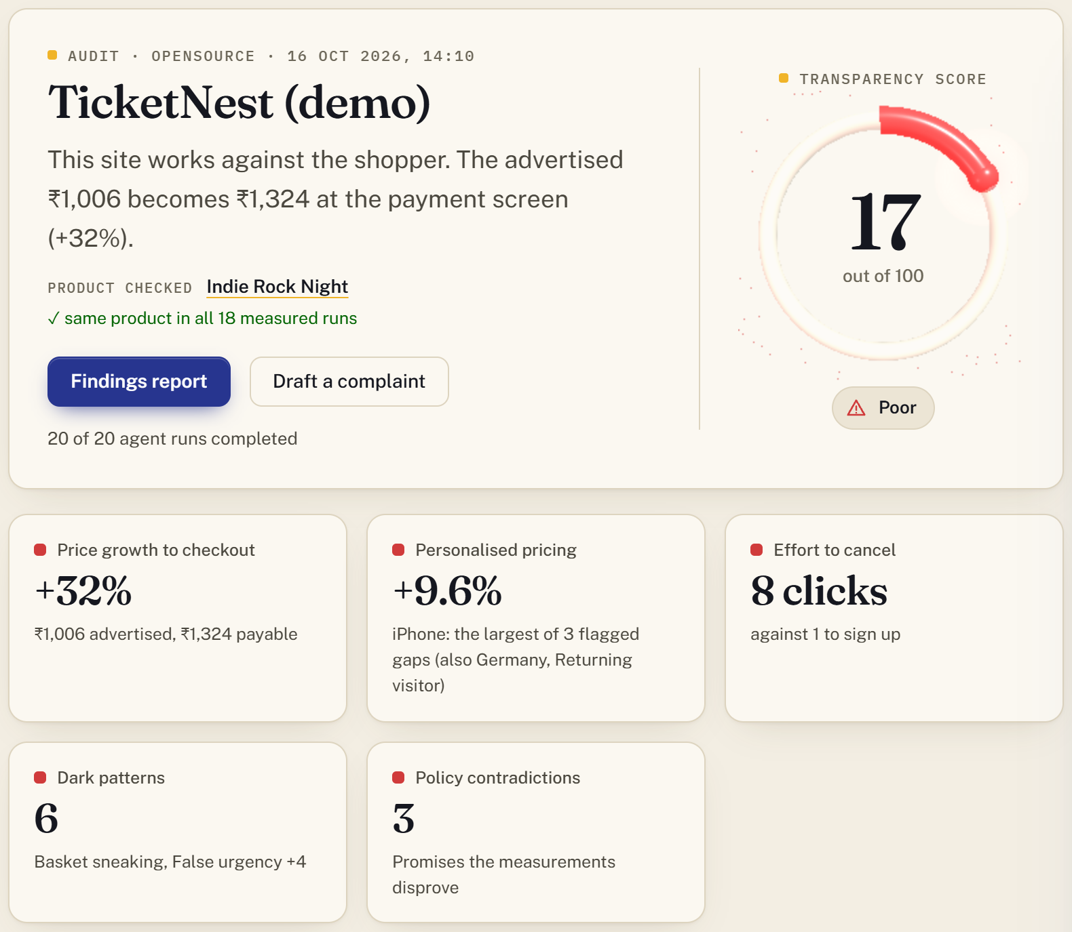
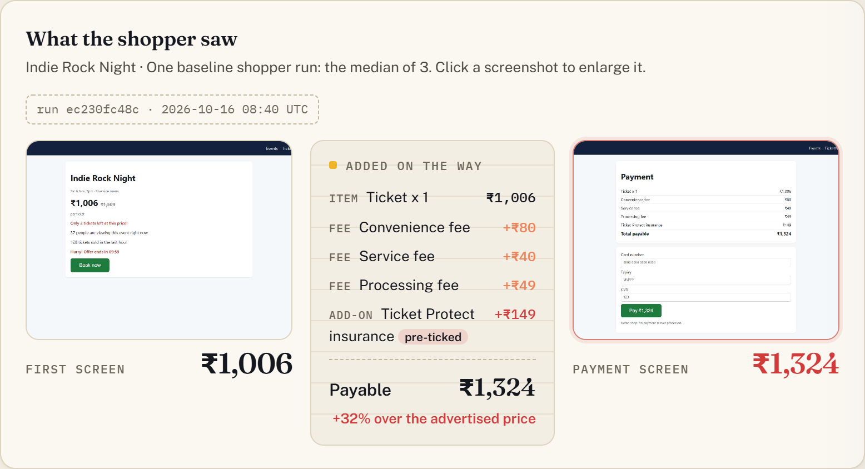
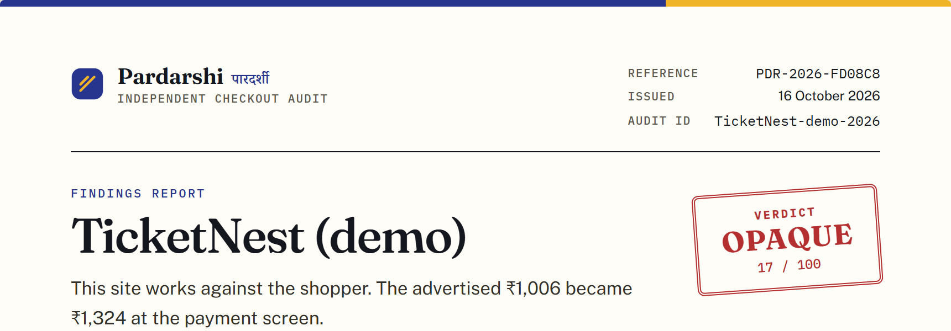
PROPOSED TECHNICAL APPROACH: WORKING PRODUCT
05 · PROPOSED TECHNICAL APPROACH
Three real screens from one audit: no mock-ups
Evidence: first screen vs payment, every added line
Findings report
Reference, verdict stamp, exhibits, SHA‑256 integrity section
Console: score, verdict, same product in all runs, key measurements
Notes:
All three screens come from one audit of our ground-truth demo shop, 20 of 20 runs. Left: the console with the score, the product check and the key measurements. Right: the evidence strip from one real run, and the printable findings report.

Slide 12
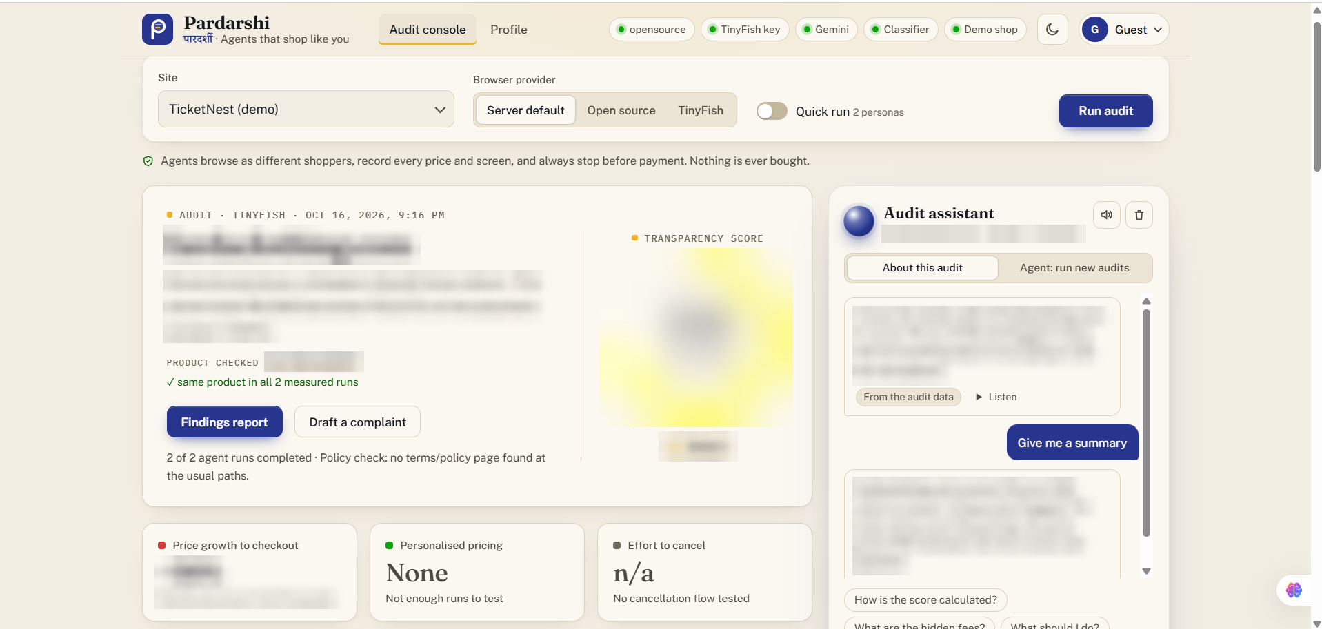
REAL-WORLD VALIDATION: INDIAN SITES
06 · REAL-WORLD VALIDATION
Live Indian shops, audited as Indian shoppers, 16 Oct 2026: what worked and what blocked us
bummer.in
Payment page · ₹599
Reached the payment page as an Indian shopper in about 2 minutes; one product pinned, every screen captured.
fardaclothing.com
Payment · ₹6,999
Reached the payment page in under a minute; checkout read and captured as evidence.
bummer.in · TinyFish
Checkout · ₹599
Agent API: product to cart to checkout in 13 steps, stopped before payment, $0.21.
30 Indian sites probed. 8 large platforms (Myntra, Meesho, Ajio, Nykaa, MakeMyTrip, BookMyShow, BigBasket, Croma) block bots at the door: reported, never bypassed. Login walls: use Connect account.
TinyFish audit in the console (shop name and figures withheld)
Hardened on live checkouts: pop-ups and new tabs, mid-load redirects, Shopify totals, busy-model retries.
Notes:
Tested on live Indian shops on 16 Oct 2026, as Indian shoppers (en-IN, Asia/Kolkata), open-source lane, one shopper at a time, never paying. bummer.in: reached the payment screen as an Indian shopper, product pinned (Modal Stretch Trunks, ₹599); The agent reached payment without paying. fardaclothing.com: The agent reached payment without paying. TinyFish Agent API on bummer.in: The Agent API walked product, cart and checkout in 13 steps, stopped at payment without paying, and priced Modal Stretch Trunks at ₹599 (₹28.52 tax included) for $0.21 of credit. Of 30 Indian sites probed, 8 large platforms blocked automated browsers at the door; those blocks are reported as evidence, never bypassed.

Slide 13



PROPOSED TINYFISH INTEGRATION
07 · PROPOSED TINYFISH INTEGRATION
All four TinyFish APIs integrated, each with a specific job, and run live on a real Indian shop
Browser API
per shopper run
Agent API
unscripted sites
A cloud browser per shopper over the Chrome DevTools Protocol (CDP), with a country proxy (US, GB, CA, DE, FR, JP, AU). Our flows set device, locale and timezone, take screenshots and reload to expose fake countdowns.
A goal (reach checkout, never pay) plus a typed output_schema: advertised price, every price line with its pre‑ticked flag, verbatim urgency copy, the product and where it stopped.
Fetch API
policy pages
Search API
peer sites
Terms, refund and cancellation pages as clean markdown, up to 10 URLs per call, feeding the Gemini policy-vs-reality check.
Finds comparable services on the live web for the Google ADK agent's peer-site tool, so a site can be compared with its peers.
Live on a real Indian shop: Agent API on bummer.in: 13 agent steps, stopped before payment, ₹599 returned as typed JSON for $0.21.
Cost: that run $0.21 · ≈ $0.04 per 20-run Browser API audit · Search and Fetch $0 (TinyFish rates, 16 Oct 2026)
Notes:
TinyFish is the production browser layer. Browser API: a cloud browser per shopper run with a country proxy, driven over CDP by our flows. Agent API: goal plus typed output_schema for unscripted sites. Fetch API: policy pages as markdown. Search API: peer sites. Verified live: Browser API session with a German exit IP; Agent API on the real Indian shop bummer.in: The Agent API walked product, cart and checkout in 13 steps, stopped at payment without paying, and priced Modal Stretch Trunks at ₹599 (₹28.52 tax included) for $0.21 of credit. No India exit node yet.

Slide 14
PROPOSED TINYFISH INTEGRATION: ONE RUN
07 · PROPOSED TINYFISH INTEGRATION
One shopper run through TinyFish, step by step, with its real output
1
Pick a shopper
Agent API · real output from bummer.in (abridged)
e.g. iPhone · Germany · new visitor
{
"product_name": "Modal Stretch Trunks",
"advertised_price": 599,
"final_payable_total": 599,
"tax_included": 28.52,
"stopped_at": "payment",
"steps": [ ... ]
}
2
Open a session
Browser API with a country proxy, or the Agent API
3
Become that shopper
CDP: device metrics, user agent, locale, timezone
4
Walk the checkout
Pinned product → basket → checkout, every screen captured
5
Stop safely
Why TinyFish
At payment, a login wall or a CAPTCHA (reported, never bypassed)
Real geography: country exit IPs, verified live; India exits are on our roadmap.
Unscripted sites: the Agent API walked a live Indian checkout nobody scripted.
Managed browsers: our effort goes into measurement, not infrastructure.
6
Hand back evidence
Typed JSON + screenshots → RunRecord → ML and statistics
Notes:
One shopper run: pick a persona, open a TinyFish session in that country, become that shopper via CDP or hand the goal to the Agent API, walk the product to checkout, stop safely, and hand back typed JSON plus screenshots. The JSON shown is the real Agent API output from bummer.in, abridged.

Slide 15
EXPECTED IMPACT
08 · EXPECTED IMPACT
From a shopper's suspicion to evidence a regulator can act on
One shopper's view → Many profiles
+32%
+9.6%
6 shopper profiles × 3 runs; real sites one shopper at a time
Suspicion → Statistics
first screen to payment (demo shop)
quoted to iPhone shoppers, 95% CI 8.4–10.9% (demo)
price gaps with 95% confidence intervals and a noise floor
Complaint → Case file
8 vs 1
13
an NCH-ready letter with exhibits and SHA‑256 hashes
Self-declaration → Independent check
clicks to cancel against clicks to join (demo)
Agent API steps to a live Indian checkout
a repeatable re-check a regulator can ask for
Pilot goal 2 consumer NGOs · 50 Indian sites in 3 months · ≈ ₹22,000 on the TinyFish Agent API (≈ ₹440 per audit), then monthly re-checks
Notes:
Four shifts: one shopper's view to many profiles; suspicion to statistics; complaint to case file; self-declaration to an independent check. Pilot goal: 2 consumer NGOs, 50 Indian sites in 3 months on the TinyFish Agent API, about Rs 440 per audit, roughly Rs 22,000 in all.

Slide 16

FEASIBILITY
09 · FEASIBILITY
Built, tested on real sites and running today, with an honest list of risks
Built and working
Risk | Mitigation
Bot protection | Measured: 8 of 30 sites block. Reported with evidence, never bypassed; standard browsers; own-account session
Login before payment | Measure to the furthest price screen; Connect account (the user signs in in their own Chrome)
False positives | Noise floor, Benjamini–Hochberg, 2% minimum gap, random run order; a person files
Evidence in court | SHA‑256 hashes reveal tampering; next: trusted timestamps, Section 63 (BSA 2023) certificate
Legal and ethics | Allowlisted sites, observe only, never pays, one shopper at a time
Cost | ₹0 open-source; ≈ ₹3.5 per Browser API audit, ≈ ₹440 per Agent API audit
End to end: 20 of 20 runs in 35 s on the demo shop
Live Indian shops audited: bummer.in, fardaclothing.com
TinyFish Agent API run on bummer.in; all 4 APIs verified
94 automated tests: ML, flows, guards, auth, TinyFish
Classifier on unseen strings: macro-F1 0.89
Open source on GitHub; private accounts, live console, report
Notes:
Everything on the left exists and runs. The right side is the honest risk list with the mitigation for each.

Slide 17









FUTURE SCOPE
10 · FUTURE SCOPE
From a hackathon tool to public consumer-protection infrastructure
NEXT 3 MONTHS
6 MONTHS
12 MONTHS
Pilot with consumer NGOs on 50 Indian sites
Shopper capture extension: real people, no bot
Platform allowlisting for independent audits
India exit nodes for geo-pricing tests
Continuous monitoring with alerts
Filing into NCH's INGRAM complaint portal
Hindi and Indic-language copy classifier
Regulator dashboard across sites
Apps and quick-commerce audits
Sustainability free for shoppers and consumer NGOs; paid, consented recurring audits for platforms that want to prove compliance.
Notes:
Next three months: pilots with consumer NGOs, India exit nodes, Indic-language classifier. Six months: a capture extension so real shoppers add evidence with no bot; monitoring; regulator dashboard. Twelve months: platform allowlisting under CCPA, NCH filing, app audits.

Slide 18
TEAM RED-HAT · AZINHACK '26
MEASURED, NOT SURVEYED
MEASURED, NOT SURVEYED
Pardarshi sends AI shoppers through checkout, stops before paying, and hands consumers and regulators the evidence: the hidden fees, the fake urgency and the personalised prices.
4
7
13
94
TinyFish APIs, run live
checks mapped to Indian law
agent steps to a live Indian checkout
automated tests
Demo video https://youtu.be/xR9-eA1mp7o · Code https://github.com/mathurojus/Pardarshi
Thank you पारदर्शी
Notes:
Close: Pardarshi turns a shopper's suspicion into measured evidence, on a ground-truth shop and on live Indian sites. Code: https://github.com/mathurojus/Pardarshi. Team RED-HAT.

