Slide 1
SSL handshak

Slide 2
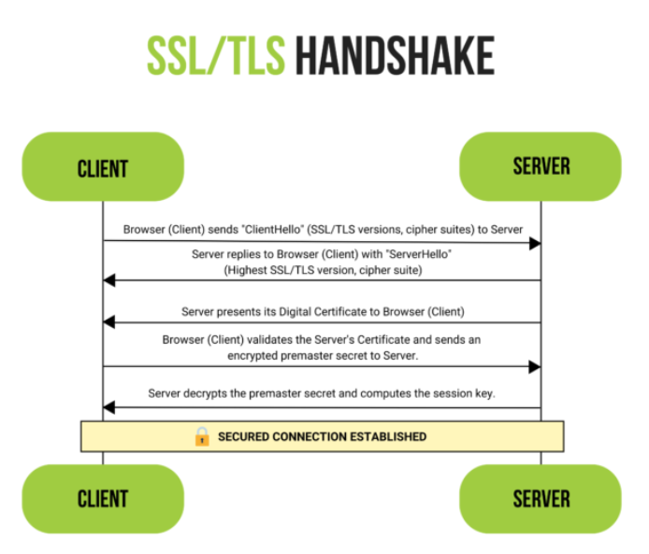
Flow

Slide 3
Links
https://www.ssl.com/article/ssl-tls-handshake-ensuring-secure-online-interactions/

