Slide 1
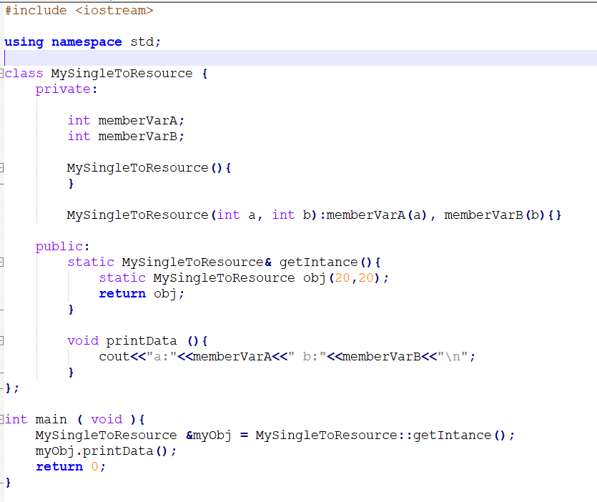
Design patterns
Creational
Structural
Behavioral
Adapter
Chain of responsibility
Singleton
Builder
Shared resource where
we can not have
multiple instances
AbstrctFactory
Bridge
State design pattern
Factory
Observer
Decorator
Prototype
Proxy

Slide 2
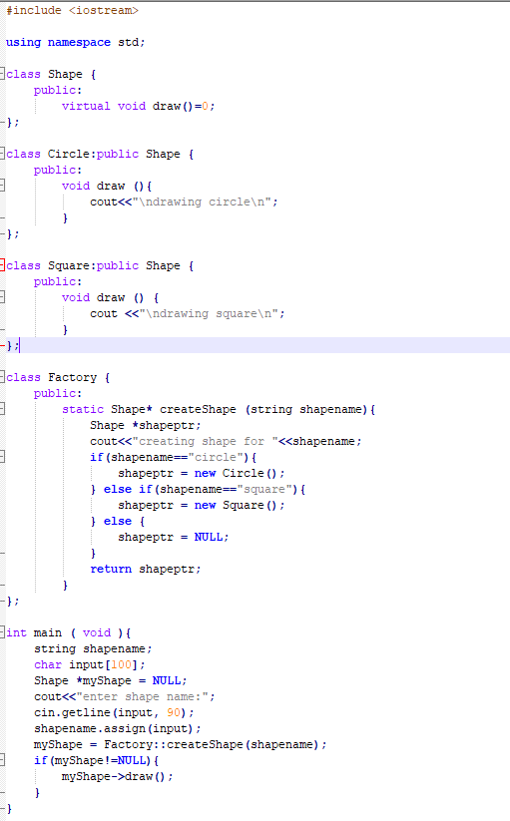
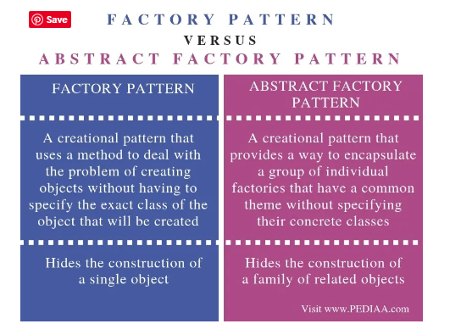
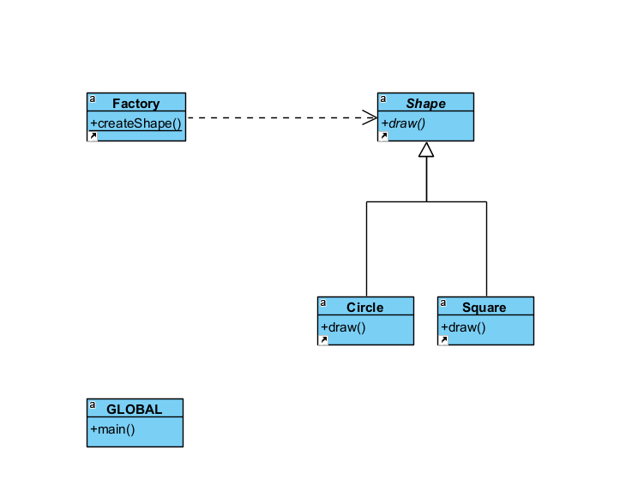
https://pediaa.com/what-is-the-difference-between-factory-pattern-and-abstract-factory-pattern/
Factory design pattern lets the client to create object that that want without knowing the concrete details of the class
Requesting factory by specifying the object that they want it isolates the concrete details of class
Abstract factory pattern is helpful when it is needed to abstract the factory details where there are multiple factories are possible

Slide 3
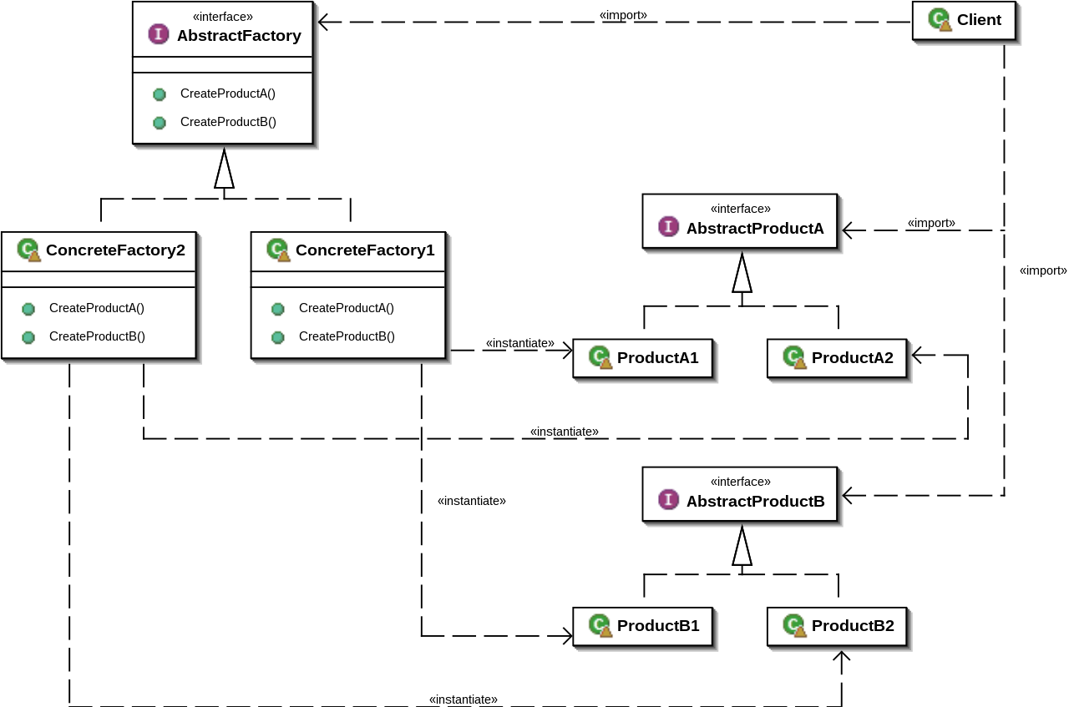
Abstract factory design pattern

Slide 4
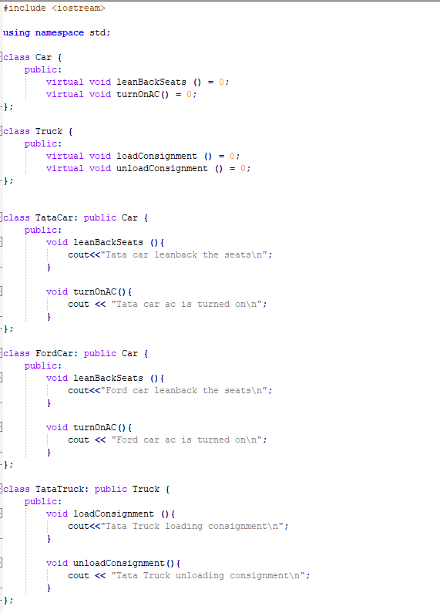
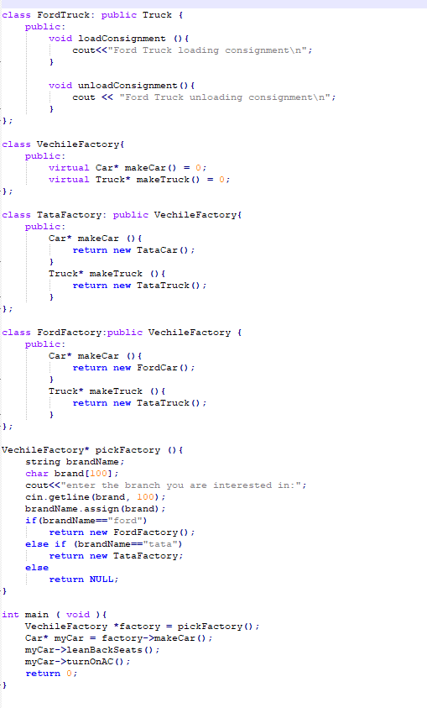
Abstract factory design pattern example

Slide 5
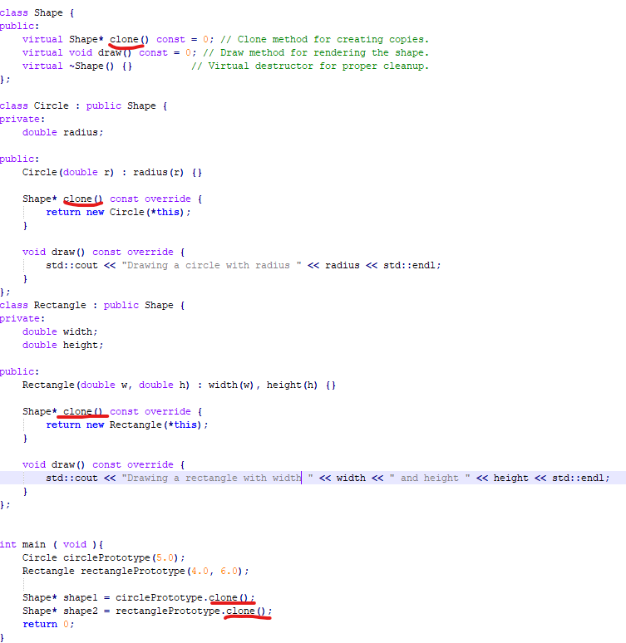
Prototype design pattern
The Prototype design pattern specifically focuses on creating new objects by copying an existing prototype object.
This pattern typically involves defining a prototype interface or base class and concrete implementations that provide cloning behavior.
Note: copy constructor is not prototype

Slide 6
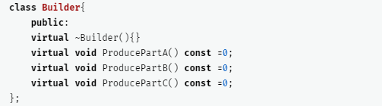
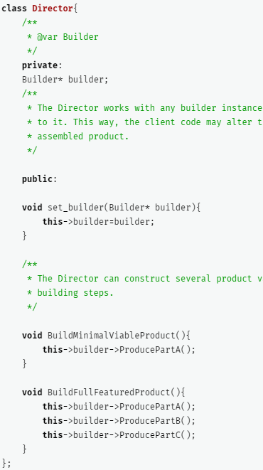
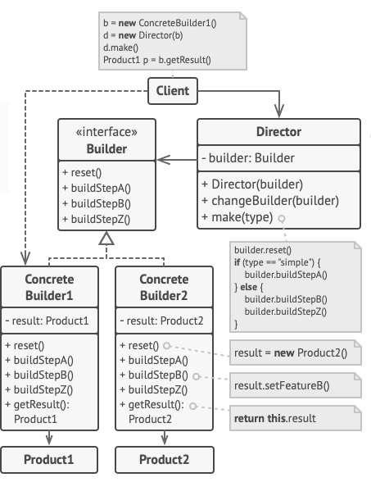
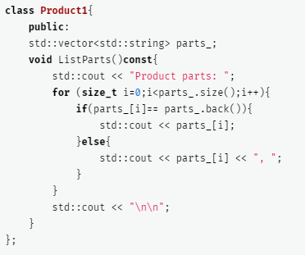
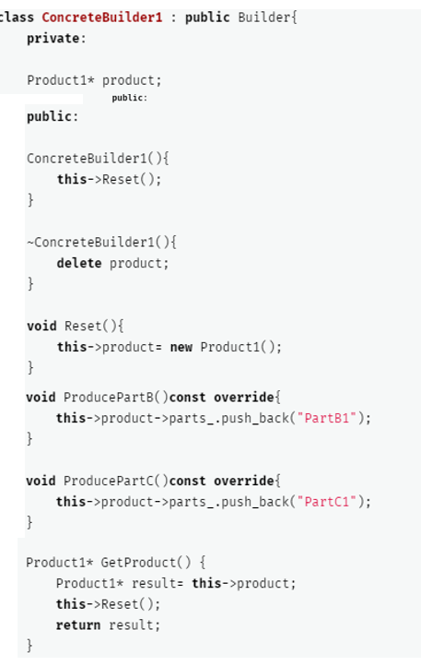
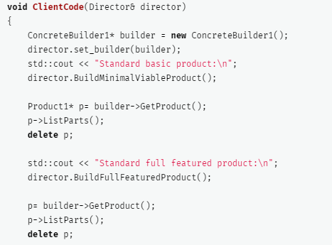
Builder design pattern

Slide 7
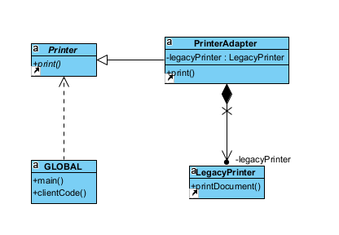
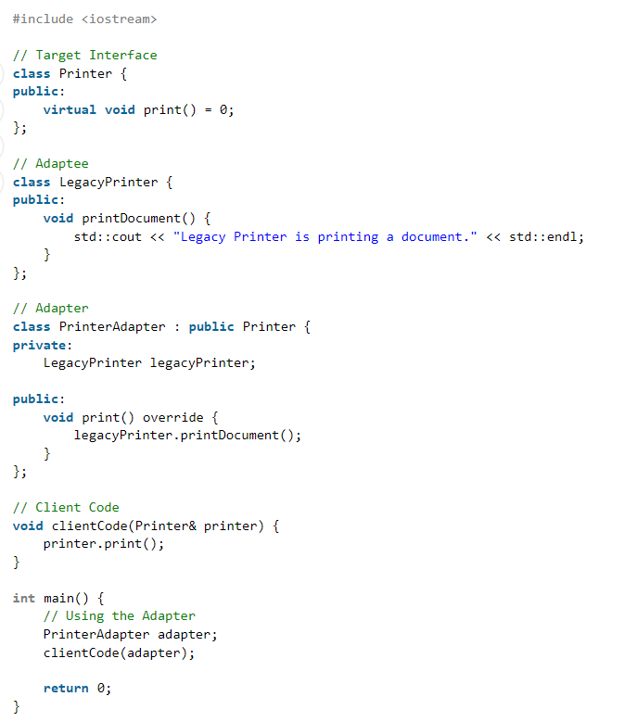
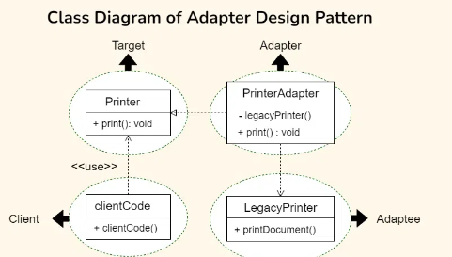
Adapter design pattern
Actual target
(that uses different interface)
Implements
methods
Defined by
interface
Adapter
Interface defined
Target
Client uses
Interface to make calls to target
calls
Client

Slide 8
Adapter design pattern
Positioning SW is a client which accesses underlying OS for various reasons
OS abstraction interfaces are defined
It is implemented by a module called TOS (Adapter)
TOS implements the interface (expected by POS SW) and calls actual OS layer (Adaptee)

Slide 9
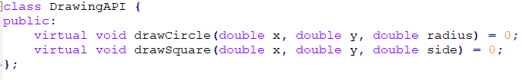
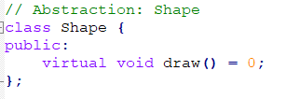
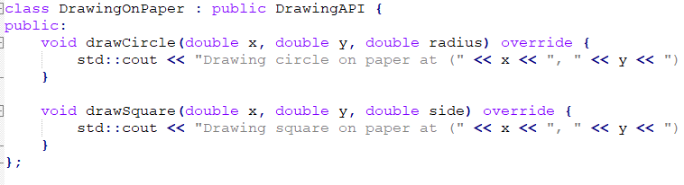
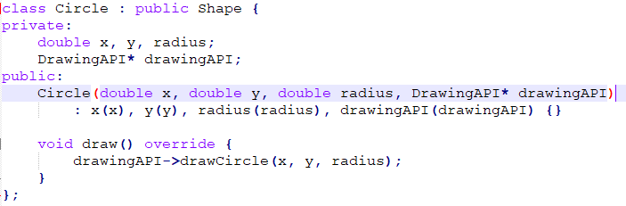
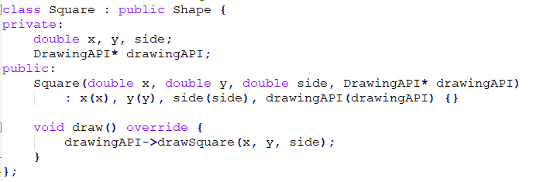
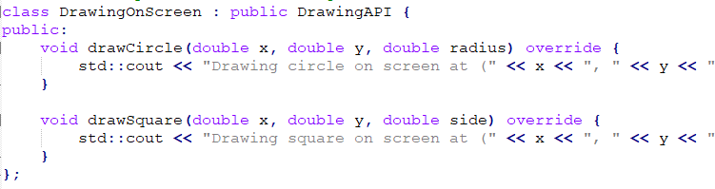
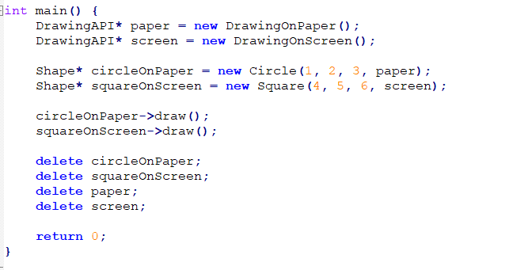
Bridge design pattern
When an abstraction is implemented, and if it needs to be extended for additional dimension (functionality), instead of adding more complexity to the abstraction and extension, implement the additional dimension as a separate class and supply as an additional input to the Abstraction extension, so that based on client’s choice appropriate implementation will be used
Implementation
Abstraction
Step2: Supply it to abstraction
Step1: Create implementation

Slide 10
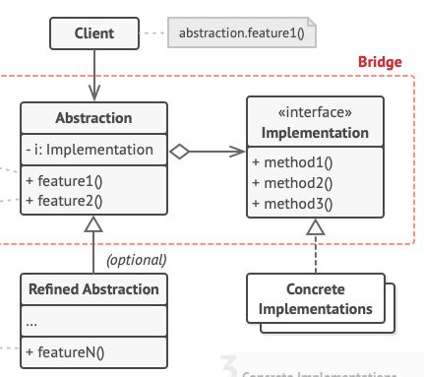
Bridge design pattern

Slide 11
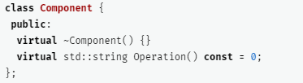
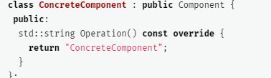
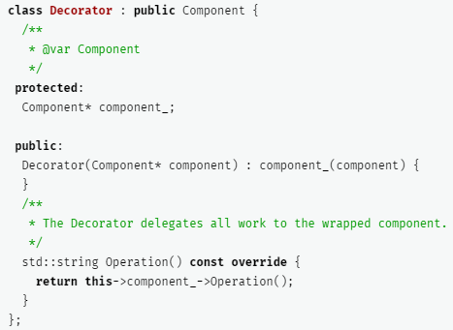
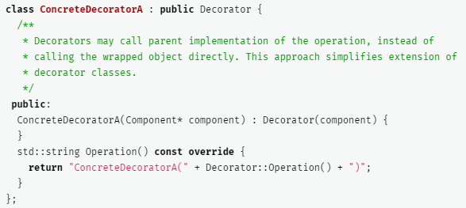
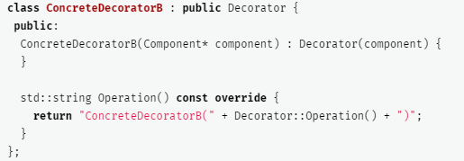
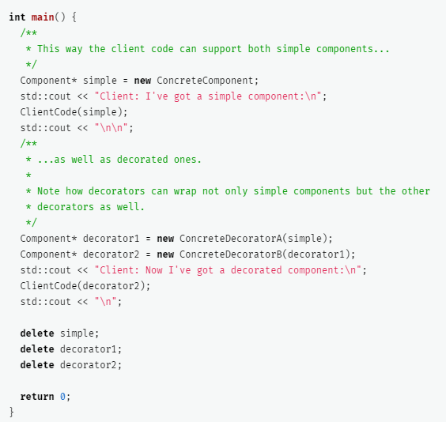
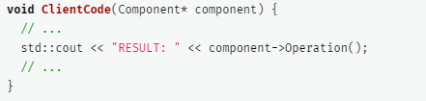
Decorator design pattern

Slide 12
State design pattern
There is a context who is common for all states. Context means the main context of the application
At any time the context will be assigned one state
Any external trigger will be triggering the context to process. The context in turn will trigger the current state’s handler
The state handler will process the request and will trigger the next state via the same context. And context will assign the new state
State1
2. Process the message
0 Trigger for state transition
1 handler
5 Trigger for state transition
3 set the next state for the context
Context
4 state of the
context is state 2
6 handler
State 2
7. Process the message
8 set the next state for the context
State N
State 3

