Slide 1
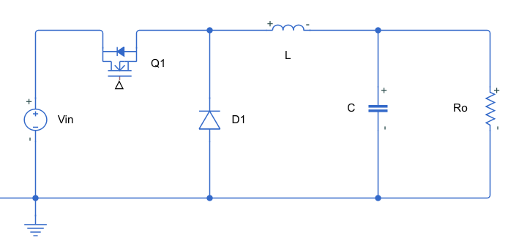
Copyright (c) 2022, The MathWorks, Inc.All rights reserved.
iL
Iout
iL
Iout

