Slide 1
Presentation Title
By Author
Date

Slide 2
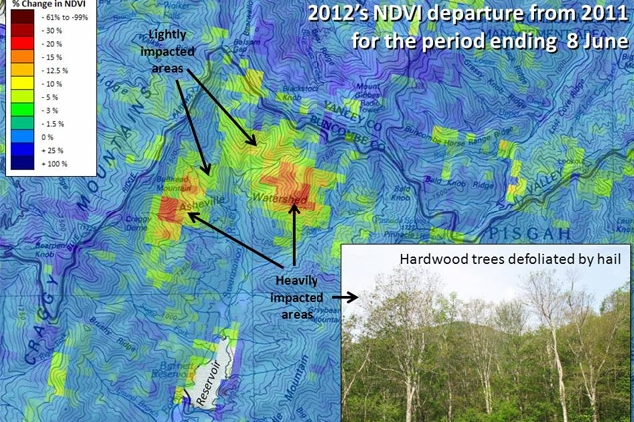
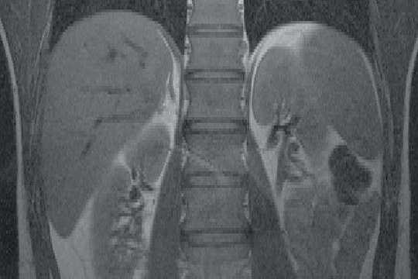
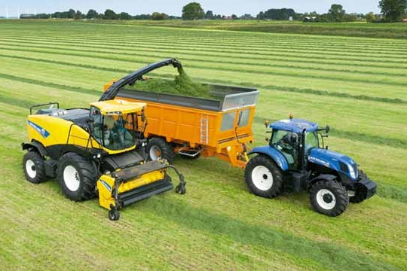
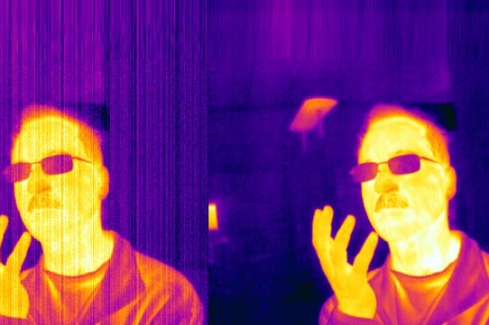
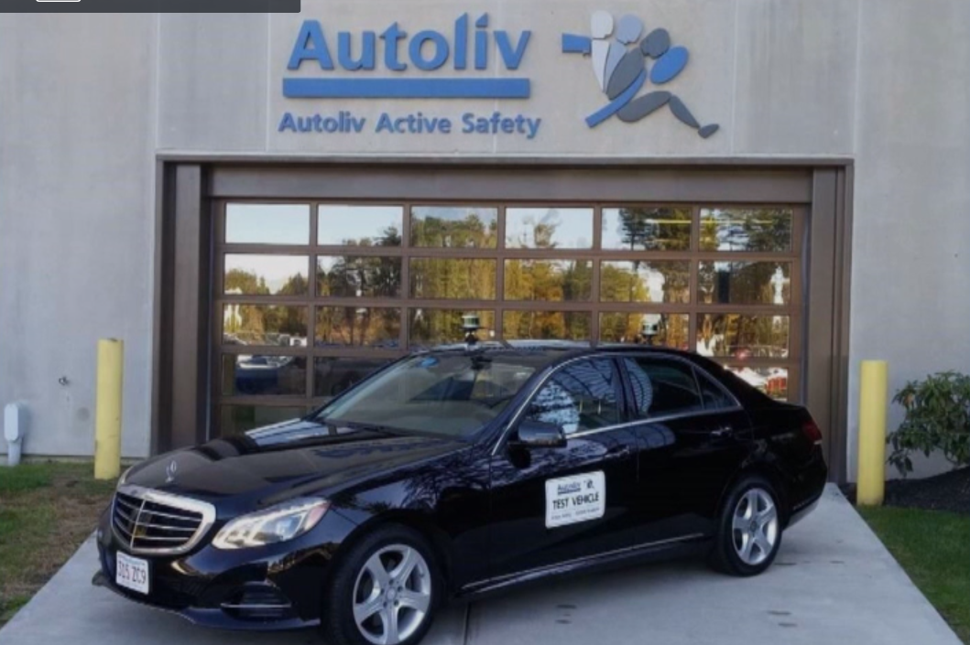
IPCV Applications
NASA Develops Warning System for Detecting Forest Disturbances
Beth Israel Medical Center Improves MRI Accuracy
CNH Develops Intelligent Filling System for Forage Harvesters
FLIR Accelerates Development of Thermal Imaging FPGA
Veoneer (Autoliv) Builds Radar Sensor using LiDAR-Based Verification
Notes:
Mention that these are all user stories and that people can look on the website if they’re interested in learning how to accomplish these workflows.
NASA: https://www.mathworks.com/company/user_stories/nasa-develops-early-warning-system-for-detecting-forest-disturbances.html
FLIR: https://www.mathworks.com/company/user_stories/flir-accelerates-development-of-thermal-imaging-fpga.html
Beth Israel: https://www.mathworks.com/company/user_stories/beth-israel-deaconess-medical-center-improves-mri-accuracy.html
CNH: https://www.mathworks.com/company/user_stories/cnh-develops-intelligent-filling-system-for-forage-harvesters.html
Veoneer: https://www.mathworks.com/videos/automated-lidar-point-cloud-annotation-for-sensor-verification-1527491006097.html

Slide 3
Image Processing & Computer Vision
Import, Display, and Exploration
Camera Calibration and 3D-Vision
Geometric Transform and Image Registration
Tracking and Motion Estimation
Image Filtering and Enhancement
Feature Detection and Extraction
Image Segmentation and Analysis
LiDAR and Point Cloud Processing
3D Volumetric Processing
Deep Learning
Notes:
People often ask what is the difference between IP and CV toolbox. This will clarify the functionality contained within the toolboxes.

Slide 4
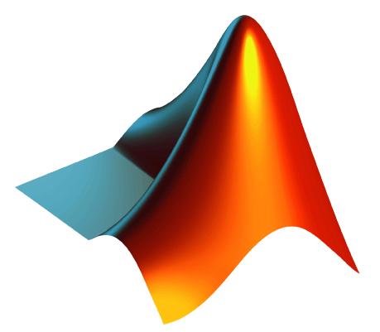
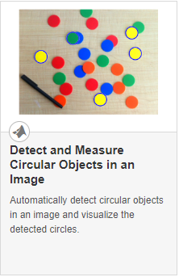
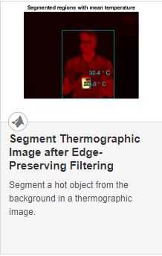
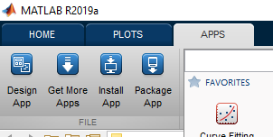
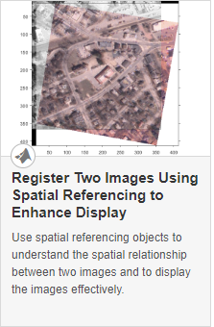
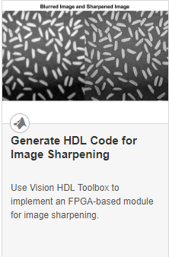
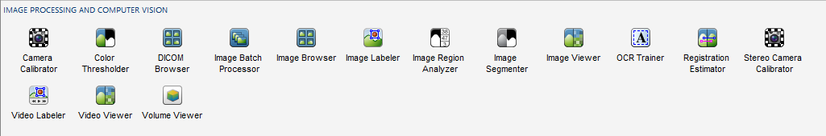
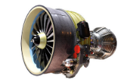

Why Use MATLAB?
Ease of Use and Thorough Documentation
Rapid Prototyping and Algorithm Development
Code Generation for Embedded Deployment
MATLAB Code
(…)
Embedded Hardware
C, C++
HDL
GPU
Need Technical Help?
Technical Support
Application Engineers
Notes:
Talk about general ease of use of MATLAB (easy syntax, great documentation examples apps to accelerate the process, access to technical support).
Apps – visual and interactive algorithm development + function generation = ability to rapidly prototype. Productivity boost!
Code generation – save time by generating embedded code from MATLAB code (standard coder product messaging)

Slide 5



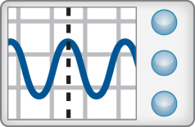
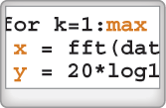
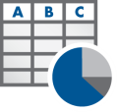
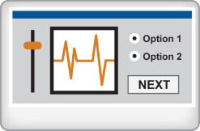



Image Processing Workflow
Access Data
Explore and Discover
Share Results
Files
Data Analysis and Modeling
Embedded Code
Algorithm Development
Enterprise Application
Hardware
Application
Creation
Software
Reports
Iterate and Automate
Notes:
Access and Explore data – files, hardware, software
Explore and Discover – this is the part we will focus on today. We iterate on these steps to get the results we want, then look to scale and automate our analysis.
After building applications and algorithms, you can deploy them to embedded devices, scale them up to the cloud or generate documents and reports.

Slide 6
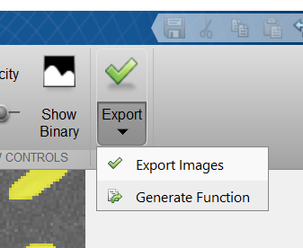
IPCV Apps Accelerate Workflow
Notes:
IPCV ships with many apps that accelerate workflow. They provide interactive tools for tweaking parameters and visualizing results. When you are finished developing an algorithm, you can export your results or generate a function to scale your algorithm to a larger dataset

Slide 7
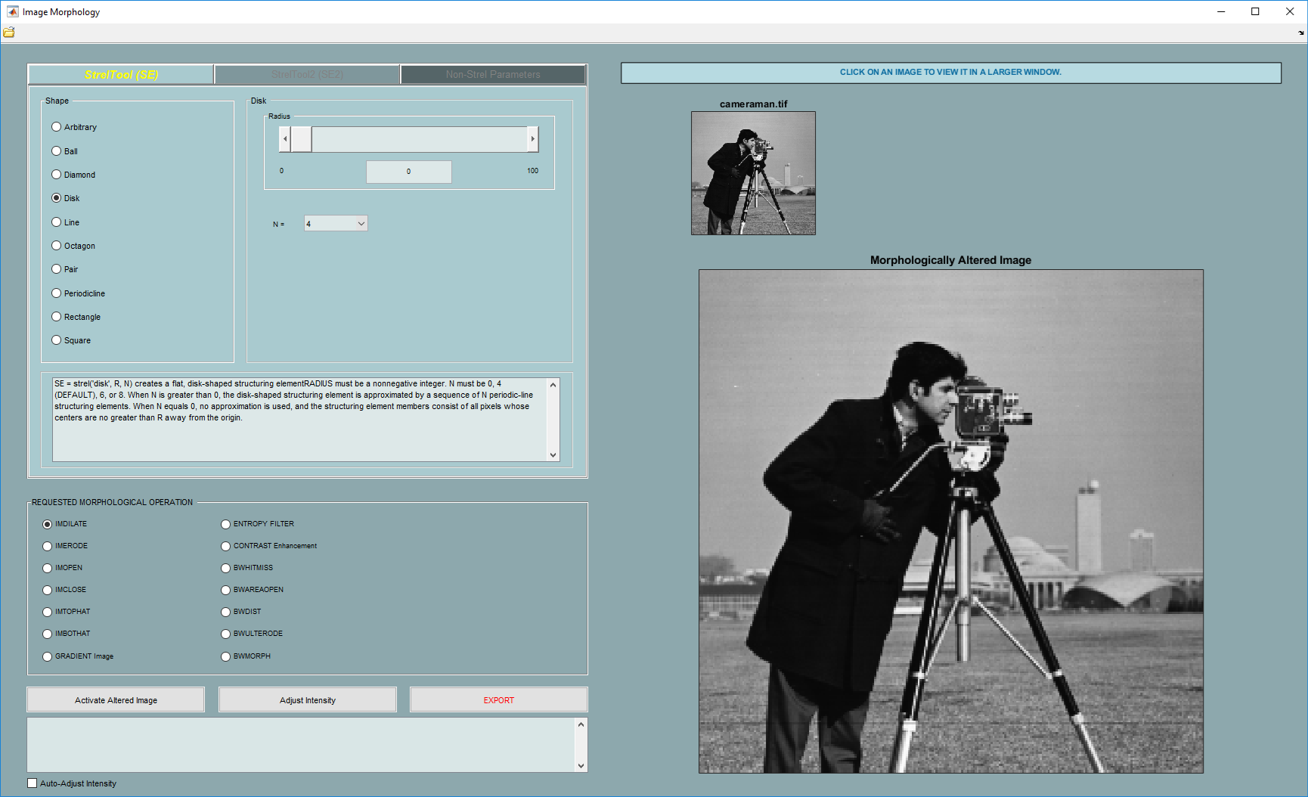
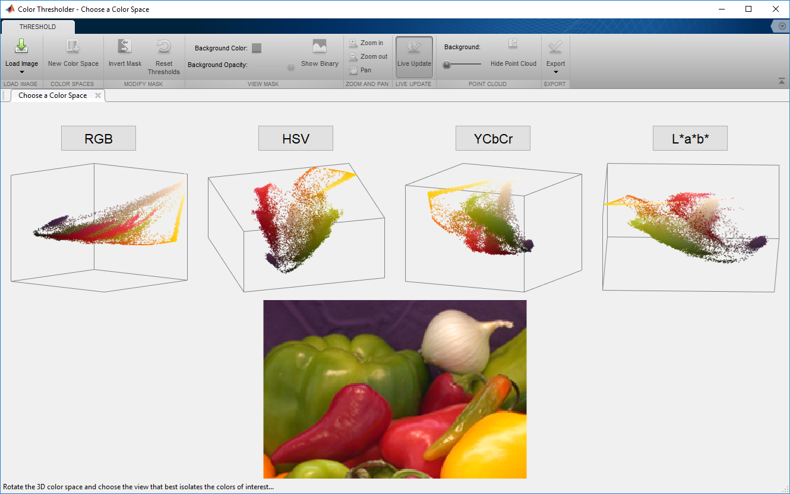
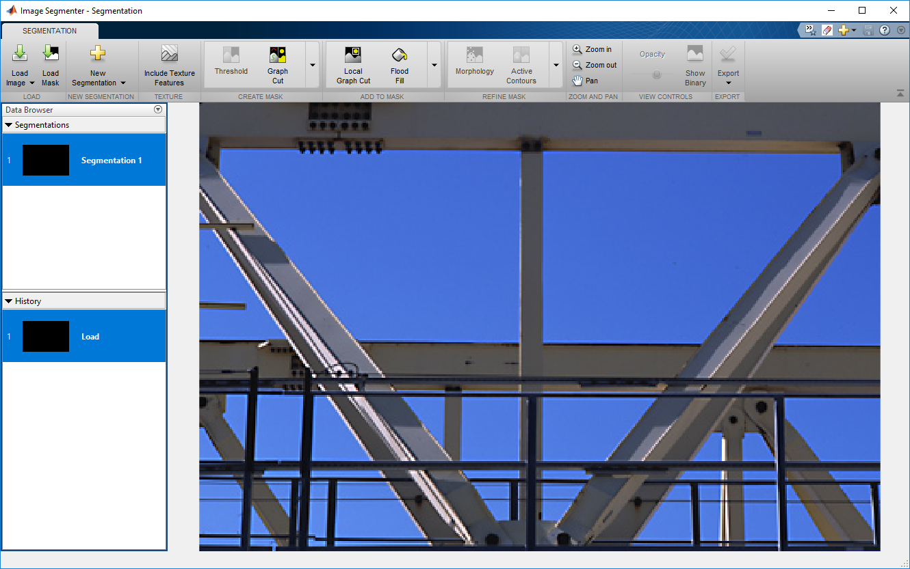
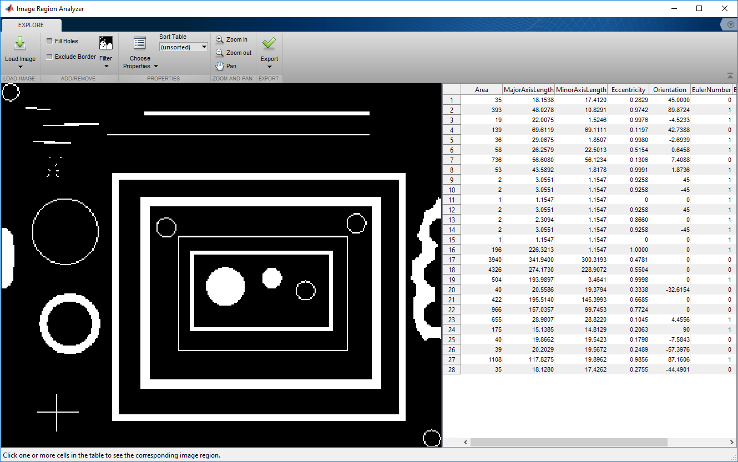
Apps for Morphology and Segmentation
Image Morphology
(file exchange)
Color Thresholder
Image Segmenter
Image Region Analyzer

