Slide 1
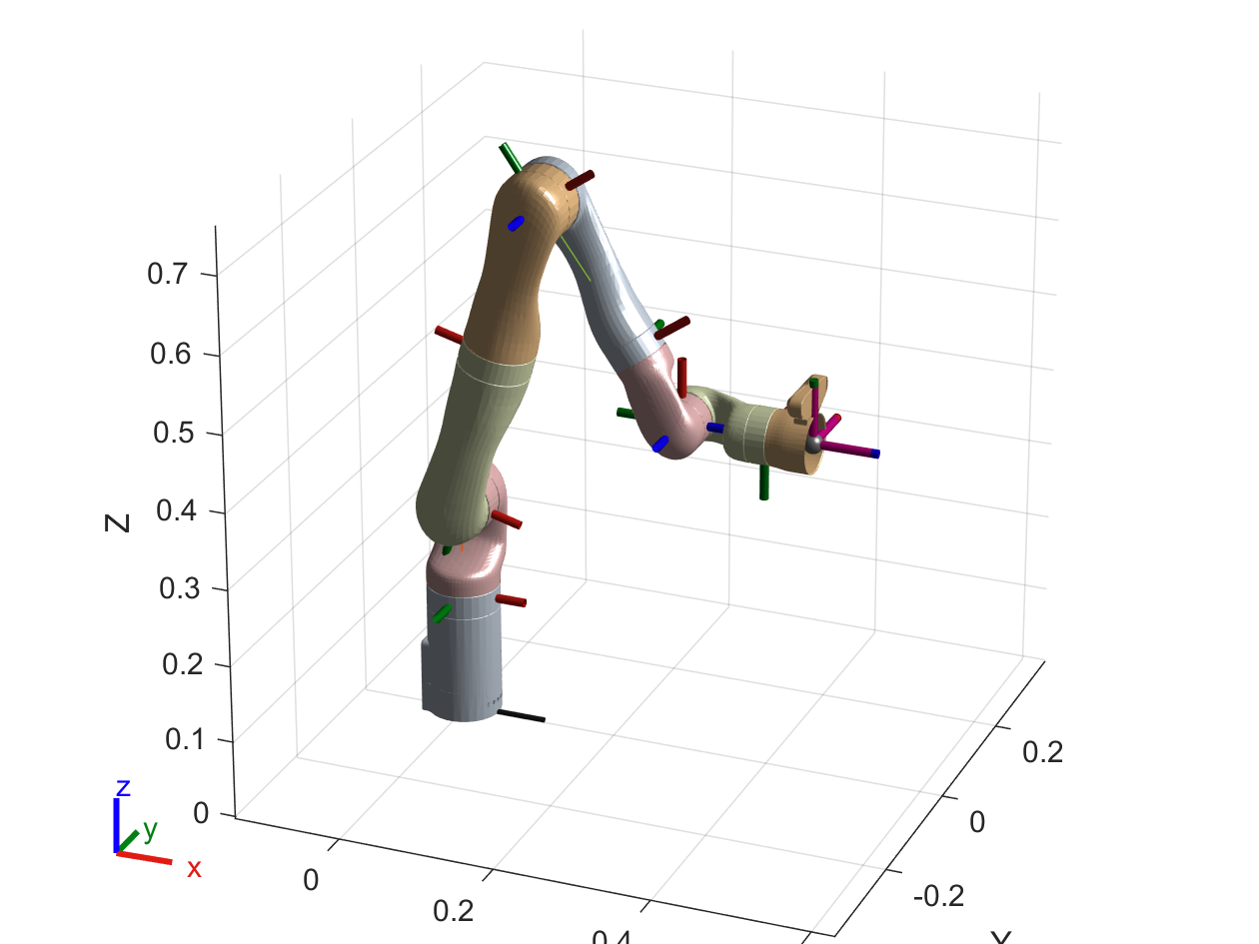

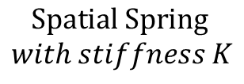



$$Spatial Spring$$
$$with stiffness K$$
$$H_{d}^{0}$$
$$H_{t}^{0}$$
$$q_{n}$$
$$D_{n}$$

