Slide 1

Mask Images

Slide 2
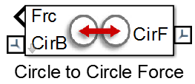
Circle to Circle
Circle to Circle Contact Force
CirF
CirF
Follower Radius in XY plane of CirF
CirB
CirB
Base Radius in XY plane of CirB
X
Reference frames for forces
Y
Active Range for force
Min and max angle measured with respect to frame CirB Full circle = [-180 180]

Slide 3
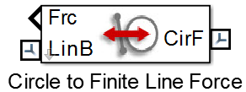
Circle to Finite Line
Circle to Finite Line Contact Force
CirF
CirF
Circle Radius in XY plane of CirF
LinB
Line Depth to Reference Frame along X axis of LinB
LinB
Line Length/2
X
Force active on both sides of line
Use this size, Reduce by 50%
Y
Reference frames for forces

Slide 4
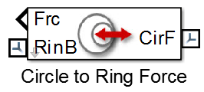
Circle To Ring
Ring
Thickness
Circle Radius
RinB
CirF
CirF
RinB
Force active inside and outside ring
Ring
Radius
Active Range for force
Min and max angle measured with respect to frame RinB Full circle = [-180 180]
X
Reference frames for forces
Y

Slide 5
Box to Box Contact Forces
Box to Box Contact Forces
Two sets of contact forces are used to model contact forces between boxes.
1. Contact between the Follower Box corners and faces of Base box
boxF_h
boxB_h
circle-to-line 4x circle 2x line
BoxF
BoxB
BoxB
boxF_l
boxB_l
BoxF
2. Contact between the Base box corners and faces of Follower box
circle-to-line 4x circle 2x line
BoxF
BoxB

Slide 6

Box to Box Contact Force, Follower Corners to Base Faces (2D)
Contact Forces between
Follower Corners and Base Faces
C
boxF_contact_rad
BoxB
(2 frames)
A
B
C1 (x4)
X
D
Y
Reference frames
for forces
Follower Box (C1) (x4)
Base Box (BoxB) (x2) (lines AB, CD)
boxF_contact_rad (hidden parameter):
Circle Radius of corner contact (min(Follower Box height, length)*0.05)
C3
C4
C2
C1

Slide 7
Box to Box Contact Force, Base Corners to Follower Faces (2D)
Contact Forces between
Base Corners and Follower Faces
C
boxB_contact_rad
BoxF
(2 frames)
A
B
C1 (x4)
X
D
Y
Reference frames
for forces
Base Box (C1) (x4)
Follower Box (BoxF) (x2) (lines AB, CD)
boxB_contact_rad (hidden parameter):
Circle Radius of corner contact (min(Base Box height, length)*0.05)
C3
C4
C2
C1

Slide 8

Box to Belt Contact Forces
Box
Box to Belt Contact Forces
Two sets of contact forces are used to model contact forces between boxes.
Bel
1. Contact between the Box corners and faces of Belt
box_l
box_h
Box
circle-to-line 4x circle 1x line
Circle radius for corner contact (min(box height, box length)*0.05)
Bel
belt_h
belt_l
2. Contact between the Base box corners and faces of Follower box
circle-to-line 2x circle 2x line
Box
Bel

Slide 9
Contact Force
Follower
x_{pen}
r_{pen}
Base
Base
Contact Stiffness (k):
Spring stiffness for force law
Contact Damping (b):
Damping constant for force law
Linear
A linear spring-damper resists penetration. Damping force is 0 as penetration decreases. Force is applied only along the direction of penetration.
Circle to Line
Circle to Circle, Ring
k*x_{pen}+b*v_{pen}
x_{pen}>0, v_{pen}>0
k*x_{pen}+b*v_{pen}
r_{pen}>0, v_{pen}>0
F_{x} =
k*x_{pen}
x_{pen}>0, v_{pen}<0
F_{r} =
k*x_{pen}
r_{pen}>0, v_{pen}<0
0
x_{pen}<=0
F_{r} = 0
x_{pen}<=0
F_{y} = 0
Nonlinear
Same as Linear except:
Stiffness force increases exponentially with penetration k*(x_{pen})^{e}, where e is parameter Penetration Exponent
Damping force increases gradually during initial penetration b*v_{pen}*(Smooth Step), where Smooth Step is a polynomial whose value increases from 0 to 1 as the penetration increases from 0 to parameter Penetration for Full Damping
Custom

Slide 10
Friction Force
Follower
Normal Force (F_{N})
Friction Force (F_{f})
Angular Velocity
Base
Translational Velocity
Similar for other Base-Follower pairs
Point of Contact
Stick-Slip Continuous
F_{f} = F_{N}*μ; μ=f(v_{poc})
Friction force is coefficient of friction*Normal Force, where the coefficient of friction is a function of the relative velocity at the point of contact.
Coefficient of friction (μ)
μ
μ_{s}
v_{poc}*μ_{s}/v_{th}
v_{poc}<v_{th}
μ_{k}
μ =
μ_{s}-v_{poc}*
(μ_{s}-μ_{k})
v_{th} <= v_{poc}<=1.5*v_{th}
v
0.5*v_{th}
v_{th}
μ_{k}
v_{poc}>v_{th}
1.5*v_{th}
v_{poc} = Velocity at point of contact
μ_{s} = Static Friction Coefficient
v_{th} = Threshold velocity
μ_{k} = Kinetic Friction Coefficient
v_{th} = Velocity Threshold
None
F_{f} = 0
Circle to Circle, Ring
k*x_{pen}+b*v_{pen}
r_{pen}>0, v_{pen}>0
F_{r} =
k*x_{pen}
r_{pen}>0, v_{pen}<0
F_{r} = 0
x_{pen}<=0

Slide 11
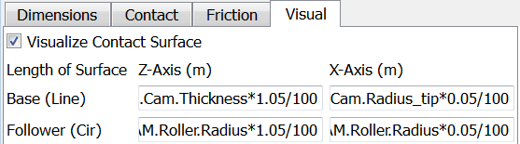

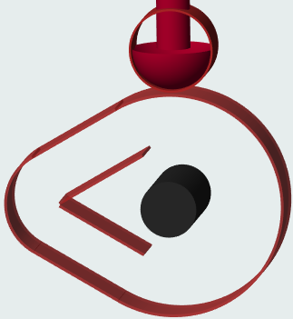
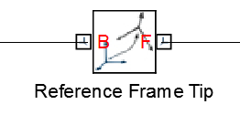
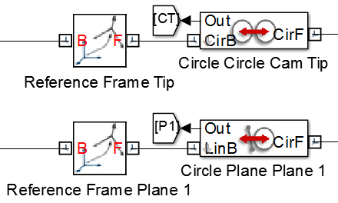
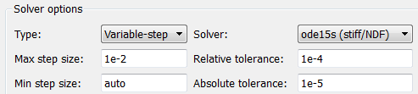
Using the Simscape Multibody Contact Forces Library
5. Verify location of contact surfaces
1. Identify the surfaces or points that may touch
Enable surface visualization on contact force blocks
2. Categorize contacts according to available contact forces (circle-circle, circle-ring, circle-line,…)
Circle to Circle
Circle to Line
Circle to Circle
Hide solids in Mechanics Explorer (if necessary)
Circle to Line
X
Y
Reference frames
for forces
3. Identify or create reference frames
Check location of surfaces in Mechanics Explorer
4. Connect frames to contact force models
6. Assign parameters and test. Solver tolerances should be <=1e-4 and max step size should be <=1e-2.

Slide 12
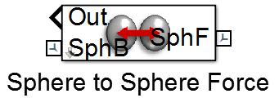
Sphere to Sphere Contact Force
SphF
SphF
Follower Sphere Radius distance from SphF
SphB
Base Sphere Radius distance from SphB
SphB
X
Reference frames for forces
Y
Z

Slide 13
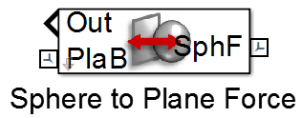
Sphere to Plane Contact Force
Sphere Radius distance from SphF
SphF
SphF
PlaB
Plane Depth to Reference Frame along Z axis of PlaB
PlaB
Plane Length along Y axis of PlaB
Force active on both sides of plane
Plane Length along X axis of PlaB
X
Y
Reference frames for forces
Z

Slide 14
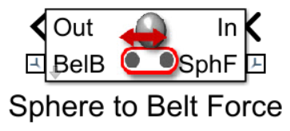
Sphere to Belt Contact Force
SphF
Sphere Radius distance from SphF
PlaB
SphF
SphF
Belt Width along Y axis of BelB
BelB
BelB
Belt Height
along Z axis of BelB
Force active on both sides of plane
Belt Length along X axis of BelB
X
Y
Reference frames for forces
Z

Slide 15
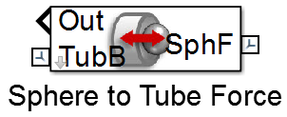
Sphere to Tube Contact Force
CirF
Sphere Radius distance from SphF
LinB
Force active on inner and outer surface of tube
SphF
Tube
Radius
TubB
SphF
Tube Length
TubB
Tube
Thickness
X
Reference frames for forces
Active Range for force
Min and max angle measured with respect to frame CirB Full circle = [-180 180]
Y
Z

Slide 16

Sphere to Cone Contact Force
Sphere Radius distance from SphF
SphF
SphF
Force active on inner and outer surface of tube
Cone Outer
Radius
Cone Inner
Radius
ConB
ConB
Active Range for force
Min and max angle measured with respect to frame ConB Full circle = [-180 180]
Cone
Height
X
Reference frames for forces
Y
Z

Slide 17
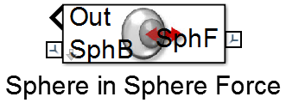
Sphere in Sphere Contact Force
SphF
PlaB
SphF
SphB
SphB
SphF
Follower Sphere Radius distance from SphF
Base Sphere Radius distance from SphB
X
Reference frames for forces
Y
Z

Slide 18
Sphere to Plane Contact Force
Face Length along x axis
of FacF
Face Length along Y axis
of FacF
Face Depth to Reference Frame along z axis
of FacF
FacF
Radius of Sphere for face contact
FacF
PlaB
Plane Depth to Reference Frame along Z axis of PlaB
PlaB
Plane Length along Y axis of PlaB
Force active on both sides of plane
X
Reference frames for forces
Plane Length along X axis of PlaB
Y
Z

