Slide 1
Changing images:
For changing images to your own photo/logo:
• Right click image > Change Picture > From a file
If it doesn’t fit properly, then:
• Delete image. Insert > Pictures > Picture from file, and then resize to fit space
For replacing QR code:
• Create new QR code with a generator and correct URL
• Select image > Right click image > Change Picture > From a file

Slide 2

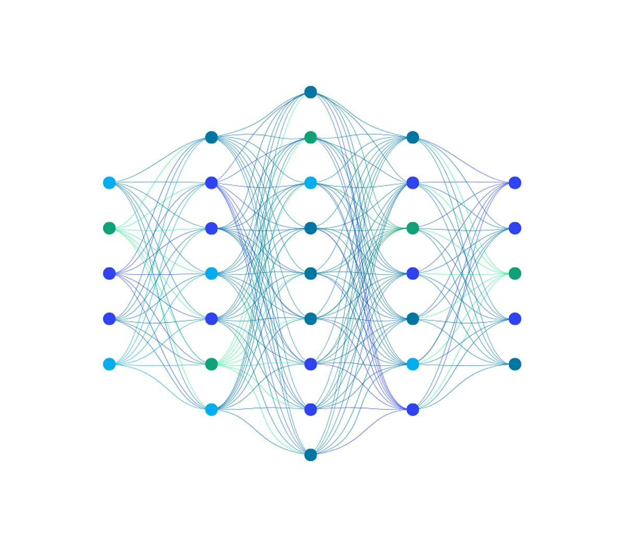
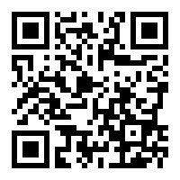
Put your MATLAB skills to the test at [INSERT NAME OF HACKATHON]! MATLAB is a programming language with specialized toolboxes for computer vision, deep learning, signal processing, hardware programming, and finance plus lots more.
Scan the QR code to learn more!
Questions?
Contact us:
[email address]

Slide 3

Put your MATLAB skills to the test at [INSERT NAME OF HACKATHON]! MATLAB is a programming language with specialized toolboxes for computer vision, deep learning, signal processing, hardware programming, and finance plus lots more.
Scan the QR code to learn more!
Questions?
Contact us:
[email address]

Slide 4
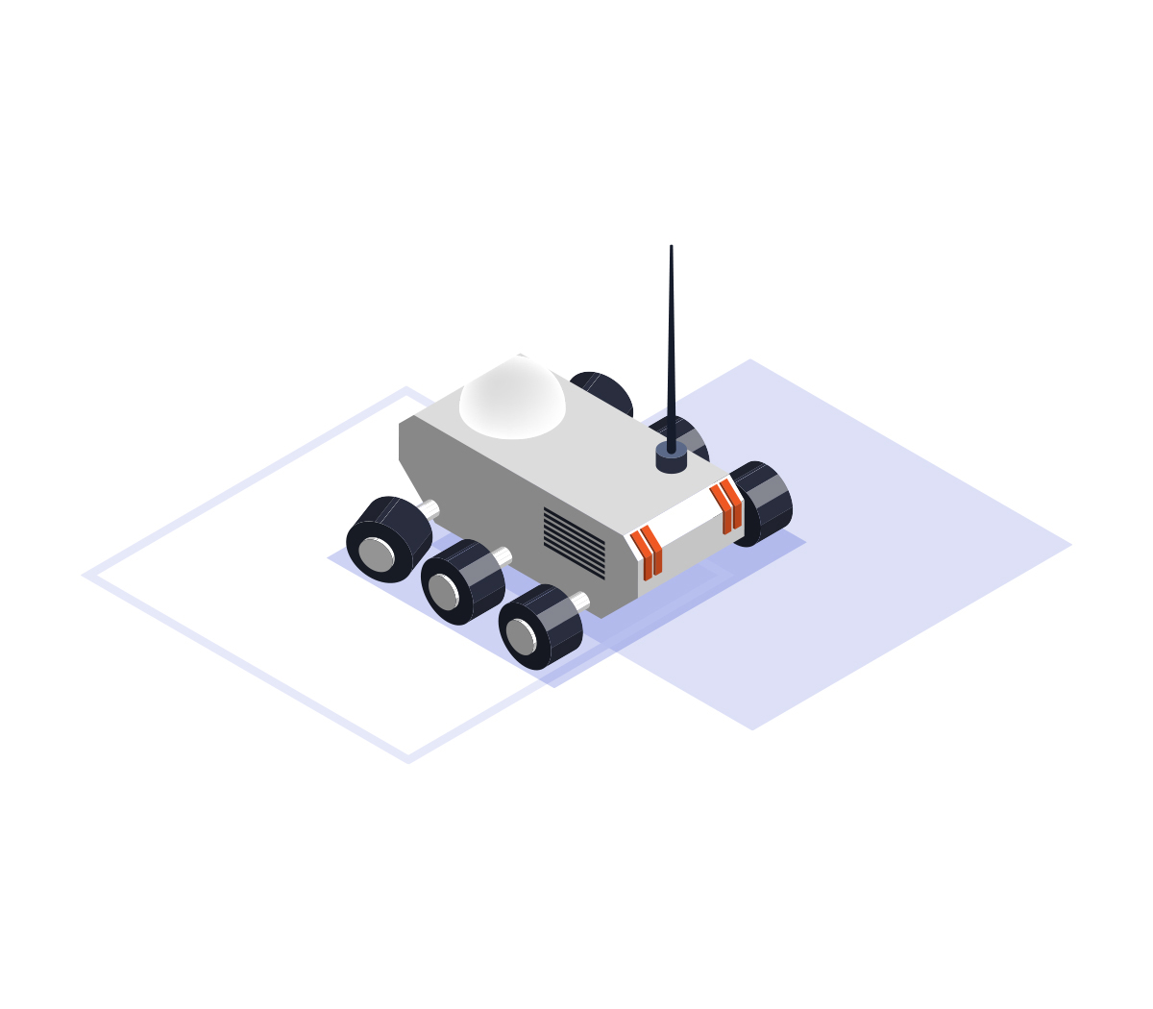
Put your MATLAB skills to the test at [INSERT NAME OF HACKATHON]! MATLAB is a programming language with specialized toolboxes for computer vision, deep learning, signal processing, hardware programming, and finance plus lots more.
Scan the QR code to learn more!
Questions?
Contact us:
[email address]

Slide 5

MATLAB is a programming language with specialized toolboxes for computer vision, deep learning, signal processing, hardware programming, and finance plus lots more!
Visit our GitHub repo for complimentary software and getting-started resources.
Questions?
Contact us:
[email address]

Slide 6
MATLAB is a programming language with specialized toolboxes for computer vision, deep learning, signal processing, hardware programming, and finance plus lots more!
Visit our GitHub repo for complimentary software and getting-started resources.
Questions?
Contact us:
[email address]

Slide 7
MATLAB is a programming language with specialized toolboxes for computer vision, deep learning, signal processing, hardware programming, and finance plus lots more!
Visit our GitHub repo for complimentary software and getting-started resources.
Questions?
Contact us:
[email address]

