Slide 1
Intergalactic Vegan Soup Factory
Architecture trade study at behavioral fidelity
Three candidates scored side by side - every number reproducible with runFullAnalysis

Slide 2
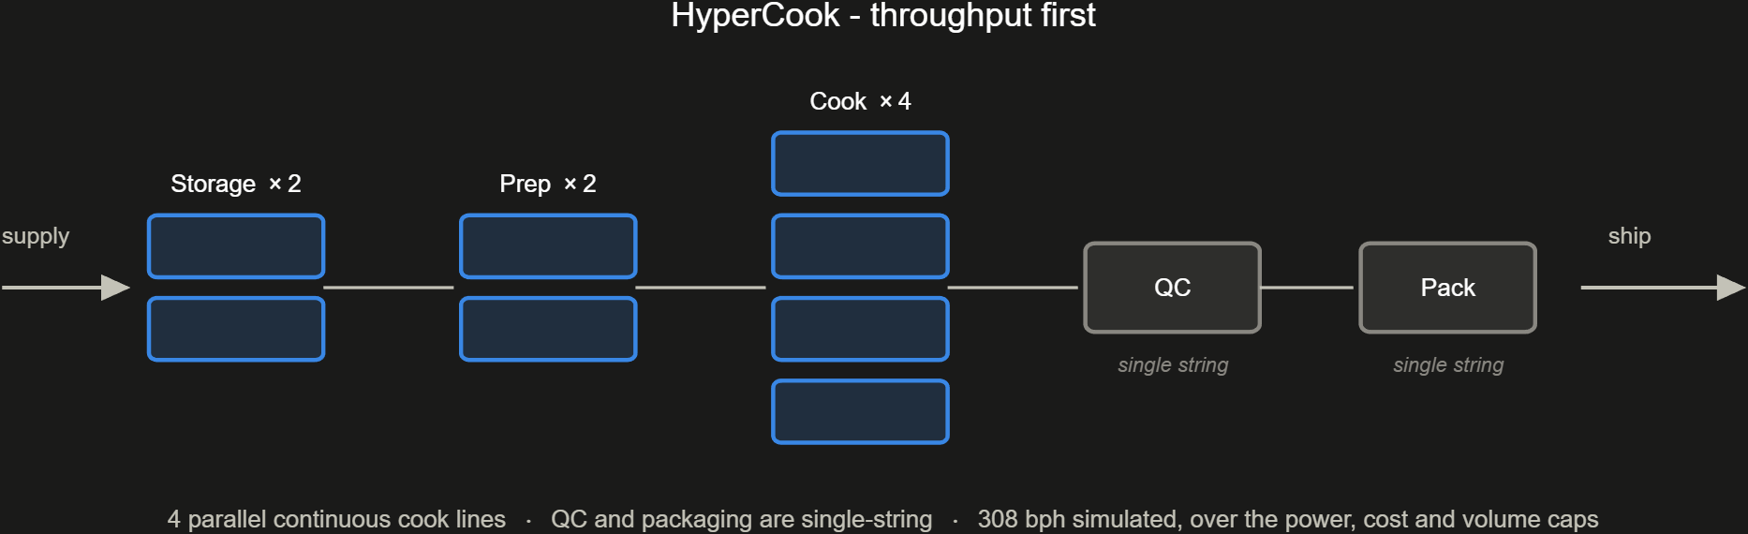
HyperCook - throughput first

Slide 3
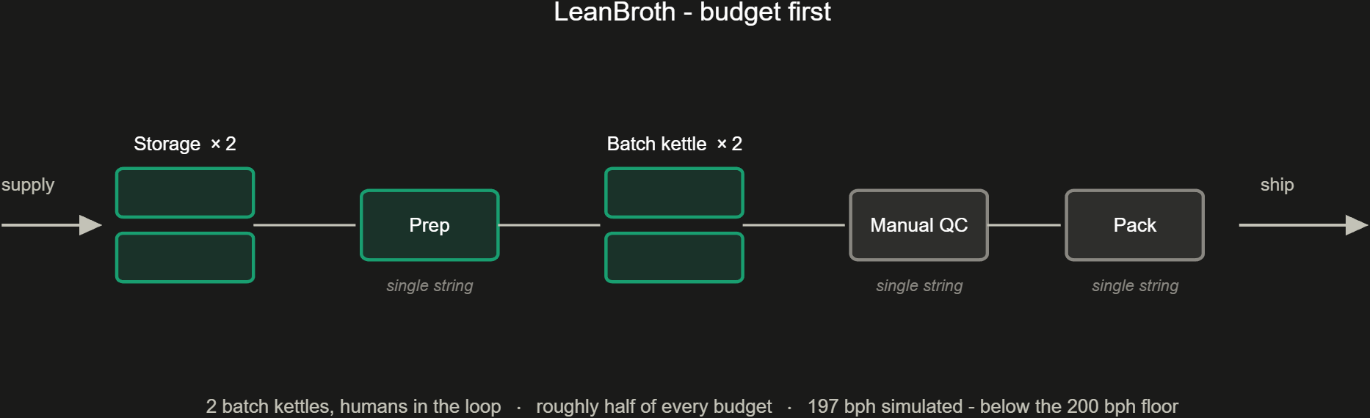
LeanBroth - budget first

Slide 4
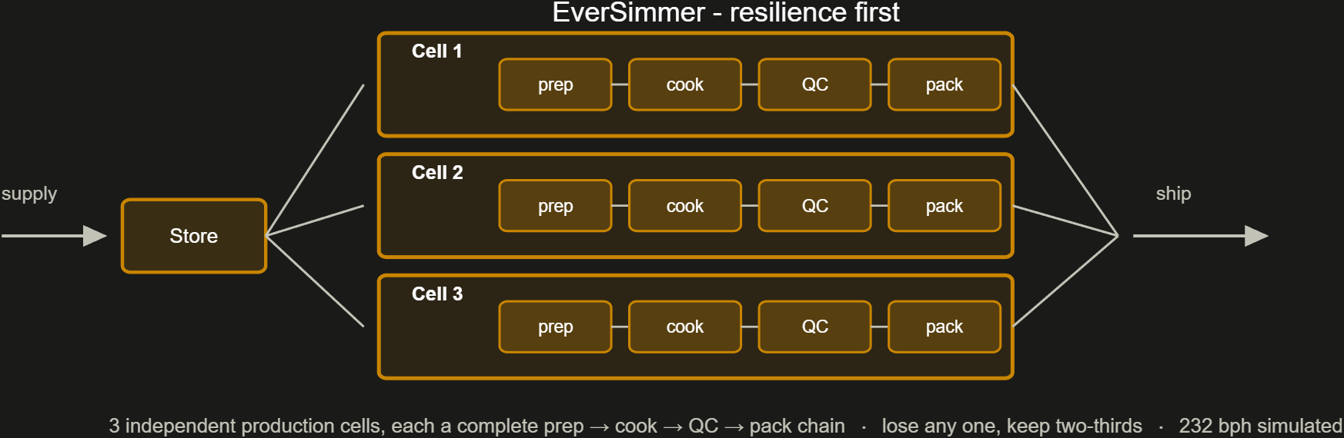
EverSimmer - resilience first

Slide 5
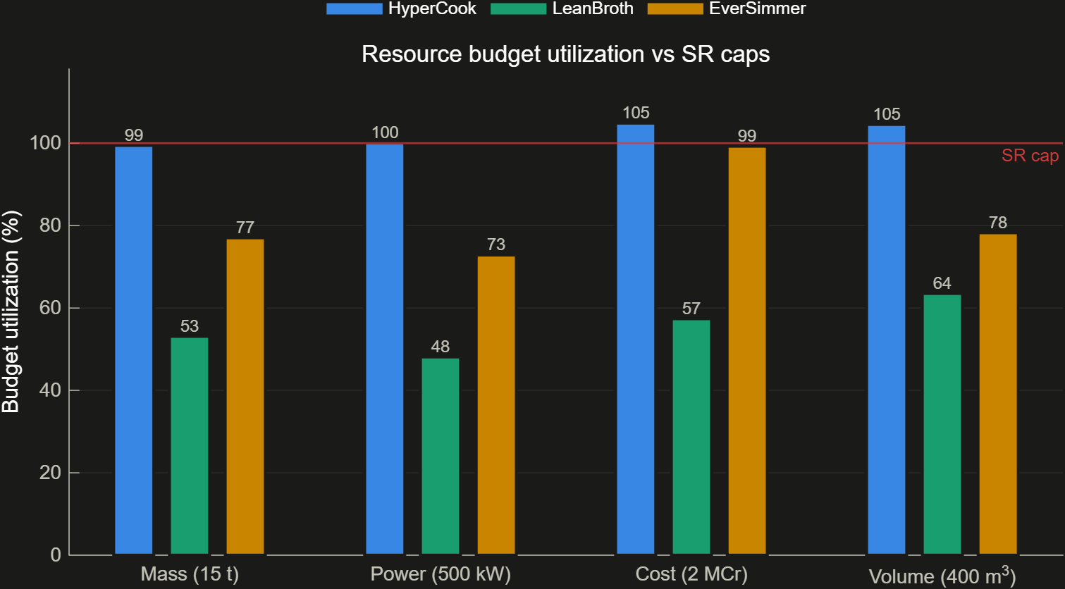
1. The paper numbers (static roll-up)
Every component carries the same 11-property stereotype
Mass, power, cost, volume sum bottom-up through the hierarchy
Throughput is bottleneck math: a chain runs at its slowest stage
Budget caps are parsed from the requirement text at run time
HyperCook: 500.4 kW, 2097.2 kCr, 418.2 m^3
HyperCook is over power, cost and volume before anything runs
Claims, not evidence: assumes lossless flow

Slide 6
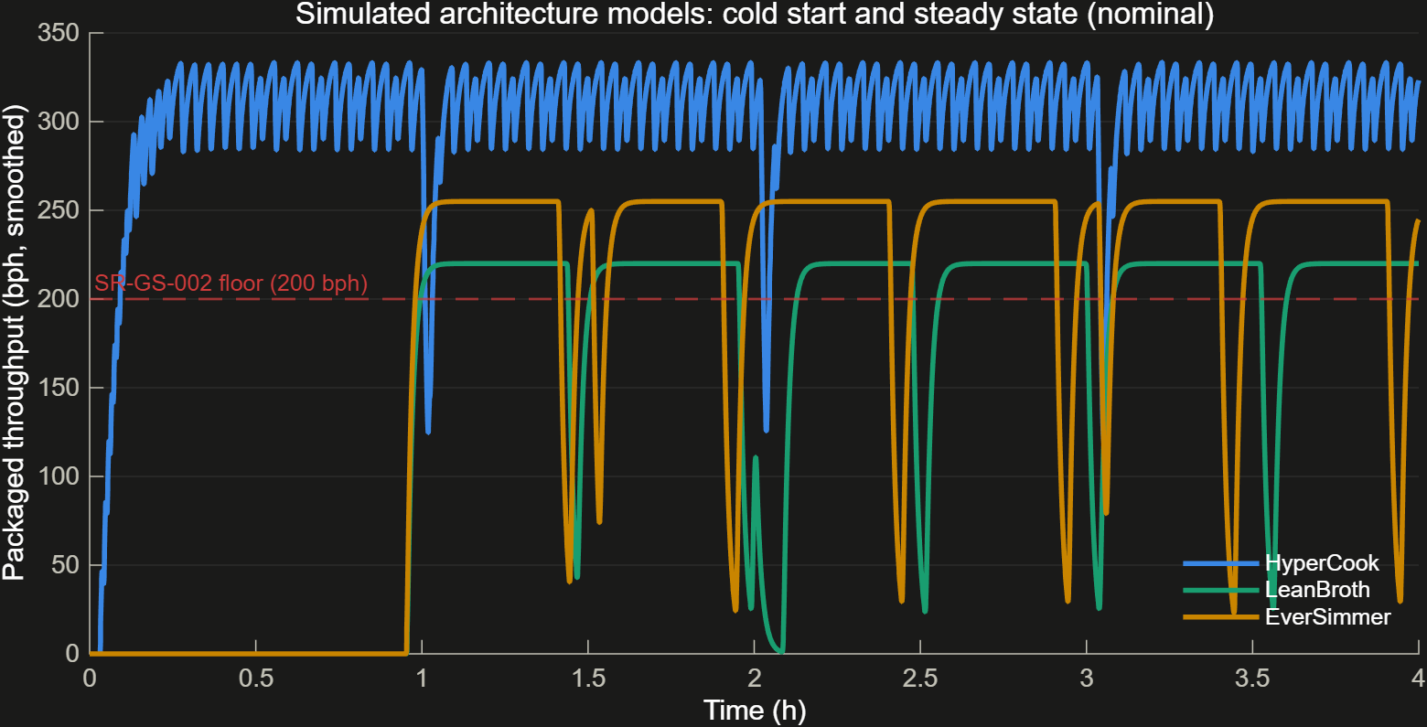
2. Run the factory (nominal simulation)
Behaviors live inside the architecture models themselves
Batch kettles heat up physically; QC rejects a few percent and recalibrates
Simulated vs rated: 308 vs 320, 197 vs 210, 232 vs 240 bph
First bowl: 119 s continuous vs ~57 min batch cold start
LeanBroth's margin is gone before the trade study even starts

Slide 7
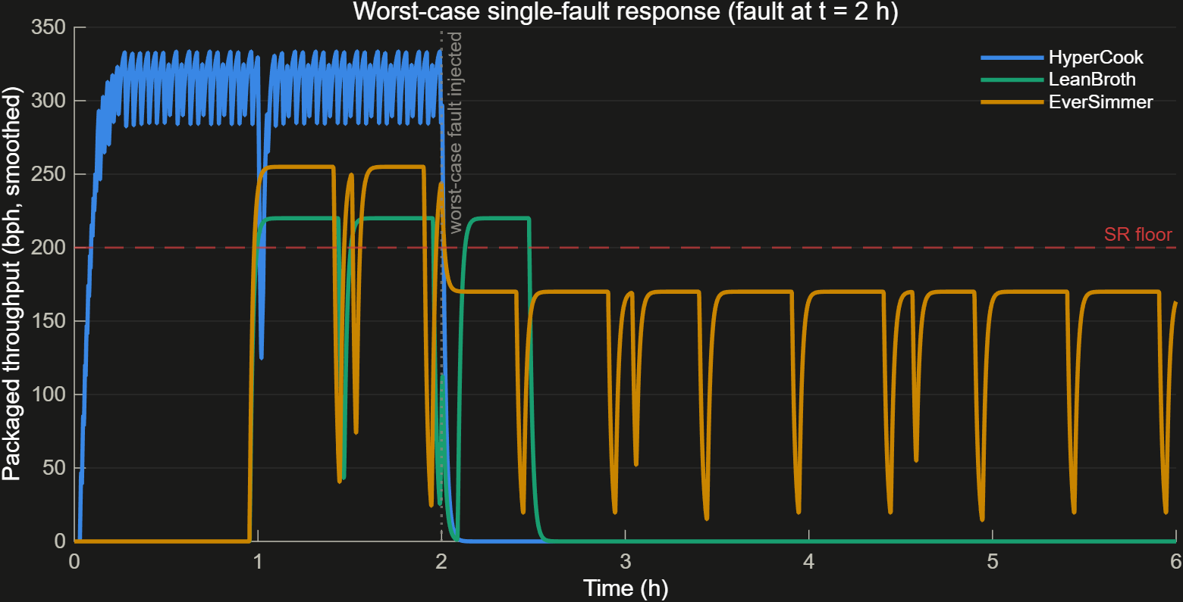
3. Break something on purpose (worst-case fault)
Variant | Worst single fault | Retention
HyperCook | InlineQCScanner (serial single-string) | 0%
LeanBroth | PrepWorkstation (serial single-string) | 0%
EverSimmer | ProductionCell1 (one of three cells) | 67%

Slide 8
4. The pass/fail line (formal compliance gate)
8 quantitative requirements as executable Requirements Table rows
Canonical roll-up and simulation metrics feed the gate
A parallel hand-coded check must agree with every formal verdict
A failed gate stays visible when all three candidates are scored
Variant | Formal gate result
HyperCook | fails power, cost and volume
LeanBroth | fails throughput
EverSimmer | compliant on all 8
Checks passing | 20 of 24
Recovery | QC reject <= ~1.3% clears the 200 bph floor

Slide 9
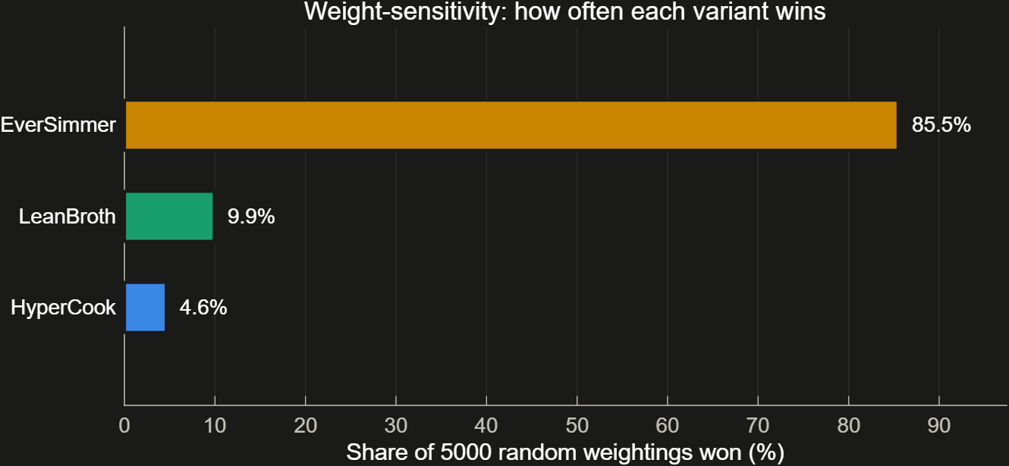
5. Pick a winner you can defend (MCDA + Monte Carlo)
Scenario | HyperCook | LeanBroth | EverSimmer | Winner
Balanced | 0.35 | 0.35 | 0.69 | EverSimmer
ThroughputFirst | 0.47 | 0.30 | 0.60 | EverSimmer
CostLean | 0.20 | 0.61 | 0.53 | LeanBroth
MissionAssurance | 0.25 | 0.31 | 0.82 | EverSimmer

Slide 10
Where this leaves the selection
No baseline is committed: ADR-035 reopened the selection for team review
EverSimmer leads on the merits: wins 3 of 4 named scenarios and 85.5% of 5,000 random weightings
it is the only candidate that clears all 8 formal gates and still produces after any single fault (67% retention)
LeanBroth remains a descope option, but misses the 200 bph throughput floor
HyperCook keeps the 119 s cold-start and raw-rate advantages, but fails power, cost and volume
Every number regenerates from the repo: runFullAnalysis for results, runAllTests for evidence

