Slide 1
HEXCoreH
Moist Air flow
HEXTubeH
finSpacing
gapHTubes
HEXTubeL
Thermal Liquid flow
HEXTubeW

Slide 2
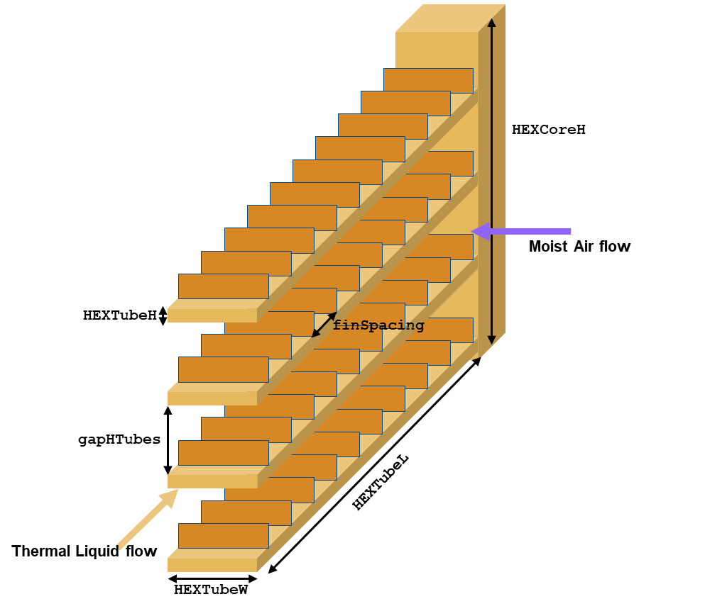
HEXCoreH
Moist Air flow
HEXTubeH
finSpacing
gapHTubes
HEXTubeL
Thermal Liquid flow
HEXTubeW

Slide 3
cpWidth
cpLength
effFlowLength
channelPitch
channelHeight
channelWidth
cpThickness
Figure 1: Serpentine channel configuration

Slide 4
cpWidth
channelMargin
channelPitch
cpLength
effFlowLength
channelHeight
channelWidth
cpThickness
Figure 1: U-shaped channels configuration

Slide 5
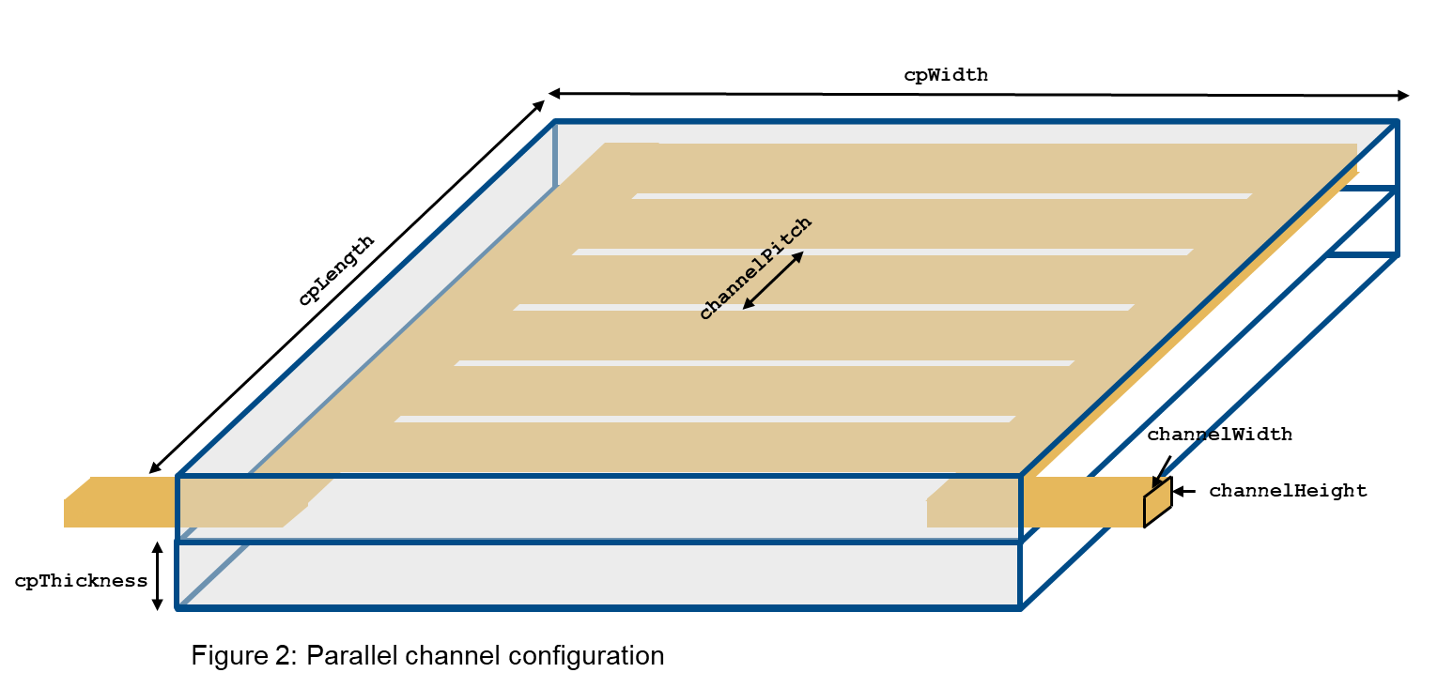
cpWidth
channelMargin
channelPitch
cpLength
channelLength
channelHeight
channelWidth
cpThickness
Figure 1: Parallel channels configuration

Slide 7
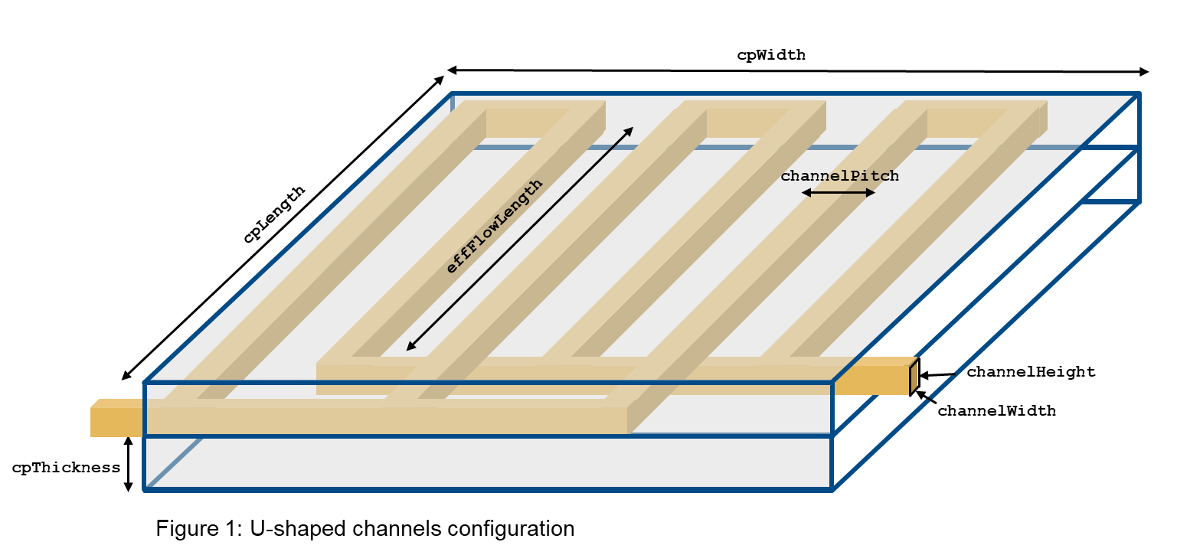
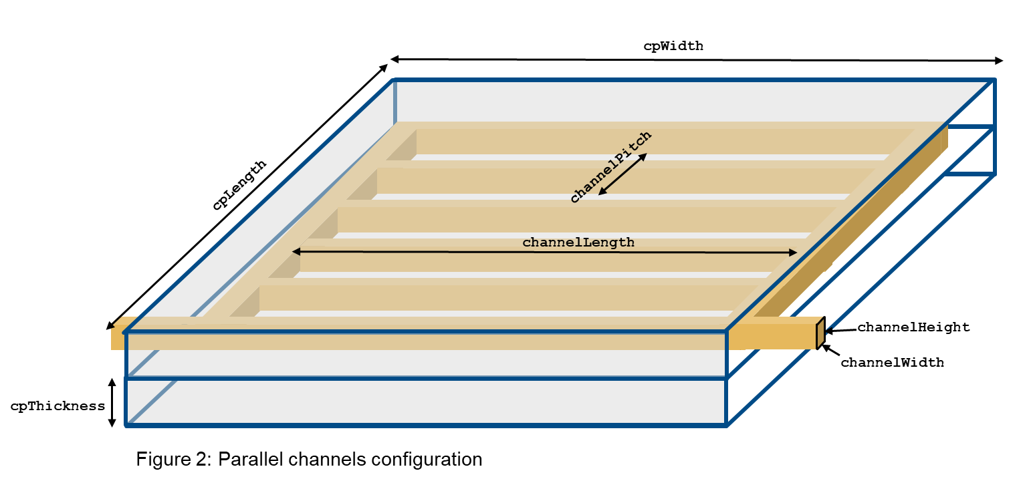

Slide 8
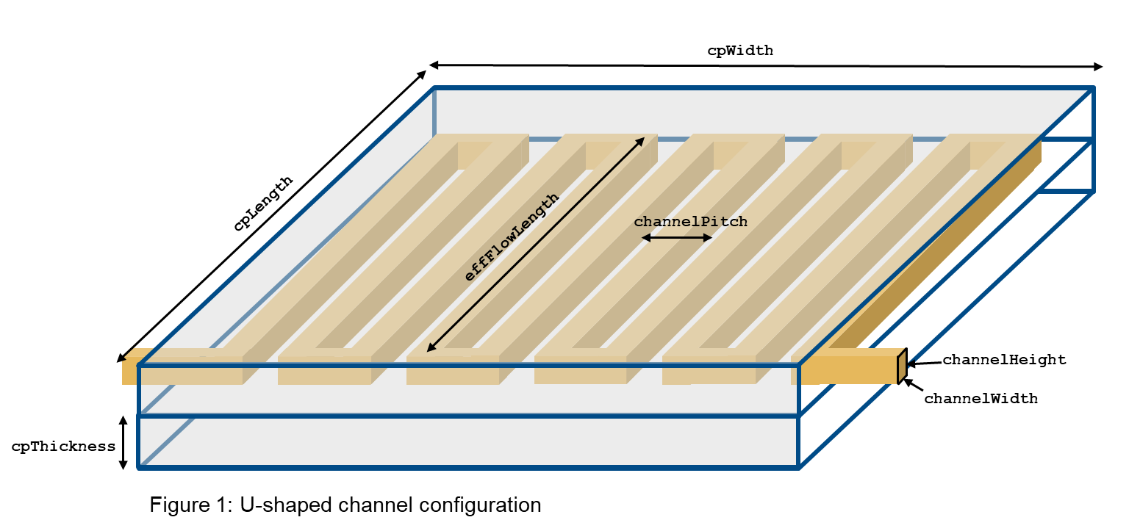

Slide 9
cpWidth
channelPitch
cpLength
effFlowLength
channelWidth
channelHeight
cpThickness
Figure 1: U-shaped channel configuration

Slide 10
cpWidth
cpLength
channelPitch
channelWidth
channelHeight
cpThickness
Figure 1: Parallel channel configuration

Slide 11
cpWidth
cpLength
channelPitch
channelWidth
channelHeight
cpThickness
Figure 2: Parallel channel configuration

Slide 12
