Slide 1


Liquid-to-Ambient HEX
Expansion Device
Device
Cold Plate
Pump

Slide 2
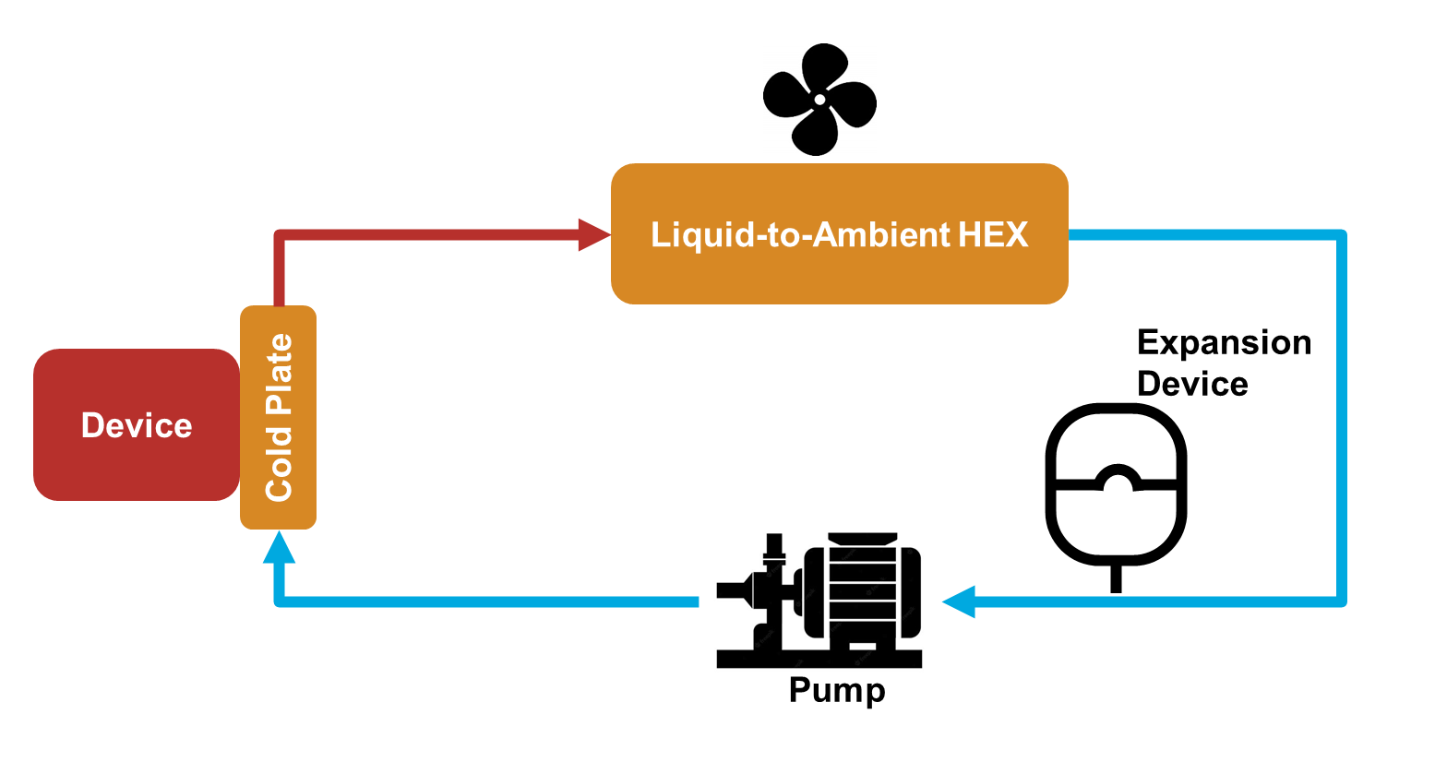

Slide 3
HEXCoreH
Moist Air flow
HEXTubeH
finSpacing
gapHTubes
HEXTubeL
Thermal Liquid flow
HEXTubeW

Slide 4
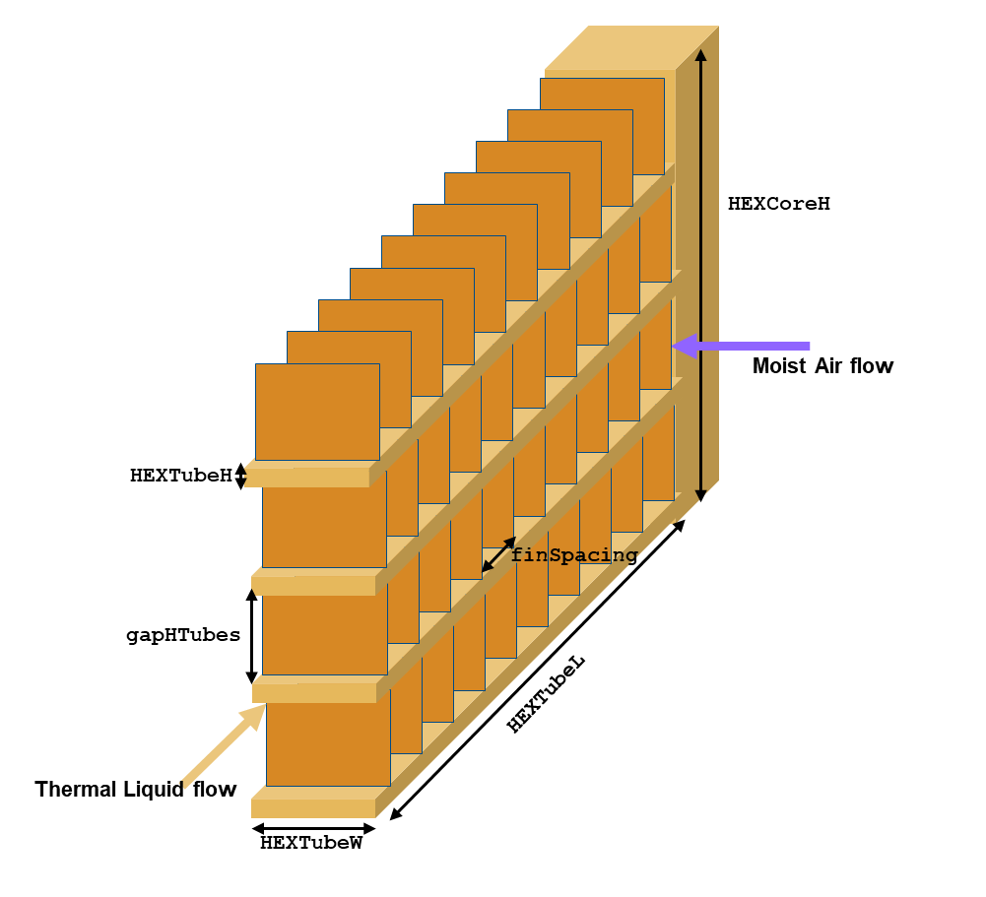

Slide 5
cpWidth
cpLength
effFlowLength
channelPitch
channelHeight
channelWidth
cpThickness
Figure 1: Serpentine channel configuration

Slide 6
cpWidth
channelMargin
channelPitch
cpLength
effFlowLength
channelHeight
channelWidth
cpThickness
Figure 1: U-shaped channels configuration

Slide 7
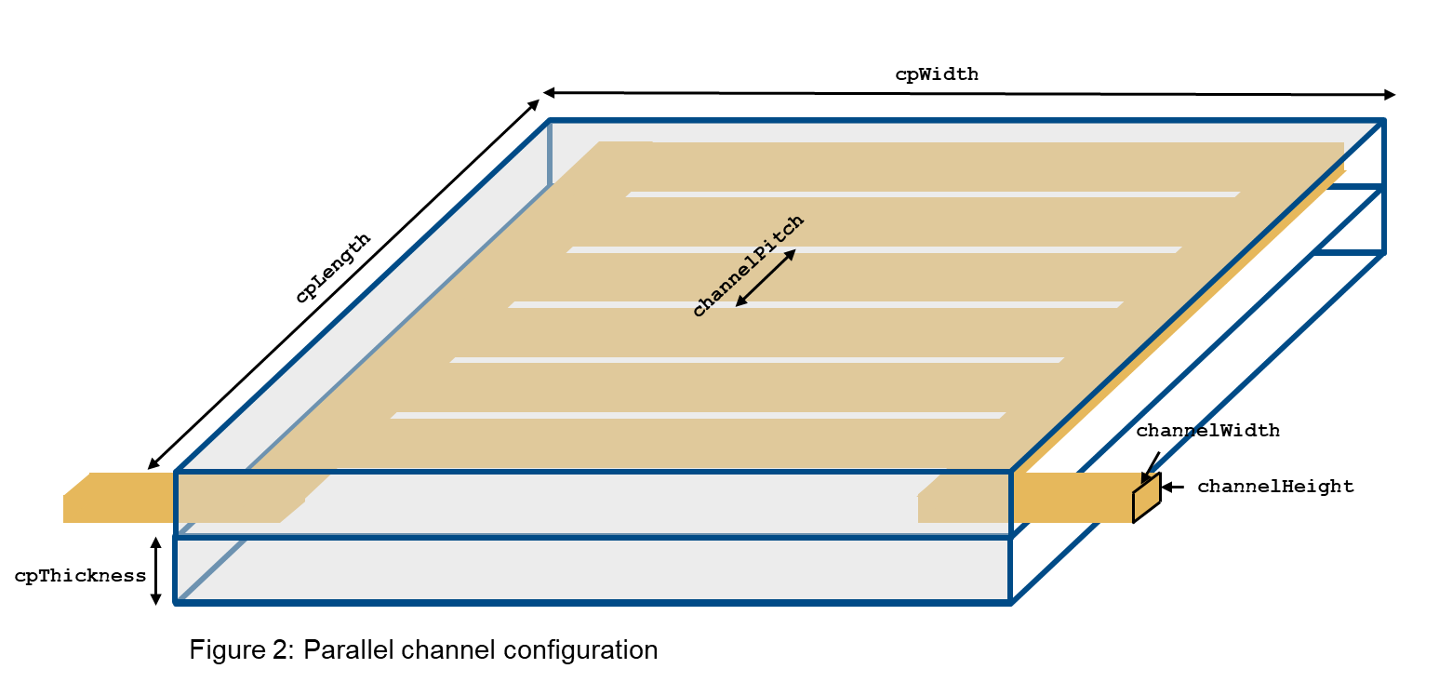
cpWidth
channelMargin
channelHeight
channelPitch
channelWidth
cpLength
channelLength
cpThickness
Figure 2: Parallel channels configuration

Slide 8
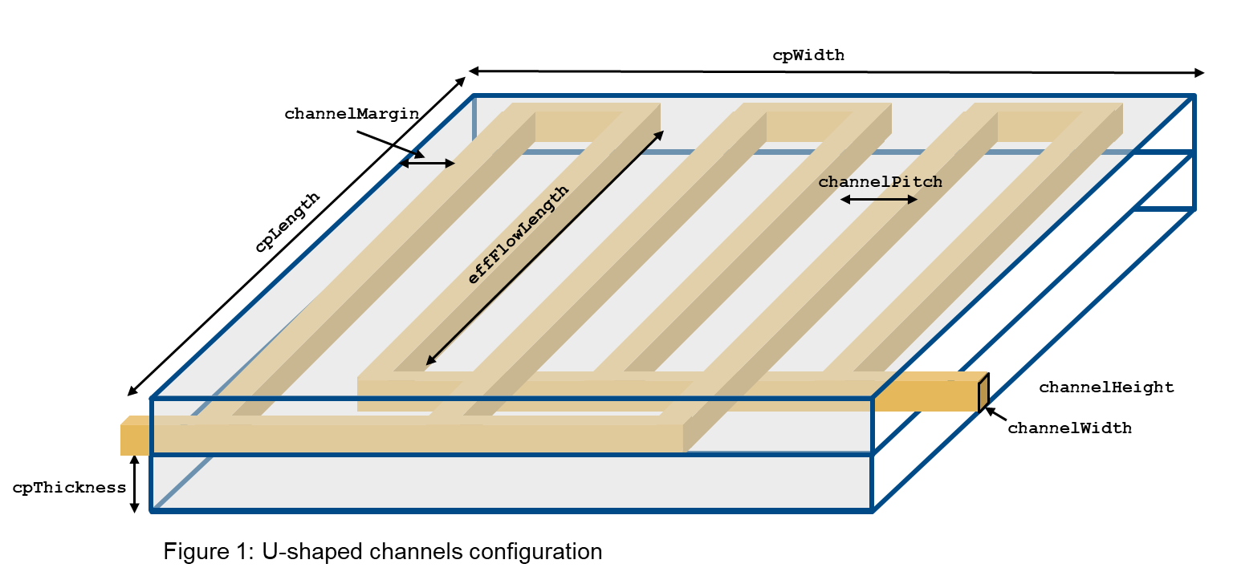
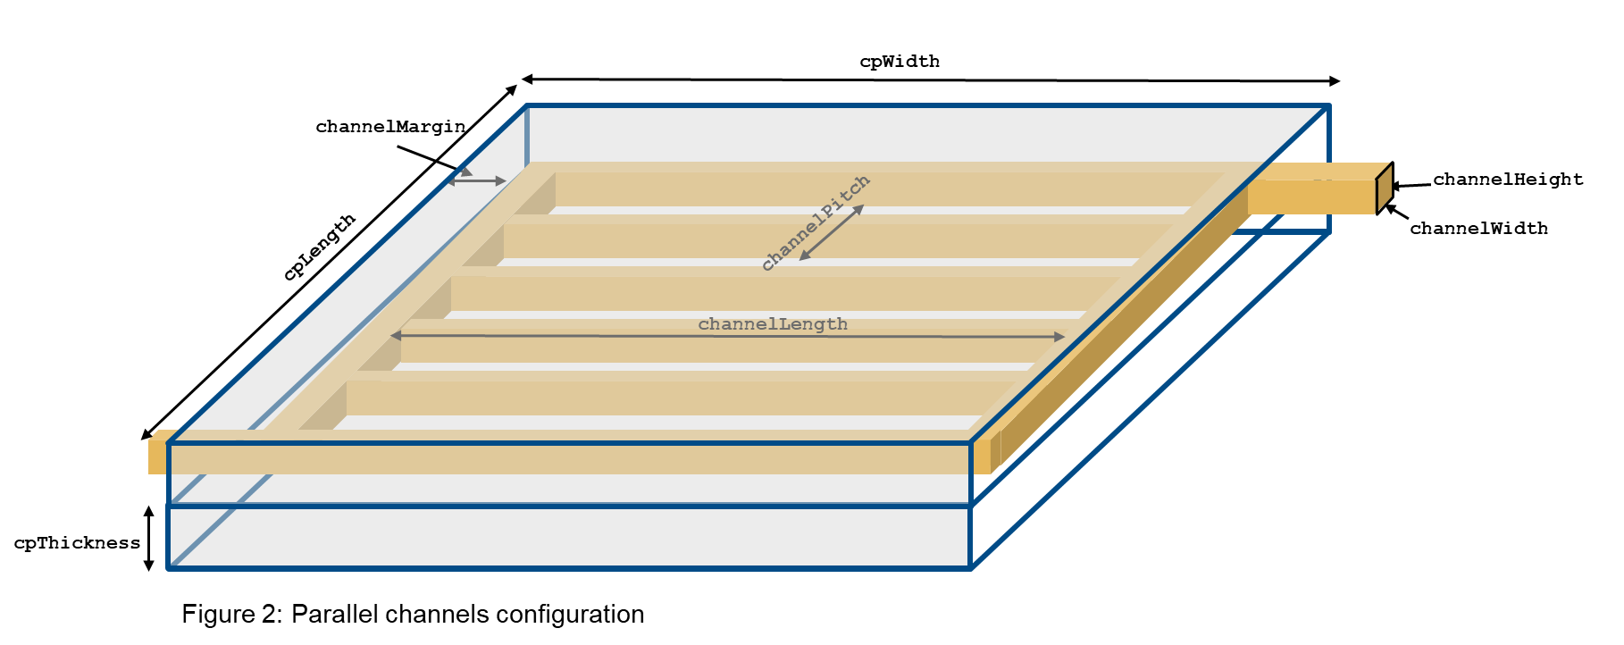

Slide 9
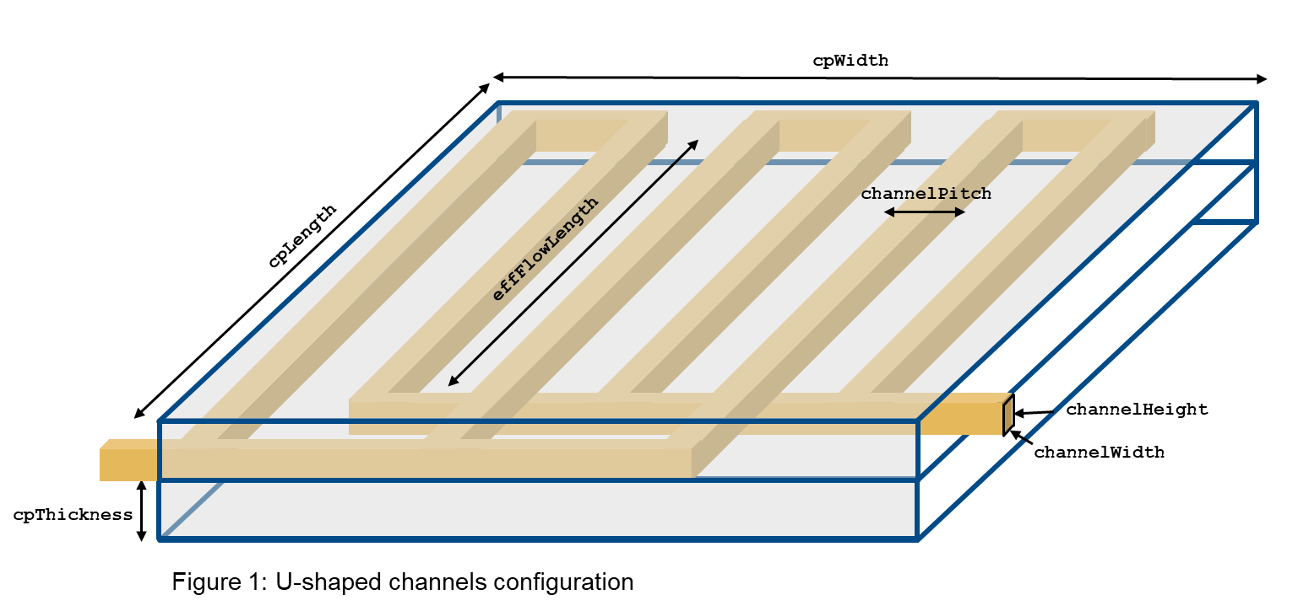
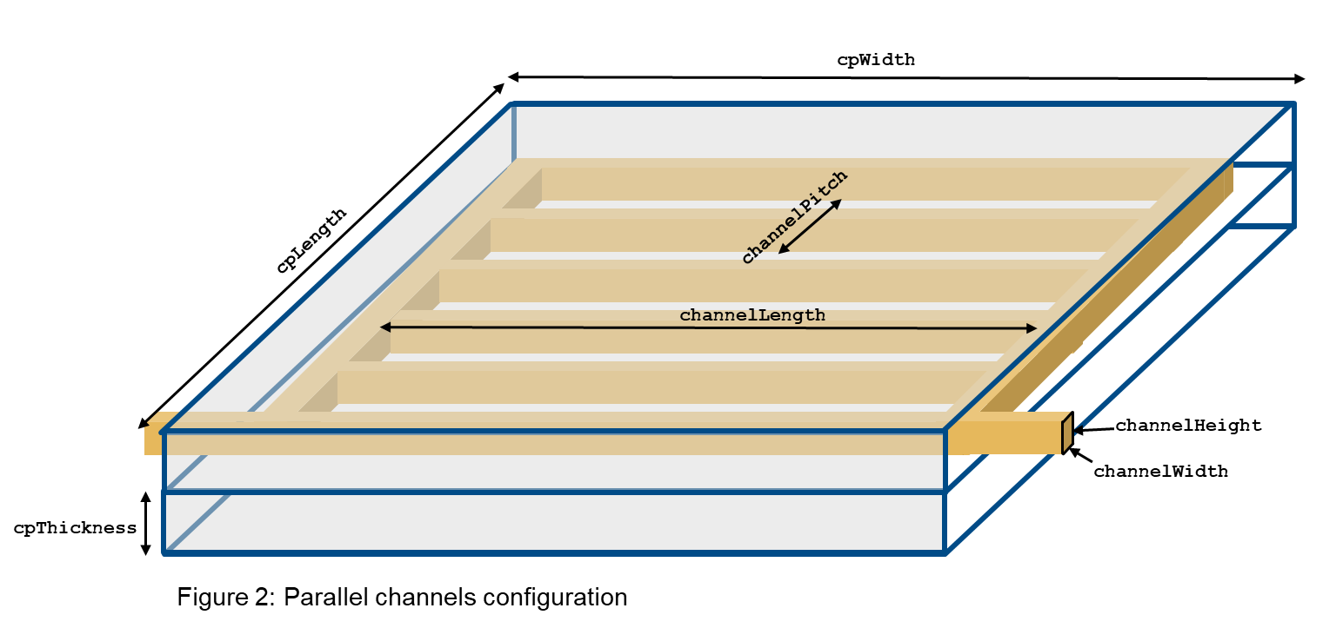

Slide 12
cpWidth
channelPitch
cpLength
effFlowLength
channelWidth
channelHeight
cpThickness
Figure 1: U-shaped channel configuration

Slide 13
cpWidth
cpLength
channelPitch
channelWidth
channelHeight
cpThickness
Figure 1: Parallel channel configuration

Slide 14
cpWidth
cpLength
channelPitch
channelWidth
channelHeight
cpThickness
Figure 2: Parallel channel configuration

Slide 15
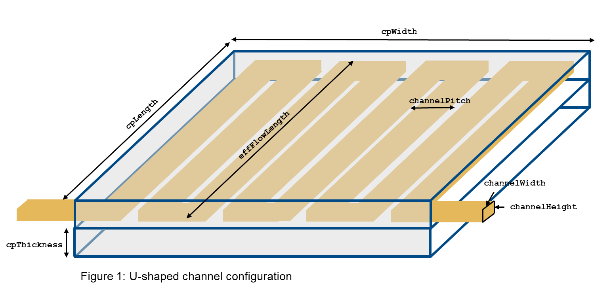

Slide 16
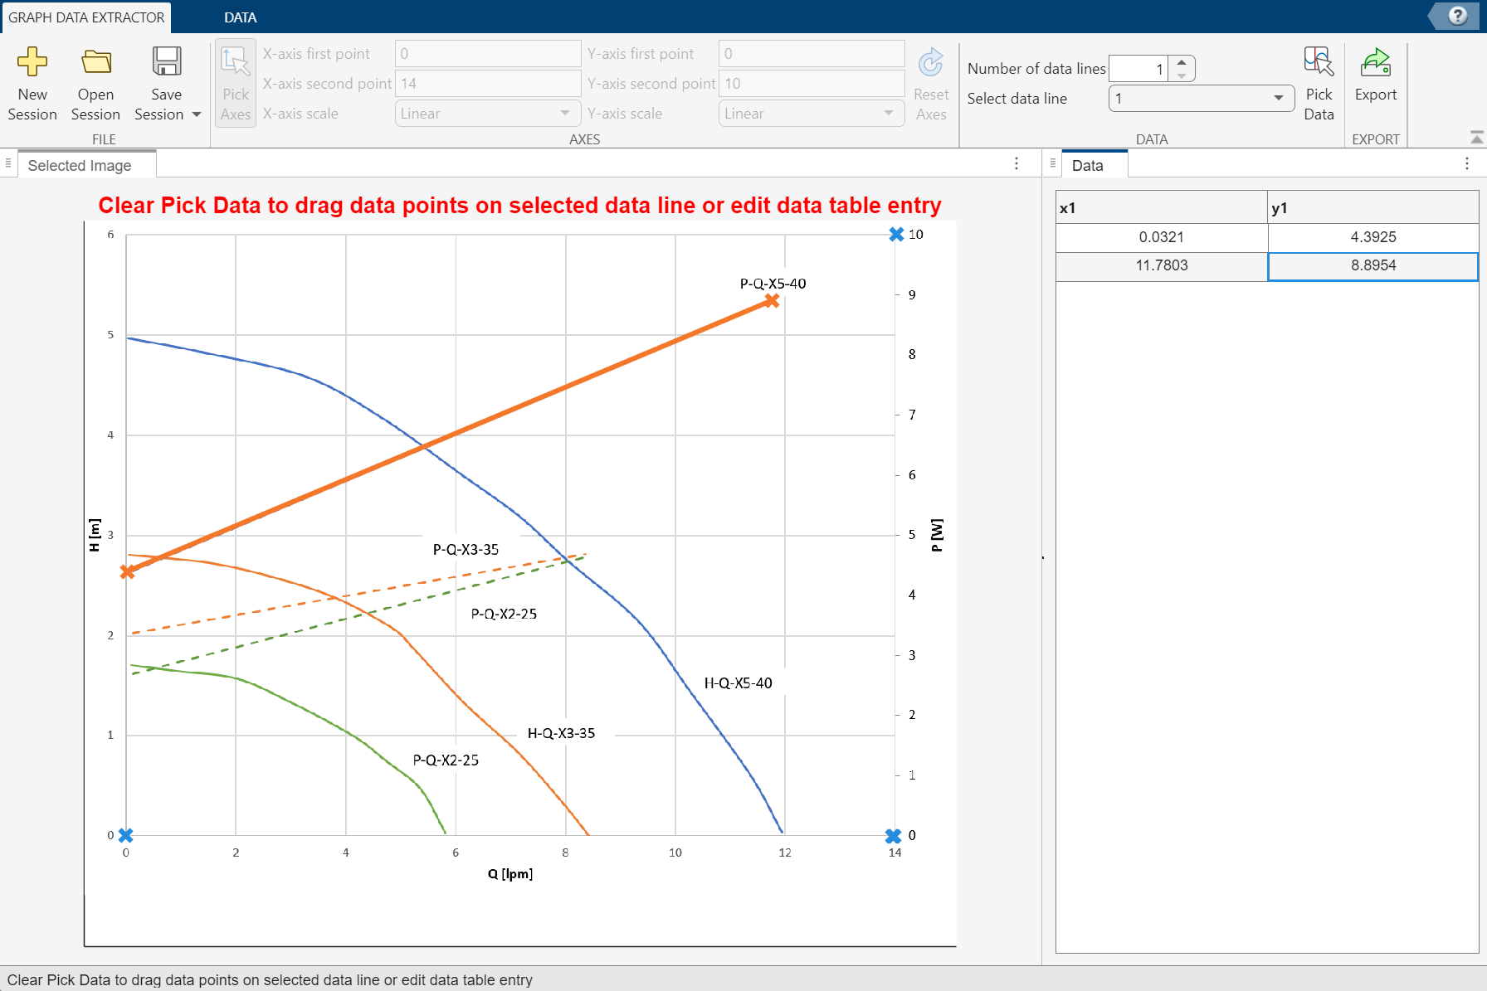
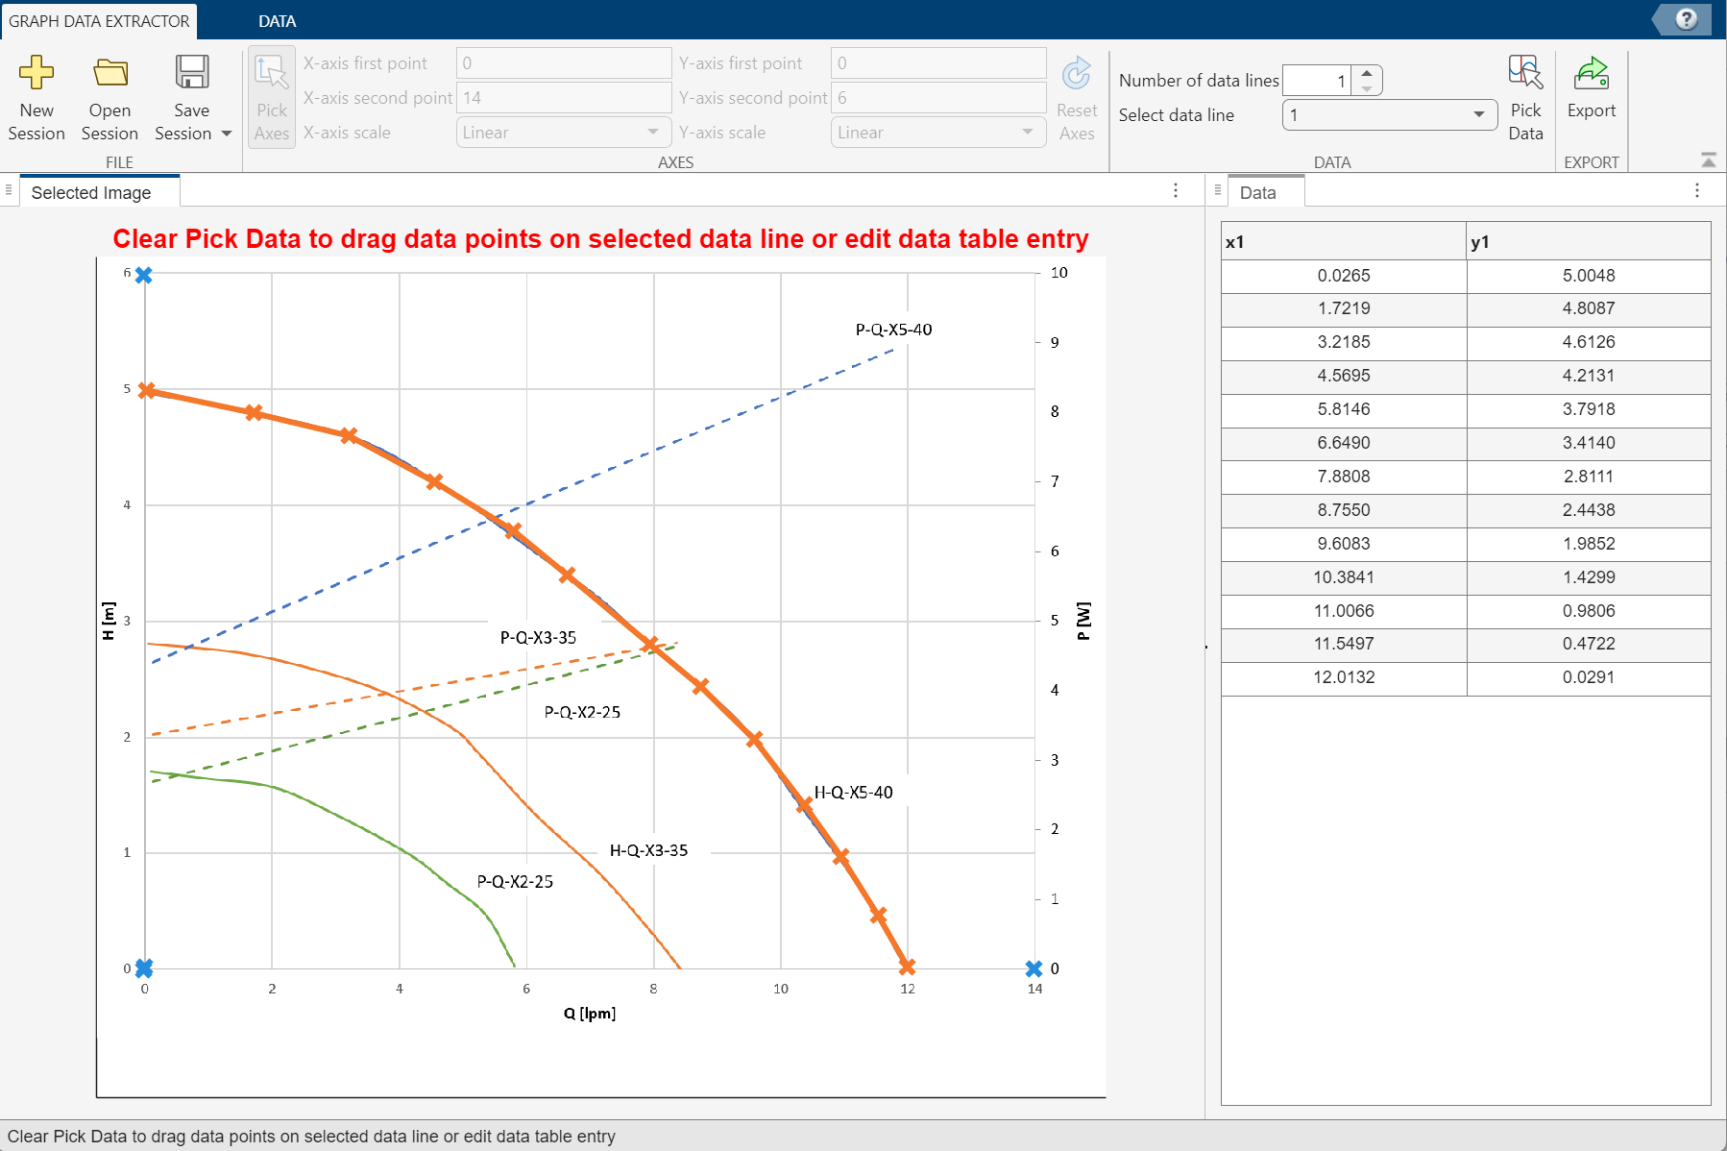

Slide 17
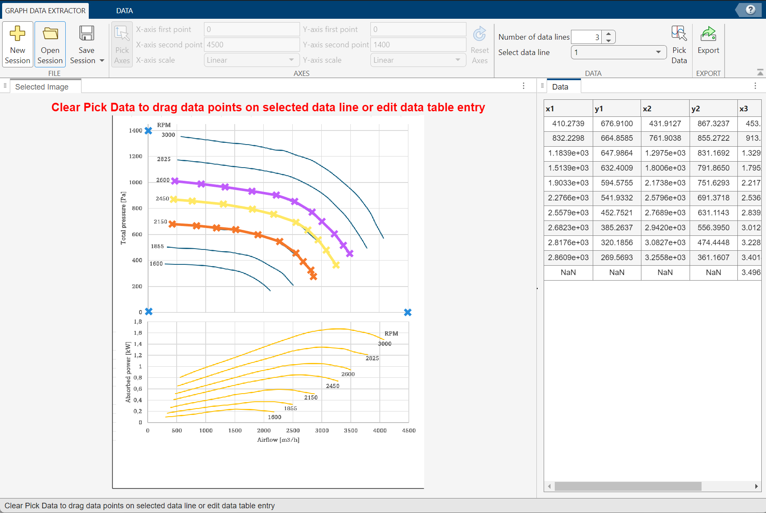
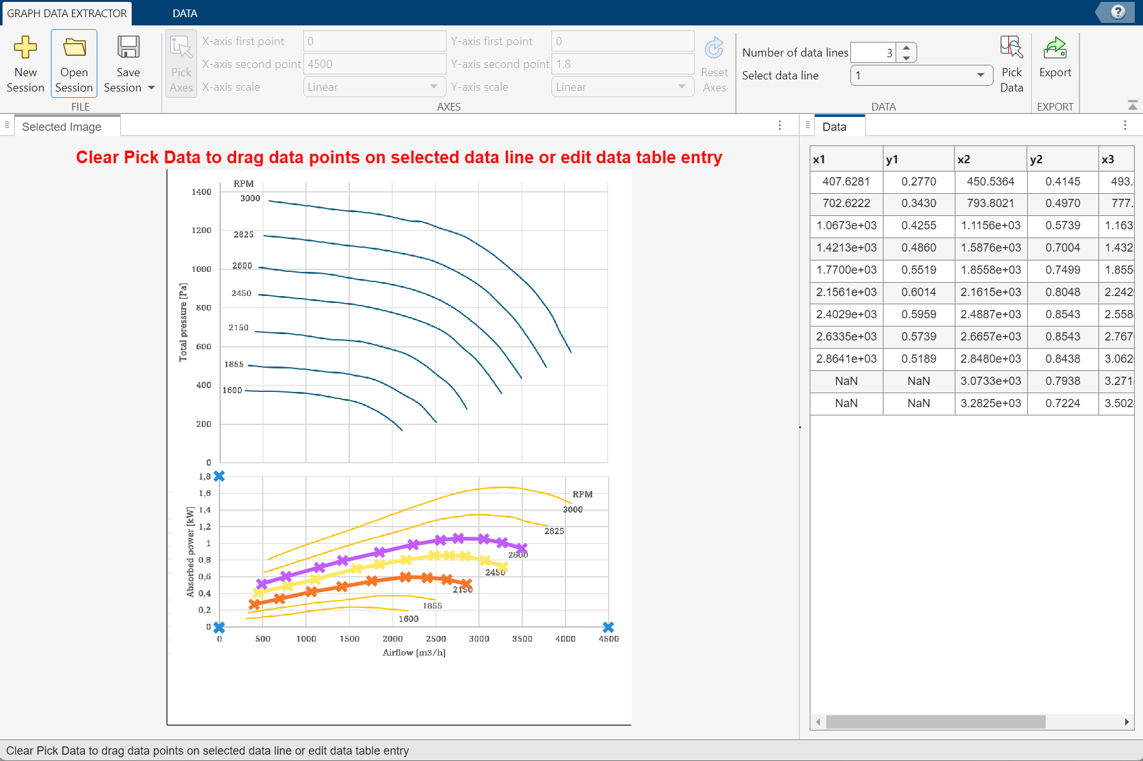

Slide 18
