Slide 1
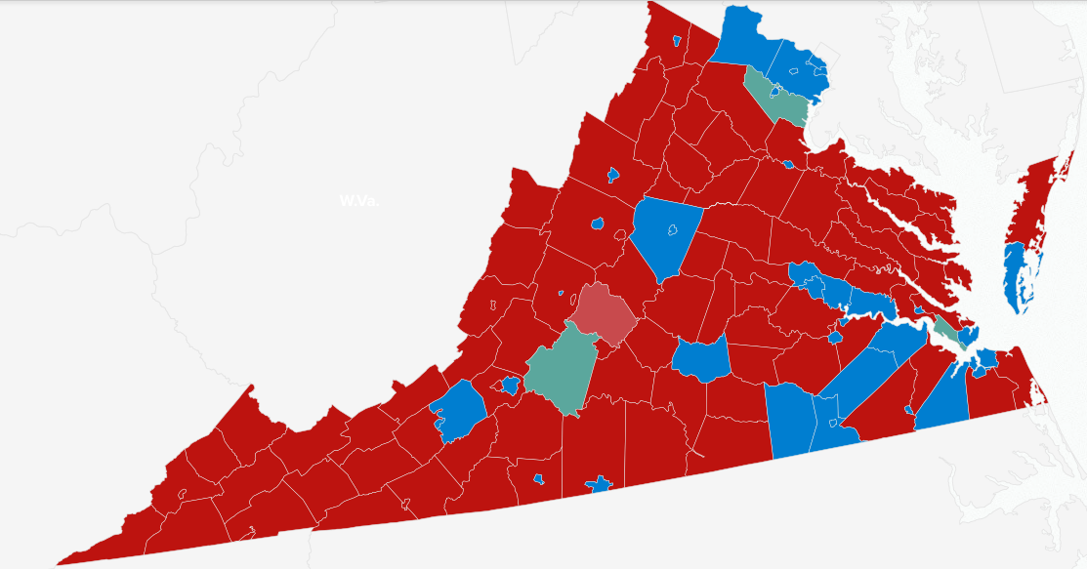
2016 Presidential Election
Results by county in the
state of Virginia
Bridget Connelly, Brad Miller, & Kelly Whelan

Slide 2
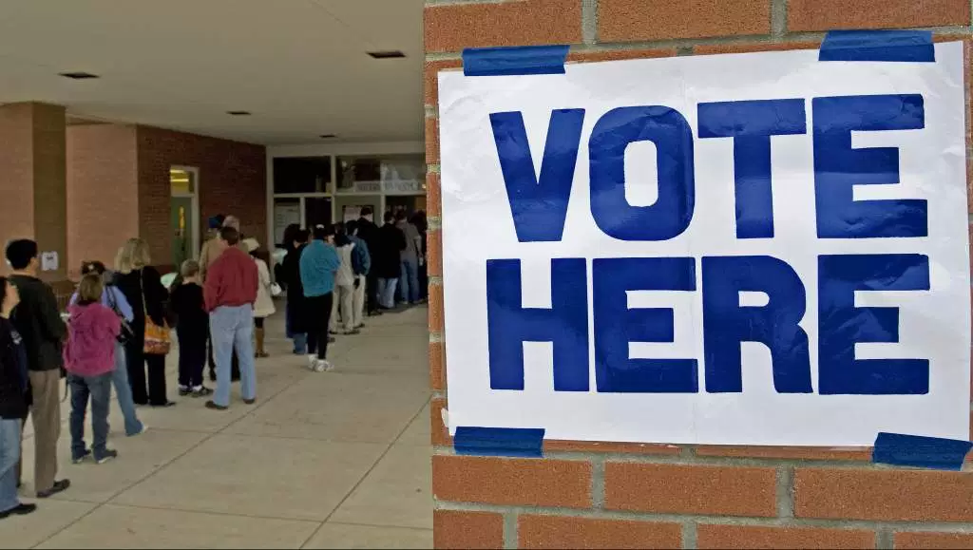
2016 Presidential Nominees
Donald Trump,
Republican
Hillary Clinton,
Democrat
Jill Stein,
Green Party
Gary Johnson,
Libertarian
Evan McMullin,
Independent

Slide 3

About Virginia
One of the original 13 colonies and birthplace of four of the first five U.S. presidents
Joined the Union in June 1788
In 1792, Virginia controlled 15.9% of all electoral votes (the largest concentration in U.S. history)
Did not participate in the 1864 and 1868 elections due to secession
From the post-Civil War Reconstruction period through 1948, Virginians almost always sided with the Democrats in elections
1952 through 2004, Virginia was reliably Republican (except for the landslide of Lyndon Johnson over Barry Goldwater in 1964)

Slide 4
About Virginia Continued
Since 2008, Virginia has consistently voted for the Democratic nominee
Virginia has 95 counties along with 38 independent cities, which are considered county equivalents for census purposes
Hillary Clinton won Virginia overall with 49.9% of the popular vote
Donald Trump won the popular vote in 93 out of the 133 counties in Virginia

Slide 5
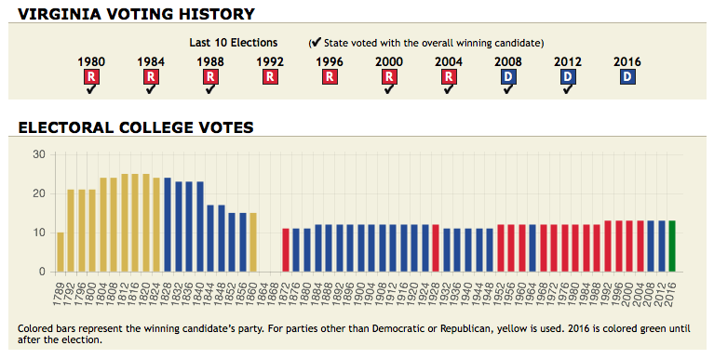

Slide 6
Our Project Questions
Is the average median income different for counties who voted for Donald Trump than for counties who voted for Hillary Clinton?
Are educational attainment and racial makeup statistically significant predictor variables for which candidate the county voted for?
What, if any, are the correlations among the predictor variables?
Is the percent of unemployment among the counties statistically significant in determining which candidate they voted for?
Is the average median age in years per county different in the counties that voted for Trump than in the counties that voted for Clinton?

Slide 7
Variables
Unemployment rate (Population 16 years and over)
Bachelor’s Degree (25 years or older)
Graduate Professional Degree (25 years or older)
County Names
Percent for Trump (response variable)
Median Household Income
Median Age (years)
Percent White (One Race)

Slide 8
Data
From Politico:
County Name, Percent voting Trump, and Percent voting Third Party
From the American Community Survey:
Median Income and Percent Unemployment from “Selected Economic Characteristics”
Percent with a Bachelor’s degree and Percent with a Graduate degree from “Educational Attainment”
Percent White and Median Age from “ACS Demographic and Housing Estimates”
Manually created:
Categorical variable Trump Won which is equal to 1 if Trump won and equal to 0 if Hillary Clinton won

Slide 9
Statistical Techniques
Multiple Regression Analysis
Test that the model satisfies the residual assumptions of constant variance, a mean of 0, independence and normality
Breusch-Pagan test for constant variance & Lilliefors test for normality
Adjusted R-Squared, Mallow’s Cp, PRESS, AIC to select the best model
DFFITS, DFBETAs, Cook’s Distance, Hat Matrix Diagonal elements and Covariance Ratio to find outliers or influencers

Slide 10
Statistical Techniques
One-Way Analysis of Variance
Non-constant variance in models is fixed by a weighted least squares model or model transformations
Brown-Forsythe test - constant variance
Box-Cox method - select appropriate transformation for the model
Normal QQ Plot - normality
Tukey HSD, Boxplots - test whether factor means are equal

Slide 11
What’s the Best Model?
Adjusted R-squared - designed to combat overfitting, penalizes for unnecessary terms
Mallow’s Cp statistic - measures the predictive ability of a fitted model. Bias decreases and prediction variance increases as more variables enter the model
Adjusted R-Squared & Mallow’s CP PRESS and AIC statistics
PRESS statistic - evaluates the predictive ability of a model by omitting one observation at a time. A small PRESS value indicates a better model
AIC statistic - represents the tradeoff between precision of fit against the number of parameters used, if the AIC increases when a parameter is added to the model, then that parameter is not needed.
Notes:
So we start with the multiple linear regression, and although we have a set of variables we want to choose which subset of these models is the best one. We only started with seven variables, so that is not too many to have to choose from. But these methods still relate when you are choosing from many more variables. Even starting with only seven variables, it is a good idea to see if smaller groups will create better models because complexity is never good. Often, smaller models are just as good. So what are the statistics that we used to choose our best models?
Adjusted r-squared, which is designed to combat the overfitting.
As we all know, the r2 is the

Slide 12
Top Three Models
Percent.Trump ~ Percent Third + Median.Income + Median.Age + Percent.White + Unemployment.Rate + Graduate
2. Percent.Trump ~ Percent Third + Median.Income + Median.Age + Percent.White + Unemployment.Rate + Bachelors + Graduate
3. Percent.Trump ~ Percent Third + Median.Income + Median.Age + Percent.White + Graduate
Notes:
These were the top three models returned by adjusted r2,

Slide 13
Best Model
Percent.Trump ~ Percent Third + Median.Income + Median.Age + Percent.White + Unemployment.Rate + Graduate
Adjusted R-Squared = 0.9093301
Cp = 6.724347
PRESS = 3691.668
AIC = 815.7276

Slide 14
Multiple Regression Model
Y² = β₀+β₁X₁ + β₂X₂ + β₃X₃ + β₄X₄² + β₅X₅ + β₆X₆^{-1/2}
Y = Percent Trump
X₁= Percent Third
X₂= Median Income
X₃= Median Age
X₄= Percent White
X₅= Unemployment Rate
X₆= Percent with Graduate Degrees
β₀=-4018
β₁=-146.5
β₂=0.01007
β₃=36.71
β₄=54.72
β₅=62.99
β₆=5828

Slide 15
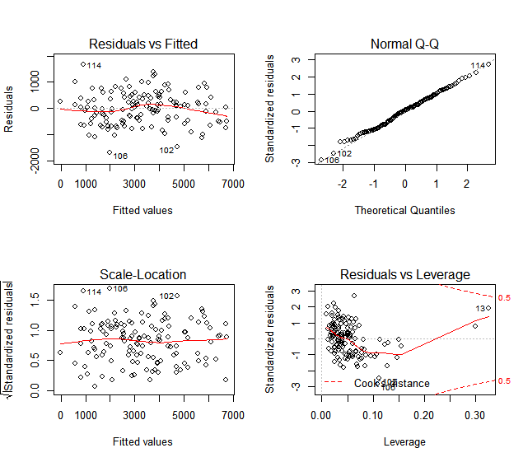
Multiple Regression Model
Passed the Breusch-Pagan test for constant variance
Test statistic = 9.2492
P-value = 0.16
Df = 6
Passed the Lilliefors test for normality
Test statistic = 0.050511
P-value = 0.5563

Slide 16
Any outliers?
DFFITS - standardized difference between the ith fitted value with all the observations and with the ith case removed
DFBETAS - influence of each case on each regression coefficient
Cook’s Distance- influence of each case on all fitted values
Hat Matrix Diagonal - variance of the residuals, or how closely the fitted values correspond to the original data
Covariance Ratio - change in determinant of the covariance matrix of the estimates by deleting each observation

Slide 17
Any outliers?
Notes:
(numbers 13, 45, 51, 88, 98, 102, 104, 106, 113, 114, 117, 121, 124) - Appomattox County, Brunswick County, Lancaster County, Loudon County, Sussex County, Lynchburg City County, Buena Vista City, Covington City, Emporia City, Falls Church City, Radford City,

Slide 18
ANOVA Example
Predictor Variable Median Income against the categorical response variable Trump Won
Brown-Forsythe test
F statistic = 4.8988
p-value = 0.02861 ⇒ non-constant variance
This violates the model assumptions, so we create a Box-Cox plot

Slide 19
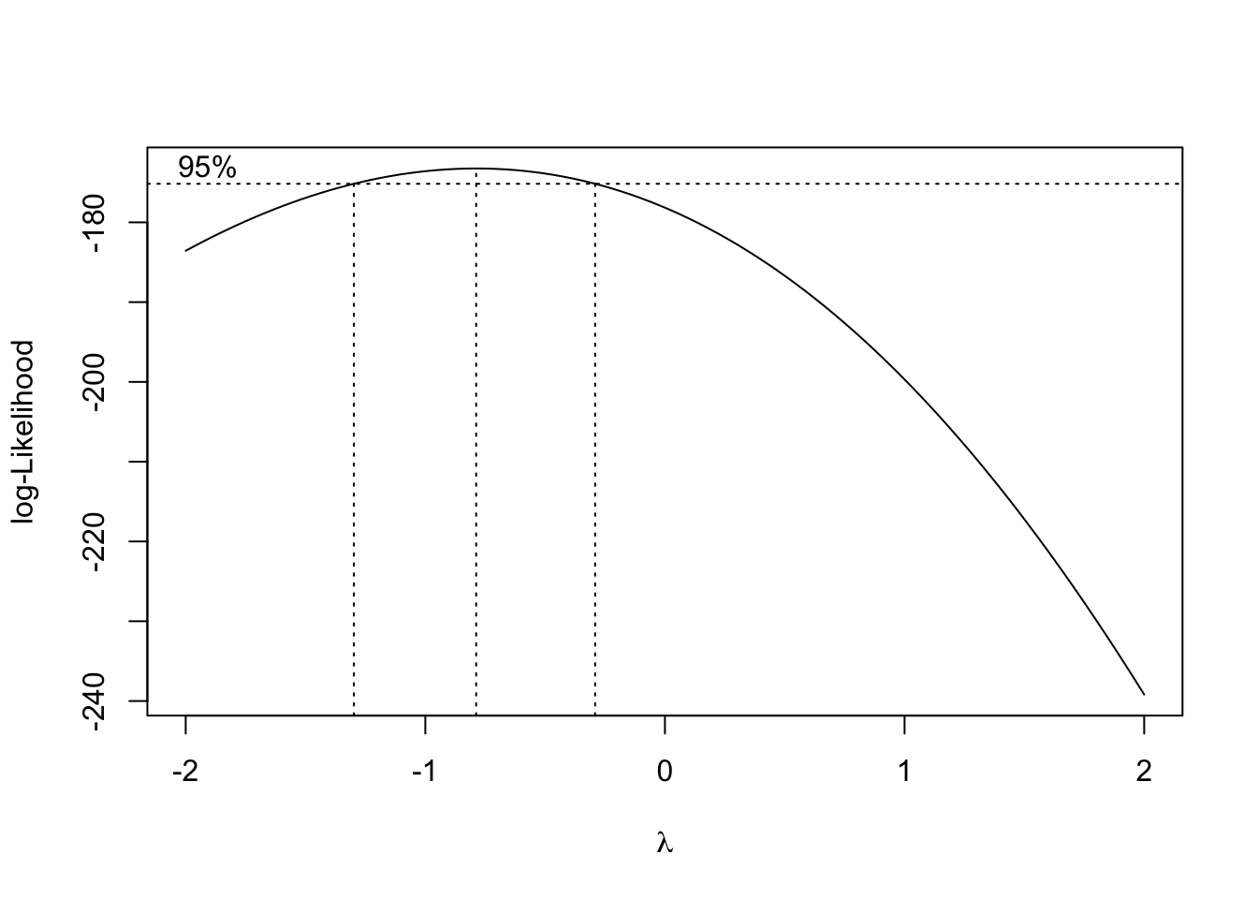
Box-Cox Plot
Median Income ~ Trump Won

Slide 20
ANOVA Example
Inverse of the Median Income against Trump Won
Brown-Forsythe test
F statistic = 3.4563
p-value = 0.06525 ⇒ constant variance
Boxplot to compare the factor means for Median Income
Although the boxplot provides some information, to test whether these factor means are equal we use Tukey’s test
This gives a lower bound of -2.80486e-06 and an upper bound of 2.011593e-06
Fail to reject the H₀ and conclude that the factor means are the same

Slide 21
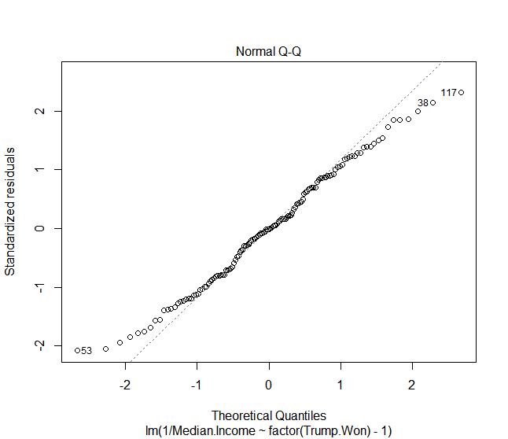
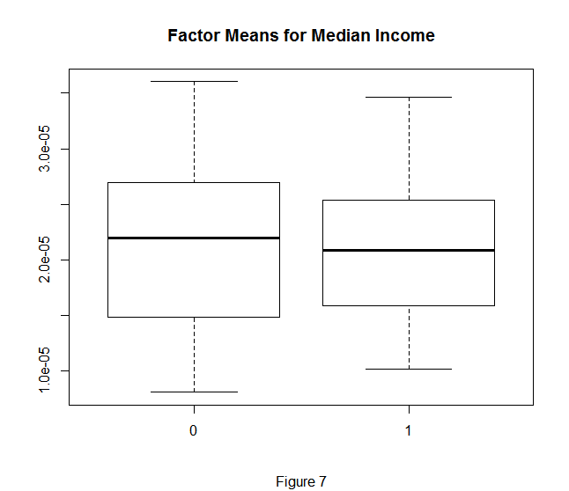
Boxplot
Median Income ~ Trump Won

Slide 22
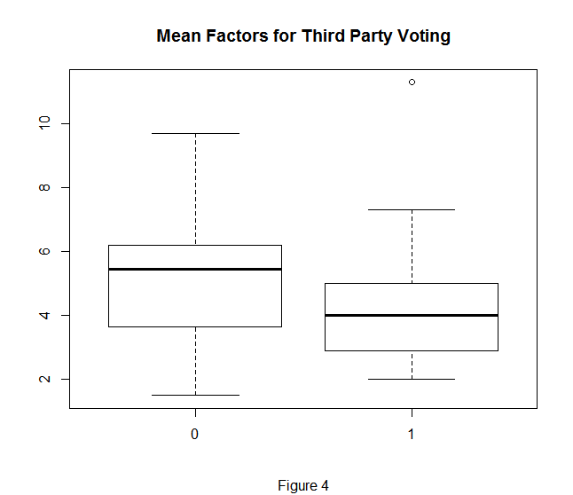
Anova Results:
Third Party Voting
This model did not require any transformations and met the model assumption
In counties where Clinton won, there was a higher percent of third party voting on average
Notes:
Outlier is Buena Vista City

Slide 23
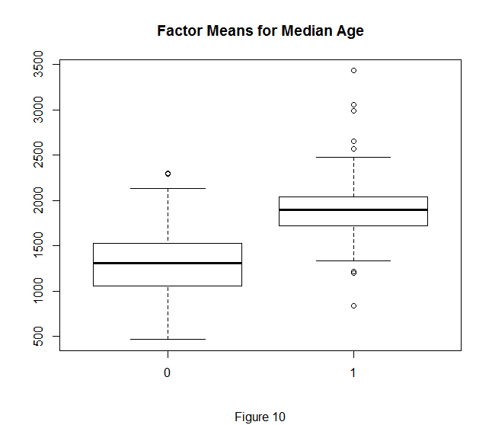
Anova Results:
Median Age
To meet model assumptions, used median age squared
In counties where Trump won, there was a higher median age on average

Slide 24
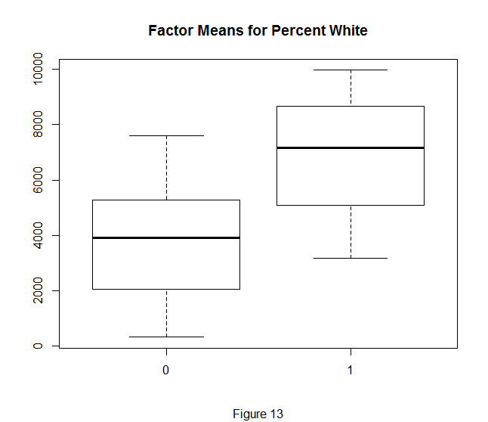
Anova Results:
Percent White
To meet model assumptions, used percent white squared
In counties where Trump won, there was a higher percent white on average

Slide 25
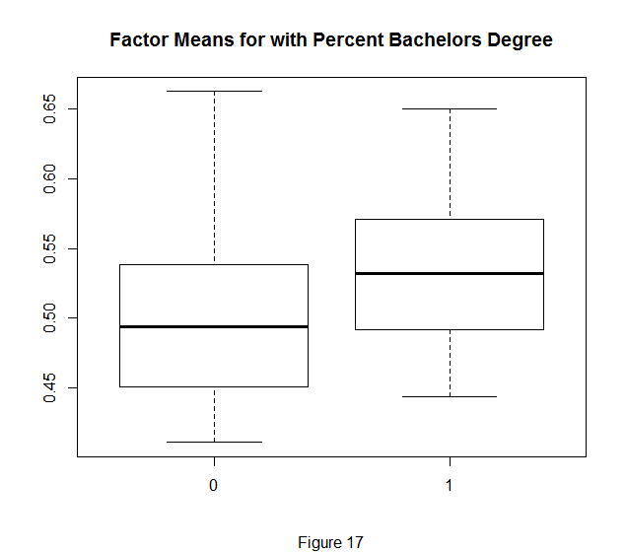
Anova Results:
Bachelor’s Degree
To meet model assumptions, used the inverse fourth root of Bachelor’s
In counties where Trump won, there was a lower percent with Bachelor’s degree on average

Slide 26
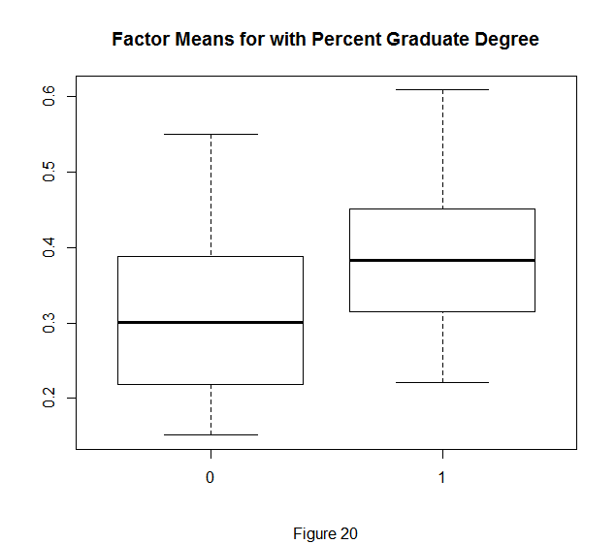
Anova Results:
Graduate Degree
To meet model assumptions, used inverse square root of Graduate
In counties where Trump won, there is a lower percent with Graduate degrees on average

Slide 27
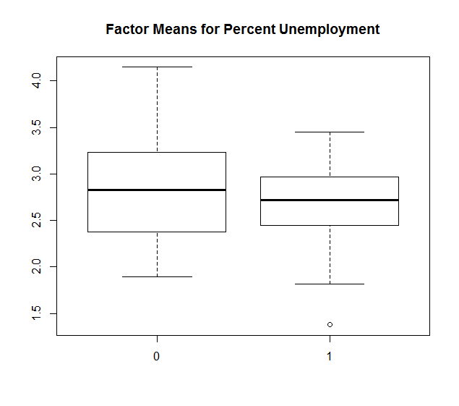
Anova Results:
Unemployment Rate
Fails to meet constant variance assumption so we did not perform the Tukey HSD test

Slide 28
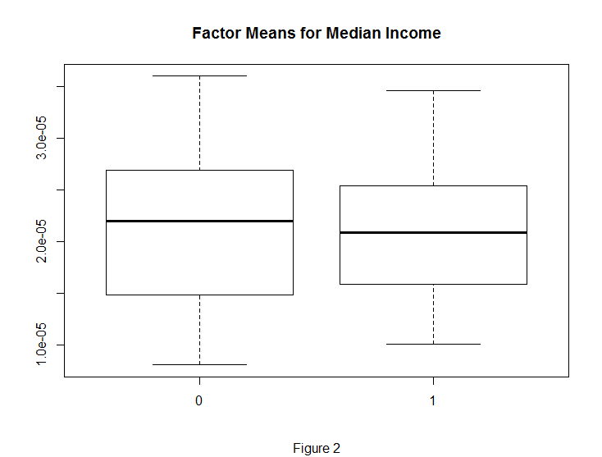
And the answers are…
Is the average median
income different for
counties who voted for
Donald Trump than for
counties who voted for
Hillary Clinton?
Notes:
No! According to the Tukey Test, the mean of the median income for counties that voted for Donald Trump is no different than the mean of the median income for counties that voted for Hillary Clinton. This was, in fact, the only variable for which we found the means to be the same. Two variables (Unemployment and Graduate) were not able to be transformed into valid results, but all the other variables had different means.

Slide 29
And the answers are…
Are educational attainment and racial makeup statistically significant predictor variables for which candidate the county voted for?
Estimate Std. Error t value Pr(>|t|) (Intercept) -4.018e+03 8.737e+02 -4.599 1.02e-05 ***
I(project$Percent.White^2) 5.472e-01 2.813e-02 19.454 < 2e-16 ***
I(project$Graduate^-0.5) 5.828e+03 9.182e+02 6.347 3.62e-09 ***
---
Signif. codes: 0 ‘***’ 0.001 ‘**’ 0.01 ‘*’ 0.05 ‘.’ 0.1 ‘ ’ 1
Notes:
Yes, although with modification! We see that in our final model, both Percent.White and Graduate needed to be transformed to make the entire model follow the model assumptions. So in reality, we find that the squared values of Percent White and the inverse square root values of Graduate (the only educational attainment variable we used in that model) are the ones that are statistically significant. When we interpret these values, we transform them back into their original form. Interestingly, the only other variable that needed to be transformed for the model was the response variable Percent.Trump, which we squared. All of the other variables we kept in their original form for easier interpretation.

Slide 30
And the answers are…
What, if any, are the correlations among the predictor variables?
 | Trump | Income | Third | Age | Race | Unemploy | Grad
Trump | 1 | -0.2559 | -0.3518 | 0.5772 | 0.7329 | -0.09812 | -0.5809
Income | 0.2559 | 1 | 0.4050 | -0.1541 | 0.02284 | -0.5335 | 0.68130
Third | -0.3518 | 0.4050 | 1 | -0.5331 | 0.1267 | -0.4171 | 0.5827
Age | 0.5772 | -0.1541 | -0.5331 | 1 | 0.2543 | -0.05348 | -0.4487
Race | 0.7329 | 0.02284 | 0.1267 | 0.2543 | 1 | -0.4765 | -0.01600
Unemploy | -0.0981 | -0.5335 | -0.4171 | -0.05348 | -0.4765 | 1 | -0.4498
Grad | -0.5809 | 0.6813 | 0.5827 | -0.4487 | -0.01600 | -0.4498 | 1
Notes:
What indeed! The top two strongest correlations are between Trump and Race and Grad and Income. We could guess Grad and Income, because it is more likely that those with Graduate degrees will earn more, and that maybe the places where those with graduate degrees settle will contain more higher paying jobs. Interesting though that the strongest correlation is between Race and Trump. As percent white goes up, so does the percent who voted for trump. That is not an ambiguous number either, at 0.7329.
Highlighted in yellow all that were near 0.5, and these are really interesting too. Positive corr between age and Trump, but stronger negative corr between grad and trump. High corr between grad and third, almost as strong negative corr between age and third. Obs negative corr income and income, negative corr grad and unemploy.

Slide 31
And the answers are…
Is the percent of unemployment among the counties statistically significant in determining which candidate they voted for?
Estimate Std. Error t value Pr(>|t|)
(Intercept) -4.018e+03 8.737e+02 -4.599 1.02e-05 ***
project$Unemployment.Rate 6.299e+01 3.083e+01 2.044 0.04309 *
---
Signif. codes: 0 ‘***’ 0.001 ‘**’ 0.01 ‘*’ 0.05 ‘.’ 0.1 ‘ ’ 1
Notes:
Well isn’t this another interesting one to consider. We see here that yes, it is statistically significant. But when we were doing the adjusted R2, Cp, PRESS and AIC statistics to find the best subset, the next best model did NOT include unemployment rate in it.

Slide 32
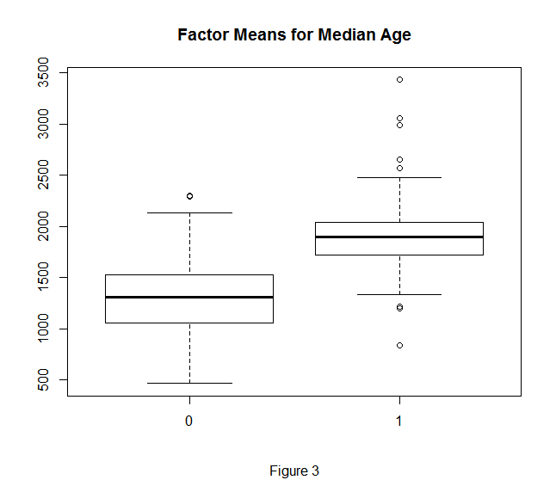
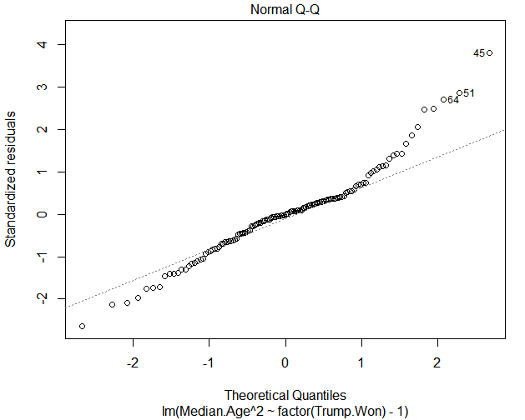
And the answers are…
Is the average median age in years per county different in the counties that voted for Trump than in the counties that voted for Clinton?
Notes:
Here we have an interesting bit. We have got the age to a constant variance, but see that the normality is a bit off. But if our test is to be trusted, then they have different means. The counties where trump won, the 1 counties, have a higher median age on average than the counties where clinton won

