Slide 1
Will the Caps EVER win a Stanley Cup?
Bridget Connelly

Slide 2




Intro
Washington DC sports teams never win
Last championship was Redskins in 1992
Caps are our best hope!
Last DC team in playoff final (in 1998)
But….. haven’t won the championship in their 42 year history
Notes:
Cousin is asenior in high school, made a bet freshman year that he would only cut his hair when a Washington sports team won a championship. Good thing he didn’t start it when he was born, becausue that hasn’t happened since 1992.
Hockey is a good hope, because a the last time a waashington sports team was in a championship was for hockey – in 1998. Pretty sad though that in its 42 year history the caps have never won a championship.
But hockey actually is a good hope. If you know anything about hockey you’ve probably heard of our star player, alexander Ovechkin. We have won the presidents trophy (the winners of the league) for the pas 2 years

Slide 3
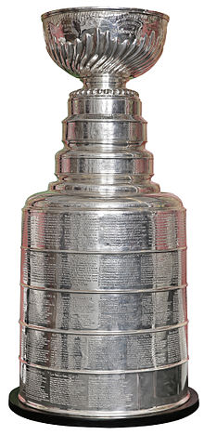
Objective
What will each team rank at the end of the season?
Who will win the Stanley Cup?
Data?
30 teams
8 seasons
Notes:
- Wanted to know how the caps wer going to do in this years playoffs (happening now…. Literally right now they are playing a game against the Toronto Maple Leafs in Toronto). I was going to do this by examining the stats that the NHL provides, such as goals for and against, shots fired and saved, and faceoff wins. Then, I was going to use individual player stats to determine the best players of the league. This was too much for me, and I will just be looking at the team rankings and potential for cup victory this year.

Slide 4
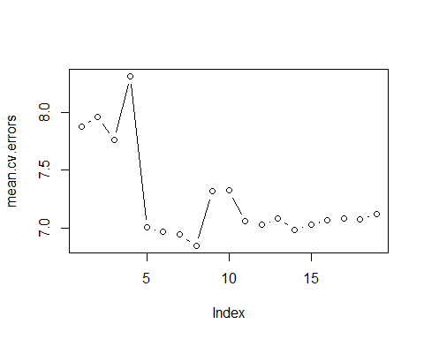
Analysis - Regression
## Call: ## lm(formula = Rank ~ GF + GA + GF60 + GA60 + GF. + SA + Sh. + CF., data = yearswol) ## ## Coefficients: ## Estimate Std. Error t value Pr(>|t|) ## (Intercept) 80.966332 25.708519 3.149 0.001852 ** ## GF 1.152352 0.210826 5.466 1.19e-07 *** ## GA -1.205087 0.210895 -5.714 3.38e-08 *** ## GF60 -79.287371 13.763621 -5.761 2.66e-08 *** ## GA60 77.182580 13.557587 5.693 3.77e-08 *** ## GF. -2.063256 0.475653 -4.338 2.15e-05 *** ## SA 0.005159 0.002294 2.249 0.025480 * ## Sh. 2.256616 0.666699 3.385 0.000837 *** ## CF. 0.459467 0.155389 2.957 0.003430 ** ## Residual standard error: 2.446 on 231 degrees of freedom ## Multiple R-squared: 0.9231, Adjusted R-squared: 0.9205
Notes:
Did two main things: analyze the rankings for each team at the end of the season ( a numeric, continuous variable) and the cup ranking at the end (a discrete, categorical variable)
For regression, I did a normal regression, lasso and ridge regression. I used cross-validation to choose my subsets, and found that many of my variables were very highly coreelated. For example, I didn’t take any of the varaibles that the NHL collects out of my initial data, so goals for (the # of goals scored that season), goals for percent (the percentage of all goals scored by that team) and goals for per 60 (the average number of goals scored during 60 minutes of pplay (the length of one game)) were all in there.
For categorical, created a column that had 0 if a team was not in the final round for the cup that year, a -1 if they were the runners up and a 1 if they were the winners. This created a data set with 226 0’s, 7 -1’s and 7 1’s. wanted to make sure that I would have a good model, one that wouldn’t predict all 0’s. Chose LDA because it helps classify with multiple classes

Slide 5
Analysis- Regression ctd
## Actual Reg Lasso Ridge ## 1 Washington Washington Washington Washington ## 2 Columbus Minnesota Minnesota Minnesota ## 3 Minnesota Pittsburgh Columbus Pittsburgh ## 4 Pittsburgh Columbus Chicago Columbus ## 5 Chicago Chicago Pittsburgh Chicago ## 6 Edmonton San Jose Montreal San Jose ## 7 Montreal Montreal San Jose Montreal ## 8 Anaheim Edmonton Edmonton Edmonton ## 9 Nashville NY Rangers NY Rangers NY Rangers ## 10 San Jose Nashville Nashville Nashville ## 11 St. Louis NY Islanders NY Islanders NY Islanders ## 12 NY Ranger Toronto Dallas Toronto ## 13 Toronto Dallas Toronto Dallas ## 14 NY Islanders Anaheim Anaheim Anaheim ## 15 Tampa Bay St. Louis St. Louis Los Angeles ## 16 Calgary Tampa Bay Tampa Bay St. Louis ## 17 Boston Los Angeles Los Angeles Tampa Bay ## 18 Dallas Calgary Calgary Winnipeg ## 19 Ottawa Winnipeg Winnipeg Calgary ## 20 Winnipeg Boston Boston Detroit ## 21 Los Angeles Detroit Detroit Boston ## 22 Detroit Ottawa Ottawa Ottawa ## 23 Carolina Buffalo Buffalo Buffalo ## 24 Philadelphia Vancouver Vancouver Vancouver ## 25 Buffalo New Jersey Florida Florida ## 26 Florida Florida New Jersey New Jersey ## 27 Vancouver Arizona Arizona Arizona ## 28 Arizona Carolina Carolina Carolina ## 29 New Jersey Philadelphia Philadelphia Philadelphia ## 30 Colorado Colorado Colorado Colorado
Notes:
Regression did best with a 16.6667% correct rate… then lasso with a 13.33% correct rate… then ridge with a 3.333%

Slide 6
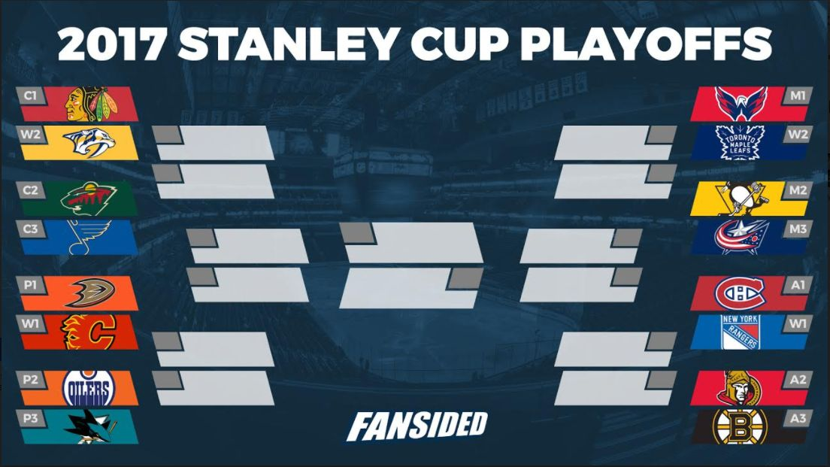
Analysis - LDA
Call: ## lda(Cup ~ GA60 + GF. + SF + SA + Sv. + PDO + CA60 + CF. + OZFO. + NZFO., data = team16) ## ## Prior probabilities of groups: ## -1 0 1 ## 0.03333333 0.93333333 0.03333333
Confusion matrix:
## -1 0 1 ## -1 0 0 0 ## 0 8 222 6 ## 1 0 2 2
Predictions:
## [1] 1 -1 0 0 0 0 0 0 0 0 0 0 0 0 0 0 0 0 0 0 0 0 0 0 0 0 0 0 0 0 ## Levels: -1 0 1
Minnesota
Washington
Notes:
- Trees only predicted 0’s, which make sense. There are tons more 0’s than there are 1s or -1s. Settled on LDA for the reasons above, that its good for multiclass prediction.

Slide 7
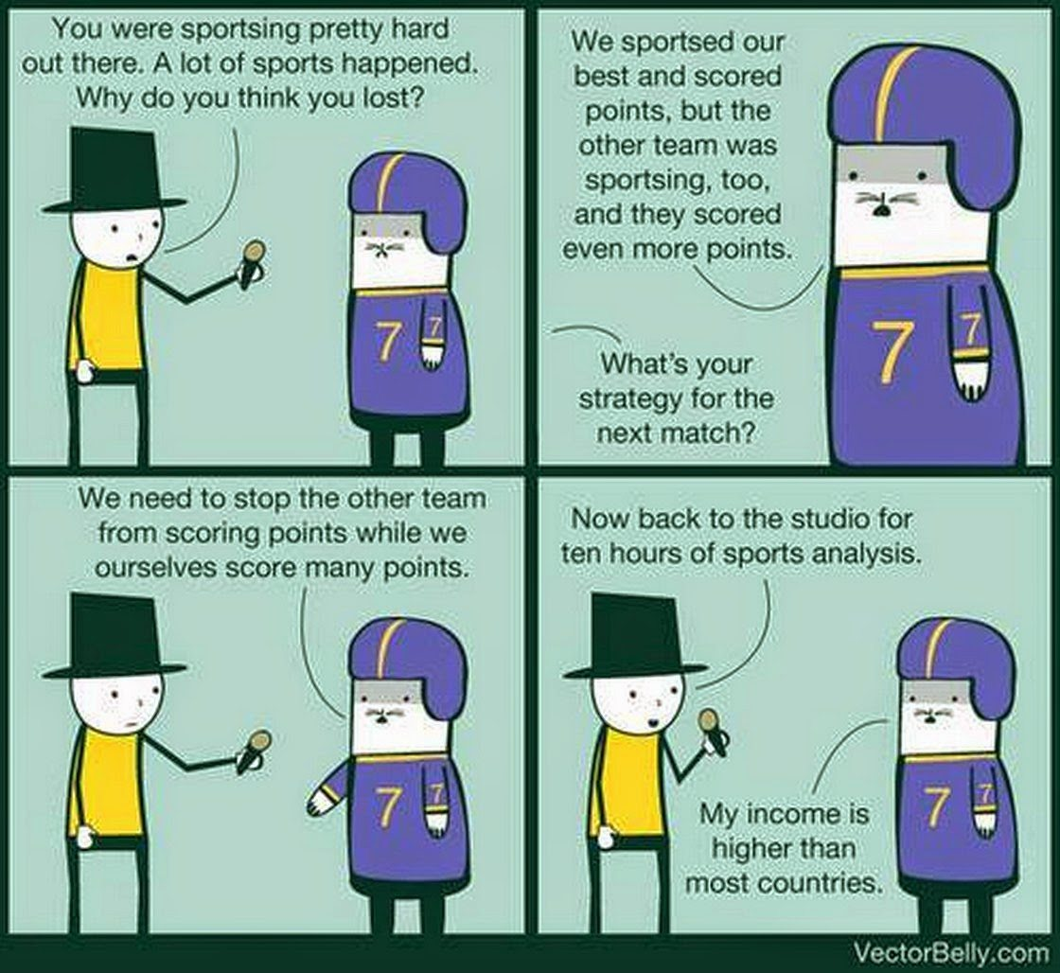
Conclusions
The Caps will top the league in the rankings
The Caps will have an epic playoff with Minnesota
The way to winning is to score more points!
Notes:
The rankings are already in for this year (put those up)
The cup is being decided as we speak :--, but these are my predictions for the winners (put up where they are in the bracket)
Put up that comic with the goals win games. One of the most statistically significant predictor variables for my regression was the goals scored percent, which is the percentage of all the goals in the league scored by that team. No duh, this is what they are always saying (what we really need to do, is score more goals than the other team). No doubt I’ve discovered a new conclusion in sports analysis and the caps will hire me to be their next statistical analyst ( a position that they actually have)

Slide 8
