Slide 1

ECEN 4/5632 Theory and Application of Digital Filters
Lecture 13, 10-20-26, 10-22-26
Peter Mathys*
* With generous help from Gemini Pro and ChatGPT

Slide 2
WEEK 8 ● LECTURE 13
Downsampling,
Decimation, and
CNN Strides
↓M
frequency copies stretch
and can overlap
Classical sampling theory meets modern convolutional networks
Conv1d
stride = M
Oppenheim & Schafer §4.6 | Raschka: CNN architecture
Notes:
0:00–0:02. Frame the lecture as one idea appearing in two communities: sample-rate reduction in DSP and striding/pooling in CNNs.

Slide 3
ROADMAP
Learning objectives
By the end of 75 minutes, students should be able to reason in both time and frequency domains.
• Compute downsampled sequences from x[n] and M.
• Predict spectral stretching and aliasing using the DTFT relation.
• Design the anti-aliasing stage of a decimator.
• Explain why stride > 1 in a CNN is a sampling operation.
• Diagnose shift-equivariance failures caused by aliased feature maps.
Pacing
0–25 min: downsampling
25–50 min: decimation
50–75 min: CNN strides
Core question
What must happen before we throw samples away?
Notes:
Ask students to connect to Week 2 sampling/aliasing. Emphasize that the “new” operation is discrete-time rate change, but the sampling logic is familiar.

Slide 4
01
Downsampling in time
Keep every Mth sample; the sample spacing grows by M.
Notes:
0:02–0:04. Transition into the formal definition.

Slide 5

0:04–0:10
0:04–0:10
Downsampling: the time-domain definition
• Input sample rate: F_s.
• Output sample rate: F_s/M.
• No new values are computed—the operation selects a subsequence.
• Information loss is harmless only when the discarded samples are redundant relative to the signal bandwidth.
Notes:
Work M=3 explicitly: x_d[0]=x[0], x_d[1]=x[3], x_d[2]=x[6]. Ask: what happens to the physical time spacing between samples?

Slide 6
0:10–0:14
A quick index-mapping example
Suppose x[n] = { 2, 1, −1, 3, 4, 0, 5, 2, −2, 1, … } and M = 3.
n
0
1
2
3
4
5
6
7
8
9
x[n]
2
1
-1
3
4
0
5
2
-2
1
Result
x_d[n] = { 2, 3, 5, 1, … }
Notes:
Have students compute the result before revealing the callout. Common error: students confuse downsampling by M with dividing amplitudes by M.

Slide 7
0:14–0:20
What happens in frequency?
stretch
shift
add
• Stretch: each input spectrum is evaluated at ω/M, so features expand by M on the output frequency axis.
• Shift: M periodically shifted copies appear.
• Add: the copies are summed; overlap is irreversible aliasing.
• Scale: the 1/M factor accounts for the rate change in the DTFT relation.
Interpretation
Downsampling is a sampling operation performed on an already-discrete signal.
Notes:
Do not over-derive unless this class needs it. The important mental model is “stretch, shift, add.” Connect overlap directly to aliasing.

Slide 8


Slide 9



Slide 12




Slide 13






































Slide 14


0:20–0:25
Aliasing: when stretched copies overlap
Alias-free requirement
Before ↓M, confine the signal to |ω| < π/M (with a practical transition band).
Notes:
Ask students to describe the difference between the two figures without equations first. Then connect the safe bandwidth to π/M.

Slide 15
02
Decimation = filter + downsample
The lowpass filter removes content that would fold into the preserved band.
Notes:
0:25. This is the engineering implementation, not just the mathematical operator.

Slide 16
0:25–0:32
Why the anti-aliasing filter is necessary
HAA(z)
lowpass
↓ M
x[n]
y[n]
Ideal cutoff
Practical filter
Design tradeoff
ω_c = π/M
Choose passband edge < π/M and stopband edge ≤ π/M.
Sharper transition ⇒ longer FIR ⇒ more delay and computation.
Notes:
Emphasize that ωc = π/M is the idealized boundary. Practical FIR filters need a transition band; the passband must end below π/M.

Slide 17

0:32–0:39
Filter design example: decimate by 2
• Output Nyquist limit corresponds to input |ω| = π/2.
• Preserve the useful band below the transition region.
• Suppress energy above π/2 before ↓2.
• A linear-phase FIR gives constant group delay in the passband.
Implementation note
scipy.signal.decimate or resample_poly handles filtering + rate change for you—but the design assumptions still matter.
Notes:
Show the difference between “cutoff = π/2” as theory and a realizable response with transition width. Ask where the first aliased energy would land if not removed.

Slide 18
0:39–0:46
Why linear-phase FIR is a common choice
Preserved waveform shape
Stable by construction
Constant group delay keeps relative phase relationships across the passband.
Finite impulse response filters have no recursive poles to destabilize the decimator.
Predictable delay
Efficient structures
Symmetric taps give delay (N−1)/2 samples at the input rate.
Polyphase implementations avoid computing samples that will be discarded.
Important nuance: linear phase is useful, not mandatory. Minimum-phase or IIR designs may be preferred when latency dominates.
Notes:
Use the nuance statement to avoid turning “FIR linear phase” into a universal rule. For audio, latency may motivate different choices.

Slide 19
CONCEPT CHECK
Concept check: safe decimation
A signal occupies |ω| ≤ 0.22π. What is the largest integer M that can be used without aliasing, assuming an ideal anti-alias filter that preserves the whole band?
Reveal after discussion
Notes:
Suggested answer: Need 0.22π ≤ π/M, so M ≤ 1/0.22 ≈ 4.54. Largest integer M is 4.

Slide 20
03
CNN strides are downsampling
A strided convolution combines learned filtering with sample selection.
Notes:
0:50. This connection is the conceptual bridge to ML.

Slide 21
0:50–0:57
Conv1d with stride M: the DSP view
learned FIR-like
kernel h[k]
↓ M
stride
feature map
x[n]
output
y[n]
Key difference from classical decimation
The kernel is learned for task loss—not explicitly constrained to be a lowpass anti-aliasing filter.
Notes:
A Conv1d stride=M can be written as convolution followed by taking every Mth output. That makes the sampling interpretation exact.

Slide 22



Slide 24
















Visualizing Stride 2 as a Weighted Network

Slide 26
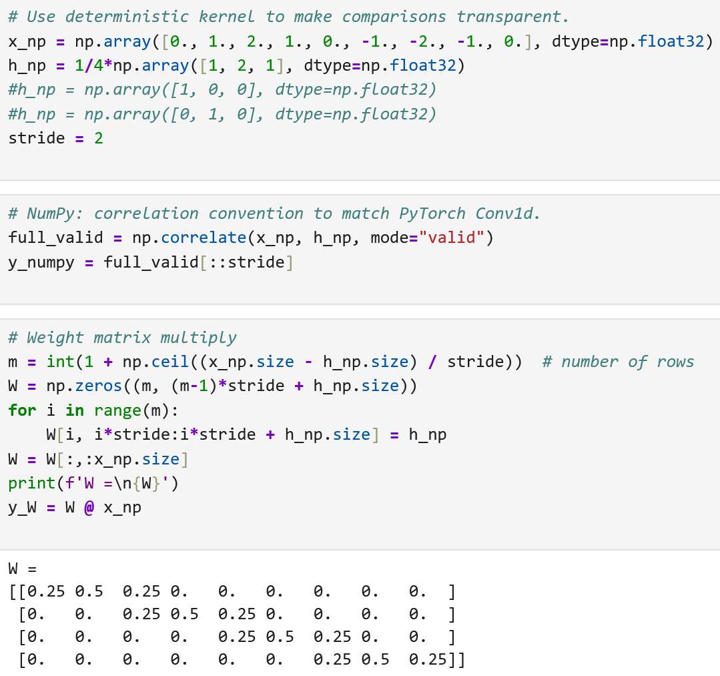
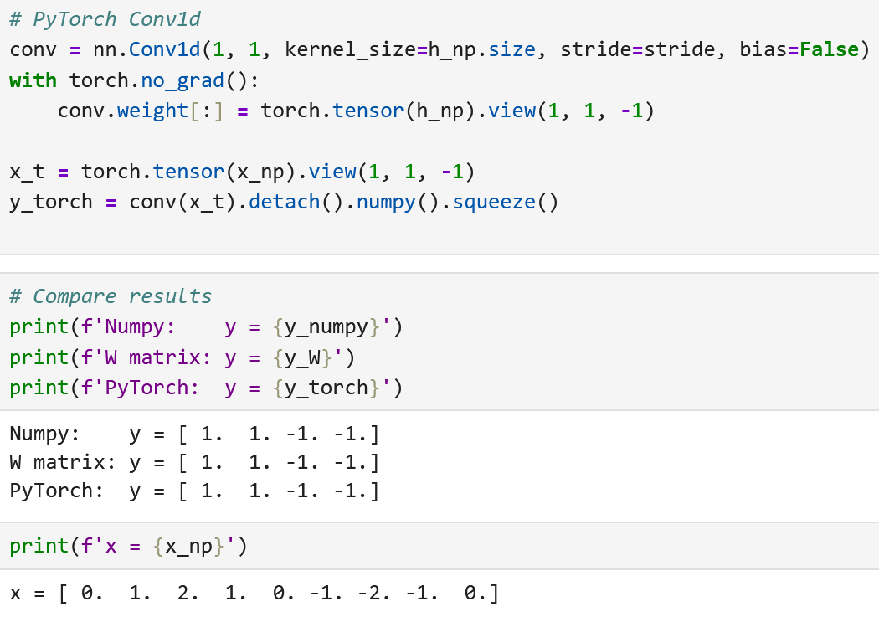
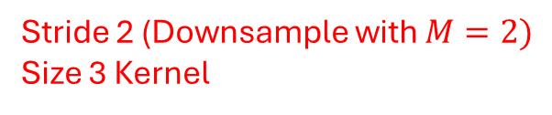
Filtering and Downsampling with numpy, weight matrix $W$ and Conv1d
Stride 2 (Downsample with $M=2)$
Size 3 Kernel

Slide 27
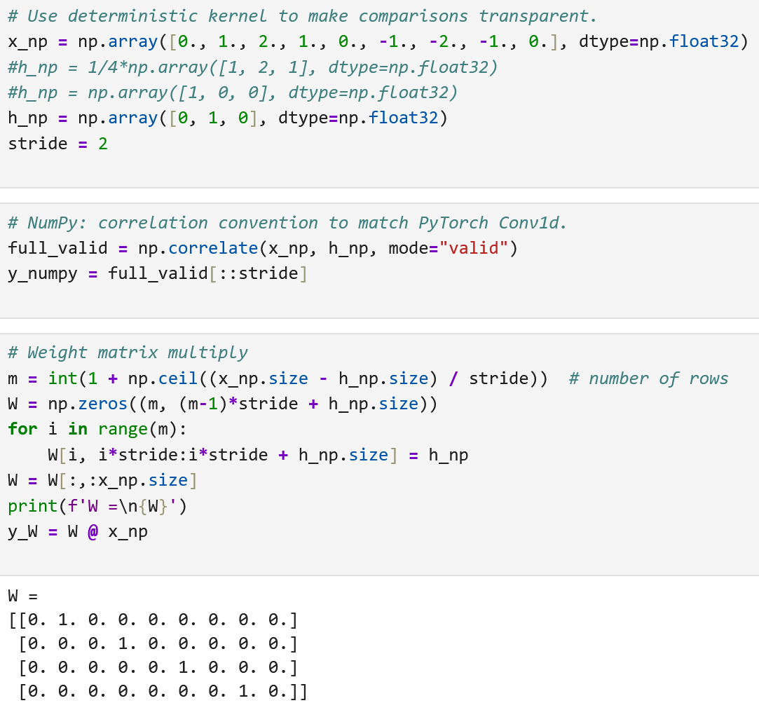
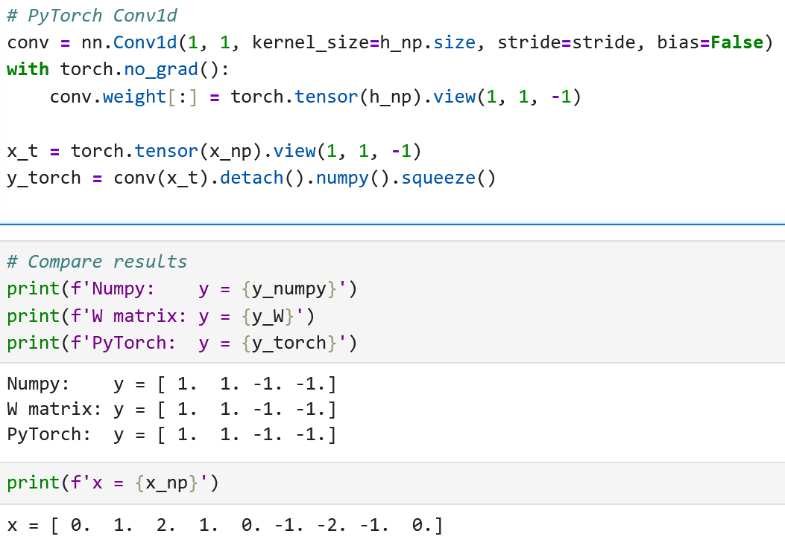
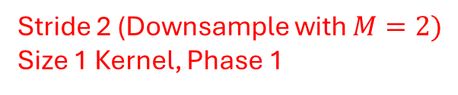
Downsampling Without Filtering, hurting Shift Equivariance
Stride 2 (Downsample with $M=2)$
Size 1 Kernel, Phase 1

Slide 28
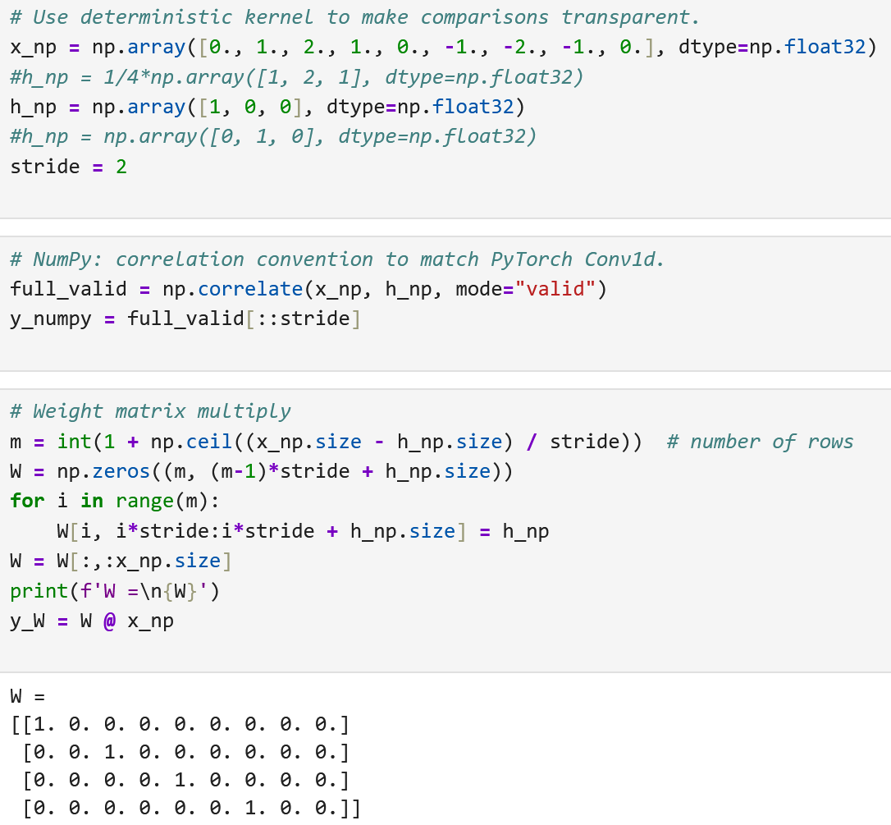
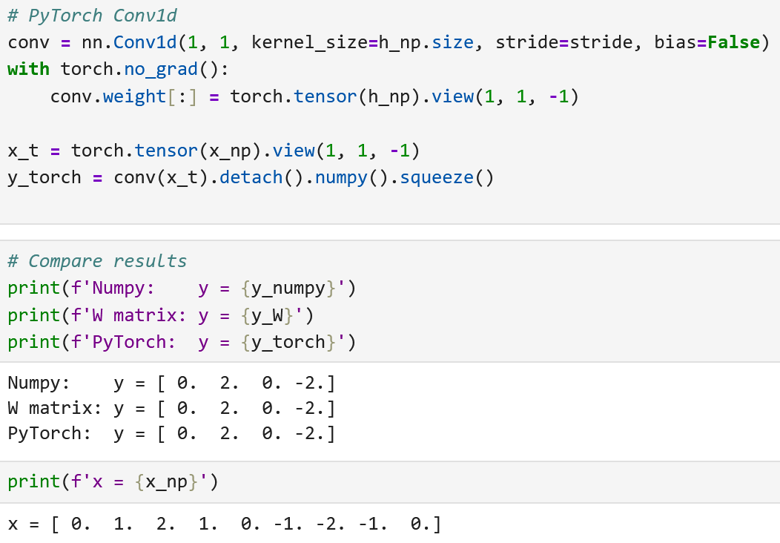
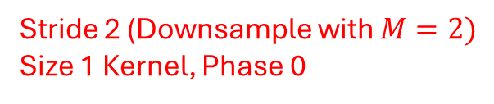
Downsampling Without Filtering, hurting Shift Equivariance
Stride 2 (Downsample with $M=2)$
Size 1 Kernel, Phase 0

Slide 29

0:57–1:04
Why aliasing can hurt shift equivariance
• Convolution alone is shift equivariant (ignoring boundaries).
• Subsampling chooses a sampling phase.
• A one-sample input shift can move energy to a different phase before ↓M.
• Aliased high-frequency feature content makes the output vary sharply under small shifts.
Practical symptom
Predictions or feature maps can change more than expected after tiny translations or time shifts.
Notes:
Distinguish exact equivariance from robustness. Striding inherently reduces resolution; aliasing makes phase sensitivity worse.

Slide 30
1:04–1:10
Anti-aliased CNNs: restore the missing DSP step
fixed / constrained
lowpass blur
learned conv
nonlinearity
↓ M
• BlurPool-style idea: lowpass before spatial or temporal subsampling.
• Alternative: constrain the strided kernel to have stronger lowpass behavior.
• Tradeoff: suppressing high-frequency detail can reduce aliasing but may also remove task-relevant features.
Notes:
Present anti-aliased CNNs as a design pattern, not a magic rule. The right amount of lowpass filtering depends on data, task, and architecture.

Slide 31
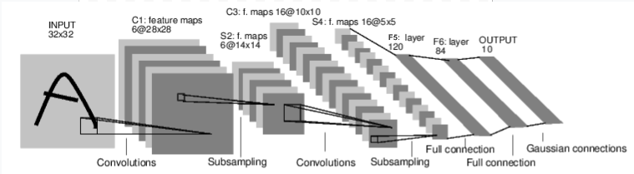
CNN for Classifying Digit Images

Slide 32
1:10–1:14
Mini-demo / coding prompt
Compare three stride-2 pipelines on the same 1-D signal:
A. Raw subsampling
B. Learned stride-2 conv
C. Blur + stride
y = x[::2]
torch.nn.Conv1d(..., stride=2)
lowpass(x) → take every 2nd sample
Shift the input by one sample. Which pipeline changes least, and why?
Use the accompanying notebook
Sections 1–5 reproduce the DSP spectra and the PyTorch stride comparison.
Notes:
Let pairs predict before running the notebook. The lowpass+stride pipeline should be less sensitive for signals dominated by content near the new Nyquist boundary.

Slide 33
1:14–1:15
Lecture 13 wrap-up
• Downsampling changes the sample rate and stretches spectral copies.
• Aliasing occurs when those copies overlap.
• Decimation is anti-alias lowpass filtering followed by ↓M.
• Strided CNN layers are learned-filter + downsample systems.
• Anti-aliased CNNs reintroduce an explicit lowpass step before subsampling.
Exit question
In one sentence: why can a perfectly reasonable learned convolution still be a poor anti-aliasing filter?
Next lecture
Zero insertion creates images; interpolation removes them.
Notes:
Good exit answer: because task loss does not force the kernel to suppress frequencies above the post-stride Nyquist limit, so high-frequency feature energy can alias.

