Slide 1
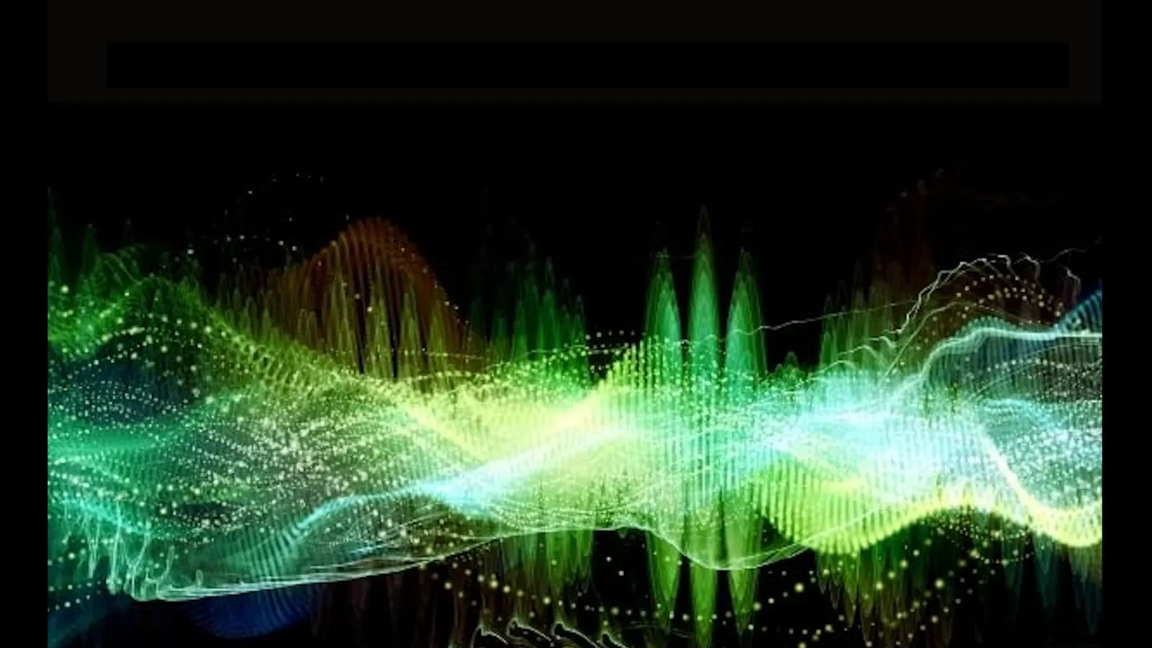
ECEN 4/5632 Theory and Application of Digital Filters
Lecture 5, 9-08-26
Peter Mathys*
* With generous help from Gemini Pro and ChatGPT

Slide 2
WEEK 3 • LECTURE 5
The z-Transform and the Region of Convergence
DTFT = z-transform on the unit circle
Beyond the DTFT: convergence becomes geometry.
75 minutes • rigorous DSP foundations • audio examples • Python sandbox • ML bridge
Week 3 • DSP + ML • Oppenheim & Schafer
1

Slide 3
Learning outcomes
00–15 MIN
By the end, students should reason from both algebra and ROC geometry.
• Explain why the DTFT can fail while a z-transform exists elsewhere in the z-plane.
• Compute bilateral z-transforms of common right- and left-sided sequences.
• Use the ROC to distinguish sequences with the same rational expression.
• Perform inverse z-transforms by partial fraction expansion.
• Connect unit-circle inclusion to the existence of the DTFT.
Week 3 • DSP + ML • Oppenheim & Schafer
2

Slide 4
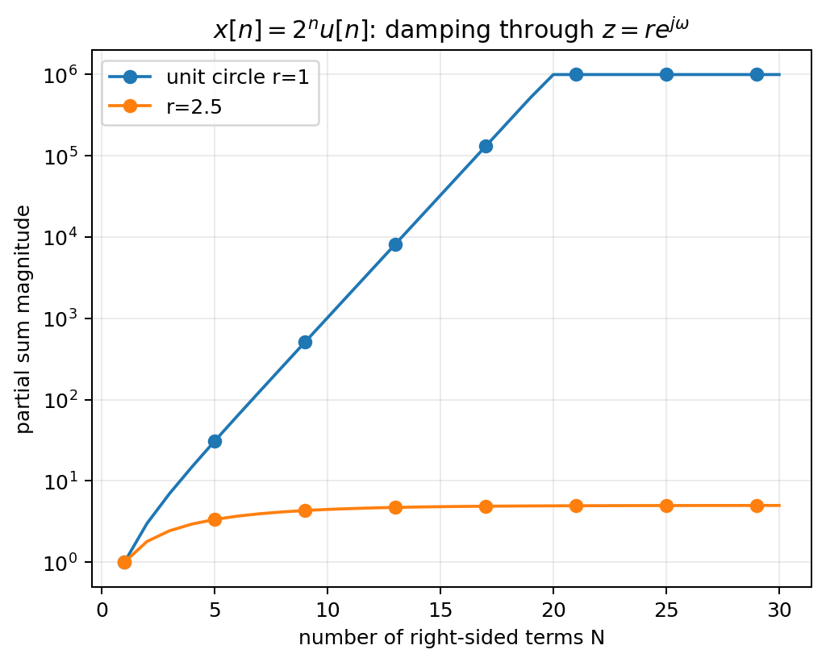
Beyond the DTFT: sometimes the unit circle is the problem
00–15 MIN
The DTFT is only one radial slice of a larger transform.
Example
On the unit circle
Move radially outward
x[n] = 2ⁿu[n] grows too quickly.
Σ 2ⁿe⁻ʲ^{ω}ⁿ does not converge in the ordinary sense.
z⁻ⁿ = r⁻ⁿe⁻ʲ^{ω}ⁿ adds damping. For r>2, (2/r)ⁿ decays.
Week 3 • DSP + ML • Oppenheim & Schafer
3

Slide 5
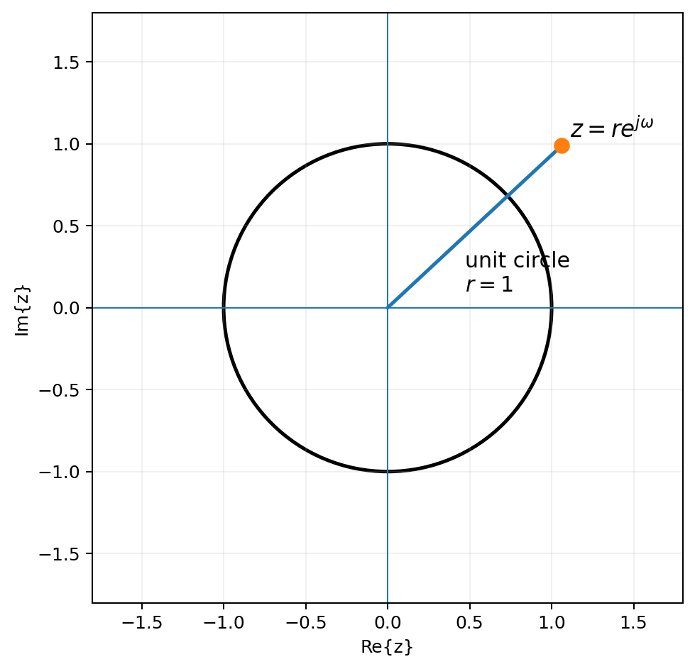
The damping-factor interpretation
00–15 MIN
Write z in polar form: radius controls convergence; angle probes frequency.
z = r e^{jω}
• r^{-n} changes the weighting of positive-time samples.
• ω supplies the familiar complex sinusoidal rotation.
• At r=1 there is no radial damping: this is exactly the DTFT.
• Convergence can hold for some radii and fail for others.
Week 3 • DSP + ML • Oppenheim & Schafer
4

Slide 6

Definition of the bilateral z-transform
15–35 MIN
A transform value exists only where the infinite sum converges.
Complex variable
Transform + ROC
Bilateral
z can be anywhere in the complex plane—not just on the unit circle.
A rational formula without its ROC is incomplete information.
Both positive and negative n may contribute; this is why annular ROCs appear.
Week 3 • DSP + ML • Oppenheim & Schafer
5

Slide 7

The DTFT lives on the unit circle
15–35 MIN
The z-transform generalizes frequency analysis radially.
• If the ROC includes |z|=1, the DTFT exists in the ordinary sense.
• Move around the unit circle: z=e^{jω}.
• A pole on the unit circle prevents a finite frequency response at that angle.
• Later: stability of an LTI system is tied to the unit circle lying in the ROC.
Week 3 • DSP + ML • Oppenheim & Schafer
6

Slide 8

Standard pair: right-sided exponential
15–35 MIN
Derive it as a geometric series—do not memorize the ROC separately.
Derivation
Interpretation
X(z)=Σₙ₌₀∞ aⁿz⁻ⁿ = Σₙ₌₀∞(az⁻¹)ⁿ Geometric series converges when |a z⁻¹|<1 ⇒ |z|>|a|
• Pole at z=a.
• ROC extends outward from the pole.
• Right-sided sequences naturally produce exterior ROCs.
• If |a|<1, the unit circle lies in the ROC and the DTFT exists.
Week 3 • DSP + ML • Oppenheim & Schafer
7

Slide 9
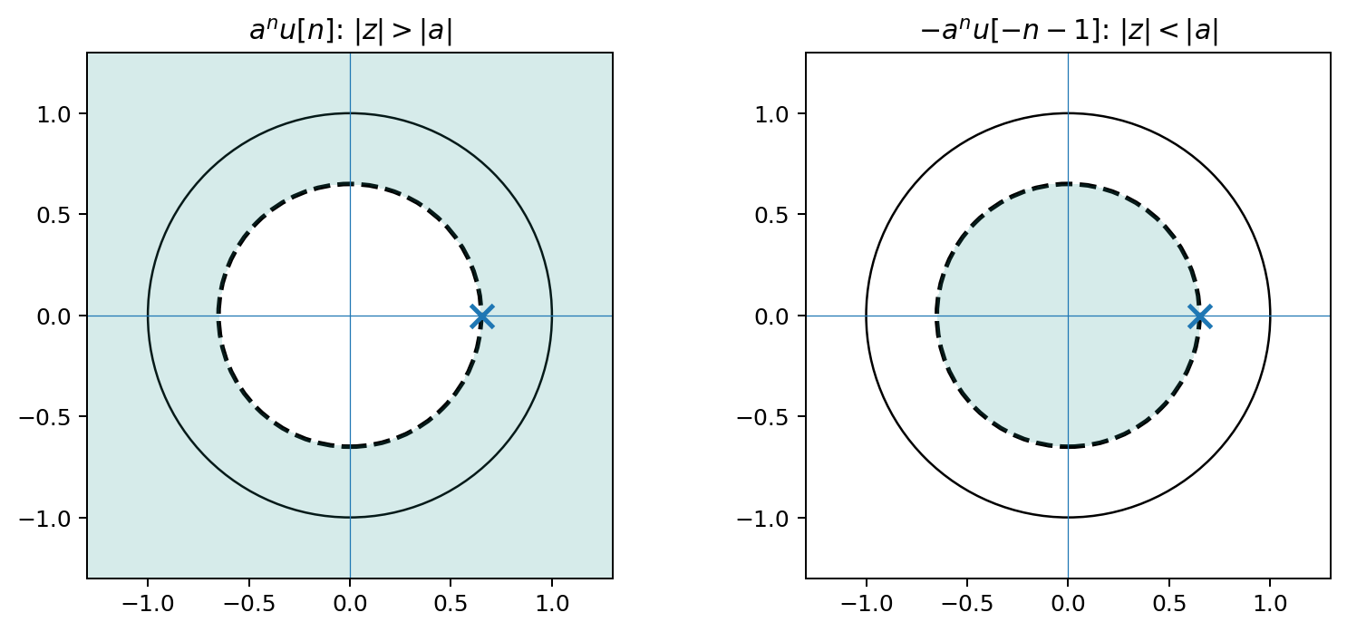
Same rational expression, different sequence
35–55 MIN
The ROC is what tells you which time support is intended.
Key fact: 1/(1−az⁻¹) alone does NOT uniquely determine x[n]. The ROC is part of the transform.
Week 3 • DSP + ML • Oppenheim & Schafer
8

Slide 10
Left-sided exponential: why the minus sign appears
35–55 MIN
Expand the same rational function in powers appropriate to |z|<|a|.
For |z|<|a|
Inverse sequence
1/(1−az⁻¹) = z/(z−a) Rewrite so the geometric ratio has magnitude < 1: = −(z/a)/(1−z/a) = −Σₖ₌₁∞ (z/a)ᵏ
−aⁿ u[−n−1] Nonzero only for n≤−1. Same pole at z=a. Different support. Different ROC.
Week 3 • DSP + ML • Oppenheim & Schafer
9

Slide 11
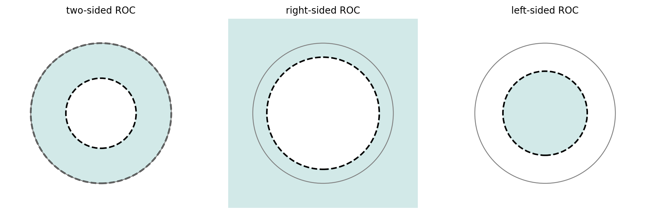
ROC geometry: annuli bounded by poles
35–55 MIN
For rational transforms, the ROC cannot contain a pole.
Right-sided
Left-sided
Two-sided
ROC is outside the outermost pole.
ROC is inside the innermost pole.
ROC lies between pole radii.
Week 3 • DSP + ML • Oppenheim & Schafer
10

Slide 12
ROC rules worth being able to reason from
35–55 MIN
These are consequences of convergence, not arbitrary conventions.
1
ROC is a connected annulus centered at the origin.
2
ROC contains no poles.
3
Right-sided rational sequence → ROC outside outermost pole.
4
Left-sided rational sequence → ROC inside innermost pole.
5
Finite two-sided sequence: ROC is essentially entire z-plane except possible 0 or ∞.
6
DTFT exists iff the unit circle lies in the ROC.
Week 3 • DSP + ML • Oppenheim & Schafer
11

Slide 13
Quick classification: infer support from the ROC
35–55 MIN
Think first; compute only if needed.
A
X(z)=1/(1−0.7z⁻¹), |z|>0.7
B
X(z)=1/(1−1.2z⁻¹), |z|>1.2
C
X(z)=1/(1−1.2z⁻¹), |z|<1.2
D
poles at 0.5 and 0.9, 0.5<|z|<0.9
Week 3 • DSP + ML • Oppenheim & Schafer
12

Slide 14
Quick classification: infer support from the ROC
35–55 MIN
Think first; compute only if needed.
A
X(z)=1/(1−0.7z⁻¹), |z|>0.7
Good answer: right-sided; DTFT exists
B
X(z)=1/(1−1.2z⁻¹), |z|>1.2
Good answer: right-sided; DTFT does not exist
C
X(z)=1/(1−1.2z⁻¹), |z|<1.2
Good answer: left-sided; DTFT exists because unit circle is inside ROC
D
poles at 0.5 and 0.9, 0.5<|z|<0.9
Good answer: two-sided; DTFT does not exist
Week 3 • DSP + ML • Oppenheim & Schafer
12

Slide 15
Inverse z-transform: practical workflow
55–75 MIN
For rational functions, partial fractions turns algebra back into transform pairs.
1
2
3
4
5
Express X(z) in powers of z⁻¹.
Factor the denominator into first-order or quadratic factors.
Compute partial-fraction coefficients.
Use the ROC to choose right-sided vs left-sided form for each pole.
Check by recomputing poles / a few samples.
Do not invert the algebraic expression without the ROC: the same residues can map to different time-domain supports.
Week 3 • DSP + ML • Oppenheim & Schafer
13

Slide 16
Worked partial fractions
55–75 MIN
One rational expression; multiple inverse transforms depending on ROC.
X(z) = 1 / [(1−0.5z⁻¹)(1−0.8z⁻¹)]
= −5/3 · 1/(1−0.5z⁻¹) + 8/3 · 1/(1−0.8z⁻¹)
ROC |z|>0.8
ROC 0.5<|z|<0.8
Both terms are right-sided. x[n]=−(5/3)(0.5)ⁿu[n]+(8/3)(0.8)ⁿu[n]
0.5-pole term is right-sided; 0.8-pole term is left-sided. x[n]=−(5/3)(0.5)ⁿu[n]−(8/3)(0.8)ⁿu[−n−1]
Week 3 • DSP + ML • Oppenheim & Schafer
14

Slide 17
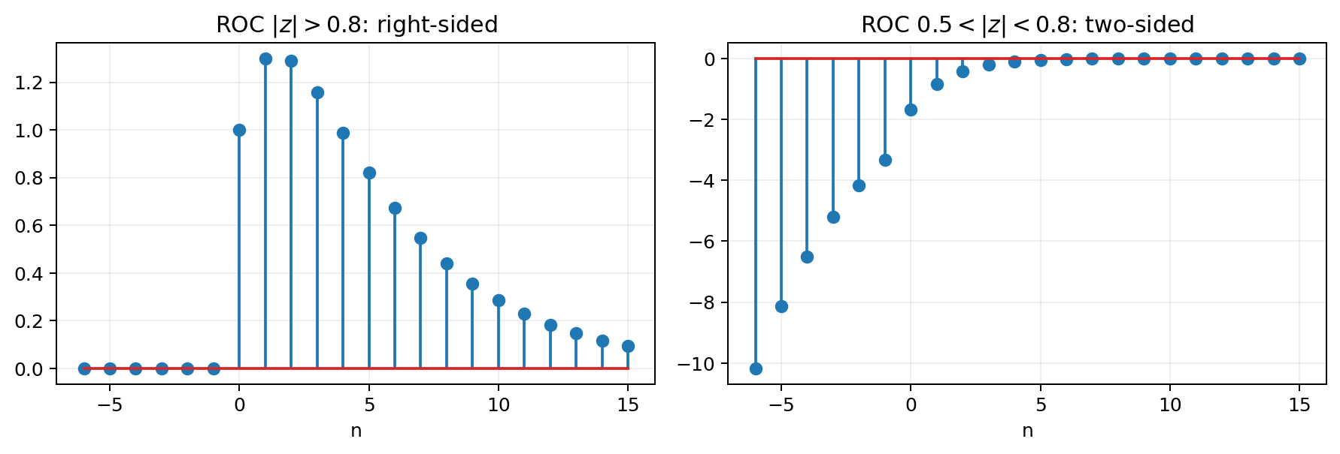
The ROC changes the time-domain signal dramatically
55–75 MIN
Same poles and residues do not imply the same sequence.
This is why “X(z)=rational function” is incomplete unless the ROC (or an equivalent support/causality condition) is specified.
Week 3 • DSP + ML • Oppenheim & Schafer
15

Slide 18
Python demo: see convergence and residues numerically
55–75 MIN
Numerical tools confirm the analysis; they do not decide the ROC for you.
from scipy import signal b = [1.0] a = [1.0, -1.3, 0.4] r, p, k = signal.residuez(b, a) print(r, p) # residues ≈ [-5/3, 8/3] # poles = [0.5, 0.8]
What SciPy knows
• Algebraic residues and pole locations.
• A rational transfer-function representation.
• Frequency response if a stable interpretation is appropriate.
What SciPy does NOT infer
• Whether each term is right- or left-sided without an ROC/support condition.
Week 3 • DSP + ML • Oppenheim & Schafer
16

Slide 19
Audio connection: poles forecast decay and resonance
55–75 MIN
Lecture 6 will turn ROC geometry into filter behavior.
Pole magnitude |p|
Pole angle ∠p
Unit circle
Sets exponential growth/decay rate in impulse-response terms.
Sets oscillatory frequency of a complex-conjugate pole pair.
Frequency response is evaluated here—if this circle lies in the ROC.
Preview: moving a pole closer to the unit circle makes the associated resonance sharper and the time-domain ringing last longer.
Week 3 • DSP + ML • Oppenheim & Schafer
17

Slide 20
Concept check
CHECK
The expression and ROC must be interpreted together.
For X(z)=1/(1−1.1z⁻¹), which ROC gives a DTFT?
A. |z|>1.1
B. |z|<1.1
C. Both
D. Neither
Week 3 • DSP + ML • Oppenheim & Schafer
18

Slide 21
Concept check
CHECK
The expression and ROC must be interpreted together.
For X(z)=1/(1−1.1z⁻¹), which ROC gives a DTFT?
A. |z|>1.1
B. |z|<1.1
C. Both
D. Neither
Correct: B. The unit circle |z|=1 lies inside the ROC |z|<1.1.
Week 3 • DSP + ML • Oppenheim & Schafer
18

Slide 22
Common mistakes to prevent
WRAP-UP
These are high-value exam and debugging traps.
“The rational formula determines x[n].”
“The z-transform always exists.”
“DTFT and z-transform are separate ideas.”
“A pole can lie in the ROC.”
Week 3 • DSP + ML • Oppenheim & Schafer
19

Slide 23
Common mistakes to prevent
WRAP-UP
These are high-value exam and debugging traps.
“The rational formula determines x[n].”
No—the ROC/support is part of the transform.
“The z-transform always exists.”
No—the ROC may be empty for some sequences.
“DTFT and z-transform are separate ideas.”
DTFT is the unit-circle evaluation when the ROC includes it.
“A pole can lie in the ROC.”
Never: the transform diverges at a pole.
Week 3 • DSP + ML • Oppenheim & Schafer
19

Slide 24
Lecture 5 synthesis
WRAP-UP
The z-transform is frequency analysis plus convergence geometry.
sequence
z-transform
ROC
unit circle
inverse
x[n]
X(z)
where it converges
DTFT if included
PFE + ROC
Exit ticket: Why can the same rational X(z) correspond to different sequences?
Week 3 • DSP + ML • Oppenheim & Schafer
20

Slide 25
Lecture 5 synthesis
WRAP-UP
The z-transform is frequency analysis plus convergence geometry.
sequence
z-transform
ROC
unit circle
inverse
x[n]
X(z)
where it converges
DTFT if included
PFE + ROC
Exit ticket: Why can the same rational X(z) correspond to different sequences? Good answer: because different power-series expansions converge in different ROCs, producing different time supports.
Week 3 • DSP + ML • Oppenheim & Schafer
20

Slide 26
Board reserve: finite-duration sequences
RESERVE
Use if students need an easy ROC anchor before rational examples.
x[n] = 2δ[n+1] − δ[n] + 3δ[n−2]
X(z) = 2z − 1 + 3z⁻²
ROC idea
Only finitely many terms are present. Divergence can occur only at z=0 because of negative powers, or at z=∞ because of positive powers.
Here both positive and negative powers occur ⇒ 0 < |z| < ∞.
Week 3 • DSP + ML • Oppenheim & Schafer
21

Slide 27
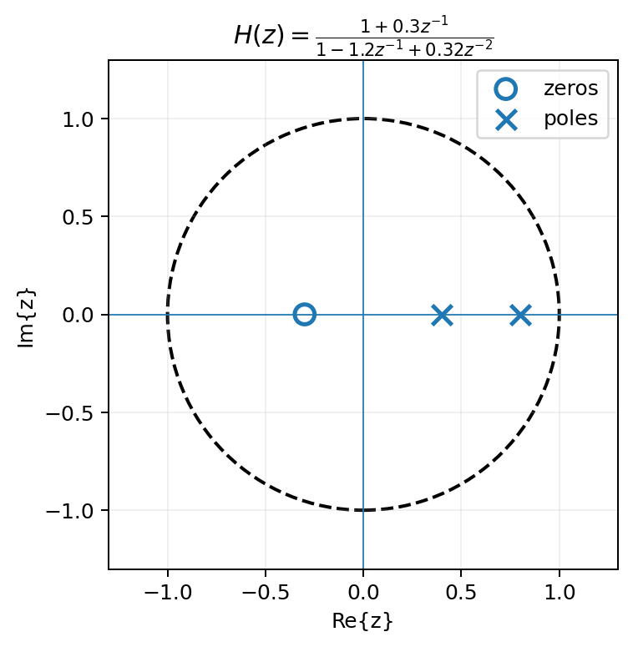
Next: transfer functions, poles, zeros, stability
NEXT
Lecture 6 turns the z-plane into a filter-design map.
• Difference equations become rational H(z).
• Poles + ROC determine causality and stability.
• Zeros suppress nearby unit-circle frequencies.
• Poles enhance nearby frequencies.
• Audio filters become geometry you can see.
Week 3 • DSP + ML • Oppenheim & Schafer
22

