Slide 1
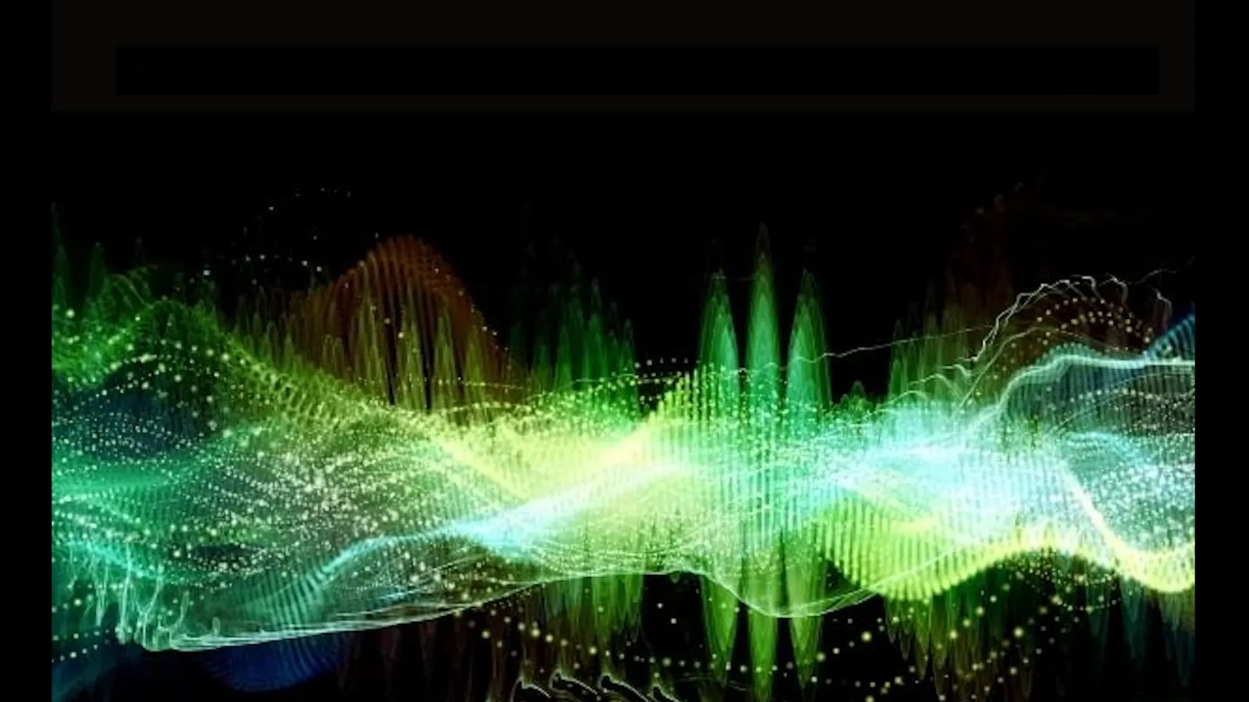
ECEN 4/5632 Theory and Application of Digital Filters
Lecture 2, 8-25-26, 8-27-26
Peter Mathys*
* With generous help from Gemini Pro and ChatGPT

Slide 2
DSP + ML
Eigenfunctions and
the DTFT
Week 1 • Lecture 2 • 75 minutes
Why sinusoids survive LTI systems—and why frequency-domain multiplication is so powerful
e^{jωn}
LTI system
H(e^{jω})
DTFT
Features
probe
h[n]
eigenvalue
spectrum
spectrogram
Notes:
Timing: 2 min. Ask: if a pure tone enters an LTI filter, what can change—frequency, amplitude, phase?

Slide 3
Today’s learning objectives
00–10 MIN
Move from time-domain mechanics to frequency-domain structure.
Prove that complex exponentials are eigenfunctions of LTI systems.
Define the DTFT and inverse DTFT and explain 2π periodicity.
Use time shift, convolution, and Parseval properties.
Derive frequency response directly from a linear constant-coefficient difference equation.
Interpret a one-pole filter in time and frequency domains.
Graduate expectation
Be able to state convergence or stability assumptions when a transform/frequency response is used.
Notes:
Timing: 3 min.

Slide 4

Recap: an LTI system is convolution by h[n]
00–10 MIN
Now choose an input that makes convolution simplify dramatically.
Notice
The input waveform e^{jωn} factors back out. The system can only multiply it by a complex number.
Notes:
Timing: 4 min. This is the proof. Keep emphasizing what depends on n and what does not.

Slide 5
Complex exponentials are eigenfunctions of every LTI system
00–10 MIN
The eigenvalue depends on frequency.
What stays the same
What changes
Frequency ω
Exponential form
Infinite-duration mode
Magnitude: |H(e^{jω})|
Phase: ∠H(e^{jω})
Possibly complete cancellation
Notes:
Timing: 4 min. Use ordinary sinusoids as real parts of exponentials. An LTI system cannot generate a new frequency from a single sinusoid.

Slide 6
Frequency response is a gain-and-phase lookup table
10–35 MIN
One complex number for each normalized frequency ω.
Tone in
Magnitude
Phase
Tone out
cos(ω₀n)
× |H(e^{jω₀})|
+ ∠H(e^{jω₀})
same ω₀
Audio EQ
A graphic equalizer is approximately a deliberately shaped |H(e^{jω})|.
Notes:
Timing: 4 min. Bridge from eigenfunction proof to intuitive filter behavior.

Slide 7


The DTFT analyzes a sequence as a continuous function of frequency
10–35 MIN
Time is discrete; frequency remains continuous.
Forward DTFT
Inverse DTFT
Sequence x[n] → function X(e^{jω})
Weighted sum of rotating phasors
Requires convergence in an appropriate sense
Integrates one period of spectrum
Reconstructs each integer sample
Any interval of length 2π works
Notes:
Timing: 6 min. Mention absolute summability as a simple sufficient condition for ordinary convergence; do not derail into distributions unless desired.

Slide 8


Why is the DTFT 2π-periodic?
10–35 MIN
Because sampled-time exponentials cannot distinguish ω from ω+2πk.
−2π
−π
0
π
2π
same spectral content repeats every 2π
Notes:
Timing: 5 min. Instructor tip: point ahead to sampling/aliasing. π rad/sample corresponds to the Nyquist frequency after a sampling rate is specified.

Slide 9





Normalized frequency ↔ physical frequency
10–35 MIN
Week 2 will make this relationship central.
Example
At f_s=48 kHz: ω=π/2 ↔ 12 kHz, and ω=π ↔ 24 kHz.
The interval −π≤ω<π represents one unique frequency period.
Frequencies outside that interval wrap into it modulo 2π.
Notes:
Timing: 4 min. This slide sets up the Week 2 sampling lecture without teaching aliasing yet.

Slide 10


Two DTFT pairs worth knowing immediately
10–35 MIN
Use them as anchors—not as a substitute for reasoning.
Why the condition?
For |a|<1, the geometric series is absolutely summable; |a|≥1 does not converge on the unit circle in the ordinary sense.
Notes:
Timing: 4 min. The a^n u[n] pair will be reused for the one-pole system.

Slide 12


Time shifting becomes linear phase
35–55 MIN
Delays are easy to recognize in the frequency domain.
Magnitude
Phase
|e^{-jωn₀}|=1
A pure delay does not change spectral magnitude
Adds −ωn₀ radians
Linear phase slope encodes delay
Audio connection
An ideal sample delay preserves the spectrum’s magnitude exactly; it only rotates phase versus frequency.
Notes:
Timing: 4 min.

Slide 13


Convolution in time ↔ multiplication in frequency
35–55 MIN
This is one of the most important DSP simplifications.
Time domain
DTFT
Frequency domain
IDTFT
slide / multiply / sum
transform
pointwise multiply
reconstruct
Computational echo
FFT-based convolution exploits the same multiplication idea numerically for long signals.
Notes:
Timing: 6 min. Sketch the proof by substituting y[n]=Σx[k]h[n−k] into the DTFT and changing variables. Avoid drowning in indices; focus on the separation into X times H.

Slide 14
Parseval: energy is preserved across representations
35–55 MIN
The spectrum redistributes energy; it does not create it.
Time-domain view
Frequency-domain view
Energy = sum of squared samples
Natural for waveforms
Energy density across ω
Natural for bands and features
ML bridge
Many audio features—band energies, log spectra, mel features—summarize how signal energy is distributed across frequency.
Notes:
Timing: 4 min. Clarify that mel scaling and log magnitude are later nonlinear transformations; Parseval applies before those.

Slide 15




Difference equations give H(e^{jω}) directly
35–55 MIN
Use the eigenfunction or DTFT property instead of solving every input separately.
Substitute x[n]=e^{jωn}, y[n]=H(e^{jω})e^{jωn}.
Factor out e^{jωn}.
Solve the remaining algebraic equation for H(e^{jω}).
Notes:
Timing: 5 min. Students should understand this as the same eigenfunction argument, not a separate trick.

Slide 16

One-pole example: y[n]=0.5y[n−1]+x[n]
55–75 MIN
A simple recursive smoother with a strong low-frequency preference.
At ω=0
At ω=π
H=1/(1−0.5)=2
DC is amplified
H=1/(1+0.5)=2/3
Nyquist-frequency alternation is attenuated
Notes:
Timing: 5 min. Ask students to predict low-pass vs high-pass before plotting.

Slide 17
Think–Pair–Share: sketch |H(e^{jω})| before computing
55–75 MIN
Reason from a few strategically chosen frequencies.
Given y[n] = 0.5y[n−1] + x[n]
1 minute: derive H(e^{jω}).
2 minutes: evaluate |H| at ω=0, π/2, π.
2 minutes: sketch a smooth 2π-periodic magnitude curve.
Pair discussion: what audio behavior would you expect?
Prompt
What feature of the recursion causes “memory” of prior samples?
Graduate extension
Relate the coefficient 0.5 to a pole at z=0.5 and explain why moving it toward 1 increases low-frequency selectivity.
Notes:
Timing: 5 min active work. Do not reveal the next slide until pairs have committed to a sketch.

Slide 18
Think–Pair–Share solution
55–75 MIN
The denominator is smallest near ω=0, so the response peaks at low frequency.
Three checkpoints
Interpretation
ω=0: 2 • ω=π/2: 0.894 • ω=π: 0.667
Smooth low-pass tendency • recursive memory • stable because |0.5|<1
Notes:
Timing: 4 min. Point out periodic continuation beyond ±π.

Slide 19
Python demo: freqz and filtering
55–75 MIN
The numerical tools should confirm—not replace—the analysis.
SciPy frequency response
Filtering
import numpy as np
from scipy import signal
b = [1.0]
a = [1.0, -0.5]
w, H = signal.freqz(b, a, worN=1024)
mag = np.abs(H)
x = np.random.randn(48000)
y = signal.lfilter(b, a, x)
# Compare spectra / listen if desired
Notebook task
Change the recursion coefficient from 0.5 → 0.9 → 0.99. Predict the shape first; then verify with freqz.
Notes:
Timing: 4 min. Use the provided notebook cell.

Slide 20


DTFT vs DFT vs FFT
55–75 MIN
Three related terms that students often collapse into one.
DTFT
DFT / FFT
Input: discrete-time sequence
Frequency: continuous ω
2π-periodic spectrum
Mathematical transform
Input: finite N samples
Frequency: N discrete bins
DFT is the transform
FFT is an algorithm for the DFT
Practical bridge
In code, we sample the DTFT-like spectrum on a finite grid using the DFT/FFT. The grid and window matter.
Notes:
Timing: 4 min. This prevents a major vocabulary problem before later spectrogram work.

Slide 21
ML bridge: spectrograms are structured frequency-domain features
BRIDGE
The DTFT is the conceptual ancestor of the STFT.
Waveform
Window
DTFT/DFT
Stack over time
CNN
x[n]
local segment
local spectrum
spectrogram
learn patterns
DSP explains what the axes and magnitudes mean.
Windowing and sampling choices determine resolution and leakage.
ML operates on features whose structure comes directly from signal-processing choices.
Notes:
Timing: 3 min. Preview: later weeks will build spectrograms and feed them to models.

Slide 22
Concept check
CHECK
Reason from the denominator, not from memorized filter labels.
For H(e^{jω}) = 1/(1 − 0.9e^{−jω}), where is |H| largest?
A. Near ω=0
B. Near ω=π/2
C. Near ω=π
D. It is constant for all ω
Notes:
Timing: 2 min. Correct answer A.

Slide 23
Concept check
CHECK
Reason from the denominator, not from memorized filter labels.
For H(e^{jω}) = 1/(1 − 0.9e^{−jω}), where is |H| largest?
A. Near ω=0
B. Near ω=π/2
C. Near ω=π
D. It is constant for all ω
Correct: at ω=0 the terms 1 and 0.9e^{-jω} nearly cancel in the denominator, making the magnitude large.
Notes:
Timing: 2 min. Correct answer A.

Slide 24
Lecture 2 synthesis
WRAP-UP
The frequency domain turns LTI systems into multiplication.
Complex exponential
Eigenvalue
DTFT
Convolution theorem
Spectral features
e^{jωn}
H(e^{jω})
X(e^{jω})
Y=XH
energy / shape
Be able to derive H(e^{jω}) from h[n] or a difference equation.
Be able to explain 2π periodicity and the relation ω=2πf/fs.
Be able to reason qualitatively about a response before plotting it.
Week 2
Sampling will explain which analog frequencies map to the same discrete-time frequency—and why aliasing occurs.
Notes:
Timing: 3 min. Exit ticket: “Why can an LTI system change the amplitude and phase of a sinusoid but not its frequency?”

Slide 25
Weekly quiz
ASSESSMENT
15 minutes • closed notes unless your course policy says otherwise
Core skills: LTI properties, convolution, eigenfunction reasoning, DTFT periodicity.
One short calculation: derive H(e^{jω}) from a first-order difference equation.
One conceptual explanation: interpret a frequency response without plotting.
Suggested use
Give the quiz at the start of Week 2 or as the last 15 minutes of Lecture 2, depending on pacing.
Notes:
If the Think-Pair-Share runs long, move the quiz to the start of Week 2.

