Slide 1
LECTURE 12
Upsampling,
Interpolation, and
Rational Rate Changes
↑L
images appear
LPF × L
From zero insertion to sample-rate conversion and transposed convolutions
L / M
Oppenheim & Schafer §4.6
Notes:
0:00–0:02. Connect directly to previous lecture: downsampling risks aliasing; upsampling produces images. Both need filtering.

Slide 2
ROADMAP
Learning objectives
The goal is to design complete sample-rate conversion chains and connect them to learned upsampling.
• Construct an upsampled sequence by zero insertion.
• Explain why the DTFT becomes X(e^{jωL}) and why spectral images appear.
• Choose and scale an interpolation lowpass filter.
• Build an L/M rational rate converter and select its cutoff.
• Relate ConvTranspose1d to zero insertion + convolution and diagnose periodic artifacts.
Pacing
0–20 min: upsampling
20–45 min: interpolation
45–60 min: L/M conversion
60–75 min: transposed conv
Core question
After inserting zeros, what must the filter do in both frequency and amplitude?
Notes:
Preview the amplitude-scaling issue: zero insertion does not change old sample values, but the interpolation filter needs DC gain L to preserve amplitudes after smoothing.

Slide 3
01
Upsampling by zero insertion
Create a higher-rate sequence by inserting L−1 zeros between samples.

Slide 4

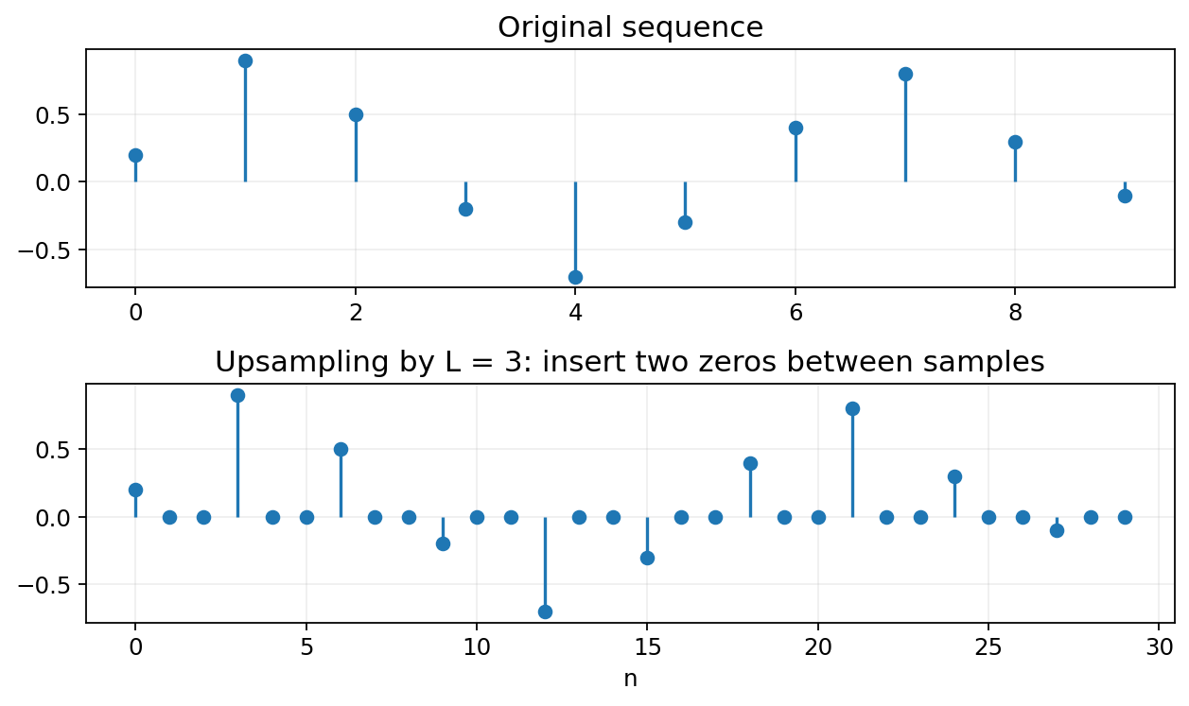
0:02–0:08
Upsampling: the time-domain definition
• Output sample rate becomes L F_s.
• Original samples remain at indices n = kL.
• Inserted zeros are placeholders—not estimates of the missing waveform.
• Interpolation filtering will fill in meaningful intermediate values.
Notes:
Use the phrase “zero stuffing” once, then emphasize that upsampling alone is not interpolation.

Slide 5
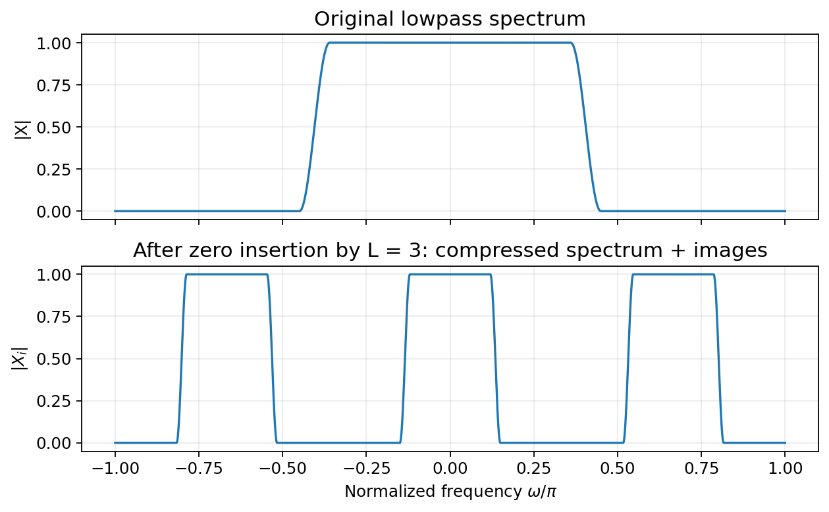
0:08–0:15
Frequency-domain effect: compression + images
• Compression: the original spectrum is squeezed by L.
• Periodicity: the compressed copy repeats L times over [−π, π].
• Images: the extra replicas are artifacts of zero insertion.
• Goal: keep the baseband copy; remove the rest.
Notes:
Ask: why do images appear even though the inserted samples are zeros? Answer: changing the sampling lattice changes how the periodic DTFT maps into the new normalized frequency variable.

Slide 6
CONCEPT CHECK
Concept check: image locations
If L = 3 and the original signal is baseband, how many compressed spectral copies appear over one 2π interval after zero insertion?
Reveal after discussion
Notes:
Suggested answer: Three copies. The argument X(e^{j3ω}) traverses three periods as ω spans one 2π interval.

Slide 7
02
Interpolation = upsample + lowpass
The anti-imaging filter isolates the desired baseband replica and reconstructs intermediate samples.

Slide 8
0:20–0:28
The interpolation filter
↑ L
HI(z)
lowpass
x[n]
y[n]
Ideal cutoff
Pass only one image
DC gain
ω_c = π/L
The lowpass retains the compressed baseband copy centered at ω = 0.
Set H_I(e^{j0}) = L so the reconstructed sequence preserves amplitude.
Notes:
This is the point where many students forget the gain of L. Tie it to a constant input x[n]=1: after zero insertion only 1 in L samples is nonzero, so averaging without gain would reduce the level.

Slide 9
0:28–0:34
Why the gain must be L
Test signal: x[n] = 1 for all n.
After ↑L
Lowpass with unit DC gain
Sequence is 1, 0, 0, …, 1, 0, 0, …
Average value = 1/L
Smoothing preserves the reduced average → output tends toward 1/L.
Correct interpolation filter
Multiply the lowpass by L so constant input stays constant: y[n] = 1.
Notes:
This constant-signal argument is more intuitive than a formal derivation. It gives students a reliable check when coding.

Slide 10
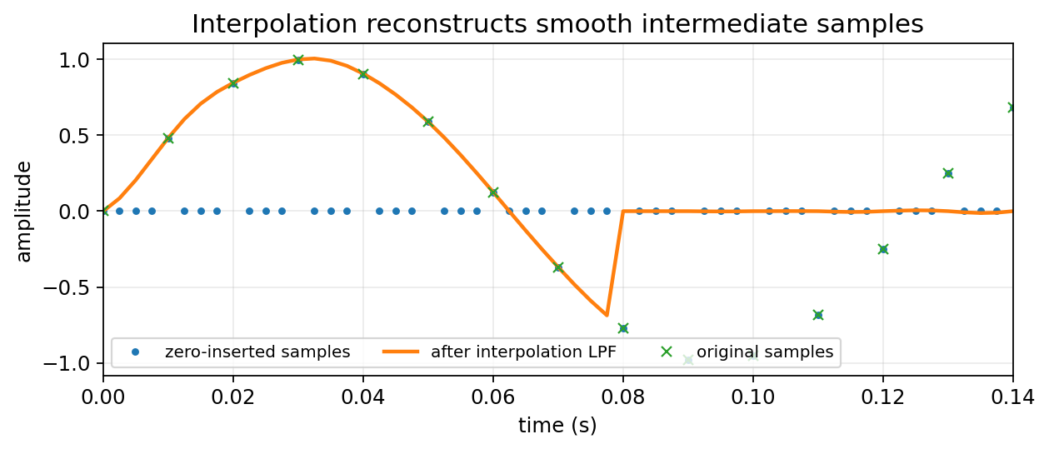
0:34–0:40
Interpolation in the time domain
• Inserted zeros disappear after filtering.
• Original sample locations are retained (subject to filter delay / edge effects).
• Intermediate samples are weighted combinations of neighboring originals.
• Ideal sinc interpolation is conceptually exact for bandlimited signals; FIR approximations are practical.
DSP interpretation
The filter is reconstructing a smoother sequence on a denser sampling grid.
Notes:
Connect to reconstruction from Week 2: the mathematics is analogous, but this time both the input and output are discrete-time sequences.

Slide 11
0:40–0:45
Choosing an interpolation FIR
Passband
Stopband
Preserve the compressed baseband: |ω| ≤ ωp < π/L.
Suppress the first image beginning near π/L.
Gain
Delay
Scale coefficients so the DC gain is L.
For N-tap linear-phase FIR, delay = (N−1)/2 high-rate samples.
Implementation check: feed a constant signal and verify the output amplitude is unchanged away from transients.
Notes:
This slide can be fast if students already understand FIR design. Focus on the three checks: cutoff, gain, delay.

Slide 12
03
Rational sample-rate conversion L/M
Upsample first, filter once, then downsample.

Slide 13
0:45–0:51
Why the order is ↑L then ↓M
x[n]
↑ L
H(z)
↓ M
y[n]
• Upsampling first makes the intermediate grid fine enough to represent the desired output sample times.
• A single lowpass filter can remove interpolation images and prevent later decimation aliasing.
• Reduce L/M to lowest terms before implementation.
Notes:
Example: 48 kHz to 44.1 kHz = 147/160. We conceptually create a 7.056 MHz intermediate grid, but efficient polyphase implementations never form all those zeros explicitly.

Slide 14
0:51–0:56
One filter serves two jobs
Anti-imaging constraint
Combined design
After ↑L, reject replicas outside the desired compressed baseband.
Use the stricter cutoff. In practice, reserve a transition band below the ideal boundary.
Anti-aliasing constraint
Before ↓M, remove content that lies above the new Nyquist limit.
Notes:
Clarify that this normalized cutoff is expressed on the high-rate intermediate grid. Students often mix the input-rate and intermediate-rate normalized frequencies.

Slide 15
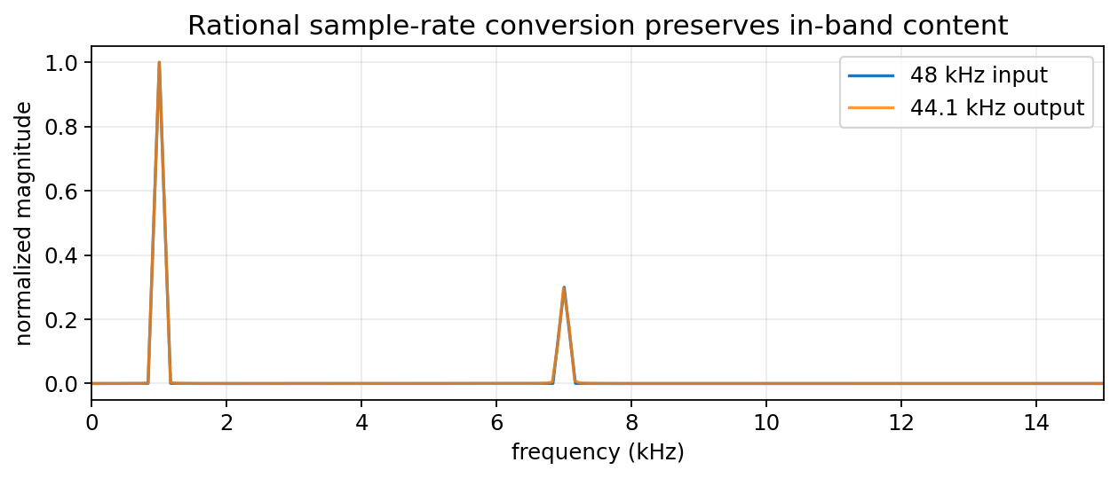
0:56–1:00
Real example: 48 kHz → 44.1 kHz
Rate ratio
44,100 / 48,000 = 147 / 160
Conceptual chain
↑147 → lowpass → ↓160
Efficient implementation
Polyphase filtering computes only the output samples that are needed.
Notes:
Use scipy.signal.resample_poly as the practical demo. Do not derive polyphase in detail if it is reserved for a later week.

Slide 16
04
Transposed convolutions and learned upsampling
A stride in the reverse direction is closely related to zero insertion followed by filtering.

Slide 17
1:00–1:06
ConvTranspose1d: a DSP interpretation
↑ stride
(zero insertion)
learned
convolution
input
feature map
higher-rate
output
• For stride > 1, transposed convolution can be viewed as inserting zeros and then applying a learned filter (with indexing/padding details).
• The learned filter is not automatically an anti-imaging filter.
• Uneven overlap or poorly controlled imaging can create periodic artifacts.
Notes:
Use “transposed” rather than “deconvolution”; it is the transpose of the linear operator, not an inverse convolution in general.

Slide 18
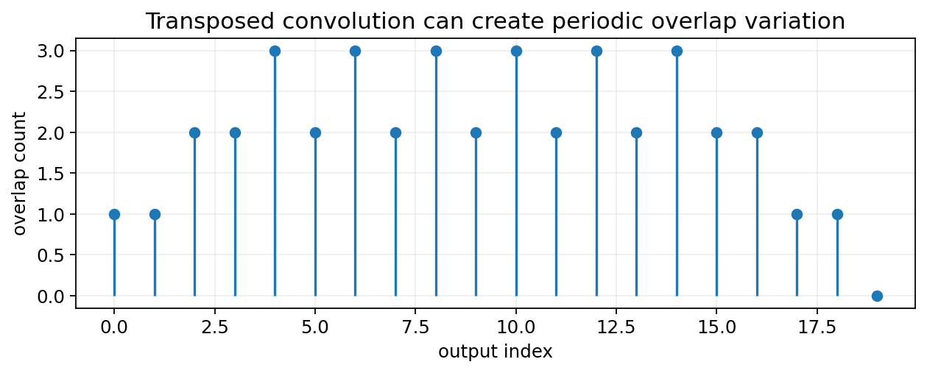
1:06–1:11
Where periodic / checkerboard artifacts come from
• Uneven overlap: some output positions receive more kernel contributions than others.
• Spectral images: zero insertion creates replicas that a learned kernel may not suppress.
• Training can exploit phase patterns: periodic structure may become visible or audible.
Mitigation patterns
Resize/upsample + ordinary convolution, kernel/stride choices with even overlap, or explicit lowpass / anti-imaging constraints.
Notes:
In 2-D images this appears as checkerboard texture; in 1-D audio it can appear as periodic or tonal artifacts. Avoid claiming anti-imaging initialization alone always solves it.

Slide 19
1:11–1:14
A DSP-informed initialization idea
Start from interpolation
Then learn
Initialize each upsampling kernel with a smooth lowpass / linear-interpolation-like response.
Allow gradient descent to adapt the kernel while regularization or architecture preserves reasonable spectral behavior.
Why it helps
• The model begins with less imaging energy.
• Early training outputs can be smoother and more stable.
• The initialization encodes a physically sensible prior without preventing learning.
Notes:
Present this as an engineering prior, not a universal guarantee. The notebook includes a direct zero-insert + conv equivalence demo.

Slide 20
1:14–1:15
Lecture 12 wrap-up
• Upsampling inserts zeros and creates spectral images.
• Interpolation lowpass filters those images and uses gain L.
• Rational conversion uses ↑L → LPF → ↓M with cutoff min(π/L, π/M).
• ConvTranspose1d is closely related to zero insertion + learned filtering.
• DSP insight helps explain and mitigate periodic artifacts in learned upsampling.
Exit question
Why does an interpolation filter need gain L rather than unity gain?
Weekly work
Homework + quiz solutions are in the instructor packet.
Notes:
Good exit answer: after zero insertion only 1/L of the high-rate samples contain the original amplitude, so a unity-gain smoother would reduce a constant signal by L; DC gain L restores it.

Slide 21
APPENDIX
References and instructor resources
• Oppenheim & Schafer, Discrete-Time Signal Processing, §4.6: sampling-rate conversion.
• Raschka et al., Machine Learning with PyTorch and Scikit-Learn: convolutional network architectures.
• Accompanying notebook: Week6_Multirate_DSP_and_ML_Demos.ipynb.
• Homework and weekly quiz: Week6_Multirate_Homework_Quiz_Solutions.docx.

