Slide 1
WEEK 5 ● LECTURE 9
Time/Frequency Responses and Group Delay
From pole-zero geometry to waveform dispersion and all-pass phase equalization
pole-zero geometry → group delay → all-pass → ML feature timing
75 minutes • senior + first-year graduate ECE
All equations shown as raw $...$ / $$...$$ text

Slide 2
DSP + Machine Learning • Week 5
Roadmap
0–15 min • Read magnitude and phase directly from pole-zero geometry.
15–40 min • Distinguish phase delay from group delay and connect nonlinear phase to dispersion.
40–60 min • Build all-pass systems from reciprocal pole-zero structure.
60–75 min • Ask whether preprocessing preserves the timing features an ML model actually uses.
Oppenheim & Schafer + Raschka
2

Slide 3
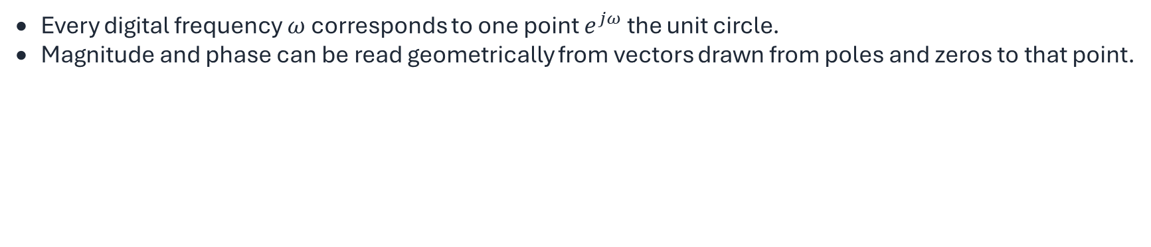
DSP + Machine Learning • Week 5
Frequency response is the z-transform evaluated on the unit circle
$$H(e^{jω})=H\left(z\right){\left.​\right|}_{z=e^{jω}}$$
Every digital frequency $ω$ corresponds to one point $e^{jω}$ the unit circle.
Magnitude and phase can be read geometrically from vectors drawn from poles and zeros to that point.
Oppenheim & Schafer + Raschka
3

Slide 4
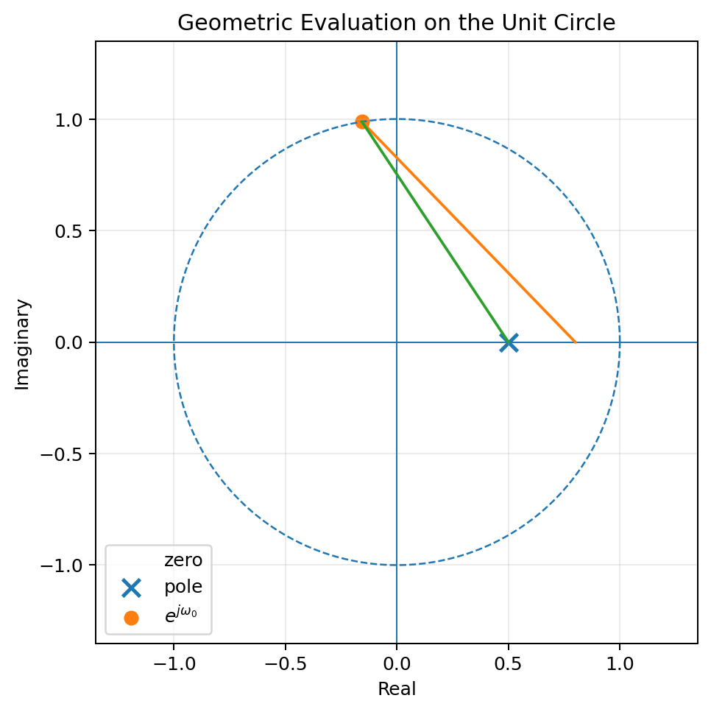
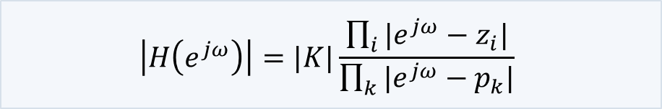
DSP + Machine Learning • Week 5
Pole-zero geometry: magnitude is a distance ratio
$$\left|H\left(e^{jω}\right)\right|=|K|\frac{\prod_{i}{|e^{jω}−z_{i}|}}{\prod_{k}{|e^{jω}−p_{k}|}}$$
Interpretation
Zeros pull the response toward zero when the unit-circle point passes nearby. Poles push the response upward when the unit-circle point passes nearby.
Oppenheim & Schafer + Raschka
4

Slide 5
DSP + Machine Learning • Week 5
Pole-zero geometry: phase is an angle sum
$$∠H\left(e^{jω}\right)=∠K+\sum_{i}{∠\left(e^{jω}−z_{i}\right)−\sum_{k}{∠(e^{jω}−p_{k})}}$$
Each zero contributes a vector angle.
Each pole contributes a vector angle with the opposite sign.
Phase can vary rapidly even when magnitude looks smooth.
Oppenheim & Schafer + Raschka
5

Slide 6
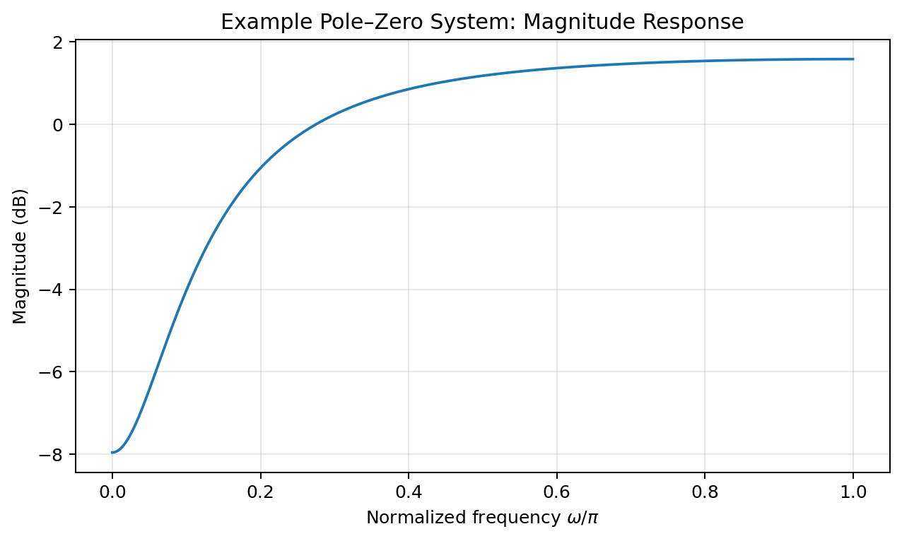
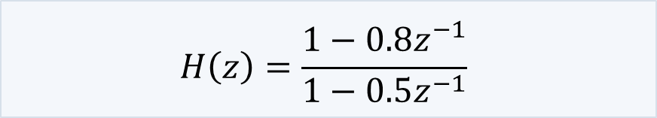
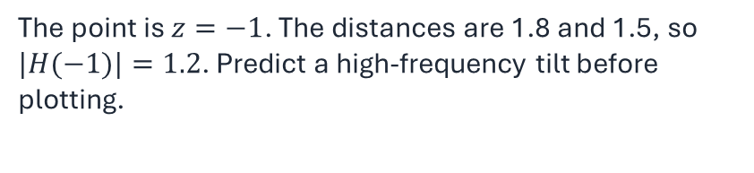
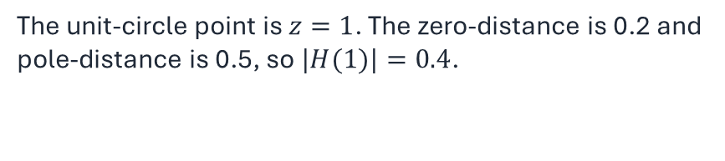
DSP + Machine Learning • Week 5
Worked geometry example
$$H\left(z\right)=\frac{1−0.8z^{−1}}{1−0.5z^{−1}}$$
At $\omega=0$
The unit-circle point is $z=1$. The zero-distance is 0.2 and pole-distance is 0.5, so $|H(1)|=0.4$.
At $\omega=\pi$
The point is $z=−1$. The distances are 1.8 and 1.5, so $|H(−1)|=1.2$. Predict a high-frequency tilt before plotting.
Oppenheim & Schafer + Raschka
6

Slide 7

DSP + Machine Learning • Week 5
Concept check: move a pole toward the unit circle
A pole at angle $ω_{0}$ moves radially from radius 0.5 to radius 0.95. What happens near $ω_{0}$?
Good answer: the denominator vector becomes much shorter, so magnitude increases sharply and the phase changes more rapidly.
Graduate-level addition: the pole also produces a more concentrated group-delay contribution near its angle.
Oppenheim & Schafer + Raschka
7

Slide 8
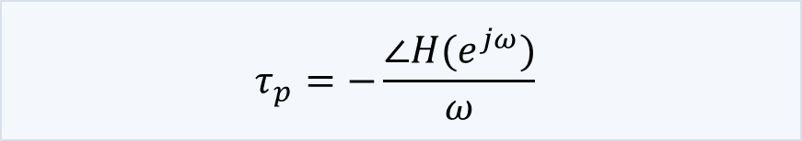
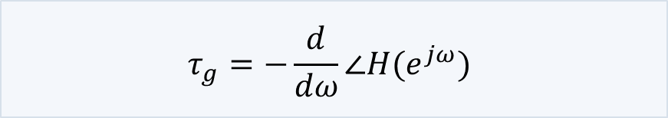
DSP + Machine Learning • Week 5
Phase delay and group delay answer different questions
$$τ_{p}=−\frac{∠H(e^{jω})}{ω}$$
$$τ_{g}=−\frac{d}{dω}∠H(e^{jω})$$
Phase delay
Group delay
For a single sinusoidal component, how much phase corresponds to an equivalent delay?
For a narrowband packet, how does the envelope / modulation arrive versus frequency?
Do not conflate them
They are equal for pure linear phase through the origin, but generally differ.
Oppenheim & Schafer + Raschka
8

Slide 9
DSP + Machine Learning • Week 5
Linear phase gives constant group delay
$$\angle H(e^{j\omega})=\beta-\alpha\omega$$
$$\tau_g(\omega)=\alpha$$
All passband frequency components receive the same local delay.
The constant $\beta$ can shift phase without changing the group-delay slope.
Possible $\pi$ jumps from a real amplitude sign change should not be mistaken for physical dispersion.
Oppenheim & Schafer + Raschka
9

Slide 10
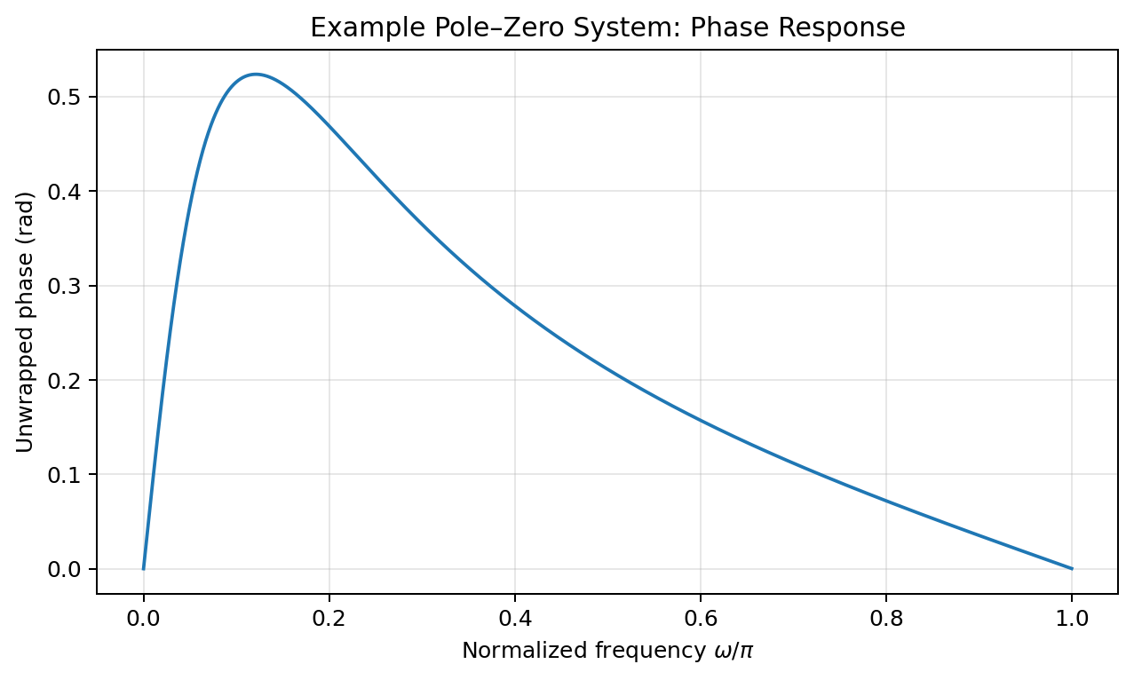
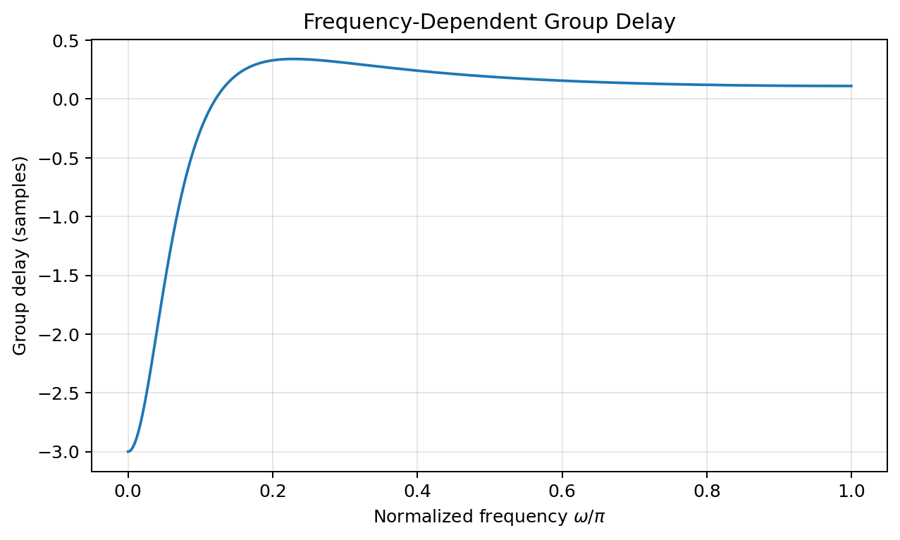
DSP + Machine Learning • Week 5
Nonlinear phase produces frequency-dependent delay
Read both plots
The phase curvature becomes group-delay variation. The derivative makes rapid phase changes easier to interpret as timing dispersion.
Oppenheim & Schafer + Raschka
10

Slide 11
DSP + Machine Learning • Week 5
A transient is a superposition of many frequencies
A sharp onset or pulse requires many spectral components.
If each component experiences a different delay, the components no longer reassemble at the same relative times.
The result can be peak shift, ringing, smearing, or altered onset slope—even if $|H(e^{j\omega})|$ looks acceptable.
$$x[n]=\frac{1}{2\pi}\int_{-\pi}^{\pi}X(e^{j\omega})e^{j\omega n}d\omega$$
Oppenheim & Schafer + Raschka
11

Slide 12
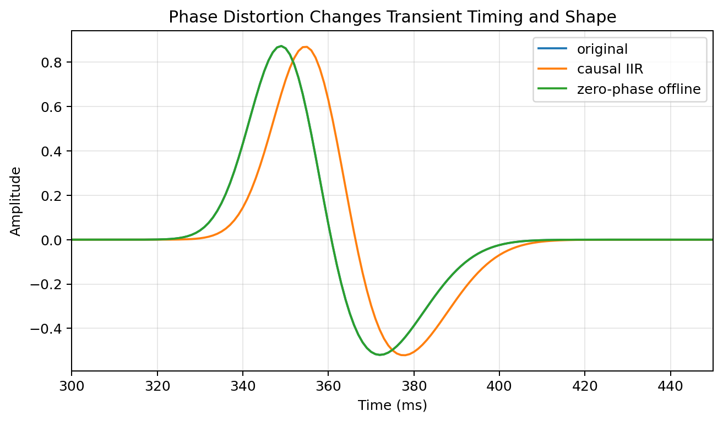
DSP + Machine Learning • Week 5
Demonstration: causal IIR dispersion versus zero-phase offline filtering
Good observation
The causal IIR can shift and reshape the transient. Forward-backward filtering restores timing much better, but it is noncausal and changes the effective magnitude response.
Oppenheim & Schafer + Raschka
12

Slide 13
DSP + Machine Learning • Week 5
All-pass systems: magnitude one does not mean “does nothing”
$$|H_{ap}(e^{j\omega})|=1\quad\forall\omega$$
An all-pass changes phase without changing magnitude.
That makes it a phase / group-delay design element rather than a magnitude-shaping element.
Useful for phase equalization, fractional-delay structures, and decomposing a system into minimum-phase and all-pass parts.
Oppenheim & Schafer + Raschka
13

Slide 14
DSP + Machine Learning • Week 5
First-order all-pass structure
$$H_{ap}(z)=\frac{z^{-1}-a^*}{1-az^{-1}},\qquad |a|<1$$
Pole at $z=a$ lies inside the unit circle.
Zero at $z=1/a^*$ lies at the conjugate reciprocal location outside the unit circle.
On $|z|=1$, numerator and denominator distances match, so magnitude is unity.
Oppenheim & Schafer + Raschka
14

Slide 15
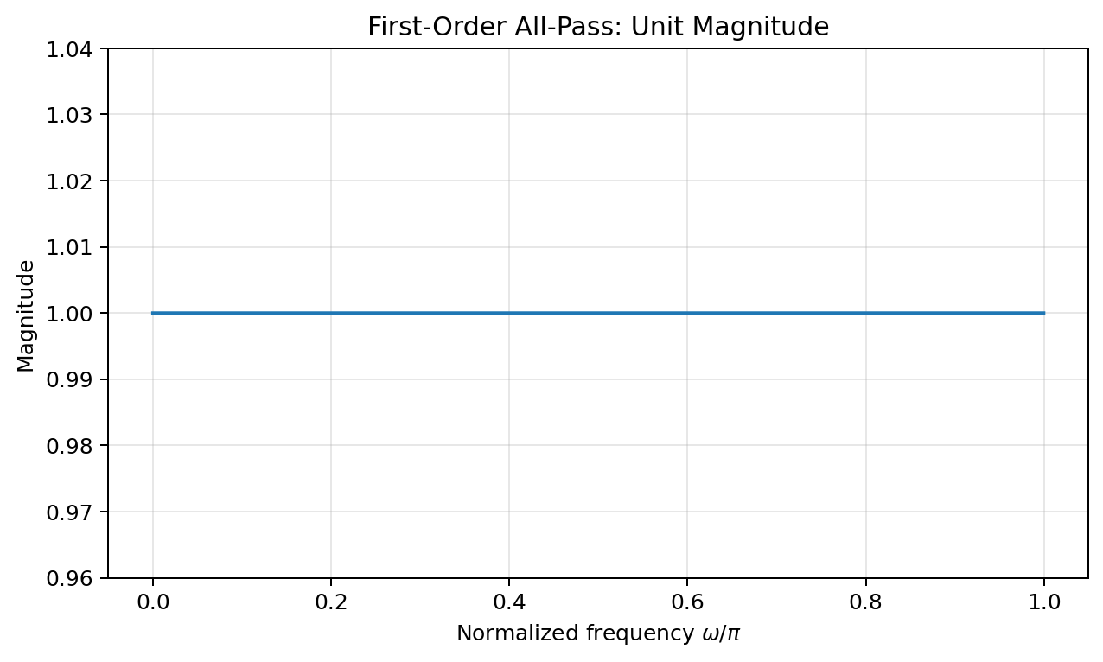
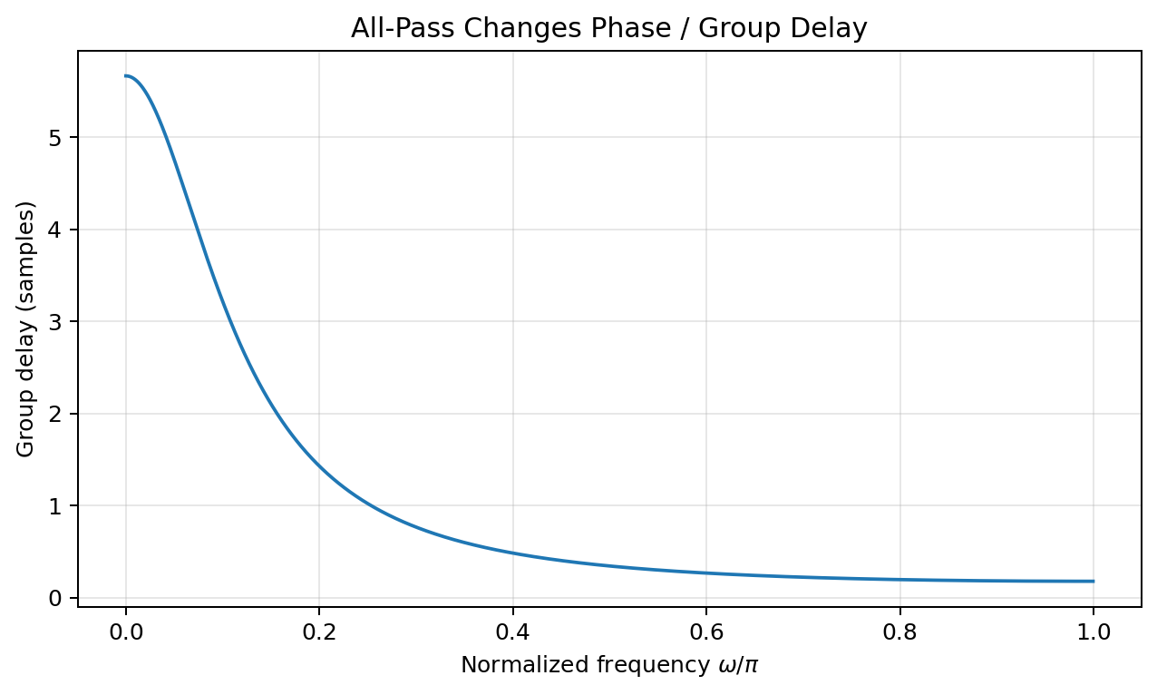
DSP + Machine Learning • Week 5
All-pass magnitude is flat while group delay is not
Key insight
An all-pass can produce substantial timing changes without leaving any trace in a magnitude-only plot.
Oppenheim & Schafer + Raschka
15

Slide 16
DSP + Machine Learning • Week 5
Phase equalization with an all-pass
Suppose a magnitude response is acceptable but group delay is uneven.
Cascading an all-pass leaves total magnitude unchanged because $|H_{tot}|=|H||H_{ap}|=|H|$.
Choose the all-pass phase so its group-delay contribution makes the total delay flatter over the band of interest.
$$\tau_{g,tot}(\omega)=\tau_{g,H}(\omega)+\tau_{g,ap}(\omega)$$
Oppenheim & Schafer + Raschka
16

Slide 17
DSP + Machine Learning • Week 5
What can an all-pass equalizer not fix?
It cannot repair magnitude notches, stopband leakage, or insufficient bandwidth because its magnitude is exactly one.
It can only redistribute phase / group delay.
A causal stable all-pass generally adds nonnegative group delay; “flattening” often means adding delay where the original system was too fast rather than subtracting delay where it was too slow.
Oppenheim & Schafer + Raschka
17

Slide 18
DSP + Machine Learning • Week 5
ML context: feature distortion happens before the model
ECG anomaly detection: QRS peak timing and slope may be predictive.
Audio event detection: onset rise time and inter-channel timing may be predictive.
Vibration fault detection: impulse spacing and envelope timing may be predictive.
A preprocessing filter that disperses these structures changes the features before an SVM, RF, MLP, or CNN can use them.
Oppenheim & Schafer + Raschka
18

Slide 19
DSP + Machine Learning • Week 5
Good ML engineering question
Ask before filtering
Does the downstream task depend primarily on long-term spectral magnitude, or on timing / waveform morphology?
If magnitude statistics dominate, nonlinear phase may be harmless.
If local timing is predictive, preserve phase or make training/deployment use the same causal distortion.
Do not assume “denoised” means “more informative for the classifier.”
Oppenheim & Schafer + Raschka
19

Slide 20
DSP + Machine Learning • Week 5
Python demo: inspect response and delay
b = np.array([1.0, -0.8])
a = np.array([1.0, -0.5])
w, H = signal.freqz(b, a, worN=2048)
phase = np.unwrap(np.angle(H))
w_gd, gd = signal.group_delay((b, a), w=2048)
# Pole-zero geometry
zeros = np.roots(b)
poles = np.roots(a)
# Compare causal IIR and zero-phase offline filtering
y_causal = signal.sosfilt(sos, x)
y_zero = signal.sosfiltfilt(sos, x)
Oppenheim & Schafer + Raschka
20

Slide 21
DSP + Machine Learning • Week 5
Concept check
Two filters have identical $|H(e^{j\omega})|$ but different $\angle H(e^{j\omega})$. Must their outputs be identical for every input?
Good answer: no. Their spectra have the same magnitudes but different phases, so transient waveform shapes can differ.
When would they sound or look nearly equivalent? When the task or perception is insensitive to the altered phase relationships.
Oppenheim & Schafer + Raschka
21

Slide 22
DSP + Machine Learning • Week 5
Lecture 9 synthesis
Pole-zero distance ratios explain magnitude; vector-angle sums explain phase.
Group delay turns phase slope into a timing diagnostic.
All-pass systems have unit magnitude but can strongly reshape phase and delay.
ML preprocessing must preserve—or consistently reproduce—the temporal features the model needs.
Oppenheim & Schafer + Raschka
22

Slide 23
DSP + Machine Learning • Week 5
Homework — Lecture 9
1 • Pole-zero geometry for $H(z)=(1-0.8z^{-1})/(1-0.5z^{-1})$.
2 • Compute phase delay and group delay for $\phi(\omega)=-3\omega+0.4\sin\omega$.
3 • Prove unit magnitude for a first-order all-pass.
4 • Explain how nonlinear phase can alter ECG timing features and propose offline/streaming mitigations.
Oppenheim & Schafer + Raschka
23

Slide 24
DSP + Machine Learning • Week 5
Instructor solution sketch — Lecture 9
P1: $|H(1)|=0.4$, $|H(-1)|=1.2$; distance ratios predict the tilt.
P2: $\tau_p=3-0.4\sin\omega/\omega$ and $\tau_g=3-0.4\cos\omega$.
P3: numerator and denominator squared magnitudes are both $1+a^2-2a\cos\omega$.
P4: preserve timing offline with validated zero-phase processing or use a linear-phase / deployment-matched causal front end.
Oppenheim & Schafer + Raschka
24

