Slide 1
LECTURE 25
Tensors and
Automatic Differentiation
x
L
From DSP arrays to computational graphs
tensor
∇
75 minutes • tensors → shapes → broadcasting → autograd → learnable FIR
Senior + first-year graduate ECE

Slide 2
ROADMAP
What changes when a DSP array becomes a tensor?
The data may be familiar; the container now knows shape, device, and gradient history.
20 min
FROM VECTORS TO TENSORS
one object, richer metadata
waveforms • spectra • spectrograms
20 min
TENSOR OPERATIONS FOR DSP
think in shapes, not loops
matmul • broadcasting • reshape
35 min
CHAIN RULE + AUTOGRAD
learn parameters from a loss
computational graph • backward pass
Reading bridge
Oppenheim & Schafer: discrete-time signals, linear transforms, convolution/STFT context • Raschka: PyTorch tensor and autograd foundations

Slide 3
DSP → ML
TENSORS
Same signal, richer container
Start with objects students already know.
DSP notation
NumPy view
PyTorch view
Finite waveform
x[0], x[1], …, x[L−1]
A sequence of samples
ndarray
shape = (L,)
dtype = float32
Fast vectorized CPU math
Tensor
shape = (L,)
dtype = torch.float32
device = cpu / accelerator
requires_grad = False / True
Key idea
A tensor is not inherently a neural-network object. It can represent the same waveform, spectrum, filterbank, or feature matrix used throughout DSP.

Slide 4
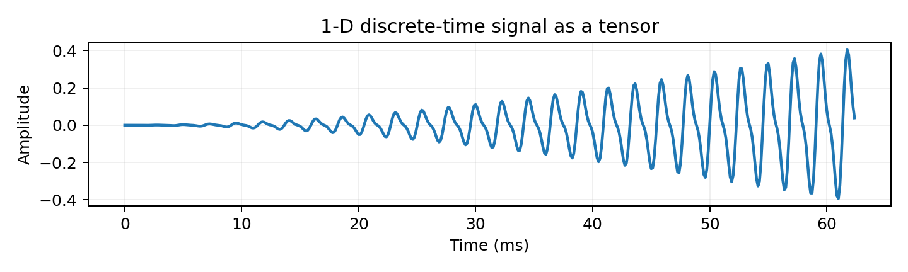
FROM VECTORS TO TENSORS
TENSORS
A 1-D discrete-time signal is already tensor-shaped
The first dimension can simply be sample index.
PyTorch representation
A finite observation with L samples is naturally stored as shape (L,). Indexing x[n] remains the same conceptual operation as in DSP.
Waveform tensor
x = torch.tensor(samples, dtype=torch.float32)
print(x.shape) # torch.Size([L])
print(x.device) # cpu
Ask:
What extra information does the tensor carry that the mathematical sequence x[n] does not?
Good answer: shape, dtype, device placement, and whether operations should be tracked for gradients.

Slide 5
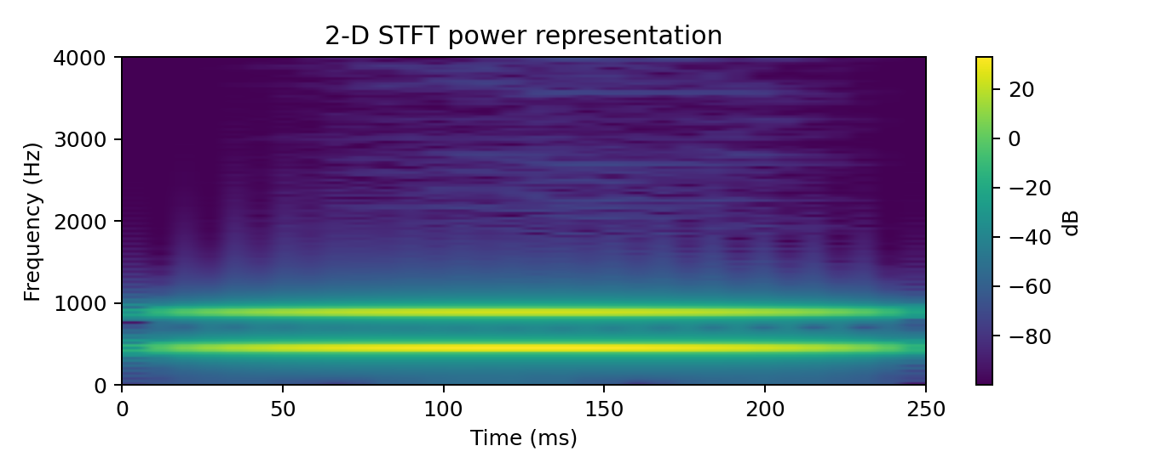

FROM VECTORS TO TENSORS
TENSORS
A spectrogram is naturally a rank-2 tensor
Frequency and frame index become two tensor dimensions.
Shape example
With n_fft = 256, a one-sided real-input STFT has 129 frequency bins. A result might have shape (129, 32): frequency × frame.
Complex dtype is okay
PyTorch tensors can be complex. Magnitude, power, phase, and differentiable STFT operations can all remain inside a computational graph.

Slide 6
TENSOR ANATOMY
TENSORS
Four properties to inspect before debugging the math
Many PyTorch errors are shape/device/dtype errors, not “ML errors.”
shape
How many axes? What does each axis mean?
dtype
float32? float64? complex64? integers?
(N, C, L)
torch.float32
device
Where is the memory and computation?
requires_grad
Should PyTorch record operations for derivatives?
cpu / cuda / mps
True / False
ECE habit
Print or assert shapes at subsystem boundaries. Treat tensor dimensions the way you treat units and signal conventions in DSP.

Slide 7
NUMPY VS. PYTORCH
TENSORS
Similar syntax; different responsibilities
The distinction is less “array versus tensor” than “numerics versus differentiable compute.”
Question
NumPy ndarray
PyTorch tensor
Vectorized arithmetic
Yes
Yes
CPU numerical work
Excellent
Excellent
Accelerator placement
Not its core model
Built into tensor/device model
Gradient tracking
No
Yes, when requires_grad=True
NN layers + optimizers
External libraries
Integrated ecosystem
Interop
—
torch.from_numpy / .numpy() on CPU
Subtle example: torch.from_numpy(a) can share CPU memory with a NumPy array; torch.tensor(a) creates a new tensor copy.

Slide 8
DEVICE PLACEMENT
TENSORS
GPU acceleration is a placement decision, not magic
Moving data has a cost; computation must be large enough to justify it.
CPU
ACCELERATOR
general-purpose cores
low transfer overhead
great for small problems
x = x.to(device)
many parallel operations
large batched tensor math
transfer + memory constraints
Important
A tensor and the model parameters that operate on it must live on compatible devices. “Expected all tensors to be on the same device” is a shape/unit-style bookkeeping error.

Slide 9
CONCEPT CHECK
PAUSE & PREDICT
Map familiar audio objects to tensor shapes
Do this before introducing any new syntax.
A
One mono clip, 16,000 samples
?
B
32 stereo clips, 16,000 samples each
?
C
One STFT with 257 bins × 101 frames
?
D
32 one-channel spectrograms, 257 × 101
?
Good answers
A: (16000,) • B: (32, 2, 16000) • C: (257, 101) • D: often (32, 1, 257, 101)

Slide 10
TENSOR OPERATIONS
OPERATIONS
Shape manipulation is part of the algorithm
The values may be correct while the axis order is wrong.
Shape operations
unsqueeze
x = torch.randn(8, 4000) # (N,L)
x = x.unsqueeze(1) # (N,1,L)
S = torch.randn(8, 257, 101) # (N,F,T)
S = S.unsqueeze(1) # (N,1,F,T)
A = torch.randn(8, 20, 30)
B = A.permute(0, 2, 1) # (8,30,20)
Insert a length-one axis. This is how a mono batch (N,L) becomes the Conv1d convention (N,1,L).
permute
Reorder existing axes. The data are re-indexed logically; the semantic meaning of each dimension changes.
reshape / view
Change how contiguous elements are grouped. Never reshape blindly to “make the error go away”; preserve the intended axis semantics.

Slide 11

BATCHED AUDIO
OPERATIONS
The common Conv1d convention: batch, channel, length
This convention matters later when CNN layers arrive.
N
Batch
C
Channel
L
Length
independent clips
mono, stereo, sensor channels
time samples
Example
32 stereo one-second clips at 16 kHz → shape (32, 2, 16000). Index x[7, 1, 250] means batch item 7, channel 1, time sample 250.

Slide 12
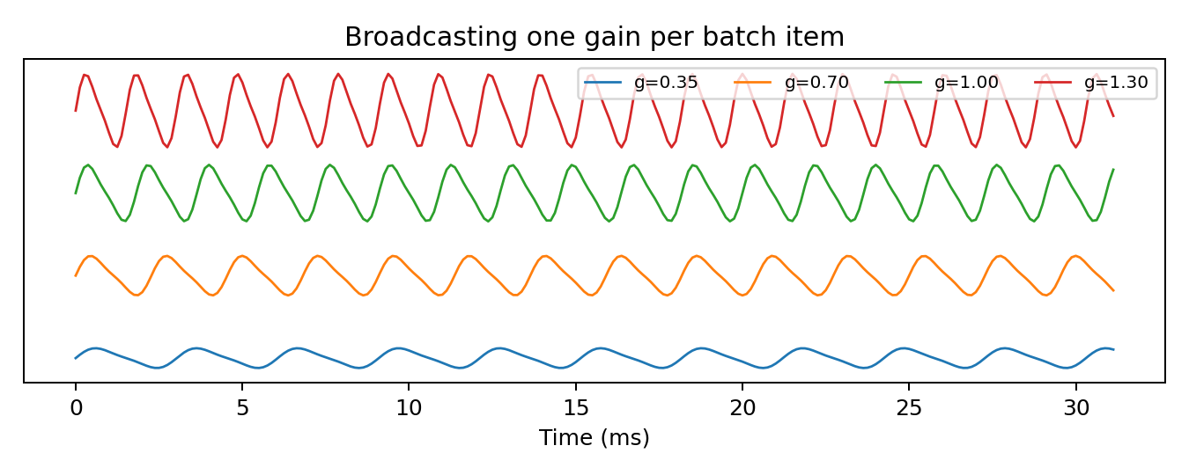
BROADCASTING
OPERATIONS
Write the shape of the parameter you mean
Broadcasting replaces many explicit loops — when the dimensions line up semantically.
One gain per channel
audio.shape # (N,C,L)
channel_gain = torch.tensor([0.5, 1.25])
channel_gain = channel_gain.view(1, C, 1)
y = audio * channel_gain
Why (1,C,1)?
Dimension 0 broadcasts across the batch. Dimension 1 matches channel. Dimension 2 broadcasts across time.
Good debugging question: “Which physical meaning does each axis carry?”

Slide 13

MATRIX MULTIPLICATION
OPERATIONS
A filterbank is already a tensor operation
Classical DSP linear transforms fit naturally into PyTorch.
DSP interpretation
W
40 × 257
P
257 × 100
E
40 × 100
Each column is one time frame. The filterbank combines 257 frequency-bin powers into 40 band energies for that frame.
@
=
PyTorch
E = W @ P # (40,257) @ (257,100) -> (40,100)

Slide 14
CONCEPT CHECK
PAUSE & PREDICT
A shape error is often a model-design clue
Predict first; run second.
Given:
Will this broadcast as intended?
Question 1
audio.shape = (8, 2, 1000)
gain.shape = (2,)
y = audio * gain
Will the operation succeed? If not, why does the last dimension cause trouble?
Question 2
What shape should gain have to mean “one gain per channel”?
Good answer
Use gain.view(1, 2, 1). The semantic channel axis is the middle axis, not the final time axis.

Slide 15

THE TRANSITION
AUTOGRAD
What if the DSP coefficients are unknown?
Automatic differentiation turns a fixed signal-processing computation into a learnable one.
input x[n]
DSP operation
parameters θ
prediction ŷ
loss L
Question:
How should each coefficient change to reduce the loss?
Autograd answers this by chaining local derivatives backward through the forward computation.

Slide 16

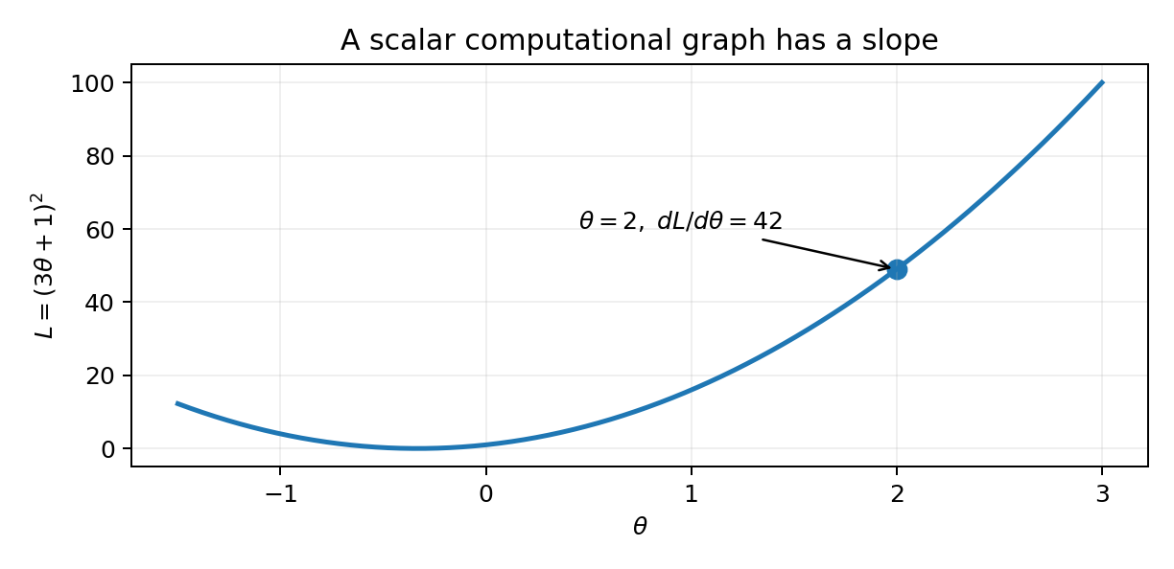

CHAIN RULE
AUTOGRAD
Do one derivative by hand before trusting autograd
Students should see exactly what the graph will automate.
At θ = 2
u = 7, L = 49, and dL/dθ = 42.
Interpretation: the gradient is the local slope of the loss with respect to the parameter.

Slide 17
COMPUTATIONAL GRAPH
AUTOGRAD
The forward pass builds a directed acyclic graph
Nodes are intermediate values; edges correspond to differentiable operations.
du/dθ = 3
dL/du = 2u
backward()
θ = 2
u = 3θ + 1
L = u²
Reverse pass
Start from dL/dL = 1 and multiply local derivatives while traversing the graph backward. Shared subexpressions contribute through the chain rule.

Slide 18
REVERSE-MODE AUTODIFF
AUTOGRAD
Why backpropagation fits modern ML
One scalar loss may depend on millions of parameters.
FORWARD
BACKWARD
Compute intermediate tensors and the scalar loss L.
Record enough local information to differentiate the operations later.
Seed the output with dL/dL = 1.
Propagate sensitivities backward to obtain gradients for every upstream parameter that requires them.
Why efficient?
Reverse mode is well matched to “many inputs/parameters → one scalar objective.” A single backward traversal provides all components of ∇θL.

Slide 19

VECTOR EXAMPLE
AUTOGRAD
A scalar loss can depend on a whole parameter vector
Autograd handles vectorized expressions without expanding every partial derivative by hand.
One backward pass
PyTorch computes both ∂L/∂w and ∂L/∂b from the same graph.
Two learnable parameters
x = torch.linspace(-2, 2, 41)
y = 2.5*x - 0.4
w = torch.tensor(0.2, requires_grad=True)
b = torch.tensor(0.0, requires_grad=True)
y_hat = w*x + b
loss = ((y_hat-y)**2).mean()
loss.backward()
Important
The forward code is still ordinary vectorized math. Gradient tracking is layered on top of it.
ECE connection
Any differentiable signal model with unknown coefficients can be treated the same way.

Slide 20
AUTOGRAD API
AUTOGRAD
Four lines students need to understand
Do not let the optimizer hide the gradient mechanics.
Minimal example
requires_grad=True
theta = torch.tensor(2.0, requires_grad=True) # leaf parameter
u = 3*theta + 1 # graph grows
loss = u**2 # scalar objective
loss.backward() # reverse traversal
print(theta.grad) # tensor(42.)
Track operations that influence this tensor.
loss.backward()
Run reverse-mode autodiff from the scalar loss.
.grad
Gradient accumulated on leaf tensors.
Good question: Why does theta.grad live on θ, not on every temporary tensor by default?
Answer: leaf parameters are the quantities we intend to update; retaining every intermediate gradient would waste memory unless explicitly requested.

Slide 21

GRADIENT ACCUMULATION
AUTOGRAD
PyTorch adds gradients; it does not replace them
This behavior is useful for deliberate accumulation and dangerous when accidental.
Accumulation demo
Why?
x = torch.tensor(3.0, requires_grad=True)
(x**2).backward()
print(x.grad) # 6
(x**2).backward()
print(x.grad) # 12 <- accumulated
x.grad.zero_()
print(x.grad) # 0
A parameter can influence a loss through multiple paths. Autograd must sum contributions to the same derivative.
Normal training-loop pattern
optimizer.zero_grad()
loss.backward()
optimizer.step()

Slide 22
GRAPH CONTROL
AUTOGRAD
`no_grad()` and `detach()` intentionally break gradient flow
Use them because you mean to — not as a patch for a memory or type error.
torch.no_grad()
.detach()
Context: operations performed inside it do not create autograd history. Good for evaluation, plotting predictions, or generating a fixed target.
Tensor operation: return the same numerical values disconnected from the current graph. Good for inspection/export when upstream derivatives are no longer desired.
Common uses
with torch.no_grad():
y_ref = fixed_system(x)
plot_value = y_hat.detach().cpu().numpy()
Bad use:
detaching an intermediate tensor that the loss still needs to differentiate through.

Slide 23



DSP-NATIVE AUTOGRAD
AUTOGRAD
Treat FIR taps as learnable parameters
Now “training” means adjusting filter coefficients to match a desired signal response.
x[n]
h[k]
ŷ[n]
What autograd is doing
The analytic gradient is correlation-like: error e[n] is correlated with delayed input x[n−r]. PyTorch obtains the same result from the graph automatically.
DSP convention note
torch.nn.functional.conv1d implements cross-correlation. Flip the kernel if you want the textbook DSP convolution ordering.

Slide 24
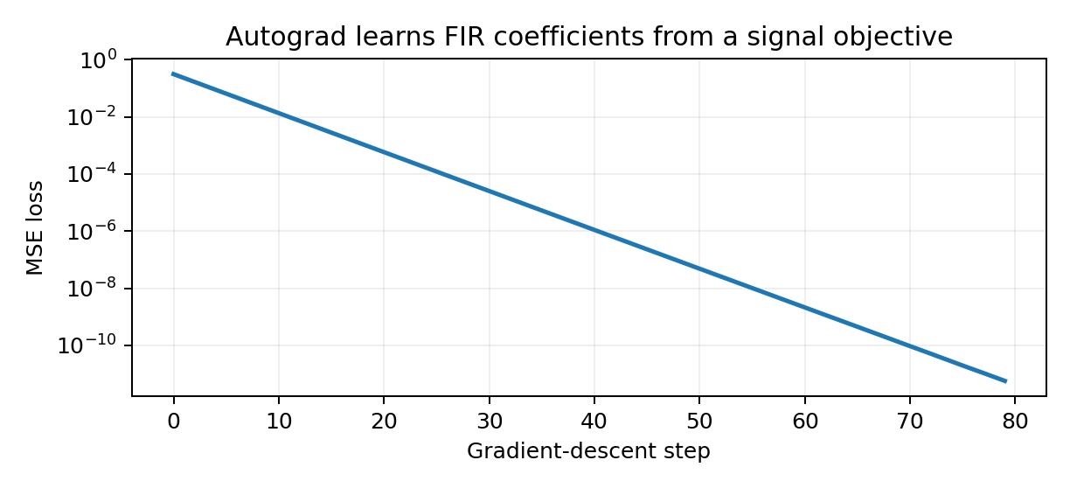
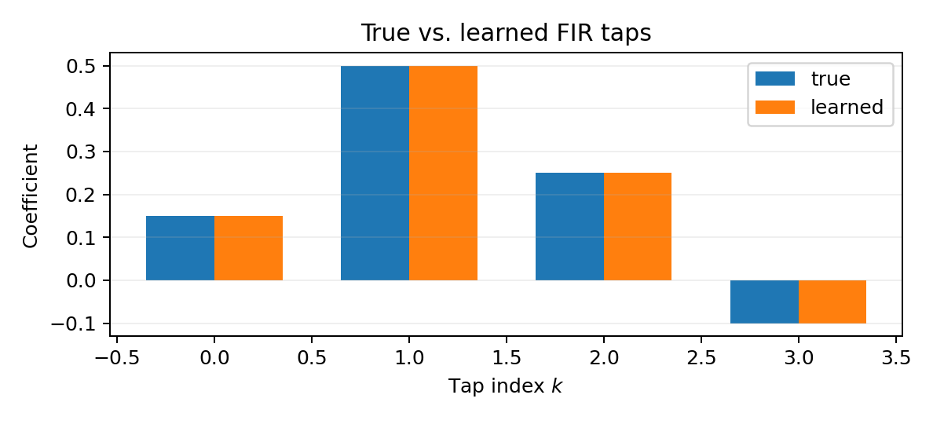
FIR DEMO
AUTOGRAD
Gradient descent recovers the unknown filter
A simple system-identification problem makes autograd tangible.
Target taps
Learned taps
Final MSE
[0.15, 0.50, 0.25, −0.10]
≈ [0.15, 0.50, 0.25, −0.10]
≈ 5.7 × 10⁻¹² in this synthetic example
Interpretation: autograd did not “understand filters.” It differentiated the operations we wrote and gradient descent used those derivatives to update h.

Slide 25
COMMON FAILURE MODES
AUTOGRAD
Most early PyTorch mistakes are bookkeeping mistakes
Teach students to diagnose them systematically.
Wrong axis order
(N,L,C) passed to code expecting (N,C,L)
Print shape + name each axis
Mixed device
input on CPU, parameters on accelerator
Move both consistently
Gradient accumulation
forgot zero_grad()
Clear intentionally each step
Detached graph
used detach/no_grad too early
Preserve required path to loss
In-place surprise
modified a needed tensor in place
Prefer clear functional steps while learning

Slide 26
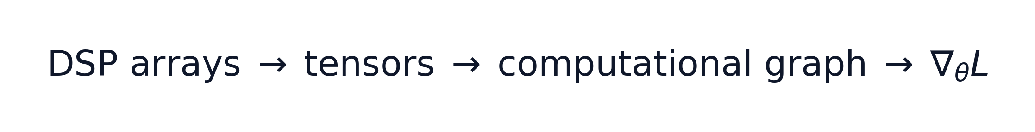
WRAP-UP
Lecture 25 synthesis
The conceptual leap is from storing values to storing values plus differentiable history.
Tensors
Same DSP data, explicit shape/dtype/device.
Operations
Broadcasting, matmul, and axis manipulation express vectorized DSP.
Autograd
Forward operations form a dynamic DAG; backward applies the chain rule.
Learning
Unknown DSP parameters can be optimized from ∇θL.
Minute paper
In one sentence: what is the difference between “a tensor contains a signal” and “a tensor participates in a computational graph”?

Slide 27
HOMEWORK
Problems 1–3: shapes, broadcasting, and linear transforms
Student version — solutions are in the instructor appendix.
1 • Tensor shapes
State a sensible shape and rank for: (a) one 16,000-sample mono clip, (b) 32 stereo clips, (c) one 257 × 101 complex STFT, (d) 32 one-channel magnitude spectrograms.
2 • Broadcasting channel gains
x has shape (24,2,8000). Apply gain 0.5 to the left channel and 1.2 to the right. Give the gain shape, PyTorch construction, and output shape.
3 • Filterbank matmul
P is 257 × 100 and W is 40 × 257. Write the matrix expression for filterbank energies, give the result shape, and interpret both axes.

Slide 28
HOMEWORK
Problems 4–7: chain rule and graph mechanics
Show your work for the analytic gradients.
4 • Chain rule
Let u = 2θ − 3 and L = (u + 1)². Derive dL/dθ, evaluate it at θ = 4, and write equivalent autograd code.
5 • Accumulation
For x = 3, call backward twice on L = x² without clearing x.grad. What are the gradients after each call, and why?
6 • FIR gradient
For a causal FIR output and MSE loss, derive ∂L/∂h[r]. Interpret the result in DSP terms.
7 • Graph control
Explain torch.no_grad() versus .detach(). Give one correct use of each and one danger of using either too early.

Slide 29
WEEKLY QUIZ
10 minutes • Questions 1–3
No notes. Show shape reasoning.
Q1
A minibatch contains 16 mono clips, each 4000 samples long. Using the (N,C,L) convention, what is the tensor shape?
Q2
A tensor has shape (8,2,1000). What gain shape applies one independent gain to each channel and broadcasts over batch and time?
Q3
True or false: every PyTorch tensor automatically tracks gradients. Briefly justify.

Slide 30

WEEKLY QUIZ
Questions 4–6
Focus on gradient meaning, not syntax memorization.
Q5
Why is reverse-mode autodiff especially appropriate when a model has many parameters but one scalar loss?
Q4
Compute the derivative shown above.
Q6
What is the most likely bug if a training loop calls loss.backward() every iteration but never clears parameter gradients?

Slide 31
INSTRUCTOR SOLUTION APPENDIX
INSTRUCTOR APPENDIX
Homework + Quiz
Solutions
SOLUTIONS
quiz
homework
Keep these slides after the student-facing material or move them to a separate instructor deck.

Slide 32
QUIZ SOLUTIONS
INSTRUCTOR SOLUTION APPENDIX
Questions 1–3
A1
(16, 1, 4000). Batch = 16, one mono channel, 4000 time samples.
A2
(1, 2, 1). The length-one axes broadcast over batch and time; the middle axis aligns with channel.
A3
False. Gradient tracking is enabled for appropriate floating/complex tensors when requires_grad=True, typically for learnable parameters.

Slide 33
QUIZ SOLUTIONS
INSTRUCTOR SOLUTION APPENDIX
Questions 4–6
A5
Reverse mode reuses one backward traversal to compute the gradient of one scalar objective with respect to many upstream parameters efficiently.
A4
The chain rule gives 2(3θ+1)·3. At θ = 2, the gradient is 42.
A6
Gradients accumulate across iterations. The optimizer sees old + new gradients unless they are intentionally cleared.

Slide 34
HOMEWORK SOLUTIONS
INSTRUCTOR SOLUTION APPENDIX
Problems 1–3
Shapes should always be accompanied by axis meaning.
1 • Shapes
(a) (16000,), rank 1. (b) (32,2,16000), rank 3. (c) (257,101), rank 2, complex. (d) often (32,1,257,101), rank 4.
2 • Broadcasting
Use g = torch.tensor([0.5,1.2]).view(1,2,1). Then y = x*g has shape (24,2,8000).
3 • Filterbank
E = WP, so (40×257)(257×100) → 40×100. Forty band energies are produced for each of 100 time frames.

Slide 35

HOMEWORK SOLUTIONS
INSTRUCTOR SOLUTION APPENDIX
Problems 4–5
5 • Accumulation
For L=x² at x=3, dL/dx=6. After the first backward: grad=6. After the second without clearing: grad=12. zero_grad() prevents unintended carry-over.
4 • Chain rule
At θ = 4, dL/dθ = 8(4) − 8 = 24. Autograd code should set theta.requires_grad=True, compute u and L, then call L.backward().
Teaching point: accumulation is mathematically sensible when multiple graph paths contribute to the same parameter; the bug is accidental accumulation across optimization steps.
Solution code
theta = torch.tensor(4.0, requires_grad=True)
u = 2*theta - 3
L = (u + 1)**2
L.backward()
print(theta.grad) # 24

Slide 36
HOMEWORK SOLUTIONS
INSTRUCTOR SOLUTION APPENDIX
Problems 6–7
The FIR derivative is a useful DSP interpretation of backpropagation.
7 • no_grad()
Context manager: do not build autograd history for operations inside the block. Example: inference or generating a fixed target.
6 • Derivation
With e[n]=ŷ[n]−y[n], dL/dh[r]=(2/N) Σn e[n]x[n−r]. The gradient correlates the current output error with the input delayed to tap r.
7 • detach()
Tensor operation: disconnect these values from the existing graph. Example: convert a prediction for plotting without backpropagating through the plotting path.
Danger
Either can silently block gradients if inserted before an operation that the loss still needs to differentiate through.

