Slide 1
LECTURE 26
MLPs for Signal Classification
From engineered DSP features to a trained neural classifier
75 minutes • architecture → cross-entropy → Adam → training loop
Senior + first-year graduate ECE
DSP features
→
MLP
→
logits
→
class

Slide 2
ROADMAP
What changes after Lecture 25?
0–20 min • Architecture
20–45 min • Objective
45–75 min • Training loop
Assemble affine layers and ReLU into an MLP. Track tensor shapes from 8 DSP features to 3 classes.
Interpret logits, softmax and cross-entropy. Connect gradients to parameter updates and Adam.
Walk through forward → loss → zero_grad → backward → step, then evaluate on held-out data.
Lecture 25 gave us tensors and ∇L. Lecture 26 answers: what computation do we differentiate, and how does it become a classifier?
DSP bridge: the inputs are still engineered features such as MFCCs, spectral flux, centroid, roll-off, ZCR and RMS.
DSP + Machine Learning • Week 13 Oppenheim & Schafer + Raschka 2

Slide 3
DSP → ML
A signal becomes one feature vector per example
Example input vector
One clip → 8 numbers → one class
• spectral centroid
• zero-crossing rate
• spectral roll-off
• RMS energy
• spectral flux
• MFCC 1–3
input shape: (8,)
minibatch shape: (N, 8)
output logits: (N, 3)
Three signal classes
Cymbal • Kick • Snare
DSP + Machine Learning • Week 13 Oppenheim & Schafer + Raschka 3

Slide 4

MLP ARCHITECTURE
The basic building block: an affine layer
Weights
Bias
Activation
W mixes the input features. Every hidden unit receives a learned weighted combination of the previous layer.
b shifts the activation threshold. It lets the affine hyperplane move away from the origin.
f(·) supplies the nonlinearity that allows stacked layers to form complex decision regions.
If f is the identity everywhere, the network never escapes the family of affine maps.
DSP + Machine Learning • Week 13 Oppenheim & Schafer + Raschka 4

Slide 5


SHAPE REASONING
Track the dimensions before touching the code
For one example
For a minibatch of N examples
x: 8 features W: 16 × 8 b: 16 z: 16 hidden pre-activations
X: N × 8 Z: N × 16
Linear(8,16) has 16·8 + 16 = 144 trainable parameters.
DSP + Machine Learning • Week 13 Oppenheim & Schafer + Raschka 5

Slide 6

NONLINEARITY
ReLU keeps positive evidence and clips negative pre-activation
Example
Derivative
Why useful
z = [−2, −0.5, 0, 1.2, 4] ReLU(z) = [0, 0, 0, 1.2, 4]
For z < 0 the local slope is 0; for z > 0 it is 1. The point z = 0 is handled by a chosen subgradient convention.
Cheap, piecewise linear, and able to create different affine behavior in different regions of feature space.
Think “piecewise-linear decision surface,” not “mysterious biological neuron.”
DSP + Machine Learning • Week 13 Oppenheim & Schafer + Raschka 6

Slide 7
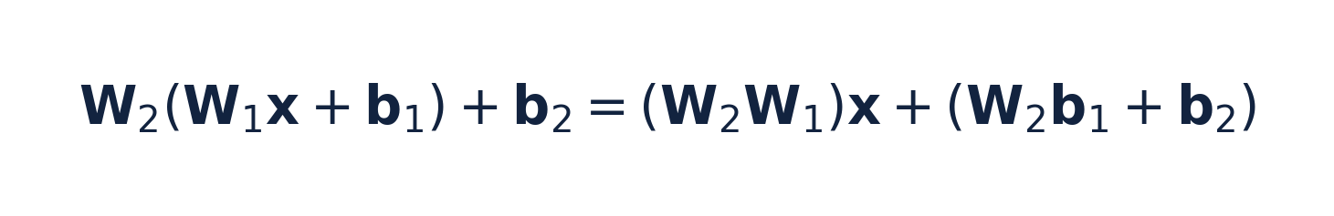
CONCEPTUAL PROOF
Without a nonlinearity, depth collapses
Define W_eq = W₂W₁ and b_eq = W₂b₁ + b₂. Then the two-layer network is just one affine layer.
What depth alone cannot do
What ReLU changes
Two, ten, or one hundred linear layers still produce an affine decision boundary.
Each activation pattern selects a different local affine map, allowing a nonlinear overall boundary.
Good answer: “The composition of affine maps is affine; ReLU breaks that collapse.”
DSP + Machine Learning • Week 13 Oppenheim & Schafer + Raschka 7

Slide 8
ARCHITECTURE
A deliberately small MLP for 8 DSP features
8 features
Linear 8→16
ReLU
Linear 16→8
ReLU
Linear 8→3
The final layer has 3 outputs because the task has 3 classes. These outputs are logits, not probabilities.
Total trainable parameters: (8·16+16) + (16·8+8) + (8·3+3) = 307.
Small enough to inspect • nonlinear enough to illustrate the full training machinery
DSP + Machine Learning • Week 13 Oppenheim & Schafer + Raschka 8

Slide 9
PYTORCH
The forward model is ordinary tensor code
class SignalMLP(nn.Module): def __init__(self): super().__init__() self.net = nn.Sequential( nn.Linear(8, 16), nn.ReLU(), nn.Linear(16, 8), nn.ReLU(), nn.Linear(8, 3), ) def forward(self, x): return self.net(x)
Input
x has shape (N,8): one row per audio clip.
Output
logits has shape (N,3): one unconstrained score per class.
No softmax here
CrossEntropyLoss will handle the stable log-softmax internally.
DSP + Machine Learning • Week 13 Oppenheim & Schafer + Raschka 9

Slide 10
CONCEPT CHECK
Pause & predict: shape reasoning
A minibatch contains 64 clips, each represented by 8 standardized DSP features. The first layer is Linear(8,16).
Question 1
Question 2
Question 3
What is the input tensor shape?
What is the first weight-matrix shape?
What is the hidden output shape?
Good answers: (64,8) • PyTorch stores Linear weight as (16,8) • hidden output is (64,16)
DSP + Machine Learning • Week 13 Oppenheim & Schafer + Raschka 10

Slide 11

LOSS FUNCTIONS
The network outputs logits: class scores before normalization
Example logits for one clip
Convert to probabilities only for interpretation
z = [2.0, 1.0, 0.0]
A logit may be negative, positive, or large. It is not itself a probability.
Softmax preserves ranking and produces positive values that sum to 1.
Key implementation rule
Feed raw logits to nn.CrossEntropyLoss(). Apply softmax afterward only when you want probabilities.
DSP + Machine Learning • Week 13 Oppenheim & Schafer + Raschka 11

Slide 12


LOSS FUNCTIONS
Cross-entropy rewards high probability on the correct class
If p_y ≈ 1
If p_y is small
Why log?
Loss approaches 0. The model assigned high probability to the true class.
The negative log becomes large. Confident wrong predictions are penalized heavily.
Products of probabilities become sums of log-probabilities; gradients remain convenient and statistically meaningful.
DSP + Machine Learning • Week 13 Oppenheim & Schafer + Raschka 12

Slide 13
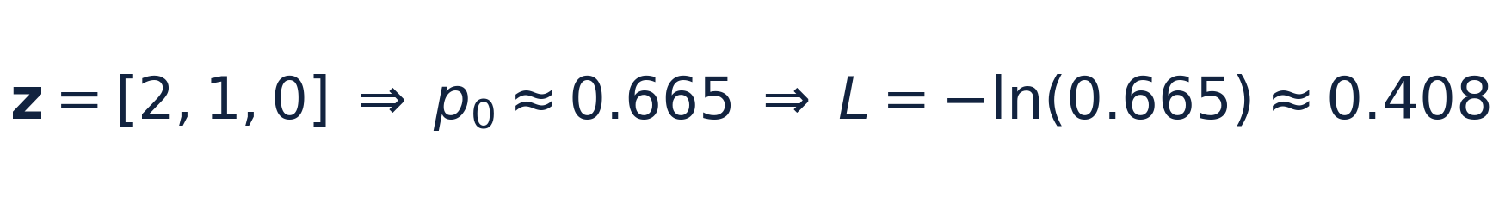
CROSS-ENTROPY
Worked example: from logits to one loss value
If class 0 is the correct label, the sample loss is about 0.408.
Interpretation
Good answer to “why not MSE?”
The network is leaning toward the correct class, but it is not yet extremely confident.
MSE can be used, but cross-entropy matches categorical likelihood and gives especially useful gradients for softmax classifiers.
DSP + Machine Learning • Week 13 Oppenheim & Schafer + Raschka 13

Slide 14
PYTORCH DETAIL
CrossEntropyLoss wants class indices, not one-hot targets
For three classes
Typical tensor shapes
Cymbal → 0 Kick → 1 Snare → 2
logits: (N, 3) labels: (N,)
criterion = nn.CrossEntropyLoss() loss = criterion(logits, y_batch) # y_batch dtype: torch.long
Common bug: applying softmax first, then passing probabilities to CrossEntropyLoss.
DSP + Machine Learning • Week 13 Oppenheim & Schafer + Raschka 14

Slide 15

GRADIENT INTUITION
The loss gradient pushes the correct logit up and incorrect logits down
For the true class y, the term becomes p_y − 1. For every incorrect class, it is simply p_k.
True class
Wrong classes
If p_y is too small, p_y − 1 is strongly negative. Gradient descent therefore tends to increase z_y.
Positive p_k values cause gradient descent to reduce competing logits.
This is the local mechanism by which a categorical error becomes weight updates throughout the network.
DSP + Machine Learning • Week 13 Oppenheim & Schafer + Raschka 15

Slide 16

OPTIMIZERS
Optimization turns gradients into parameter updates
θ
η
∇θL
All trainable weights and biases in the network.
Learning rate: how large a step we take.
Direction of greatest local increase in loss; we move in the negative direction.
Too large η → unstable/overshooting. Too small η → painfully slow progress.
DSP + Machine Learning • Week 13 Oppenheim & Schafer + Raschka 16

Slide 17



OPTIMIZERS
Adam adapts the update using gradient history
First moment
Second moment
Practical message
m tracks an exponentially weighted average of recent gradients — momentum-like behavior.
v tracks squared-gradient scale, allowing different parameters to get different effective step sizes.
Adam is a strong default, not a guarantee. Learning rate and validation still matter.
DSP + Machine Learning • Week 13 Oppenheim & Schafer + Raschka 17

Slide 18
PYTORCH
The optimizer owns the update rule; autograd owns the gradients
model = SignalMLP() criterion = nn.CrossEntropyLoss() optimizer = torch.optim.Adam( model.parameters(), lr=0.01 )
model.parameters()
Gives Adam the tensors it is allowed to update.
loss.backward()
Computes .grad values. It does not change parameters.
optimizer.step()
Reads those gradients and applies Adam’s update rule.
DSP + Machine Learning • Week 13 Oppenheim & Schafer + Raschka 18

Slide 19
TRAINING LOOP
The five-step training idiom
1
2
3
4
5
Forward
Loss
Clear
Backward
Update
logits = model(xb)
loss = criterion(logits, yb)
optimizer.zero_grad()
loss.backward()
optimizer.step()
Conceptually: predict → measure error → forget stale sensitivity → compute current sensitivity → change parameters.
DSP + Machine Learning • Week 13 Oppenheim & Schafer + Raschka 19

Slide 20
TRAINING LOOP
Step 1 — forward: compute class scores for the minibatch
logits = model(xb) # shape: (B, 3)
What happens?
• matrix multiplies + biases
• ReLU gates hidden activations
• final affine layer produces 3 logits
• autograd records the differentiable operations
At this point no parameter has changed. We have only evaluated the current model.
Good debugging habit: assert logits.shape == (xb.shape[0], 3).
DSP + Machine Learning • Week 13 Oppenheim & Schafer + Raschka 20

Slide 21
TRAINING LOOP
Step 2 — loss: turn many predictions into one scalar objective
loss = criterion(logits, yb)
Why one scalar?
What the scalar summarizes
Reverse-mode autodiff is especially efficient when many parameters feed one scalar objective.
How much probability the model assigned to the correct class over the current minibatch.
Loss is a training objective; accuracy is an evaluation metric. They are related but not interchangeable.
DSP + Machine Learning • Week 13 Oppenheim & Schafer + Raschka 21

Slide 22
TRAINING LOOP
Step 3 — clear old gradients before computing new ones
optimizer.zero_grad()
PyTorch accumulates gradients. If the previous minibatch left g_old in .grad, backward() will add g_new to it.
Intentional accumulation
Accidental accumulation
Useful when you deliberately want several minibatches to simulate a larger effective batch.
A common bug: updates become larger and depend on stale minibatches.
Good answer: zero_grad() resets the optimizer’s parameter-gradient buffers.
DSP + Machine Learning • Week 13 Oppenheim & Schafer + Raschka 22

Slide 23
TRAINING LOOP
Step 4 — backward: apply the chain rule through the entire network
loss.backward()
The graph is traversed from the scalar loss back through the output layer, ReLU gates, hidden layers, and eventually every trainable weight and bias.
Important: backward() computes ∇θL and stores it in parameter .grad tensors. It does not perform the update.
DSP + Machine Learning • Week 13 Oppenheim & Schafer + Raschka 23

Slide 24
TRAINING LOOP
Step 5 — step: let Adam change the weights
optimizer.step()
Adam reads the gradients now stored on the parameters, updates its moment estimates, and modifies the parameter values.
Before step()
After step()
parameters θ_t + gradients ∇θL
new parameters θ_{t+1}; gradients remain until cleared
A new forward pass is required to see predictions from the updated model.
DSP + Machine Learning • Week 13 Oppenheim & Schafer + Raschka 24

Slide 25
IMPLEMENTATION
The complete minibatch training loop fits on a few lines
for epoch in range(num_epochs): model.train() for xb, yb in train_loader: logits = model(xb) loss = criterion(logits, yb) optimizer.zero_grad() loss.backward() optimizer.step()
What repeats?
Every minibatch gets a fresh forward graph and a fresh gradient.
What persists?
The model parameters and Adam’s optimizer state persist across updates.
What is an epoch?
One pass through the training examples, usually in shuffled minibatches.
DSP + Machine Learning • Week 13 Oppenheim & Schafer + Raschka 25

Slide 26
VALIDATION / TEST
Evaluation is not training
model.eval() with torch.no_grad(): logits = model(X_test) pred = logits.argmax(dim=1) accuracy = (pred == y_test).float().mean()
model.eval()
Switches layers with train/eval behavior, such as dropout or batch normalization, into evaluation mode.
torch.no_grad()
Avoids recording gradient history when we only need predictions.
Held-out data
Do not tune repeatedly on the final test set. Use validation/CV for model choices.
DSP + Machine Learning • Week 13 Oppenheim & Schafer + Raschka 26

Slide 27
DSP + ML HYGIENE
The network still depends on good experimental design
Standardize features
Stratify the split
Beware leakage
Centroid, ZCR, energy and MFCCs live on different numerical scales. Fit scaling on training data only.
Preserve class proportions so train and held-out sets represent the same classification problem.
Frames from the same original recording should not be split across train and test if that lets recording-specific artifacts leak.
A neural network does not rescue a flawed data split. It may simply learn the leakage more effectively.
DSP question to keep asking: which variability belongs to the class, and which belongs to microphone, room, gain, performer, or session?
DSP + Machine Learning • Week 13 Oppenheim & Schafer + Raschka 27

Slide 28
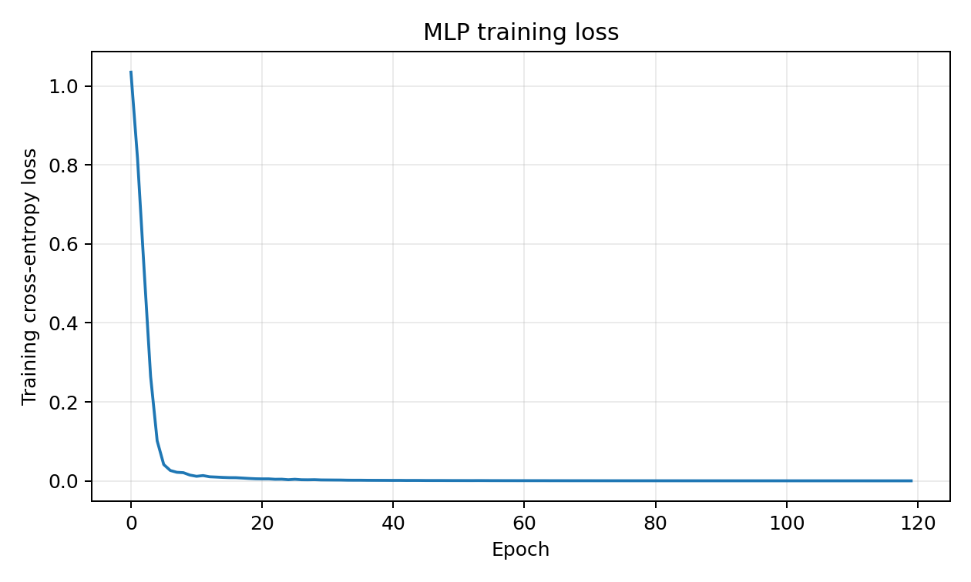
IN-CLASS RESULT
Demo: training loss falls as the MLP learns the synthetic classes
What to notice
Large early improvement, then diminishing returns as the network fits the easy synthetic structure.
Do not overclaim
Low training loss alone does not prove generalization. We still need held-out evaluation.
DSP + Machine Learning • Week 13 Oppenheim & Schafer + Raschka 28

Slide 29
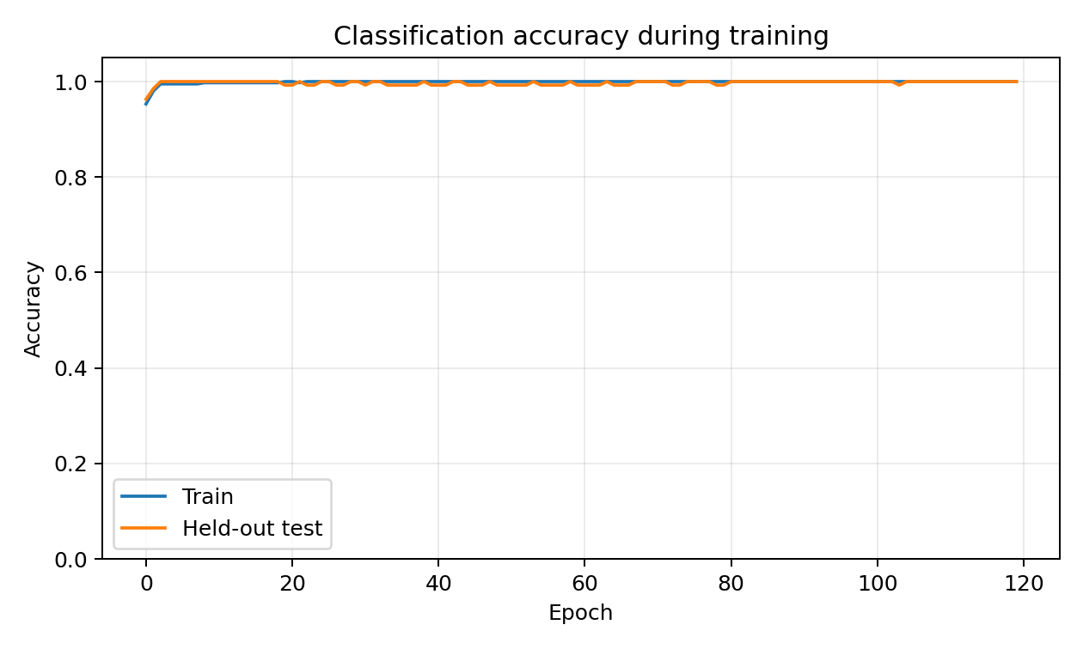
IN-CLASS RESULT
Demo: compare training and held-out accuracy
Teaching dataset
The synthetic Week 12 features are intentionally well separated, so accuracy can approach 100%.
Real audio
Expect overlap, domain shift and recording artifacts. Validation curves become more informative.
DSP + Machine Learning • Week 13 Oppenheim & Schafer + Raschka 29

Slide 30
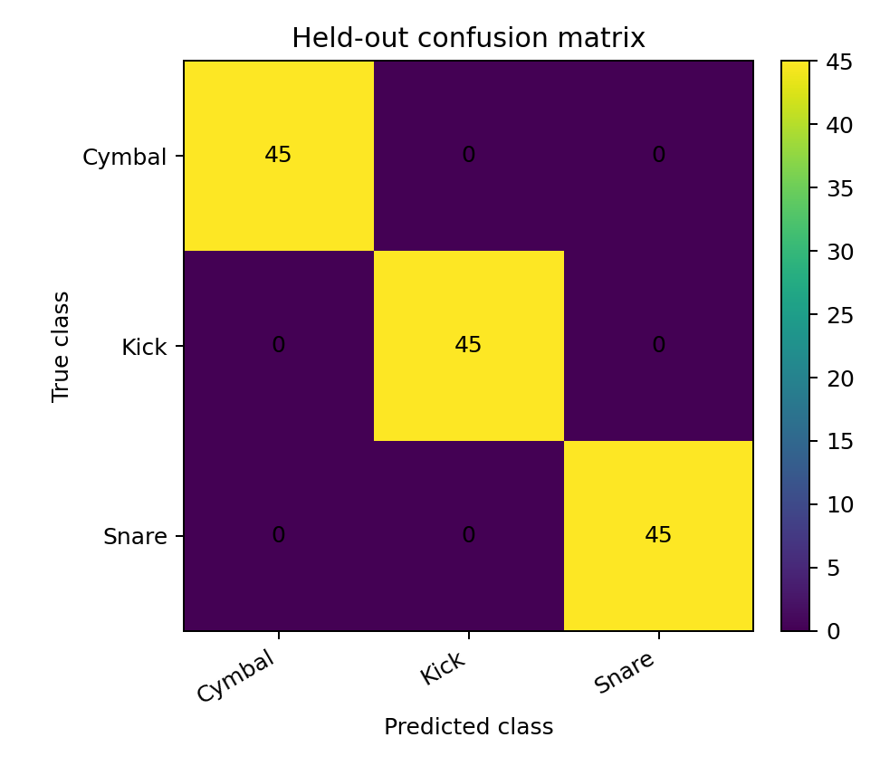
EVALUATION
Confusion matrix: which signal classes get confused?
Diagonal
Correct classifications. A strong diagonal is what we want.
Off-diagonal
Specific confusions tell us more than one accuracy number. Ask which physical features overlap.
In this synthetic example the classes are almost perfectly separable.
DSP + Machine Learning • Week 13 Oppenheim & Schafer + Raschka 30

Slide 31
CONCEPT CHECK
Pause & diagnose the training loop
for xb, yb in loader: logits = model(xb) loss = criterion(logits, yb) loss.backward() optimizer.step()
What is missing?
optimizer.zero_grad()
What happens?
Gradients from old minibatches accumulate into the current parameter gradients.
Strong answer: “The code may still run, but the update no longer represents the gradient of just the current minibatch.”
DSP + Machine Learning • Week 13 Oppenheim & Schafer + Raschka 31

Slide 32
WRAP-UP
Lecture 26 synthesis
Architecture
Loss
Autograd
Optimizer
Affine layers + nonlinear activations turn DSP feature vectors into flexible decision functions.
Cross-entropy converts class predictions into a scalar learning objective.
backward() computes gradients through the computation assembled in the forward pass.
Adam converts those gradients into parameter updates.
DSP features → standardize → minibatch → MLP → logits → cross-entropy → gradients → Adam → repeat
Minute paper: What is the conceptual difference between loss.backward() and optimizer.step()?
DSP + Machine Learning • Week 13 Oppenheim & Schafer + Raschka 32

Slide 33
STUDENT VERSION
Homework — Problems 1–3
1 • Shapes
2 • Why ReLU?
3 • ReLU
A minibatch has 64 examples with 8 DSP features. First hidden layer has 16 neurons. Give input shape, first weight/bias shapes, and hidden output shape.
Show algebraically that two affine layers with no nonlinear activation are equivalent to one affine layer. Explain the consequence for decision boundaries.
For z = [−2, −0.5, 0, 1.2, 4]^T, compute ReLU(z) and state its derivative for z<0 and z>0.
DSP + Machine Learning • Week 13 Oppenheim & Schafer + Raschka 33

Slide 34
STUDENT VERSION
Homework — Problems 4–7
4 • Cross-entropy
5 • Update
6 • Training loop
7 • DSP scaling
Logits z=[2,1,0], true class 0. Compute the softmax probability of class 0 and the sample cross-entropy.
Given θ=1.5, η=0.02 and ∂L/∂θ=4, compute one gradient-descent update.
Explain the purpose and order of the five PyTorch steps. What fails if zero_grad() is omitted?
Explain why standardization helps an MLP using centroid, ZCR, energy, flux, roll-off and MFCCs.
DSP + Machine Learning • Week 13 Oppenheim & Schafer + Raschka 34

Slide 35
10 MINUTES
Weekly quiz — Questions 1–3
Q1 • Shape
Q2 • Nonlinearity
Q3 • CrossEntropyLoss
A batch contains 32 examples, each with 8 DSP features. What is the input shape to Linear(8,16)?
Why are two consecutive affine layers with no nonlinear activation equivalent to one affine layer?
Should the final network layer apply softmax before nn.CrossEntropyLoss()? Briefly justify.
DSP + Machine Learning • Week 13 Oppenheim & Schafer + Raschka 35

Slide 36
10 MINUTES
Weekly quiz — Questions 4–6
Q4 • Loss
Q5 • backward()
Q6 • step()
The model assigns probability p_y=0.8 to the correct class. Compute the sample cross-entropy.
What does loss.backward() compute?
What is the conceptual difference between loss.backward() and optimizer.step()?
DSP + Machine Learning • Week 13 Oppenheim & Schafer + Raschka 36

Slide 37
INSTRUCTOR SOLUTION APPENDIX
Homework + Quiz Solutions
Keep after the student-facing material or move into a separate instructor deck.
DSP + Machine Learning • Week 13 Oppenheim & Schafer + Raschka 37

Slide 38
INSTRUCTOR APPENDIX
Quiz solutions — Questions 1–3
A1
A2
A3
(32,8). Thirty-two examples; eight features per example.
The composition of affine maps is affine: W₂(W₁x+b₁)+b₂ = (W₂W₁)x + (W₂b₁+b₂). Without a nonlinearity, depth does not create nonlinear boundaries.
No. Return raw logits. CrossEntropyLoss internally applies a numerically stable log-softmax plus negative log-likelihood.
DSP + Machine Learning • Week 13 Oppenheim & Schafer + Raschka 38

Slide 39
INSTRUCTOR APPENDIX
Quiz solutions — Questions 4–6
A4
A5
A6
L = −ln(0.8) ≈ 0.223.
backward() computes gradients of the scalar loss with respect to upstream learnable parameters and stores them in .grad.
backward() computes gradients. step() applies Adam’s update rule to change parameter values using those gradients.
DSP + Machine Learning • Week 13 Oppenheim & Schafer + Raschka 39

Slide 40
INSTRUCTOR APPENDIX
Homework solutions — Problems 1–3
1 • Shapes
2 • Linear collapse
3 • ReLU
Input: (64,8). Linear(8,16) weight: (16,8), bias: (16,). Hidden output: (64,16).
Substitution gives y = (W₂W₁)x + (W₂b₁+b₂), which is one affine map. ReLU is needed to create nonlinear piecewise-affine behavior.
ReLU(z) = [0,0,0,1.2,4]^T. Derivative is 0 for z<0 and 1 for z>0; behavior exactly at zero is handled by a subgradient convention.
DSP + Machine Learning • Week 13 Oppenheim & Schafer + Raschka 40

Slide 41
INSTRUCTOR APPENDIX
Homework solutions — Problems 4–7
4 • Cross-entropy
5 • Update
6 • Loop
7 • Scaling
p₀ = e²/(e²+e¹+e⁰) ≈ 0.6652. Therefore L = −ln(p₀) ≈ 0.4076.
θ_next = 1.5 − 0.02(4.0) = 1.42.
Forward → loss → clear → backward → step. Omitting zero_grad() causes unintended accumulation across minibatches.
Comparable numerical scales improve optimization conditioning. Fit mean/std on training data only to avoid leakage.
DSP + Machine Learning • Week 13 Oppenheim & Schafer + Raschka 41

