Slide 1
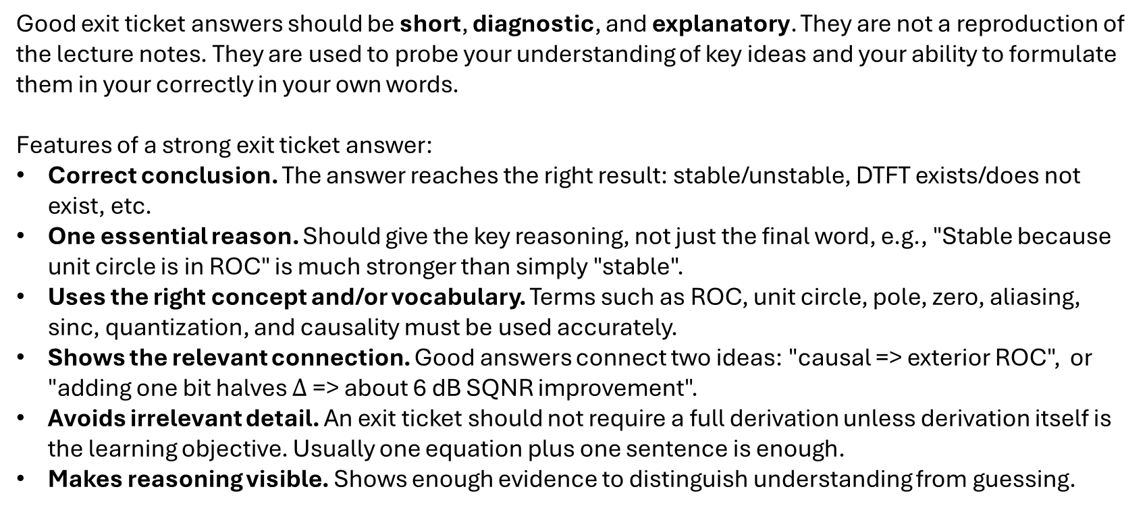
Good Exit Ticket Answers
Good exit ticket answers should be short, diagnostic, and explanatory. They are not a reproduction of the lecture notes. They are used to probe your understanding of key ideas and your ability to formulate them in your correctly in your own words.
Features of a strong exit ticket answer:
Correct conclusion. The answer reaches the right result: stable/unstable, DTFT exists/does not exist, etc.
One essential reason. Should give the key reasoning, not just the final word, e.g., "Stable because unit circle is in ROC" is much stronger than simply "stable".
Uses the right concept and/or vocabulary. Terms such as ROC, unit circle, pole, zero, aliasing, sinc, quantization, and causality must be used accurately.
Shows the relevant connection. Good answers connect two ideas: "causal => exterior ROC", or "adding one bit halves $Δ$ => about 6 dB SQNR improvement".
Avoids irrelevant detail. An exit ticket should not require a full derivation unless derivation itself is the learning objective. Usually one equation plus one sentence is enough.
Makes reasoning visible. Shows enough evidence to distinguish understanding from guessing.

