Slide 1
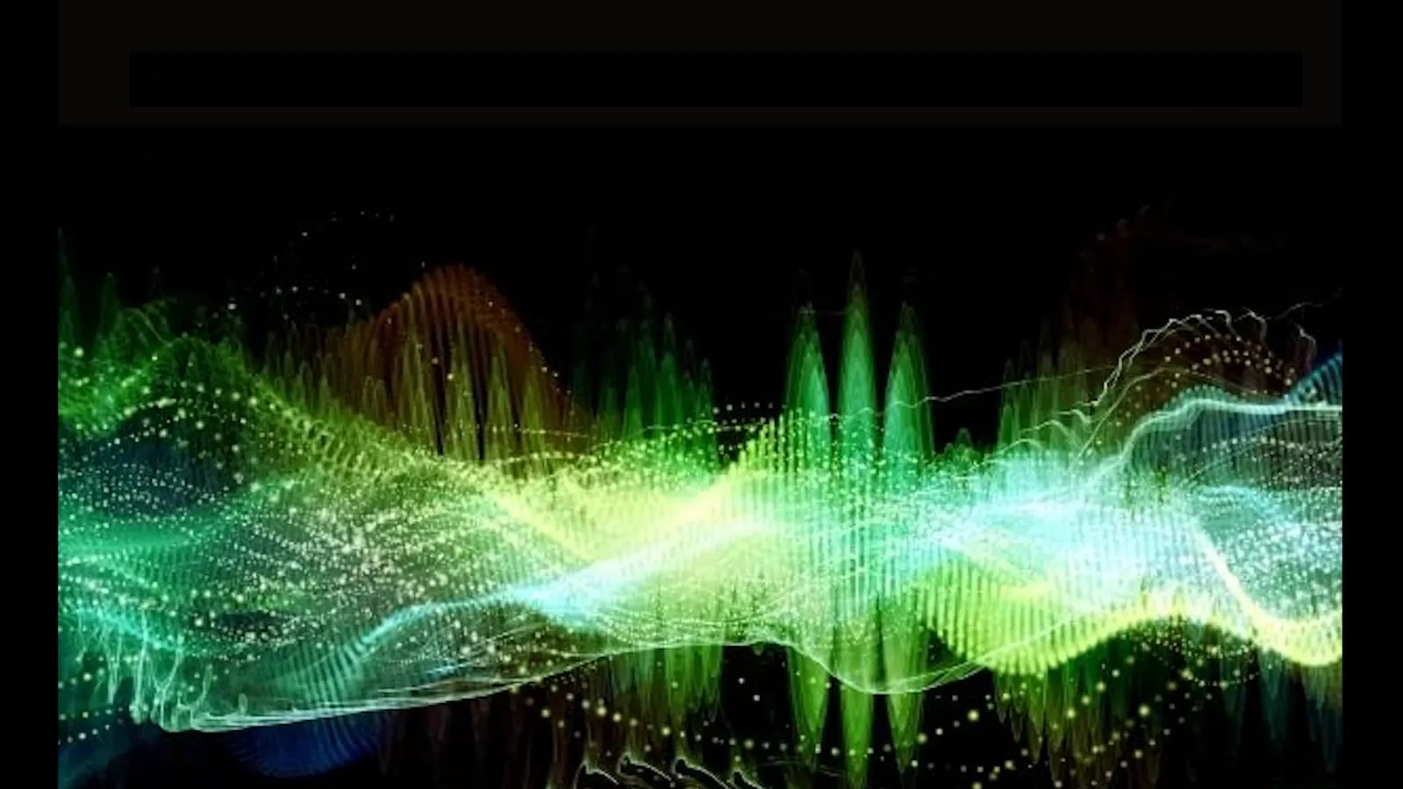
ECEN 4/5632 Theory and Application of Digital Filters
Lecture 3, 9-01-26
Peter Mathys*
* With generous help from Gemini Pro and ChatGPT

Slide 2
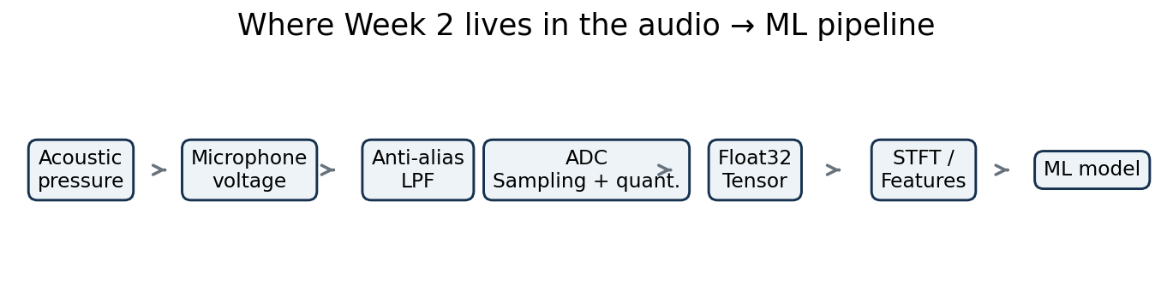
WEEK 2 • LECTURE 3
Continuous-to-Discrete
Conversion & Aliasing
How a physical waveform becomes a trustworthy digital array — or permanently loses information.
75 minutes • mathematical sampling model • frequency-domain replication • Nyquist • audio/ML aliasing
Notes:
[object Object],[object Object]

Slide 3
Where Week 2 sits in the audio → ML pipeline
Everything downstream assumes the ADC delivered faithful samples.
Aliasing is especially dangerous for ML because it can create repeatable, structured features that are physically false.
Notes:
[object Object],[object Object]

Slide 4
Learning outcomes
By the end of Lecture 3, students should be able to derive—not just quote—the sampling theorem.
Model ideal sampling as multiplication by a periodic impulse train.
Derive the replicated spectrum X_s(jΩ) from the CTFT of the impulse train.
State the no-overlap condition and explain why it enables perfect reconstruction.
Predict the alias frequency of a sinusoid at a given sample rate.
Explain why anti-alias filtering must occur before sampling or decimation.
Notes:
[object Object],[object Object]

Slide 5
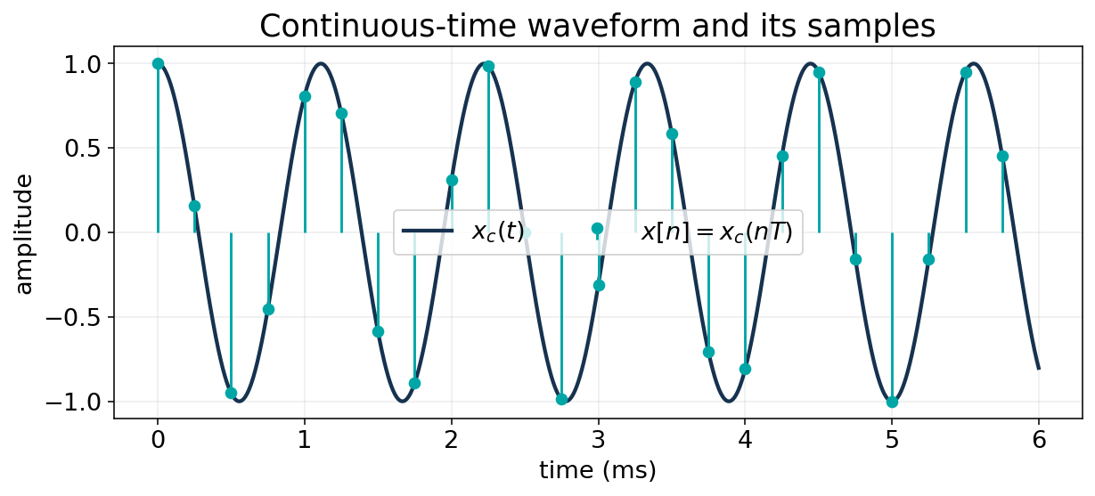

The C/D interface: from volts to an indexed sequence
A microphone produces a continuous-time voltage; software sees numbers.
n is an integer sample index.
T has units of seconds/sample.
f_s=1/T has units of samples/second (Hz).
Sampling discretizes time; quantization will discretize amplitude.
Notes:
[object Object],[object Object],[object Object]

Slide 6
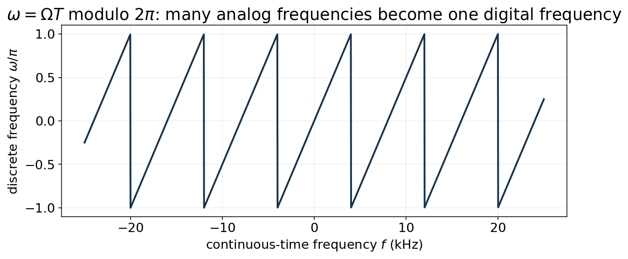






Continuous frequency and discrete frequency are related—but not identical
Sampling converts rad/s to rad/sample.
Ω: continuous-time angular frequency [rad/s].
ω: discrete-time angular frequency [rad/sample].
ω is only unique modulo 2π.
Therefore many analog frequencies can map to one digital frequency.
Notes:
[object Object],[object Object]

Slide 7
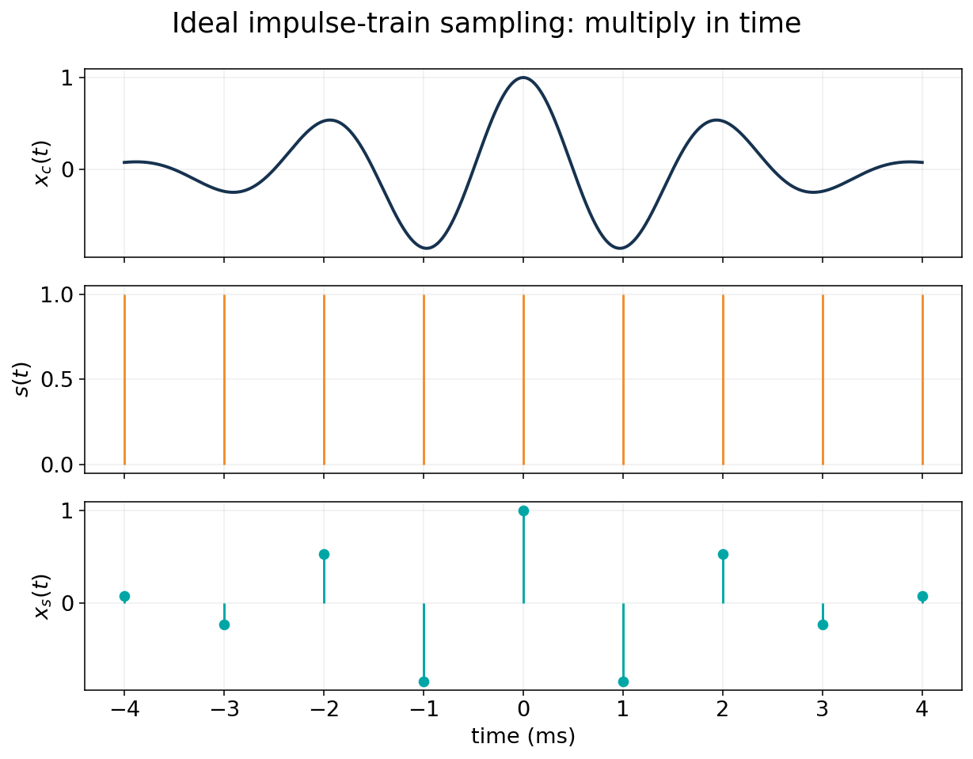


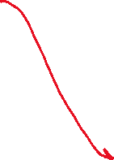
Ideal impulse-train sampling
The mathematical sampler is a multiplier.
The impulse train is an analysis device—not a literal ADC circuit.
Notes:
[object Object],[object Object]

Slide 8
Why impulses? The sifting property does the bookkeeping for us
Multiplying by δ(t−nT) keeps only the value at t=nT.
Each impulse location records one sample value. The sequence x[n] is encoded in the impulse weights.
Notes:
[object Object],[object Object]

Slide 9
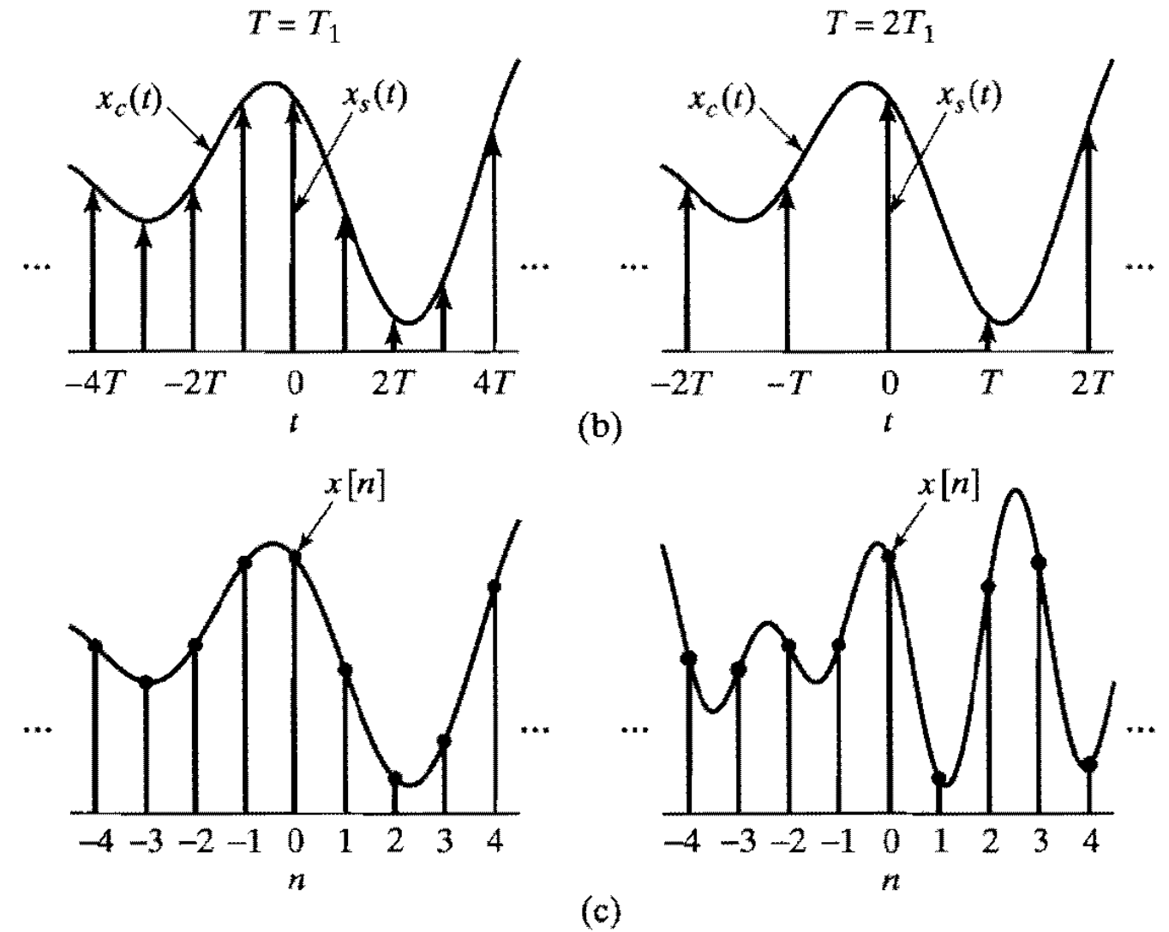
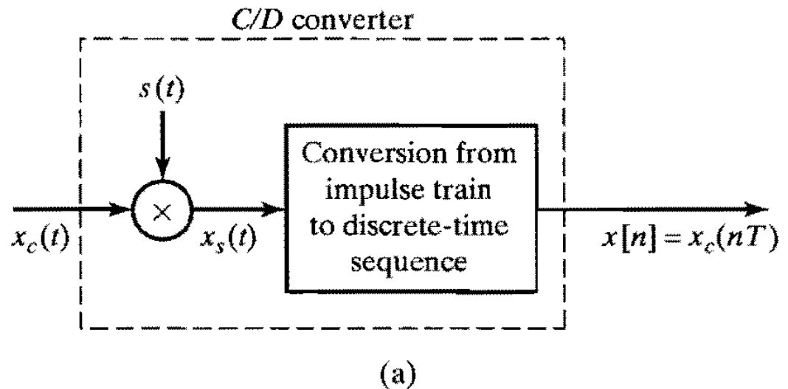
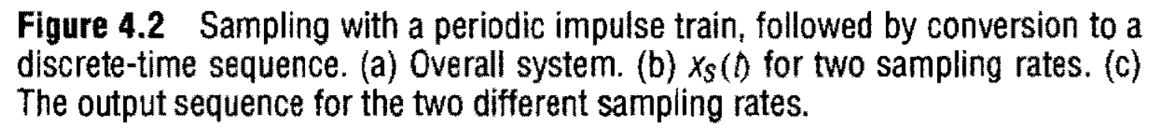

From Oppenheim/Schafer Book

Slide 10
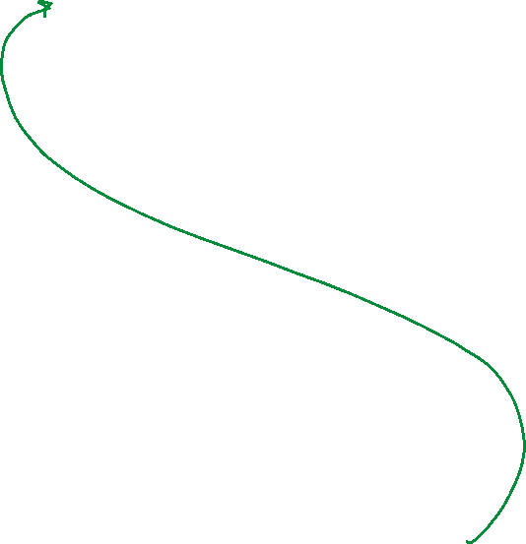



The impulse train is periodic in both time and frequency
A periodic train of impulses transforms to another impulse train.
Time spacing T ↔ frequency spacing Ω_s = 2π/T
This is the mechanism that creates spectral replicas.
Notes:
[object Object],[object Object]

Slide 11
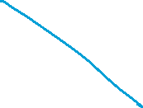




Sampling in time becomes convolution in frequency
Now the central derivation is one line of CTFT algebra.
Sampling creates shifted copies of X_c(jΩ), spaced by Ω_s and scaled by 1/T.
Notes:
[object Object],[object Object],[object Object]

Slide 12
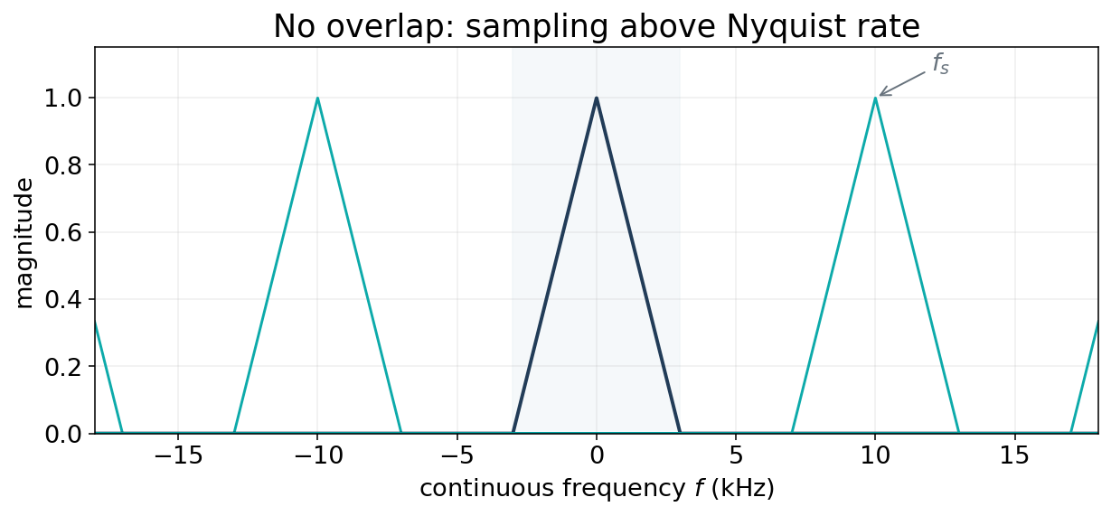



What the sampled spectrum looks like
Every copy contains the same analog information—until the copies overlap.
Replica spacing = f_s. Baseband can be isolated only when neighboring replicas do not overlap.
Notes:
[object Object],[object Object]

Slide 13








Nyquist-Shannon: the no-overlap condition
Let Ω_M be the largest analog frequency with nonzero spectrum.
If the condition holds, one spectral replica can be isolated by an ideal low-pass filter.
At exact equality, idealized edge cases require care; practical systems use transition bands and margin.
The “Nyquist frequency” f_s/2 is a property of the sample rate; the “Nyquist rate” 2f_M is a property of the signal bandwidth.
Notes:
[object Object],[object Object]

Slide 14
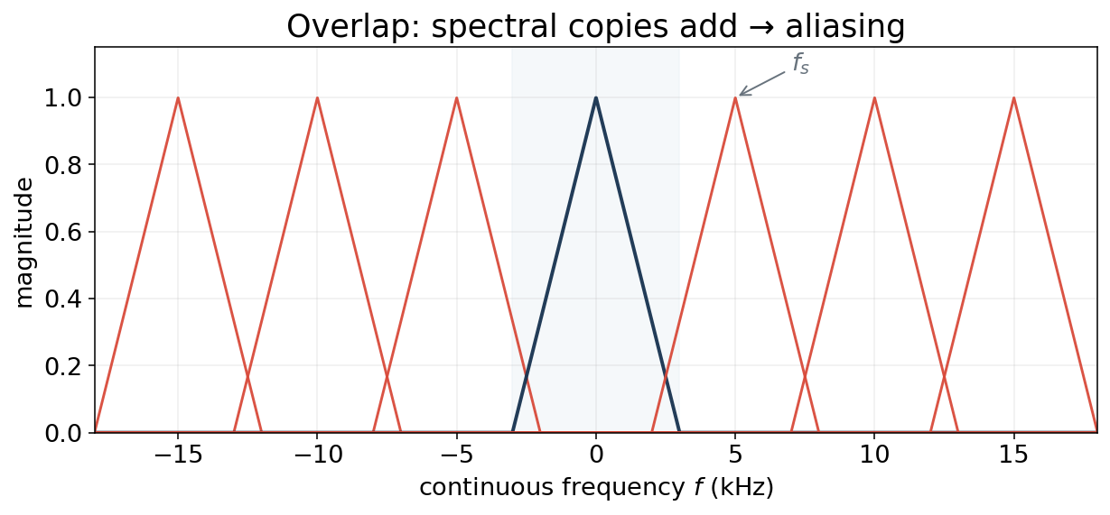











Aliasing: neighboring replicas overlap and add
After overlap, there is no unique way to separate the original copies.
This is irreversible at the sample level: multiple continuous-time spectra are consistent with the same samples.
Notes:
[object Object],[object Object]

Slide 15
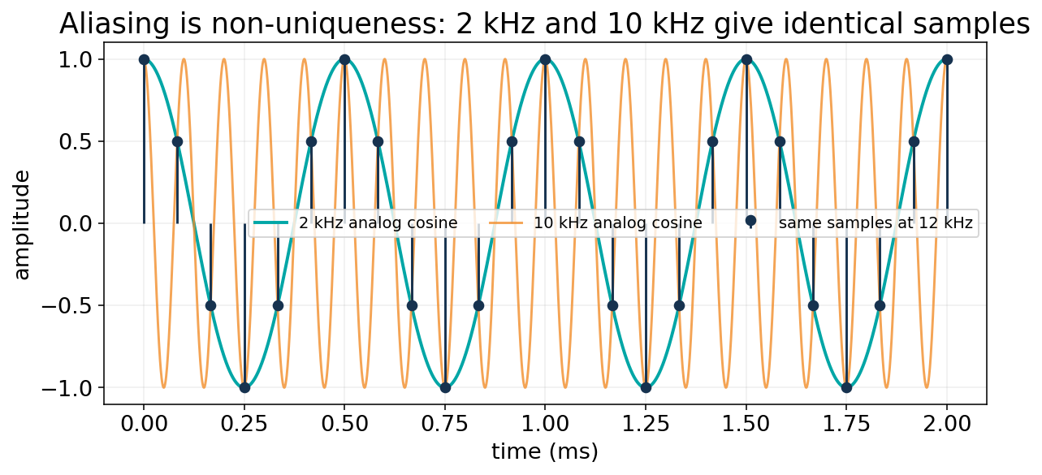
Aliasing is non-uniqueness—not ordinary additive noise
Two different analog sinusoids can produce exactly the same sequence.
Notes:
[object Object],[object Object]

Slide 16
Worked audio example: 10 kHz sampled at 12 kHz
New Nyquist frequency is only 6 kHz.
The samples contain a 2 kHz discrete-time cosine.
There is no label attached saying “this used to be 10 kHz.”
A spectrogram will confidently display energy at 2 kHz.
Prediction before demo: what will happen to 7 kHz? 9 kHz? 13 kHz?
Notes:
[object Object]

Slide 17
The same fact in normalized frequency
The mapping ω = ΩT is periodic modulo 2π.
At f_s = 12 kHz:
10 kHz → 5π/3 ≡ −π/3 → real-cosine alias at +π/3 → 2 kHz.
Notes:
[object Object],[object Object]

Slide 18
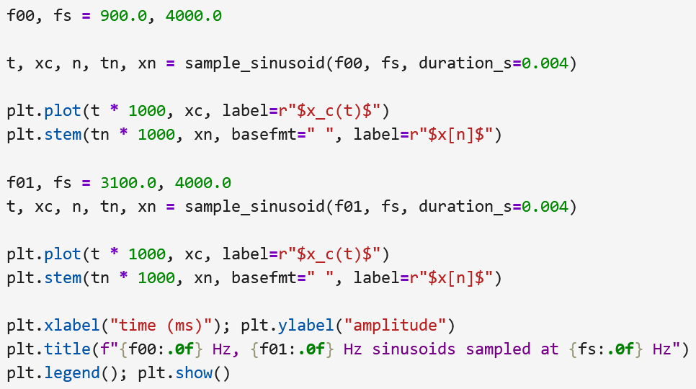
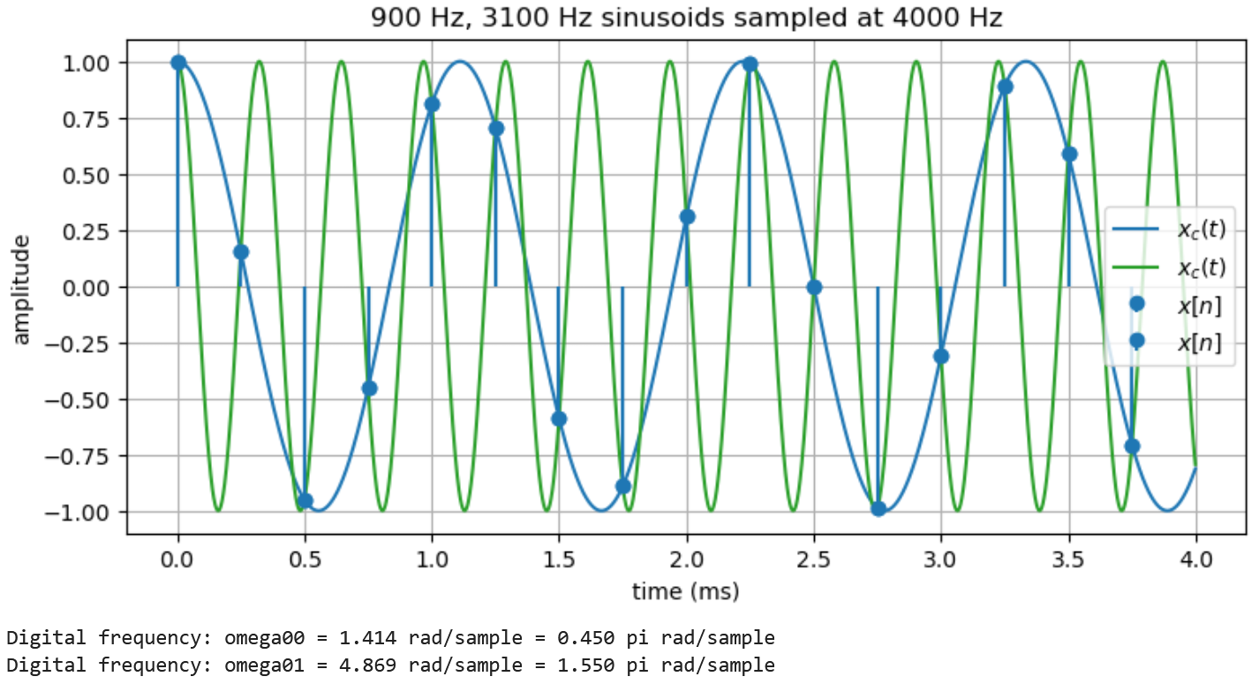
Python Demo

Slide 19
The anti-alias filter belongs before the sampler
Once energy above f_s/2 has folded, digital filtering cannot know its origin.
Microphone
$x_c(t)$
Analog
anti-alias LPF
ADC
(sample + quantize)
Digital array
$x[n]$
PyTorch
features
Filter cutoff is designed below f_s/2 so the real analog transition band fits before Nyquist.
Notes:
[object Object],[object Object]

Slide 20




























Downsampling is another sampling problem
Going from 48 kHz → 12 kHz creates a new Nyquist limit at 6 kHz.
Naive: keep every 4th sample
Correct: low-pass, then keep every 4th
x_12k = x_48k[::4]
# fast... but aliases > 6 kHz
x_12k = signal.resample_poly(
x_48k, up=1, down=4)
# FIR anti-alias filter + decimation
A 10 kHz component becomes 2 kHz after naive 4× decimation.
The anti-alias filter removes energy above the new 6 s kHz Nyquist frequency before decimation.
Notes:
[object Object],[object Object]

Slide 21
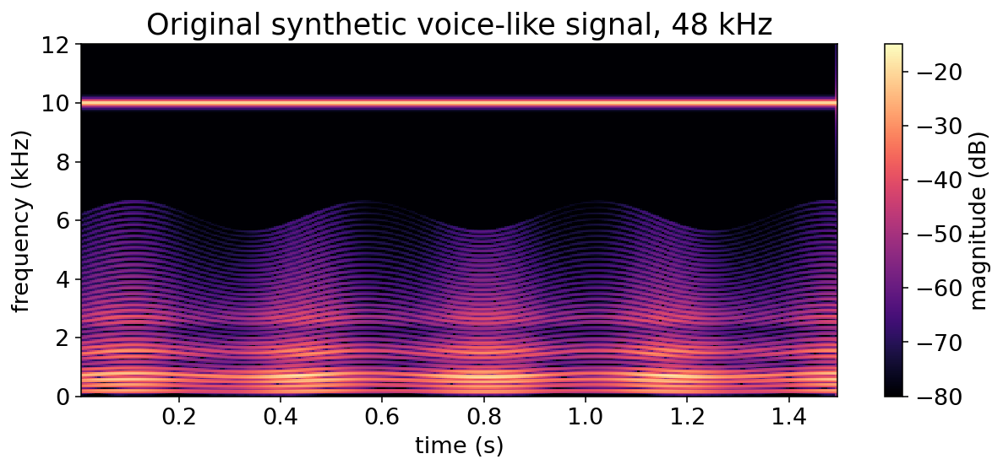
What the ML system “sees”: original 48 kHz spectrogram
The synthetic voice-like signal contains harmonics plus a deliberate 10 kHz component.
Notes:
[object Object],[object Object]

Slide 22
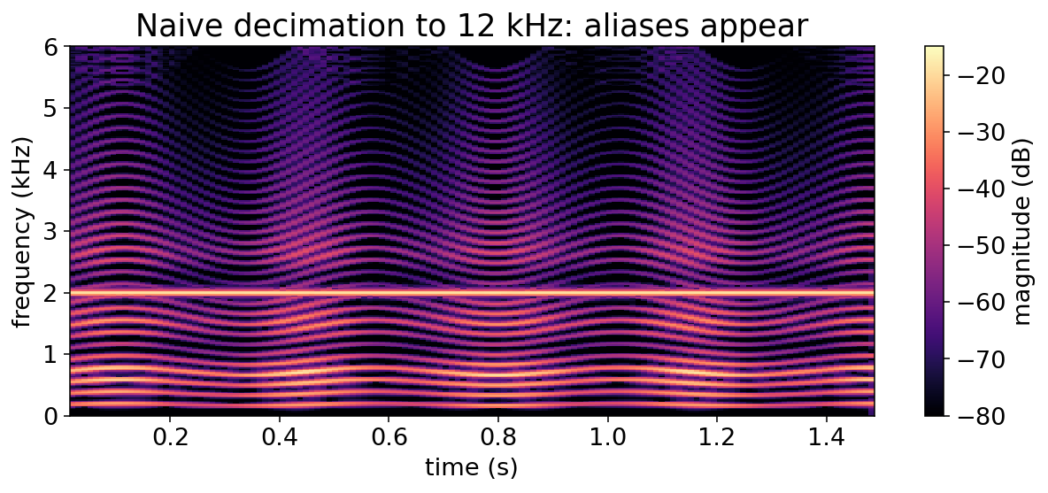
Naive 4× decimation creates false low-frequency structure
The 10 kHz component folds to 2 kHz at the new 12 kHz sample rate.
A CNN has no way to know this bright 2 kHz structure is an alias rather than a real acoustic feature.
Notes:
[object Object],[object Object]

Slide 23
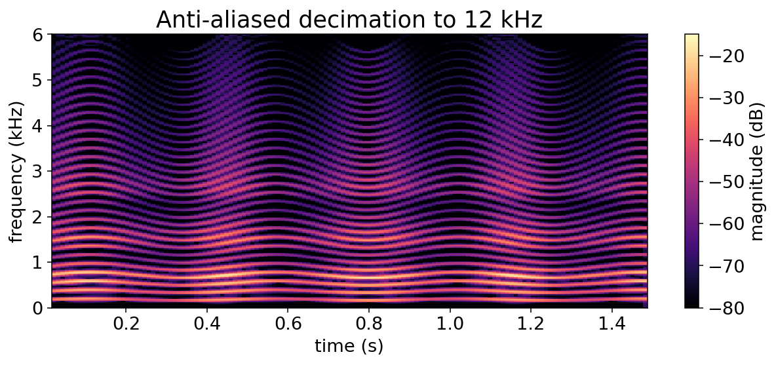
Anti-aliased decimation preserves a physically meaningful spectrum
Filter first, then change the sampling grid.
We lose content above 6 kHz by design—but we do not mislabel that content as lower-frequency energy.
Notes:
[object Object],[object Object]

Slide 24
Think–Pair–Share: three checks before data enters a model
2 minutes individually • 2 minutes in pairs • quick debrief
1 A sensor signal is bandlimited to 18 kHz. Is f_s = 32 kHz sufficient for ideal sampling?
2 A 17 kHz tone is sampled at 20 kHz. What alias frequency appears in [0,10] kHz?
3 Why can a digital low-pass filter after the ADC not “remove aliasing” in general?
Notes:
[object Object],[object Object]

Slide 25
Think–Pair–Share: three checks before data enters a model
2 minutes individually • 2 minutes in pairs • quick debrief
1 A sensor signal is bandlimited to 18 kHz. Is f_s = 32 kHz sufficient for ideal sampling?
2 A 17 kHz tone is sampled at 20 kHz. What alias frequency appears in [0,10] kHz?
3 Why can a digital low-pass filter after the ADC not “remove aliasing” in general?
Answers: 1) No: 32 < 36 kHz. 2) 3 kHz. 3) Aliased and genuine in-band components are no longer distinguishable.
Notes:
[object Object],[object Object]

Slide 26
Lecture 3 summary: sampling is an information-preservation theorem
The mathematical model explains exactly when the digital sequence remains invertible.
Ideal sampling: multiply x_c(t) by an impulse train.
Frequency domain: X_c(jΩ) is replicated every Ω_s and scaled by 1/T.
No overlap requires f_s > 2f_M for a bandlimited signal.
Aliasing means different analog signals produce the same samples—irreversible without extra assumptions.
Anti-alias filtering must happen before sampling or rate reduction.
Next: If the samples are valid, how do we turn them back into a continuous waveform—and what does finite bit depth do?
Notes:
[object Object]

