Slide 1
LECTURE 8
IIR Design, Bilinear Transformation, & Data Preprocessing
From analog prototypes to stable digital filters—and the phase choices hidden in ML preprocessing
analog prototypes
→
bilinear map
→
prewarping
→
offline ML
75 minutes • senior + first-year graduate ECE
Oppenheim & Schafer + Raschka

Slide 2
ROADMAP
Where this 75-minute lecture is going
0–15 min • Analog prototypes
15–40 min • Bilinear transform
40–60 min • Warping + prewarp
60–75 min • ML preprocessing
Butterworth, Chebyshev I/II, and elliptic tradeoffs.
Map the analog LHP into the digital unit disk while preserving stability.
Derive Ω(ω) and hit the desired digital critical frequencies.
Causal IIR versus forward-backward zero-phase filtering and deployment implications.
DSP bridge: IIR design gives efficient recursive filters; ML preprocessing must also account for phase, causality, and train/deployment consistency.
Classical DSP supplies structure and constraints; machine learning either reuses that structure or learns parameters inside it.
DSP + Machine Learning • Lectures 7–8
Oppenheim & Schafer + Raschka
2

Slide 3
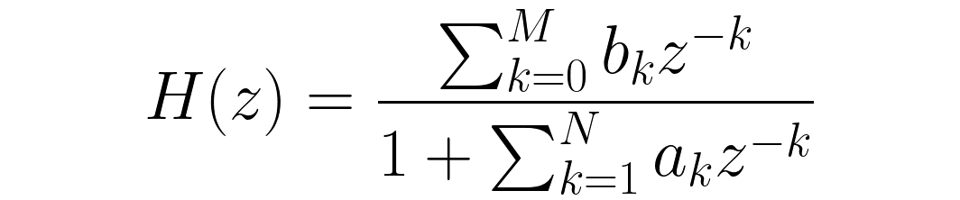
IIR MOTIVATION
Why accept feedback and nonlinear phase?
Efficiency
Tradeoff
ML preprocessing
Sharp magnitude selectivity can often be obtained with far fewer coefficients than an FIR meeting comparable magnitude specifications.
The recursive denominator introduces poles and typically nonlinear phase / frequency-dependent group delay.
For offline denoising or smoothing, compact IIR filters are attractive—but preprocessing must match the temporal assumptions of deployment.
DSP + Machine Learning • Lectures 7–8
Oppenheim & Schafer + Raschka
3

Slide 4
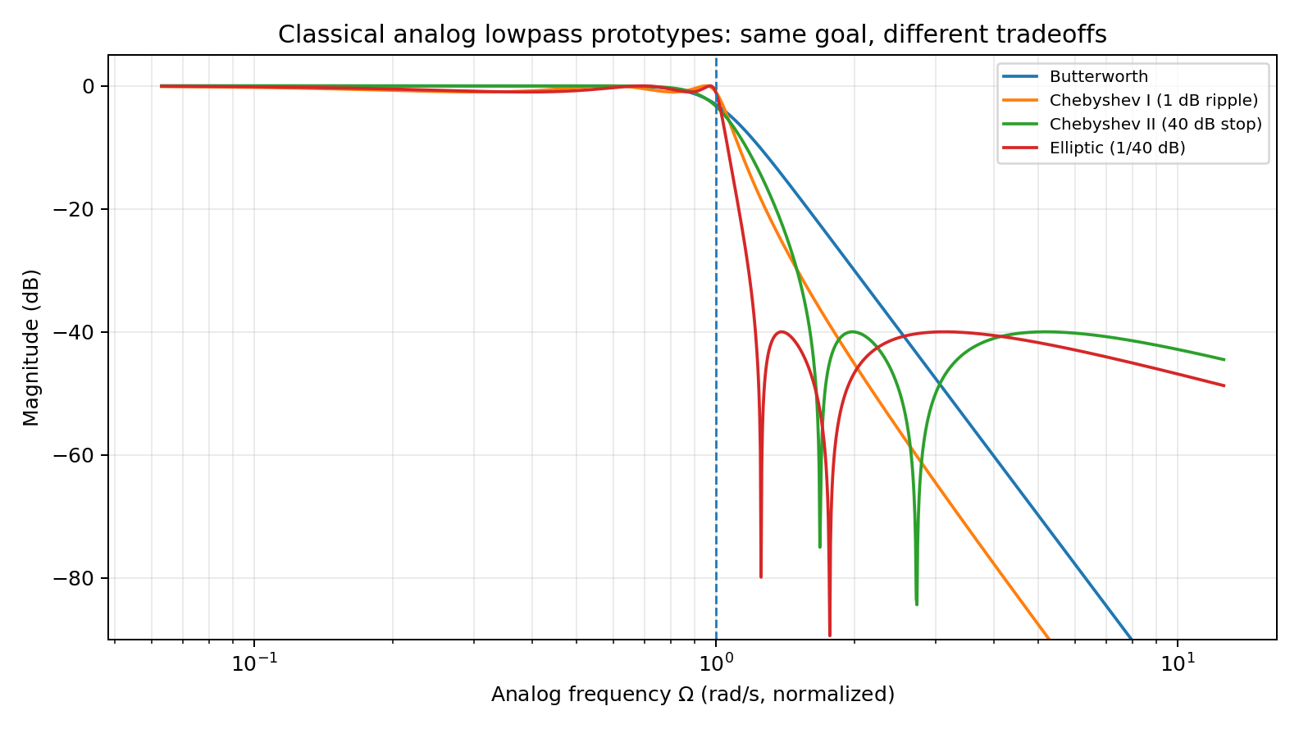
ANALOG PROTOTYPES
Four classical ways to spend ripple and transition width
Butterworth
Maximally flat magnitude in the passband; monotonic.
Chebyshev
Spend ripple in one band to sharpen the transition.
Elliptic
Ripple in both bands; steepest transition for a given order/specification.
DSP + Machine Learning • Lectures 7–8
Oppenheim & Schafer + Raschka
4

Slide 5
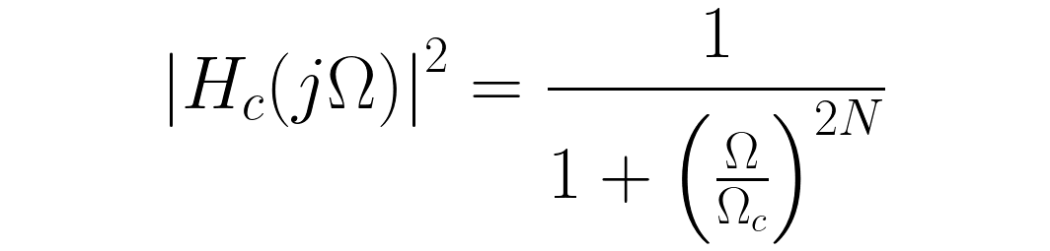
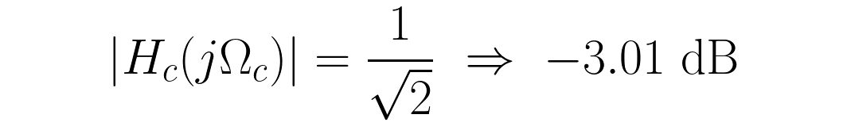
BUTTERWORTH
Maximally flat magnitude response
Order N
Higher N steepens the transition around Ω_c.
No passband ripple
Butterworth is attractive when smooth magnitude behavior matters more than the narrowest possible transition.
Good answer
At the cutoff, the squared magnitude is 1/2 regardless of N.
DSP + Machine Learning • Lectures 7–8
Oppenheim & Schafer + Raschka
5

Slide 6
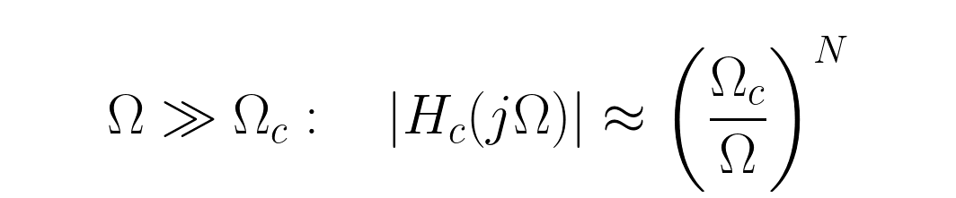
BUTTERWORTH
What increasing order buys—and what it costs
Magnitude slope
Implementation cost
Practice
Each additional pole increases asymptotic attenuation by about 20 dB/decade.
Higher order means more states / sections and greater numerical sensitivity in direct-form implementations.
Use second-order sections for moderate/high-order digital IIR implementations when possible.
DSP + Machine Learning • Lectures 7–8
Oppenheim & Schafer + Raschka
6

Slide 7
PROTOTYPE TRADEOFFS
Where the ripple is allowed to live
Prototype
Passband
Stopband
Transition / comment
Butterworth
monotonic
monotonic
maximally flat; smooth
Chebyshev I
equiripple
monotonic
sharper for allowed passband ripple
Chebyshev II
monotonic
equiripple
spend ripple in stopband
Elliptic
equiripple
equiripple
steepest transition for given order/spec
Engineering habit
Choose the prototype from passband/stopband tolerances and order requirements—not from a universal ranking.
DSP + Machine Learning • Lectures 7–8
Oppenheim & Schafer + Raschka
7

Slide 8
CONCEPT CHECK
Which prototype sounds plausible?
A • Sensor calibration
B • Tight transition
C • Most aggressive
Passband amplitude must be smooth; moderate transition width is acceptable.
A small amount of controlled passband ripple is acceptable to lower order.
Ripple is acceptable in both bands and minimum order is important.
Good answer
Good answer
Good answer
Butterworth is a natural first choice because it is monotonic and maximally flat.
Chebyshev I trades passband ripple for a sharper transition.
Elliptic is often the most aggressive classical choice.
DSP + Machine Learning • Lectures 7–8
Oppenheim & Schafer + Raschka
8

Slide 9
ANALOG → DIGITAL
What must a useful domain map preserve?
Stability
Frequency axis
One-to-one mapping
Analog stable poles satisfy Re{s}<0. They must map to |z|<1.
The analog jΩ axis should map to the digital unit circle z=e^{jω}.
Avoid aliasing of multiple analog frequencies onto the same digital frequency.
The bilinear transform satisfies these properties—but its price is nonlinear frequency warping.
DSP + Machine Learning • Lectures 7–8
Oppenheim & Schafer + Raschka
9

Slide 10


BILINEAR TRANSFORM
The substitution that maps the half-plane to the disk
Interpret T
T is the sampling period used in the analog-to-digital mapping.
Important
This is not the impulse-invariance map z=e^{sT}. The bilinear transform avoids frequency aliasing but warps the axis.
DSP + Machine Learning • Lectures 7–8
Oppenheim & Schafer + Raschka
10

Slide 11

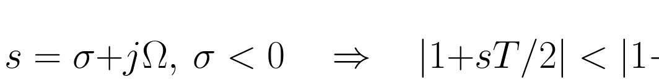

STABILITY MAPPING
Why the analog left-half plane lands inside the unit circle
Good answer
The negative real part makes the numerator magnitude smaller than the denominator magnitude, so a stable analog pole maps inside the digital unit circle.
Boundary
For σ=0, numerator and denominator magnitudes are equal, hence |z|=1.
DSP + Machine Learning • Lectures 7–8
Oppenheim & Schafer + Raschka
11

Slide 12
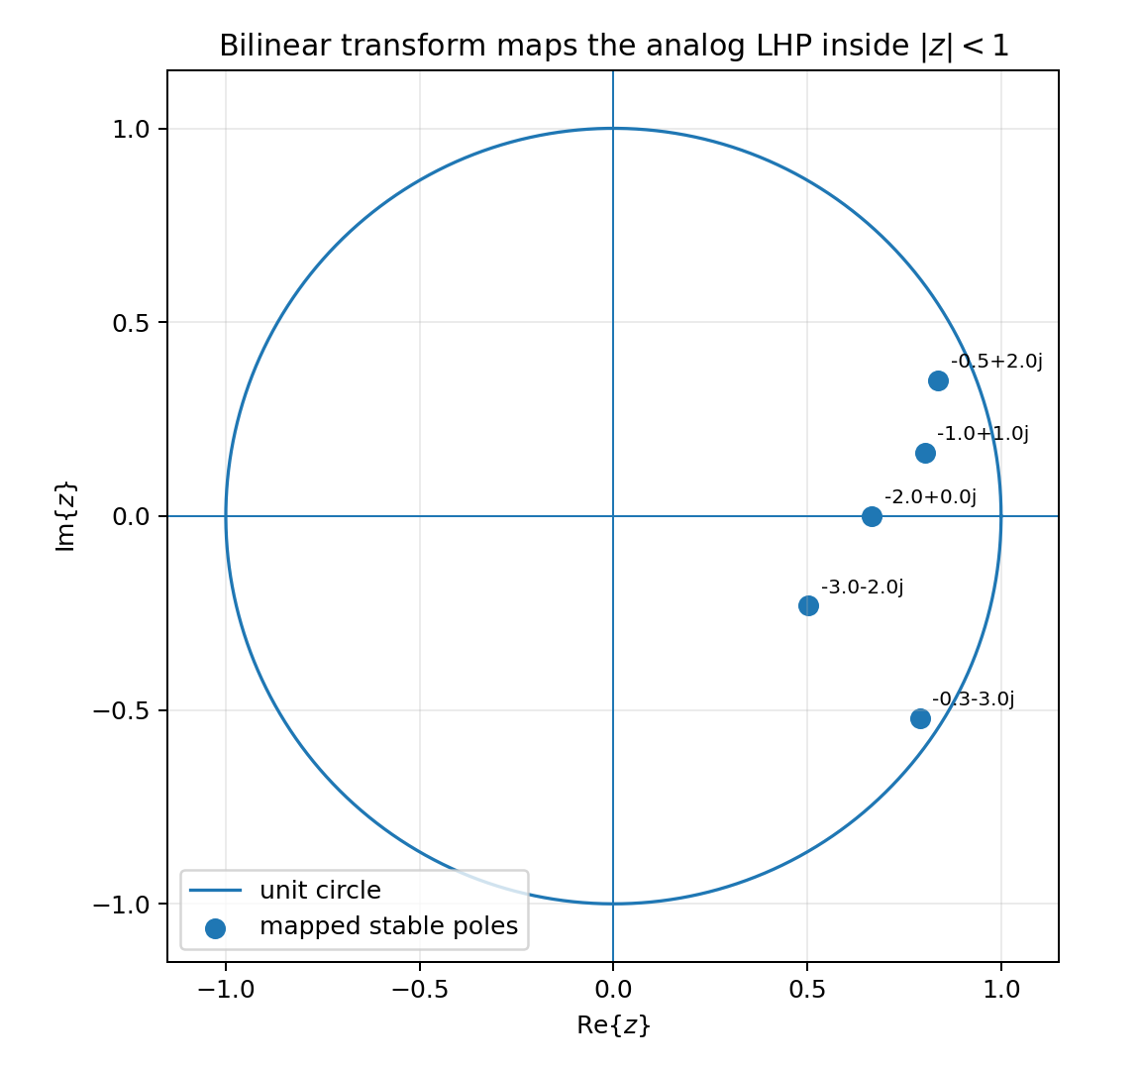
STABILITY MAPPING
Representative analog stable poles map inside |z|=1
Interpretation
Every shown analog pole has negative real part. After the bilinear map, every digital pole lies strictly inside the unit circle.
This is the guarantee we want
Start from a stable analog prototype and the mapped digital filter remains stable, barring numerical implementation issues.
DSP + Machine Learning • Lectures 7–8
Oppenheim & Schafer + Raschka
12

Slide 13



FREQUENCY MAPPING
The analog jΩ axis maps exactly onto the unit circle
Endpoints
Ω=0 maps to ω=0. As |Ω|→∞, the digital frequency approaches ±π and z approaches −1.
No aliasing
The entire analog frequency axis maps one-to-one into −π<ω<π.
DSP + Machine Learning • Lectures 7–8
Oppenheim & Schafer + Raschka
13

Slide 14

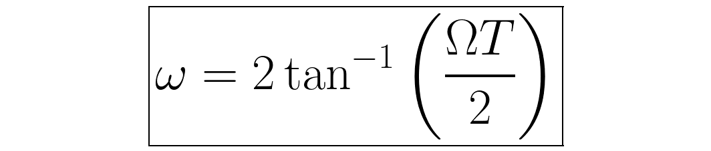
FREQUENCY WARPING
The price of the one-to-one map
Low frequency
For small ω, tan(ω/2)≈ω/2, so Ω≈ω/T.
Near Nyquist
The map becomes strongly nonlinear; equal analog frequency intervals do not remain equal digital intervals.
DSP + Machine Learning • Lectures 7–8
Oppenheim & Schafer + Raschka
14

Slide 15
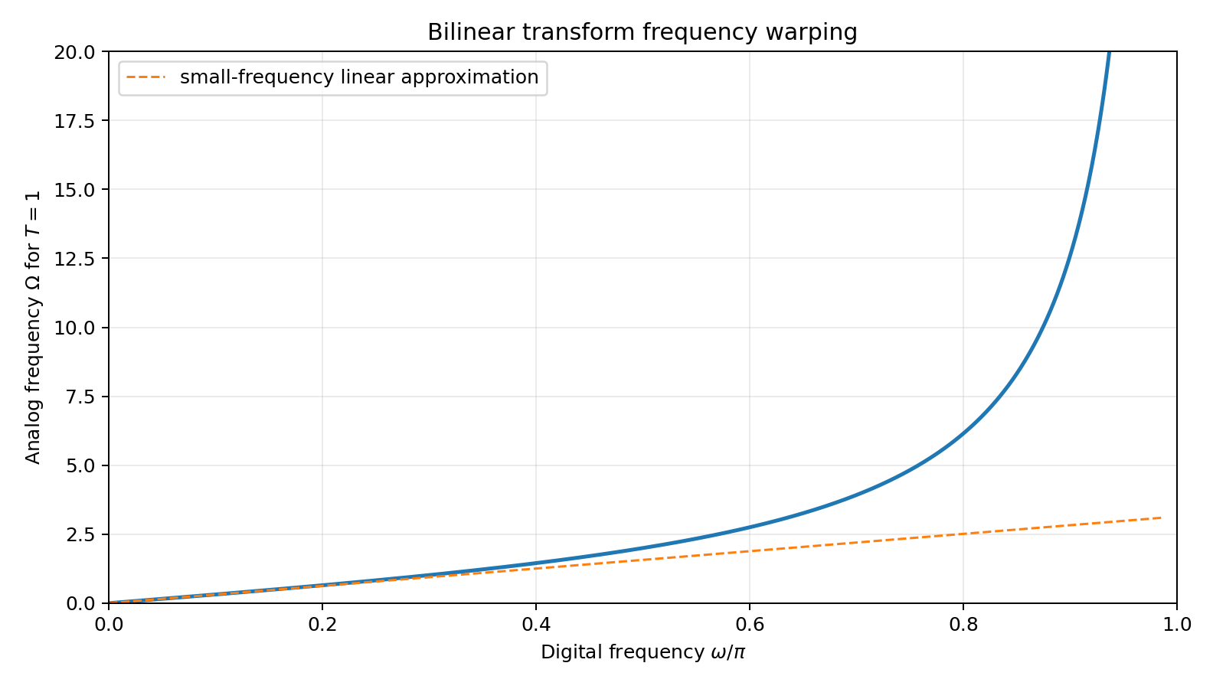
FREQUENCY WARPING
Near Nyquist, the analog axis is stretched dramatically
Read the curve
The relationship is nearly linear near DC but diverges as ω→π.
Design consequence
If you design the analog cutoff at the unwarped numeric value, the final digital cutoff misses its target.
DSP + Machine Learning • Lectures 7–8
Oppenheim & Schafer + Raschka
15

Slide 16

PREWARPING
Design the analog prototype at the frequency that maps to the desired digital edge
Design sequence
1 • Digital spec
2 • Prewarp
3 • Analog design
4 • Bilinear map
ω_p, ω_s, ripple / attenuation
map each critical digital frequency to Ω
design Butterworth / Chebyshev / elliptic prototype
substitute s(z) to obtain the digital filter
DSP + Machine Learning • Lectures 7–8
Oppenheim & Schafer + Raschka
16

Slide 17

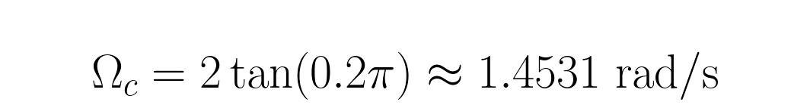
WORKED EXAMPLE
Prewarp a desired cutoff at 0.4π rad/sample
Meaning
Check
Design the analog prototype at Ω_c≈1.4531—not at 0.4π≈1.2566.
After the bilinear transform, the measured −3 dB point lands at approximately 0.4π.
DSP + Machine Learning • Lectures 7–8
Oppenheim & Schafer + Raschka
17

Slide 18
DESIGN WORKFLOW
From digital specification to digital IIR
Digital requirements
Prewarp
Analog prototype
Bilinear transform
Verify
ω_p, ω_s, A_p, A_s
→
Ω_p, Ω_s
→
H_c(s)
→
H(z)
→
freqz + numerical stability
The bilinear transform preserves stability, not exact frequency spacing. Verification is part of the design, not an optional afterthought.
DSP + Machine Learning • Lectures 7–8
Oppenheim & Schafer + Raschka
18

Slide 19
IMPLEMENTATION
Explicit analog prototype → bilinear transform in SciPy
wc = 0.4*np.pi T = 1.0 Omega_c = (2/T)*np.tan(wc/2) b_a, a_a = signal.butter(4, Omega_c, analog=True) b_z, a_z = signal.bilinear(b_a, a_a, fs=1/T) w, H = signal.freqz(b_z, a_z)
Why show the explicit path?
It makes prewarping and the analog prototype visible instead of hiding the mathematics inside one convenience function.
Implementation practice
For deployment, prefer numerically robust second-order-section forms when order becomes substantial.
DSP + Machine Learning • Lectures 7–8
Oppenheim & Schafer + Raschka
19

Slide 20
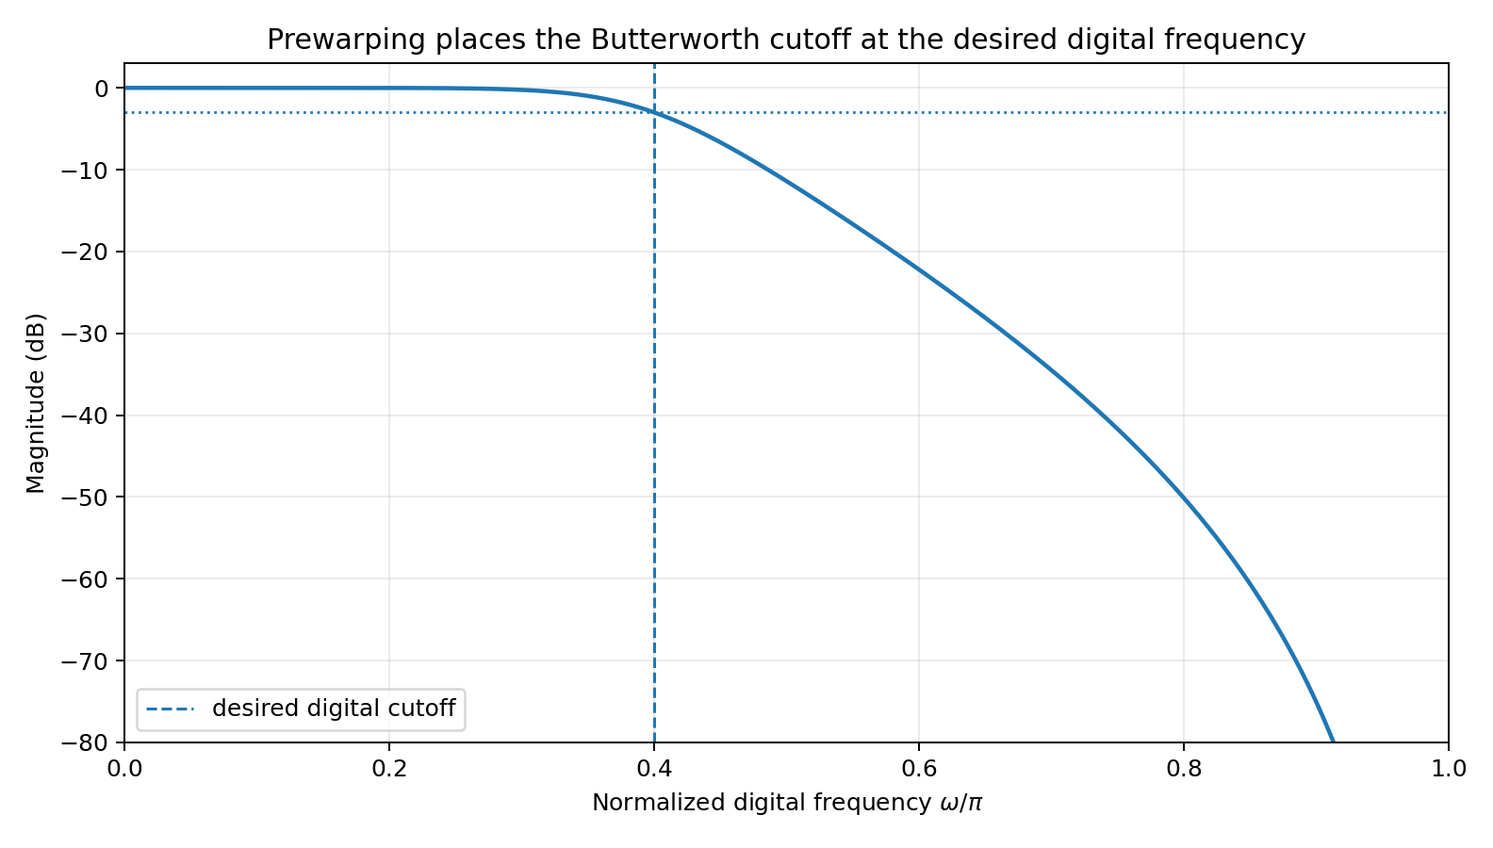
VERIFICATION
The prewarped design hits the intended digital cutoff
Target
Desired digital cutoff: ω_c = 0.4π.
Measured
The script finds the −3 dB point at ≈0.3999π.
Good habit
Always verify the digital response after mapping.
DSP + Machine Learning • Lectures 7–8
Oppenheim & Schafer + Raschka
20

Slide 21
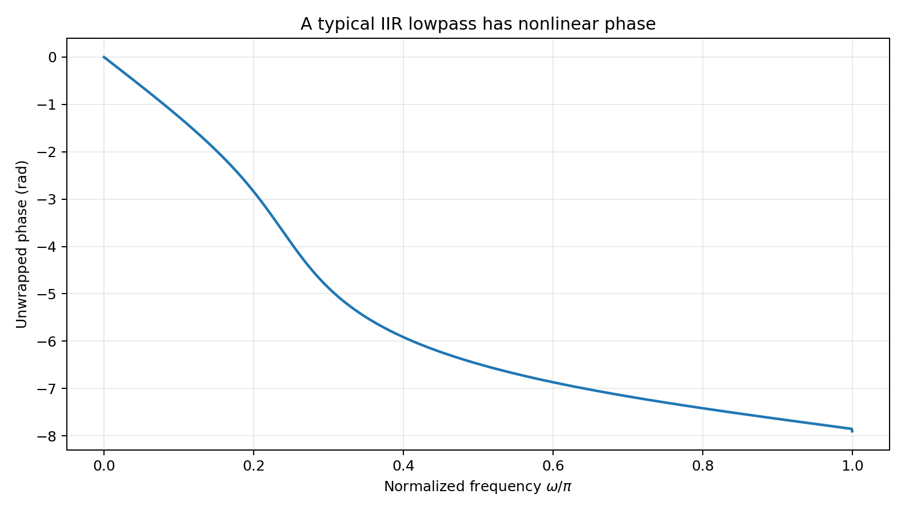
IIR PHASE
Efficient magnitude selectivity does not usually preserve waveform shape
Nonlinear phase
The phase is not a straight line in ω, so group delay varies with frequency.
ML implication
If timing relationships are part of the feature, causal IIR preprocessing can alter them. That may or may not matter depending on the task.
DSP + Machine Learning • Lectures 7–8
Oppenheim & Schafer + Raschka
21

Slide 22
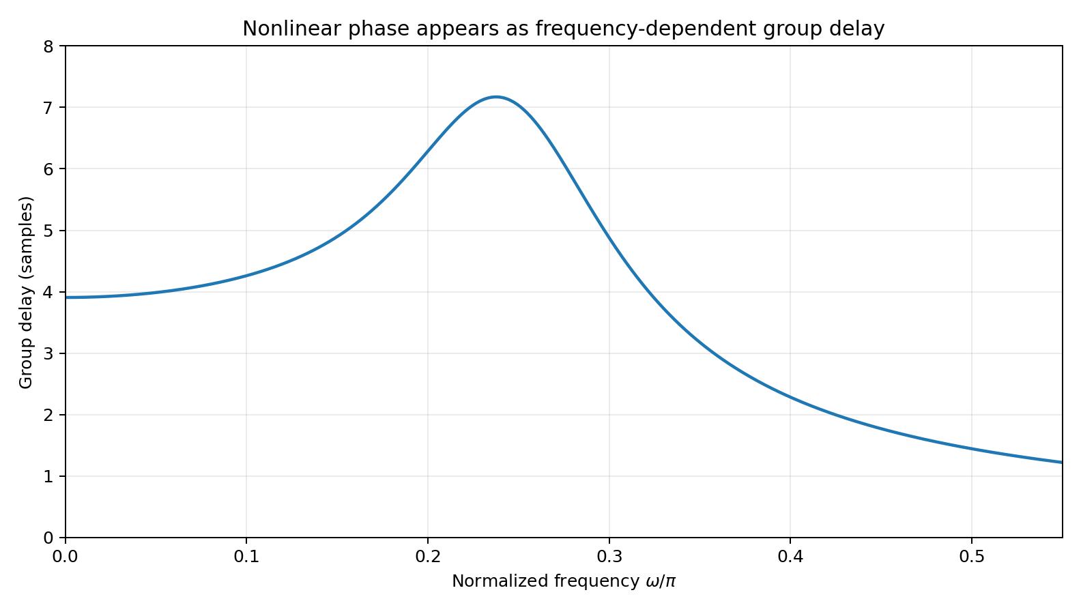
IIR PHASE
Frequency-dependent group delay makes the distortion easier to see
Contrast with Lecture 7
The symmetric FIR had nearly constant τ_g. Here the delay changes across the passband/transition.
Practical question
Does the downstream model care about absolute timing, relative timing, or only long-term spectral statistics?
DSP + Machine Learning • Lectures 7–8
Oppenheim & Schafer + Raschka
22

Slide 23
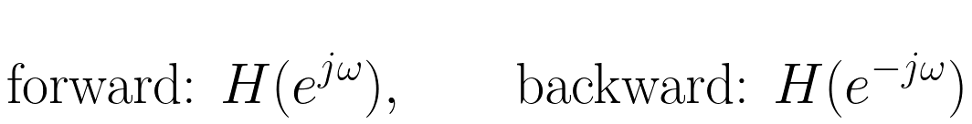
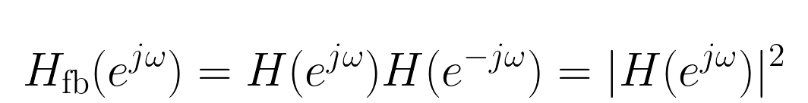
OFFLINE PREPROCESSING
Forward-backward filtering cancels phase
Net phase
For real-coefficient filters, the phases cancel: zero-phase distortion.
But magnitude changes
The magnitude is squared, so attenuation in dB is approximately doubled.
And causality is gone
The backward pass uses future samples relative to a streaming implementation.
DSP + Machine Learning • Lectures 7–8
Oppenheim & Schafer + Raschka
23

Slide 24
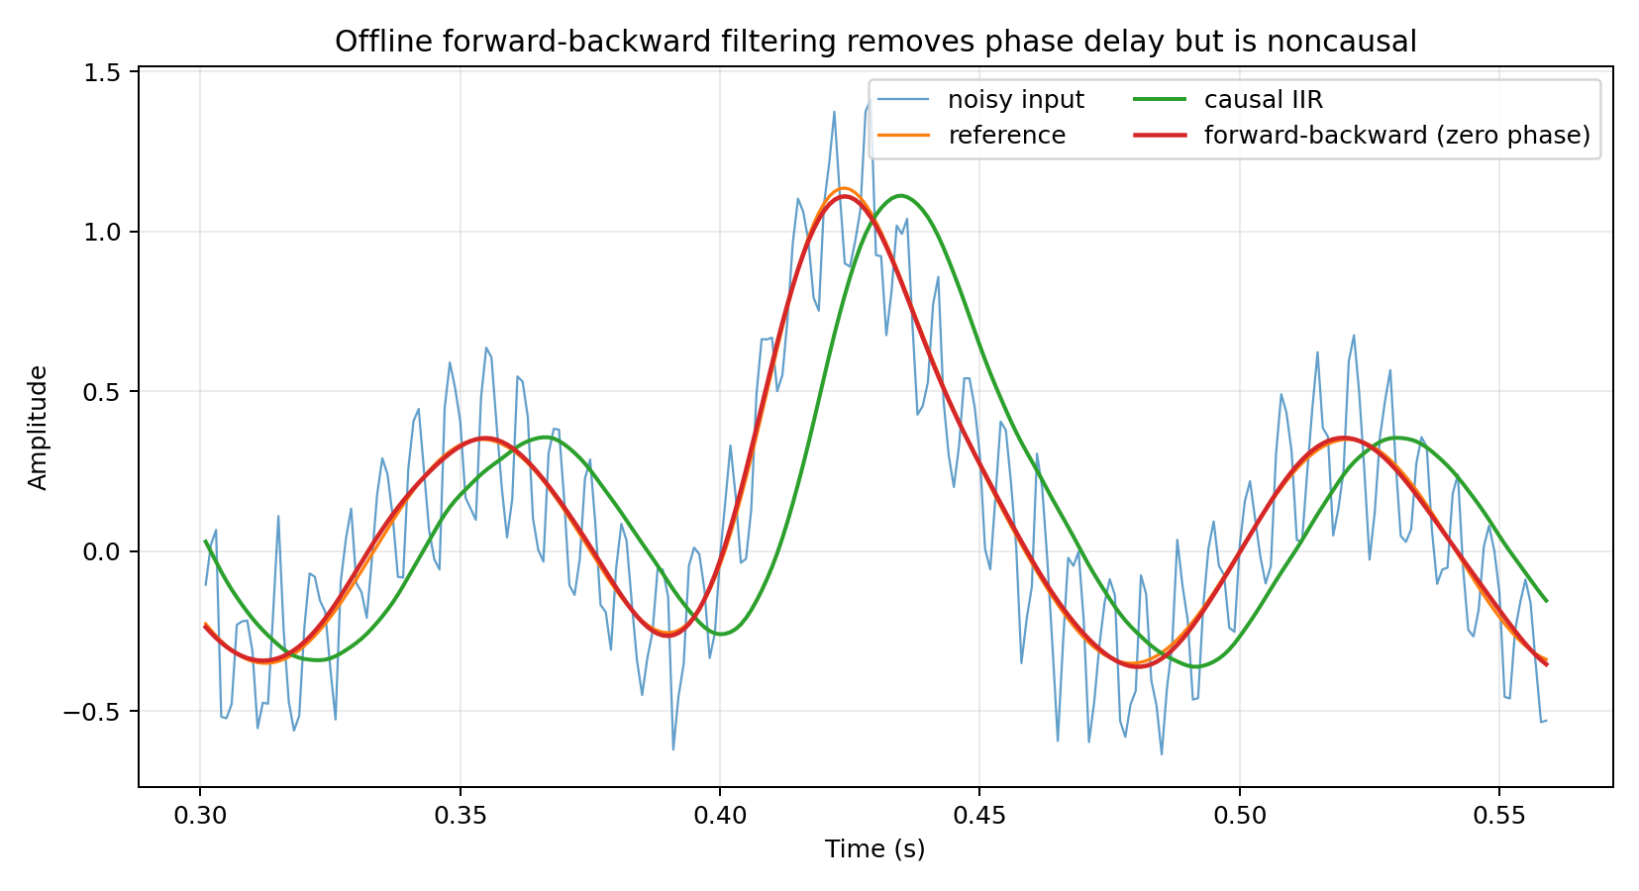
OFFLINE PREPROCESSING
Compare causal IIR delay with forward-backward zero phase
Causal filter
The transient is delayed and reshaped according to the filter phase/group delay.
Forward-backward
The transient aligns much more closely in time—but the method is offline and noncausal.
DSP + Machine Learning • Lectures 7–8
Oppenheim & Schafer + Raschka
24

Slide 25
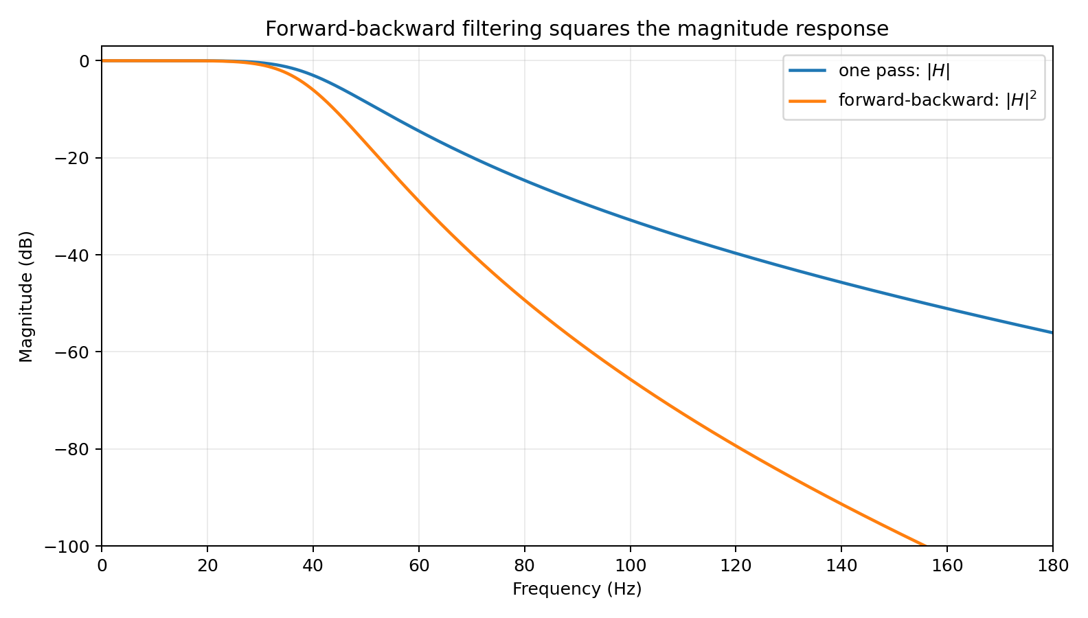
FORWARD-BACKWARD FILTERING
Zero phase does not mean “the same filter twice for free”
One pass
Magnitude is |H|.
Two passes
Magnitude becomes |H|²; order/effective selectivity are increased.
Design implication
If you need a final −3 dB edge after forward-backward filtering, design with the two-pass response in mind.
DSP + Machine Learning • Lectures 7–8
Oppenheim & Schafer + Raschka
25

Slide 26
CAVEATS
Zero-phase preprocessing can quietly change the learning problem
Noncausal
Boundary transients
Magnitude squared
Train/serve skew
Future samples are used; not reproducible in a strict real-time stream.
Finite-record initial conditions and padding can distort the beginning/end.
The effective response is not the same as one causal pass.
A model trained with future-aware filtering may see a different distribution when deployed causally.
Good engineering question: “Will the exact same preprocessing be available when the model is actually used?”
DSP + Machine Learning • Lectures 7–8
Oppenheim & Schafer + Raschka
26

Slide 27
ML PIPELINE
Where a classical IIR can fit
Raw signal
Fixed IIR
DSP features
Classifier
sensor / audio
→
remove nuisance band
→
MFCCs, energy, flux
→
SVM / RF / MLP
Appropriate example
Question before filtering
A known high-frequency interference band is irrelevant to the classification task and can be attenuated efficiently before features are computed.
Could the “noise” contain class information? Fixed preprocessing is an inductive assumption and should be validated.
DSP + Machine Learning • Lectures 7–8
Oppenheim & Schafer + Raschka
27

Slide 28
DESIGN CHOICE
FIR, IIR, or learned front end?
Choice
Strength
Cost / risk
Good fit
Linear-phase FIR
controlled phase + finite support
more taps / delay
waveform alignment matters
IIR
sharp response with few coefficients
nonlinear phase; feedback
efficient causal preprocessing
filtfilt IIR
zero phase offline
noncausal; |H|²; edges
offline dataset preparation
Learned Conv1d
task-adaptive front end
needs data/validation
end-to-end models
DSP + Machine Learning • Lectures 7–8
Oppenheim & Schafer + Raschka
28

Slide 29
WRAP-UP
Lecture 8 synthesis
Prototype
Bilinear map
Prewarp
Preprocessing
Choose where ripple is allowed and how much transition width you need.
Stable analog LHP → stable digital unit disk.
Critical frequencies must be mapped through tan(ω/2).
Phase, causality, edges, and deployment consistency are part of the ML problem.
Minute paper: Why can a zero-phase offline preprocessing pipeline give misleading confidence about a streaming deployment?
DSP + Machine Learning • Lectures 7–8
Oppenheim & Schafer + Raschka
29

Slide 30
HOMEWORK
Problems 5–8 • IIR, bilinear transform, preprocessing
5 • Butterworth
6 • Stability map
7 • Prewarp
8 • filtfilt
Evaluate a fourth-order Butterworth response at Ω_c and 2Ω_c.
Map s=−2+j3 through the bilinear transform for T=0.1 and verify |z|<1.
Compute Ω_c for desired ω_c=0.4π, T=1.
Explain phase cancellation, |H|², noncausality, and ML train/serve risk.
Full worked solutions are included in Lectures7_8_Homework_Quiz_Solutions.md.
DSP + Machine Learning • Lectures 7–8
Oppenheim & Schafer + Raschka
30

Slide 31
WEEKLY QUIZ
Questions 1–4 • 10–12 minutes total
Q1 • Delay
Q2 • Window
Q3 • Gibbs
Q4 • Conv1d
A symmetric FIR has N=31 taps. What is its group delay?
Hamming vs rectangular: which has lower sidelobes? Which has narrower main lobe?
Explain Gibbs phenomenon in one sentence.
Why flip fixed FIR taps when reproducing textbook convolution?
DSP + Machine Learning • Lectures 7–8
Oppenheim & Schafer + Raschka
31

Slide 32
WEEKLY QUIZ
Questions 5–8
Q5 • Butterworth
Q6 • Warping
Q7 • Prewarp
Q8 • Zero phase
Magnitude in dB at Ω=Ω_c?
State the Ω–ω bilinear frequency relation.
For ω_c=0.6π, should the analog prototype use Ω_c=0.6π/T directly? Why?
Main benefit and main deployment limitation of forward-backward filtering?
DSP + Machine Learning • Lectures 7–8
Oppenheim & Schafer + Raschka
32

Slide 33
INSTRUCTOR SOLUTION APPENDIX
Weekly Quiz + Homework Solutions
Keep these slides after the student-facing material or move them to a separate instructor deck.

Slide 34
INSTRUCTOR APPENDIX
Quiz solutions • Questions 1–4
A1
A2
A3
A4
τ_g=(31−1)/2=15 samples.
Hamming → lower sidelobes; rectangular → narrower main lobe.
Abrupt truncation produces oscillatory ripple near a frequency discontinuity; increasing N narrows the ripple region but does not drive peak overshoot to zero.
Conv1d uses cross-correlation ordering; textbook convolution contains x[n−k], which reverses one sequence.
DSP + Machine Learning • Lectures 7–8
Oppenheim & Schafer + Raschka
34

Slide 35
INSTRUCTOR APPENDIX
Quiz solutions • Questions 5–8
A5
A6
A7
A8
−3.01 dB because |H|=1/√2.
Ω=(2/T)tan(ω/2).
No. Prewarp with Ω_c=(2/T)tan(0.3π).
Benefit: zero net phase offline. Limitation: noncausal/future-aware, so it cannot be reproduced directly in a strict streaming pipeline.
DSP + Machine Learning • Lectures 7–8
Oppenheim & Schafer + Raschka
35

Slide 36
INSTRUCTOR APPENDIX
Homework solutions • Problems 5–6
5 • Butterworth
6 • Pole mapping
At Ω=Ω_c: |H|=1/√2 → −3.01 dB. At Ω=2Ω_c with N=4: |H|²=1/(1+2⁸)=1/257, so |H|≈0.0624 → ≈−24.1 dB.
For T=0.1 and s=−2+j3, z=(1+sT/2)/(1−sT/2)≈0.785+j0.243, so |z|≈0.822<1.
DSP + Machine Learning • Lectures 7–8
Oppenheim & Schafer + Raschka
36

Slide 37
INSTRUCTOR APPENDIX
Homework solutions • Problems 7–8
7 • Prewarp
8 • Forward-backward
For ω_c=0.4π and T=1:
Magnitude becomes |H|² and phase cancels. It is noncausal, has boundary handling issues, and can create train/deployment mismatch if inference must be causal.
DSP + Machine Learning • Lectures 7–8
Oppenheim & Schafer + Raschka
37

